Slide 1
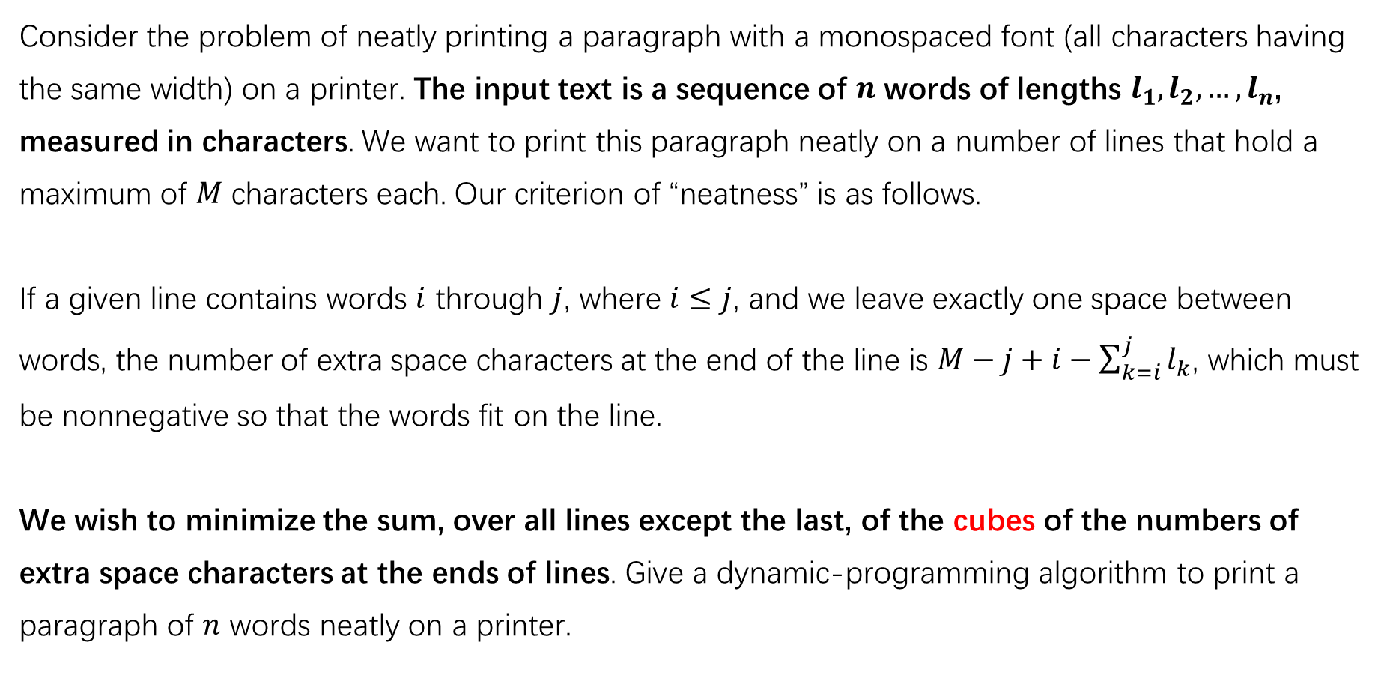
Printing Neatly
Consider the problem of neatly printing a paragraph with a monospaced font (all characters having the same width) on a printer. The input text is a sequence of $n$ words of lengths $l_{1}, l_{2},…, l_{n}$, measured in characters. We want to print this paragraph neatly on a number of lines that hold a maximum of $M$ characters each. Our criterion of “neatness” is as follows.
If a given line contains words $i$ through $j$, where $i≤j$, and we leave exactly one space between words, the number of extra space characters at the end of the line is $M−j+i−\sum_{k=i}^{j}{l_{k}}$, which must be nonnegative so that the words fit on the line.
We wish to minimize the sum, over all lines except the last, of the cubes of the numbers of extra space characters at the ends of lines. Give a dynamic-programming algorithm to print a paragraph of $n$ words neatly on a printer.

Slide 2


Example
word like first as the the complete
$$M=10$$
Optimal Printing
word like
first as
the the
complete
$${\left(10−9\right)}^{3}+{\left(10−8\right)}^{3}+{\left(10−7\right)}^{3}=36$$
Note that the last line shouldn’t be taken into account.
$$\sum_{line=1}^{L−1}{{\left(M−j+i−\sum_{k=i}^{j}{l_{k}}\right)}^{3}}$$

Slide 3


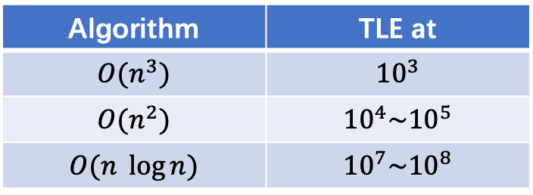
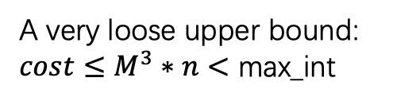
Notes
Input / Output
$0<n≤2000$
$$0<M≤100$$
All words contain only English letters
Your output: print only the minimal cost
Limits
Time limit: 1s
Memory limit: 16MB
Complexity
$O(n^{2})$ is acceptable
Python, memorized top-down method: OK!
A very loose upper bound:
$cost≤M^{3}∗n<$ max_int
$$n=2000$$
$$n^{2}=4∗{10}^{6}≤{10}^{8}$$
Algorithm | TLE at
$$O(n^{3})$$ | $${10}^{3}$$
$$O(n^{2})$$ | $${10}^{4}\sim {10}^{5}$$
$$O(n \log{n})$$ | $${10}^{7}\sim {10}^{8}$$

Slide 4
Optimal Substructure
Choice?
Make a choice to split the problem into one or more subproblems.
word like first as the the complete
Current problem
To print neatly from the 1st word to the very end
Choice
To decide from which word we start a new line
Subproblem?
To print neatly from the k-th word to the very end
word like ↵
first as the the complete
↑
k-th word

Slide 5
Optimal Substructure
Subproblem
To print neatly from the k-th word to the very end
Choice
To decide which k it is where we start a new line
k = 3
If this choice leads to an optimal solution,
word like ↵
first as the the complete ?
To print neatly from the 3rd word to the very end
← Must be an optimal solution to the subproblem!

Slide 6

Recursive Solution
Let $C[i]$ be the minimal cost of printing from the i-th word to the very end.
Our goal: $C\left[1\right]$
$$C\left[i\right]=\left\{\begin{aligned}0, if n−i+\sum_{j=i}^{n}{l_{j}}≤M \\ \min_{k=i+1 to n}\left\{{\left(M−\left(k−1−i\right)−\sum_{j=i}^{k−1}{l_{j}}\right)}^{3}+C\left[k\right]\right\}, otherwise\end{aligned}\right.$$
first as the complete
The remaining words can fit into one line
(The last line. Not in the total cost.)
The cost of this line
(from word i to word k-1)
Optimal subproblem
k
i
n

Slide 7
More…
How to print an optimal printing ?
word like
first as
the the
complete
Unique solution ?

