Slide 1
Monads
Trying to understand monads

Slide 2
Agenda
What means “Monad”...
  In philosophy
  In mathematics
  In computer programming
A Monad Example
Another Monad Example ( most known )
A Mathematical Representation
The Ultimate Monad Representation

Slide 3
In Philosophy
Greek:
  μονάς monas, "unit"
  μόνος monos, "alone“

Slide 4
In Philosophy
Gottfried Wilhelm Leibniz in “The Monadology”
  “The Monad, of which we shall here speak, is nothing but a simple substance, which enters into compounds. By 'simple' is meant 'without parts.'”
  “And there must be simple substances, since there are compounds; for a compound is nothing but a collection or aggregatum of simple things”

Slide 5
In Mathematics
In “Category Theory”
  “A monad is an endofunctor together with two associated natural transformations”.
    http://www.euclideanspace.com/maths/discrete/category/concepts/monad/index.htm
  And endofunctor is a functor that maps a category in itself.
    For example: the sum operation of integers always generates integers.
    I x I -> I

Slide 6
In Mathematics
Let us try to understand!

Slide 7
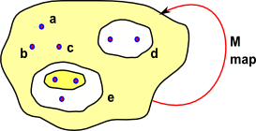
In Mathematics
We start with a set which contains elements such as a,b & c, it may also contain subsets which themselves consist of elements like these and subsets of subsets and so on.

Slide 8
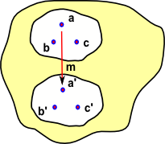
In Mathematics
Imagine that we have some mapping 'm' that maps say a->a' (or in a different notation a -> m a)

Slide 9
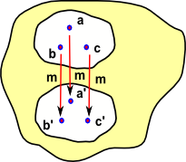
In Mathematics
Now imagine that b and c are also compatible with this mapping so we can add similar maps b->b' and c->c' and so on.

Slide 10
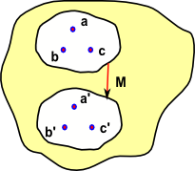
In Mathematics
It would be useful to be able to avoid the need to iterate over the elements and map them individually. We can map the whole set as a complete object provided that:
M {a,b,c} = {m a,m b,m c}
Usually in mathematical terminology we don't make a distinction between M and m, we use the same symbol regardless of whether we are mapping elements or whole subsets.

Slide 11
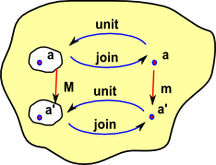
In Mathematics
We can add two functions:
  unit: maps 'a' to a set (a subset inside the main set) containing a.
  join: maps 'a set containing a' to a.
So 'unit' and 'join' are inverses.

Slide 12
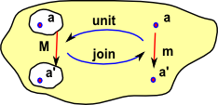
In Mathematics
In the same way that we can use 'M' to map elements or whole sets we can use 'unit' and 'join' to map elements, sets or mappings.
So here 'unit' and 'join' represent mappings of mappings. In fact they are natural transformations.

Slide 13
In Mathematics
But how is this useful?

Slide 14
In Mathematics
Suppose you are at a and you want to arrive at a’. You have two “paths”:
  a -> a’
  a -> subset a -> subset a’ -> a’
This means that m and M are dual. Sometimes the second “path” are easier to follow.

Slide 15
In Mathematics
Informally we can say that unit enters in the monad; join exits the monad and M are transformations to the monad.

Slide 16
In Computer Programming
In “Computer Programming”
  The Essence of Functional Programming
    Philip Wader
    https://wiki.ittc.ku.edu/lambda/images/1/12/Wadler_-_The_essence_of_functional_programming_%281992%29.pdf

Slide 17
In Computer Programming
A Simple Example
  In C#

Slide 18
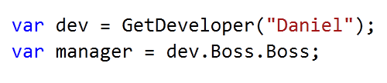
In Computer Programming

Slide 19
In Computer Programming
What if “dev” is null?

Slide 20
In Computer Programming
What if one of the “Boss” is null?

Slide 21
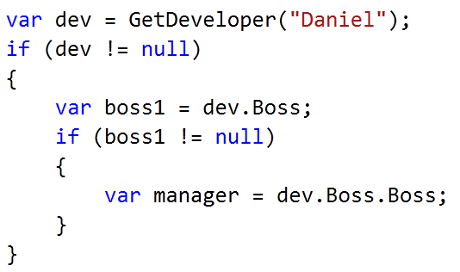
In Computer Programming

Slide 22
In Computer Programming
Ugly!!
and violates the called “Law of Demeter”

Slide 23
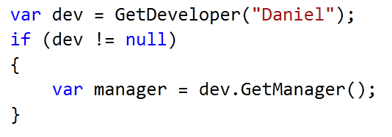
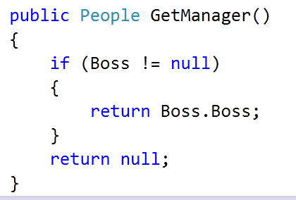
In Computer Programming

Slide 24
In Computer Programming
Is this better?
Really better?
Really really better?

Slide 25
In Computer Programming
So, for this particular case:
  The Null Object Pattern
    Bobby Woolf
“Provide a surrogate for another object that shares the same interface but does nothing. The Null Object encapsulates the implementation decisions of how to “do nothing” and hides those details from its collaborators.”
* This pattern has others uses besides this one.

Slide 26

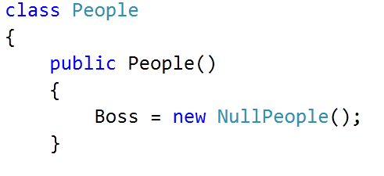
In Computer Programming
Boss is never null, now!

Slide 27

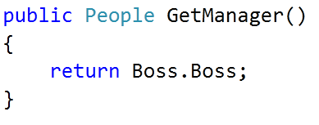
In Computer Programming
Now this is safe.
This is also safe.

Slide 28
In Computer Programming
Now this is safe.
This is also safe.

Slide 29
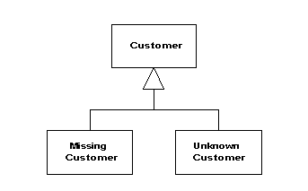
In Computer Programming
Is this good?
  Of course it is... It is “A PATTERN”.
  Even Fowler uses it:
    http://martinfowler.com/eaaCatalog/specialCase.html

Slide 30
In Computer Programming
Seriously...
  It is a good solution for a Object Oriented Languague...
  But there is life outside OO!!

Slide 31
In Computer Programming
Coming back to Monads...
We do not know if the value
is null or not.

Slide 32
In Computer Programming
Although any class can be null, let us say that method was declared like this:

Slide 33
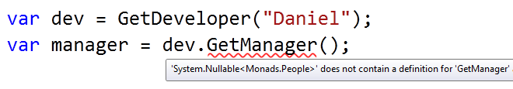
In Computer Programming
We have a problem now:
  Any code that works with “People” class does not work with Nullable<People>.

Slide 34
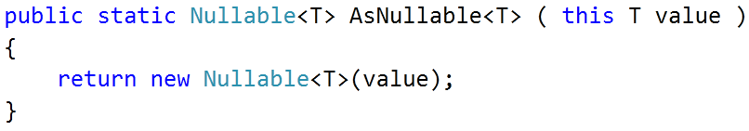
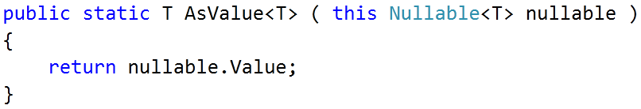
In Computer Programming
We need two transformations:
People
Nullable<People>
People
Nullable<People>

Slide 35
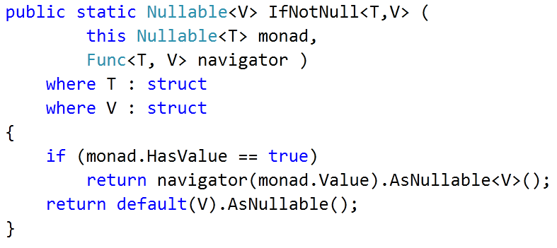
In Computer Programming
Let us analyse the following extension method:

Slide 36
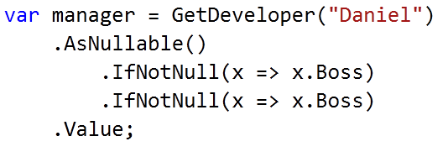
In Computer Programming
This allows me to do the following code:
I still do not know if manager is null or not...
  But i do not throw any exception
  And...

Slide 37
In Computer Programming
Before “and...”
  Where is the monad??

Slide 38
In Computer Programming
Before “and...”
  Where is the monad??
Entering in the monad

Slide 39
In Computer Programming
Before “and...”
  Where is the monad??
Working in the monad.

Slide 40
In Computer Programming
Before “and...”
  Where is the monad??
Still working in the monad.

Slide 41
In Computer Programming
Before “and...”
  Where is the monad??
Leaving the monad.

Slide 42
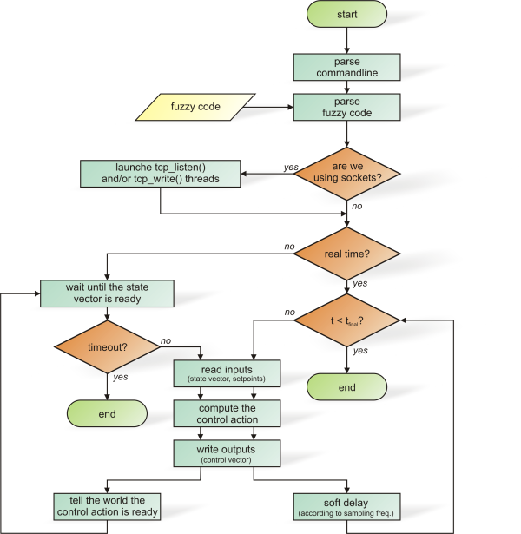
In Computer Programming
A monad is a “abstract unit of composition of a domain”.
  We use monad everywhere!!
  Examples?
I see dead Monads!!

Slide 43
In Computer Programming
We just did the “Maybe Monad”
  http://www.haskell.org/all_about_monads/html/maybemonad.html
  You sincerely will not want to see the Haskell code copied here...
    Believe me...

Slide 44
In Computer Programming
Reading the paper

Slide 45

In Computer Programming

Slide 46
In Computer Programming
Entering the monad
In the example:
T -> Nullable<T>

Slide 47
In Computer Programming
unitM is a method that accepts
any type ( named “a”) and return its associated monadic type ( named “M a” )

Slide 48
In Computer Programming
bindM is a method that accepts
a monad and a function that transform a monad and return this tranformed monad

Slide 49
In Computer Programming
unitM
  Monad constructor.
bindM
  Abstract composition of the monad.

Slide 50
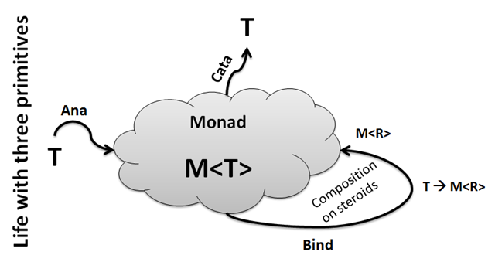
In Computer Programming
LINQ is also a monad...
  The “List Monad”

Slide 51
In Computer Programming
Anamorphism is the entrance in the monad.
  Enumerable.Range()
  AsEnumerable()
Catamorphism is the exit of the monad.
  Sum()
  First()

Slide 52
In Computer Programming
SelectMany is the BindM
  Where, Skip, Take, etc... are specifs uses of SelectMany

Slide 53
In Computer Programming
Mathematical Representation
  Monads as sets

Slide 54
Must Reads!
  http://www.euclideanspace.com/maths/discrete/category/monad/index.htm
  https://wiki.ittc.ku.edu/lambda/images/1/12/Wadler_-_The_essence_of_functional_programming_%281992%29.pdf
  http://www.haskell.org/all_about_monads/html/maybemonad.html
  http://blogs.msdn.com/b/wesdyer/archive/2008/01/11/the-marvels-of-monads.aspx
  http://community.bartdesmet.net/blogs/bart/archive/2010/01/01/the-essence-of-linq-minlinq.aspx

Slide 55
And now...
  The Pythagorean Representation of a monad...

Slide 56


