Slide 1

Brazilian Olist E-Commerce Data Analysis (2016-2018)
Fantastic Quartz : Szu Wei, Vallabi, Deepak & Yixun
Olist is a significant player in Brazilian e-commerce. Small and medium enterprises can scale through this rich marketplace.

Slide 2

Content
Brazil At A Glance
About Olist
Problem Statement
Schema Diagram
ETL Process
Challenges
Analysis & Implementation
Summary
Appendix

Slide 3

Brazil At A Glance
Key Facts
Population: 213M (São Paulo: 46M)
Area: 8.5M km² (5th largest country)
States: 26 + 1 federal district
Geography
Climate: Tropical, diverse ecosystems
Mountains : Serra do Mar , Andes
Major Rivers: Amazon, Paraná
E-Commerce Growth
14th largest market globally
14.3% estimated growth rate

Slide 4
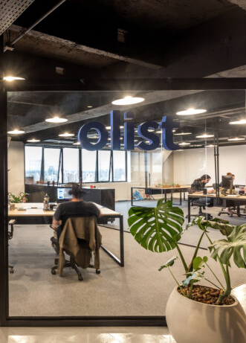
Olist
Company
Founded in 2015
Valued at $1.5 billion
Annual Revenue 50 Million to 75 Million
Competitors
Other competitors like Mercado Livre
Amazon, Vnda, Le Biscuit & Melhor Envio

Slide 5
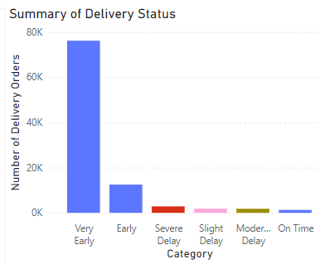
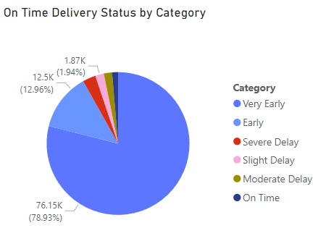
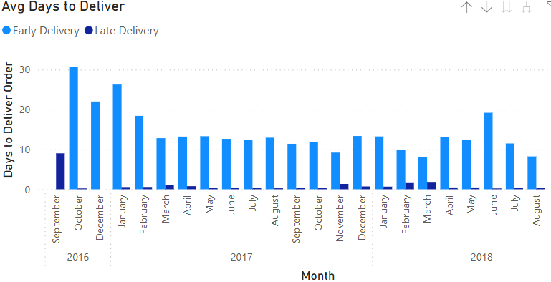
Problem Statement
Overview
Analysis of Olist’s 100k orders dataset (2016-2018)
Objectives
Analyze 8 % late deliveries
Find relationship between Customer’s Satisfaction and Late Deliveries
Compare World Cup vs Normal Day delivery performance

Slide 6

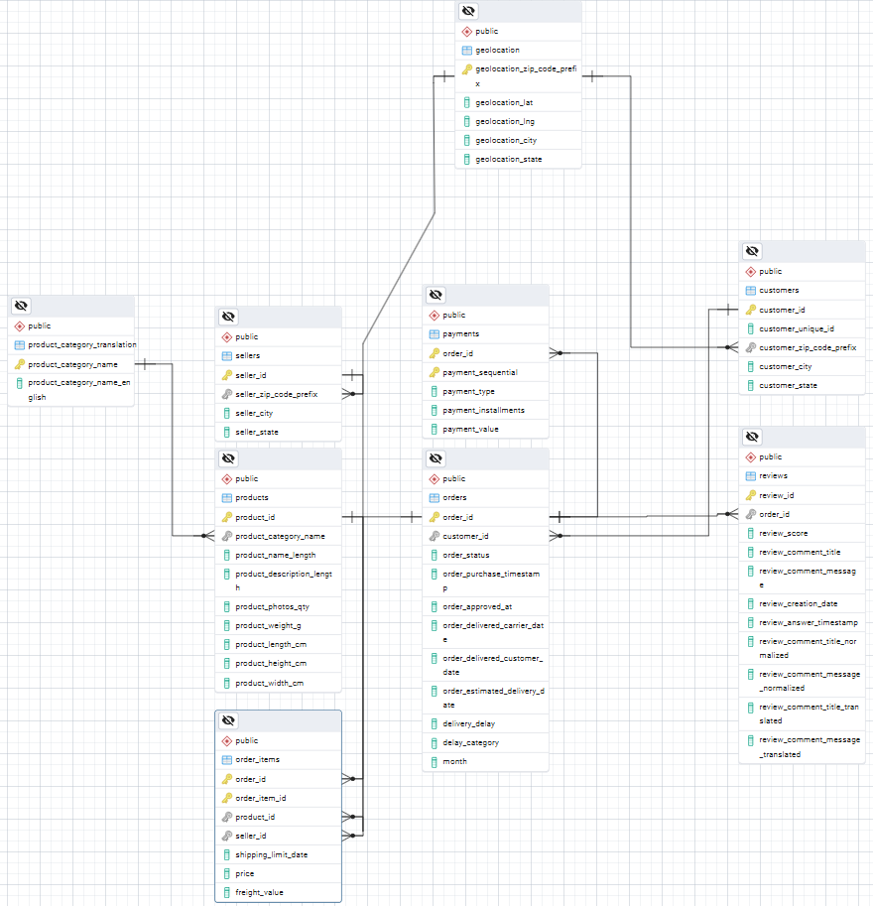
Schema Diagram
olist_customers_dataset.csv
olist_geolocation_dataset.csv
olist_order_items_dataset.csv
olist_order_payments_dataset.csv
olist_order_reviews_dataset.csv
olist_orders_dataset.csv
olist_products_dataset.csv
olist_sellers_dataset.csv
product_category_name_translation.csv
Tables
Orders Table (Added Columns)
orders
order_items
geolocation
reviews
delivery_delay
delay_category
month

Slide 7


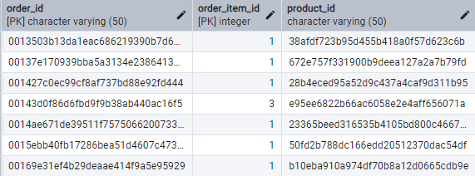



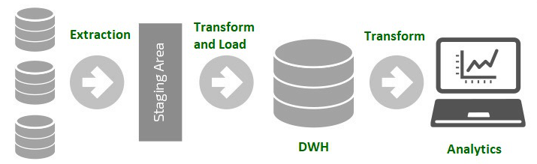



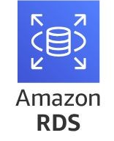








ETL Process
Staging Area
Validate
9 CSV files
Create database
Add new columns
Drop duplicates
Drop NA
Setting up AWS
Deploy to online AWS RDS
Validate

Slide 8
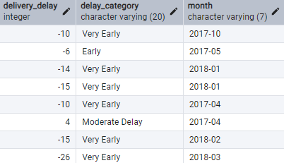
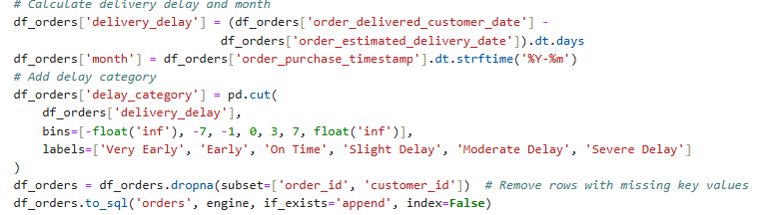
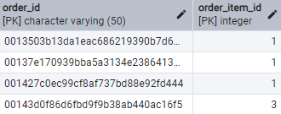
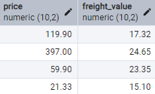
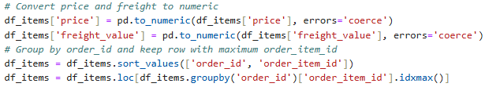
ETL Process
Transformation
Orders – Classifying Severity of Delay
order_items – Highest order_item_id value

Slide 9
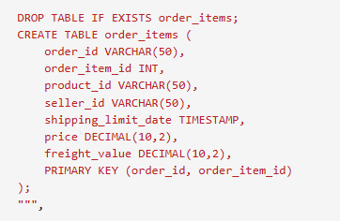
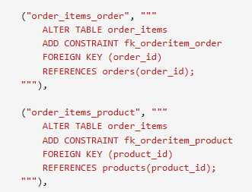



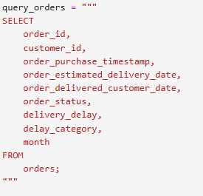
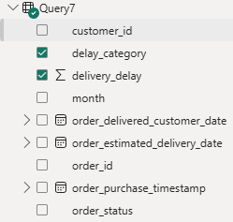
Challenges
1
Foreign Key Implementation
Challenge: Database errors occur when implementing foreign key constraints
Solution: Implement foreign keys separately for each table after loading
2
AWS RDS Database Configuration
Challenge: Initial setting up of cloud database deployment
Solution: Documentation, online resources, & tutorials
3
Data Visualization Consistency
Challenge: Discrepancies between Power BI & Jupyter notebook visualizations
Solution: Standardize data queries across platforms
Jupyter
PowerBI

Slide 10
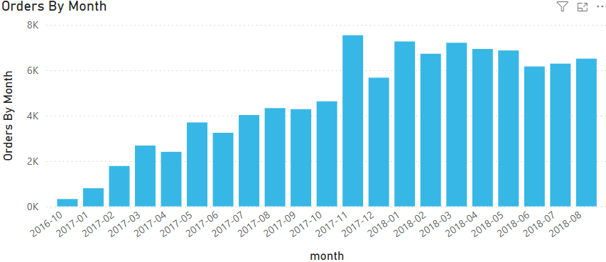
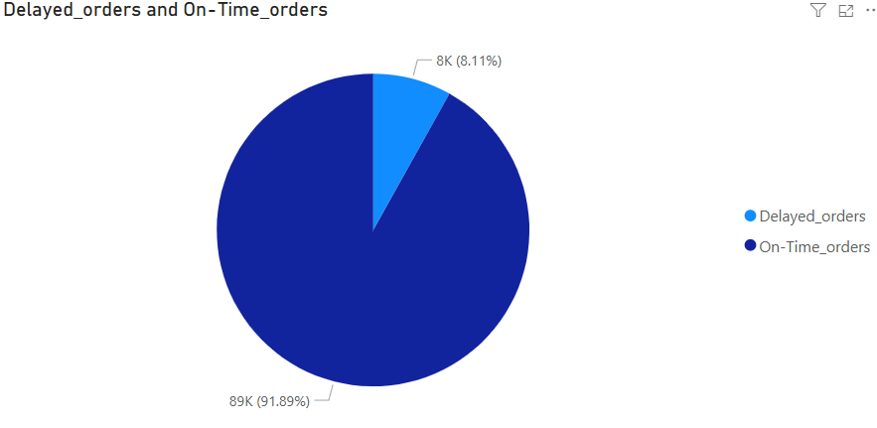
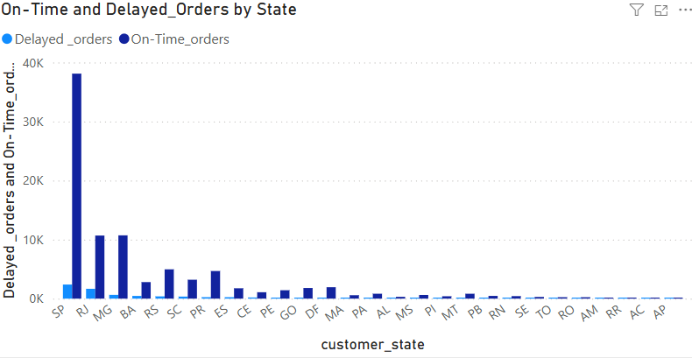
Analysis & Implementation
Data Analysis & Delivery Optimization
Findings
Delivery Performance
92 % on time delivery
8% delayed delivery​
No. of orders (2018):​
May - 6873​
June - 6167 (-10.3%)​
Jul - 6292 (+2.0%)​
Strategies
Utilize More Historical Data: Analyze past, existing order records, delivery times, and customer reviews
Predictive Analytics with ML: Track key metrics and forecast delays using ML models
Innovative Delivery: Offer strategic freight discounts and explore drone options

Slide 11
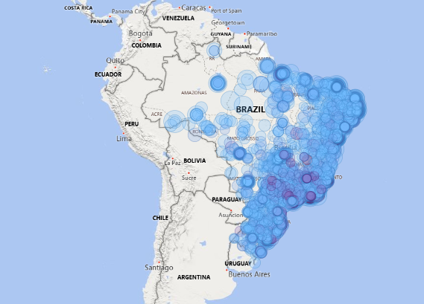
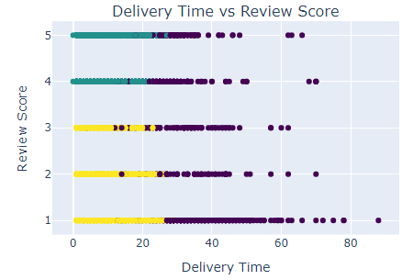
Analysis & Implementation
Real-Time Tracking & Updates
Findings
Brazil Map
Concentration of customer orders
Around populous state
Scatter Plot Graph (DT vs RS)
Deliveries 0-60 days
> 60 days outlier deliveries
Longer delivery time ≠ Low satisfaction
Strategies
Real-Time GPS Tracking: Implement order tracking with GPS integration for live updates
Automated Notifications: Status notifications via SMS, email, and in-app messages
Self-Service Portal: Offer customer portal for order tracking and history

Slide 12
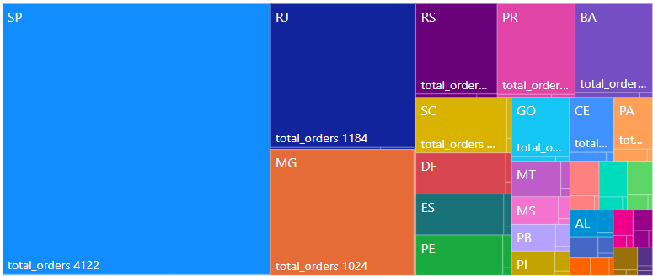
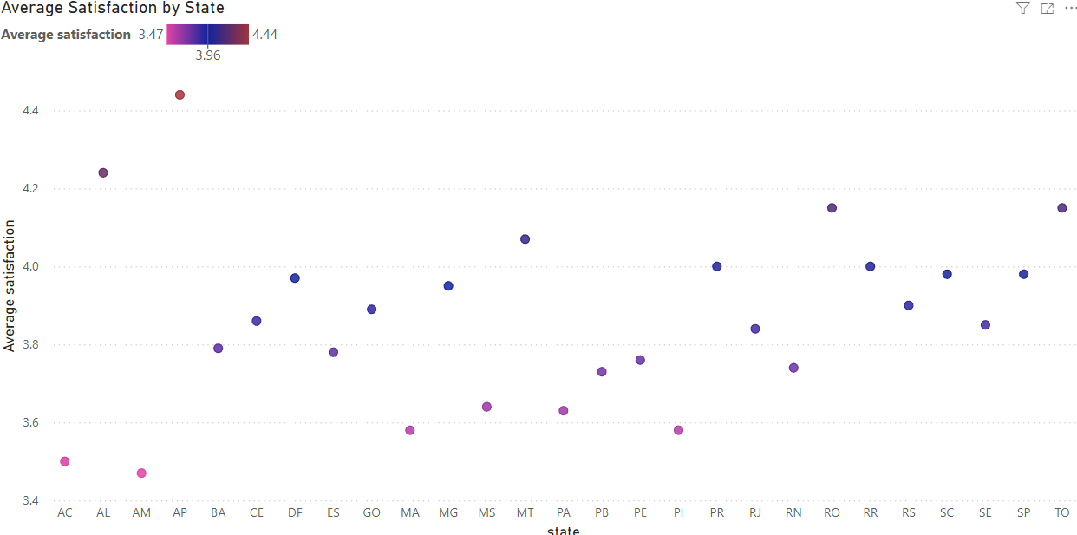
Analysis & Implementation
Delivery Time & Customer Satisfaction
Findings
Top 3 States By Orders
SP (São Paulo)
RJ (Rio de Janeiro)
MG (Minas Gerais)
Satisfaction By State
Avg delivery satisfaction 3.6 to 4.2
Strategies
Target High-Delay States: Prioritize states with longer delivery times for improvements
Strategic Distribution Centers: Place hubs in high-volume areas (e.g. SP, RJ, MG)
Local Partnerships: Partner with regional delivery services in remote areas

Slide 13
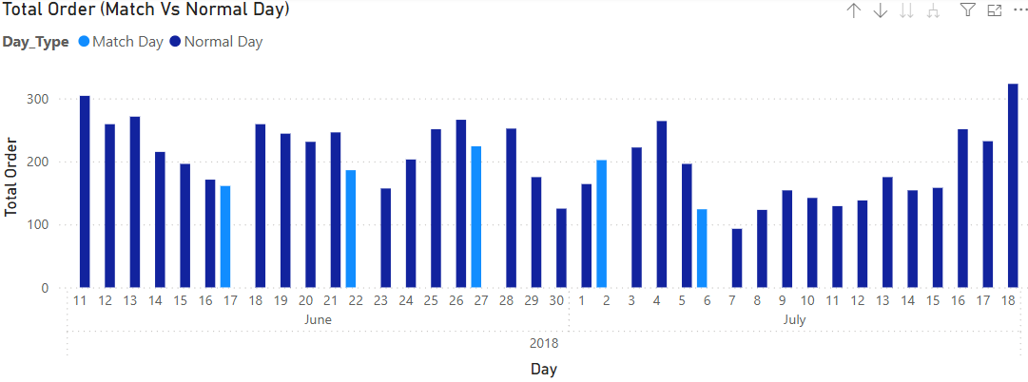
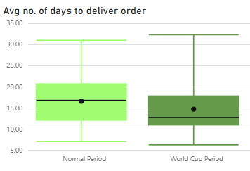
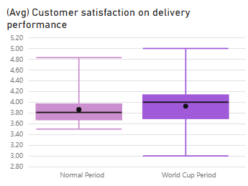
Analysis & Implementation
Match Days: June 17, June 22, June 27, July 2, July 6
Findings
Normal day | World Cup’18
Higher orders | Lower orders
Avg 17 days to deliver | Avg 13 days to deliver
Avg delivery satisfaction 3.8 | Avg delivery satisfaction 4.0
Data shows events can cause order to drop
Order delivery time is shortened, satisfaction improves

Slide 14

Summary
Event-Driven Scalability
Real-Time Tracking & Updates
Event Day
Scale up delivery capacity for major events e.g. World Cup
Incentivize off-peak orders during special events
Special Event Strategy Impact
Enhanced Customer Experience and sales during event periods.
Transparency on Demand
Live tracking and automated alerts to keep customers informed at every stage
Impact
Boosts efficiency & Customer Experience.
Route Optimization
AI-Powered Efficiency
Using more past order data and ML to predict delays and optimize delivery routes
Drones delivery
Improved Delivery Performance
Reduced delays and faster shipping
Delivery Time & Customer Satisfaction
Delivery Improvements
Prioritize hubs in SP, RJ, and MG, partnering with regional experts for faster delivery
Increase manpower - delivery staff
Cost Efficiency & Localized Speed
Partnering with regional centers helps to reduce operational costs & delivery delays.

Slide 15
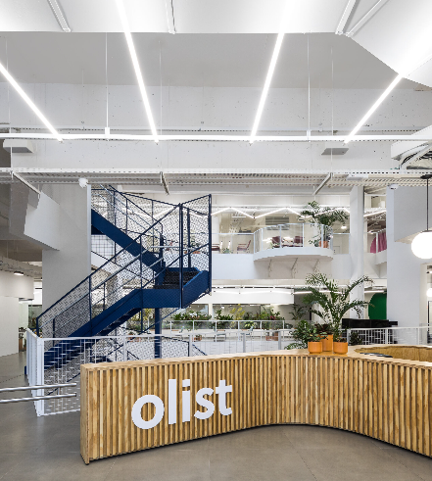
End Of Presentation
Thank you ! We look forward to optimize Olist delivery performance and customer satisfaction

Slide 16
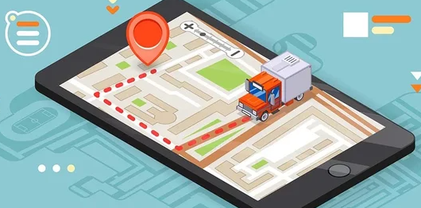

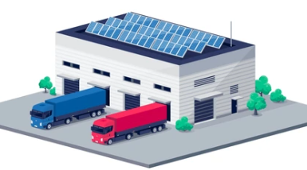

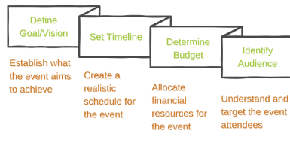

Appendix
Next Step – Suggested Implementation Plan
Phase 1
Data Analysis & Delivery Optimization ( 3 Months )
Phase 2
Real-Time Tracking & Updates (3 Months )
Phase 3
Regional Distribution Centers (6 - 8 Months)
Phase 4
System Integration & Scalability (3 Months)
Phase 5
Special Event Preparedness (6 - 8 Months)

Slide 17
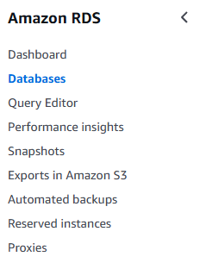
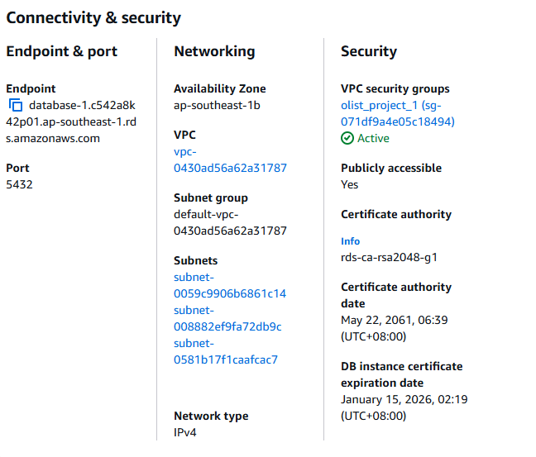
Appendix
Amazon RDS
Setting up AWS RDS Link
https://medium.com/@sjacks/using-rds-on-aws-with-jupyter-notebooks-c2703299fcc8

