Slide 1
E-Storm: Replication-based State Management in Distributed Stream Processing Systems
Xunyun Liu, Aaron Harwood, Shanika Karunasekera, Benjamin Rubinstein and Rajkumar Buyya
The Cloud Computing and Distributed Systems Lab
The University of Melbourne, Australia

Slide 2
Outline of Presentation
Background
Stream Processing
Apache Storm
Performance Issue with the Current Approach
Solution Overview
Basic Idea
Framework Design
State Management Framework
Error-free Execution
Failure Recovery
Evaluation
Conclusions and Future Work

Slide 3
Background
Stream Processing
Stream Data
Arriving continuously & possible infinite
Various data sources & structures
Transient value & short data lifespan
Asynchronous & unpredictable
Process-once-arrival Paradigm
Computation
Queries over the most recent data
Computations are generally independent
Strong latency constraint
Result
Incrementally result update
Persistence of data is not required
Notes:
Stream processing is an emerging paradigm that harnesses the potential of transient data in motion
Asynchronous: source of data doesn't interact with the stream processing directly, like by waiting for an answer

Slide 4
Background
Distributed Stream Processing System
Logic Level
Inter-connected operators
Data streams flow through
these operators to undergo
different types of computation
Middleware Level
Data Stream Management
System (DSMS)
Apache Storm, Samza…
Infrastructure Level
A set of distributed hosts in cloud or cluster environment
Organised in Master/Slave model
Notes:
By far we have only introduced the stream processing as a abstract concept, it has to be carried out by concrete stream processing applications, also known as streaming applications.
A typical streaming application consists of three tiers, the highest tiers is the logic level, where continuous queries are implemented as standing-by and inter-connected operators that continuously filter the data streams until the developers explicitly shut them off.
The second tier is the middleware level, like Database management systems, various Data Stream Management Systems live here to support the upper-level logic and manage continuous data streams with intermediate event queues and processing entities.
The third tiers is the computing infrastructure, composed by a centralized machine or a set of distributed hosts.

Slide 5
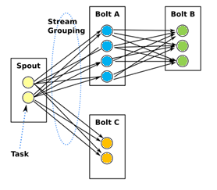
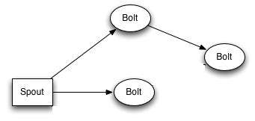
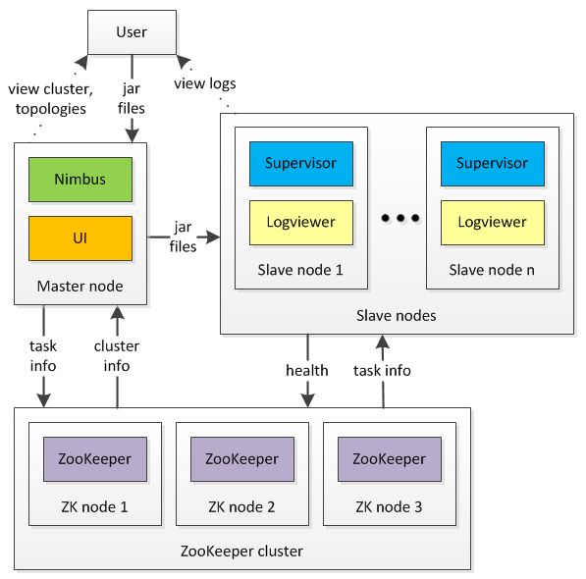
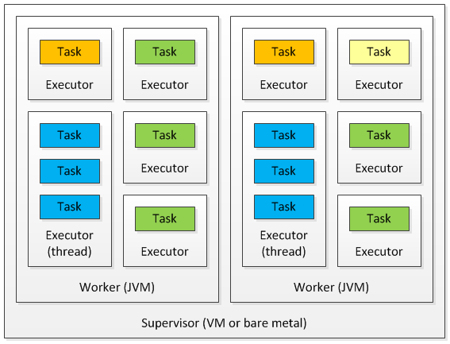
Background
A Sketch of Apache Storm
Operator Parallelization
Topology
Logical View of Storm
Physical View of Storm
Task Scheduling

Slide 6
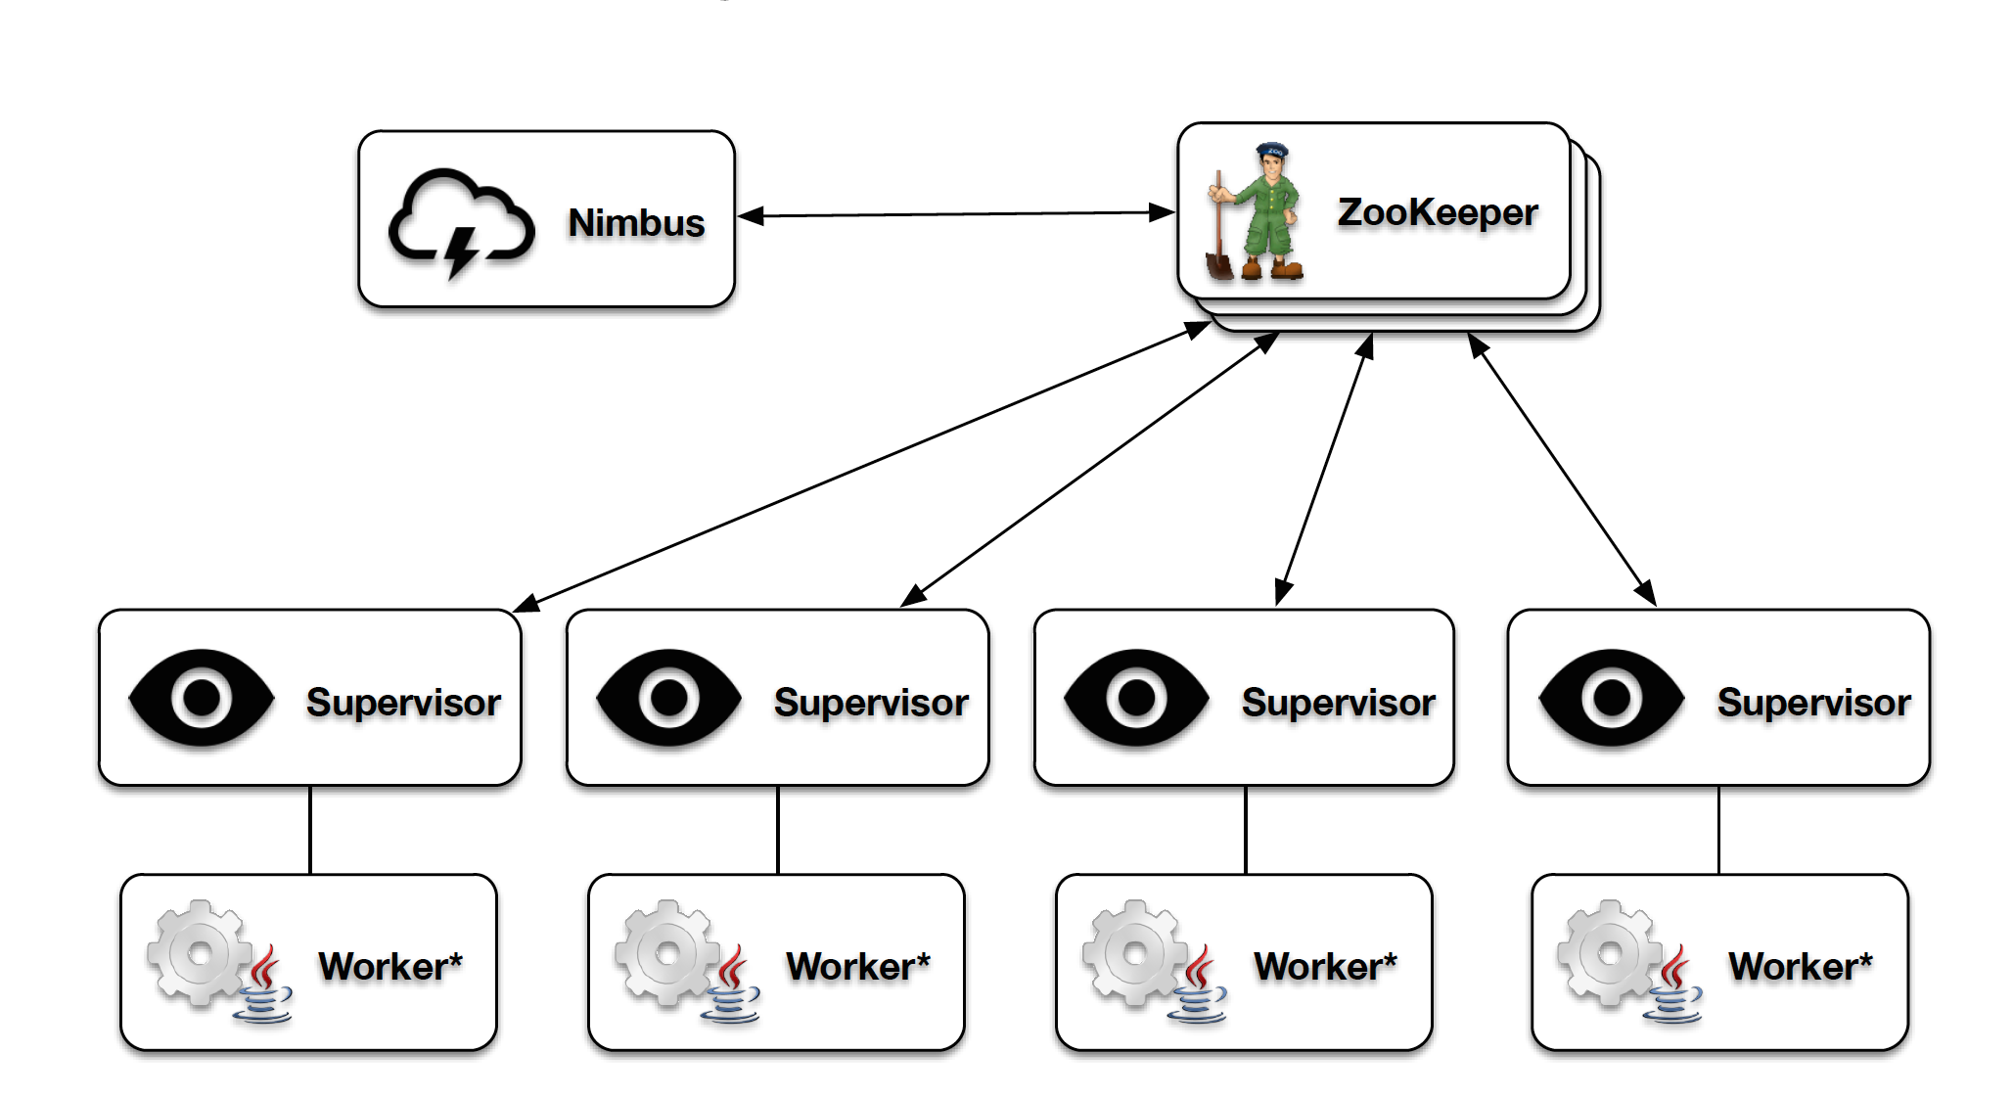
Background
Fault-tolerance in Storm
Supervised and stateless daemon execution
If a worker process dies (fails to heartbeat), the Supervisor will restart it.
If a worker process dies repeatedly, Nimbus will reschedule the worker.
Notes:
Worker processes heartbeat back to Supervisors and Nimbus via Zookeeper, as well as locally
If a worker process dies (fails to heartbeat), the Supervisor will restart it.
If a worker process dies repeatedly, Nimbus will reassign the work to other nodes in the cluster
If a supervisor dies, Nimbus will reassign the work to other nodes
If Nimbus dies, topologies will continue to function normally, but won’t be able to perform reassignments.

Slide 7
Background
Fault-tolerance in Storm
Supervised and stateless daemon execution
If a Supervisor dies, an external process monitoring tool will restart it
If a Worker node dies, the tasks assigned to that machine will time-out and Nimbus will reassign those tasks to other machines.
Notes:
Worker processes heartbeat back to Supervisors and Nimbus via Zookeeper, as well as locally
If a worker process dies (fails to heartbeat), the Supervisor will restart it.
If a worker process dies repeatedly, Nimbus will reassign the work to other nodes in the cluster
If a supervisor dies, Nimbus will reassign the work to other nodes
If Nimbus dies, topologies will continue to function normally, but won’t be able to perform reassignments.

Slide 8
Background
Fault-tolerance in Storm
Supervised and stateless daemon execution
If Nimbus dies, topologies will continue to function normally, but won’t be able to perform reassignments.
Storm v1.0.0 introduces the highly available Nimbus to eliminate the single point of failure
Notes:
Worker processes heartbeat back to Supervisors and Nimbus via Zookeeper, as well as locally
If a worker process dies (fails to heartbeat), the Supervisor will restart it.
If a worker process dies repeatedly, Nimbus will reassign the work to other nodes in the cluster
If a supervisor dies, Nimbus will reassign the work to other nodes
If Nimbus dies, topologies will continue to function normally, but won’t be able to perform reassignments.

Slide 9
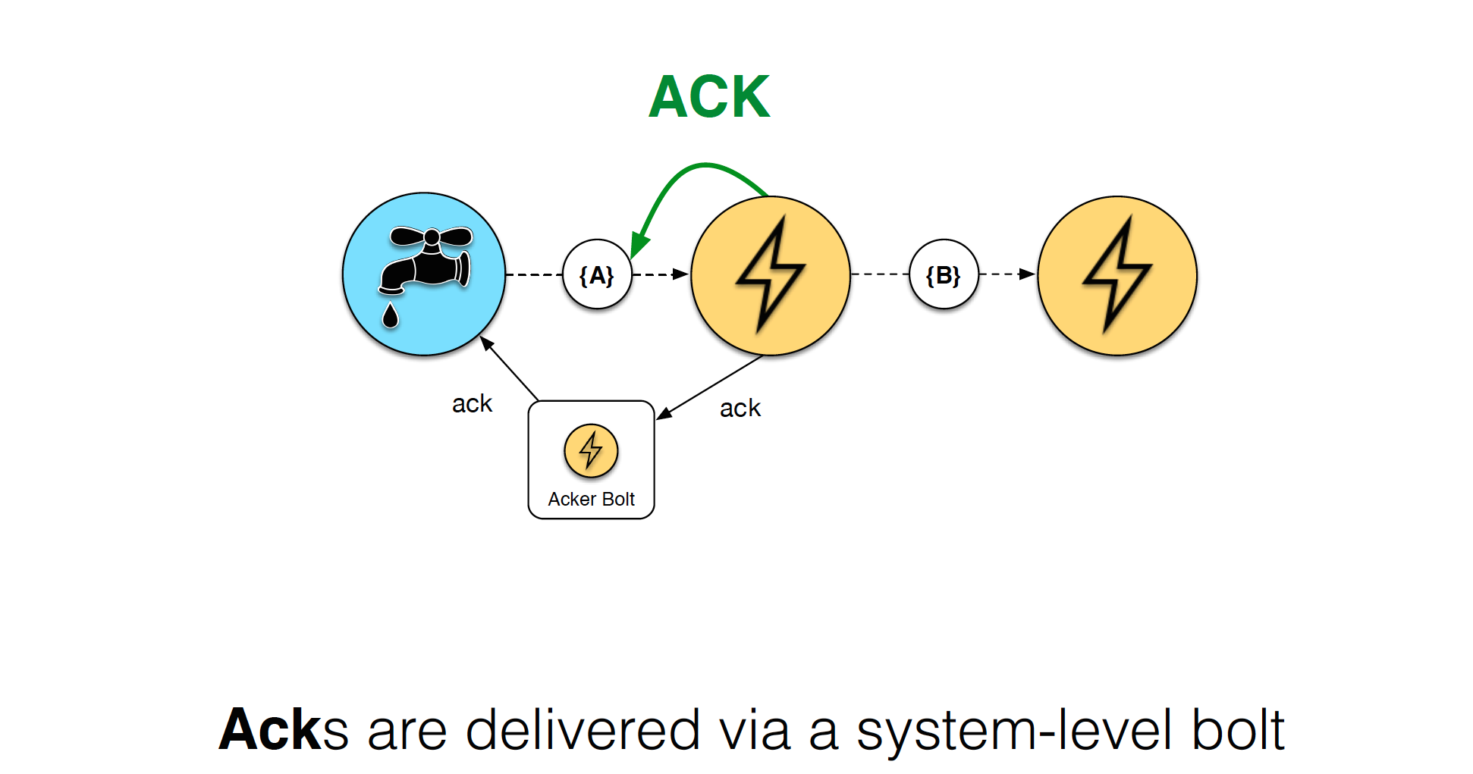
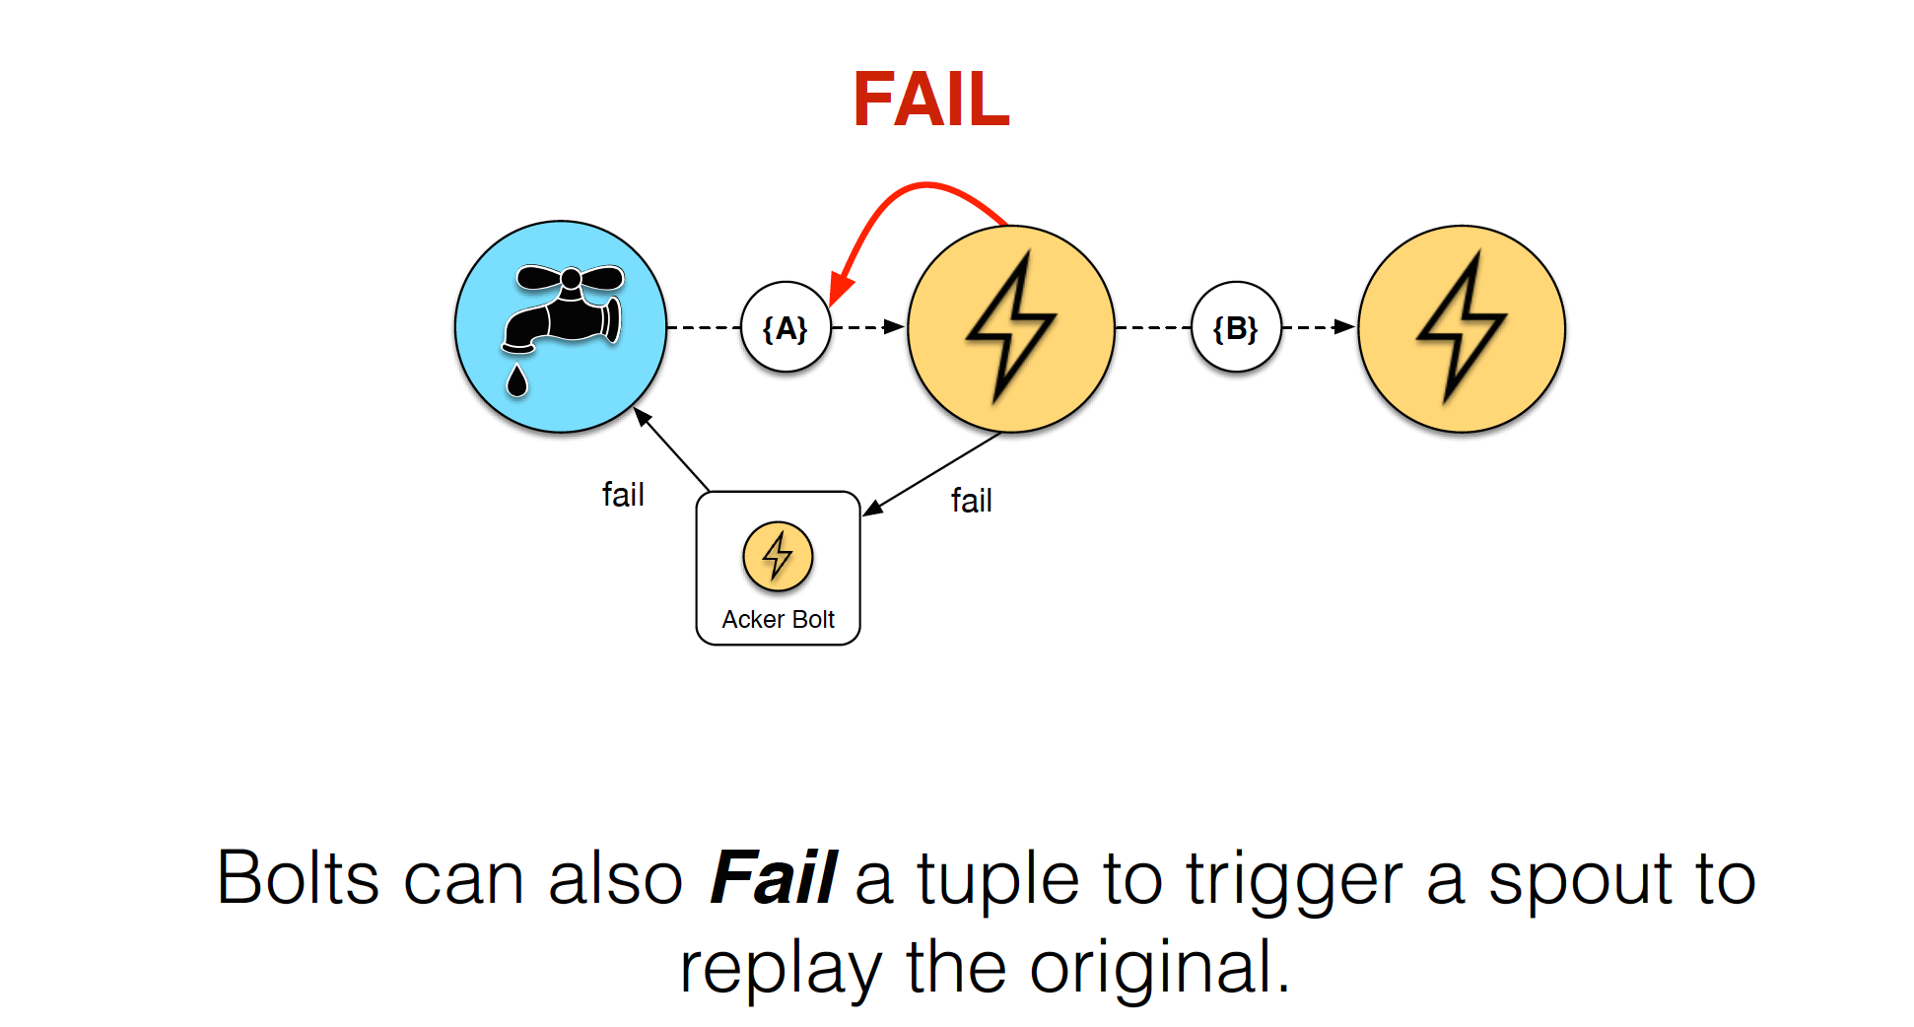
Background
Fault-tolerance in Storm
Message delivery guarantee (At-least-once by default)

Slide 10
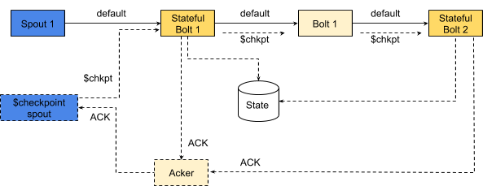
Background
Fault-tolerance in Storm
Checkpointing-based State Persistence
New spout added, which sends checkpoint messages across the whole topology through a separate internal stream
Stateful bolts save their states as snapshots
Used Chandy-Lamport algorithm to guarantee the consistency of distributed snapshots
Notes:
Storm has abstractions for bolts to save and retrieve the state of its operations. There is a default implementation that provides state persistence in a remote Redis cluster.
So the framework automatically and periodically snapshots the state of the bolts across the topology in a consistent manner.

Slide 11
Background
Performance Issue with the Current Approach
A remote data store is constantly involved
High state synchronization overhead
Significant access delay to the remote data store
Hard to tune the frequency of checkpointing
Excessive overhead
Risk losing uncommitted states
Access Delay
Synchronization
Overhead
Redis
Notes:
Storm has abstractions for bolts to save and retrieve the state of its operations. There is a default implementation that provides state persistence in a remote Redis cluster.
So the framework automatically and periodically snapshots the state of the bolts across the topology in a consistent manner.

Slide 12
Outline of Presentation
Background
Stream Processing
Apache Storm
Performance Issue with the Current Approach
Solution Overview
Basic Idea
Framework Design
State Management Framework
Error-free Execution
Failure Recovery
Evaluation
Conclusions and Future Work

Slide 13
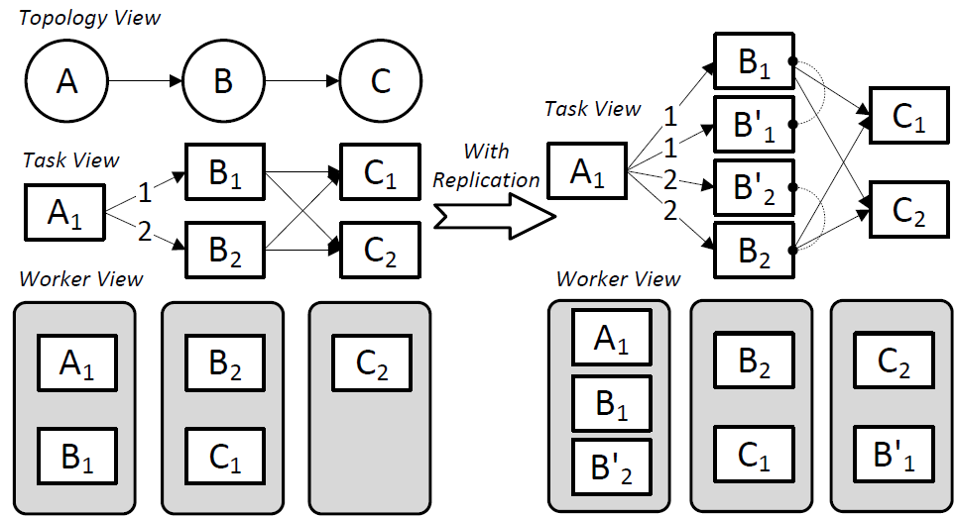
Solution Overview
Basic Idea: Fine-grained Active Replication
Duplicate the execution of stateful tasks
Maintain multiple state backups independently
Primary
Task
Shadow
Task

Slide 14
Solution Overview
Basic Idea: Fine-grained Active Replication
Primary task and shadow tasks are placed on separate nodes
Restarted tasks recover their states from the alive partners

Slide 15
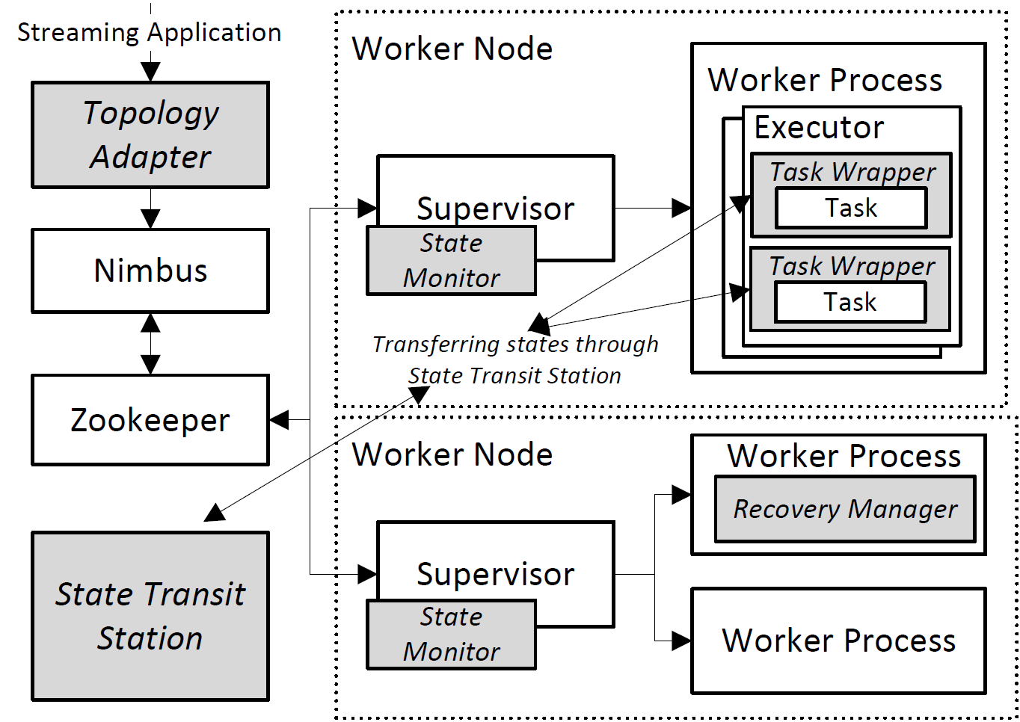
Solution Overview
Provide replication API
Hide adaptation effort
Framework Design

Slide 16
Solution Overview
Monitor the health of states
Send recovery request after detecting a issue
Framework Design

Slide 17
Solution Overview
Watch Zookeeper to monitor recovery request
Initialise, oversee and finalise recovery process
Framework Design

Slide 18
Solution Overview
Encapsulates the task execution with logic to
handle state transfer and recovery
Framework Design

Slide 19
Solution Overview
Decouple senders and receivers during the
state transfer process
Framework Design
Notes:
Task wrappers perform state management without synchronization and leader selection

Slide 20
Outline of Presentation
Background
Stream Processing
Apache Storm
Performance Issue with the Current Approach
Solution Overview
Basic Idea
Framework Design
State Management Framework
Error-free Execution
Failure Recovery
Evaluation
Conclusions and Future Work

Slide 21
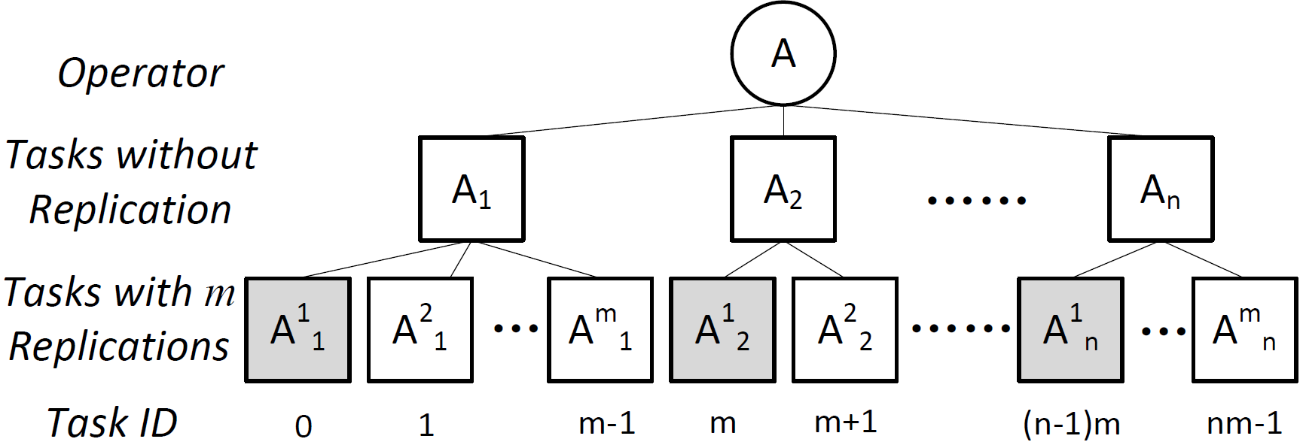
State Management Framework
Error-free Execution
Determine task role based on task ID
Rewire tasks using a replication-aware grouping policy

Slide 22
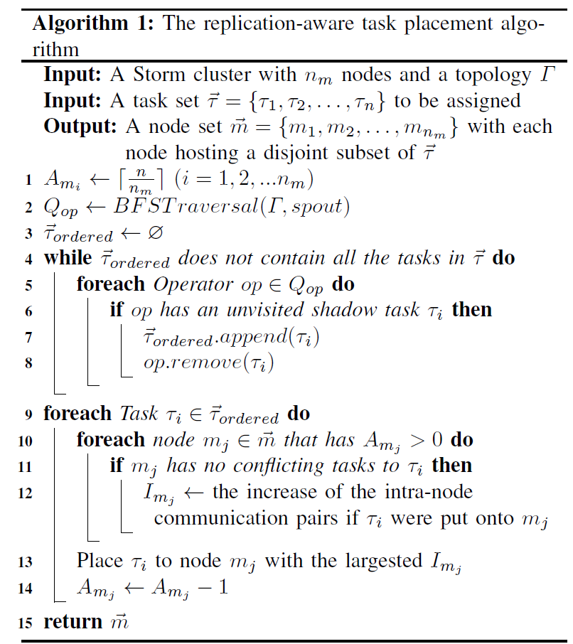
State Management Framework
Error-free Execution
Replication-aware Task Placement
Based on greedy heuristic
Only places shadow tasks
Shadow tasks from the same fleet are spread as far as possible
Communicating tasks are placed as close as possible

Slide 23
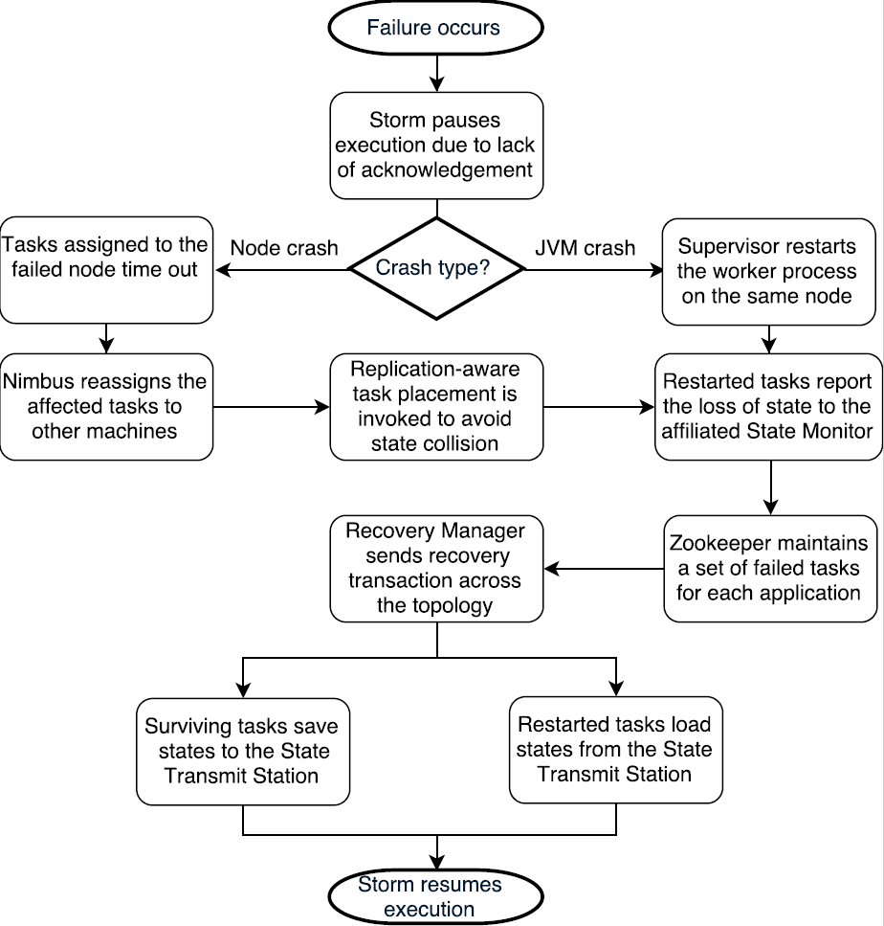
State Management Framework
Failure Recovery
Storm restarts the failed tasks
State monitor sends recovery request
Recovery manager initialises the recovery process
Task wrapper conducts the state transfer process autonomously and transparently

Slide 24
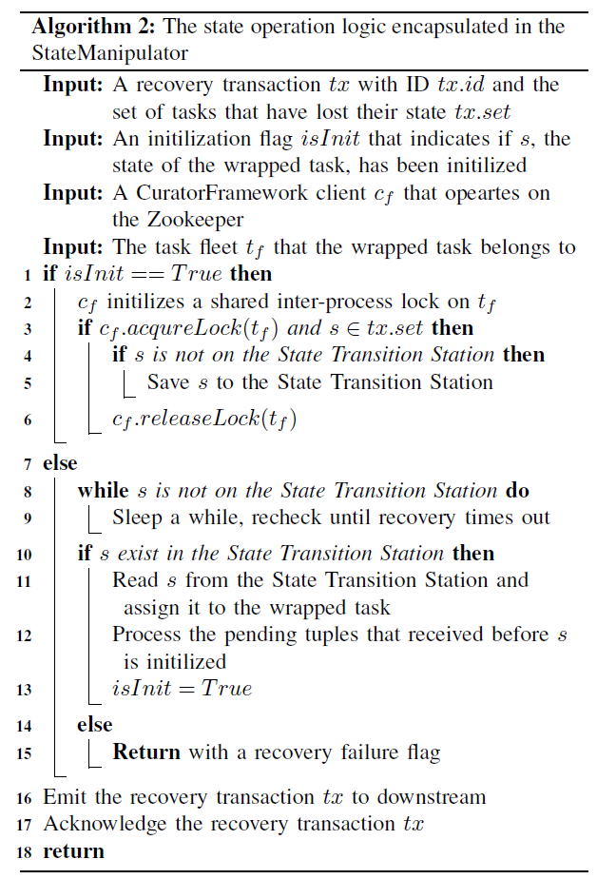
State Management Framework
Failure Recovery
Simultaneous state transfer without synchronization
In a failure-affected fleet, only one alive task gets to write its states
Restarted tasks query the state transmit station for accessing their lost state

Slide 25
Outline of Presentation
Background
Stream Processing
Apache Storm
Performance Issue with the Current Approach
Solution Overview
Basic Idea
Framework Design
State Management Framework
Error-free Execution
Failure Recovery
Evaluation
Conclusions and Future Work

Slide 26
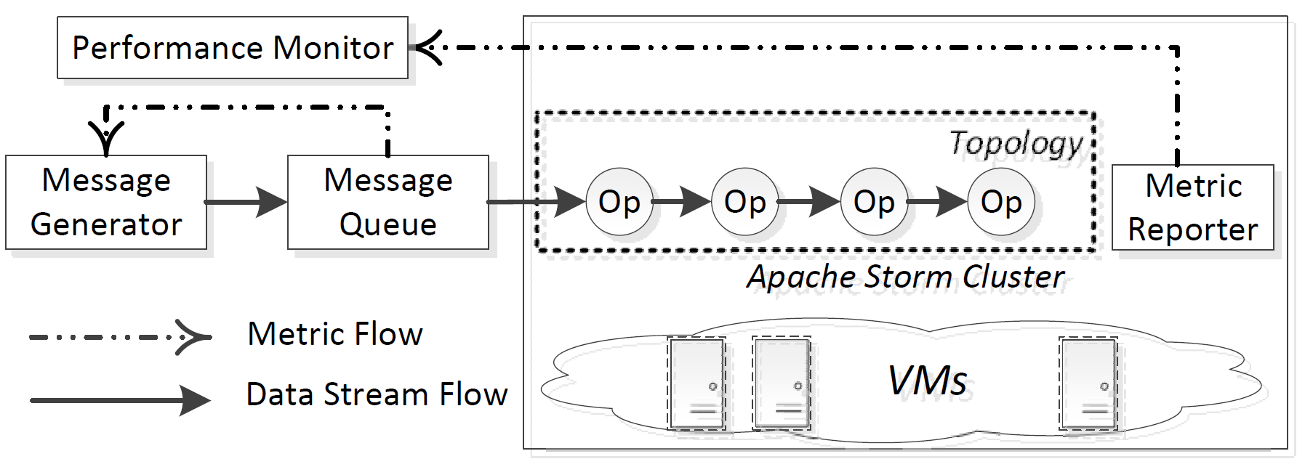
Evaluation
Experiment Setup
Nectar IaaS Cloud
10 worker nodes: 2 VCPUs, 6GB RAM and 30GB disk
1 Nimbus, 1 Zookeeper, 1 Kestrel node
Two test applications
Synthetic test application
URL extraction topology
Profiling environment

Slide 27
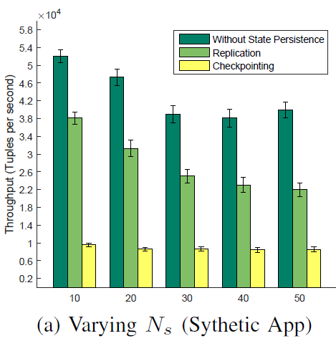
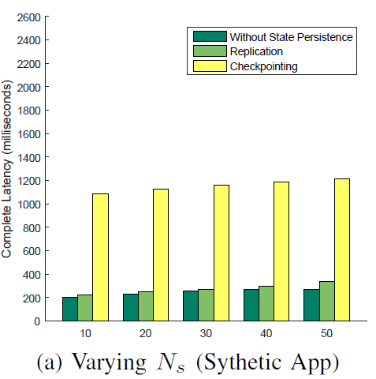
Evaluation
Overhead of State Persistence
Synthetic application
Throughput
Latency

Slide 28
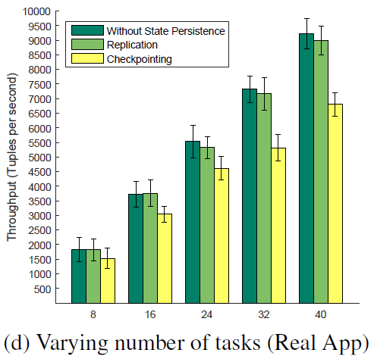
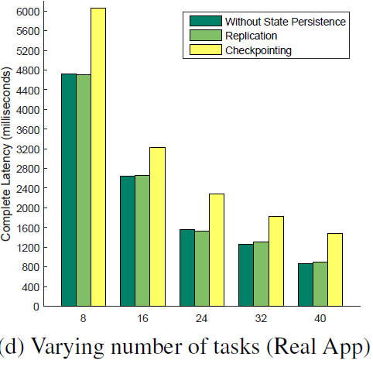
Evaluation
Overhead of State Persistence
Realistic application
Throughput
Latency

Slide 29
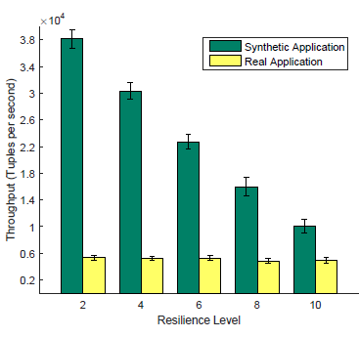
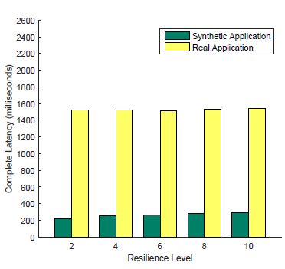
Evaluation
Overhead of Maintaining More Replicas
Throughput changes
Latency changes

Slide 30
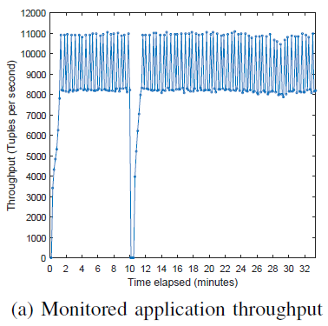
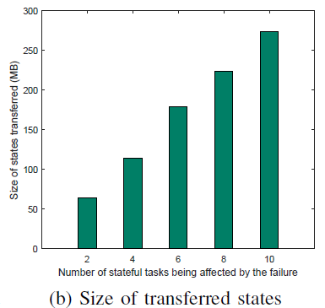
Evaluation
Performance of Recovery

Slide 31
Outline of Presentation
Background
Stream Processing
Apache Storm
Performance Issue with the Current Approach
Solution Overview
Basic Idea
Framework Design
State Management Framework
Error-free Execution
Failure Recovery
Evaluation
Conclusions and Future Work

Slide 32
Conclusions and Future work
Proposed a replication-based state management system
Low overhead on error-free execution
Concurrent and high performance recovery in the case of failures
Identified overhead of checkpointing
Frequent state access
Remote synchronization
Future work
Adaptive replication schemes
Intelligent replica placement strategies
Location-aware recovery protocol

Slide 33


© Copyright The University of Melbourne 2017

