Slide 1
GTI

Slide 2
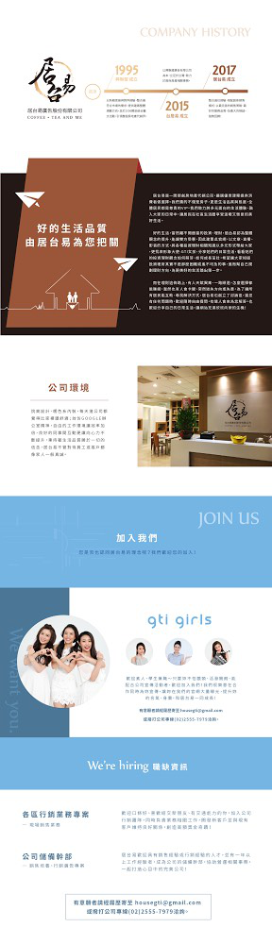
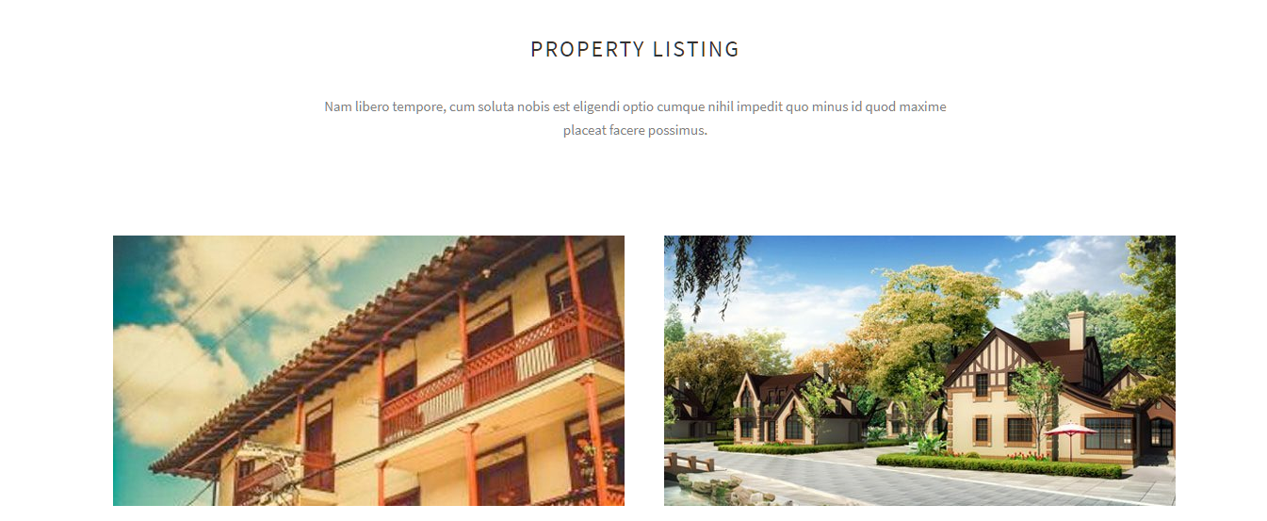
http://massive.markup.themebucket.net/mp-index-real-state.html

Slide 3
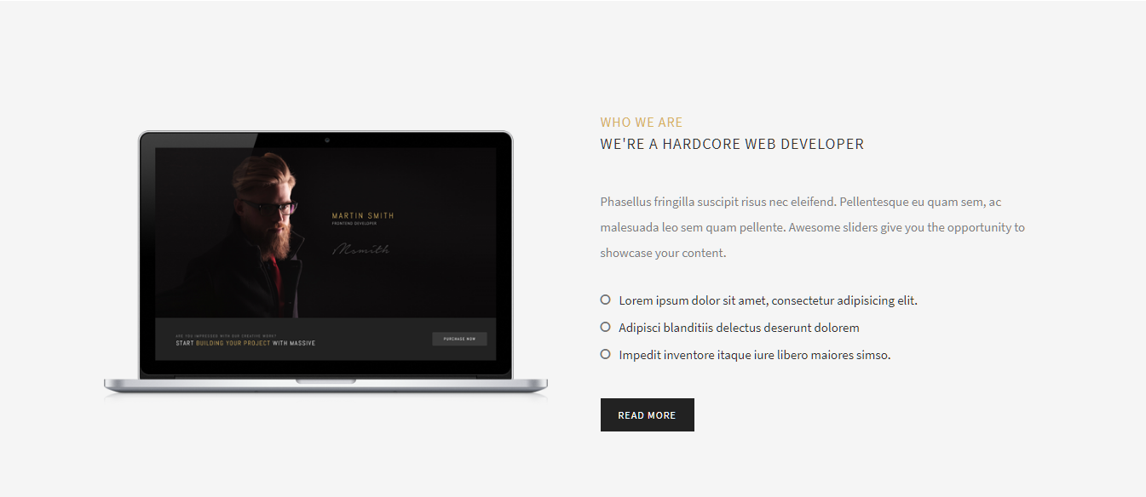

Slide 4
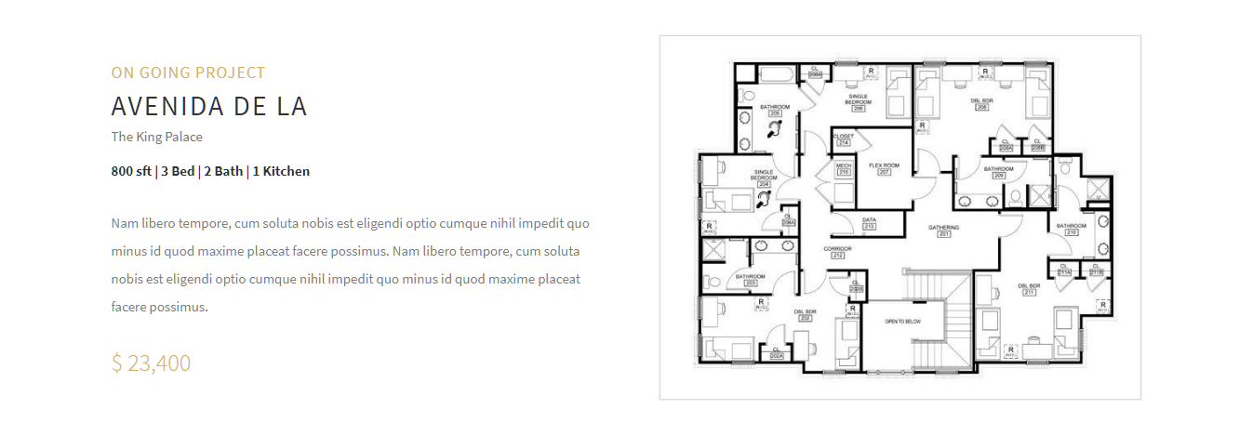
http://massive.markup.themebucket.net/mp-index-real-state.html

Slide 5

http://massive.markup.themebucket.net/mp-index-creative-1.html

Slide 6

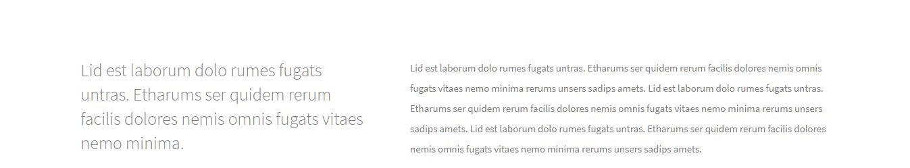

http://massive.markup.themebucket.net/mp-index-corporate-3.html
http://massive.markup.themebucket.net/mp-index-corporate-4.html
http://massive.markup.themebucket.net/shortcode-career.html

