Slide 1
Brief for蘇林
前端頁面

Slide 2

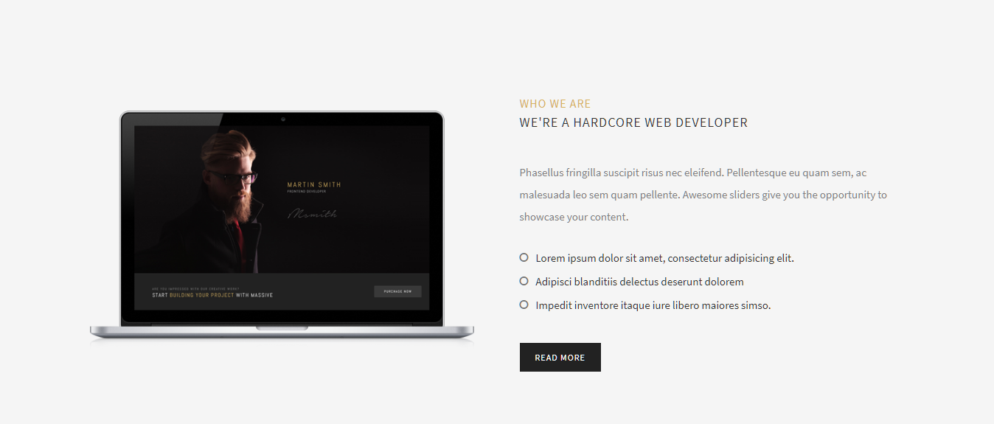
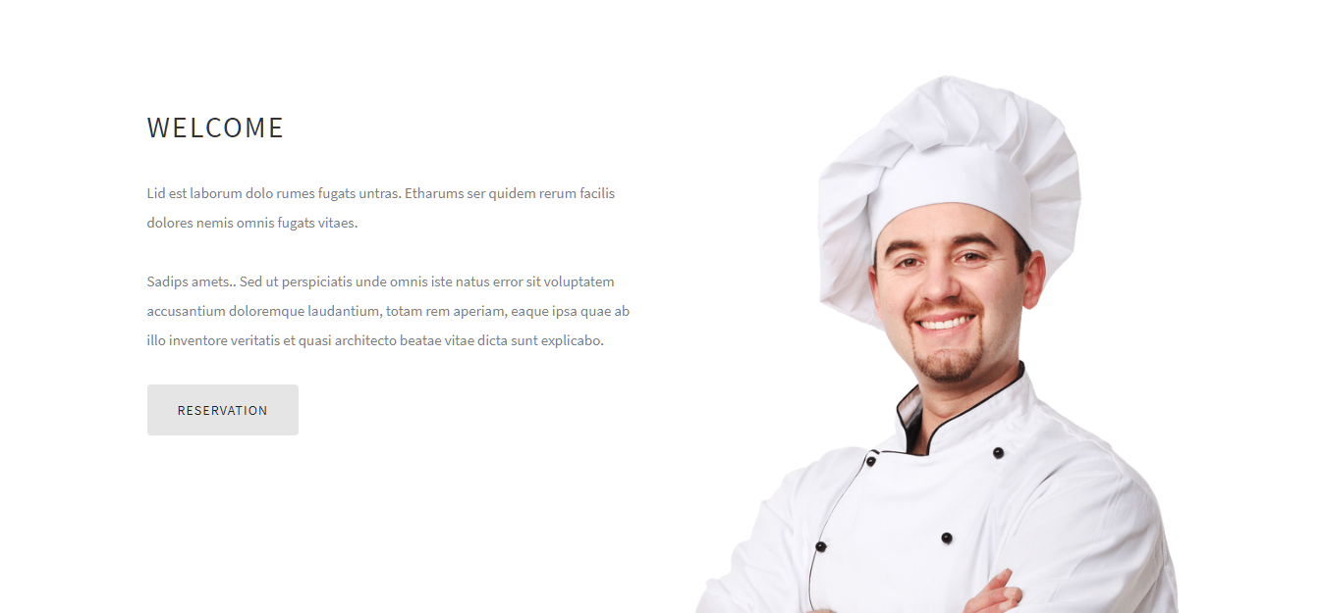
http://massive.markup.themebucket.net/mp-index-general-3.html
http://massive.markup.themebucket.net/mp-index-restaurant.html

Slide 3
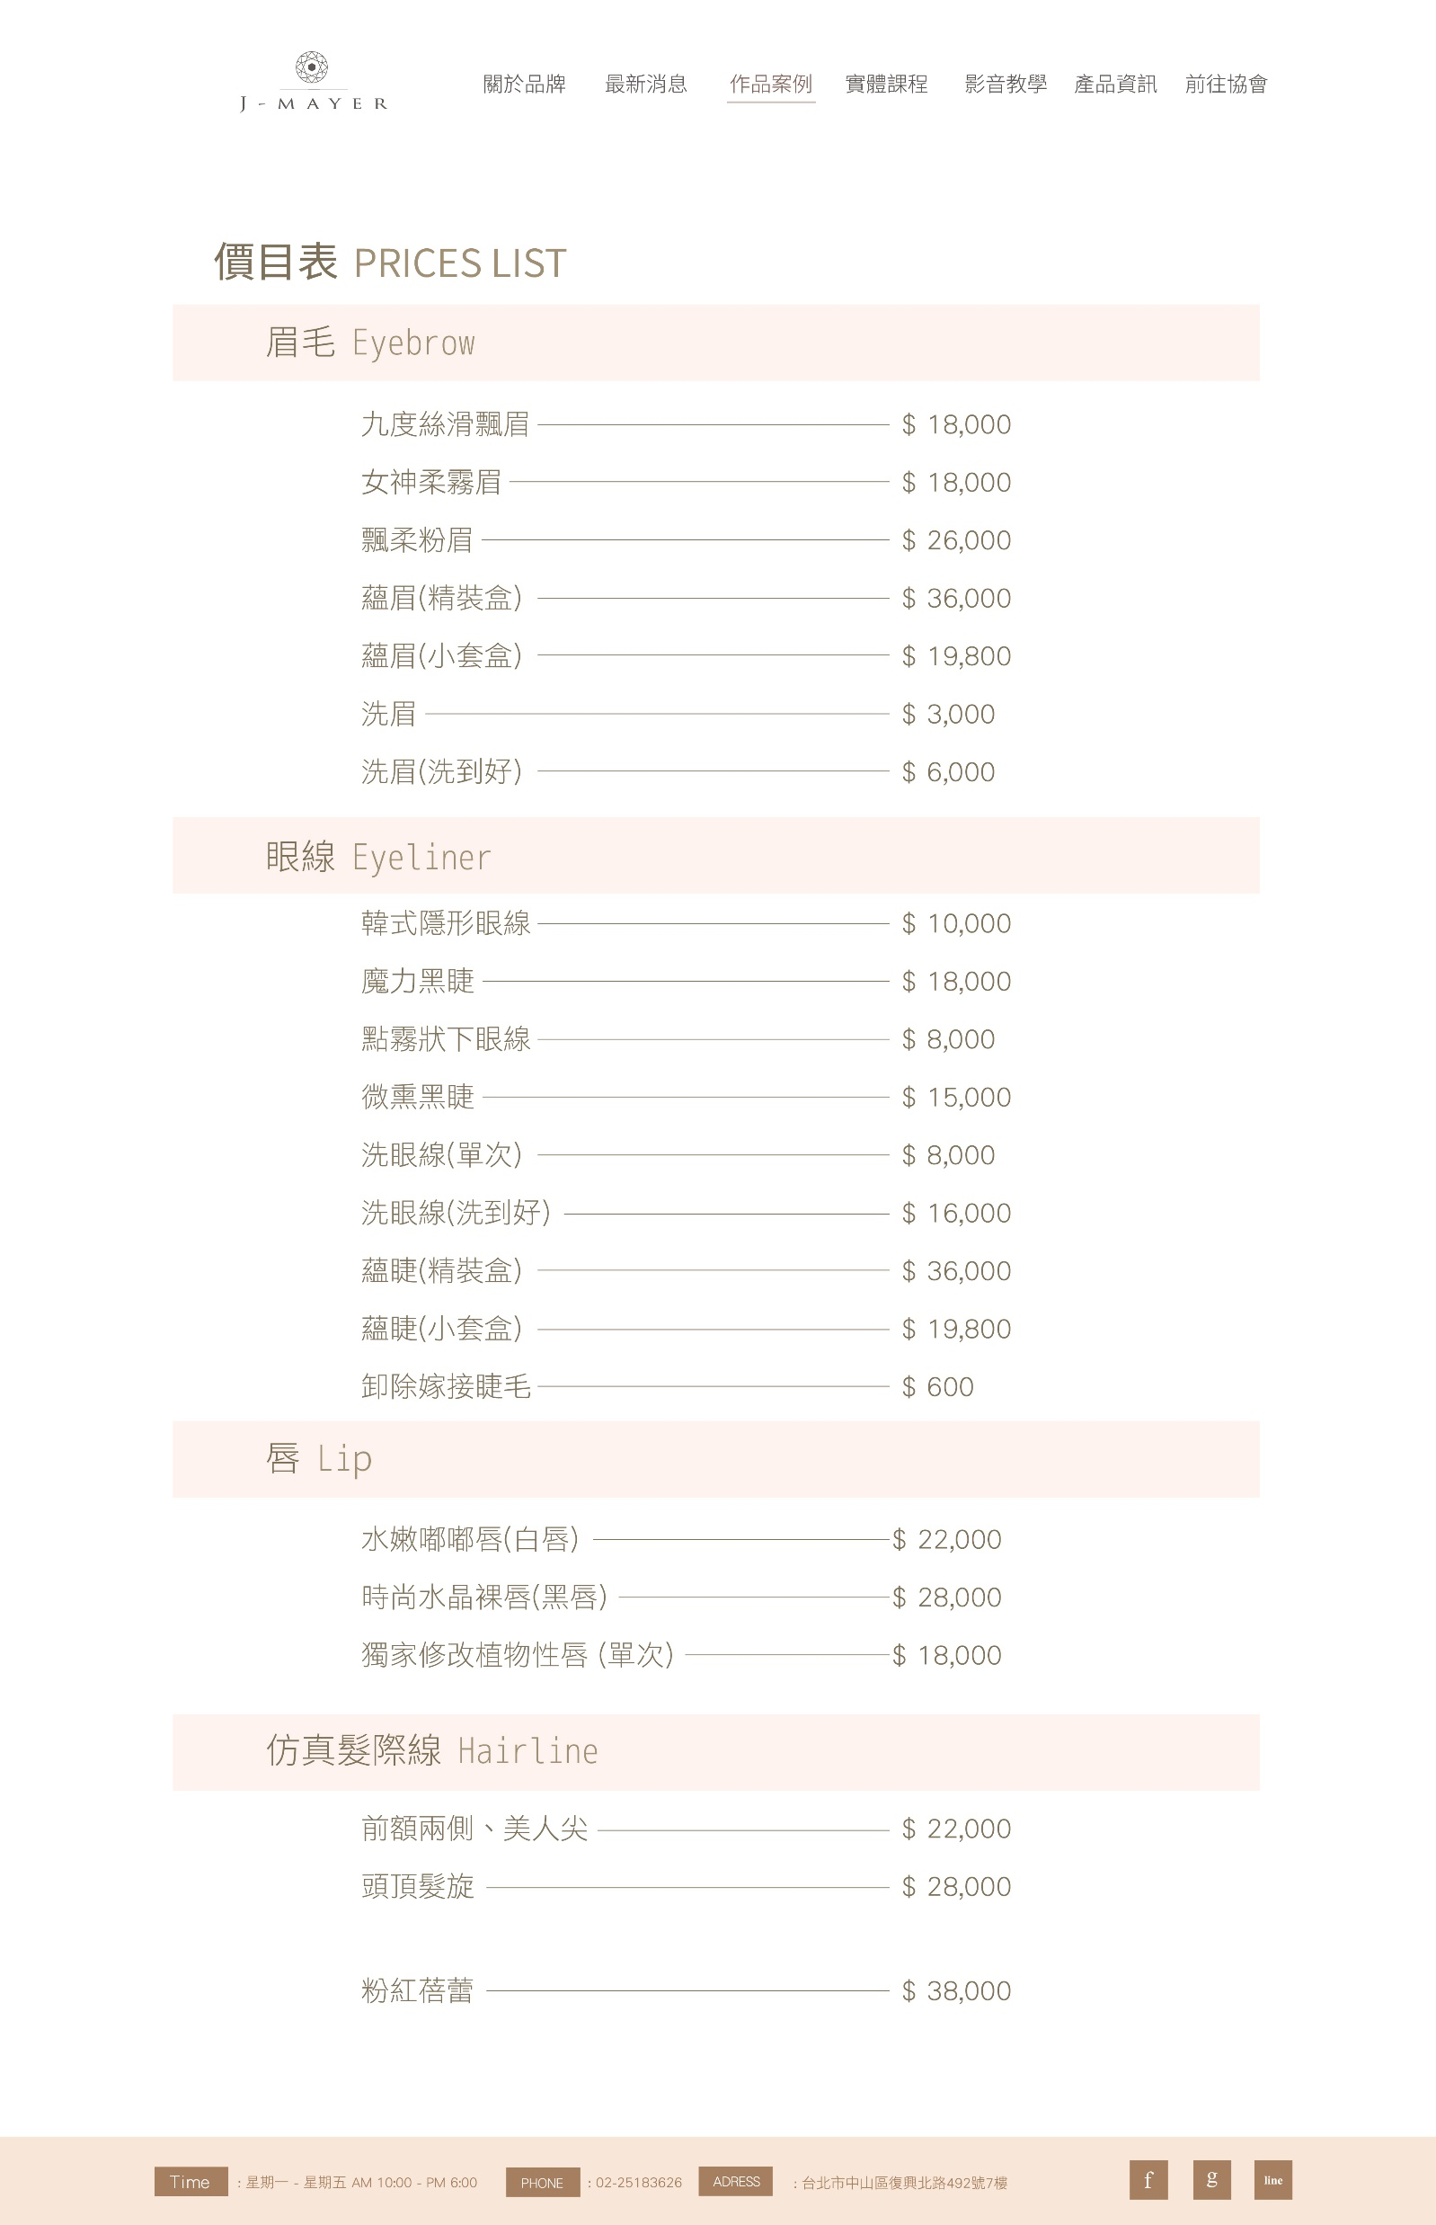

Slide 4
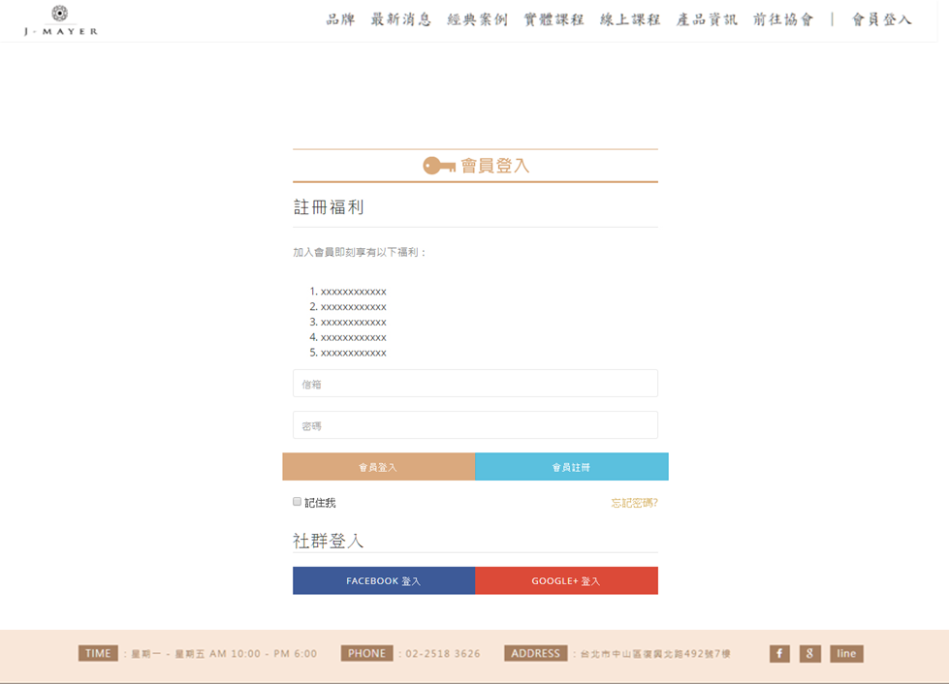

Slide 5
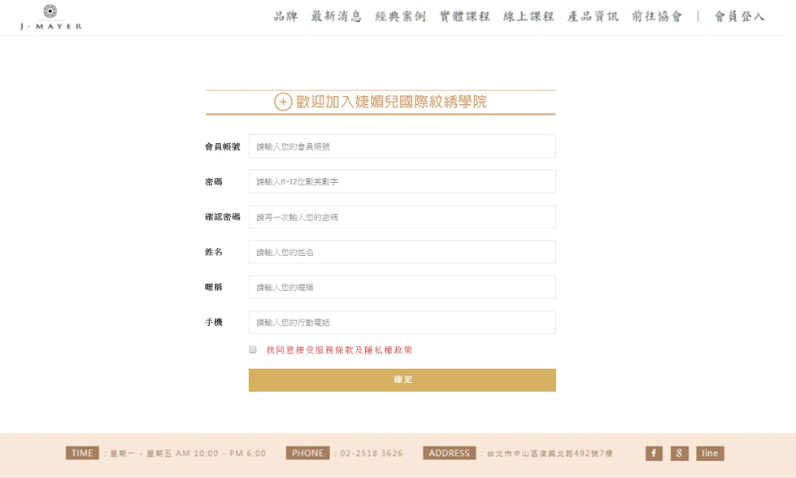

Slide 6
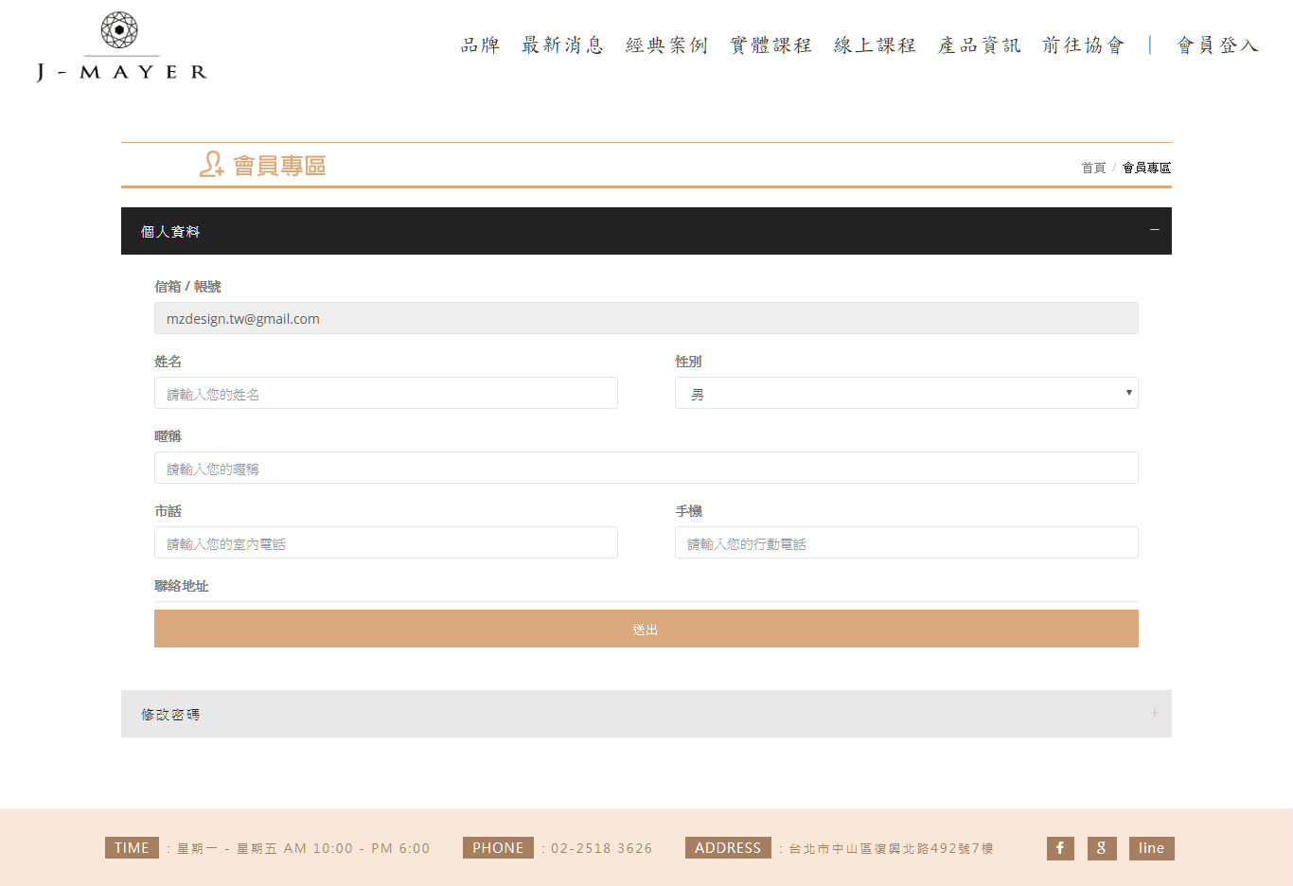
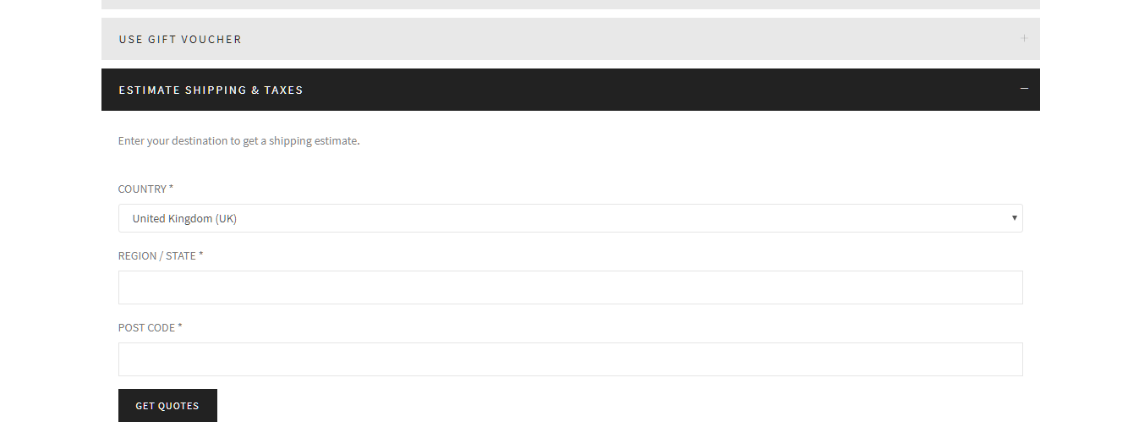
gti頁面
http://gti-dev.funcode.win/member
版
http://massive.markup.themebucket.net/shop-cart.html

