Slide 1
#ff5d41 / 255,93,65
20% #82c0c2 / 130,192,194
40% #46a2a4 / 70,162,164
60% #008080 / 0,128,128
80% #066363 / 6,99,99
100% #0b4545 / 11,69,69

Slide 2





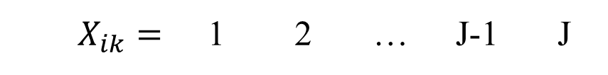










$$T_{k}=0$$
Cultural Truth:
$$T_{k}=1$$
$$\frac{E_{i}(1−Q_{k})}{E_{i}(1−Q_{k})+\left(1−E_{i}\right)Q_{k}}=$$
$$p_{ik}$$
$$1−p_{ik}$$
$$1−p_{ik}$$
$$p_{ik}$$
Know
Don’t Know
Know
$${1−b}_{i}$$
$$b_{i}$$
$$S_{ik}=0$$
$$S_{ik}=1$$
Latent State:
$$g_{i,1\sim J−1}$$
$$d_{i,2\sim J}$$
$$X_{ik}=$$ | 1 | 2 | … | J-1 | J
Response:
$T_{k}$is$0$
confidence
$T_{k}$is$1$

Slide 3
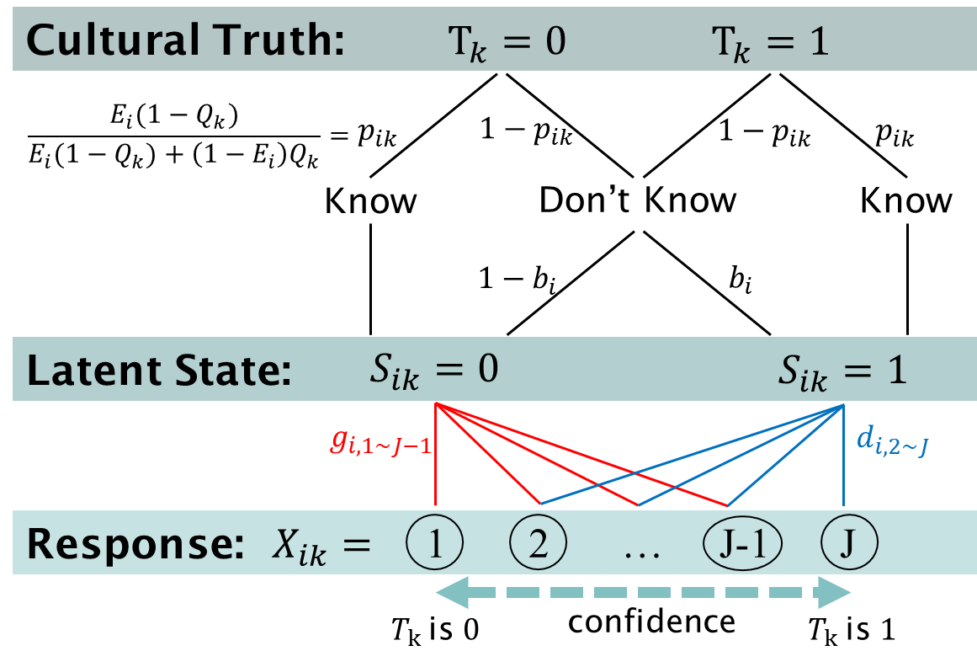

Slide 4
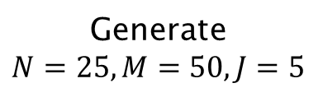
True parameter
value
Generate
$$N=25, M=50, J=5$$
Simulated
data
GCLK
model
Bayesian inference
posterior mean
95% HDI
posterior predictive check
Markov Chain Monte-Carlo
6 chains
5000 iterations
1000 iter. as burn-in
no thinning
Posterior distribution of parameter

Slide 5
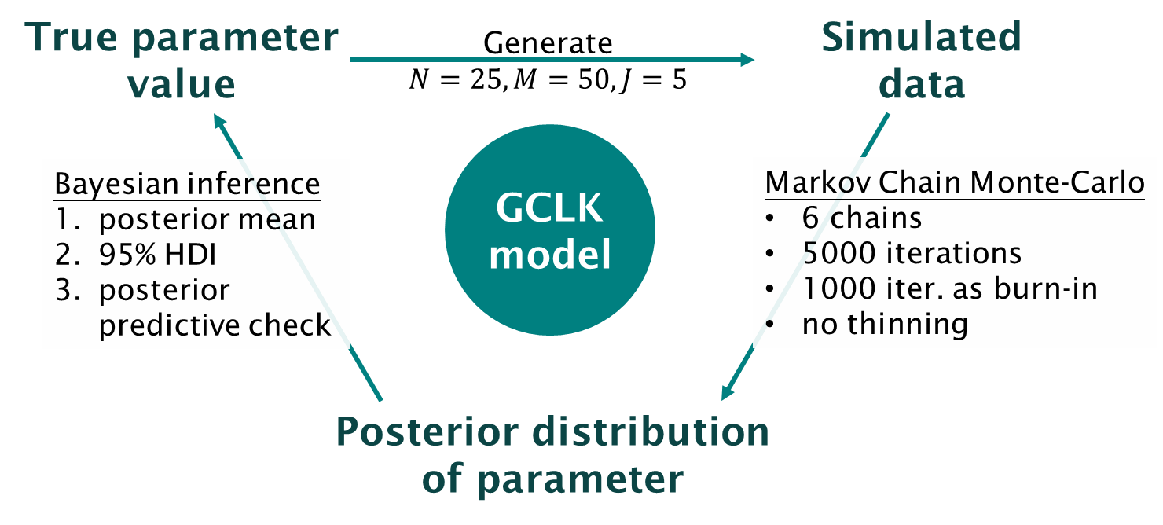

Slide 6
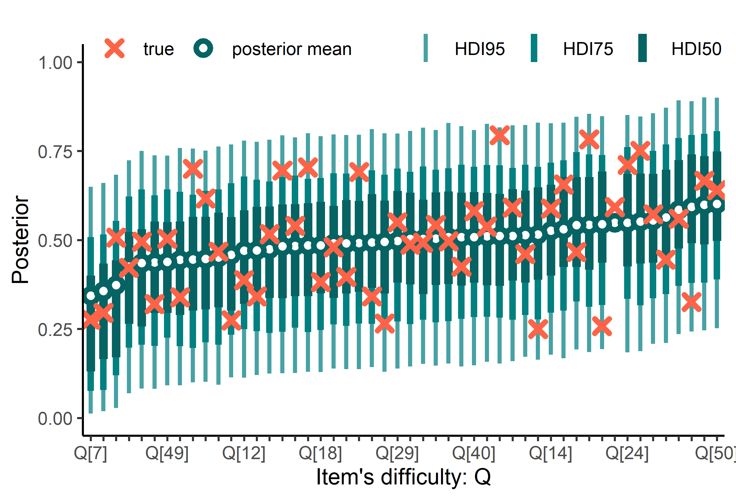
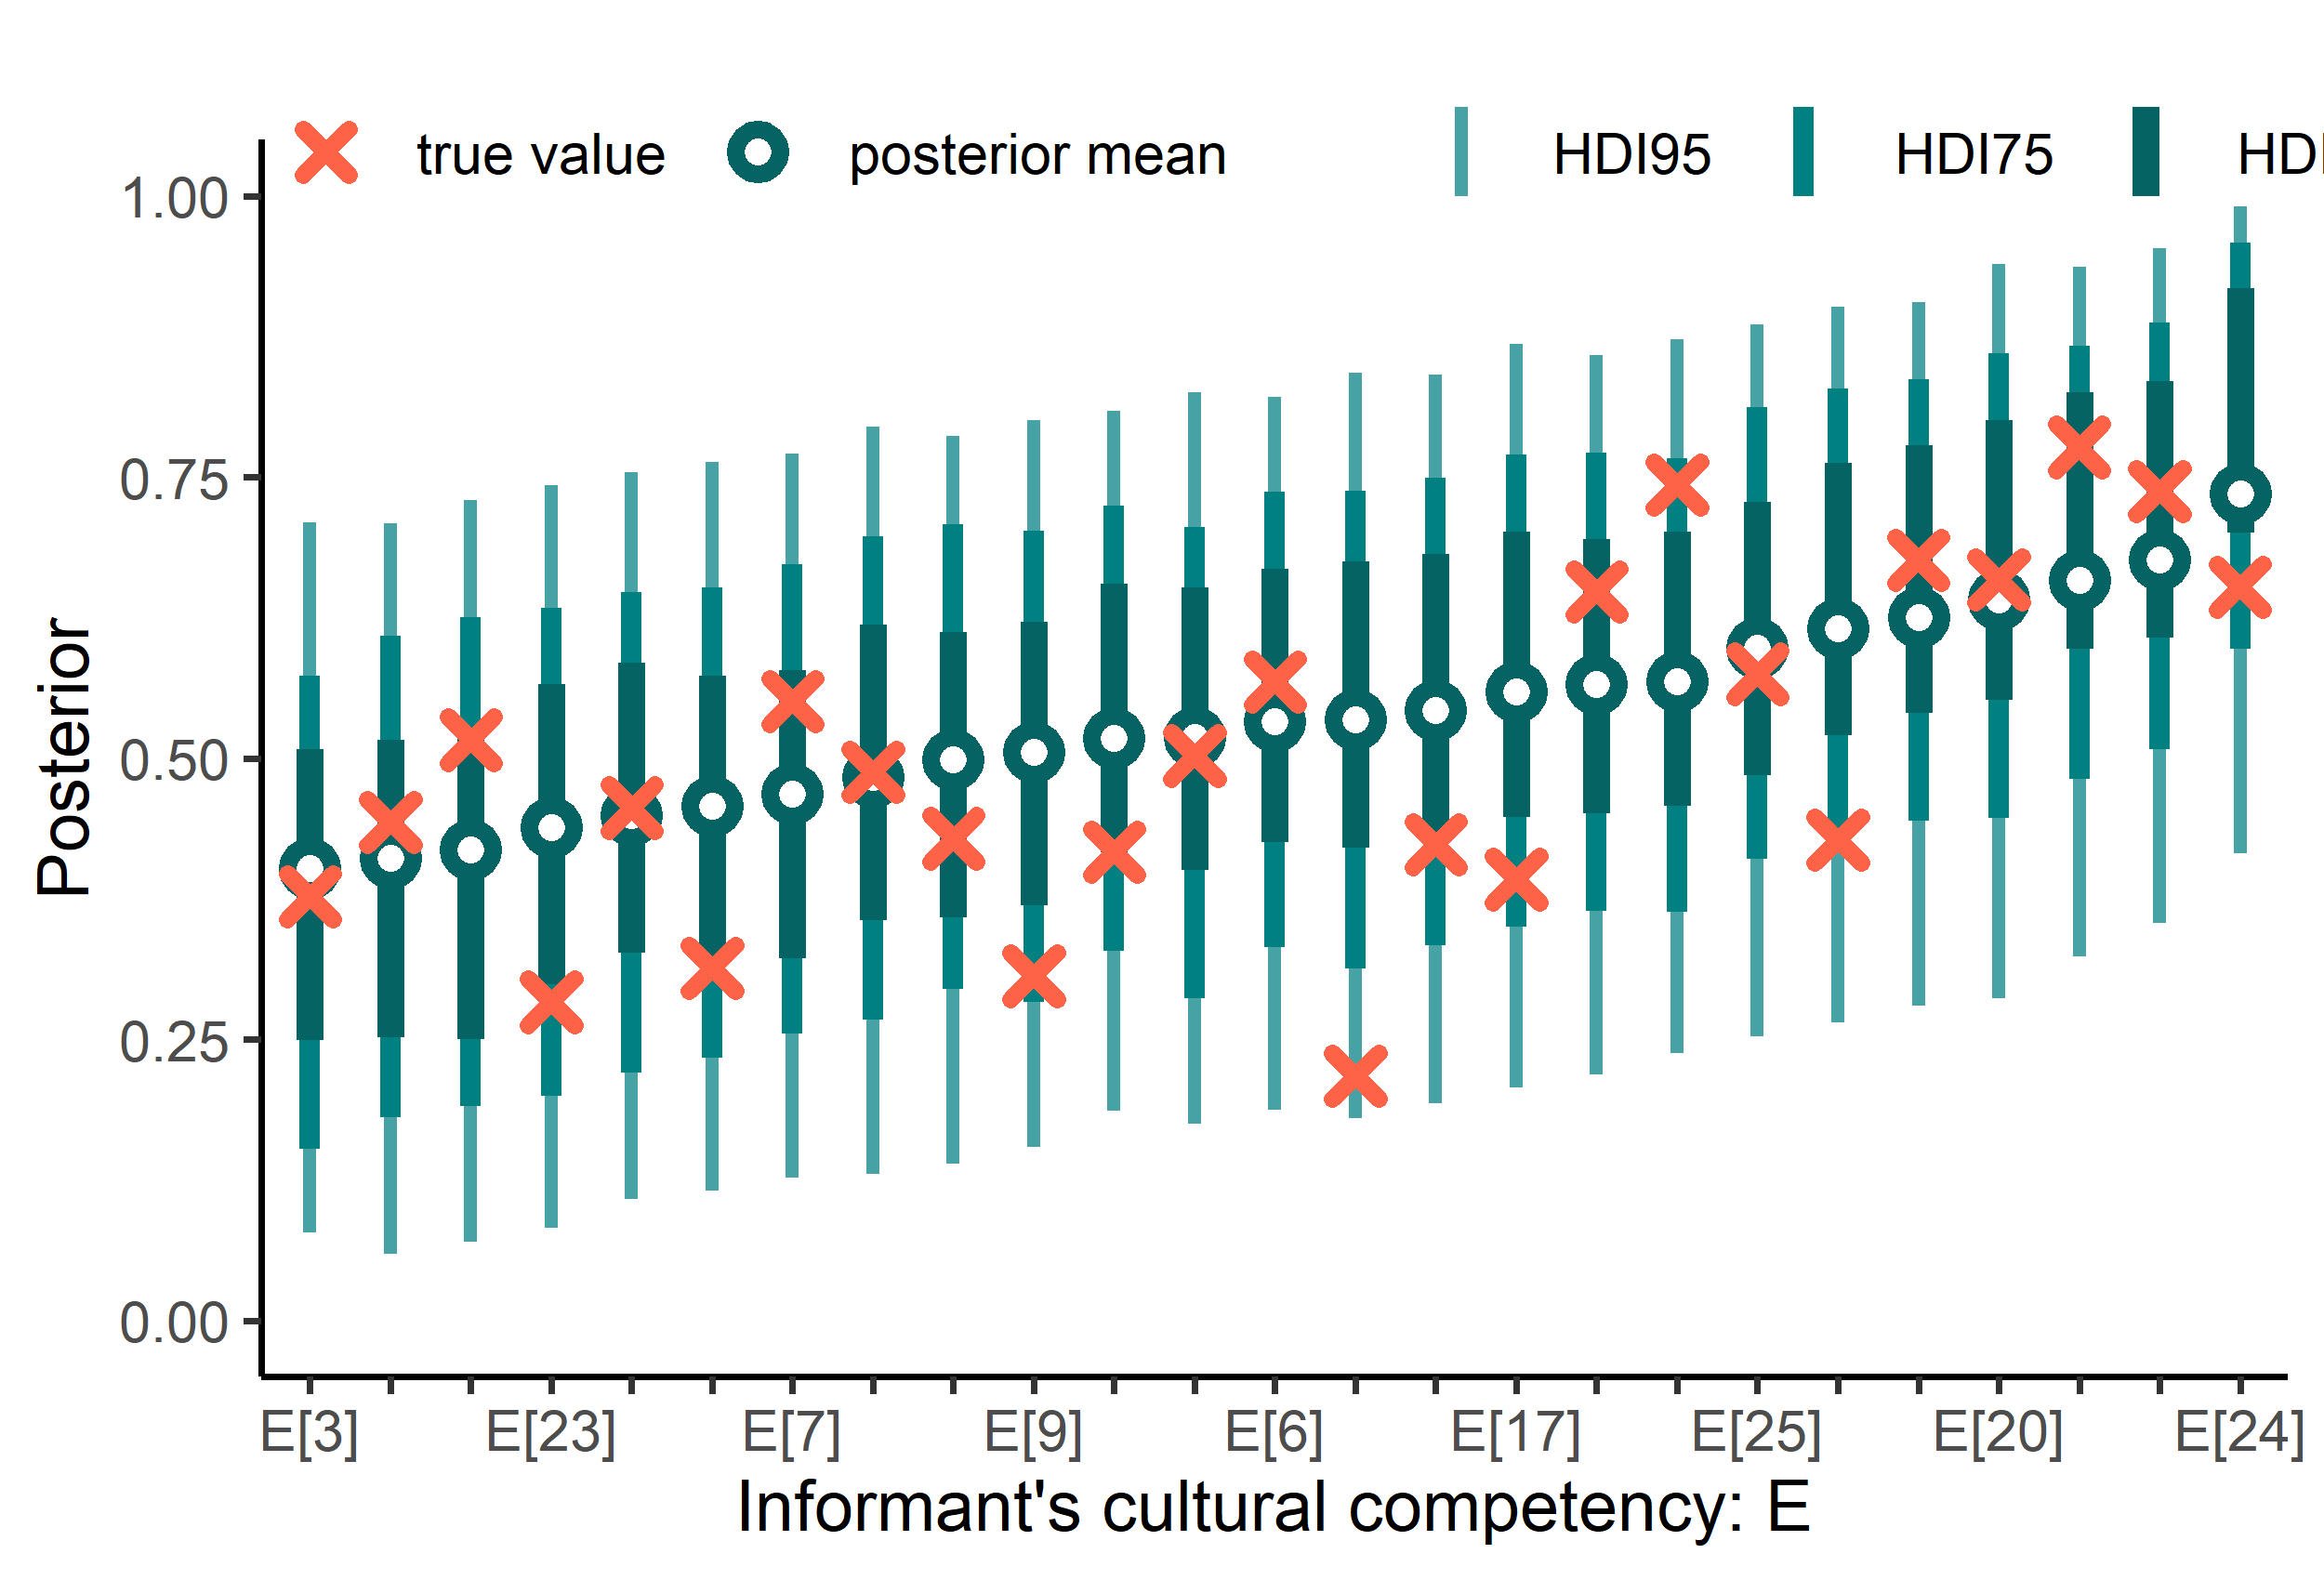
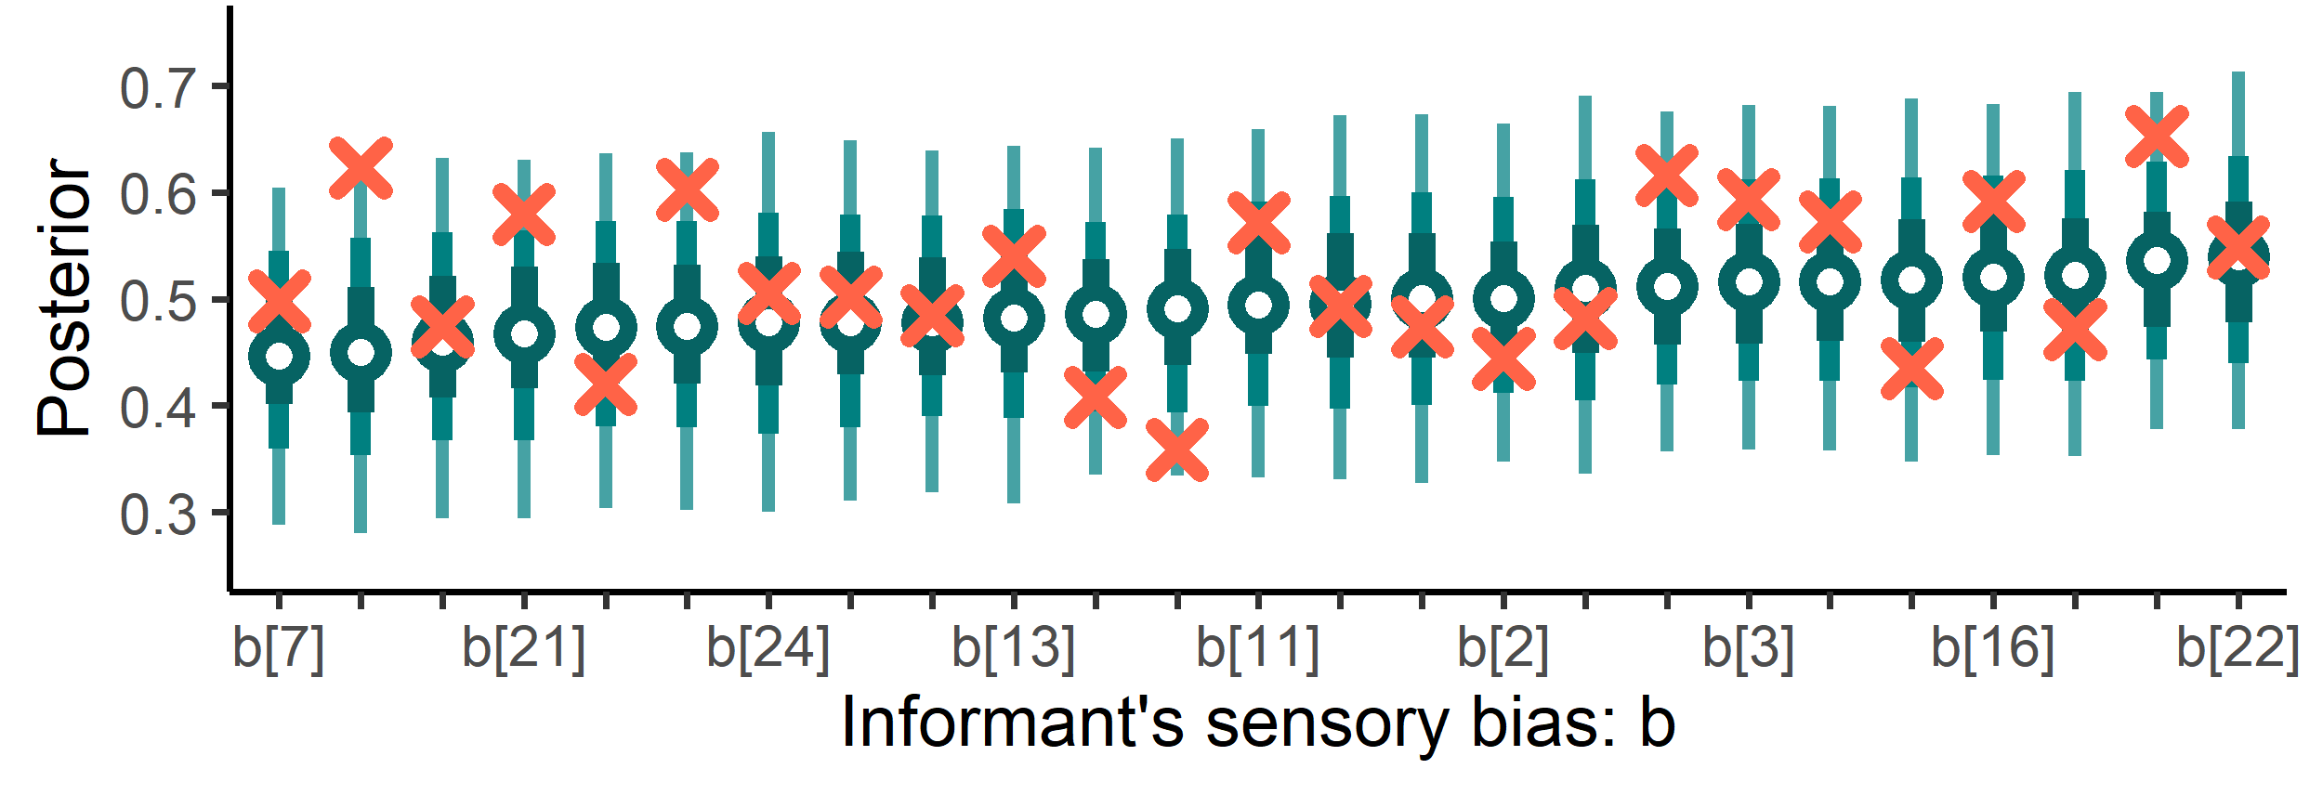

Slide 7
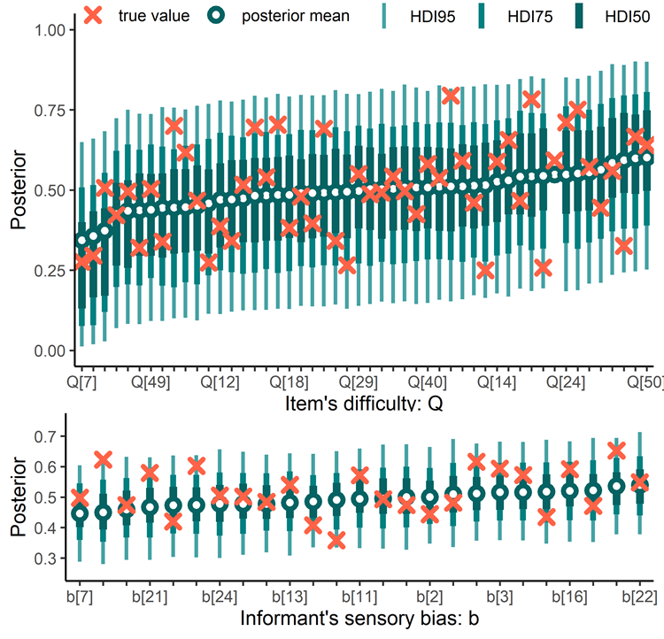

Slide 8



Slide 10
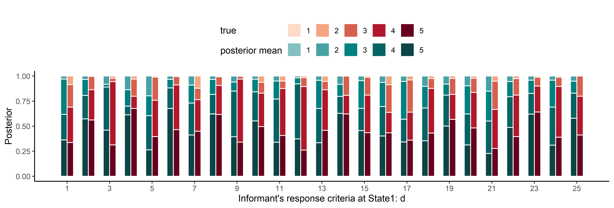
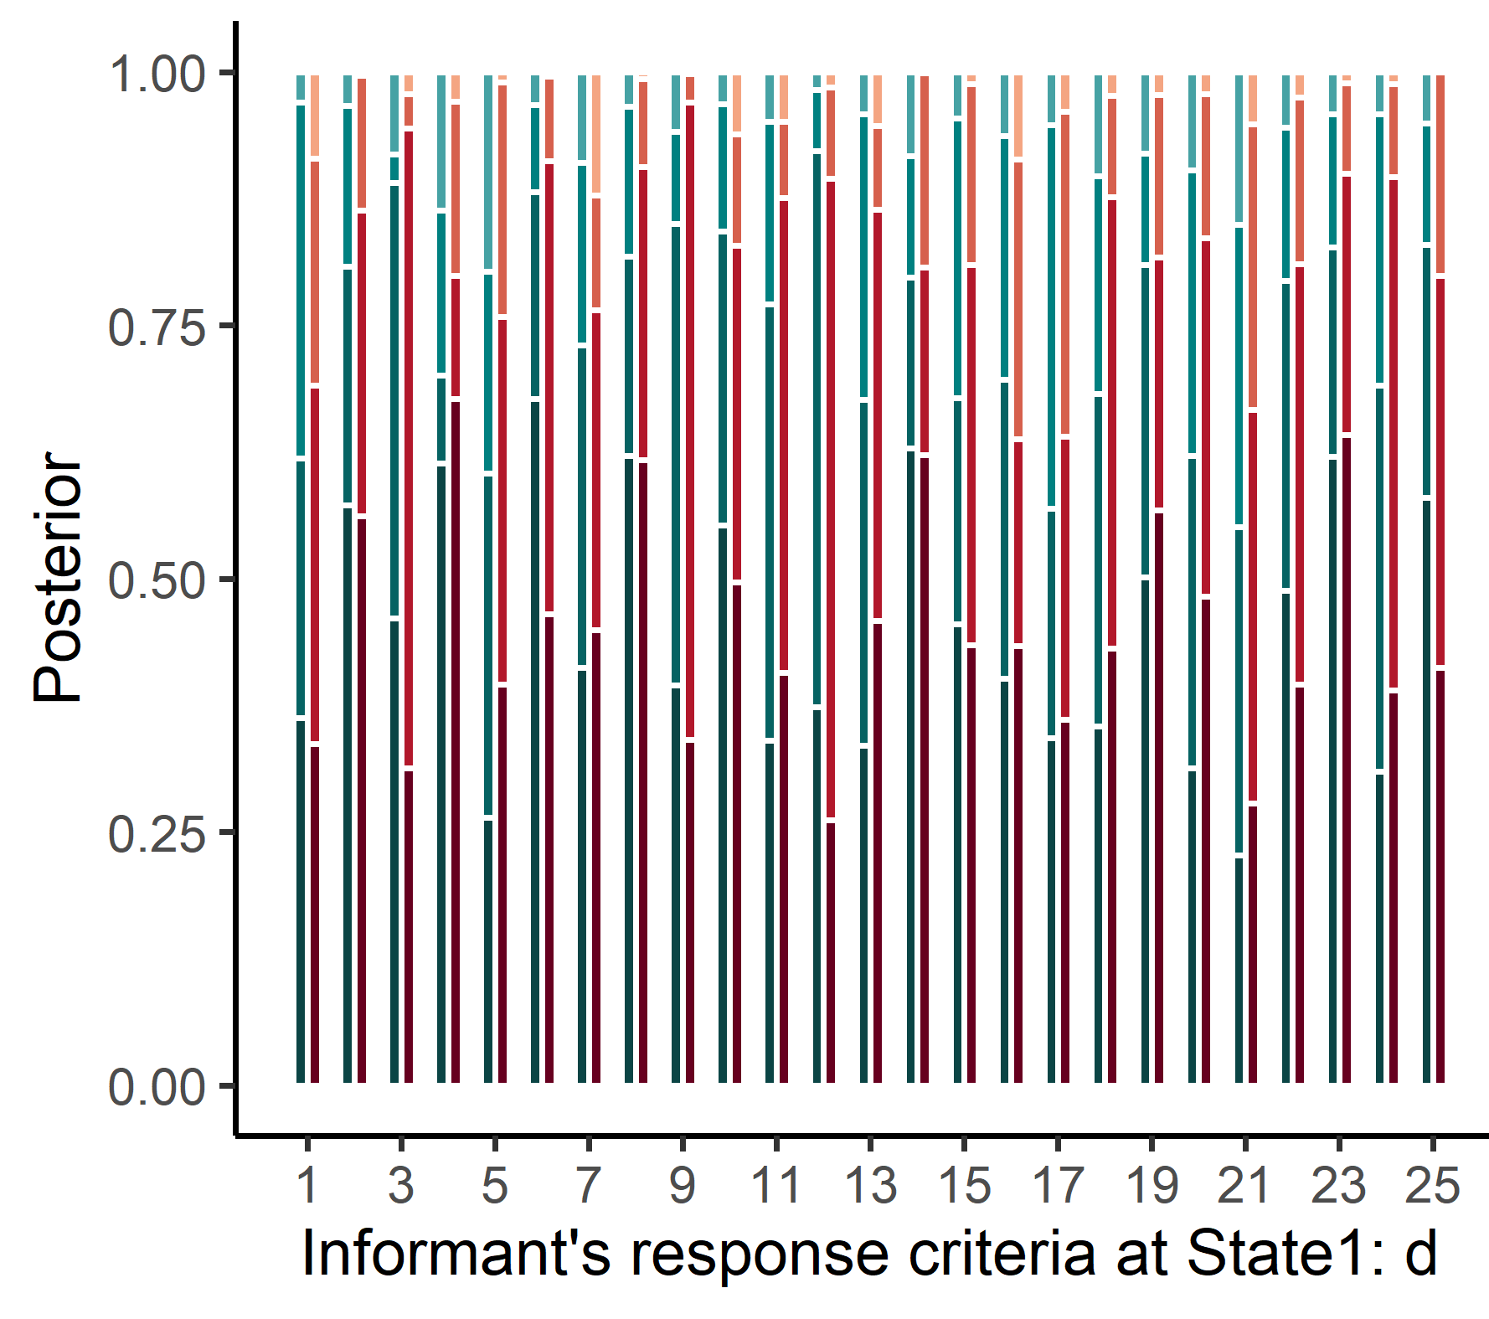
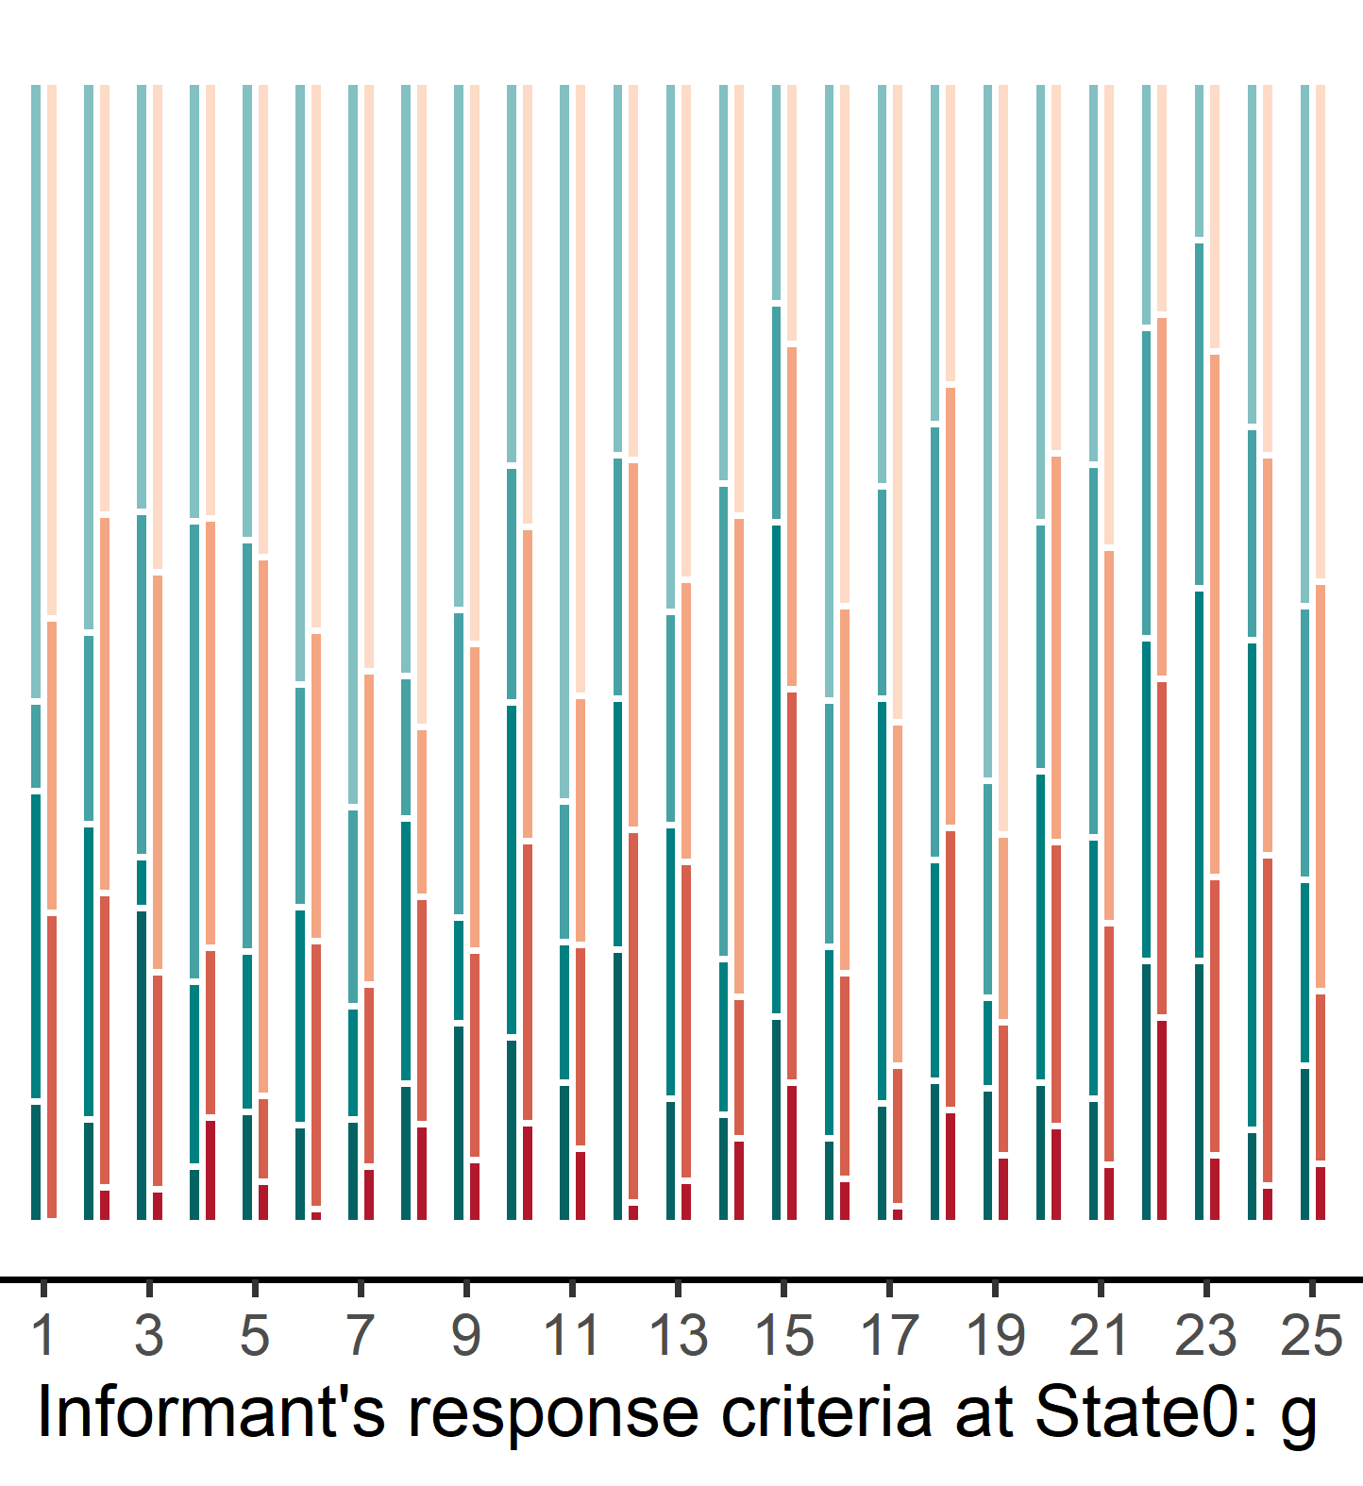
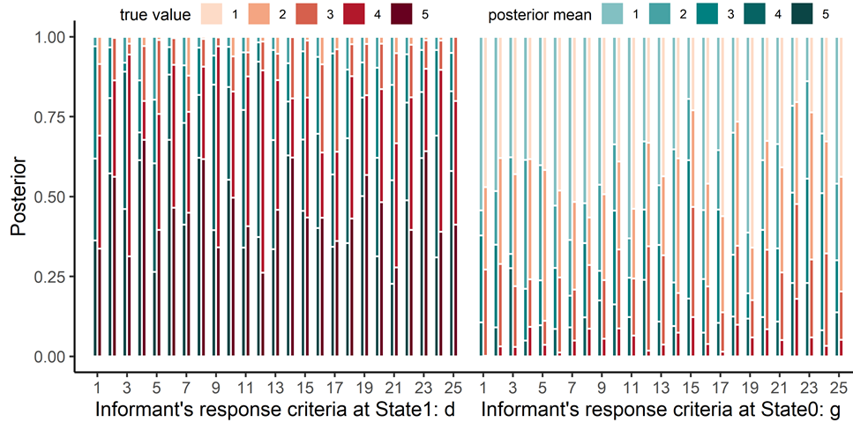

Slide 11
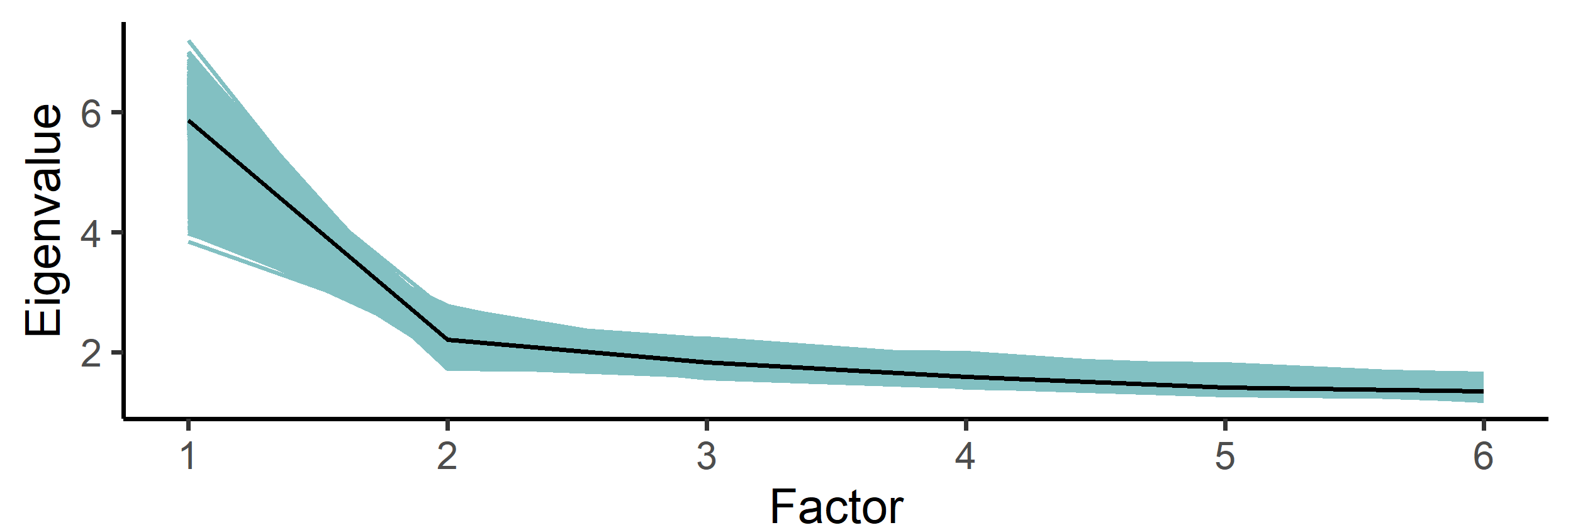

Slide 12


