Slide 1




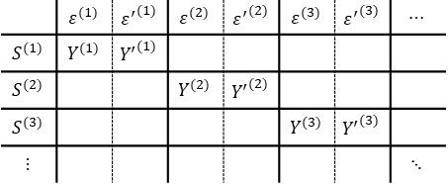

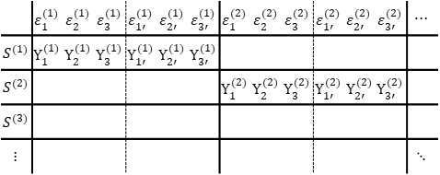



$$ℰ(ℛ)$$
$$ℰ(ℛ)$$
$$𝒮$$
 | $$ε^{(l)}$$ | $${ε′}^{(l)}$$
$$S^{(l)}$$ | $$Y^{(l)}$$ | $${Y′}^{(l)}$$
$$𝒮$$
 | $$ε_{1}^{(l)}$$ | $$ε_{2}^{(l)}$$ | $$ε_{3}^{(l)}$$ | $$ε_{1′ }^{(l)}$$ | $$ε_{2′ }^{(l)}$$ | $$ε_{3′ }^{(l)}$$
$$S^{(l)}$$ | $$Y_{1}^{(l)}$$ | $$Y_{2}^{(l)}$$ | $$Y_{3}^{(l)}$$ | $$Y_{1′ }^{(l)}$$ | $$Y_{2′ }^{(l)}$$ | $$Y_{3′ }^{(l)}$$
$l=1, 2, …$
$l=1, 2, …$
 | $$ε^{(1)}$$ | $${ε^{′}}^{(1)}$$ | $$ε^{(2)}$$ | $${ε^{′}}^{(2)}$$ | $$ε^{(3)}$$ | $${ε^{′}}^{(3)}$$ | $$⋯$$
$$S^{(1)}$$ | $$Y^{(1)}$$ | $${Y^{′}}^{(1)}$$
$$S^{(2)}$$ |  |  | $$Y^{(2)}$$ | $${Y^{′}}^{(2)}$$
$$S^{(3)}$$ |  |  |  |  | $$Y^{(3)}$$ | $${Y^{′}}^{(3)}$$
$$⋮$$ |  |  |  |  |  |  | $$⋱$$
 | $$ε_{1}^{(1)}$$ | $$ε_{2}^{(1)}$$ | $$ε_{3}^{(1)}$$ | $$ε_{1′ }^{(1)}$$ | $$ε_{2′ }^{(1)}$$ | $$ε_{3′ }^{(1)}$$ | $$ε_{1}^{(2)}$$ | $$ε_{2}^{(2)}$$ | $$ε_{3}^{(2)}$$ | $$ε_{1′ }^{(2)}$$ | $$ε_{2′ }^{(2)}$$ | $$ε_{3′ }^{(2)}$$ | $$⋯$$
$$S^{(1)}$$ | $$Y_{1}^{(1)}$$ | $$Y_{2}^{(1)}$$ | $$Y_{3}^{(1)}$$ | $$Y_{1′ }^{(1)}$$ | $$Y_{2′ }^{(1)}$$ | $$Y_{3′ }^{(1)}$$
$$S^{(2)}$$ |  |  |  |  |  |  | $$Y_{1}^{(2)}$$ | $$Y_{2}^{(2)}$$ | $$Y_{3}^{(2)}$$ | $$Y_{1′ }^{(2)}$$ | $$Y_{2′ }^{(2)}$$ | $$Y_{3′ }^{(2)}$$
$$S^{(3)}$$
$$⋮$$ |  |  |  |  |  |  |  |  |  |  |  |  | $$⋱$$
$$ICC\left(1\right)=Cor( , )$$
$$ICC\left(3\right)=Cor( , )$$

Slide 2


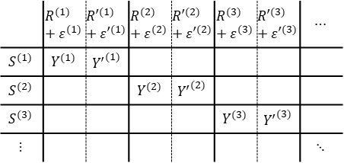



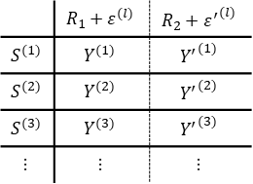




$$ℛ$$
$$R_{1}$$
$$R_{2}$$
$$ℛ$$
$ℰ$
$ℰ$
$$𝒮$$
 | $$R^{(l)}+ε^{(l)}$$ | $${R′}^{(l)}+{ε′}^{(l)}$$
$$S^{(l)}$$ | $$Y^{(l)}$$ | $${Y′}^{(l)}$$
$$𝒮$$
 | $$R_{1}+ε^{(l)}$$ | $$R_{2}+ε^{(l)}$$
$$S^{(l)}$$ | $$Y^{(l)}$$ | $${Y′}^{(l)}$$
$l=1, 2, …$
$l=1, 2, …$
 | $$R^{(1)}+ε^{(1)}$$ | $${R′}^{(1)}+{ε′}^{(1)}$$ | $$R^{(2)}+ε^{(2)}$$ | $${R′}^{(2)}+{ε′}^{(2)}$$ | $$R^{(3)}+ε^{(3)}$$ | $${R′}^{(3)}+{ε′}^{(3)}$$ | $$⋯$$
$$S^{(1)}$$ | $$Y^{(1)}$$ | $${Y^{′}}^{(1)}$$
$$S^{(2)}$$ |  |  | $$Y^{(2)}$$ | $${Y^{′}}^{(2)}$$
$$S^{(3)}$$ |  |  |  |  | $$Y^{(3)}$$ | $${Y^{′}}^{(3)}$$
$$⋮$$ |  |  |  |  |  |  | $$⋱$$
 | $$R_{1}+ε^{(l)}$$ | $$R_{2}+{ε^{′}}^{(l)}$$
$$S^{(1)}$$ | $$Y^{(1)}$$ | $${Y^{′}}^{(1)}$$
$$S^{(2)}$$ | $$Y^{(2)}$$ | $${Y^{′}}^{(2)}$$
$$S^{(3)}$$ | $$Y^{(3)}$$ | $${Y^{′}}^{(3)}$$
$$⋮$$ | $$⋮$$ | $$⋮$$
$$ICC\left(A,1\right)=Cor( , )$$
$$ICC\left(C,1\right)=Cor( , )$$

Slide 3



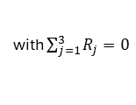
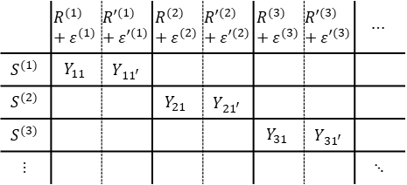


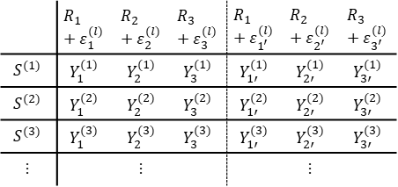
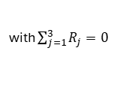

with $\sum_{j=1}^{3}{R_{j}}=0$
$ℰ$
with $\sum_{j=1}^{3}{R_{j}}=0$
$ℰ$
$$R_{1}$$ | $$R_{2}$$ | $$R_{3}$$
$$R_{1}$$ | $$R_{2}$$ | $$R_{3}$$
$$𝒮$$
 | $$R^{(l)}+ε^{(l)}$$ | $${R′}^{(l)}+{ε′}^{(l)}$$
$$S^{(l)}$$ | $$Y^{(l)}$$ | $${Y′}^{(l)}$$
$$𝒮$$
 | $$R_{1}+ε_{1}^{(l)}$$ | $$R_{2}+ε_{2}^{(l)}$$ | $$R_{3}+ε_{3}^{(l)}$$ | $$R_{1}+ε_{1^{′}}^{(l)}$$ | $$R_{2}+ε_{2^{′}}^{(l)}$$ | $$R_{3}+ε_{3^{′}}^{(l)}$$
$$S^{(l)}$$ | $$Y_{1}^{(l)}$$ | $$Y_{2}^{(l)}$$ | $$Y_{3}^{(l)}$$ | $$Y_{1′}^{(l)}$$ | $$Y_{2′}^{(l)}$$ | $$Y_{3′}^{(l)}$$
$l=1, 2, …$
$l=1, 2, …$
 | $$R^{(1)}+ε^{(1)}$$ | $${R′}^{(1)}+{ε′}^{(1)}$$ | $$R^{(2)}+ε^{(2)}$$ | $${R′}^{(2)}+{ε′}^{(2)}$$ | $$R^{(3)}+ε^{(3)}$$ | $${R′}^{(3)}+{ε′}^{(3)}$$ | $$⋯$$
$$S^{(1)}$$ | $$Y_{11}$$ | $$Y_{{11}^{′}}$$
$$S^{(2)}$$ |  |  | $$Y_{21}$$ | $$Y_{{21}^{′}}$$
$$S^{(3)}$$ |  |  |  |  | $$Y_{31}$$ | $$Y_{{31}^{′}}$$
$$⋮$$ |  |  |  |  |  |  | $$⋱$$
 | $$R_{1}+ε_{1}^{(l)}$$ | $$R_{2}+ε_{2}^{(l)}$$ | $$R_{3}+ε_{3}^{(l)}$$ | $$R_{1}+ε_{1^{′}}^{(l)}$$ | $$R_{2}+ε_{2^{′}}^{(l)}$$ | $$R_{3}+ε_{3^{′}}^{(l)}$$
$$S^{(1)}$$ | $$Y_{1}^{(1)}$$ | $$Y_{2}^{(1)}$$ | $$Y_{3}^{(1)}$$ | $$Y_{1′}^{(1)}$$ | $$Y_{2′}^{(1)}$$ | $$Y_{3′}^{(1)}$$
$$S^{(2)}$$ | $$Y_{1}^{(2)}$$ | $$Y_{2}^{(2)}$$ | $$Y_{3}^{(2)}$$ | $$Y_{1′}^{(2)}$$ | $$Y_{2′}^{(2)}$$ | $$Y_{3′}^{(2)}$$
$$S^{(3)}$$ | $$Y_{1}^{(3)}$$ | $$Y_{2}^{(3)}$$ | $$Y_{3}^{(3)}$$ | $$Y_{1′}^{(3)}$$ | $$Y_{2′}^{(3)}$$ | $$Y_{3′}^{(3)}$$
$$⋮$$ |  | $$⋮$$ |  |  | $$⋮$$
$$ICC\left(A,1\right)=Cor( , )$$
$$ICC\left(A, 3\right)=Cor( , )$$

Slide 4



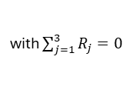



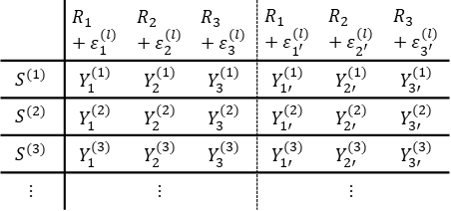



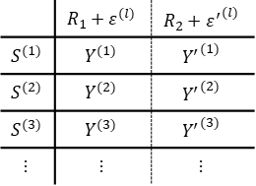
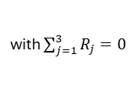
$$R_{1}$$ | $$R_{2}$$ | $$R_{3}$$
$$R_{1}$$ | $$R_{2}$$ | $$R_{3}$$
$$R_{1}$$
$$R_{2}$$
with $\sum_{j=1}^{3}{R_{j}}=0$
$$R_{1}, R_{2}, R_{3}$$
$$R_{1}, R_{2}, R_{3}$$
with $\sum_{j=1}^{3}{R_{j}}=0$
$ℰ$
$ℰ$
$$𝒮$$
 | $$R_{1}+ε^{(l)}$$ | $$R_{2}+ε^{(l)}$$
$$S^{(l)}$$ | $$Y^{(l)}$$ | $${Y′}^{(l)}$$
$$𝒮$$
 | $$R_{1}+ε_{1}^{(l)}$$ | $$R_{2}+ε_{2}^{(l)}$$ | $$R_{3}+ε_{3}^{(l)}$$ | $$R_{1}+ε_{1^{′}}^{(l)}$$ | $$R_{2}+ε_{2^{′}}^{(l)}$$ | $$R_{3}+ε_{3^{′}}^{(l)}$$
$$S^{(l)}$$ | $$Y_{1}^{(l)}$$ | $$Y_{2}^{(l)}$$ | $$Y_{3}^{(l)}$$ | $$Y_{1′}^{(l)}$$ | $$Y_{2′}^{(l)}$$ | $$Y_{3′}^{(l)}$$
$l=1, 2, …$
$l=1, 2, …$
 | $$R_{1}+ε^{(l)}$$ | $$R_{2}+{ε^{′}}^{(l)}$$
$$S^{(1)}$$ | $$Y^{(1)}$$ | $${Y^{′}}^{(1)}$$
$$S^{(2)}$$ | $$Y^{(2)}$$ | $${Y^{′}}^{(2)}$$
$$S^{(3)}$$ | $$Y^{(3)}$$ | $${Y^{′}}^{(3)}$$
$$⋮$$ | $$⋮$$ | $$⋮$$
 | $$R_{1}+ε_{1}^{(l)}$$ | $$R_{2}+ε_{2}^{(l)}$$ | $$R_{3}+ε_{3}^{(l)}$$ | $$R_{1}+ε_{1^{′}}^{(l)}$$ | $$R_{2}+ε_{2^{′}}^{(l)}$$ | $$R_{3}+ε_{3^{′}}^{(l)}$$
$$S^{(1)}$$ | $$Y_{1}^{(1)}$$ | $$Y_{2}^{(1)}$$ | $$Y_{3}^{(1)}$$ | $$Y_{1′}^{(1)}$$ | $$Y_{2′}^{(1)}$$ | $$Y_{3′}^{(1)}$$
$$S^{(2)}$$ | $$Y_{1}^{(2)}$$ | $$Y_{2}^{(2)}$$ | $$Y_{3}^{(2)}$$ | $$Y_{1′}^{(2)}$$ | $$Y_{2′}^{(2)}$$ | $$Y_{3′}^{(2)}$$
$$S^{(3)}$$ | $$Y_{1}^{(3)}$$ | $$Y_{2}^{(3)}$$ | $$Y_{3}^{(3)}$$ | $$Y_{1′}^{(3)}$$ | $$Y_{2′}^{(3)}$$ | $$Y_{3′}^{(3)}$$
$$⋮$$ |  | $$⋮$$ |  |  | $$⋮$$
$$ICC\left(C,1\right)=Cor( , )$$
$$ICC\left(C,3\right)=Cor( , )$$

Slide 5

