Slide 1
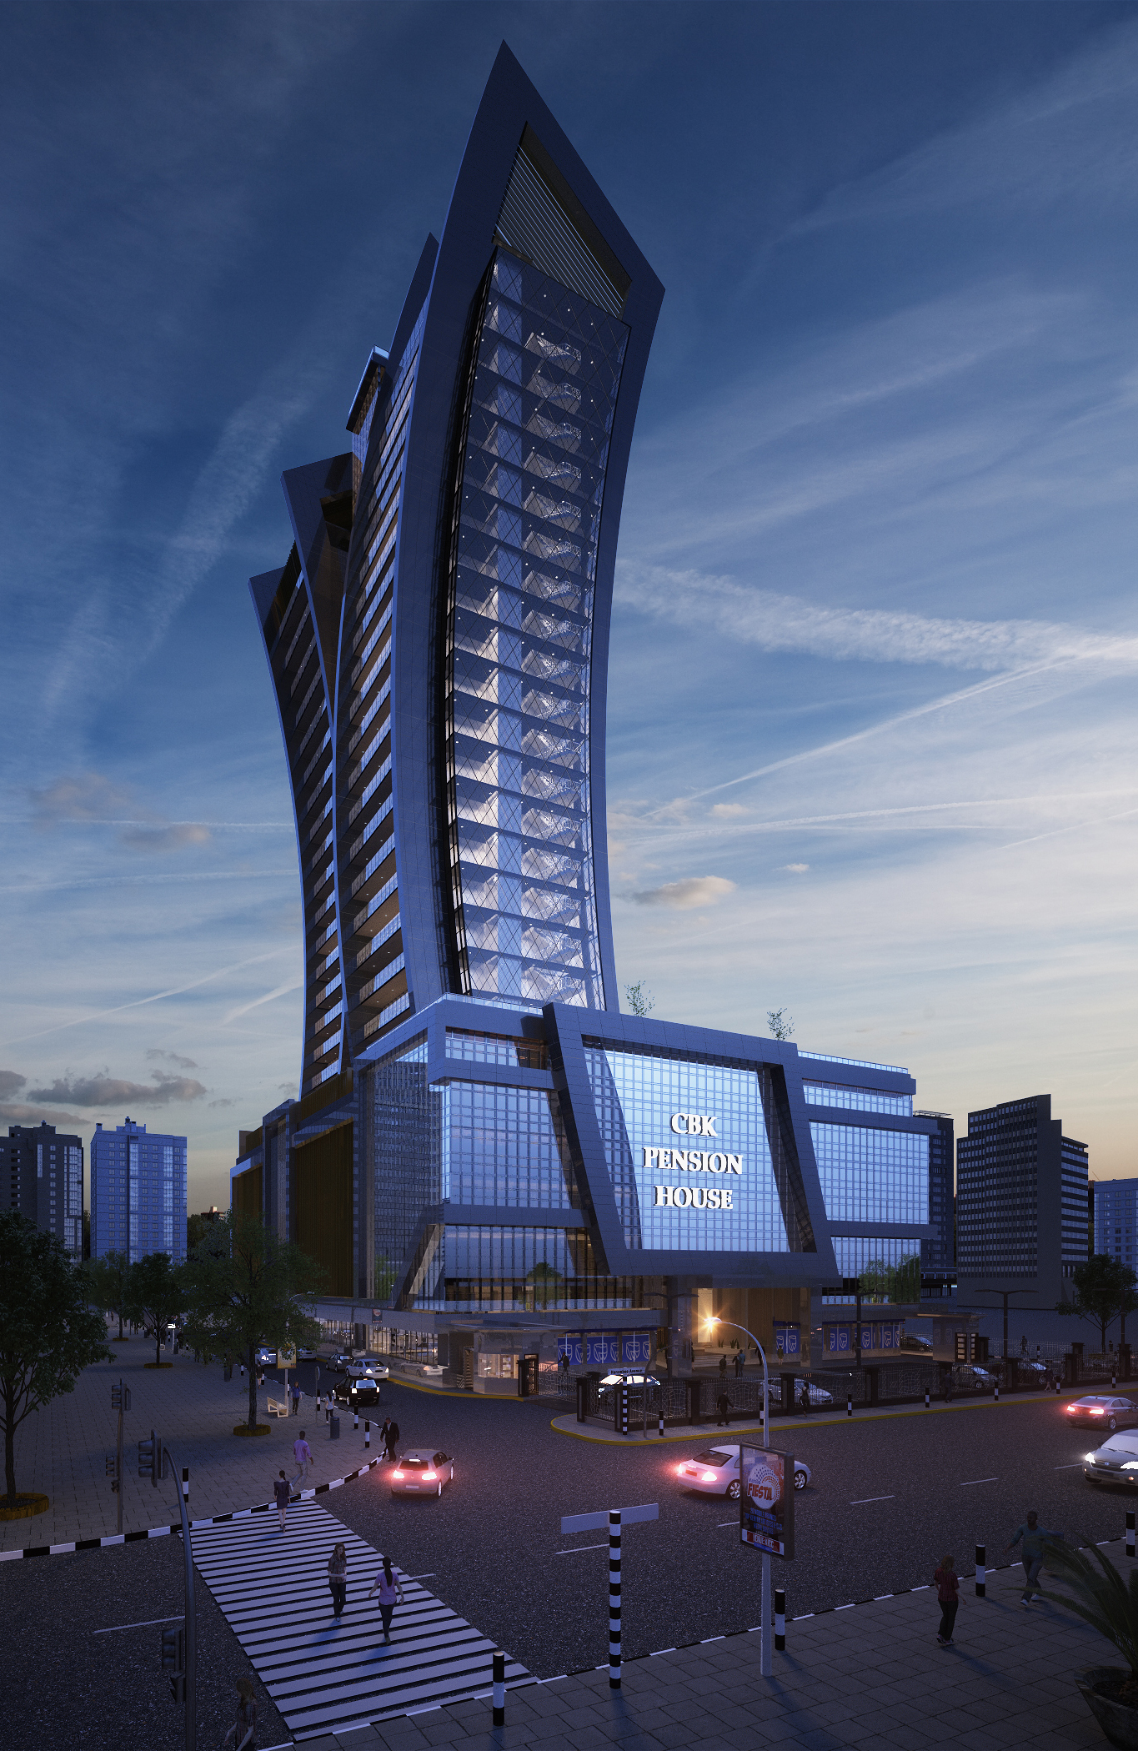
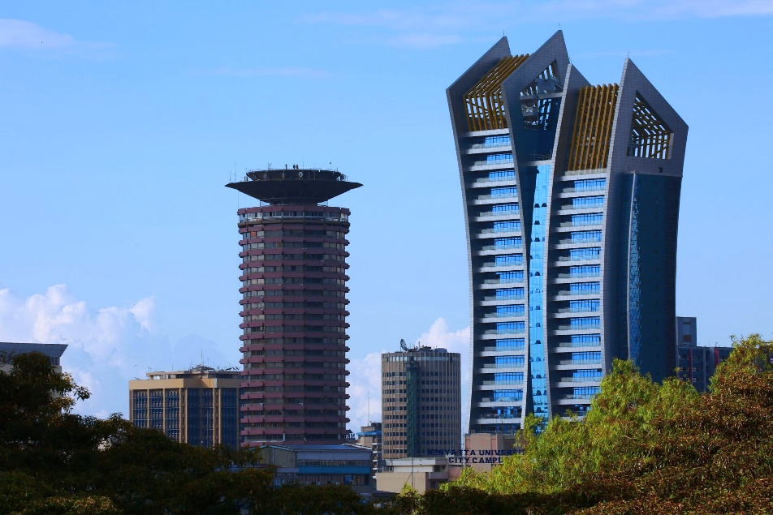
Xu Peitao
Central Bank of Kenya (CBK) Pension Towers
Site：Harambee Avenue, Central Business District, Nairobi, Kenya
My Job Responsibilities
Main Towers：
27-floor, Precast beams, Precast slabs, Steel roofing.
2018.12 – 2019.02 : Participate in Construction Drawing
2019.03 – 2019.05 : Participate in BIM Model
2019.04 – 2019.06 : Participate in Shop Drawing
Annex Building：
7-floor, Precast columns, Precast beams, Precast slabs.
2020.08 – 2020.10 : Responsible for Construction Drawing
2020.10 – 2020.12: Responsible for BIM Model
2020.11 – 2020.12 : Responsible for Shop Drawing
The location of the project near other government buildings such as the Kenyan Parliament and Harambee House made it impossible to use cast-in-place concrete technology, so our team's solution of prefabricated assembly technology with less-formwork and less-brace was adopted. This technology helped the construction projects reduce pollution distribution and achieve green construction. The building completed by the end of May 2021.
Reduce Pollution Emissions, Achieve Green Construction

Slide 2
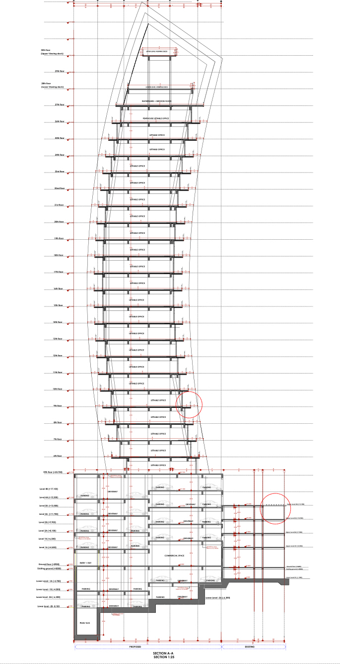
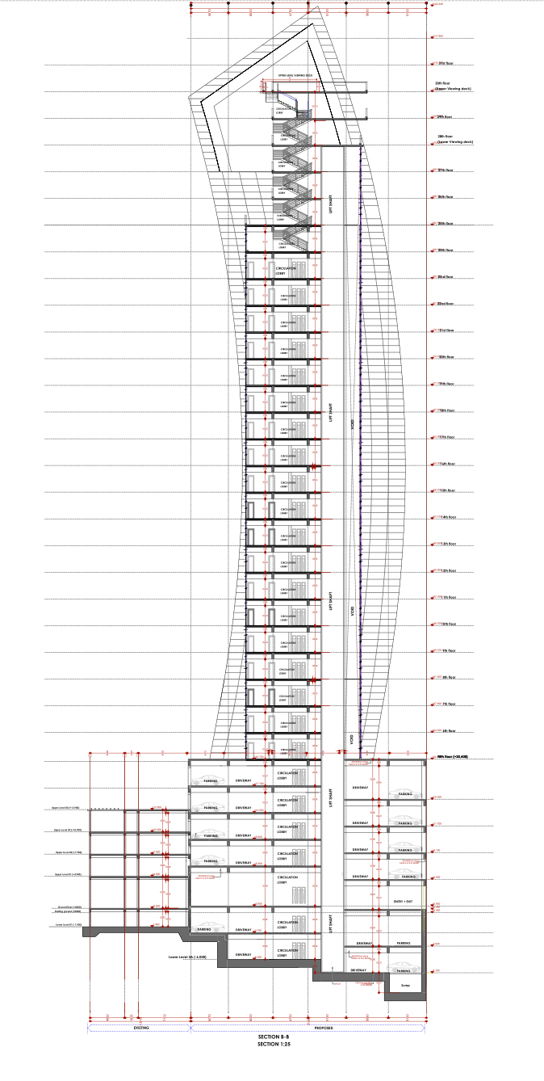
Construction Drawing
Shop Drawing
24F Planning
Precast Beam
12F Planning
Precast Slab
Section of Tower A
Section of Tower B
Ability to draw different types of drawings
2F Planning
Steel Members

Slide 3

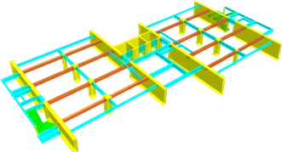
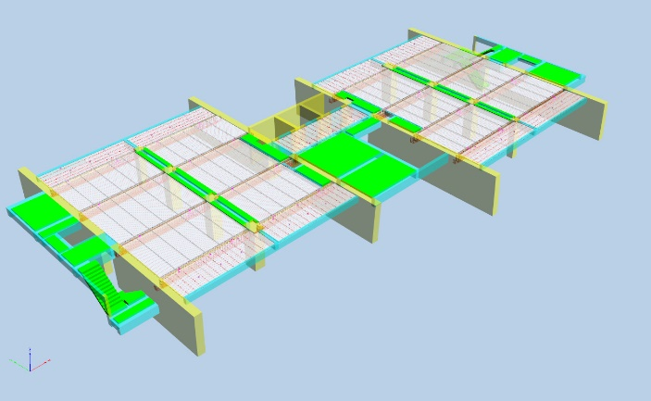

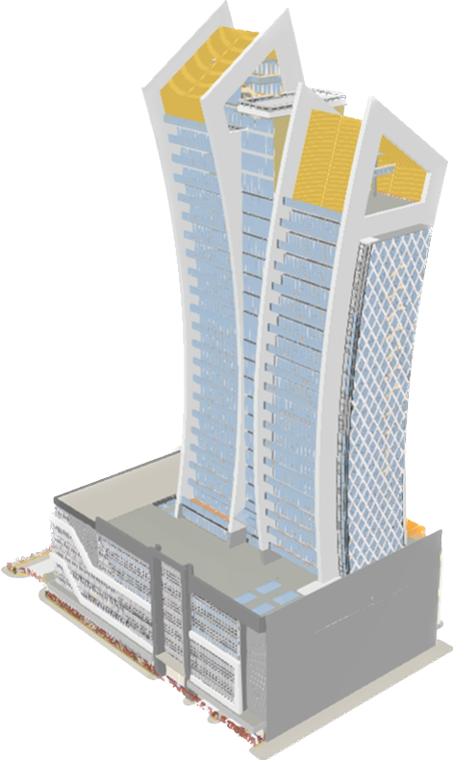
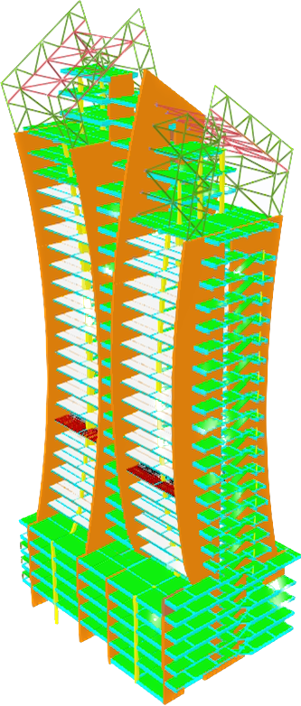

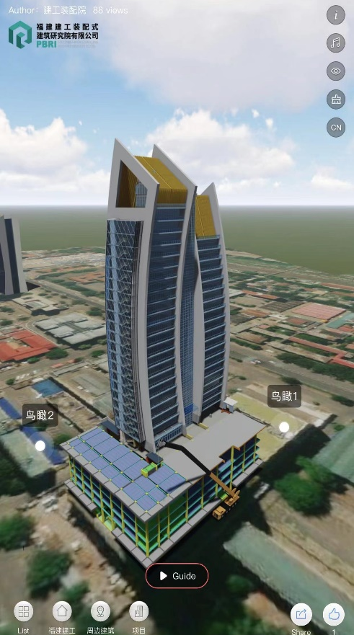
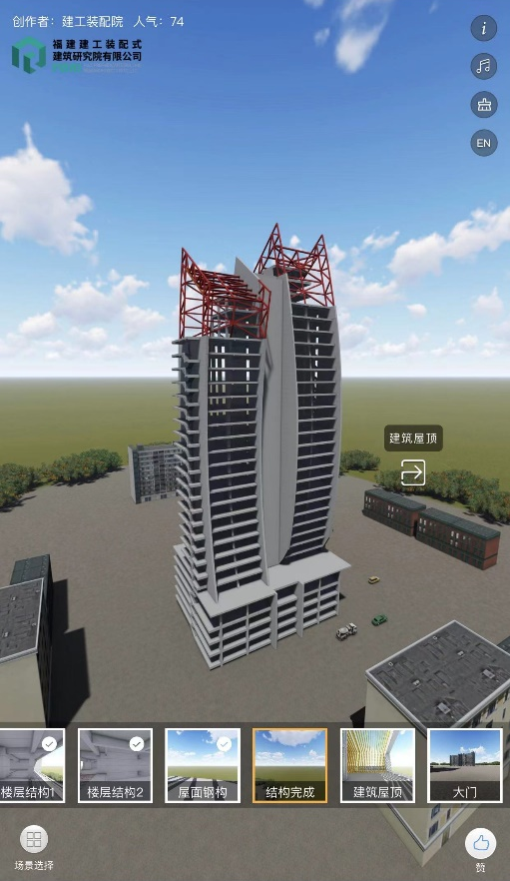
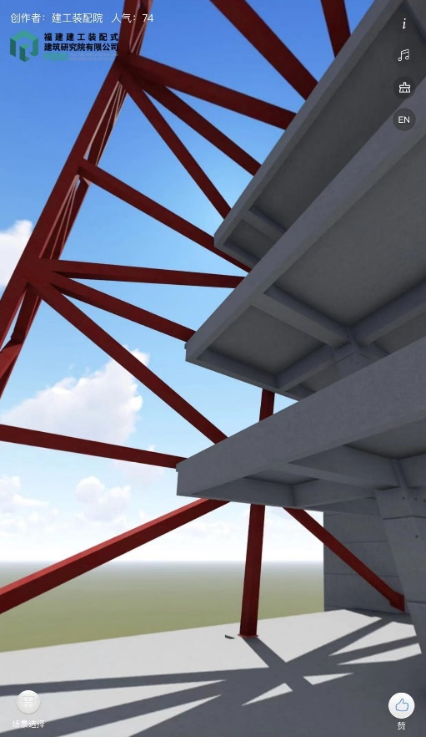
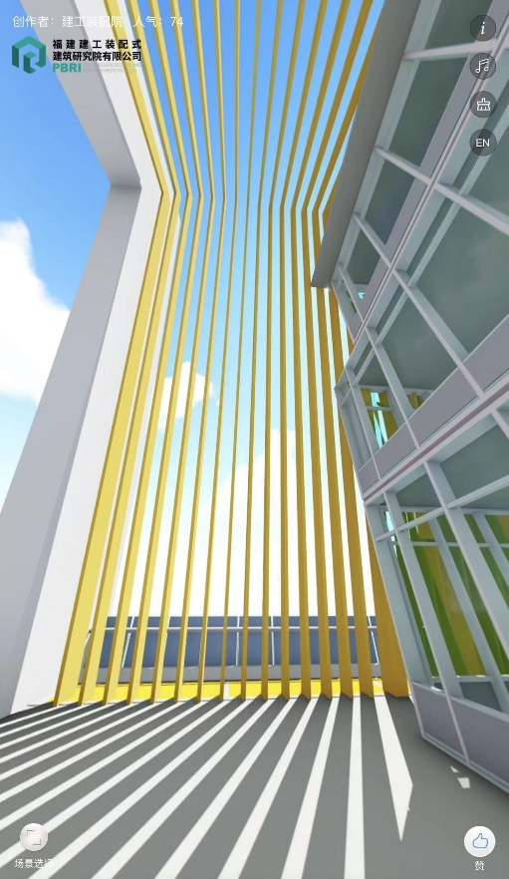
BIM Ability
Architectural Model and Structural Model
(Revit) (Planbar + Tekla)
720-Cloud
Frame Model
Prefabricated Prestressed Hollow Slab
Using the 720-cloud to create model presentations and construction simulations

Slide 4
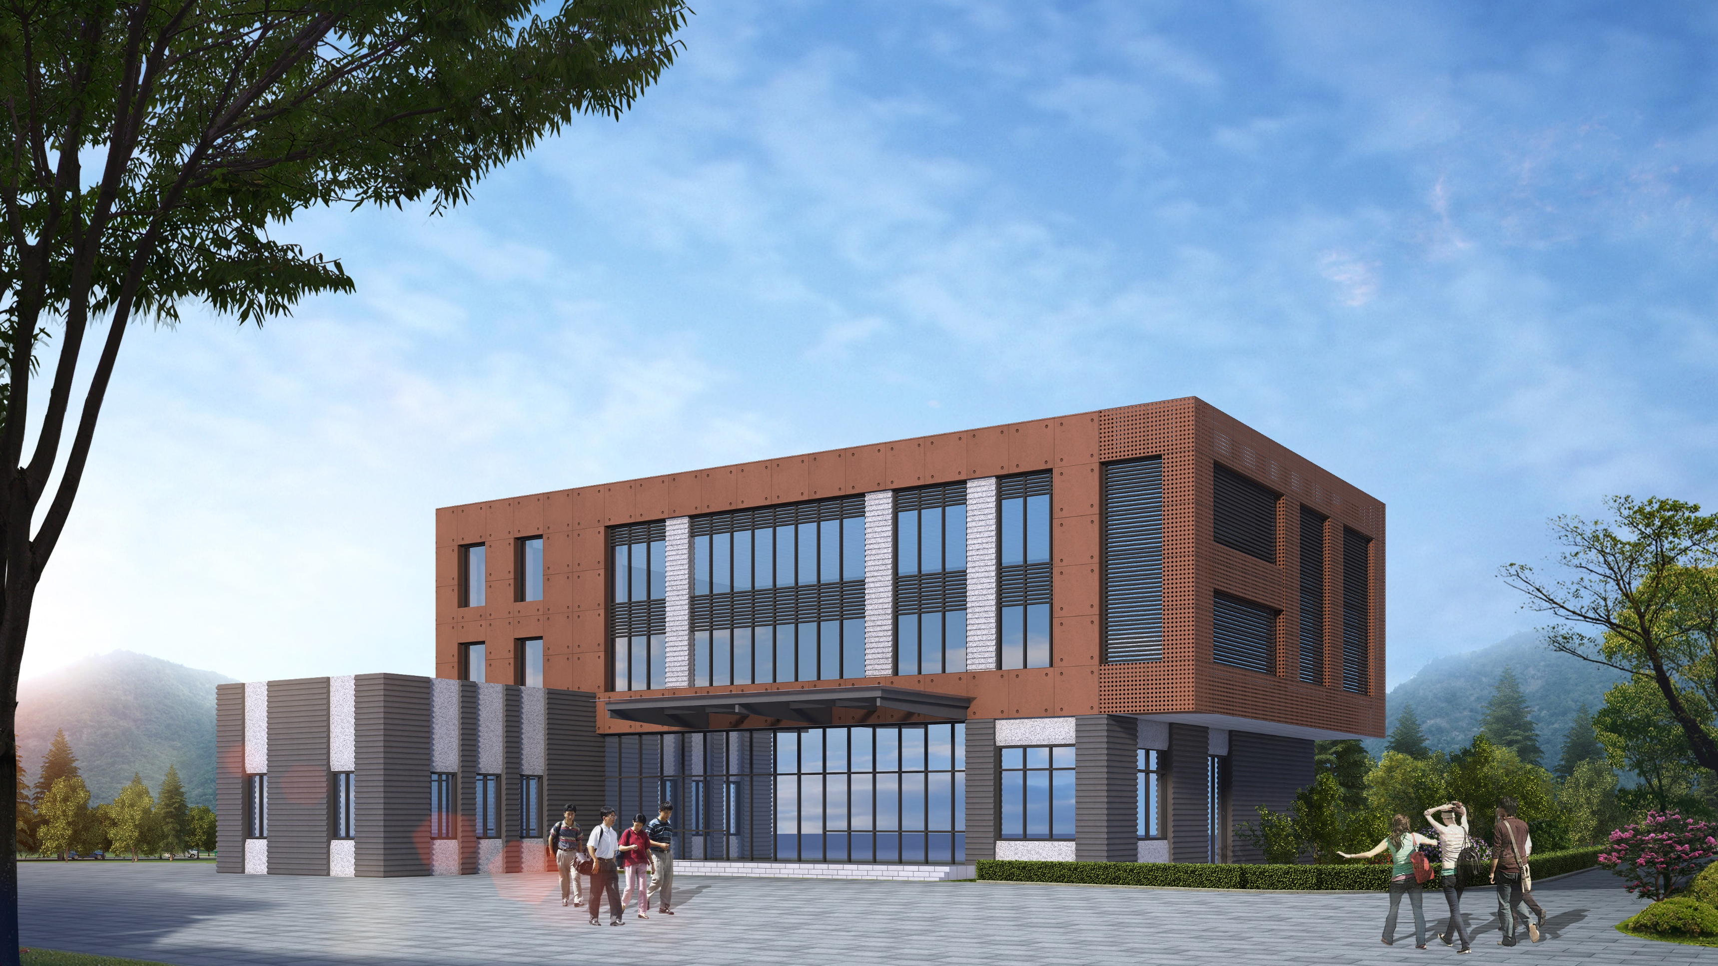

Xu Peitao
Selected Works
Office Building of Jianxiang Factory
Site：Sanming, FuJian Province, China
Reduce Work Intensity
My Job Responsibilities
Reuse the Mold for more times
Save Construction time
Key information：
3-floor, Fully prefabricated concrete structure
Precast columns, Precast beams, Precast slabs, Prefabricated stairs, Prefabricated external wall panels
Developing a new large-span precast floor system with formwork-free and scaffolding-free method
2020.11 – 2021.01 : Responsible for Finite Element Analysis of the New Floor System
2021.03 – 2021.04 : Responsible for Construction Drawing
2021.04 – 2021.05 : Responsible for BIM Model
2021.05 – 2021.06 : Participate in Shop Drawing
FFSF
SYSTEM
Reduce Cost
Control Quality
Application Scenarios of FFSF SYSTEM
This is a pilot project of our company to develop a more economical and energy-efficient prefabricated building system. I was part of a team of 5 people, and through a lot of finite element analysis, we finally launched the system.
Using this method, the precast plate and precast beam mold of this project can be reused 50 times respectively, which maximizes the utilization rate, reduces the waste of materials and construction tools, saves the project cost, and achieves the purpose of green construction.
The system can be applied to many construction projects.
Residential Building
Logistics Warehouse
Parking Garage
Showroom
Factory
Office
Housing
Educational Facility
Formwork-free and Scaffolding-free, Achieve Green Construction

Slide 5
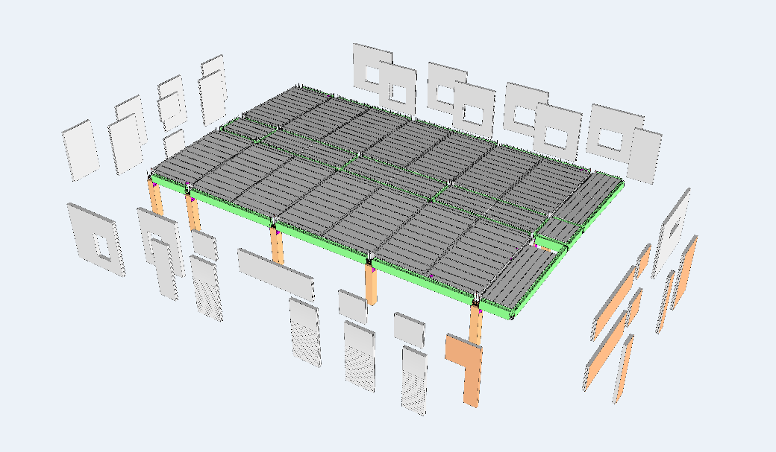
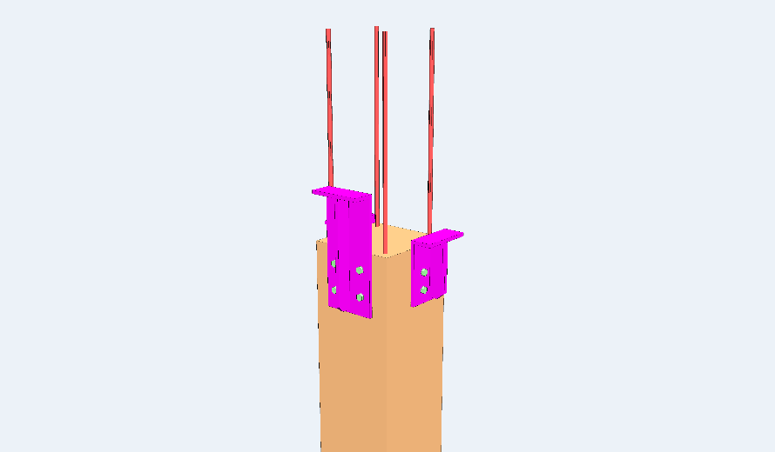
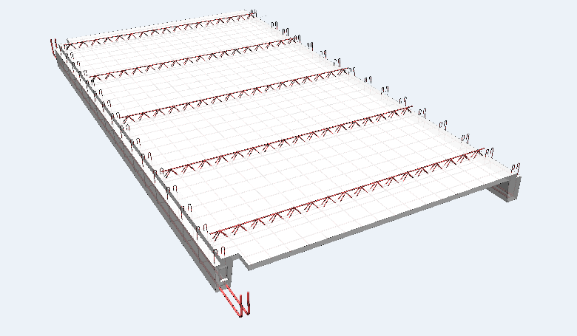
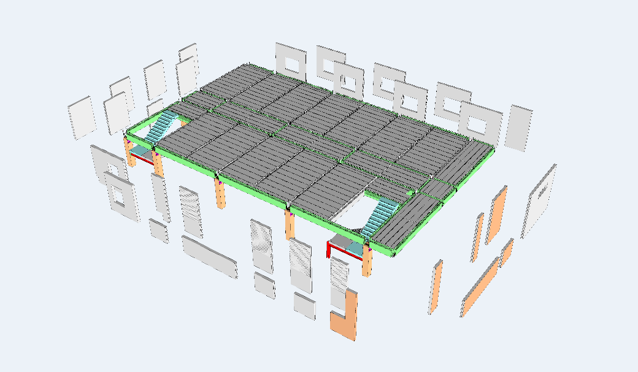
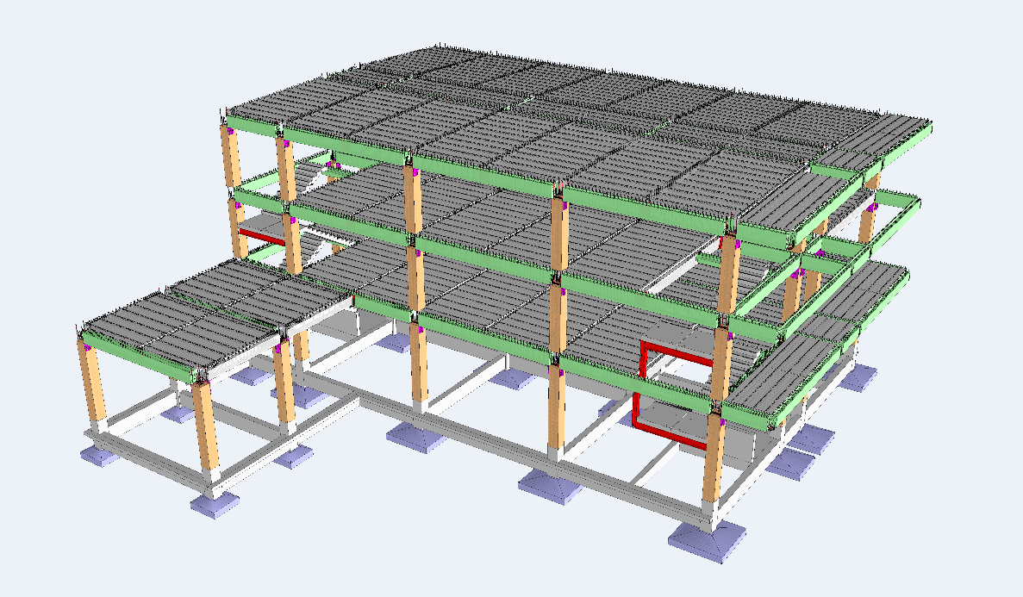
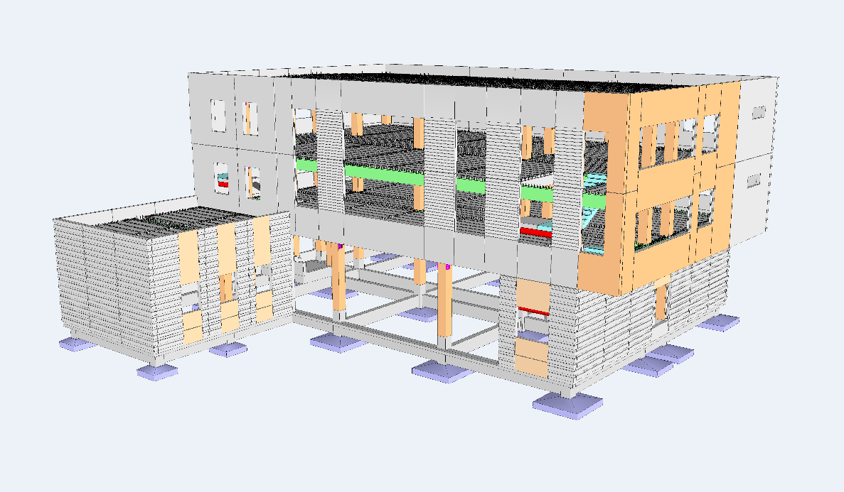
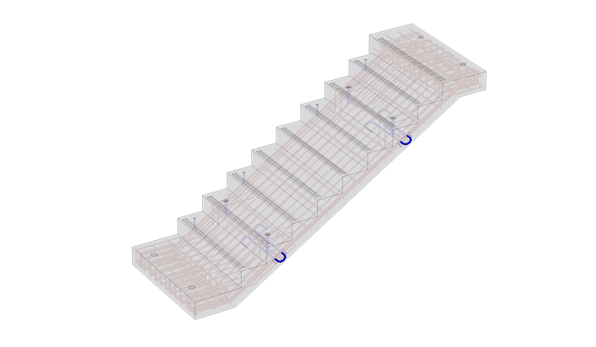
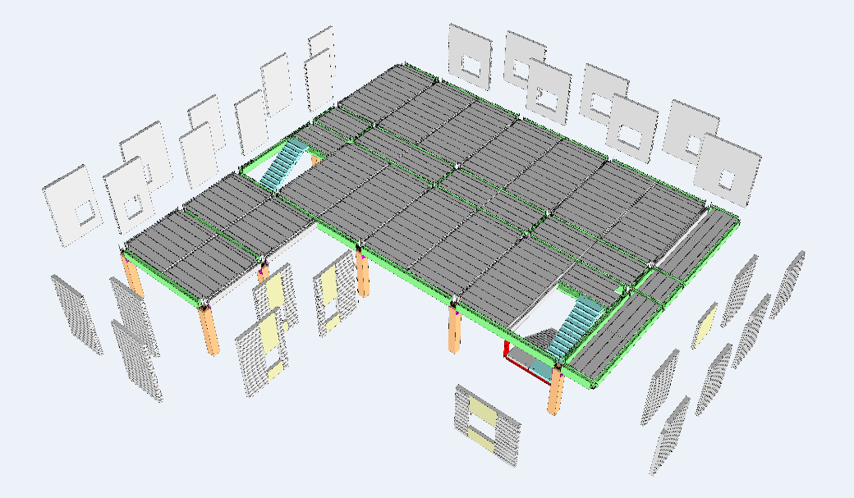
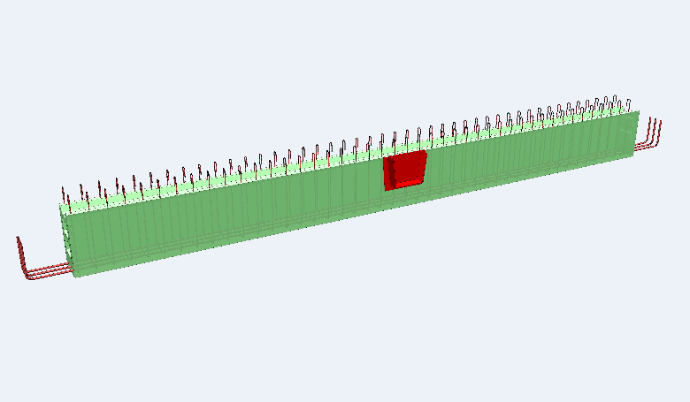
Structural and Exterior wall
BIM model
3F Panels
Precast columns
Formwork-free and
scaffolding-free precast slab
Prefabricated external wall panels
Curtain wall
2F Panels
Precast beam
Prefabricated stair
1F Panels

Slide 6
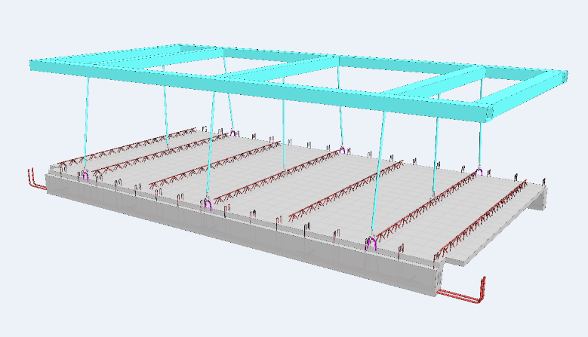
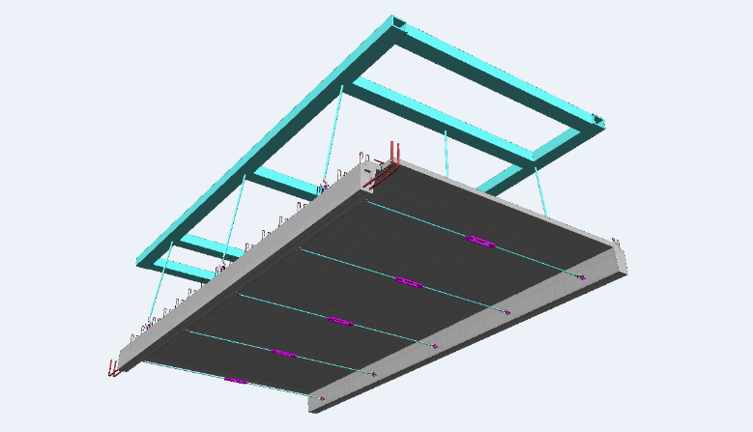
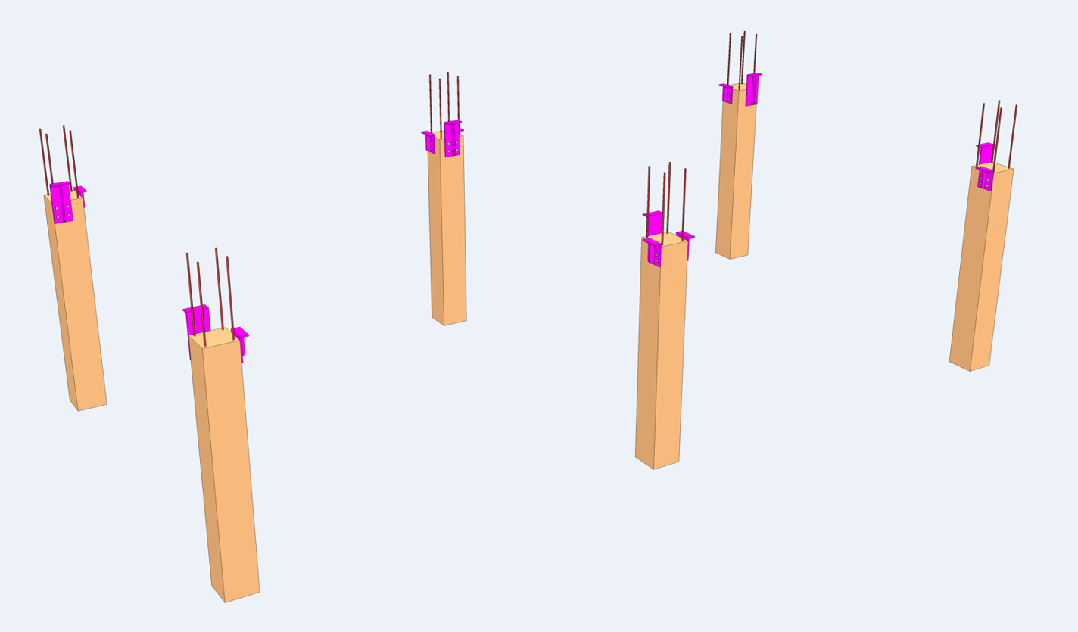
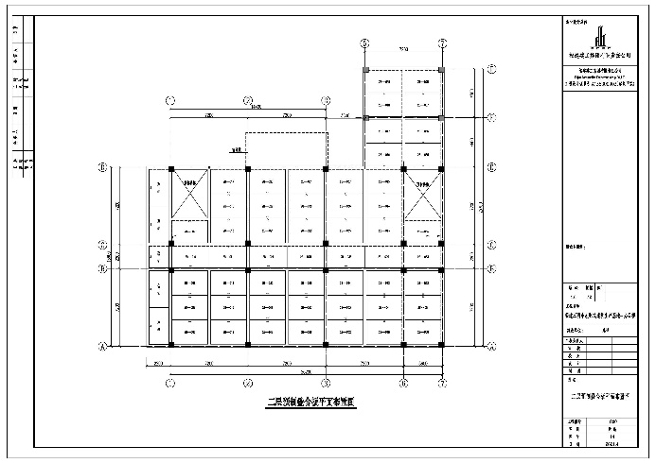
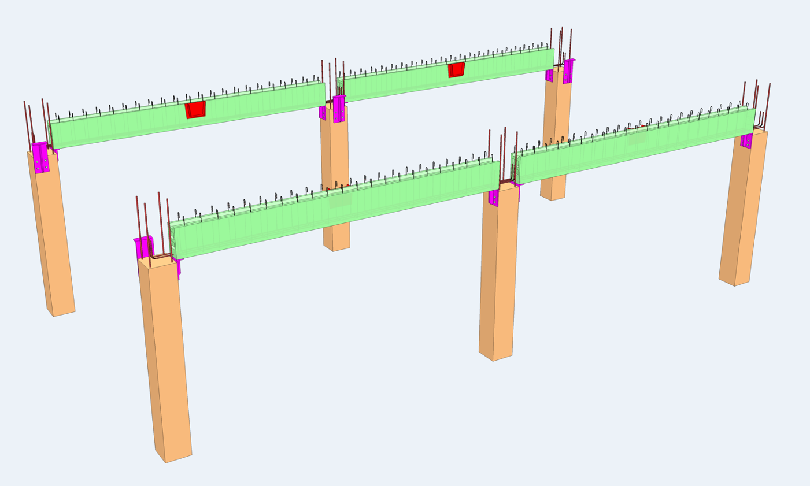
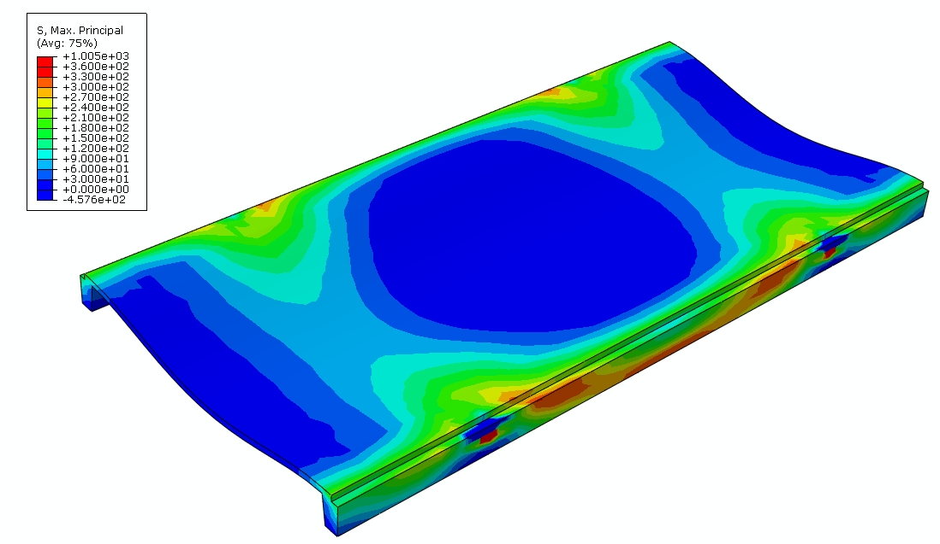
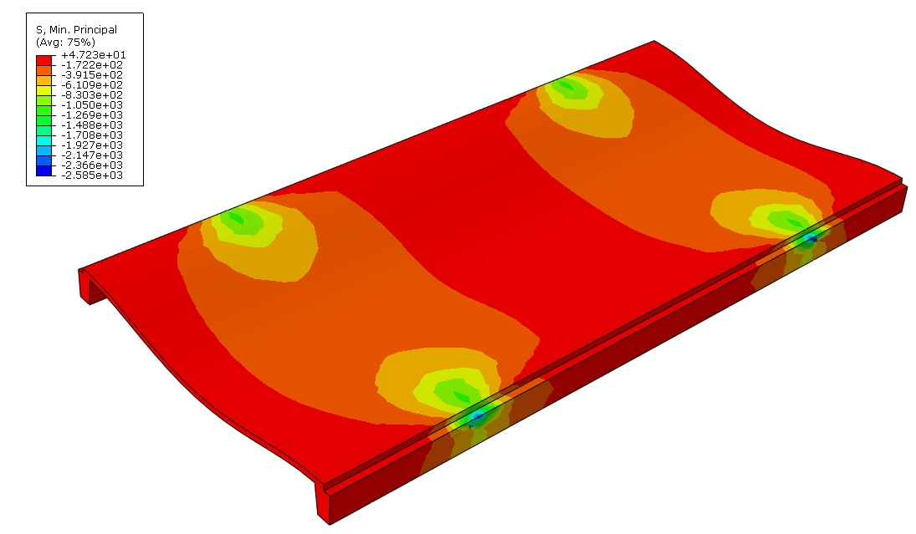
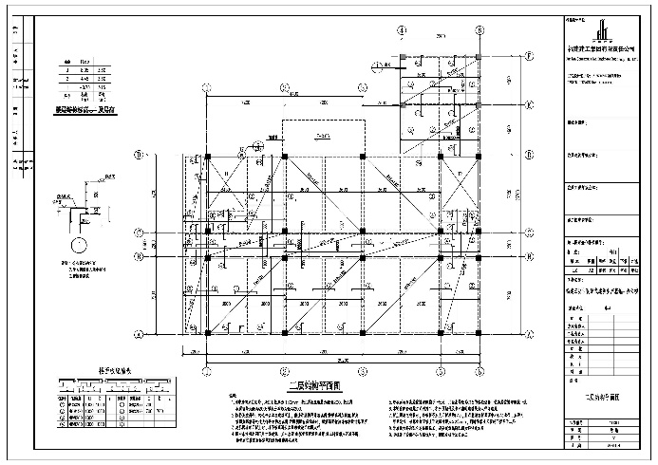
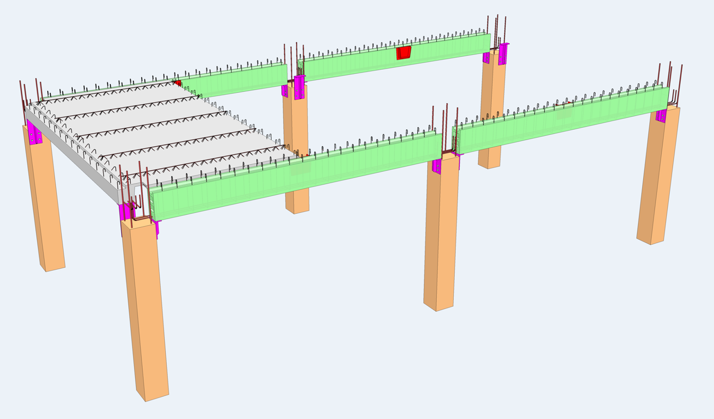
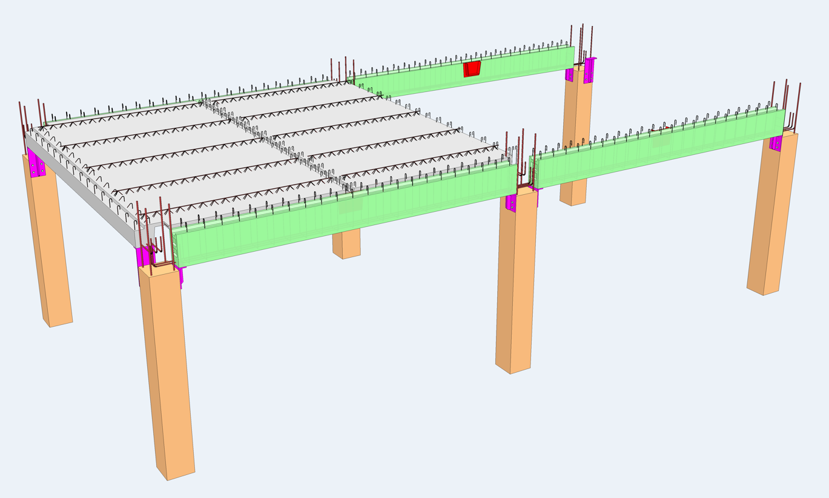
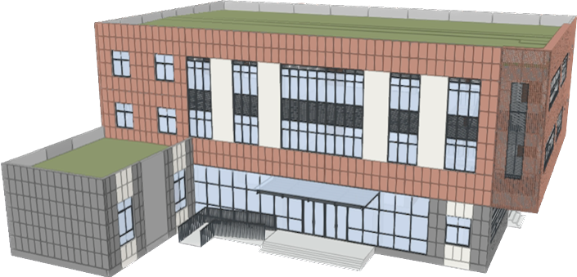
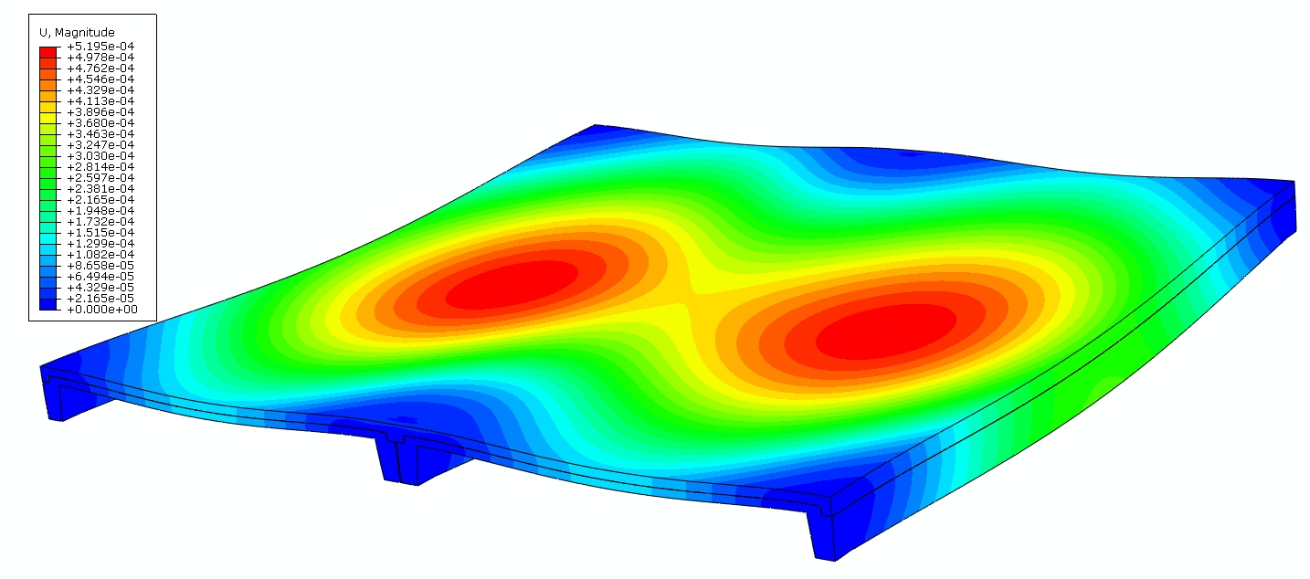
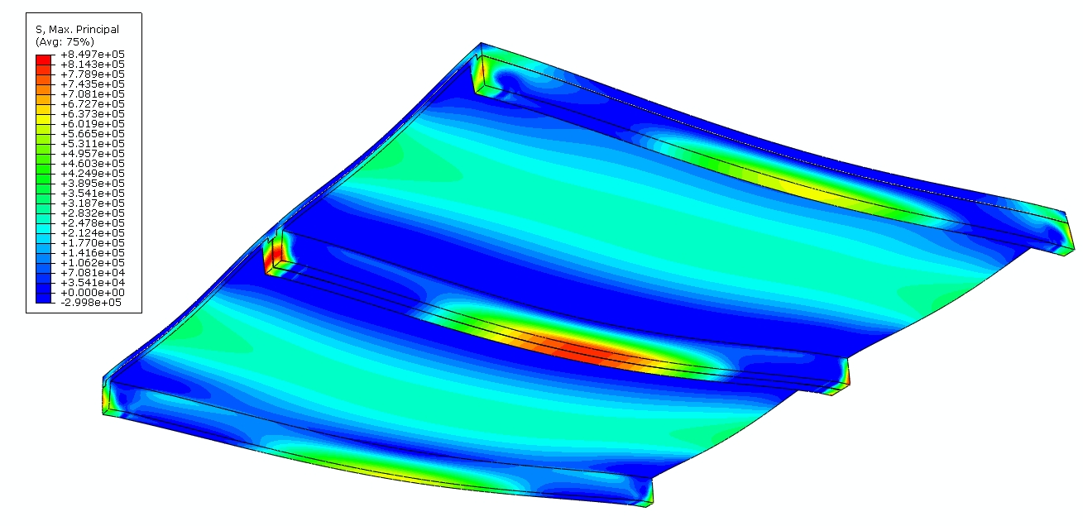
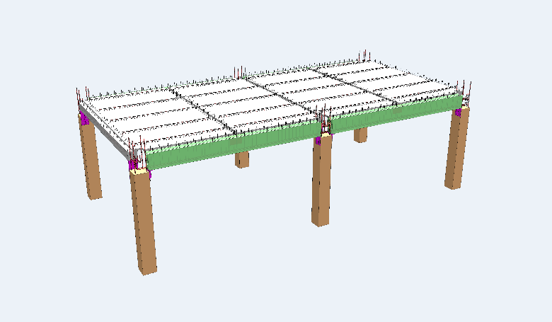
Hoisting Method and FEA Results
Installation Steps
Architectural BIM Model and Construction Drawing
Lifting distribution beam
Bottom Tie Rod
Tensile Stress
Compressive stress
Displacement
coordination on both sides
Tensile Stress
The combination beam works

Slide 7
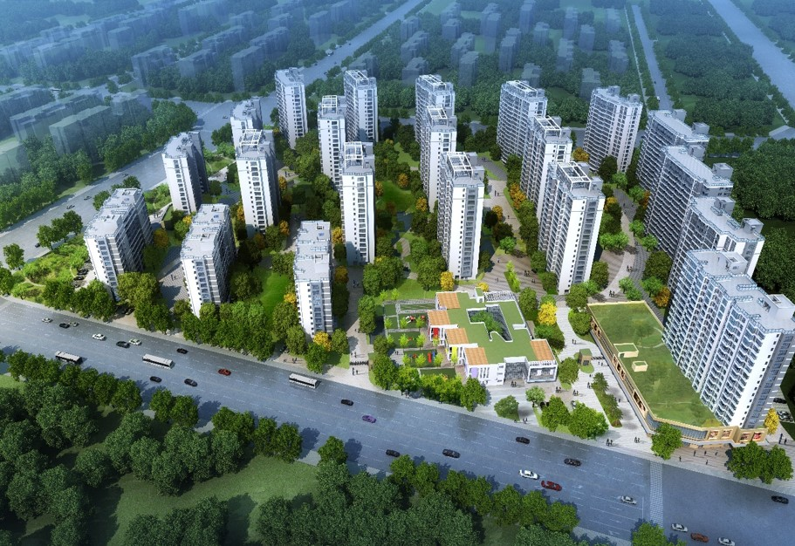
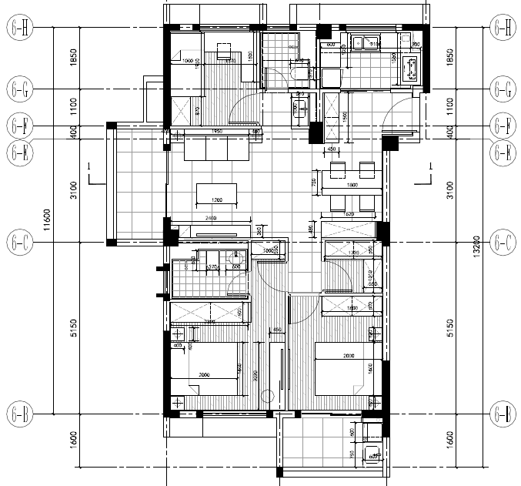
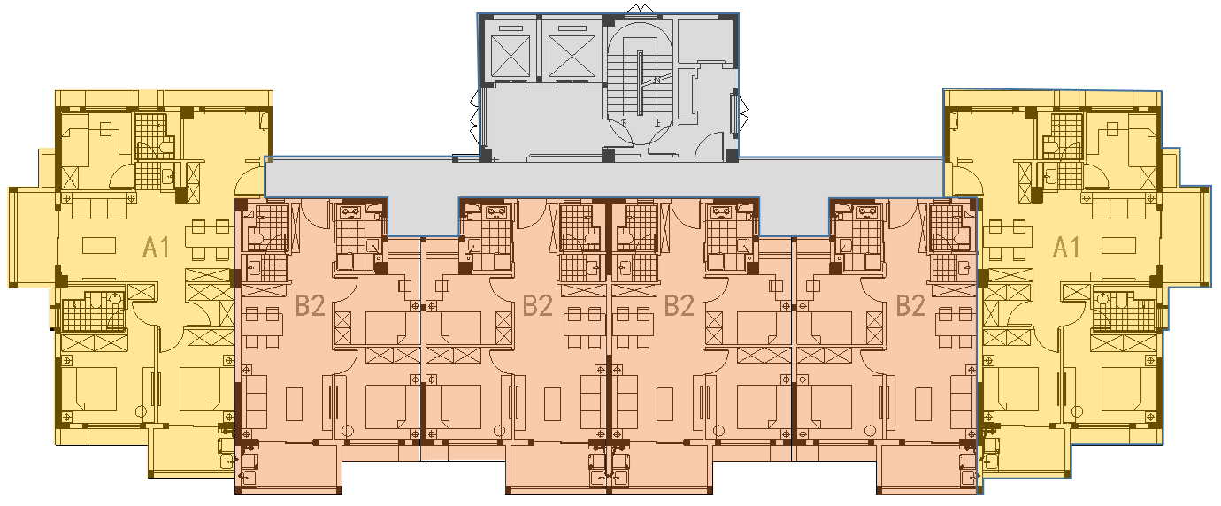
Xu Peitao
Selected Works
Rental Housing Project of Coastal City
Site：Fuzhou, FuJian Province, China
My Job Responsibilities
Key information：
Responsible for the prefabricated scheme design of Building 3#.
In this project, I created a space module BIM model in Revit with multiple unit functions, and through the combination of modules, a complete BIM model of the apartment can be formed.
2019.06 – 2019.07 : Responsible for Structural BIM Model
2019.07 – 2019.08 : Responsible for Interior Decorated BIM Model
This project is the first time that I have completed multiple professional BIM modeling work, not only the BIM model of the floor and wall panels, but also the BIM model of the interior decoration and the water and electricity pipe complex.
This project adopts prefabricated decoration and drainage on the same floor to optimize the use of functions, and users do not need to worry about future maintenance problems.
Modular, Functional, Make BIM more Effective

Slide 8
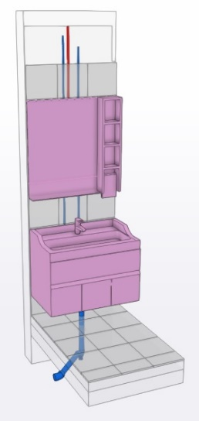
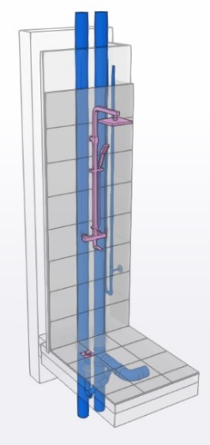
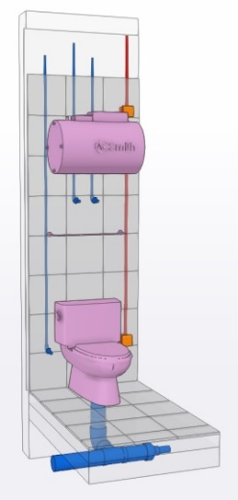
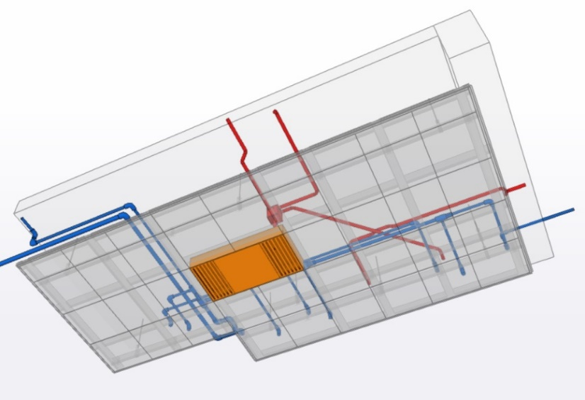
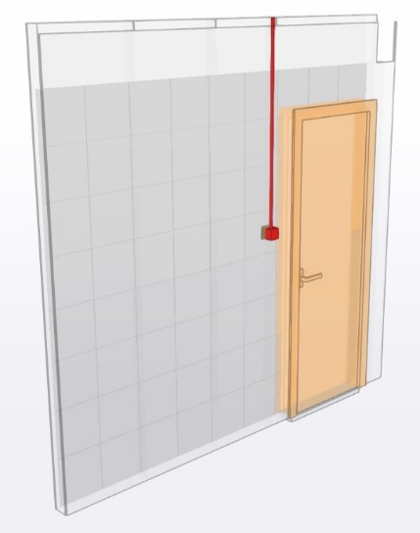
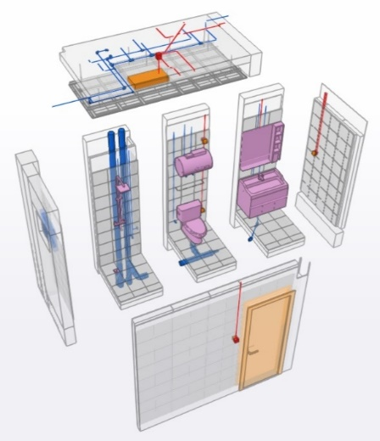
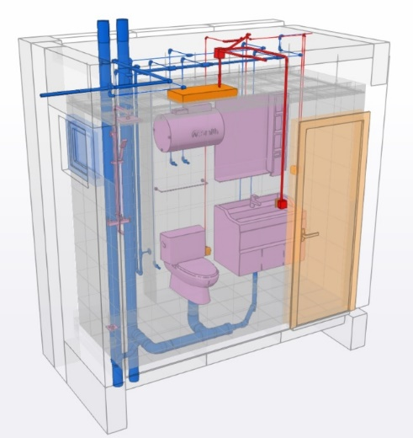
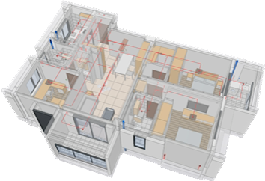
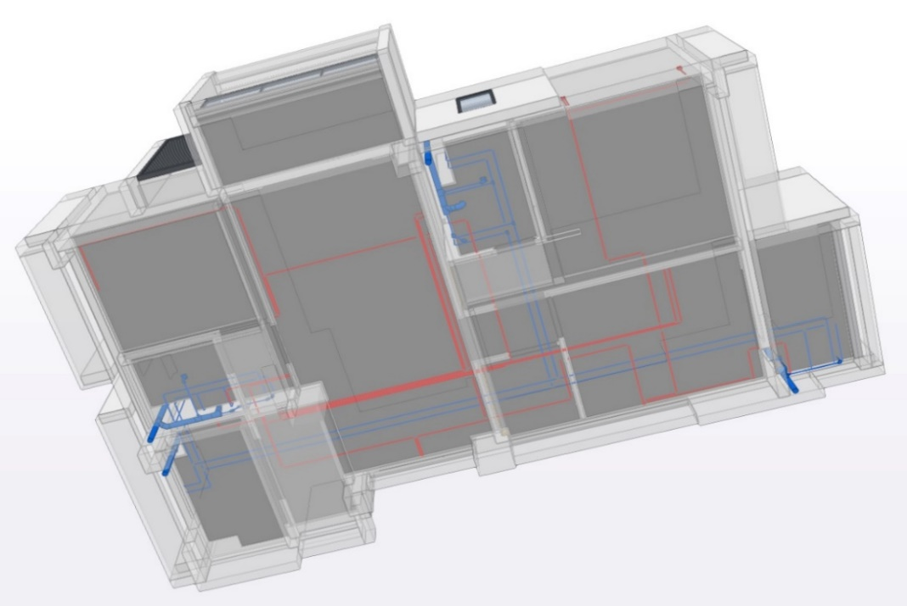
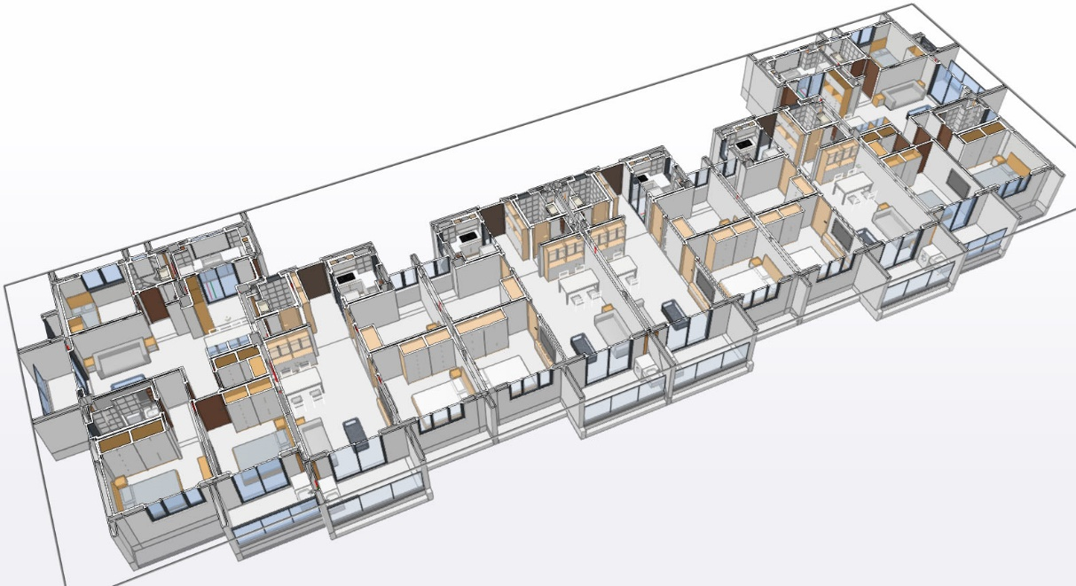
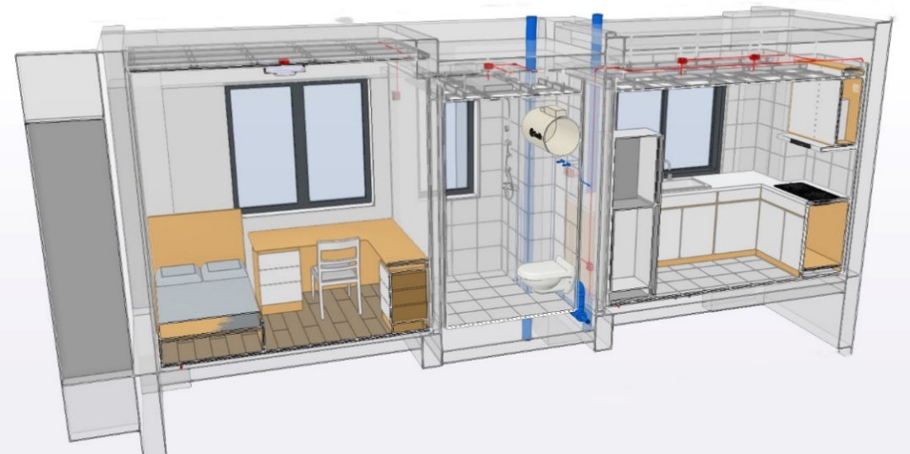





BIM Module Combination Process Display
Vanity/Shower/Bathroom space module
Ceiling system module
Wall system module
Single Module Combination
Bathroom Module
House Type A1
Full professional BIM model
720-cloud
Roaming Display
Standard Floor
Full professional BIM model
Elevated view: floor piping
Vertical profile: north-south orientation
Elevated view: ceiling arrangement
Vertical profile: east-west orientation
Precast slabs
Prefabricated external wall panels

Slide 9


Xu Peitao
Nanping No.1 Middle School
Site：Nanpin, FuJian Province, China
My Job Responsibilities
Indoor Stadium：
3 individual buildings, Steel Structure
2019.12 – 2020.05 : Responsible for Construction Drawing
2020.05 – 2020.06 : Responsible for BIM Model
Laboratory Building / Art Building：
7-floor, Concrete Structure.
2020.03 – 2020.05 : Responsible for Construction Drawing
I was involved in the planning and preliminary design of the gymnasium and the structural construction drawings of the art and physical education building and the school building for the Nanping No.1 Middle School project; and created a Tekla model for the steel structure of the gymnasium to facilitate colleagues to draw details of the steel members.
In the preliminary design of the gymnasium, steel studded concrete columns were selected to meet the building requirements using less concrete and steel reinforcement materials.
In the middle of the project, the structural finite element software YJK was used to analyze and design the building structure of the project, and the electronic drawings of the project were prepared using AutoCAD.
Ability to draw different types of drawings

Slide 10


Construction Drawing
The foundation of the Indoor Stadium
1F planning of the Indoor Stadium
Roof planning of the Indoor Stadium
Detailed drawing of stairs
2F Planning of LB
2F Planning of AB
3-4F Beams Layout of LB
Detailed drawing of stairs
1F Planning of IS
2F Planning of IS
Section of IS
Roof Planning of IS
Detailed drawing of Purlin system

Slide 11








Steel Model ( TEKLA )
A building of the Indoor Stadium
C building of the Indoor Stadium
Shuanlong Xizhu Brewhouse
Longhai Civic Center
Detail of Steel Joints
Light steel keel model for retaining wall

Slide 12



Xu Peitao
Selected Works
Yuegang Central Primary School
Site： Longhai District, Zhangzhou, FuJian Province, China
My Job Responsibilities
Teaching buildings：
5-floor, Precast columns, Precast beams, Precast slabs, Steel structure roofing, Buckling Restrict Brace (BRB)
Key information：
Secondary development based on Planbar using GDL language，
2018.08 – 2019.02 : Participate in SmartPart Developing
2018.11 – 2019.02 : Participate in BIM Model
I joined a team of 4 members, based on Planbar software, using GDL language for programming and secondary development, the development of SmartPart can parametrically design a variety of prefabricated components, achieve one editing object, generate a variety of products.
The tool has already been applied in real construction projects in 2019 and has made modelers more efficient than ever.
SmartPart makes works more smart

Slide 13
















Overall model
Command flow
Editors
Interactive Dialog
Column
Beam brace, diagonal brace
Stairs
Pre-embedded parts
Beam

Slide 14





Pre-assembly Collision Check of Prefabricated Component
Using SmartPart to help BIM models reach LOD 400

Slide 15

8 papers related to prefabricated buildings have been published,
another 2 are expected to be published in next years
(In the review process)
<Industrial Building.>
Ren yu, Xu peitao
<Wuhan University of Technology.>
Xu peitao
<Fujian Architecture.>
Ren yu, Xu peitao
<Industrial Building.>
Ren yu, Xu peitao
<Industrial Building.>
Ren yu, Xu peitao
Applied Research of Equivalent Structural Model of Valve Hall Structure with Fabricated Firewalls
Research on Load Transfer Modes of Lattice Girder Floor Slabs Based on Damage Plastic FEM
Research on Failure Modes of Lattice Girder Floor Slabs Based on Damage Plastic FEM
Buckling Analysis of Lattice Girder for Composite Slabs at Construction Phase
Seismic behavior of an inter-story hinged lateral resistance braced frame
2017.05
2018.06
2019.07
2020.09
2020.10
2020.11
2022.04
2022.10
2023
2023
Experimental and analytical study on seismic performance of frame-embedded walls
Discussion on Stress Concentration Effect at the Hoisting Point of Precast Concrete Beam
Finite Element Analysis of Concrete Damage Plastic Model about Failure Modes of Lattice Girder Floor Slabs with Double Close-joints
Finite Element Research about Punching Shear Behaviour of Prefabricated Pile Cap
Experimental and Numerical Study on the Structural Behavior of Close-fitted Composite Two-way Reinforced Concrete Slabs
<Journal of Building Structure>
Wei wenhui, Xu peitao.
Cited by 17 researchers
<Fujian Architecture>
Ren yu, Xu peitao.
<Fujian Architecture>
Ren yu, Xu peitao.
<Fujian Architecture>
Ren yu, Xu peitao.
<Building Structure>
Ren yu, Xu peitao.
(In the press)

Slide 16












Series of studies on the Structural Behavior of Close-fitted Composite Two-way Reinforced Concrete Slabs
Experimental site

Slide 17







Obtained 6 patents related to prefabricated building technology,
and participated in the compilation of 2 provincial standards and 2 enterprise standards
Assembly of monolithic concrete pools
Large span-to-thickness ratio beam-slab integrated precast unit
Precast concrete structures with integrated beams and slabs
Prefabricated Internal Partition wall Technical Specification
Rapid construction of steel structure assembly pigpen
Assembly-type plenum spacer wall structure and installation method for high-performance grain storage
Pre-casted concrete structure with beam-slab integration and construction method
Precast hollow core slabs
Precast concrete products – floor plate with lattice girders for floor systems
Technical Standard for concrete composite slab with lattice girders in Fujian

Slide 18





Participate in provincial and municipal green construction technology research and development projects,
and write 8 reports, including site survey, intelligent construction, etc.
Fujian Science and Technology Project: Research on Green Construction of Prefabricated Concrete Buildings
Research report on the prefabricated concrete slab system
Report on site research for precast projects in the Fuzhou Newly-developed District
Prefabricated development report special article in Fuzhou (2018-2021) - A total of seven volumes
I am responsible for compiling the following 3 volumes：
<Volume 1: Fuzhou 2018-2021 Prefabricated Building Development Research Report>
<Volume 5: Upgrading Prefabricated Buildings Feasibility analysis of information level>
<Volume 7: Intelligent Construction in the Fuzhou Area of implementation path studies>
Experimental report of reinforced concrete composite slab connected with gap
Five years planning for the development of prefabricated buildings in Fuzhou (2021-2025)

Slide 19












Graphic Design

Slide 20








Voluntary Works and Sports Activities
2017 Wuhan AIDS Walk Volunteer Work
2017 Wuhan AIDS Walk Volunteer Work
2016/2017 Wuhan Teachers' Workshop on Sex&Gender Diversity Volunteer Work
2015-2018 Wuhan LGBT Center Volunteer Work
2018 Xianning Marathon
2017 Wuhan City Crossing Yangtze River Competition
My Brightest Smile

Slide 21

Thanks For Watching !
I hope to join the Green Architecture program, and Enjoy the Beautiful campus of Algonquin.
Xu Pei tao ( Ewan Hsu )
Email：xupeitao9351@outlook.com
cellular：+86 15827106071
Selected Academic & Works Sample

