Slide 1
XML CLI Interface
  WW19’12
  By
  Amol A. Shinde (DCG BIOS: SV BIOS Lead/Architect)

Slide 2
What is XML CLI ?
As the name suggests XML CLI is basically a combination of 2 methodologies, XML (System or Platform Information to be consumed in XML format) & CLI (Modified & Basic form of Ilan’s Command Line Interface protocol, this modified CLI version acts as an interface layer between BIOS & outside world via S/W SMI).
In short XML CLI is the interface methodology between BIOS & External world.
During IVT requirements gathering time frame, We (Server SvBios) came up with this interface in response to a CV requirement to be able to update the BIOS knobs via ITP from a host. We did some research on methodologies used across Intel to update system settings and found each team using their own way to do the needful, with most of the teams using the good old method of changing setting by entering the setup page and doing it manually. This meant we didn’t had a standard interface to change system setting across *V’s, developers &/ debug teams. Also leverage between the teams was not possible, moreover automating this across the board was very difficult. All existing or pre-existing capabilities don’t target all or most of our validation needs &/ don’t fit in all or most of Validation environments with automation efficiency.
XML CLI addresses all of the above and in Server BIOS this was the preferred & currently is the only STD/preferred interface to update system settings for BIOSes that are distributed within Intel.
XML CLI can perform wide range of operations, but the most popular in Server world are Processing BIOS Knobs, Bios Flash Update, Ucode Update & Extracting Firmware info.
XML CLI is an open solution which is platform/Program/CPU/Segment/BIOS independent interface methodology. it’s a completely independent entity and can potentially work even if BIOS is non-EFI.
We, as part of XML CLI’s solution pkg own/develop/support/maintain Python reference scripts for the tools/users/automation. Flexcon (Our POR tool for Bios knobs update) directly imports our reference scripts.
These reference scripts are standalone, open source and can be easily integrated to any env./automation etc. based on *V needs, or can be used directly in its native form. These reference scripts are available on SVN DB under PythonSv\misc\SvBios.
Currently XML CLI reference scripts are capable of operating via following interfaces: ITP II, Legacy ITP, SVOS, SIMICS, LTB (via IPC), EFI SHELL, Linux, Windows & SV Card.
XML CLI covers all possible validation environments &/ areas. The BIOS side XML implementation is based on EFI Spec & HII DB’s, the interface layer between BIOS & external worlds is OS/framework/EFI/HII agnostic or isolated. Hence any changes in BIOS framework, EFI &/ HII spec shouldn’t affect the Interface &/ Tools in any way.

Slide 3
High level BIOS flow
XML CLI Module
Reset or Power cycle.
Initial state of the system before BIOS fetches any code
Reset
CPU starts fetching BIOS Code.
BIOS code is in asm (since no stack available yet). Very initial CPU, platform init happens here in this phase. For e.g. Init PCIEx BAR, loading Ucode patch for BSP, MTRR prog, CAR init, etc.
Platform Init
Load Microcode for BSP
CPU Init
Init CAR
Prepare the transition to PEI Phase
SEC Phase
Security Phase
CAR is initialize and stack is available. BIOS code in now in C. The initial Platform Init, CPU & PCH init happens here. The CSI/QPI init, Memory init, CPU PEI and initial AP init code is executed in this stage of BIOS boot. By the end of this stage memory is available and the BIOS is copied into memory and execute from Memory. HOB’s are published for later use.
PEI init Status code
South Board PEI Init
North Board PEI Init
CSI/OPI init
Memory Init
CPU PEI Init
Shadow BIOS to RAM/memory
Prepare to transition to DXE Phase
PEI Phase
Pre-EFI
Initialization Phase
Memory is now Available and the CPU is now execution the code from the memory. All device driver modules are called and initialized at this stage. Run time and boot time function pointers/protocols are initialized at this stage. All DXE drivers will be dispatched by end of this stage.
1. XML CLI DXE code Allocates the XML reserved memory from EFI Reserved Memory space. Installs XmlCli protocol.
2. XML CLI SMM code registers required S/W SMI’s for Run/Boot time operations
DXE Phase
Driver Execution Phase
DXE init Status Code
South Board DXE Init
North Board DXE Init
CPU DXE Init
Various DXE modules are dispatched
Dispatch XML_CLI DXE & SMM modules
In this stage we prepare to boot with available boot device. The DXE PCI enumeration, Connecting Console In & Console out devices, final system initialization is done in this stage to be prepared for OS boot.
BDS Phase
Boot Device Select Phase
PS2, floppy ctrl init
DXE PCI Enumeration
Connect Console In Devices
Connect Console Out Devices
In this stage necessary changes are made to the CPU state to be able to boot to different OS environments. A thunking layer (16-bit) for legacy OS boot, provides support for legacy INT 13h, 10h & 19h. If no bootable device is found the BIOS will either boot to EFI shell (in build application) or will enter the setup page.
Extract Platform config Info
Extract Platform information required for XML file generation.
CSM Phase
Compatibility Support Module
Generate PlatformConfig.Xml file in the Memory
Based on the platform information Generate PlatformConfig.Xml file in the target memory. This XML info is consumed by various tools.
Windows, Legacy OS’s, Linux, DOS, SVOS, etc.
OS Boot

Slide 4
System Memory Map, below 4GB
(Indicative only, not to scale)
4 GB
BIOS Flash
Space available for MMIO
PCIe CFG space (256 MB)
PCIe CFG Base
TOLM (if total DRAM memory >= PCIe CFG Base)
TSEG
(BIOS SMM & SMM driver
Code/Data space)
DRAM XML CLI Interface Memory
Block space is allocated
from this block of memory
EFI Reserved Memory
BIOS RunTime Code/Data
BIOS BootTime Code/Data
Memory available for User
DRAM Memory
0 GB

Slide 5
DRAM XML CLI Interface Memory Block Map
XML Address
0x00
0x04
0x08
0x0C
GBT XML
XML Size
0x00
Signature_1
(0xBA5EBA11)
Entry info
Signature_2
(0xBA5EBA11)
Checksum
0x10
Common Flags
SV BIOS
Spec Version
Reserved
Reserved
0x20
Legacy MB Sig
(0x5A7ECAFE)
Leg MB Offset
(Relative to DRAM shared MB ptr)
Leg MB Size
Entry Flags
This entire block of memory is from EFI Reserved Memory block. This DRAM XML CLI interface Memory block size for IVT is 7MB. 4.8 MB is reserved for GBT XML and remaining for other blocks.
0x30
CLI Req Buff Sig
(0xCA11AB1E)
CLI Req Buff
Address
CLI Req Buff
Size
Entry Flags
0x40
CLI Res Buff Sig
(0xCA11B0B0)
CLI Res Buff
Address
CLI Res Buff
Size
Entry Flags
0x50
0xDEADBEA7
0xDEADBEA7
0xDEADBEA7
0xDEADBEA7
XML Address
(Offset 0x0C)
Compressed GBT XML
(Optional)
DRAM Shared Mailbox Pointer
Leg Knobs Addr
(Offset 0x34)
Leg Knobs Size
(Offset 0x38)
Setup Knobs Addr
(Offset 0x3C)
Setup Knobs Entry List
(Internal usage)
Setup Knobs Size
(Offset 0x40)
Other Variables.
0xPQRS0000
DRAM Shared Mailbox table
DRAM Shared Mailbox Pointer is also published in EfiConfigurationTable
Legacy Mailbox
CLI Request Buffer
0x00
0x04
0x06
0x08
0x0C
0x00
CLI Req Ready Sig
(0xC001C001)
Cmd
ID
CLI
Flags
Status
Parameter
Size
CLI Response Buffer
0x10
Request Parameter list
Get the higher 16 bits of DRAM Shared Mailbox Pointer from Upper CMOS registers 0xF0 & 0xF1
0xF1
0xF0
0x00
CLI Res Ready Sig
(0xCAFECAFE)
Cmd
ID
CLI
Flags
Status
Parameter
Size
PQ
RS
0x10
Response Parameter list

Slide 6
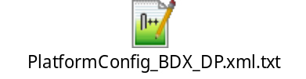
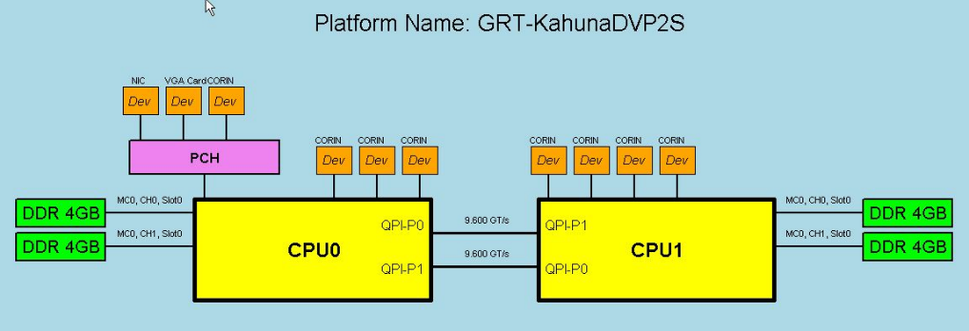
XML Generation
Bios Resources
GBT XML Sections
HII RT DB
(varstore, IFR
& Strings Pkg)
Bios Knobs Section
in XML <biosknobs>
This section of XML (BiosKnobs) Info is consumed by Flexcon, XML CLI Reference Scripts & others to fetch System supported knobs info, this info is also instrumental in processing the desired BIOS Knobs Via XML CLI.
Bios Knobs
Names & expr DB
(Build time, FFS)
SMM Get/Set Variable
MpService Protocol
CPU Package Section
in XML <package>
QPI Hob (topology)
Topology Section
in XML <Topology>
This section of XML Info is consumed by SV tools like Café, Raccoon, Maestro, Star Gate . Also used by Platform Enabling, Debug & BIOS developers.
Platform Info Hob
Misc. platform
specific info in XML
Mem Info Hob
Dimm Info Section
in XML <DimmInfo>
Aakruti App
Memory/Reserved Memory
blocks Section in XML
<reserved-memory> &
<memory-block>
gBS->GetMemoryMap
Pci Devices info
in XML <pci-devices>

Slide 7
Typical CLI flow
CLI BIOS SMM Handler
2
On a CLI S/W SMI (0xF6): Bios will Read the Request buffer, if valid then will process the requested CLI command.
3
On completion of requested CLI command: BIOS will populate the response buffer accordingly.
CLI Request Buffer
0x00
0x04
0x06
0x08
0x0C
0x00
CLI Req Ready Sig
(0xC001C001)
Cmd
ID
CLI
Flags
Status
Parameter
Size
CLI Response Buffer
0x10
Request Parameter list
1
CLI Res Ready Sig
(0xCAFECAFE)
Cmd
ID
CLI
Flags
Tool/Script will initiate the desired operation by populating the CLI command buffer accordingly, and then triggers S/W SMI requesting BIOS to process it.
2
0x00
Status
Parameter
Size
After Populating the Request Buffer, Tool/Script will loop on Response buffer for the requested command to be processed.
0x10
Response Parameter list
Tool/Script

Slide 8
BIOS CLI
Bios Resources
CLI
SMM CLI Driver
Boot Time &/ Runtime
CLI command handler
(Authenticates, interprets
& Processes Requests
via CLI Request &
Response Buffers)
SMM Register S/W SMI
CLI S/W SMI handler
Smm Get/Set Variable
Process Bios Knobs API
CLI API’s
Setup Knobs Entry List
#define APPEND_BIOS_KNOBS_OPCODE 0x0048
#define RESTOREMODIFY_KNOBS_OPCODE 0x0049
#define READ_BIOS_KNOBS_OPCODE 0x004A
#define LOAD_DEFAULT_KNOBS_OPCODE 0x004B
#define BIOS_VERSION_OPCODE 0x00B1
#define BURN_BLOCK_OPCODE 0x00B4
#define READ_BLOCK_OPCODE 0x00B5
#define WRITE_MSR_OPCODE 0x0011
#define READ_MSR_OPCODE 0x0021
#define IO_READ_OPCODE 0x0031
#define IO_WRITE_OPCODE 0x0032
#define MEM_WRITE_OPCODE 0x0041
#define MEM_READ_OPCODE 0x0042
#define EXE_SV_SPECIFIC_CODE_OPCODE 0x0300
#define RESET_OPCODE 0xFFF0
Smm SPI Protocol
Flash Update API’s
MpService &
SmmStartupThisAp
Read/Write MSR’s
BaseLib & IoLib
Read/Write IO/Mem
gRT->ResetSystem
System Reboot

Slide 9
XML CLI Flow
Start
Fetch Dram Shared
Mailbox Pointer
XmlCli/SvBios Reference Scripts
is
DRAM MB
Valid?
NO
Abort!
Yes
Abort!
XML CLI
BIOS Code
Need
XML
Info?
Yes
NO
XML Valid?
NO
Yes
Platform BIOS
Fetch CLI Request & Response Buffer Ptr
Fetch GBT XML from Target Memory
Prepare CLI Request Buffer based on Desired Cmd/Request
NO
Time out ?
Yes
Abort!
System Under Test (SUT)
NO
Send XML CLI S/W SMI (0xF6)
Resp. Buffer published?
Fetch CLI Response Buffer, print return Data/Results, Return results to caller.
Yes
Authenticate & Parse CLI Request Buffer
Process the Cmd ID and Call the desired or requested XML CLI API to do the Need-full.
Yes
is CLI Request Valid &/ Supported?
NO
Publish CLI Response Buff accordingly & Return from SMM

Slide 10
XML CLI Work Env.
Online
Host <-> Target
ITP
On-Target
ITP II
SIMICS
LTB via IPC
SUT
SV Card
SVOS
SPI
BIOS
LINUX
XML CLI
SvBios / XML CLI Python Reference Scripts
PythonSv/misc/SvBios
WINDOWS
EFI SHELL
Original BIOS
Binary File
Offline
Generated
Custom BIOS
Binary File

Slide 11
Next Steps (TBD’s)…
Currently XML CLI operates in SMM environment with basic level of Authentication and Input validation layer. Considering XML CLI’s capabilities, reach & infra structure, we plan to extend its security enclave by adding AES layer. AES is currently supported by SecurityPkg and we could leverage this capability to make XML CLI a secure & STD interface for any BIOS interactions.
To add Android as a new interface type in our Python reference scripts.
To work on plugging Capsule Flash update mechanism (as a new CLI API) using already available XML CLI BIOS & Python Script infrastructure.
Work with key contacts/architects to see if we can make XML CLI a STD BIOS interface across board.
Will include all your suggestions/Feedbacks/requirements here, as and when I receive them.
Some Key Acronyms used…
EFI : Extensible Firmware Interface
HII : Human Interface Infrastructure
GBT XML : Global Bios Tables (in XML format)
CLI : Command Line Interface
AES : Advanced Encryption Standard
SUT : System Under Test
Please feel free to send in your queries, suggestions, feedback, comments (if any) to amol.shinde@intel.com

Slide 12
Back-up

Slide 13


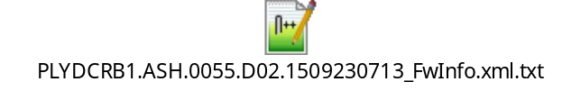
XML CLI / SvBios Python Reference Scripts
It’s the python infrastructure for XML CLI tools, These scripts are stand-alone, open source and are designed to be common and interface independent implementation. Currently the reference scripts enables the user to work with following interfaces: ITP II, Legacy ITP, LTB (via IPC), SIMICS, Sv Card, SVOS, LINUX, Windows & EFI SHELL (hence covering all possible working environments &/ usage models). These scripts can either be directly used in its native form or imported by tools &/ automation to do the needful. Flexcon is one such tool which imports our reference scripts for processing Bios Knobs. These reference scripts are available on SVN under PythonSv\misc\SvBios folder. See below for some of our most popular XML CLI capabilities (usage models, with examples).
Save XML
Fetch Online SUT XML
Fetch Offline XML

Slide 14
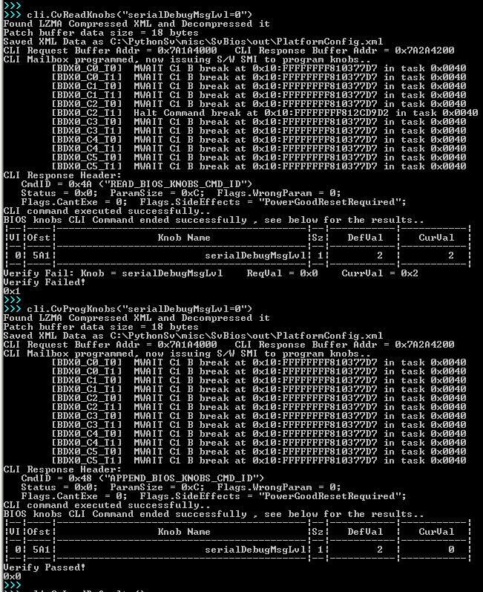
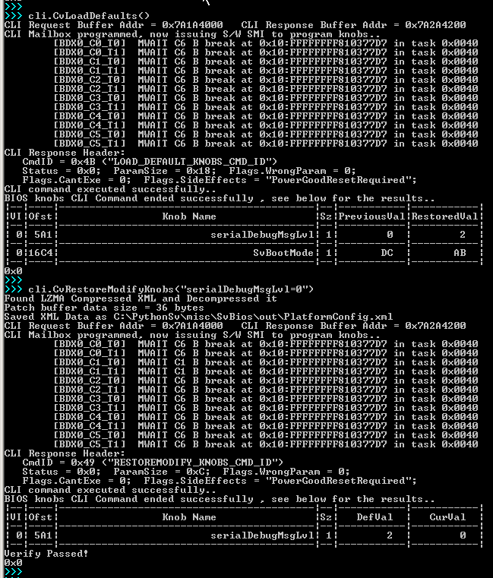
XML CLI / SvBios Python Reference Scripts continued..…
Process Bios Knobs (Online, Operates on SUT)

Slide 15
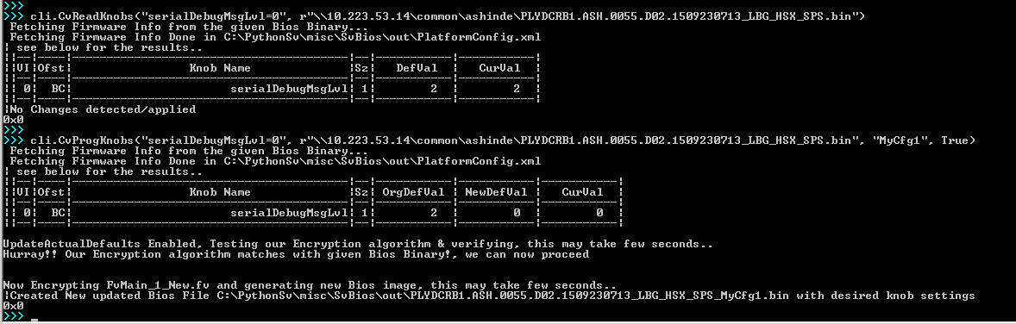
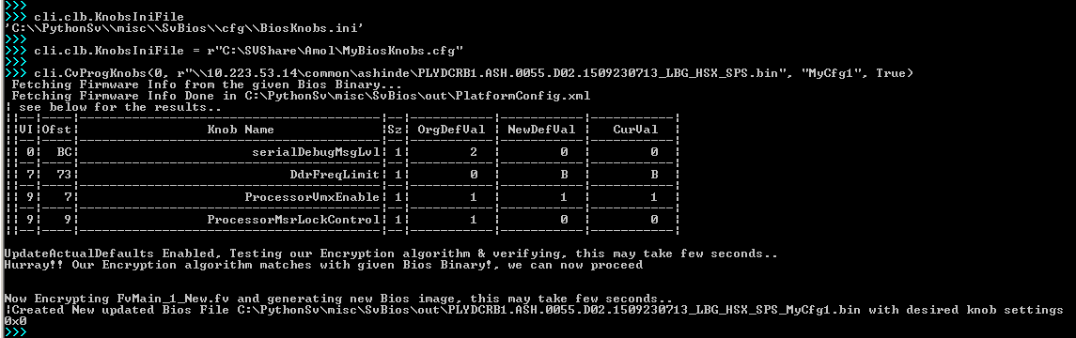
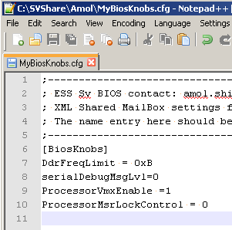
XML CLI / SvBios Python Reference Scripts continued..…
Process Bios Knobs (Offline, Operates on Given Bios Binary)
Bios Knob String in Command line
Bios Knob list from a desired config fie

Slide 16
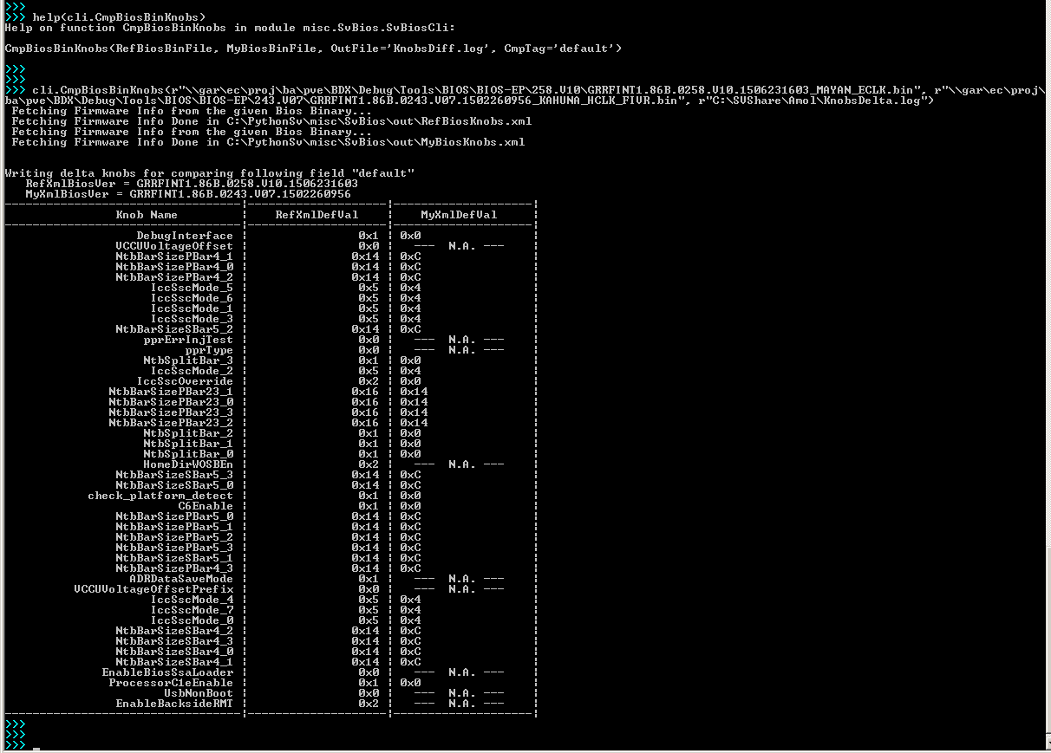

XML CLI / SvBios Python Reference Scripts continued..…
Process Bios Knobs (Offline, Compare & Automate Knobs)
Compare Bios Knobs delta between Binaries.
Automate Custom BIOS binary build with desired set of Bios Knobs configs.

Slide 17


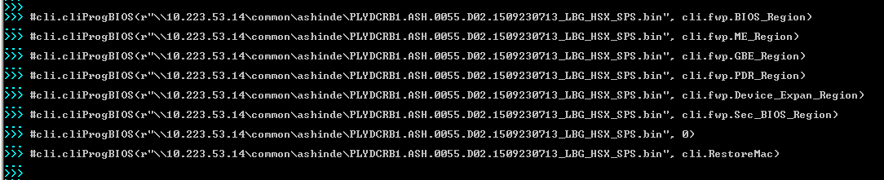
XML CLI / SvBios Python Reference Scripts continued..…
Process Bios SPI Flash Blocks (Online Only)
Fetch BIOS block, Save as File
Program BIOS Flash
Program BIOS Flash, Examples..

Slide 18
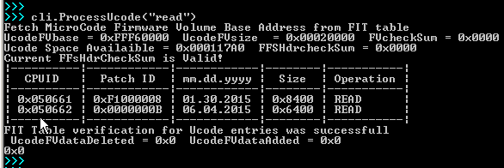
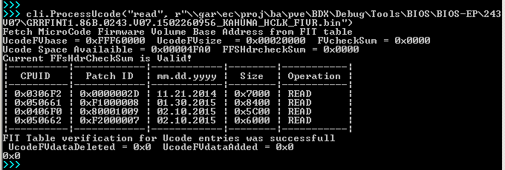
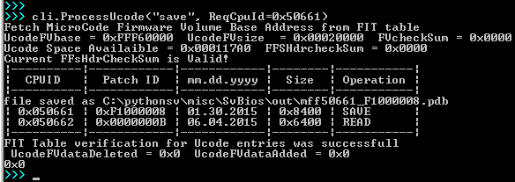
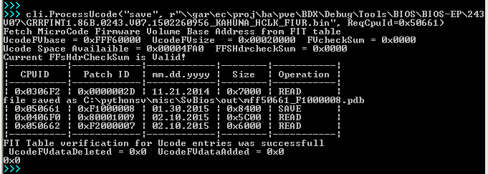

XML CLI / SvBios Python Reference Scripts continued..…
Process Ucode (Read, Save, Delete, Update)
Online
Ucode Read Operation
Offline
Online
Ucode Save Operation
Offline
Patch/Update Ucode on all Bios binaries (Offline only)

Slide 19
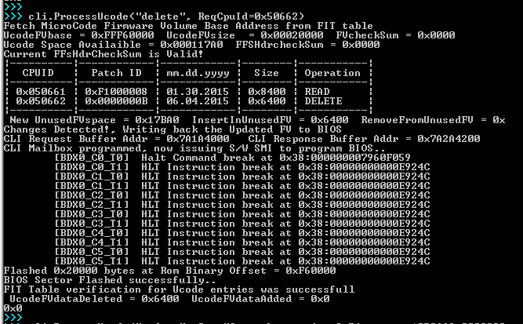
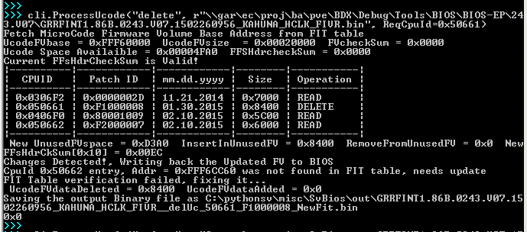
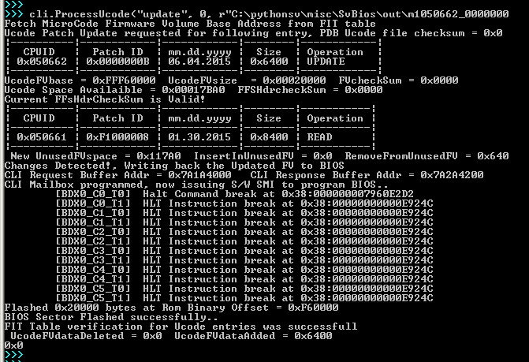
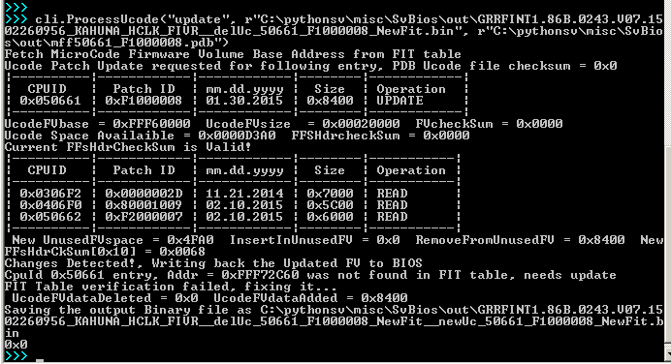
XML CLI / SvBios Python Reference Scripts continued..…
Process Ucode (Read, Save, Delete, Update)
Online
Ucode Delete Operation
Offline
Online
Ucode Update Operation
Offline

Slide 20
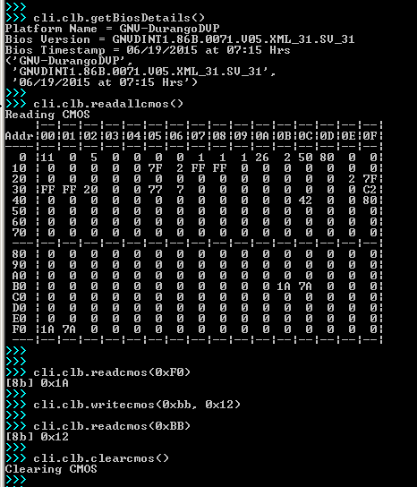
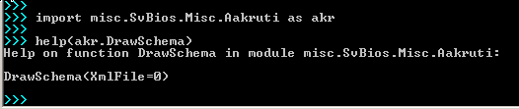
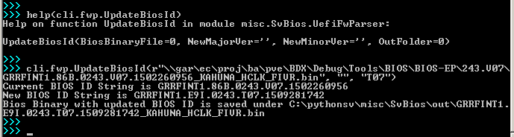
XML CLI / SvBios Python Reference Scripts continued..…
Misc script functions/capabilities…
Aakruti App

Slide 21
Thanks!

