Slide 1

BDA411/511
Introduction to Machine Learning
Linear Regression
Dr. Xuping Xie
Department of Math & Stat
Notes:
Note: on these slides, feel free to use as many or as few photos or other images (logos, screenshots, etc.) as you think are appropriate. You are not limited to the images in this layout pattern. Make it your own! (And take this note off of the slides.)

Slide 2
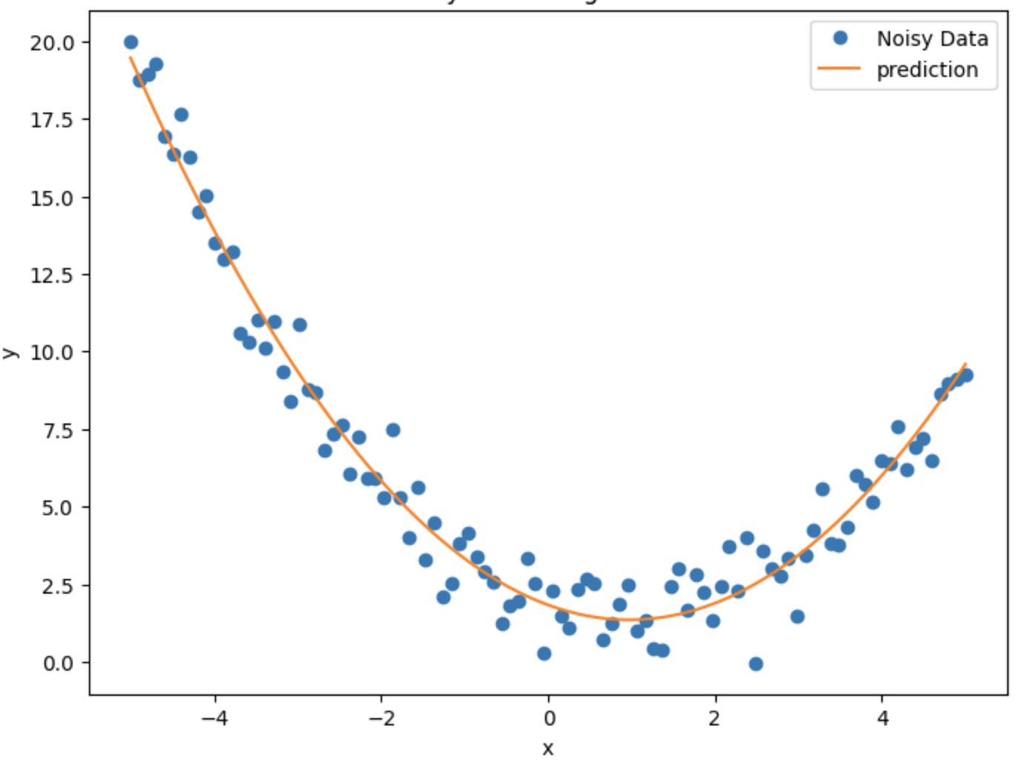
Regression
Fit a function given a dataset, input x and output y (prediction)
Notes:
Note: on these slides, feel free to use as many or as few photos or other images (logos, screenshots, etc.) as you think are appropriate. You are not limited to three images in this layout pattern. Make it your own! (And take this note off of the slides.)

Slide 3
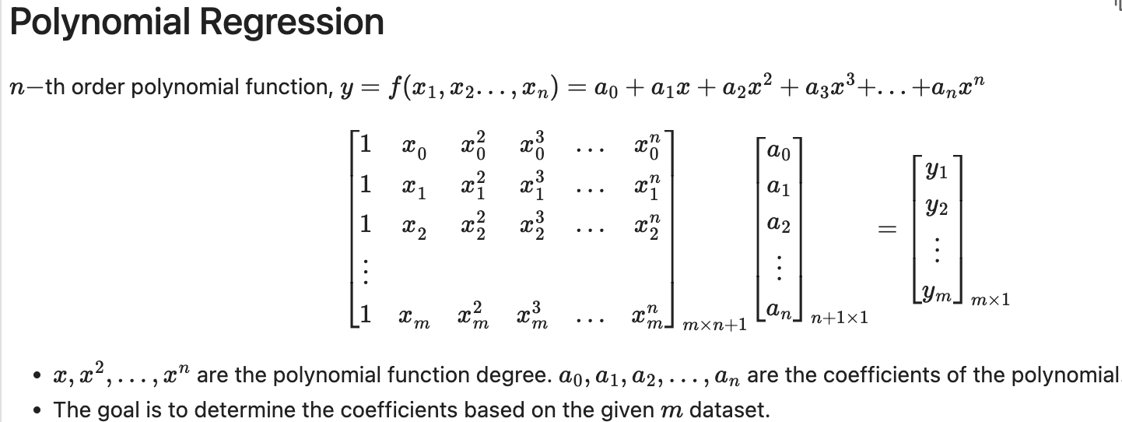
Regression
Fit a function given a dataset, input x and output y (prediction)
Notes:
Note: on these slides, feel free to use as many or as few photos or other images (logos, screenshots, etc.) as you think are appropriate. You are not limited to three images in this layout pattern. Make it your own! (And take this note off of the slides.)

Slide 4
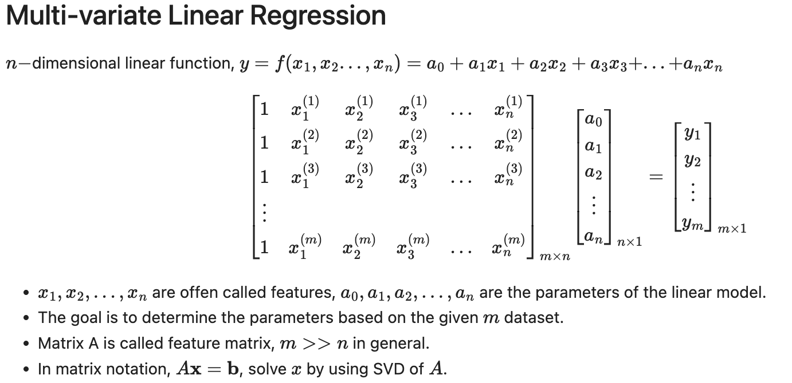
Regression
Notes:
Note: on these slides, feel free to use as many or as few photos or other images (logos, screenshots, etc.) as you think are appropriate. You are not limited to three images in this layout pattern. Make it your own! (And take this note off of the slides.)

Slide 5
Regression
Minimize the error
It is often called Loss Function, or Cost Function
Linear regression lost function can be written as a linear system
f(x) is approximated by a linear system
Notes:
Note: on these slides, feel free to use as many or as few photos or other images (logos, screenshots, etc.) as you think are appropriate. You are not limited to three images in this layout pattern. Make it your own! (And take this note off of the slides.)

Slide 6
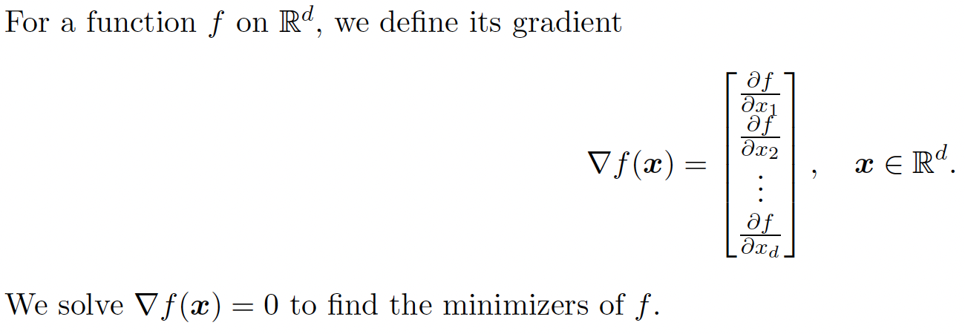
Minimizing a function
Example 2.
Find the minimizer of function f(x)
Notes:
Note: on these slides, feel free to use as many or as few photos or other images (logos, screenshots, etc.) as you think are appropriate. You are not limited to three images in this layout pattern. Make it your own! (And take this note off of the slides.)

Slide 7
Minimizing a function
Example 2.
Find the minimizer of function f(x)
Notes:
Note: on these slides, feel free to use as many or as few photos or other images (logos, screenshots, etc.) as you think are appropriate. You are not limited to three images in this layout pattern. Make it your own! (And take this note off of the slides.)

Slide 8
Nonlinear function example
Fit the data with exponential (nonlinear) function
Assume 1 data point (x, y), loss function:
Gradient:
Notes:
Note: on these slides, feel free to use as many or as few photos or other images (logos, screenshots, etc.) as you think are appropriate. You are not limited to three images in this layout pattern. Make it your own! (And take this note off of the slides.)

Slide 9
Nonlinear function example
Fit the data with exponential (nonlinear) function
Assume 1 data point (x, y), loss function:
Gradient:
Nonlinear equation of
gradient:
Notes:
Note: on these slides, feel free to use as many or as few photos or other images (logos, screenshots, etc.) as you think are appropriate. You are not limited to three images in this layout pattern. Make it your own! (And take this note off of the slides.)

Slide 10
Nonlinear function example
Assume n data points, i=1,2,…n
Gradient of Loss
function:
Gradient equation:
Nonlinear system:
Notes:
Note: on these slides, feel free to use as many or as few photos or other images (logos, screenshots, etc.) as you think are appropriate. You are not limited to three images in this layout pattern. Make it your own! (And take this note off of the slides.)

Slide 11
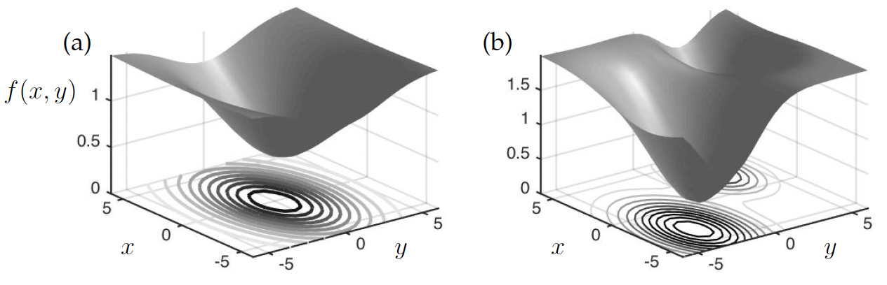
Gradient Descent
Convex function (strictly concave)
Non-convex function
(curves up and down)
Figure reference: N.Kuz&S.Brunton Data-Driven Science Book
Notes:
Note: on these slides, feel free to use as many or as few photos or other images (logos, screenshots, etc.) as you think are appropriate. You are not limited to three images in this layout pattern. Make it your own! (And take this note off of the slides.)

Slide 12
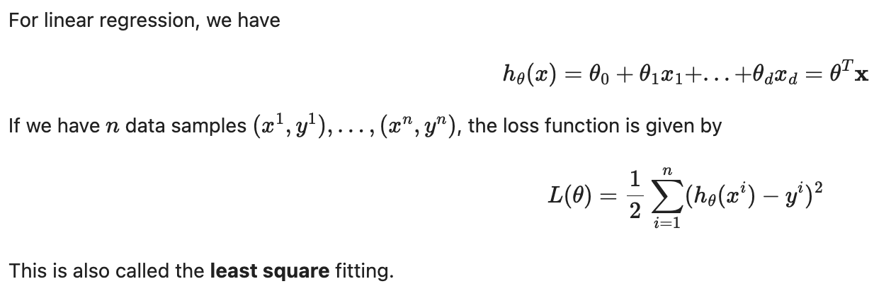
Gradient Descent
Notes:
Note: on these slides, feel free to use as many or as few photos or other images (logos, screenshots, etc.) as you think are appropriate. You are not limited to three images in this layout pattern. Make it your own! (And take this note off of the slides.)

Slide 13
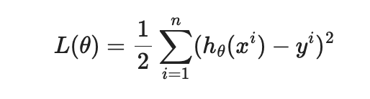
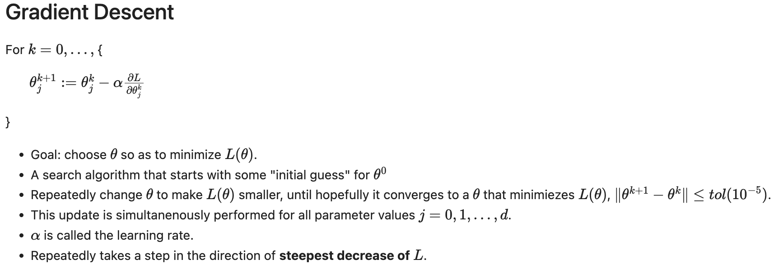
Gradient Descent
Notes:
Note: on these slides, feel free to use as many or as few photos or other images (logos, screenshots, etc.) as you think are appropriate. You are not limited to three images in this layout pattern. Make it your own! (And take this note off of the slides.)

Slide 14
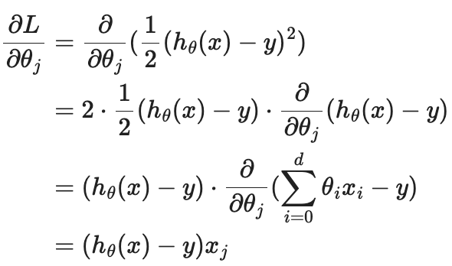

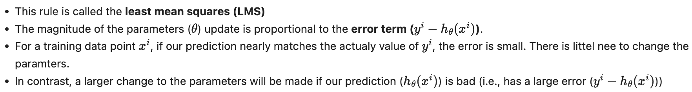
Gradient Descent
Derivative of the loss function:
Updating rule for single training data point i:
Notes:
Note: on these slides, feel free to use as many or as few photos or other images (logos, screenshots, etc.) as you think are appropriate. You are not limited to three images in this layout pattern. Make it your own! (And take this note off of the slides.)

Slide 15


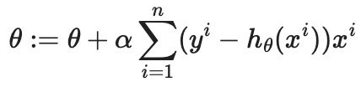
Batch Gradient Descent
For one data point:
For n- data points:
Batch gradient descent (BGD)
GD can be susceptible to local minimum
Linear regression (least-square fitting) always converge to global minimum.
The loss function is a convex quadratic function.
Notes:
Note: on these slides, feel free to use as many or as few photos or other images (logos, screenshots, etc.) as you think are appropriate. You are not limited to three images in this layout pattern. Make it your own! (And take this note off of the slides.)

Slide 16
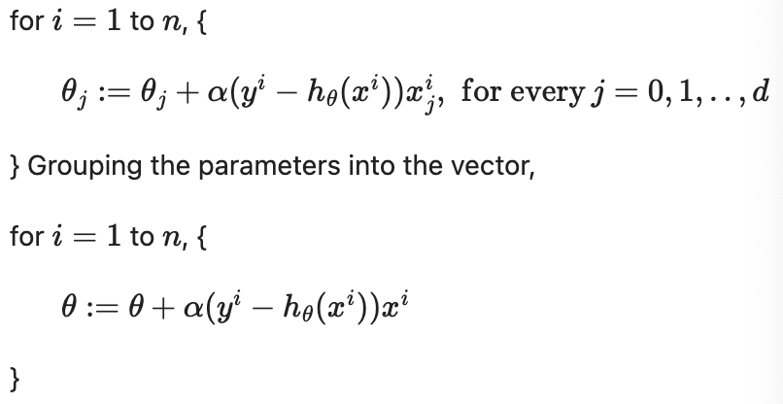
Stochastic Gradient Descent
Each time we update the parameters
according one training data
This algorithm is called Stochastic Gradient
Descent (SGD)
The BGD has to scan through the entire training
set before taking an update of the parameters.
Computationally expensive if n is large.
(think about if you have 1 million dataset).
SGD can start making progress right away, and
continues to make progress with each example it looks at.
SGD gets θ "close" to the minimum much faster than BGD. However, it may never converge to the minimum, and the paramters θ will keep oscillating around the minimum of L(θ). But in practice, most of the values near the minimum will be reasonably good approximations to the true minimum.
Notes:
Note: on these slides, feel free to use as many or as few photos or other images (logos, screenshots, etc.) as you think are appropriate. You are not limited to three images in this layout pattern. Make it your own! (And take this note off of the slides.)

Slide 17
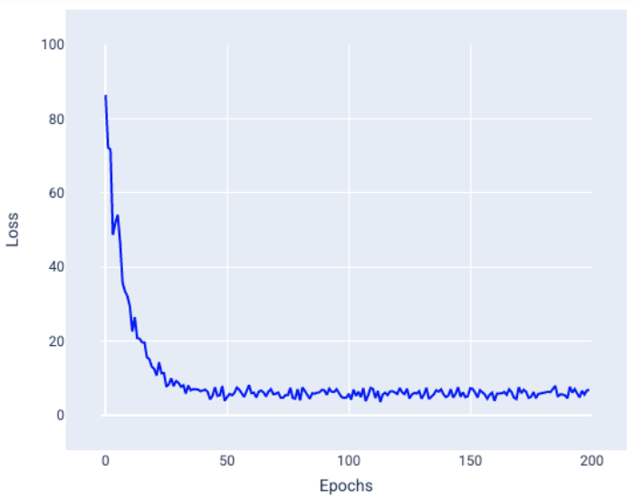
Stochastic Gradient Descent
BGD:
SGD:
For these reasons, particularly when the training dataset is large, SGD is often preferred over BGD.
Notes:
Note: on these slides, feel free to use as many or as few photos or other images (logos, screenshots, etc.) as you think are appropriate. You are not limited to three images in this layout pattern. Make it your own! (And take this note off of the slides.)

Slide 18
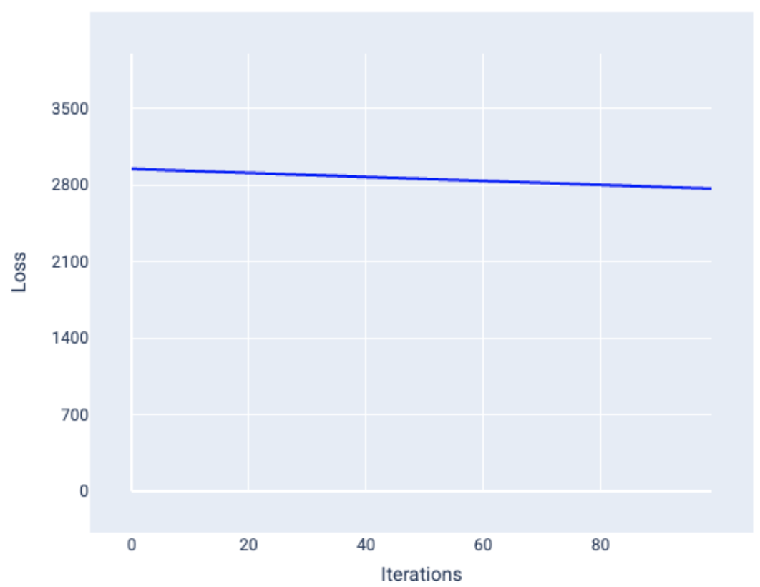
Stochastic Gradient Descent
SGD:
BGD:
Notes:
Note: on these slides, feel free to use as many or as few photos or other images (logos, screenshots, etc.) as you think are appropriate. You are not limited to three images in this layout pattern. Make it your own! (And take this note off of the slides.)

Slide 19
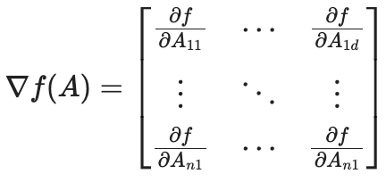
Matrix Derivative
Notes:
Note: on these slides, feel free to use as many or as few photos or other images (logos, screenshots, etc.) as you think are appropriate. You are not limited to three images in this layout pattern. Make it your own! (And take this note off of the slides.)

Slide 20
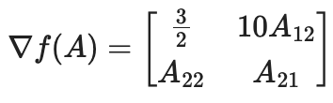
Matrix Derivative
Notes:
Note: on these slides, feel free to use as many or as few photos or other images (logos, screenshots, etc.) as you think are appropriate. You are not limited to three images in this layout pattern. Make it your own! (And take this note off of the slides.)

Slide 21
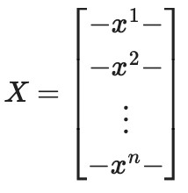
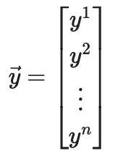
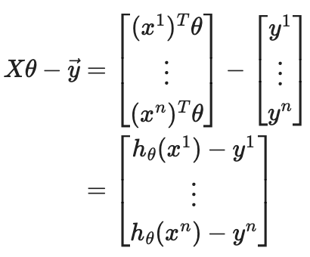

Normal Equation
Design matrix nx(d+1)
Fitting function:
Loss :
Notes:
Note: on these slides, feel free to use as many or as few photos or other images (logos, screenshots, etc.) as you think are appropriate. You are not limited to three images in this layout pattern. Make it your own! (And take this note off of the slides.)

Slide 22

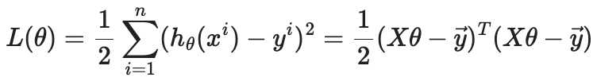
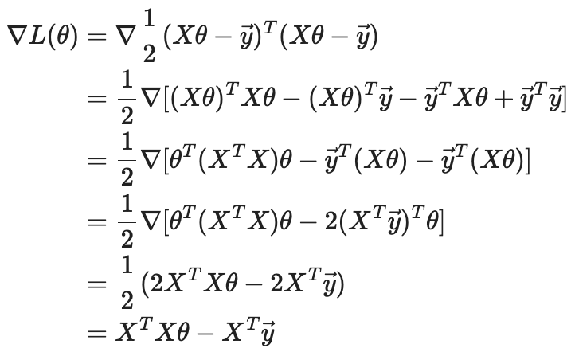
Normal Equation
Loss function:
Gradient:
Notes:
Note: on these slides, feel free to use as many or as few photos or other images (logos, screenshots, etc.) as you think are appropriate. You are not limited to three images in this layout pattern. Make it your own! (And take this note off of the slides.)

Slide 23
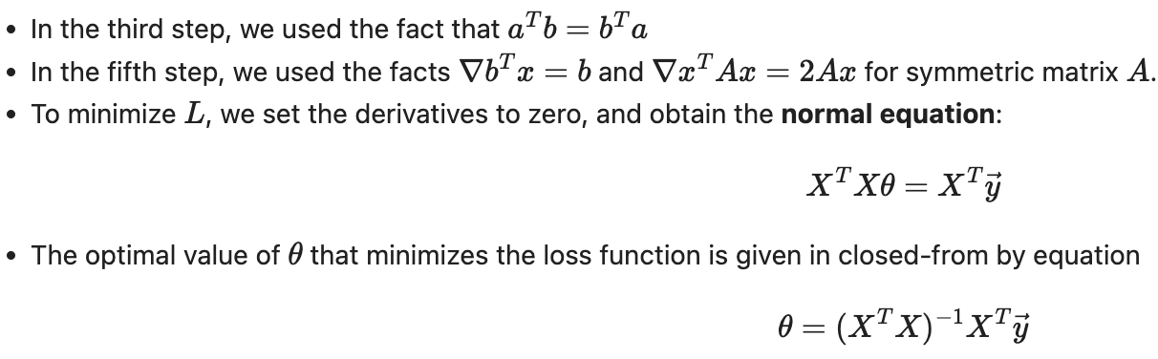
Normal Equation
Notes:
Note: on these slides, feel free to use as many or as few photos or other images (logos, screenshots, etc.) as you think are appropriate. You are not limited to three images in this layout pattern. Make it your own! (And take this note off of the slides.)

