Slide 1
BDA 411/511
Introduction to Machine Learning
2026 Fall
Dr. Xuping Xie
Department of Math & Stat

Slide 2

What Is Machine Learning?
Traditional: rules are available to solve a specific problem
  Solve a linear system Ax=b, x=A\b
What if the rules are difficult/impossible to find?
  Tell whether there is a cat in a photo
Machine learning
  Learn a rule from (historical) data
  Use the rule to make predictions on new data

Slide 3
An Example
Product recommendation for Amazon customers
Traditional approach
Customer’s profile
Machine
Recommended products
Hand-crafted rules
Machine learning
Customer’s profile
Machine
Model
Recommended products
Purchase history

Slide 4
When Do We Use Machine Learning?
Human expertise does not exist (navigating on Mars)
Humans can’t explain their expertise (speech recognition)
Models must be customized (personalized medicine)
Models are based on huge amounts of data (genomics)

Slide 5
More Examples
Recognizing patterns: Speech Recognition, facial identity, etc
Recommender Systems: Amazon, Netflix
Information retrieval: Find documents or images with similar content
Robotics: perception, planning, etc. autonomous driving, drones
Recognizing anomalies: Unusual sequences of credit card transactions, panic situation at an airport

Slide 6
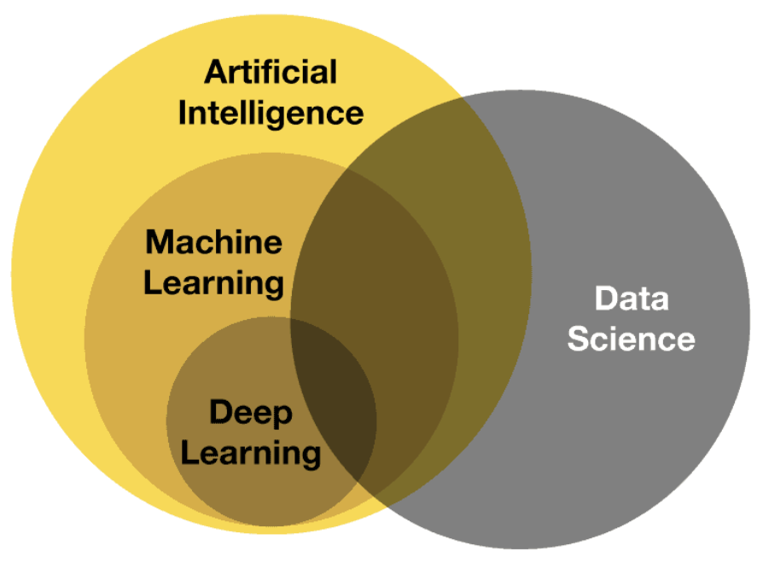
Relations in ML/AI

Slide 7
Core Techniques in Machine Learning
Math
Stat
ML
Computer Science

Slide 8
Types of Machine Learning
Supervised Learning
Given: training data + desired outputs (labels)
Unsupervised Learning
Given: training data (without desired outputs)
Semi-supervised Learning
Given: training data + a few desired outputs

Slide 9
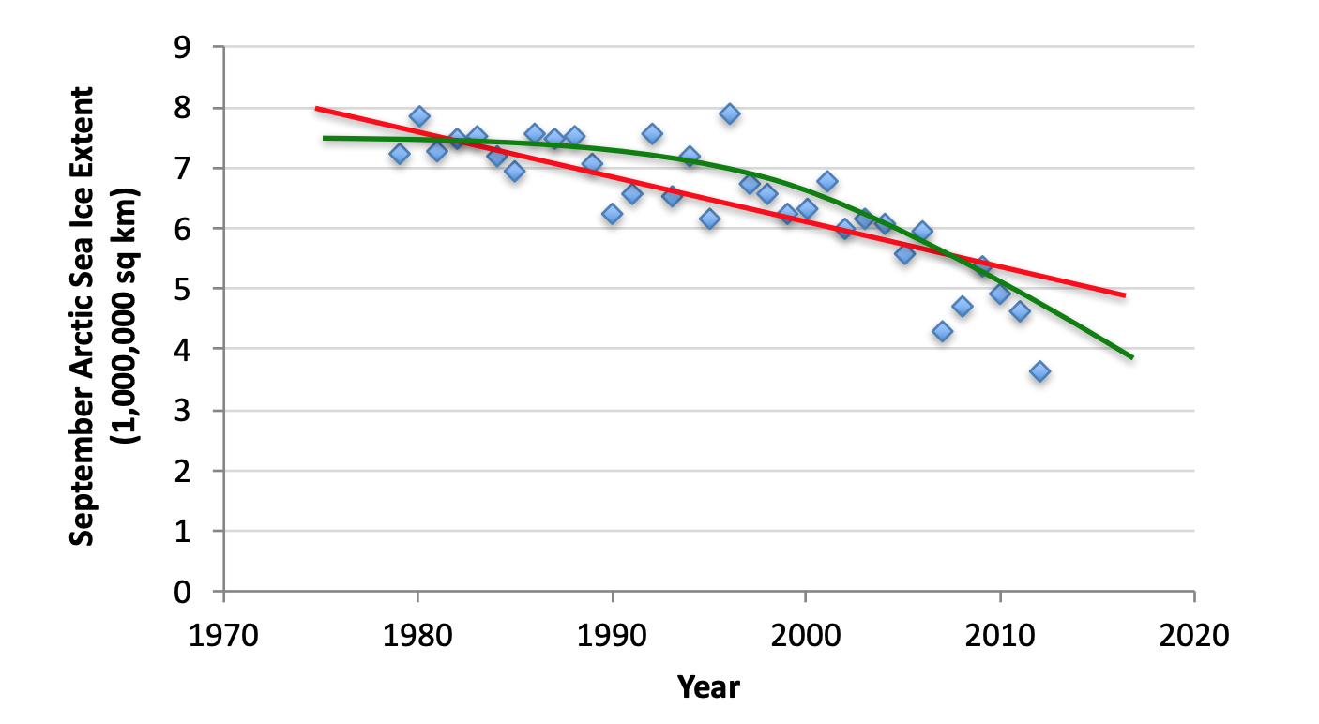
Supervised Learning: Regression
Given (x1, y1), (x2, y2), …, (xn, yn)
Learn a function f(x) to predict the output y for a given x
  Regression: y is real-valued

Slide 10
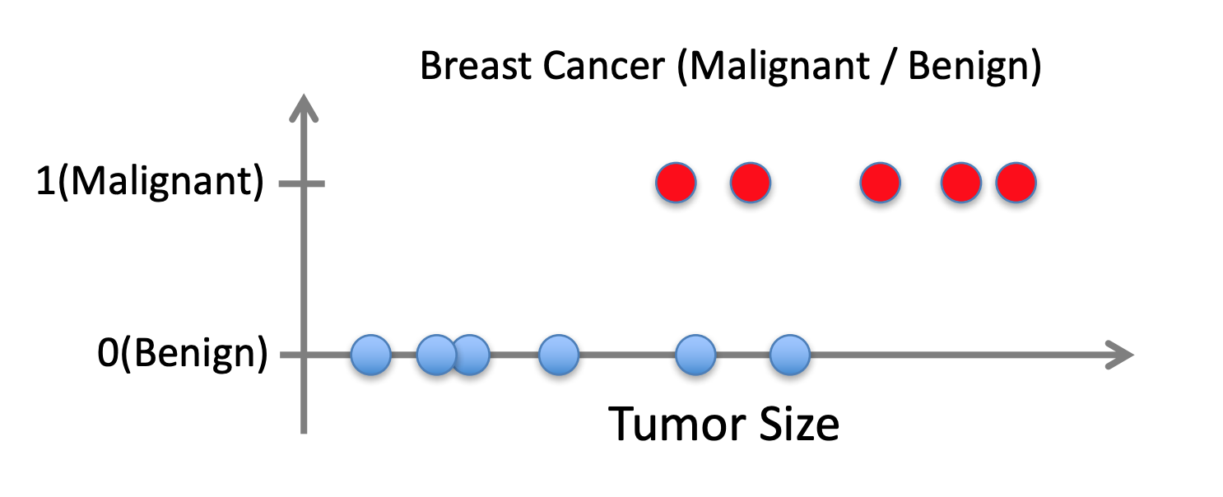
Supervised Learning: Classification
Given (x1, y1), (x2, y2), …, (xn, yn)
Learn a function f(x) to predict the output y for a given x
  Classification: y is categorical

Slide 11
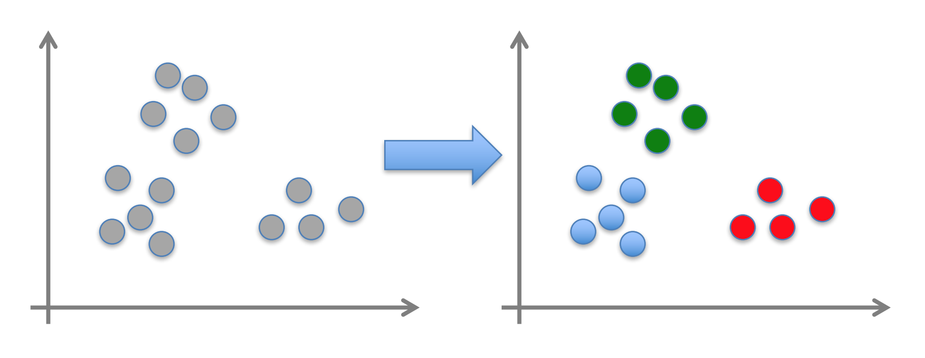
Unsupervised Learning
Given x1, x2, …, xn (without labels)
Output hidden structure behind the x’s
  E.g., clustering

Slide 12
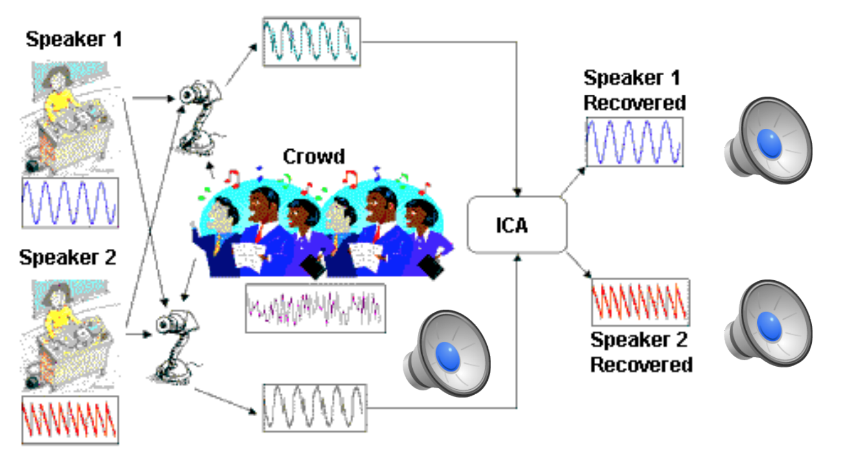
Unsupervised Learning
Independent component analysis: separate a combined signal into its original sources

Slide 13
Modern Machine Learning
Deep Learning
Reinforcement Learning
Transfer Learning

Slide 14
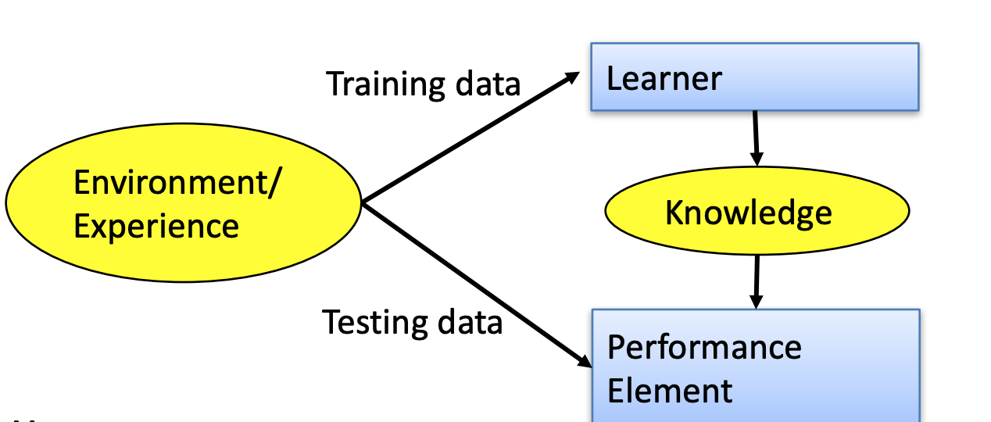
Designing a Learning System
Choose the training experience
Choose exactly what is to be learned: the target function
Choose how to represent the target function
Choose a learning algorithm to infer the target function from the experience

Slide 15
Key Components in Machine Learning
Representation
How to represent the target function?
Optimization
How to compute the “best” target function?
Evaluation
How to evaluate the performance of the learned target function?

Slide 16
Various Function Representations
Numerical functions
Linear regression; Neural networks; Support vector machines
• Symbolic functions
Decision trees; Rules in propositional logic; Rules in first-order predicate logic
• Instance-based functions
Nearest-neighbor; Case-based
• Probabilistic Graphical Models
Naive Bayes; Bayesian networks; Hidden-Markov Models (HMMs); Markov networks

Slide 17
Various Search/Optimization Algorithms
Gradient descent
Perceptron; Backpropagation
• Dynamic Programming
HMM Learning; PCFG Learning
• Divide and Conquer
Decision tree induction; Rule learning
• Evolutionary Computation
Genetic Algorithms (GAs); Genetic Programming (GP); Neuro-evolution

Slide 18
Evaluation
Accuracy
• Precision and recall
• Squared error
• Likelihood
• Posterior probability
• Cost / Utility
• Margin
• Entropy
• K-L divergence

Slide 19
ML in Practice
Understand domain, prior knowledge, and goals
• Data integration, selection, cleaning, pre-processing, etc.
• Learn models
• Interpret results
• Consolidate and deploy discovered knowledge

Slide 20
Lessons Learned about Learning
Learning can be viewed as using direct or indirect experience to approximate a chosen target function.
• Function approximation can be viewed as a search through a space of hypotheses (representations of functions) for one that best fits a set of training data.
• Different learning methods assume different hypothesis spaces (representation languages) and/or employ different search techniques.

