Slide 1
BDA 411/511
Introduction to Machine Learning
2026 Fall
Dr. Xuping Xie
Department of Math & Stat

Slide 2
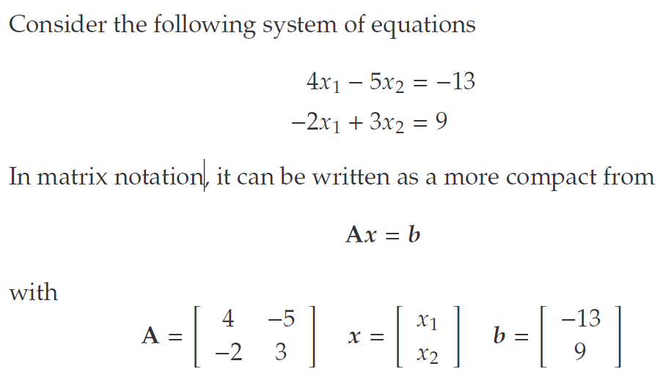

Basic Notation

Slide 3
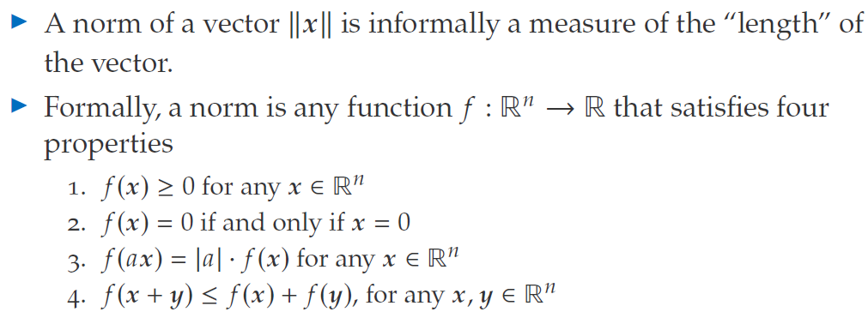
Vector norms

Slide 4

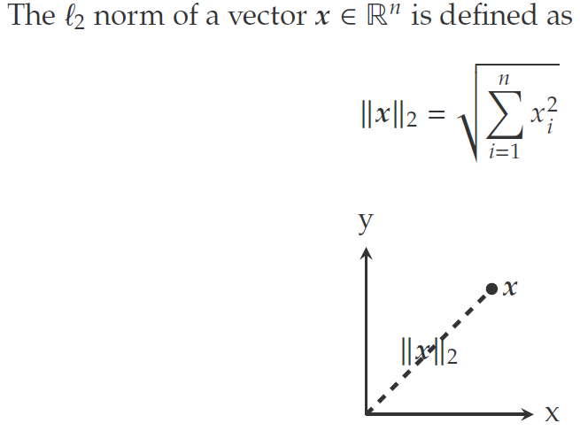
Vector norms
Question:

Slide 5
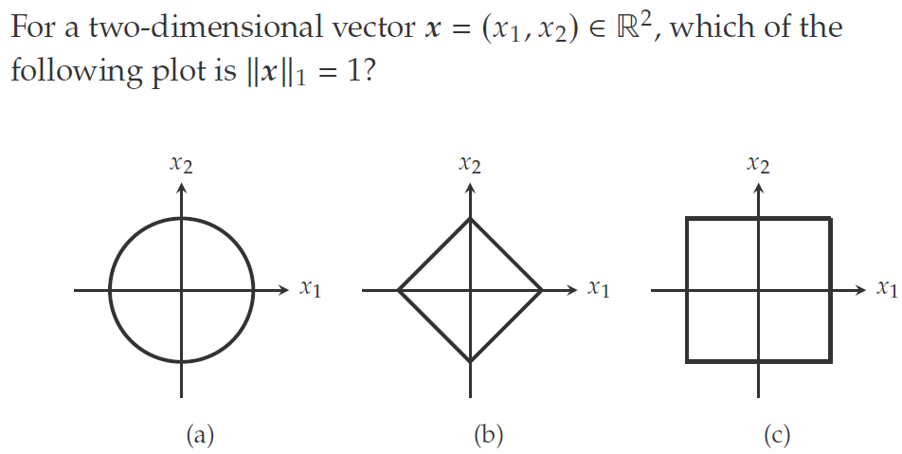
L1 norm plot

Slide 6
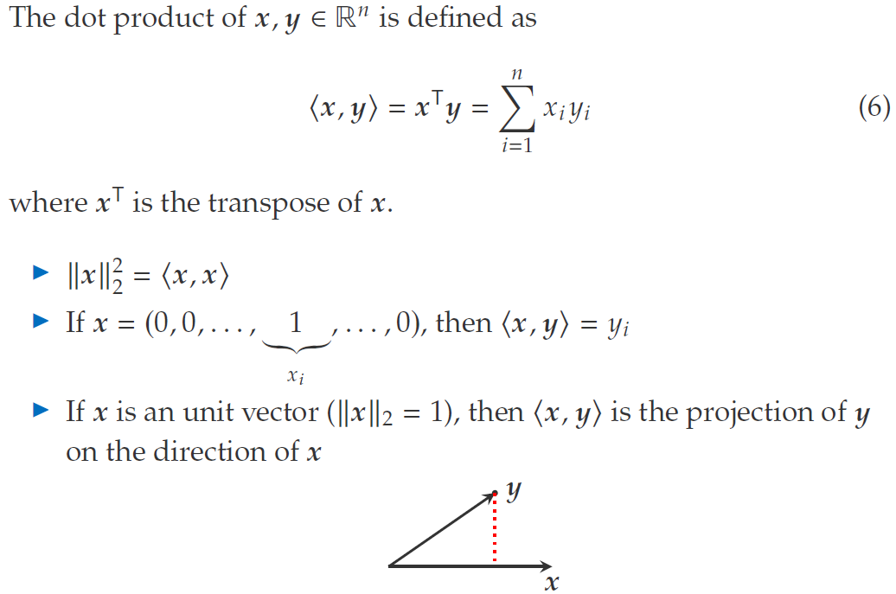
Dot product

Slide 7
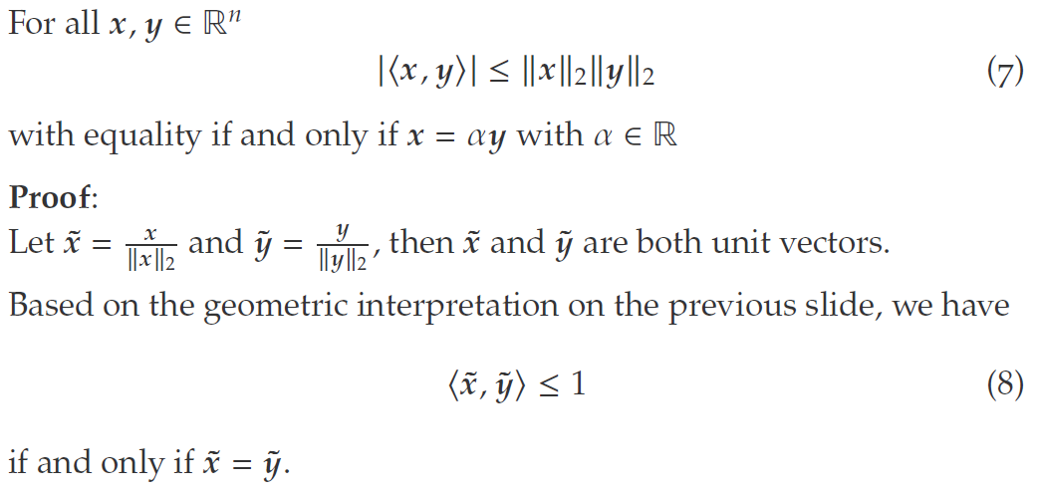
Cauchy-Schwarz inequality

Slide 8
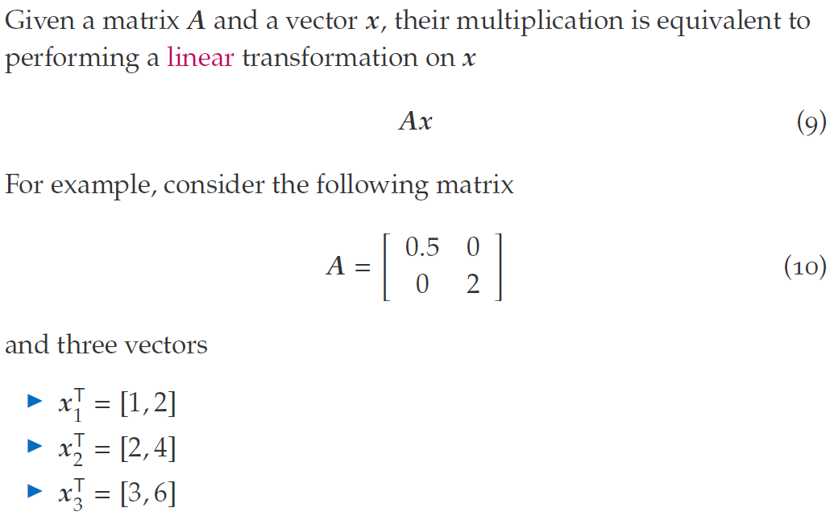
Vector-Matrix Multiplication

Slide 9
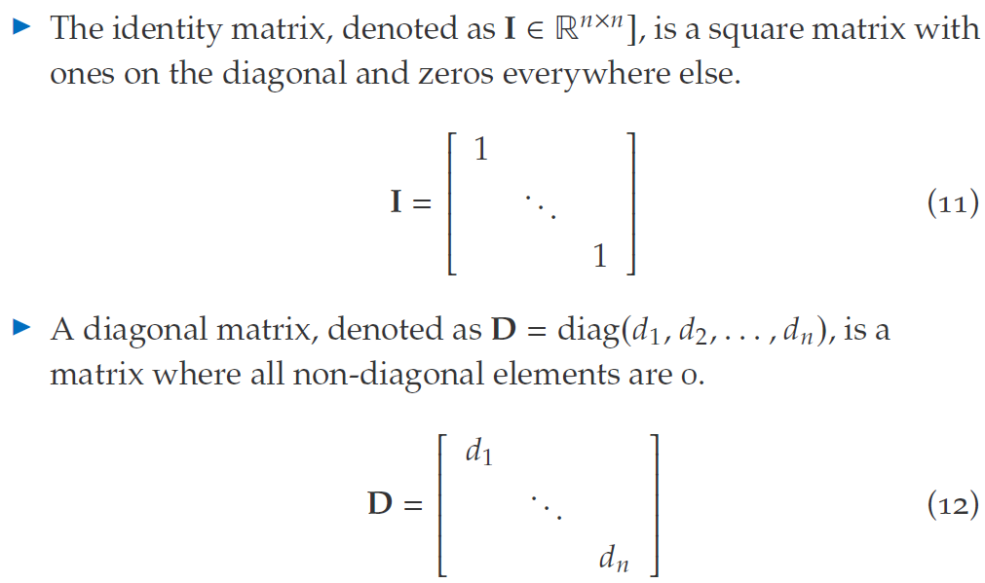
Special Matrices

Slide 10
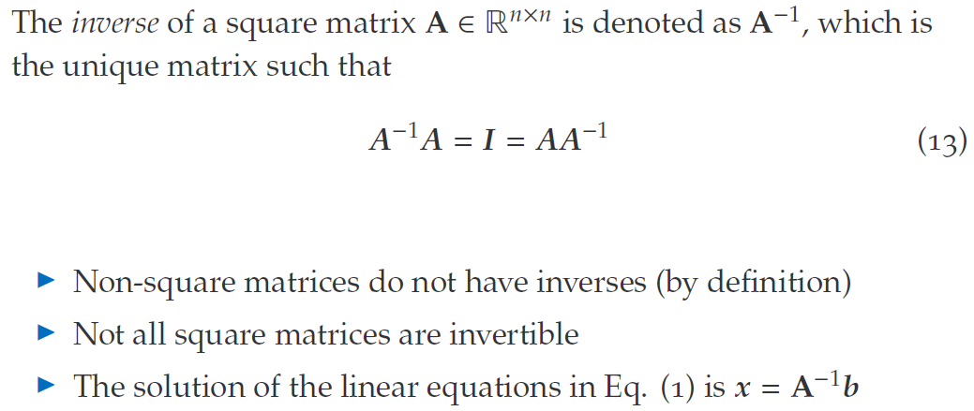
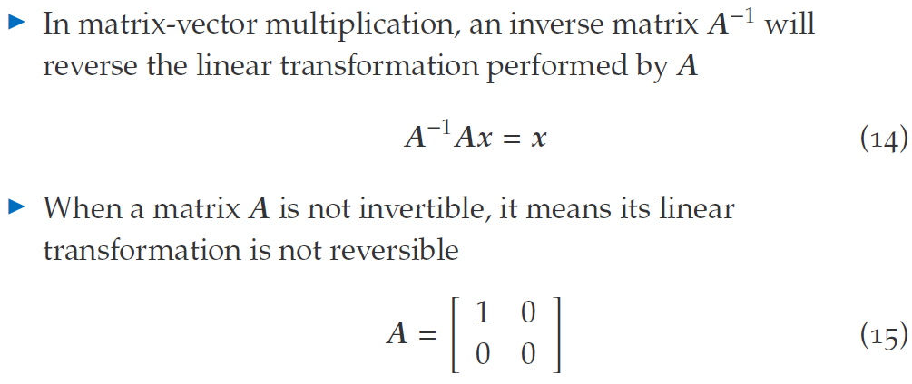
Inverse

Slide 11
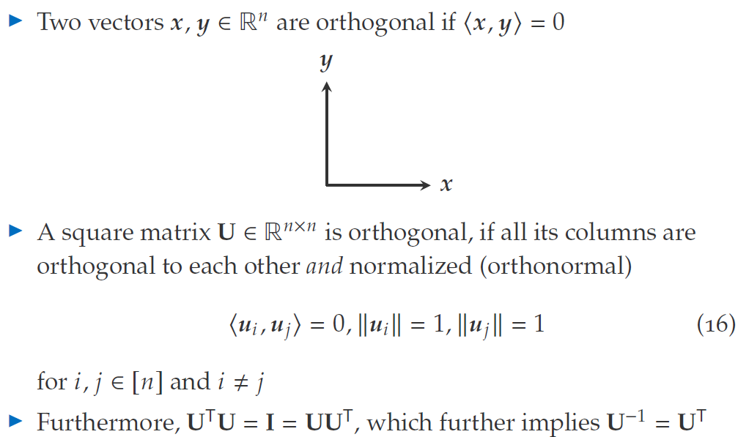
Orthogonal Matrices

Slide 12
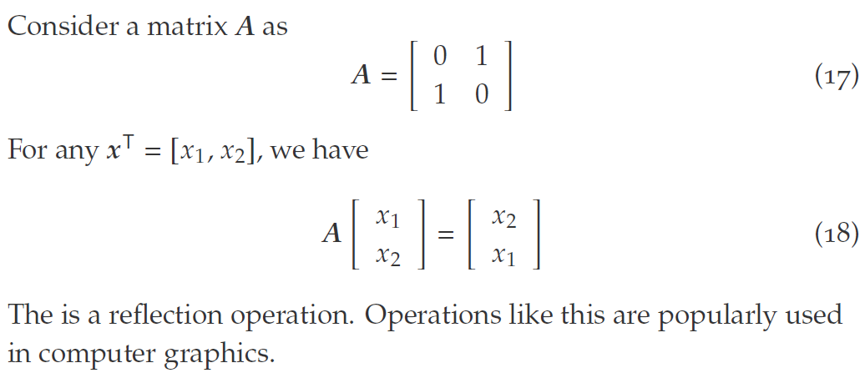
Special case

Slide 13
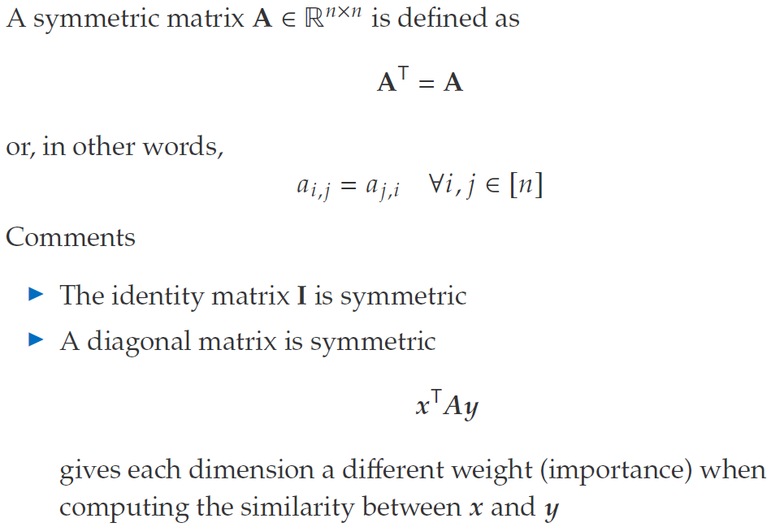
Symmetric Matrices

Slide 14
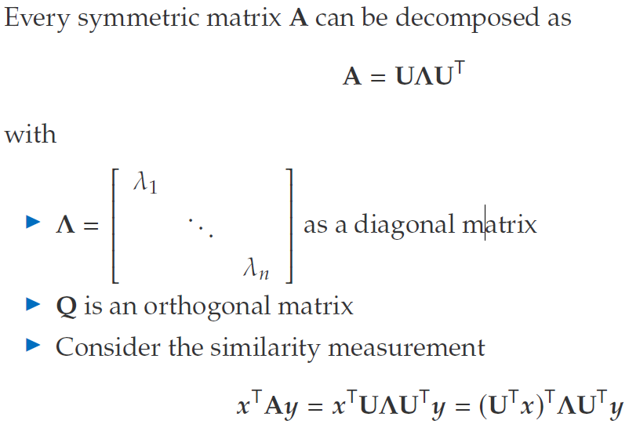

Eigen Decomposition

Slide 15
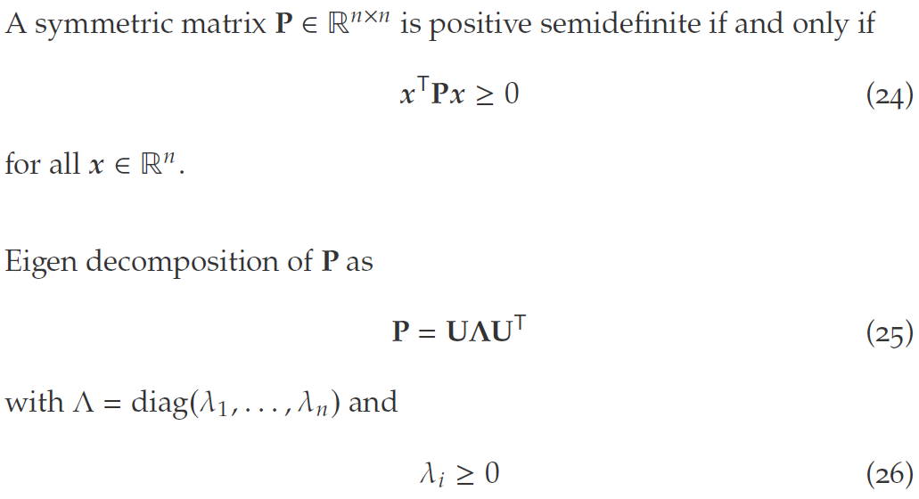
Symmetric Positive Semidefinite Matrices

Slide 16
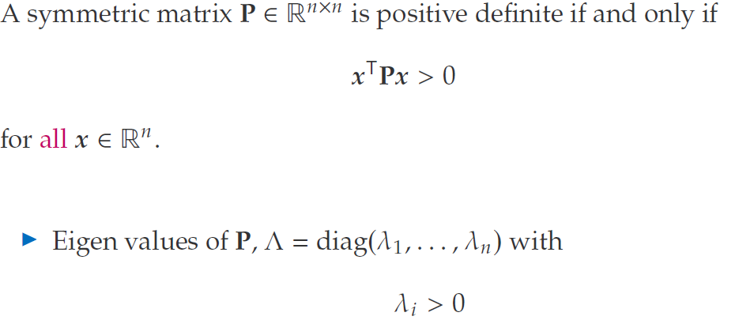
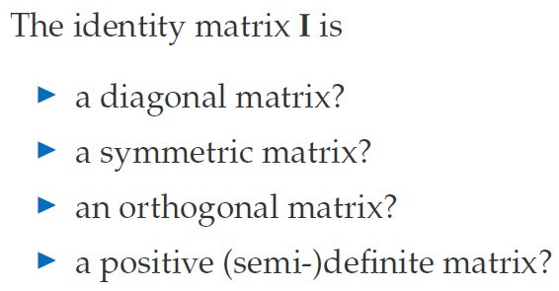
Symmetric Positive Definite

Slide 17
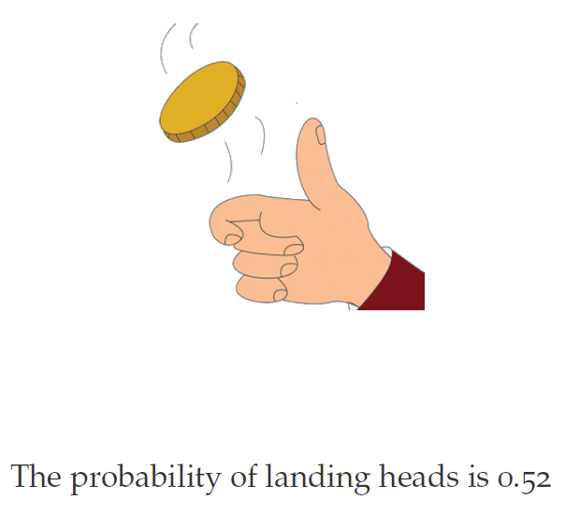
What is probability?

Slide 18

Two interpretations

Slide 19
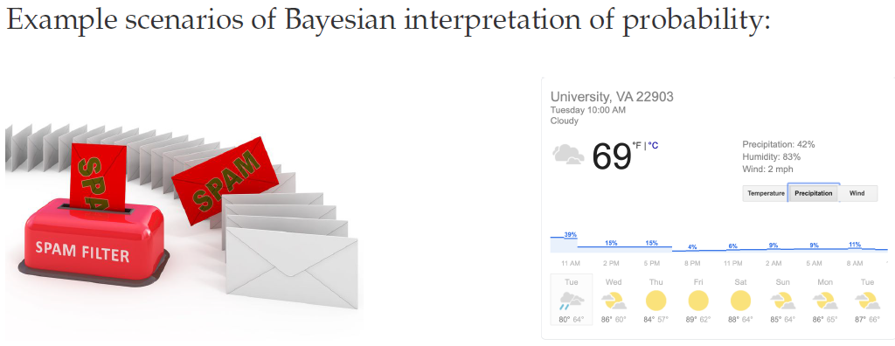
Bayesian Interpretation

Slide 20
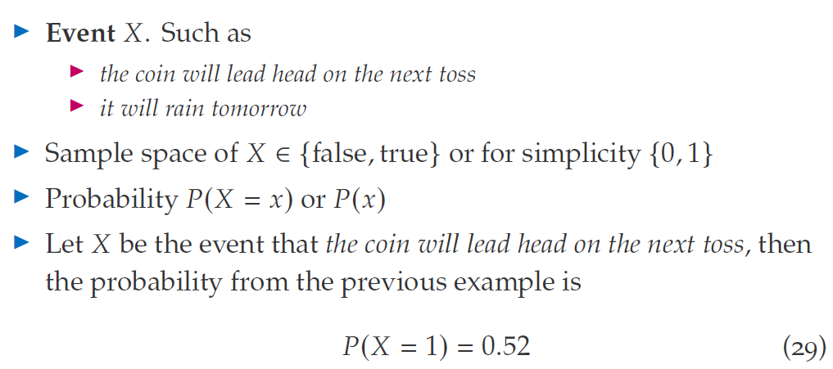
Binary Random Variables

Slide 21
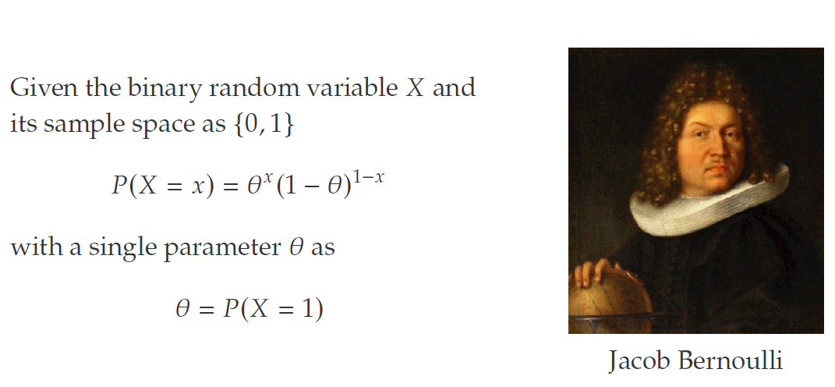
Bernoulli Distribution

Slide 22

Tossing a coin twice?

Slide 23
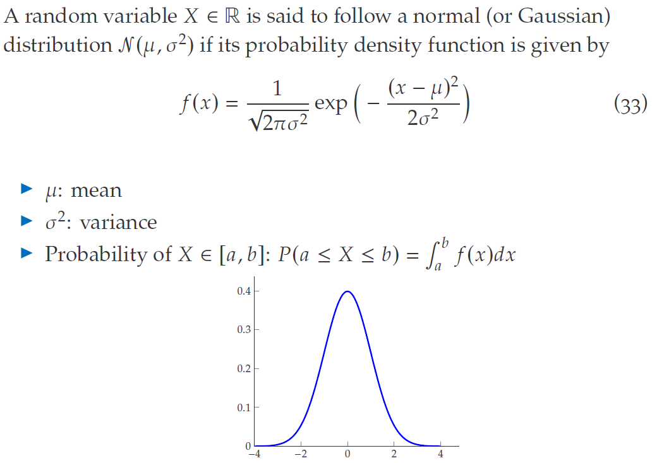
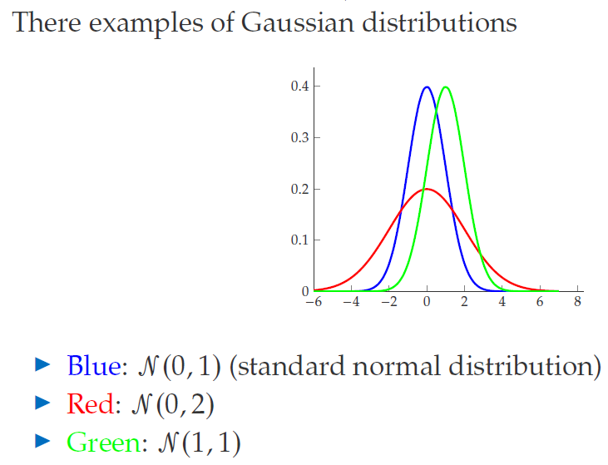
Gaussian Distribution

Slide 24
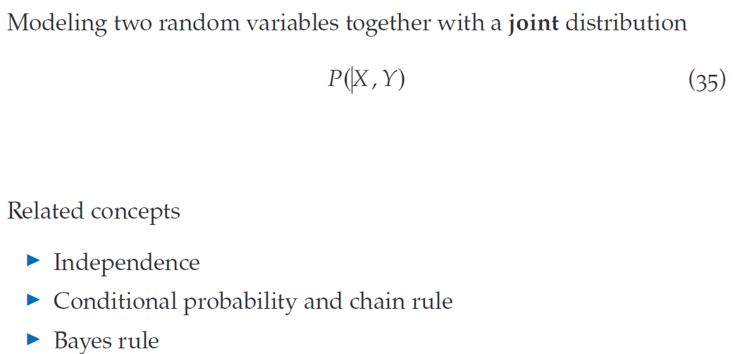
Probability of two random variables

Slide 25
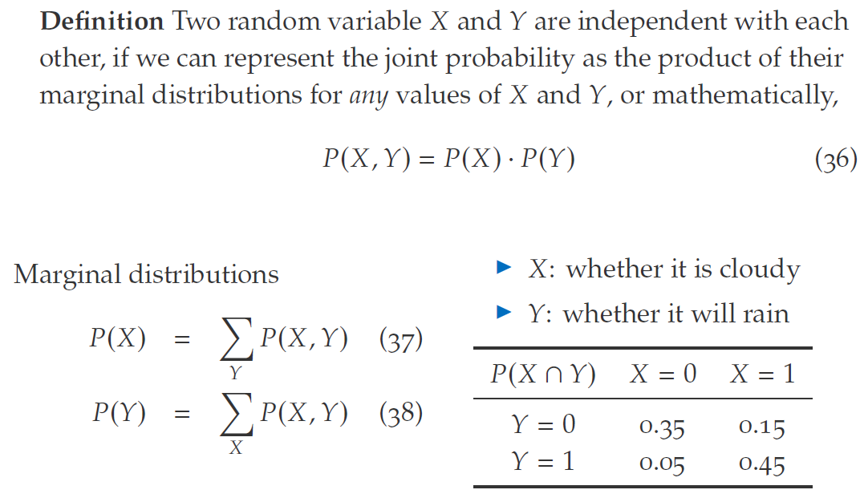
Independence

Slide 26
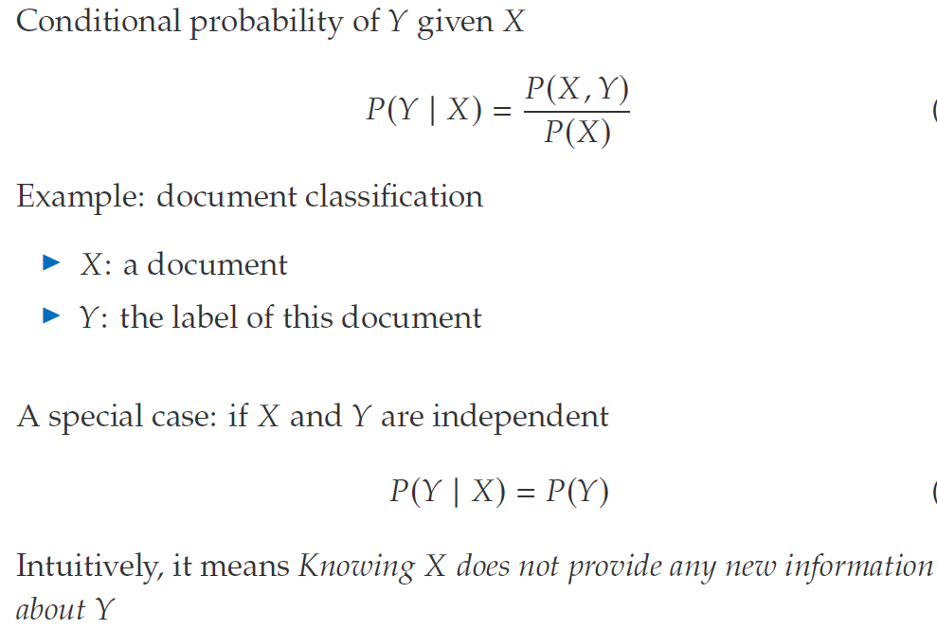
Conditional Probability

Slide 27
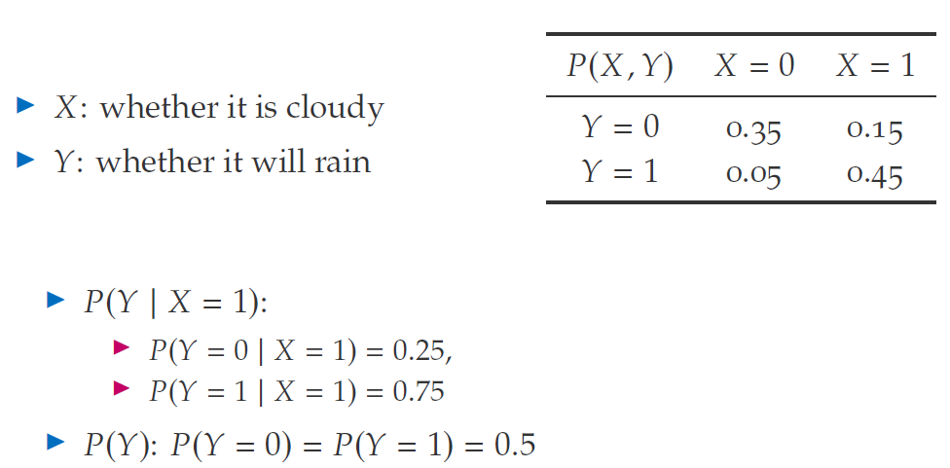
Conditional Probability

Slide 28
Thank You

