Slide 1

BDA411/511
Introduction to Machine Learning
Dr. Xuping Xie
Department of Math & Stat
Notes:
Note: on these slides, feel free to use as many or as few photos or other images (logos, screenshots, etc.) as you think are appropriate. You are not limited to the images in this layout pattern. Make it your own! (And take this note off of the slides.)

Slide 2
SVD error
SVD(Economy)
SVD truncation
(low-rank approximation)
Matrix F-norm (Frobenius norm)
Notes:
Note: on these slides, feel free to use as many or as few photos or other images (logos, screenshots, etc.) as you think are appropriate. You are not limited to three images in this layout pattern. Make it your own! (And take this note off of the slides.)

Slide 3
SVD Error
Rank-r SVD Approximation Error
Relative error
Rank-r SVD Cumulative sum
Eckart-Young Theorem:
The optimal rank-r approximation to A, in a least-square sense, is given by the rank-r SVD truncation,
Notes:
Note: on these slides, feel free to use as many or as few photos or other images (logos, screenshots, etc.) as you think are appropriate. You are not limited to three images in this layout pattern. Make it your own! (And take this note off of the slides.)

Slide 4
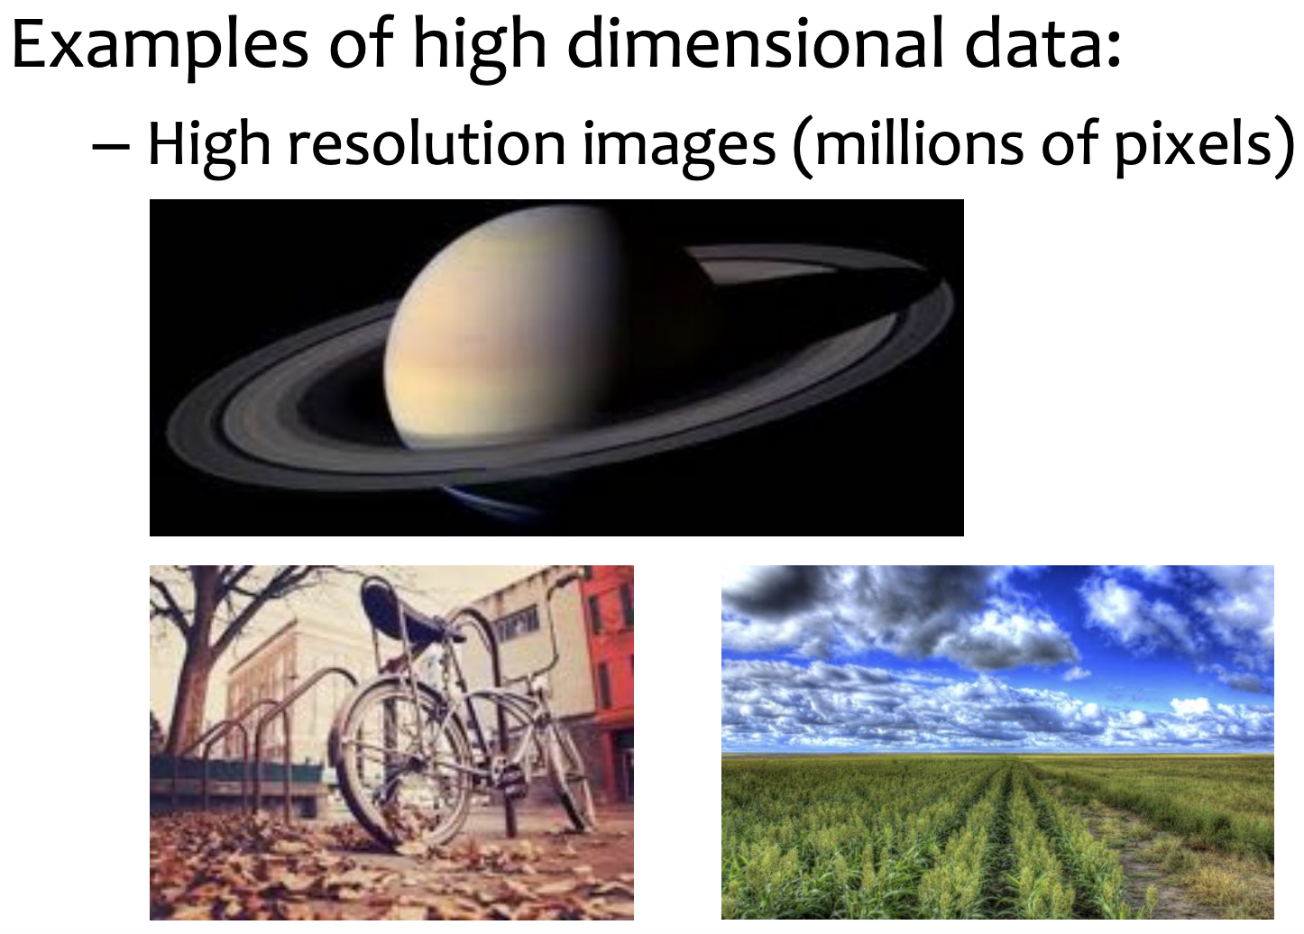
Principal Component Analysis (PCA)
Notes:
Note: on these slides, feel free to use as many or as few photos or other images (logos, screenshots, etc.) as you think are appropriate. You are not limited to three images in this layout pattern. Make it your own! (And take this note off of the slides.)

Slide 5
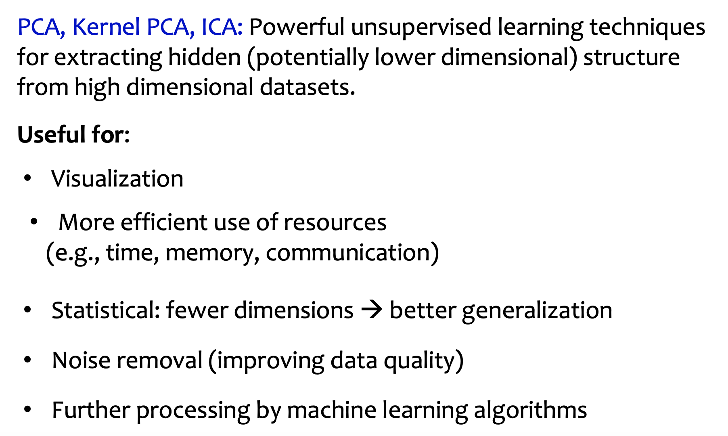
Principal Component Analysis (PCA)
Notes:
Note: on these slides, feel free to use as many or as few photos or other images (logos, screenshots, etc.) as you think are appropriate. You are not limited to three images in this layout pattern. Make it your own! (And take this note off of the slides.)

Slide 6
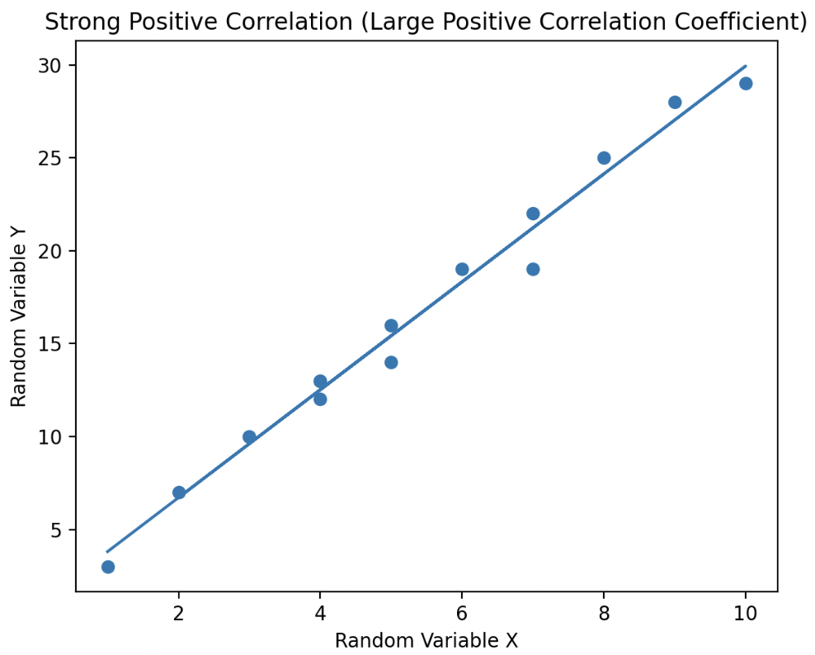
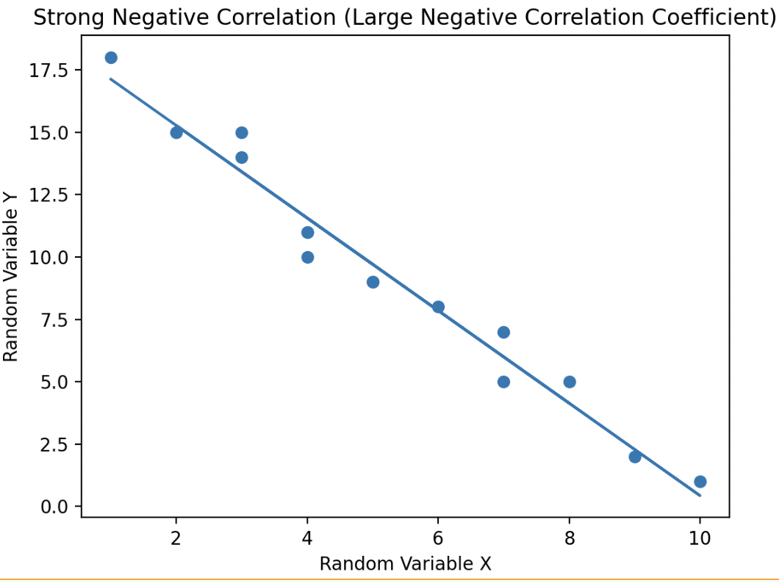
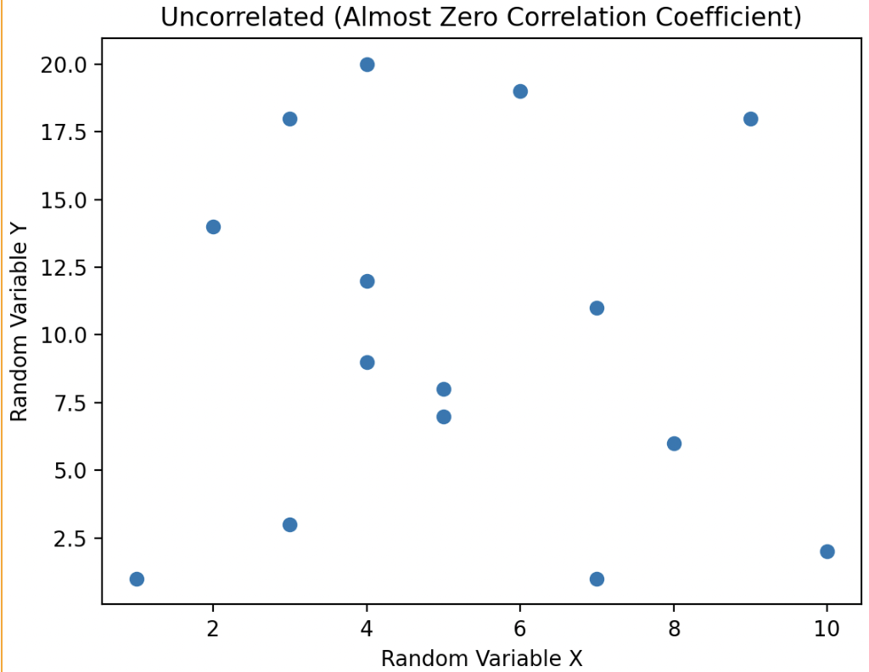
Data Correlation
Correlation coefficient
Notes:
Note: on these slides, feel free to use as many or as few photos or other images (logos, screenshots, etc.) as you think are appropriate. You are not limited to three images in this layout pattern. Make it your own! (And take this note off of the slides.)

Slide 7
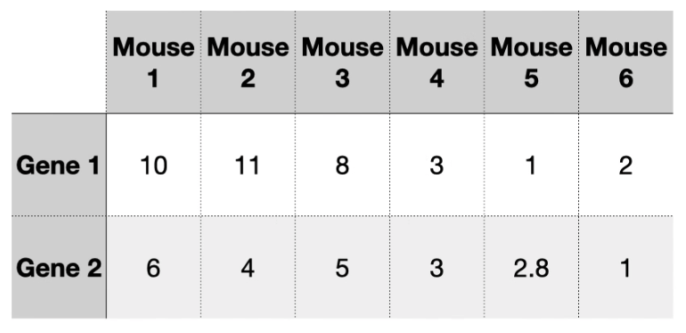
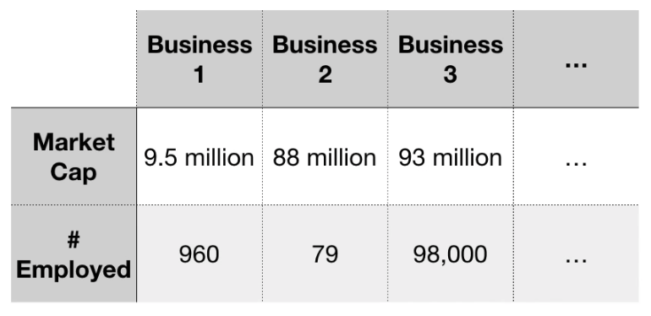
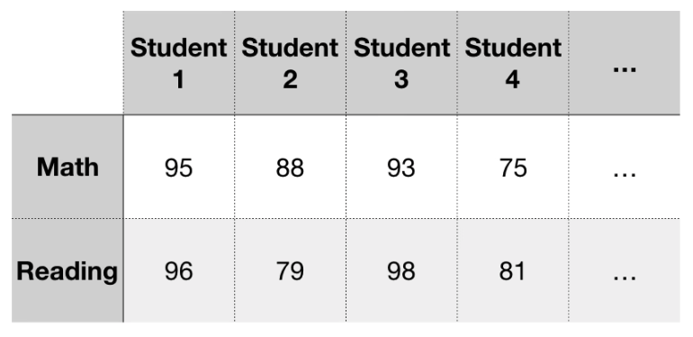
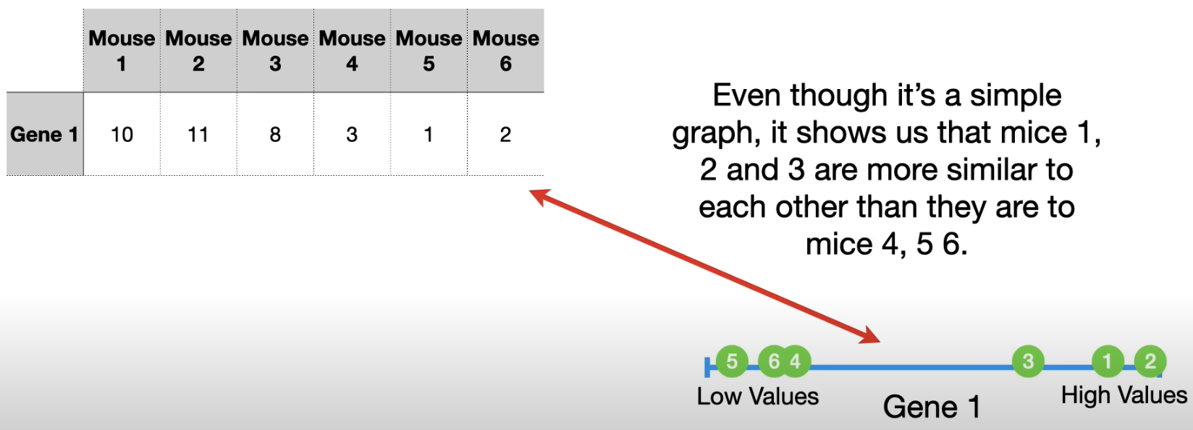
Principal Component Analysis (PCA)
An intuitive
example
Notes:
Note: on these slides, feel free to use as many or as few photos or other images (logos, screenshots, etc.) as you think are appropriate. You are not limited to three images in this layout pattern. Make it your own! (And take this note off of the slides.)

Slide 8
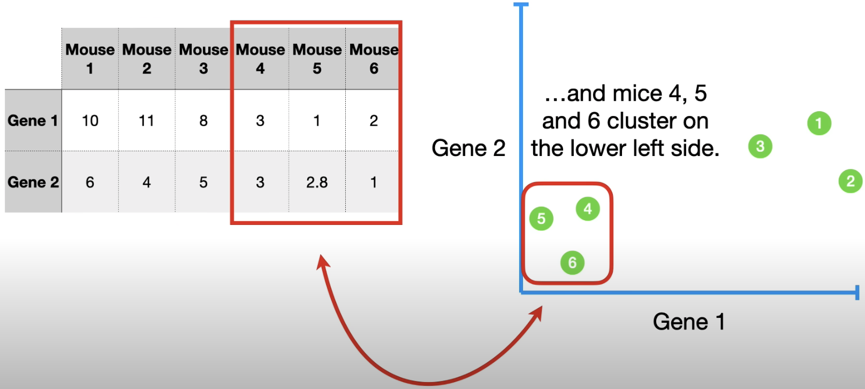
Principal Component Analysis (PCA)
An intuitive
example
Example reference youtube: StatQuest PCA
Notes:
Note: on these slides, feel free to use as many or as few photos or other images (logos, screenshots, etc.) as you think are appropriate. You are not limited to three images in this layout pattern. Make it your own! (And take this note off of the slides.)

Slide 9
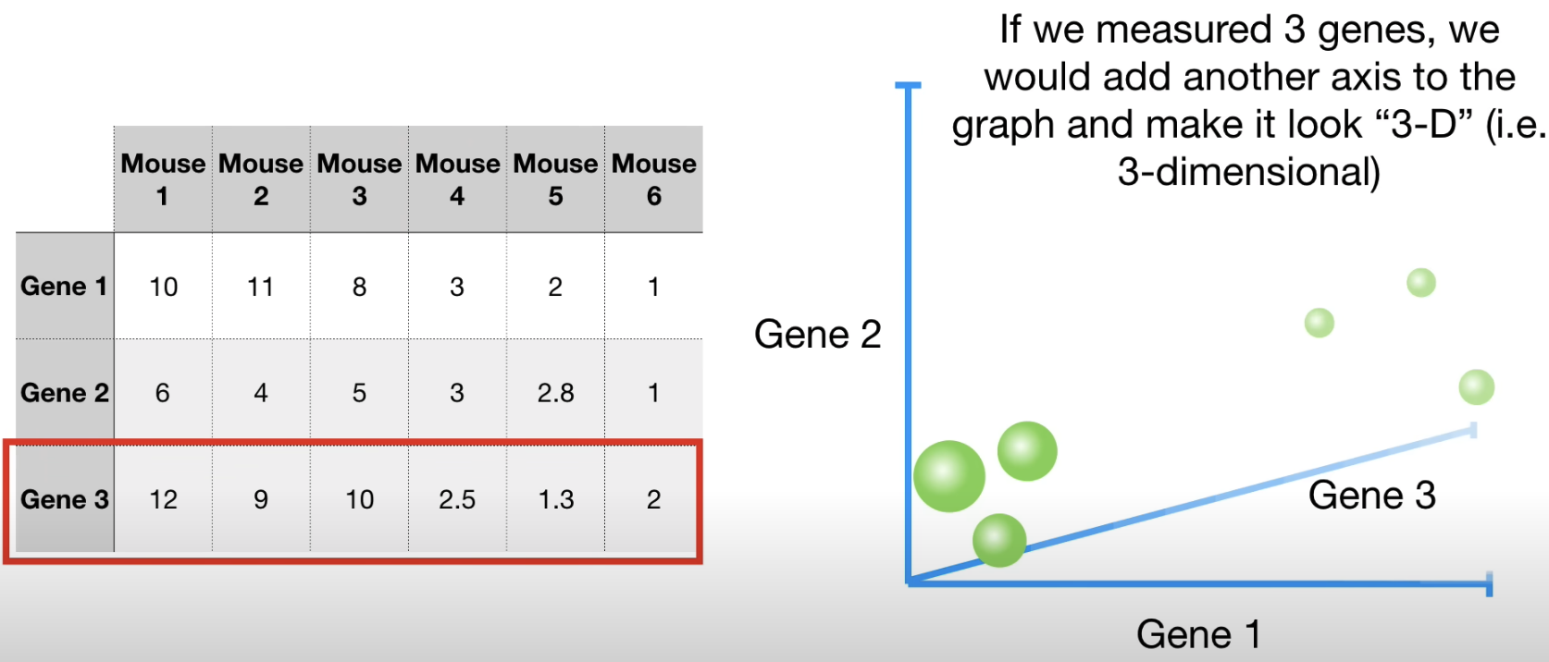
Principal Component Analysis (PCA)
An intuitive
example
Notes:
Note: on these slides, feel free to use as many or as few photos or other images (logos, screenshots, etc.) as you think are appropriate. You are not limited to three images in this layout pattern. Make it your own! (And take this note off of the slides.)

Slide 10
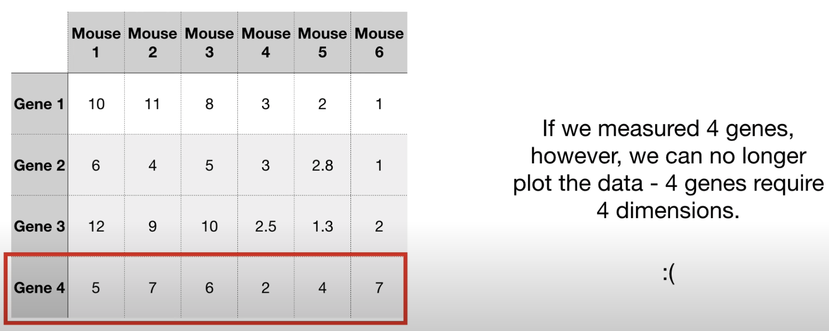
Principal Component Analysis (PCA)
An intuitive
example
What if we have 100 dimensional, or even more features. We cannot visualize data in a 100-D graph
Notes:
Note: on these slides, feel free to use as many or as few photos or other images (logos, screenshots, etc.) as you think are appropriate. You are not limited to three images in this layout pattern. Make it your own! (And take this note off of the slides.)

Slide 11
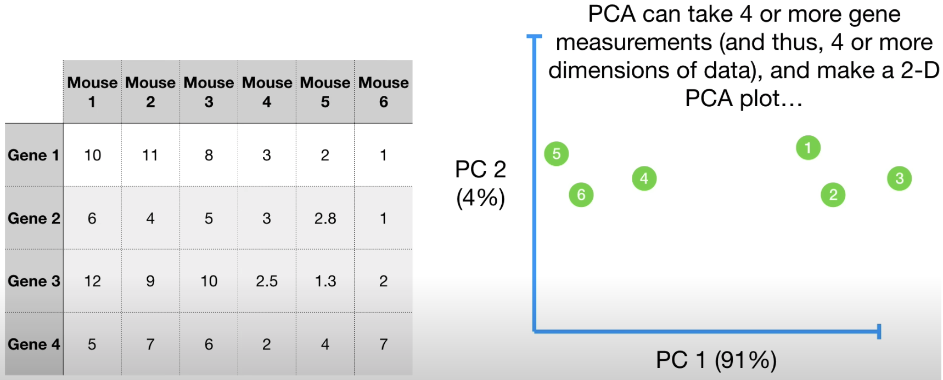
Principal Component Analysis (PCA)
An intuitive
example
Notes:
Note: on these slides, feel free to use as many or as few photos or other images (logos, screenshots, etc.) as you think are appropriate. You are not limited to three images in this layout pattern. Make it your own! (And take this note off of the slides.)

Slide 12
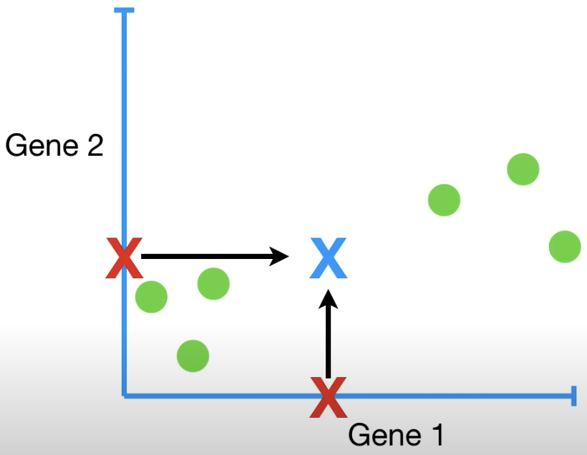
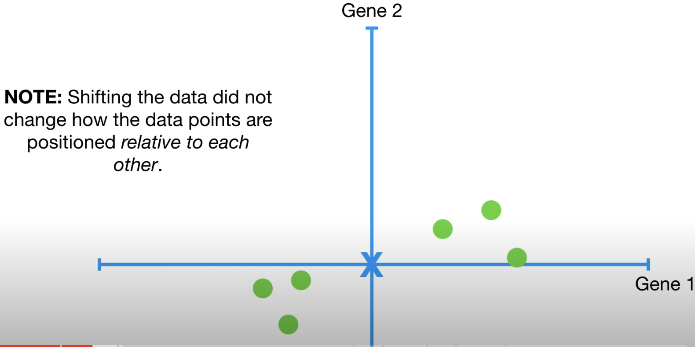
Principal Component Analysis (PCA)
Mean subtraction: shift data to origin (scaling, normalization)
Notes:
Note: on these slides, feel free to use as many or as few photos or other images (logos, screenshots, etc.) as you think are appropriate. You are not limited to three images in this layout pattern. Make it your own! (And take this note off of the slides.)

Slide 13
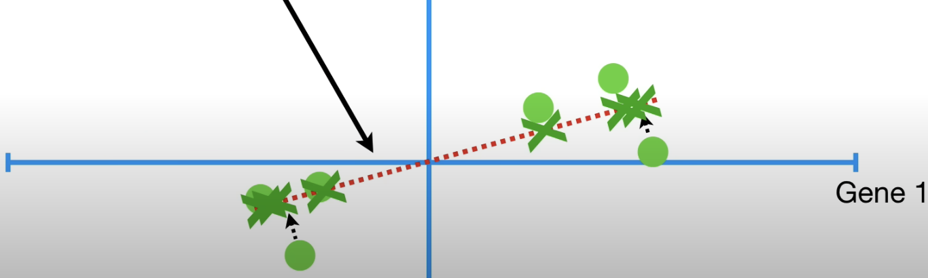
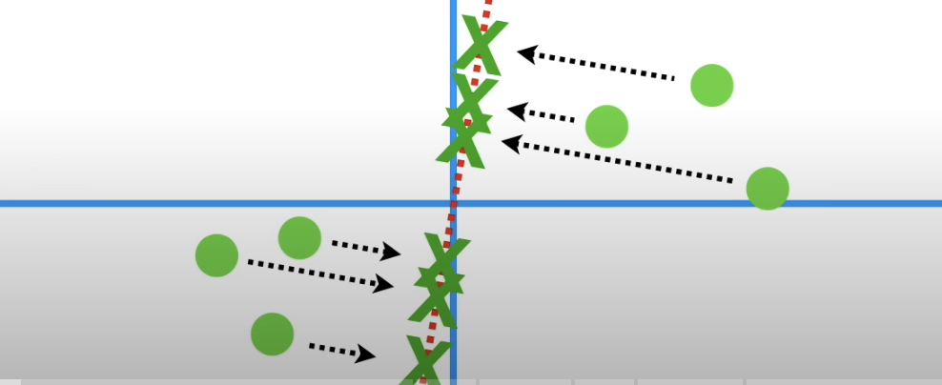
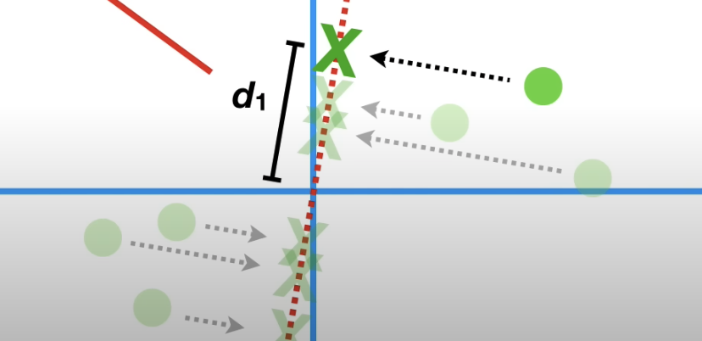
Principal Component Analysis (PCA)
PCA projects data onto this line
Find a line best fit the data.
It has the largest sum of squared distance
Minimize the distance between the data and its projection
Maximize the distance from the projected points to the origin (most variation)
Notes:
Note: on these slides, feel free to use as many or as few photos or other images (logos, screenshots, etc.) as you think are appropriate. You are not limited to three images in this layout pattern. Make it your own! (And take this note off of the slides.)

Slide 14
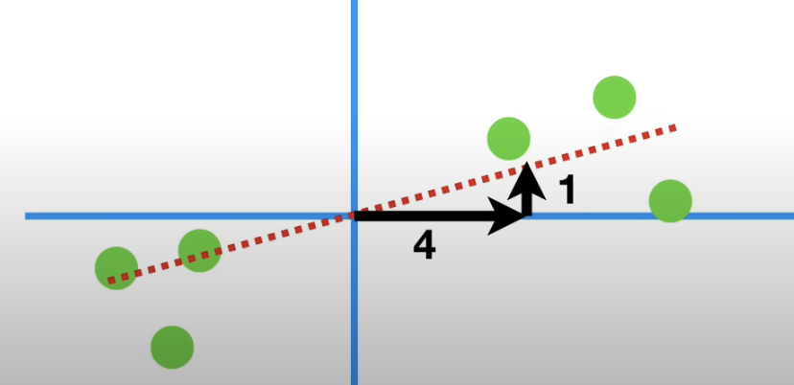
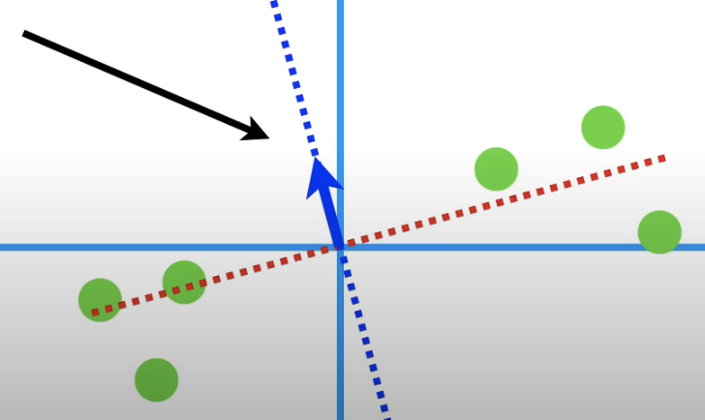
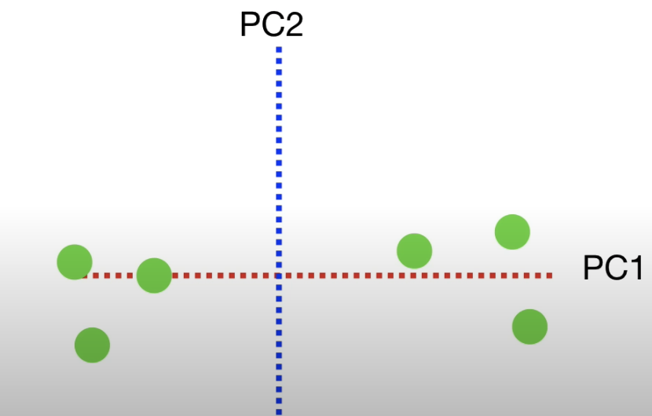
Principal Component Analysis (PCA)
This line is called Principal Component 1 (PC1)
To make PC1, mix 4 parts Gene1 with 1 part Gene 2.
Mathematically, it’s a linear combination of Gene1 and Gene2
Scale the distance to 1, PC1 vector (0.97, 0.242)
also name as Singular vector, or eigenvector of PC1
Similarly, PC2 can be found. It is perpendicular to PC1.
Data plotted in the PC axis
Notes:
Note: on these slides, feel free to use as many or as few photos or other images (logos, screenshots, etc.) as you think are appropriate. You are not limited to three images in this layout pattern. Make it your own! (And take this note off of the slides.)

Slide 15
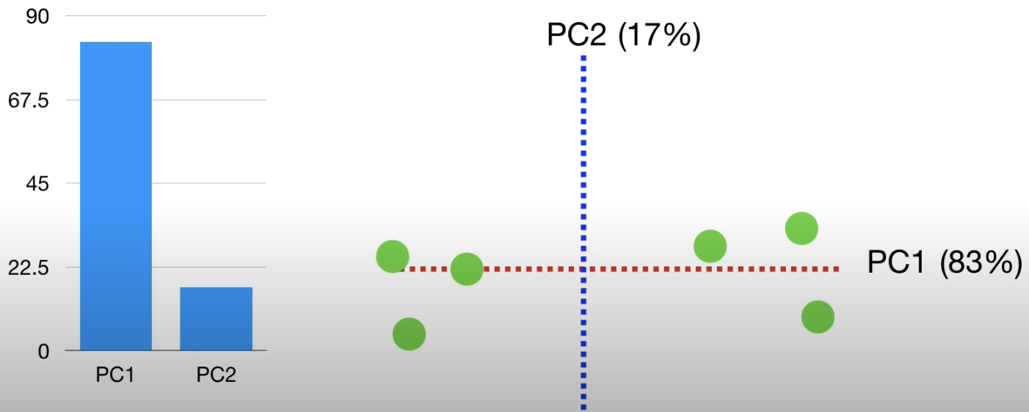
Principal Component Analysis (PCA)
Eigenvalues measure the variation for each PC (distance between projected points to the origin).
Ex. Variation for PC1 (singular value)= 15, the variation for PC2 = 3. Total variation is 18. PC1 accounts 15/18=83% of the total variation. PC1 accounts 3/18= 17%.
PC1 would span the direction of the most variation.
PC2 would span the direction of the 2nd most variation.
…
PCn would span the direction of the n-th most variation.
Notes:
Note: on these slides, feel free to use as many or as few photos or other images (logos, screenshots, etc.) as you think are appropriate. You are not limited to three images in this layout pattern. Make it your own! (And take this note off of the slides.)

Slide 16
PCA algorithm
Dataset
Centered dataset
Covariance matrix of A
Symmetric positive semi-definite
Non-negative real eigenvalues
Each entry quantifies the correlation of the i-th and j-th features across all experiments
Notes:
Note: on these slides, feel free to use as many or as few photos or other images (logos, screenshots, etc.) as you think are appropriate. You are not limited to three images in this layout pattern. Make it your own! (And take this note off of the slides.)

Slide 17
PCA algorithm
The principal components (PCs) are the eigenvectors of C, and they define a change of coordinates in which the covariance matrix is diagonal
The columns of the eigenvector matrix V are the principal components
The elements of the diagonal matrix D are the variances of the data along these directions
Notes:
Note: on these slides, feel free to use as many or as few photos or other images (logos, screenshots, etc.) as you think are appropriate. You are not limited to three images in this layout pattern. Make it your own! (And take this note off of the slides.)

Slide 18
PCA algorithm
The matrix of PCs V is also the matrix of right singular vectors of dataset A
The variance of the data in PC directions (coordinates), given by the diagonal elements of D, is related to the singular values of dataset matrix A
How to choose r ?
cumulative sum of singular values
Notes:
Note: on these slides, feel free to use as many or as few photos or other images (logos, screenshots, etc.) as you think are appropriate. You are not limited to three images in this layout pattern. Make it your own! (And take this note off of the slides.)

Slide 19
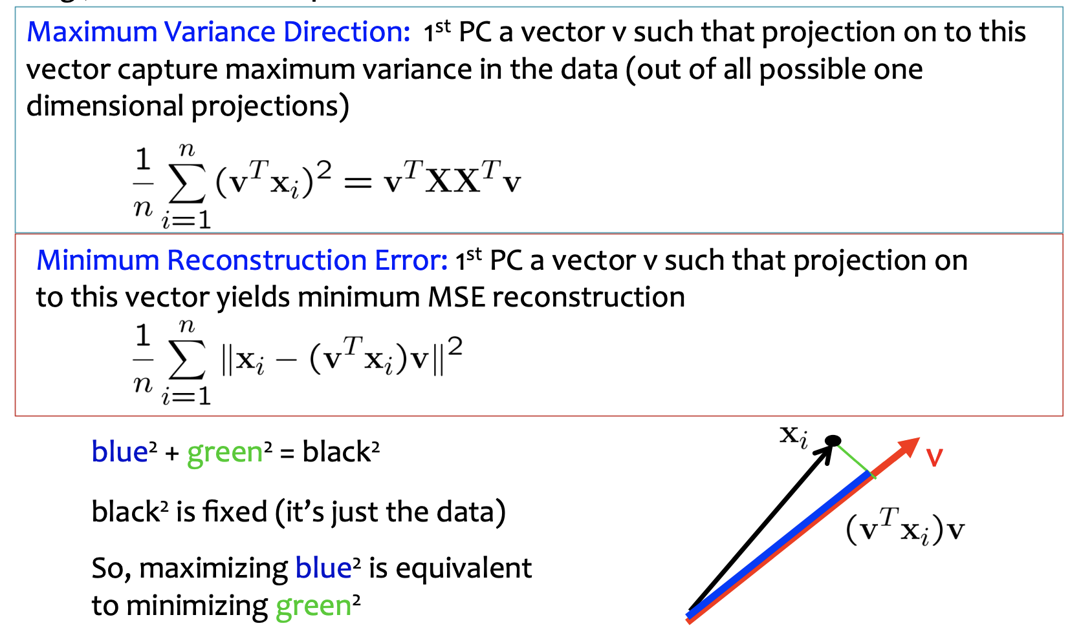
PCA algorithm
Notes:
Note: on these slides, feel free to use as many or as few photos or other images (logos, screenshots, etc.) as you think are appropriate. You are not limited to three images in this layout pattern. Make it your own! (And take this note off of the slides.)

Slide 20
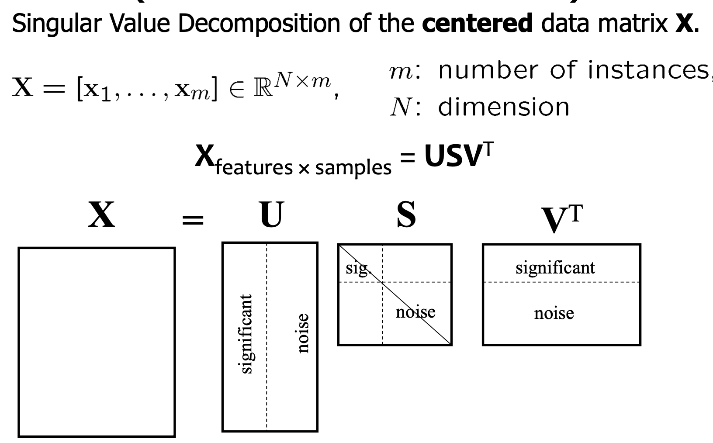
PCA algorithm
Notes:
Note: on these slides, feel free to use as many or as few photos or other images (logos, screenshots, etc.) as you think are appropriate. You are not limited to three images in this layout pattern. Make it your own! (And take this note off of the slides.)

