Slide 1
BDA 411/511
Introduction to Machine Learning
Dr. Xuping Xie
Department of Math & Stat

Slide 2
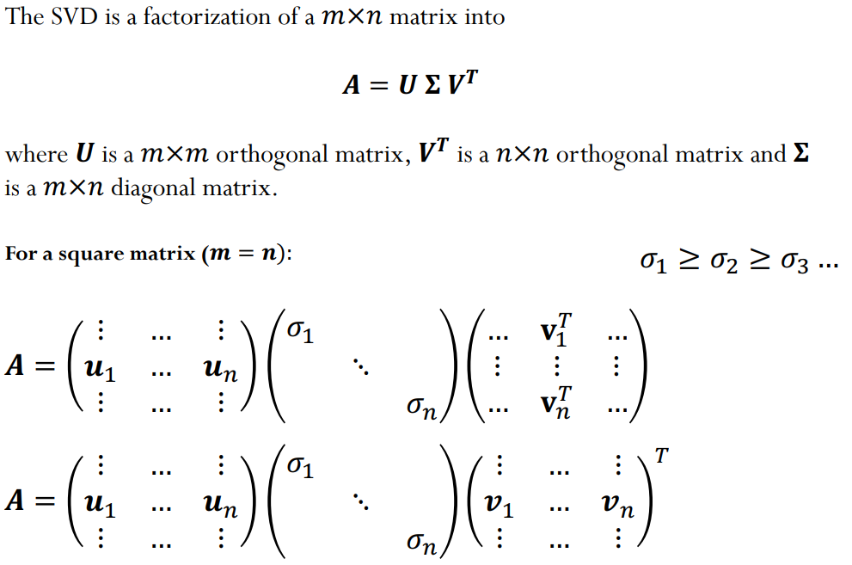
Singular Value Decomposition

Slide 3
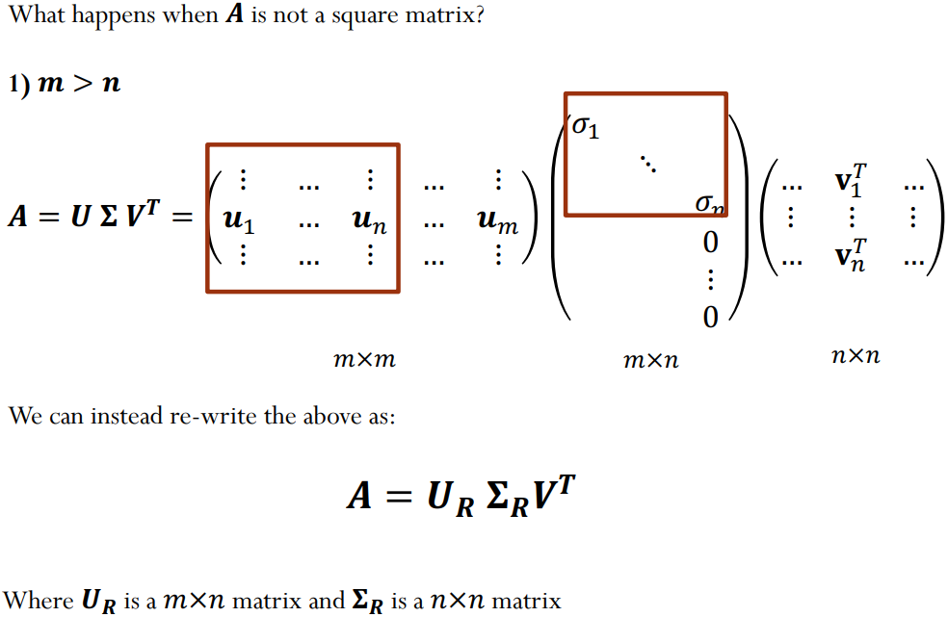
Singular Value Decomposition

Slide 4
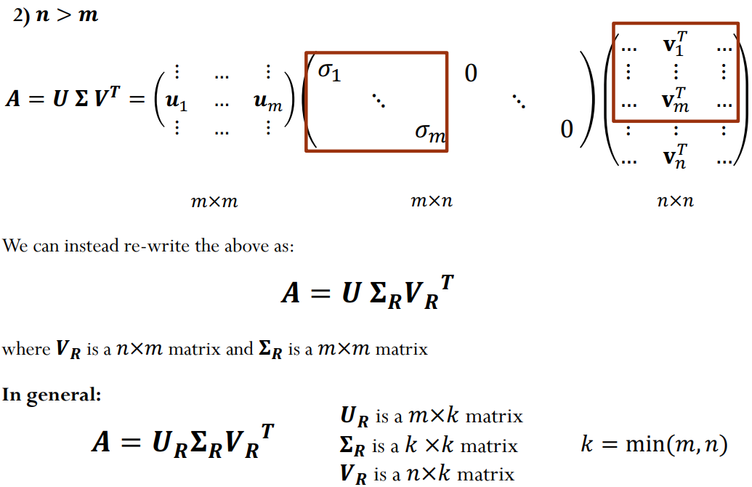
Singular Value Decomposition

Slide 5
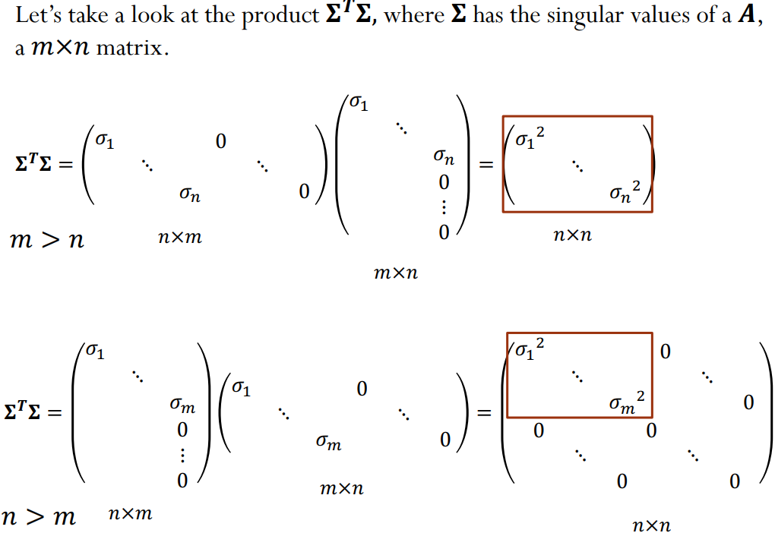
Singular Value Decomposition

Slide 6
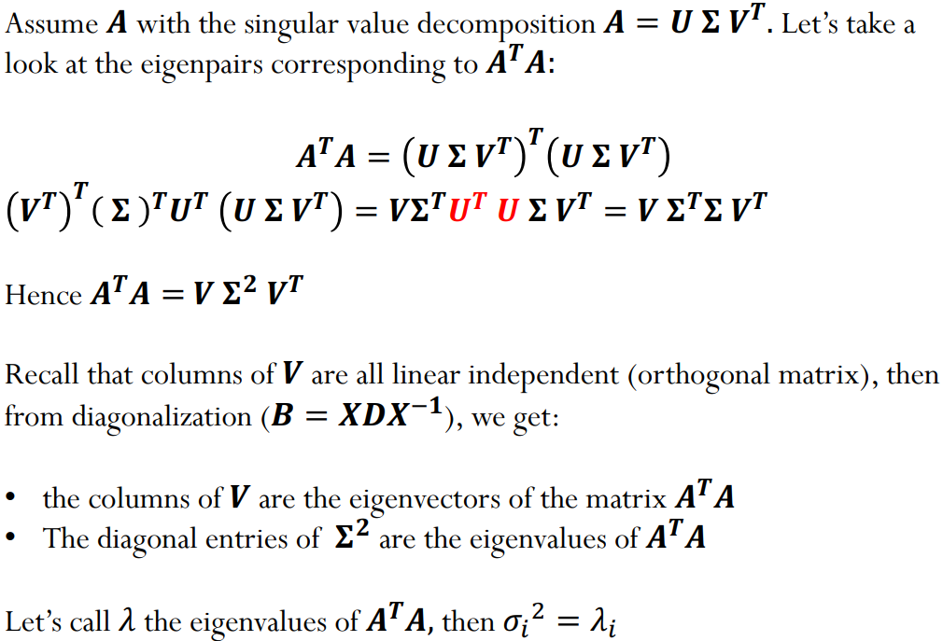
Singular Value Decomposition

Slide 7
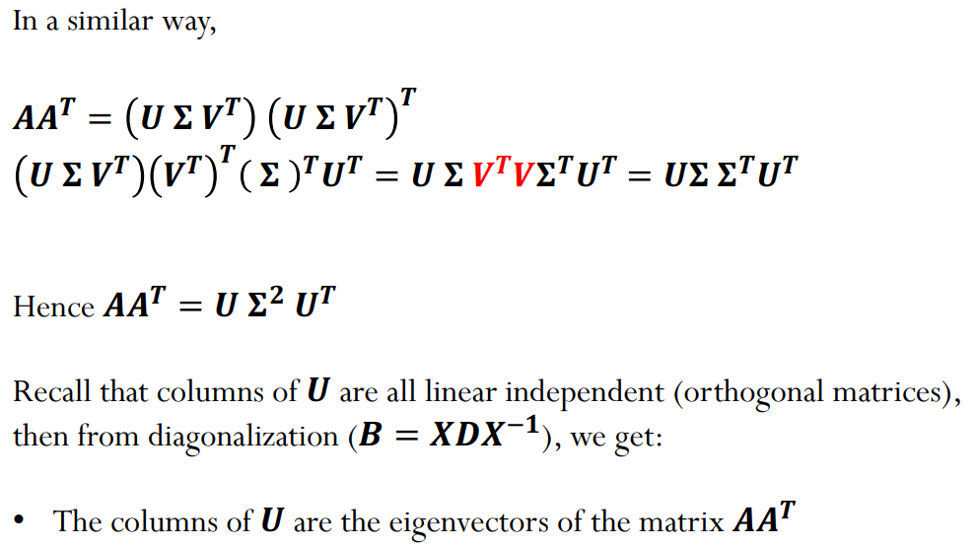
Singular Value Decomposition

Slide 8
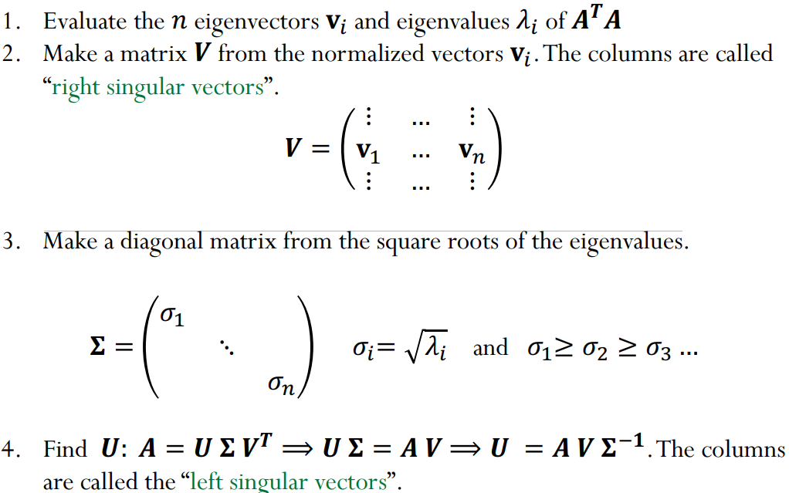
Compute SVD

Slide 9
Thank You

