Slide 1
Week 2: The Dimension of Data
PCA, Numerical Rank, and Perturbation Theory
MATH 616: Computational Linear Algebra
Dr. Xuping Xie - Old Dominion University
Notes:
One question drives both meetings: what is the true dimension of your data, and can you trust that number?

Slide 2
This Week's One Question
What is the true dimension of your data - and can you trust the answer?
Week 1 gave the tool: the SVD orders directions by importance (Eckart-Young).
First - PCA: the spectrum reveals how many dimensions data really uses.
Then - numerical rank: how to read a spectrum and choose the cutoff k.
Then - the pseudoinverse: solving; small singular values turn dangerous.
Finally - perturbation theory: the spectrum is stable under noise.
Notes:
The storyline, stated up front.

Slide 3
Bridge From Week 1
A = UΣVᵀ with σ₁ ≥ σ₂ ≥ ⋯ ≥ 0.
Keeping k terms is the BEST rank-k approximation; error = σₖ₊₁.
In the image compression exercise: a photo at 10-20% storage, little loss.
New question: what if the matrix is a dataset - each row an image, a patient, a snapshot?
Then "how compressible" becomes "how many dimensions does my data occupy." The SVD becomes a scientific instrument: PCA.
Notes:
Recap Eckart-Young; pose the new question.

Slide 4
Motivation: Drowning in Dimensions
Modern data is high-dimensional: images (784 to 10⁶ pixels), gene profiles (~20,000), documents (~10⁵ words).
High dimension hurts:
Statistics: huge samples needed; distances lose meaning.
Computation: cost grows with dimension, often quadratically.
Understanding: humans can look at 2-3 dimensions.
Saving grace: real data rarely fills its space - random pixels never look like a digit. PCA finds the best low-dimensional subspace through the data.
Notes:
Why dimension reduction, before formulas.

Slide 5
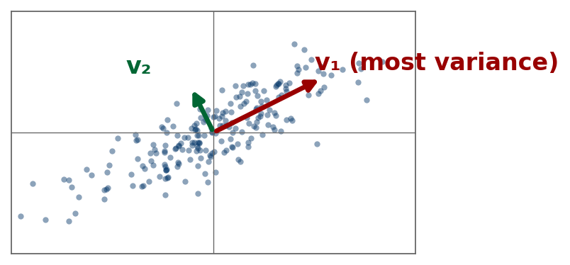
Setup: Data as a Centered Matrix
Given m points x₁, ..., xₘ in ℝⁿ:
Center: subtract the mean from each point; stack as rows of X (m-by-n). Without centering, the top direction just points at the mean.
Covariance: C = XᵀX / (m−1), symmetric positive semidefinite.
Goal: the directions along which the data varies most - the axes of the data cloud, shown at right.
Notes:
Centering and covariance; notation for today.

Slide 6
PCA as an Optimization Problem
First principal direction = the unit vector w maximizing projected variance:
w₁ = argmax over unit w of wᵀCw
Solution: w₁ = top eigenvector of C = top right singular vector v₁ of X.
Later directions maximize variance subject to orthogonality: wₖ = vₖ.
Notes:
Variance maximization; solution = top right singular vector.

Slide 7
PCA = SVD of the Centered Data
If X = UΣVᵀ, everything of PCA is in the factors:
principal directions = columns of V
variance along vᵢ = σᵢ²/(m−1)
k-dimensional representation (scores) = XVₖ = UₖΣₖ
Compute PCA via the SVD of X - never by forming XᵀX explicitly: squaring X squares its rounding sensitivity.
Notes:
The dictionary between PCA language and SVD language.

Slide 8
Example: PCA on Four Points
Centered data: (2, 1), (−2, −1), (1, 0.5), (−1, −0.5) as rows of X.
XᵀX = [ 10 5 ; 5 2.5 ], det = 0, trace = 12.5
Eigenvalues 12.5 and 0, so σ₁ = √12.5 ≈ 3.54, σ₂ = 0, v₁ = (2, 1)/√5.
All four points lie exactly on one line: one component captures 100% of the variance. The data is truly one-dimensional.
Notes:
By hand; exactly rank-1 data.

Slide 9
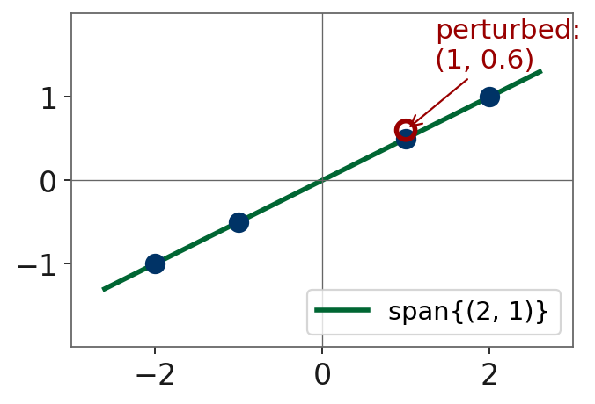
Same Example, Slightly Perturbed
Move the third point from (1, 0.5) to (1, 0.6). Recompute:
σ₁ ≈ 3.55, σ₂ ≈ 0.09 (small but no longer zero)
Is the data now "two-dimensional"?
Formally yes. Honestly no - the second direction is a whisper of noise.
Needed: a principled way to call σ₂ negligible. That is the next topic: numerical rank.
Notes:
Cliffhanger into numerical rank.

Slide 10
How Many Components? Explained Variance
Explained variance of the first k components:
ρₖ = (σ₁² + ⋯ + σₖ²) / (all σᵢ²)
By Eckart-Young, 1 − ρₖ is exactly the relative error of the best rank-k reconstruction: "variance explained" and "approximation error" are one number, two views.
Practical choices: keep ρₖ ≥ 0.90/0.95; look for an elbow or gap; use a noise threshold (next slide).
Notes:
rho_k and its identity with approximation error.

Slide 11
Numerical Rank: Counting Dimensions Honestly
Exact rank is fragile: rounding (~10⁻¹⁶) makes every stored matrix full rank.
The ε-rank: rankε(A) = number of σᵢ above ε,
with ε tied to the noise level (roundoff scale or measurement error).
Why it is right: σₖ₊₁ = distance to the nearest rank-k matrix. So rankε asks: the lowest rank consistent with the data, up to error ε.
In practice: plot σᵢ on a log scale; look for a gap or noise floor.
Notes:
Epsilon-rank definition and its Eckart-Young justification.

Slide 12
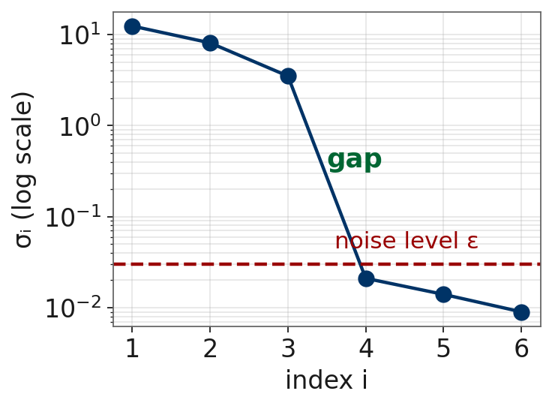
Example: A Spectrum With a Gap
Measured data, noise level ε ≈ 0.03:
σ = (12.4, 8.1, 3.5, 0.021, 0.014, 0.009)
two orders of magnitude between σ₃ = 3.5 and σ₄ = 0.021: a clean gap
the trailing three sit at the noise level - indistinguishable from zero
verdict: rankε = 3. The data supports a 3-dimensional model, no more.
Notes:
Clean case: rank is well-defined.

Slide 13
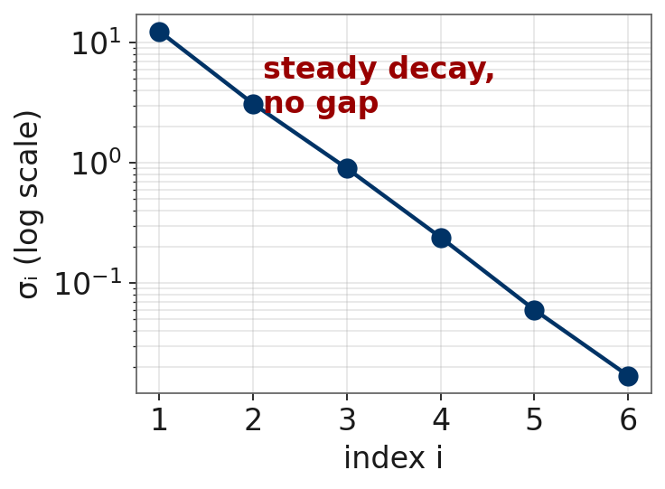
Example: A Spectrum Without a Gap
Same size, different data:
σ = (12.4, 3.1, 0.9, 0.24, 0.06, 0.017)
steady geometric decay - NO gap
rank 2, 3, and 4 are all defensible; numerical rank is genuinely ill-defined
the honest report is the whole spectrum, not one integer
Moral: always look at the spectrum before you trust a rank.
Notes:
Ambiguous case: honesty about ill-defined rank.

Slide 14
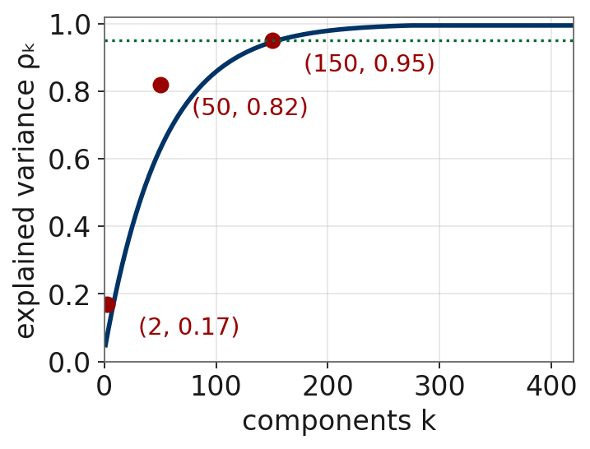
What MNIST's Spectrum Looks Like
Centered MNIST: X is 70,000-by-784. The explained variance curve (approximate) is shown at right.
784 nominal dimensions; ~150 carry 95% of the variance
60-70 directions have exactly zero variance: blank border pixels
ρ₂ = 0.17: a 2D plot shows real structure yet discards 83% of the variance
Notes:
Representative values; students verify when coding.

Slide 15
Coding: PCA on MNIST
NumPy first, then compare to scikit-learn:
1. Center X; compute the reduced SVD (do NOT form XᵀX).
2. Plot the spectrum and ρₖ; find k for 90% and 95%.
3. Show the top 16 directions as 28-by-28 images ("eigendigits").
4. Reconstruct digits at k = 5, 20, 50, 150.
5. Scatter-plot the (v₁, v₂) scores, colored by digit class.
6. Verify against sklearn.decomposition.PCA.
Question: border pixels are almost always zero - where does that show up in the spectrum?
Notes:
Task list for the Python exercise.

Slide 16
Second Application: Systems With No Solution
So far the SVD described data. Now use it to solve with data.
Fitting n parameters to m measurements gives Ax = b with A m-by-n:
sensor calibration: m = 10,000 readings, n = 5 constants
regression: m points, n features; imaging: m detectors, n pixels
m > n: inconsistent, no exact solution - settle for the best compromise.
m < n or dependent columns: infinitely many - choose one sensibly.
Notes:
Pivot from data analysis to solving.

Slide 17
The Moore-Penrose Pseudoinverse
Definition. A⁺ = V̂ Σ̂⁻¹ Ûᵀ = sum of (1/σᵢ) vᵢuᵢᵀ over i = 1..r
A square invertible: A⁺ = A⁻¹
A full column rank: A⁺ = (AᵀA)⁻¹Aᵀ
x = A⁺b: among all x minimizing ‖Ax − b‖₂, the shortest one (how lstsq thinks)
Structure: A sends vᵢ to σᵢuᵢ; A⁺ sends uᵢ back to (1/σᵢ)vᵢ, and kills anything outside range(A).
Notes:
Definition; special cases; least squares meaning.

Slide 18
Example: A Pseudoinverse by Hand
A = [ 1 1 ; 1 1 ; 0 0 ] (3-by-2, rank 1): σ₁ = 2, u₁ = (1,1,0)/√2, v₁ = (1,1)/√2.
A⁺ = (1/σ₁) v₁u₁ᵀ = (1/4) [ 1 1 0 ; 1 1 0 ]
A⁺A = (1/2)[ 1 1 ; 1 1 ]: not I - the orthogonal projector from last week's example!
b = (1, 1, 5): A⁺b = (1/2, 1/2) - the third component is outside range(A); A⁺ ignores it
Notes:
Rank-1 rectangular; A+A is last week's projector.

Slide 19
The Danger: Small σ Amplify Noise
The smallest σᵢ of A become the largest amplifiers in A⁺.
If σᵣ = 10⁻¹², components along uᵣ get multiplied by 10¹².
noise aligned with small-σ directions explodes: ill-posed inverse problems
fix 1 - truncate (TSVD), cutting at the numerical rank
fix 2 - regularize (ridge / Tikhonov)
In PCA, small σᵢ were merely unimportant. In solving, they are dangerous. Same spectrum, higher stakes.
Notes:
1/sigma coefficients; ill-posedness; TSVD and regularization fixes.

Slide 20
Example: Noise Amplification
Let σ₁ = 1, σ₂ = 10⁻⁶. Clean data b = u₁ gives A⁺b = v₁. Perfect.
Add 0.1% noise: b̃ = u₁ + 10⁻³u₂. Then:
A⁺b̃ = v₁ + (10⁻³/10⁻⁶) v₂ = v₁ + 1000 v₂
A 0.1% data error produced a solution that is 99.9% noise.
TSVD rescue: drop the σ₂ term - give up the unresolvable part, keep a stable answer for the rest. This trade-off (resolution vs. stability) is the heart of regularization.
Notes:
sigma = (1, 1e-6): a 0.1% error becomes 99.9% noise.

Slide 21
The Loose Thread
Everything today was one act: read the spectrum, cut it.
PCA keeps large σᵢ; numerical rank counts σᵢ above noise; TSVD discards the dangerous small ones.
The loose thread: your matrix is itself noisy - resampling, remeasuring, even floating point storage changes X slightly. If small perturbations could scramble the σᵢ, every cut we made was arbitrary.
Next: prove the spectrum cannot be scrambled - σᵢ move at most as far as the perturbation.
Notes:
Explicit handoff: everything rested on the spectrum.

Slide 22
Motivation: A Skeptic's Challenge
Earlier: ~150 components carry 95% of MNIST's variance. A skeptic:
"Collect 70,000 different digits tomorrow and every entry of X changes. Why should the spectrum, the rank, or the eigendigits survive?"
Not hypothetical: noise perturbs every data matrix, and rounding perturbs every stored one (‖E‖ ≈ 10⁻¹⁶‖A‖). We never compute with A - always with A + E.
If σᵢ could move arbitrarily under small E, everything so far is numerology. Today we prove they cannot.
Notes:
Frame perturbation theory as answering a concrete objection.

Slide 23
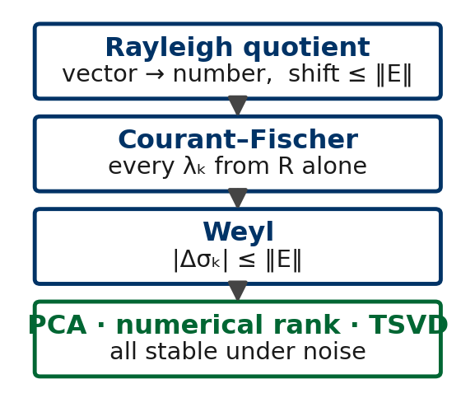
The Proof Strategy:
Goal: prove |σₖ(X + E) − σₖ(X)| ≤ ‖E‖₂.
Obstacle: σₖ and λₖ are defined through their vectors (Sq = λq) - and E scrambles vectors.
So the proof climbs three rungs:
1. Rayleigh quotient: vectors → numbers, shifting ≤ ‖E‖₂
2. Courant-Fischer: every λₖ from those numbers alone
3. Weyl: combine - the spectrum is stable
Notes:
Roadmap of the perturbation block so every piece has a stated role.

Slide 24
Rayleigh Quotient:
Eigenvalues are defined through eigenvectors: Sq = λq. But eigenvectors are exactly what noise scrambles - when two eigenvalues are close, a tiny E can rotate their eigenvectors completely.
The fix: remove the eigenvector from the eigenvalue idea. EVERY vector x reports a number R(x); if x happens to be an eigenvector, R(x) is its eigenvalue.
You have already used it: PCA's "variance along w" is R(w) with S = C. Maximizing variance WAS maximizing a Rayleigh quotient - we just never said the name.
Its superpower here: changing S by E changes R(x) by at most ‖E‖₂ - for every x at once. That gentle behavior is rung 1.
Notes:
Rung 1: the eigenvalue idea with the eigenvector removed; anchored backward to PCA and forward to Weyl.

Slide 25
Rayleigh Quotient: Definition
Definition. For symmetric S and x ≠ 0: R(x) = xᵀSx / xᵀx
In the eigenbasis, R(x) is a weighted average of the eigenvalues - so λ₁ = max R(x) and λₙ = min R(x): the extreme eigenvalues with no eigenvectors in sight.
Perturbation-friendly: R for S+E = R for S + xᵀEx/xᵀx, and |xᵀEx|/xᵀx ≤ ‖E‖₂. Every value of R shifts by at most ‖E‖₂ - rung 1, proved in one line.
Bonus meaning: R(x) is the least squares fit of α in Sx ≈ αx.
Remaining question: what about the INTERIOR eigenvalues λ₂, ..., λₙ₋₁? Neither max nor min reaches them.
Notes:
The formula, the weighted-average reading, and max/min.

Slide 26
The Rayleigh Quotient
For symmetric S with eigenvalues λ₁ ≥ ⋯ ≥ λₙ:
R(x) = xᵀSx / xᵀx
Writing x in the eigenbasis: R(x) is a weighted average of the λᵢ.
So λ₁ = max R(x) and λₙ = min R(x).
You have already used this: variance along w is a Rayleigh quotient with S = C.
Notes:
Definition; weighted average; ties back to PCA.

Slide 27
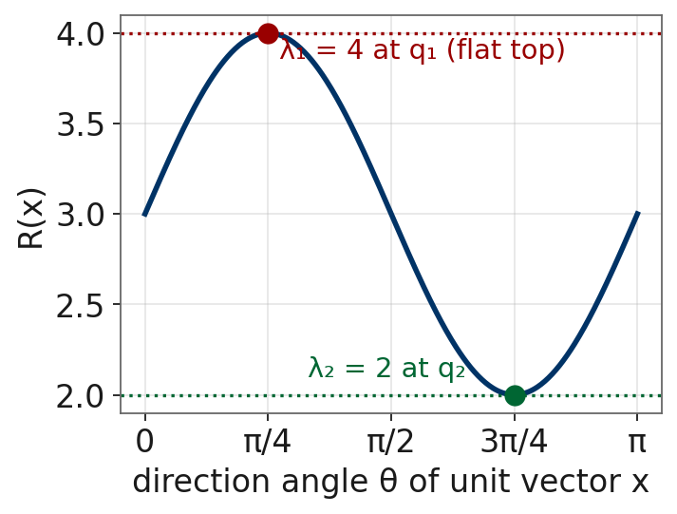
Example: Rayleigh Quotients
S = [ 3 1 ; 1 3 ]: λ₁ = 4 at q₁ = (1,1)/√2; λ₂ = 2 at q₂ = (1,−1)/√2.
R(q₁) = 4 (max); R(q₂) = 2 (min)
R(e₁) = 3: the average of 4 and 2
flat extrema: for x = q₁ + εq₂, R = 4 − 2ε² + O(ε⁴)
An O(ε) vector error costs only O(ε²) in the value - why Rayleigh-based algorithms converge so fast.
Notes:
Concrete 2x2; flatness near eigenvectors.

Slide 28
Rayleigh Quotient: Applications
This week's use: rung 1 of the stability ladder - the raw material that Courant-Fischer and Weyl are built from.
PCA: variance along any direction is a Rayleigh quotient of the covariance.
Eigenvalue estimation: iterative eigenvalue methods turn their current vector into a value via R(x) - the flatness is why those estimates are so accurate.
Physics and engineering: energy of a state; fundamental frequencies of a structure are Rayleigh quotients of stiffness against mass.
Notes:
Where R(x) is used.

Slide 29
The Courant-Fischer Min-Max Theorem
Theorem. λₖ = max over k-dim subspaces V of ( min over x in V of R(x) )
The best worst-case Rayleigh quotient over k-dimensional subspaces; the optimum is span{q₁, ..., qₖ}.
Why it matters: each λₖ is characterized with no reference to eigenvectors or other eigenvalues - so the characterization survives perturbing S.
Singular value version (apply to S = AᵀA): σₖ(A) = max over k-dim V of min over x in V of ‖Ax‖/‖x‖.
Notes:
Interior eigenvalues without eigenvectors; the stability engine.

Slide 30
Example: Courant-Fischer on diag(5, 3, 1)
Claim: λ₂ = 3 is the best worst-case R over 2-dimensional subspaces.
span{e₁, e₂}: worst case e₂, min R = 3. Optimal.
span{e₁, e₃}: worst case e₃, min R = 1. Worse.
tilted plane span{e₁, (e₂+e₃)/√2}: min R = 2. Worse.
Obstruction: every 2D subspace meets span{e₂, e₃} (2 + 2 > 3), and there R ≤ 3 - no clever subspace beats 3.
This dimension-counting trick IS the proof - and Weyl's, next.
Notes:
Candidate subspaces; dimension-counting is the proof.

Slide 31
Weyl: Spectra Are Perfectly Conditioned
Theorem (Weyl). |σₖ(A + E) − σₖ(A)| ≤ ‖E‖₂ for every k (and likewise λₖ for symmetric matrices).
Proof idea: sandwich Rayleigh quotients, then apply Courant-Fischer with the SAME subspaces on both sides.
A perturbation of size ε moves every singular value by at most ε. No amplification, ever.
Contrast: eigenvalues of nonsymmetric matrices can be violently sensitive - the symmetry behind Courant-Fischer is doing real work.
Notes:
The perturbation bound; contrast with nonsymmetric matrices.

Slide 32
Example: Weyl in Action
S = diag(5, 3, 1); add E coupling the first two coordinates, ‖E‖₂ = 0.1:
S + E = [ 5 0.1 0 ; 0.1 3 0 ; 0 0 1 ]
Exact eigenvalues: 4 ± √1.01 and 1, i.e. 5.005..., 2.995..., 1.
actual shifts ≈ 0.005 - all far within the guarantee of 0.1
the bound is the worst case; well-separated eigenvalues move ~ ‖E‖²/gap, much less
Notes:
Exact shifts vs the bound; gap damping.

Slide 33
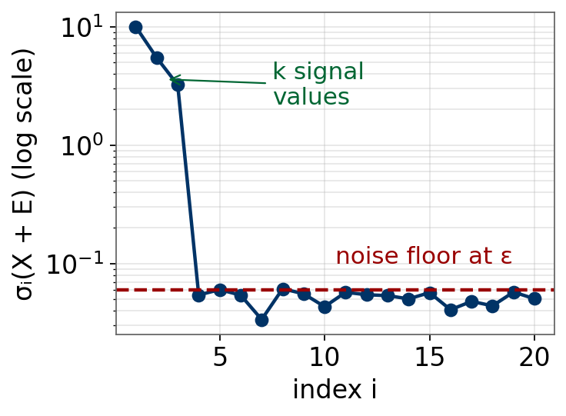
Answering the Skeptic
Data = signal + noise: X̃ = X + E, rank(X) = k, ‖E‖₂ = ε. By Weyl:
σᵢ(X̃) ≥ σᵢ(X) − ε for i ≤ k; σᵢ(X̃) ≤ ε for i > k
strong signal: k large values, a gap, a noise floor at ε
numerical rank detects the true k; truncation is stable
if σₖ(X) ≈ ε: genuinely hard for any algorithm
The decay-plus-tail picture from your coding exercises IS this theorem in action.
Notes:
Weyl assembled into the signal-plus-noise picture.

Slide 34
Scientific Computing: POD
PCA in scientific computing is called Proper Orthogonal Decomposition.
Simulations produce snapshots: the flow field at many times, each with 10⁶+ grid values. Stack, center, take the SVD:
vᵢ = POD modes: coherent flow structures; σᵢ² = kinetic energy of mode i
a handful of modes often carries 95%+ of the energy
projecting the equations onto them gives a tiny, fast surrogate model
Same theorem as the eigendigits - different community, same SVD. Active research in our department; ask me if curious.
Notes:
PCA under another name; soft research pitch.

Slide 35
Summary: The Ladder, Climbed
PCA = SVD of centered data; the spectrum is the data's true dimension.
Numerical rank: count σᵢ above the noise - trust it only across a gap.
Pseudoinverse: solving via 1/σᵢ - small singular values turn dangerous.
Courant-Fischer + Weyl: perturbations of size ε move every σᵢ by at most ε.
So gaps, ranks, and cutoffs are stable - the skeptic is answered.
Next class: Schur decomposition, spectral theorem, positive semidefinite matrices, Gershgorin disks. Reading: Horn & Johnson Ch. 2, 7.1-7.2.
Notes:
Restate the throughline; next class.

