Slide 1
End-to-end radiation therapy optimization
Qifan

Slide 2
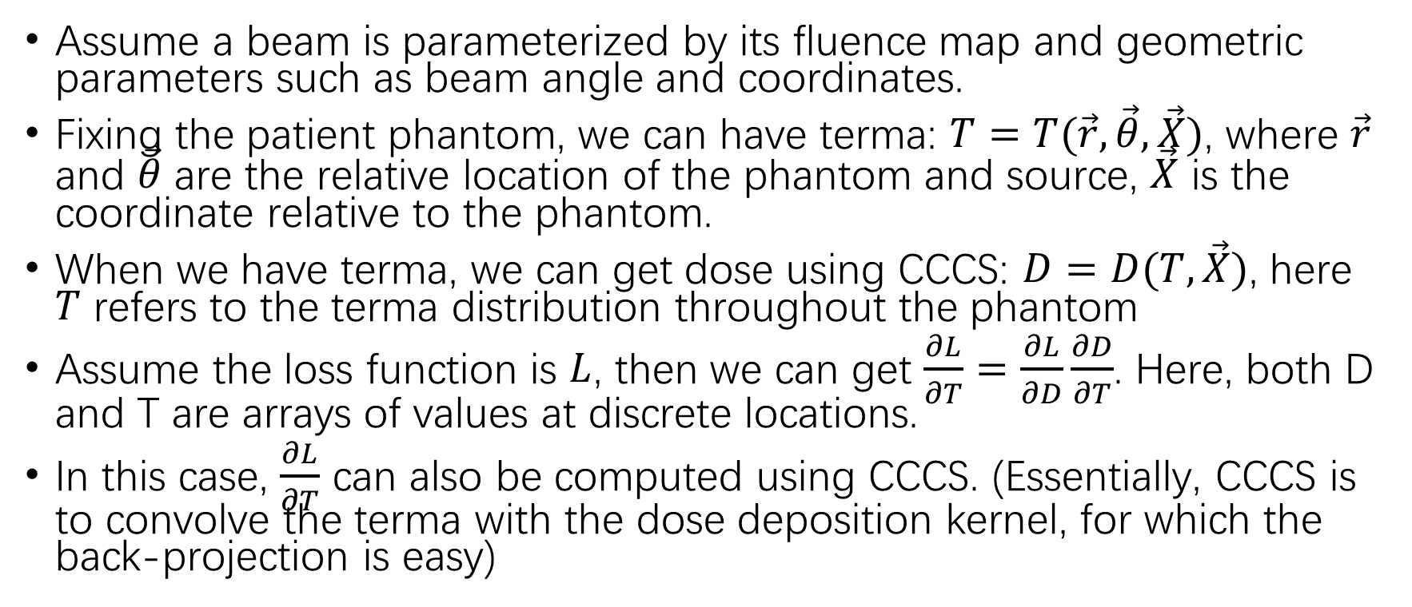
Chain rule
Assume a beam is parameterized by its fluence map and geometric parameters such as beam angle and coordinates.
Fixing the patient phantom, we can have terma: $T=T(\vec{r}, \vec{θ}, \vec{X})$, where $\vec{r}$ and $\vec{θ}$ are the relative location of the phantom and source, $\vec{X}$ is the coordinate relative to the phantom.
When we have terma, we can get dose using CCCS: $D=D(T,\vec{X})$, here $T$ refers to the terma distribution throughout the phantom
Assume the loss function is $L$, then we can get $\frac{∂L}{∂T}=\frac{∂L}{∂D}\frac{∂D}{∂T}$. Here, both D and T are arrays of values at discrete locations.
In this case, $\frac{∂L}{∂T}$ can also be computed using CCCS. (Essentially, CCCS is to convolve the terma with the dose deposition kernel, for which the back-projection is easy)

Slide 3
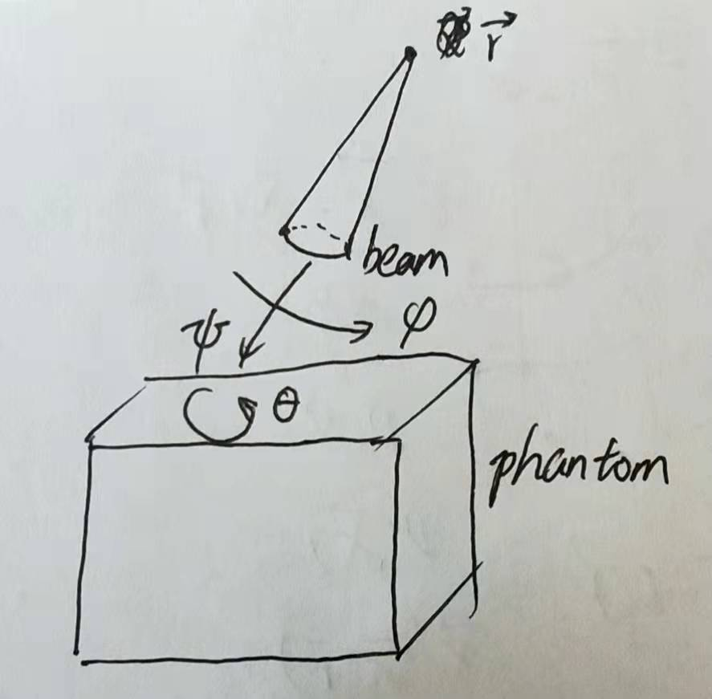

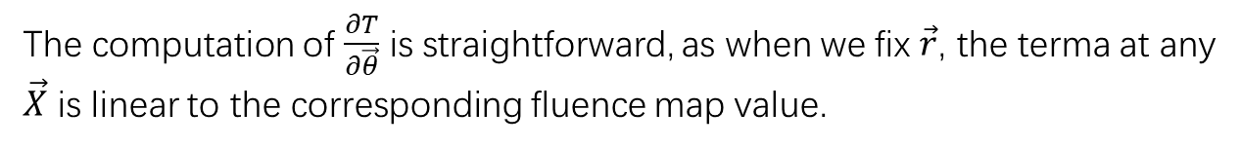
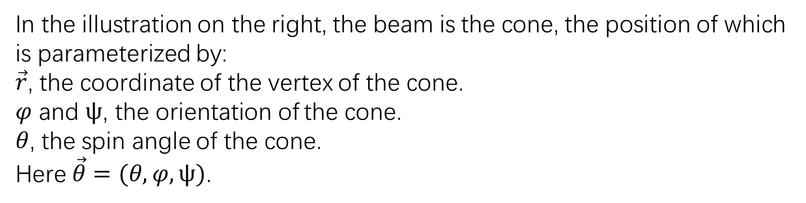
Chain rule
So now, the problem is to calculate $\frac{∂}{∂\vec{r}}T(\vec{r},\vec{θ}, \vec{X})$ and $\frac{∂}{∂\vec{θ}}T\left(\vec{r},\vec{θ}, \vec{X}\right)$.
In the illustration on the right, the beam is the cone, the position of which is parameterized by:
$\vec{r}$, the coordinate of the vertex of the cone.
$φ$ and $ψ$, the orientation of the cone.
$θ$, the spin angle of the cone.
Here $\vec{θ}=(θ,φ,ψ)$.
The computation of $\frac{∂T}{∂\vec{θ}}$ is straightforward, as when we fix $\vec{r}$, the terma at any
$\vec{X}$ is linear to the corresponding fluence map value.

Slide 4
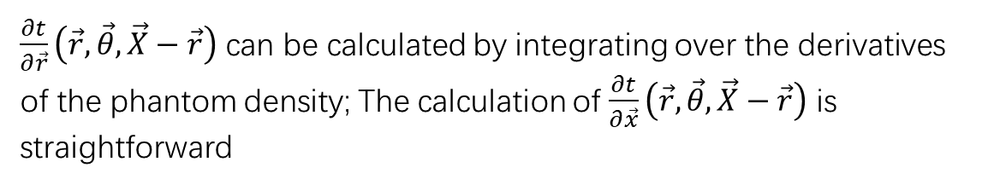
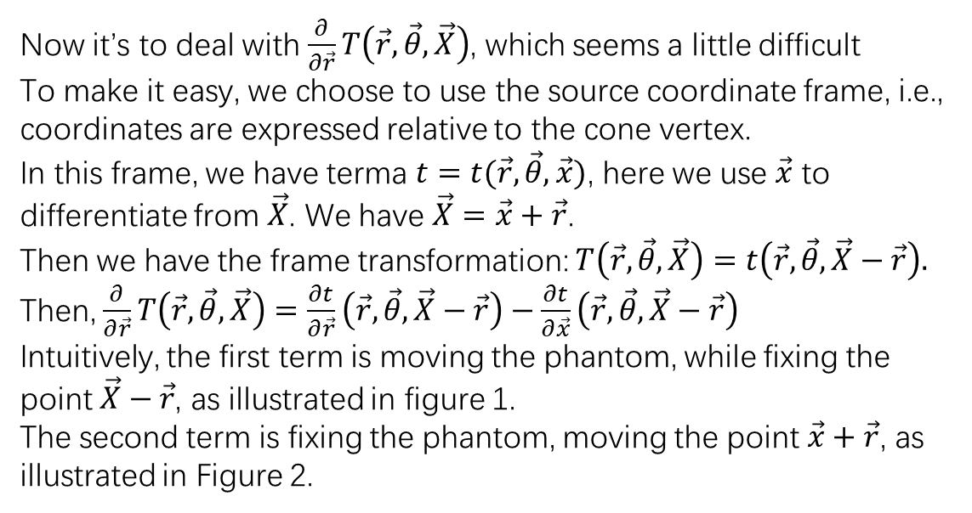

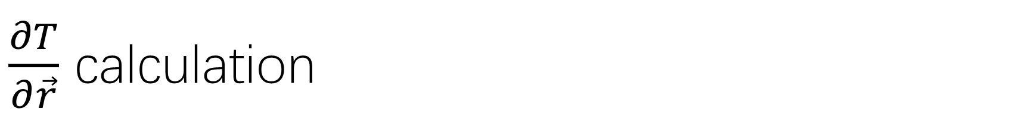



$\frac{∂T}{∂\vec{r}}$ calculation
beam
Now it’s to deal with $\frac{∂}{∂\vec{r}}T\left(\vec{r},\vec{θ}, \vec{X}\right)$, which seems a little difficult
To make it easy, we choose to use the source coordinate frame, i.e., coordinates are expressed relative to the cone vertex.
In this frame, we have terma $t=t(\vec{r},\vec{θ}, \vec{x})$, here we use $\vec{x}$ to differentiate from $\vec{X}$. We have $\vec{X}=\vec{x}+\vec{r}$.
Then we have the frame transformation: $T\left(\vec{r},\vec{θ}, \vec{X}\right)=$ $t\left(\vec{r},\vec{θ}, \vec{X}−\vec{r}\right).$
Then, $\frac{∂}{∂\vec{r}}T\left(\vec{r},\vec{θ}, \vec{X}\right)=$ $\frac{∂t}{∂\vec{r}}\left(\vec{r},\vec{θ},\vec{X}−\vec{r}\right)−\frac{∂t}{∂\vec{x}}\left(\vec{r},\vec{θ}, \vec{X}−\vec{r}\right)$
Intuitively, the first term is moving the phantom, while fixing the point $\vec{X}−\vec{r}$, as illustrated in figure 1.
The second term is fixing the phantom, moving the point $\vec{x}+\vec{r}$, as illustrated in Figure 2.
$$\vec{X}−\vec{r}$$
phantom
$$d\vec{r}$$
Figure 1
beam
$$\vec{X}−\vec{r}$$
$$d\vec{X}$$
phantom
$\frac{∂t}{∂\vec{r}}\left(\vec{r},\vec{θ},\vec{X}−\vec{r}\right)$ can be calculated by integrating over the derivatives of the phantom density; The calculation of $\frac{∂t}{∂\vec{x}}\left(\vec{r},\vec{θ},\vec{X}−\vec{r}\right)$ is straightforward
Figure 2

Slide 5
Step 1
To verify the correctness of the optimization method
Settings
A prescribed 2d dose map (A), number of beams (B).
To simplify the computation, instead of using the ray-tracing based terma calculation, we assume the beam comes perpendicular to A, and with a square aperture.
Each beam is depicted by two parameters: x, its relative location to A; and its fluence map f.
In particular, each beam has only a finite receptive field, but we aim to achieve the global minimum

Slide 6
Step 1
Each beam can be viewed as a point lattice, each point carries the corresponding fluence map value
The current dose map can also be viewed as a point lattice
Current dose map is represented by blue dots
Beam is represented by yellow dots
The boundary dots take the value 0
The current dose map values are calculated with interpolation (maybe bilinear, maybe B spline)
To minimize the difference between the current dose map and the prescribed dose map, both the beam fluence map and its relative position are updated
The reason to set the beam boundary to 0 is to make the fluence map “see” the boundary points of the current dose map, otherwise it only sees the interior points, resulting in local minimum

Slide 7
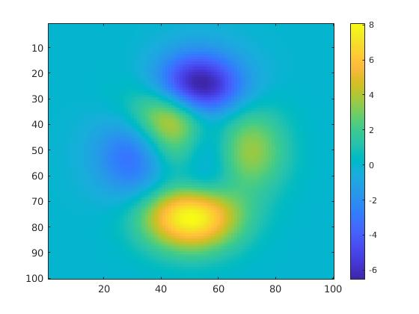
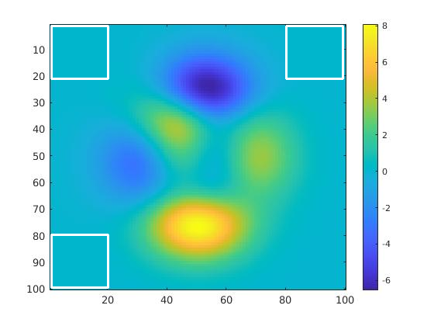
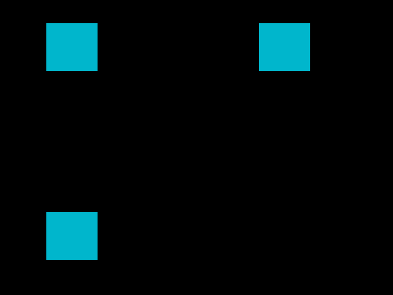
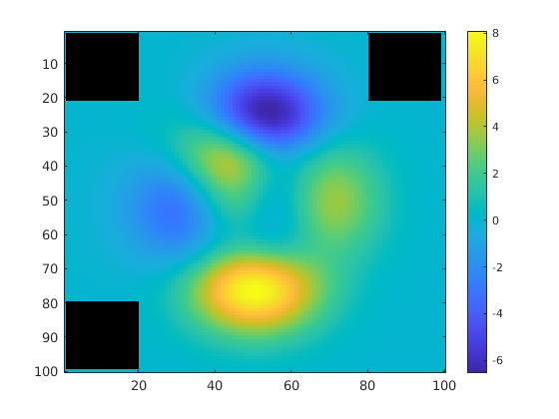
Step 1 anticipated result
Assume the prescribed dose map is like figure (a) (it has minus values, but just accept it).
Then the initial beam positions are shown as in figure (b), initial fluence map is 0.
The current dose map is like in figure (c)
The difference between the current dose map and prescribed dose map is shown in figure (d). Apparently, the difference is significant, we aim to minimize it by updating both fluence map and beam position.
(a)
(b)
(c)
(d)

Slide 8
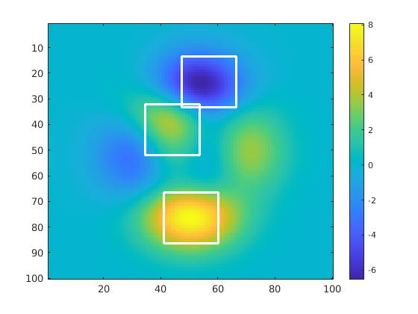
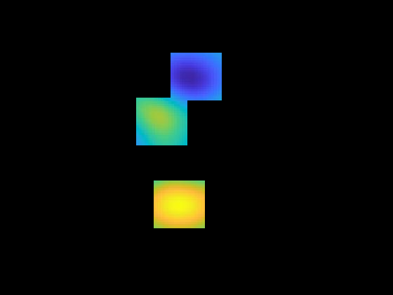
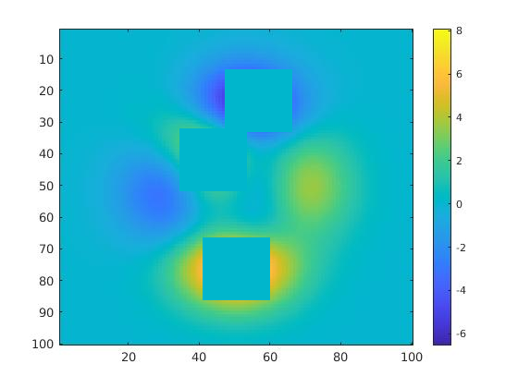
Step 1 anticipated result
After optimization, we anticipate the three beams to cover the 3 most conspicuous peaks and valleys, as shown in figure (e).
The resulting current dose map is shown in figure (f)
The deviation from the prescribed dose is shown in figure (g)
In other words, the aim of step 1 is to ensure that the beam can move to cover the most conspicuous dose areas, instead of staying there minimizing only on its receptive field
(e)
(f)
(g)

Slide 9
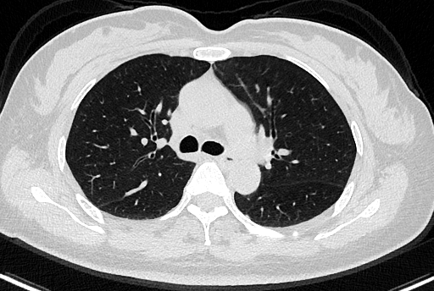
Step 2
If step 1 works, it means the optimization approach and the interpolation method work, then we go to the step 2
For the second step, we still use a 2D setting, but the beam is within the same plane, instead of perpendicular to the plane in Step 1
Also, for simplicity, we only consider the terma calculation, or in other words, we only consider the exponential attenuation and reverse square law, without considering the electron transport.
For each beam, apart from the fluence map, the position of the beam is only of 1 degree of freedom. Or we assume the beam is moving with a fixed SID, the beam direction is of radial direction
We give an initial beam position as shown in the left figure, then collectively update the fluence map and beam position

Slide 10
Step 3
If step 2 works, we can come to 3d setting, add more degrees of freedom, consider the dose deposition

Slide 11
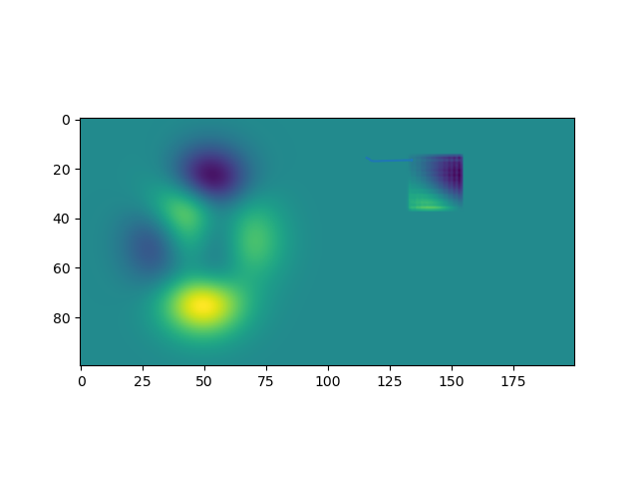
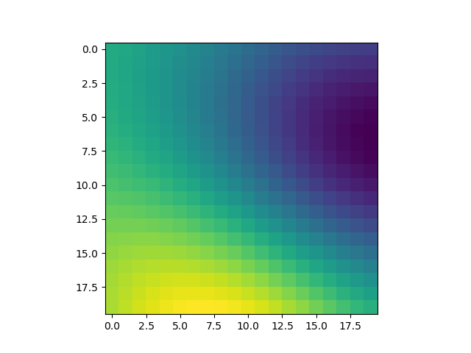
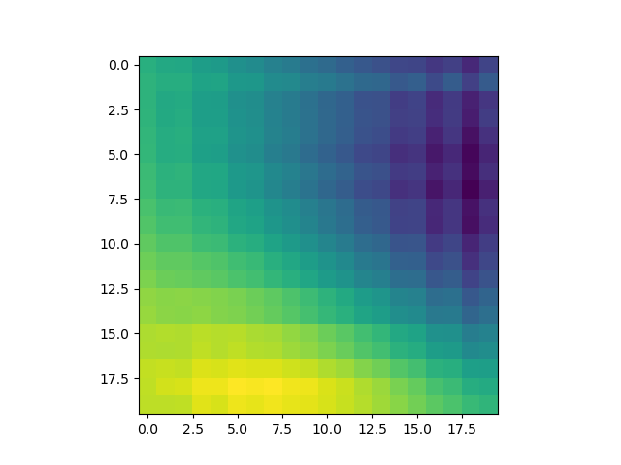
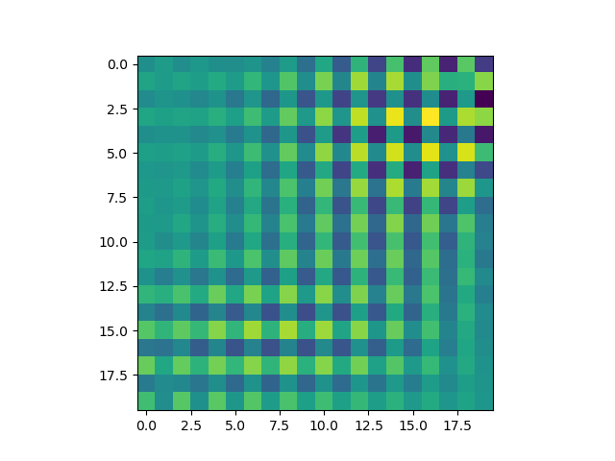
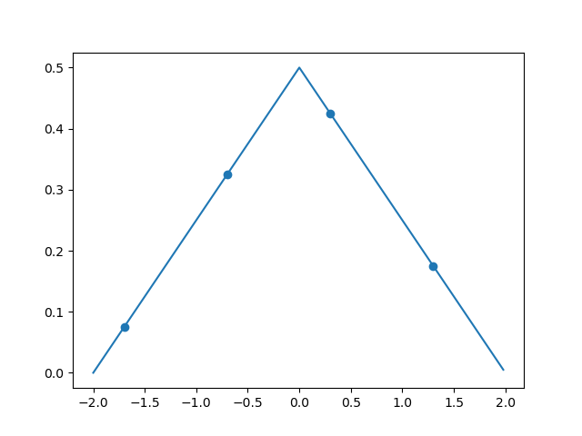
Step 1 results
Task: to cover the most of the “dose map” with a window of finite size
Original fluence map
Convolution result
“fluence map”
f(x)+f(x+1)+f(x+2)+f(x+3) = 1
Increases in [-2, 0]
Decreases in [0, 2]
Receptive field size: 4
Convolution kernel function:

Slide 12
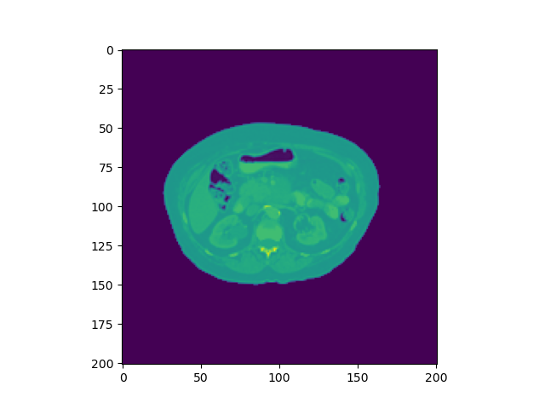
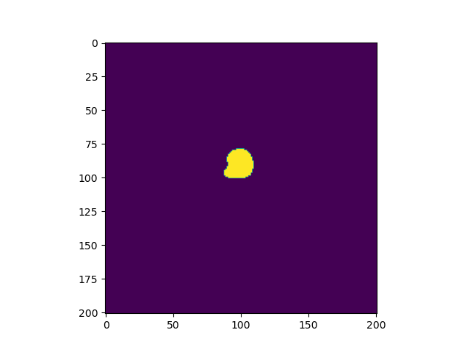
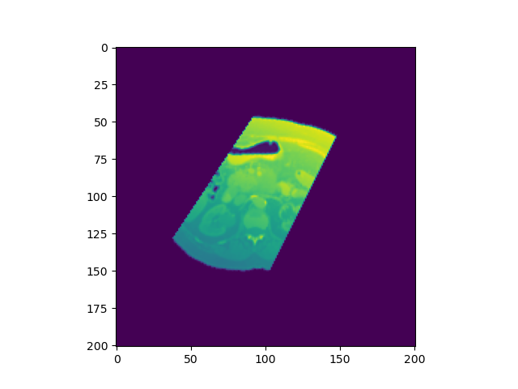
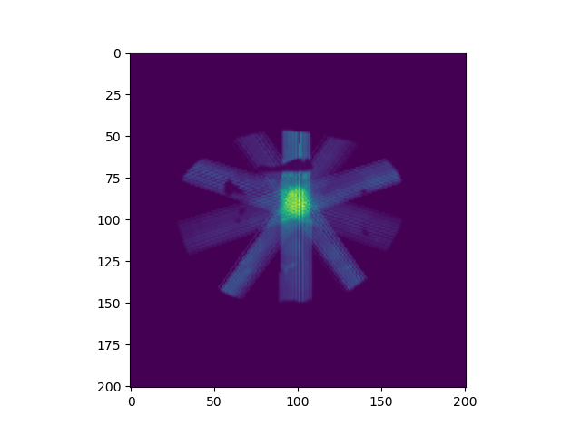
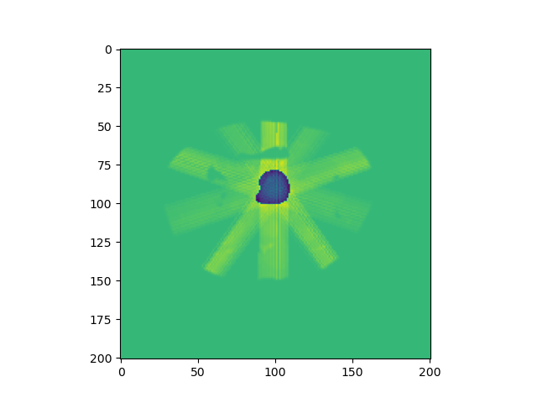
Step 2 results
Patient phantom
Pancreas PTV
Terma of a uniform beam
(provided by Pav)
Optimization result of 5 beams in normal pentagon configuration, without optimizing the orientation (some artifacts)
(the save weight between PTV and OAR)
error

Slide 13
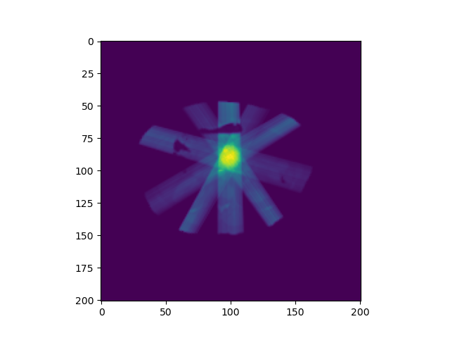
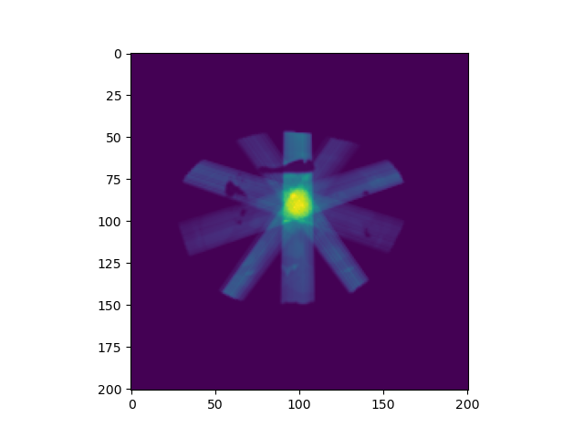
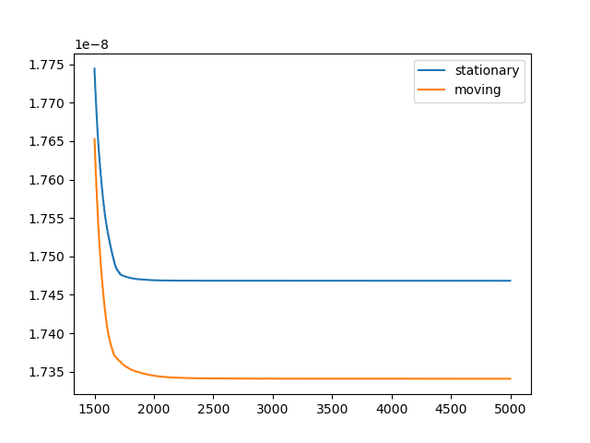
Step 2 results
moving
stationary
losses
5 beams, 1000 iterations, 5000 steps. According to the loss curve, seems 2500 steps suffices
The total optimization time was 5:56
One of the possible improvement is that, we could only count a portion of the ray tracing, while we considered all
One thing to notice is that, it’s only Terma calculation, a larger overhead would be dose deposition.

Slide 14
Step 3 program design
Input parameters:
Phantom dimension
Phantom voxel size
Phantom isocenter
Phantom file path
PTV weight file path
PTV target file path
OAR weight file path
OAR target file path
Beam energy
SAD
Number of beams
Fluence map dimension
Fluence map pixel size
Fluence map output file path
Zenithal angle range
Each beam has:
Zenith angle (float)
Azimuth angle (float)
Fluence map host (float*)
Fluence map device (pitched)
Terma map BEV host (float*)
Terma map BEV device (surface)
Terma map PVCS host (float*)
Terma map PVCS x dominant device (pitched)
Terma map PVCS y dominant device (pitched)
Terma map PVCS z dominant device (pitched)
Dose map host (float*)
Dose map x dominant device (pitched)
Dose map y dominant device (pitched)
Dose map z dominant device (pitched)
Fluence map convolved host (float*)
Fluence map convolved device (pitched)
Dose map grad host (float*)
Dose map grad x dominant device (pitched)
Dose map grad y dominant device (pitched)
Dose map grad z dominant device (pitched)
Terma map grad PVCS host (float*)
Terma map grad PVCS x dominant device (pitched)
Terma map grad PVCS y dominant device (pitched)
Terma map grad PVCS z dominant device (pitched)
Terma map grad BEV host (float*)
Terma map grad BEV device (pitched)
Fluence map grad host (float*)
Fluence map grad device (pitched)
Fluence map convolved grad host (float*)
Fluence map convolved grad device (pitched)

Slide 15
Forward algorithm design
Fluence map device
Terma map PVCS x dominant
Dose map x dominant
Terma map BEV device (surface)
Terma map PVCS y dominant
Dose map y dominant
phantom
Terma map PVCS z dominant
Dose map z dominant
Dose map grad x dominant
Reduce to dose map x dominant
Dose map grad x dominant
Dose map grad y dominant
Dose map grad z dominant
Terma map grad PVCS x dominant
Terma map grad PVCS y dominant
Terma map grad BEV device (surface)
Fluence map grad host
Terma map grad PVCS z dominant

