Slide 1

^{深度学习研读会}
许勤昆

Slide 2


^{Contents}
1. Technical Details of Continuous Variables
^{2. Information Theory}
3. Structured Probabilistic Models

Slide 3
1.Technical Details of Continuous Variables
Q：What is the probability of randomly selecting a rational number from the interval [0,1]?
A: 0

Slide 4
^{1.1 Measure}
In mathematical analysis, a measure on a set is a systematic way to assign a number to each suitable subset of that set, intuitively interpreted as its size. In this sense, a measure is a generalization of the concepts of length, area, and volume.
A particularly important example is the Lebesgue measure on a Euclidean space, which assigns the conventional length, area, and volume of Euclidean geometry to suitable subsets of the n-dimensional Euclidean space Rn. For instance, the Lebesgue measure of the interval [0, 1] in the real numbers is its length in the everyday sense of the word, specifically, 1.
From Wikipedia

Slide 5
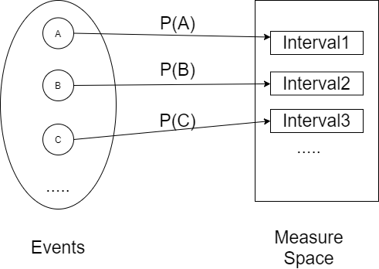
Relationship between probability and measure

Slide 6
^{Countable Set}
A set is countable if it is finite, or if it is infinite but you can give a map that matches up all of the natural numbers with all of the elements of this set.
That is, you can choose some element of your set to be 1st, and then some other element to be 2nd, etc., and eventually list everything in this fashion.

Slide 7
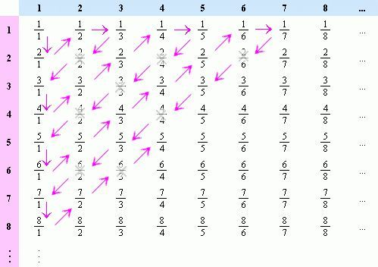
^{Rational number}
Countable
Are all rational numbers listed?

Slide 8



^{Proof}
Let C is a countable set, C = {a₁, a₂, a₃,…}
a₁ - ε/2n²
a₂ + ε/2n²
(
)
(
)
(
)
(
)
(
)
a₁
a₂
a₃
a₄
a₅
x
Now, at each point a_{n} “glue” on an interval of length ε/n², which is ε > 0 and ε is a arbitrary real number.
That is something like that (a_{n}- ε/2n², a_{n}+ε/2n²).
Call the result set S.
$μ\left(S\right)≤\sum_{n=1}^{∞}{μ(an-\frac{ε}{2n^{2}}, an+\frac{ε}{2n^{2}})}$= $ε\sum_{n=1}^{∞}{\frac{1}{n^{2}}}$= $\frac{{επ}^{2}}{6}$
$μ\left(C\right)≤μ\left(S\right)≤\frac{{επ}^{2}}{6}$
$$As ε→0, μ\left(S\right)→0,μ\left(C\right)→0$$

Slide 9


