Slide 1
MindSpore Workshop - feedforward
Session: 1st day afternoon
Security Level:

Slide 2
Contents
Introduction to ModelArts
Pratice: MindSpore on ModelArts
Device-Cloud Collaboration

Slide 3
Contents
Introduction to ModelArts
Pratice: MindSpore on ModelArts
Device-Cloud Collaboration

Slide 4
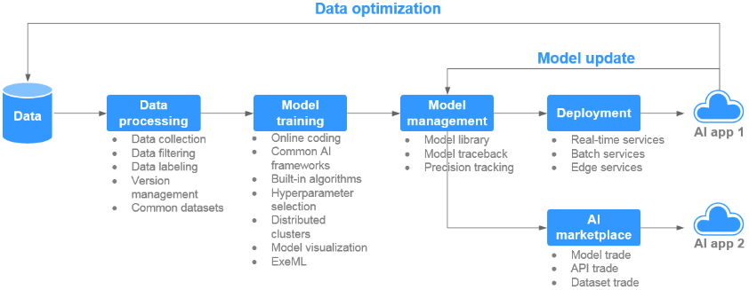
Introduction to ModelArts - Framework
Reference: https://support.huaweicloud.com/productdesc-modelarts/modelarts_01_0001.html
Video: https://www.huaweicloud.com/product/modelarts.html

Slide 5
Introduction to ModelArts - Features
Data governance
Rapid and simplified model training
Manages data preparation, such as data filtering and labeling, and dataset versions
The self-developed MoXing deep learning framework enables high-performance distributed training and simplifies coding
Model deployment
ExeML
Deploys models in various production environments such as devices, the edge, and the cloud, and supports online and batch inference
Supports model building without coding and supports auto learning with image classification, object detection, and predictive analysis
Visualized workflow
AI Market
Uses Graph Engine Service (GES) to manage and visualize the lifecycle of AI development workflows, implementing data and model lineage
Supports commonly used algorithms and datasets, and internal or public sharing of enterprise models in the market

Slide 6
Introduction to ModelArts – Product advantages
One-stop
The out-of-the-box and full-lifecycle AI development platform provides one-stop data processing, model development, training, management, and deployment
Easy to use
Multiple built-in models provided and free use of open source models
Automatic optimization of hyperparameters
Code-free development and simplified operations
One-click deployment of models to the cloud, edge, and devices
High performance
The self-developed MoXing deep learning framework accelerates algorithm development and training
Optimized GPU utilization accelerates real-time inference
Models running on Ascend AI chips achieve more efficient inference
Flexible
Popular open source frameworks available, such as TensorFlow and Spark_MLlib
Popular GPUs and self-developed Ascend chips available
Exclusive use of dedicated resources
Custom images for custom frameworks and operators

Slide 7
Contents
Introduction to ModelArts
Pratice: MindSpore on ModelArts
Device-Cloud Collaboration

Slide 8
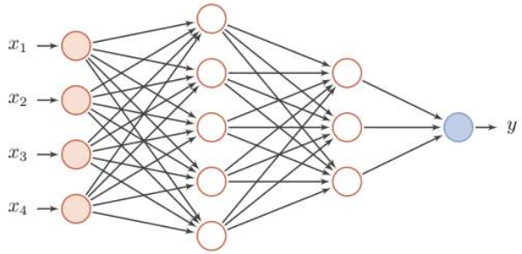
Practice: MindSpore on ModelArts
Use MindSpore to construct a simple feedforward neural network
Train the network on ModelArts
Basic concepts
OBS (Object Storage Service)
MoXing
Three ways to leverage ModelArts for your training
Upload code to OBS and create training task
Jupyter notebook on ModelArts
Pycharm ToolKit
Reference:
Code: https://gitee.com/mindspore/course/tree/develop/
MindSpore on ModelArts: https://www.mindspore.cn/tutorial/zh-CN/r0.7/advanced_use/use_on_the_cloud.html
Use notebook: https://support.huaweicloud.com/qs-modelarts/modelarts_06_0005.html
Use PyCharm ToolKit: https://support.huaweicloud.com/qs-modelarts/modelarts_06_0007.html
Feedforward neural network video: https://www.bilibili.com/s/video/BV1UE411M72D
Input
layer
Hiden
layer1
Hiden
layer2
Output
layer

Slide 9

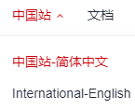
Know more about MindSpore
Reference
MindSpore online course: https://www.mindspore.cn/resources
MindSpore Official Website: https://www.mindspore.cn/en
MindSpore Code Hosting Platform: https://github.com/mindspore-ai/mindspore
MindSpore community: https://gitee.com/mindspore/community
Ascend: https://www.huaweicloud.com/ascend/home.html
Introduction to MindSpore video: https://www.youtube.com/watch?v=O7TBItvy8WI
Tips: Switch to English version website by clicking the button at the upper right corner of website
Or

Slide 10
Contents
Introduction to ModelArts
Pratice: MindSpore on ModelArts
Device-Cloud Collaboration

Slide 11
Device-Cloud Collaboration - Background
Light models
The industry proposes lightweight models and deep learning frameworks for mobile devices.
Data process ability of device
Deep learning relies heavily on big data. However, devices can only hold a limited amount of data, making pure on-device learning impractical.
Data privacy issue
Regulators and users pay more and more attention to data privacy.
Advanced AI application
The industry has extensively explored and practiced model light-weighting, on-device inference, transfer learning, and federated learning.
MindSpore cloud
Device
Device
MindSpore device
On-device inference
Automated model generation
Model compression
Compilation & optimization
Transfer learning
Federated learning

Slide 12
Device-Cloud Collaboration – Key modules
Model compression module
Compresses (prunes and distills) the retrieved model to be more lightweight without compromising accuracy.
Compilation & optimization module
Performs operator fusion, constant folding, and quantization when converting a model for on-device inference.
Performs hardware acceleration based on hardware configurations, for example, by using an NPU, GPU, ARM NEON, or other methods.

Slide 13
Device-Cloud Collaboration - Workflow
Data preparation
Model construction and training
Save model checkpoint
Model Training on Cloud
Export .mindir
Call MindSpore export API
Load checkpoint
Use MindSpore Lite to build converter_lite
Transfer .mindir (MindSpore) to .ms (MindSpore Lite)
Load .ms
Lite session
Scheduler
Executor
On-device Inference
Operator
Kernel
Tensor
……
App development and deployment
Android Application
Front end
Back end
Compile
……

Slide 14
Device-Cloud Collaboration - Summary
MindSpore's device-cloud collaboration framework streamlines the device-cloud process.
Automatically generates models for different devices.
Compresses models through pruning and quantization.
Compiles and optimizes computing graphs, and accelerates operator execution.
MindSpore's device-cloud collaboration framework gradually supports different learning patterns.
Already supports common on-device inference patterns in the industry.
Gradually supports advanced learning patterns, such as transfer learning and federated learning, that require on-device training capabilities.
Therefore, this framework can respond to various scenarios as required by developers.

Slide 15



Device-Cloud Collaboration - Summary
Reference: https://www.mindspore.cn/lite/tutorial/zh-CN/r0.7/quick_start/quick_start.html

