Slide 1


Slide 2



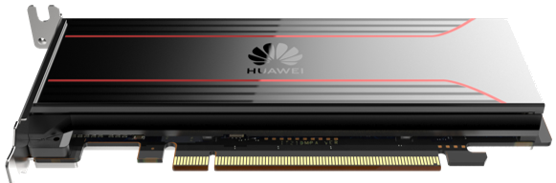
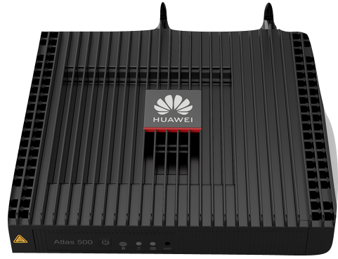
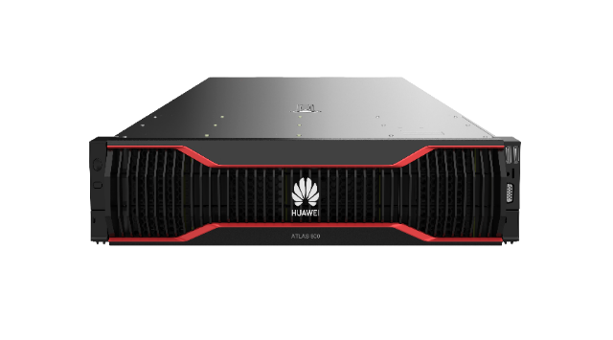

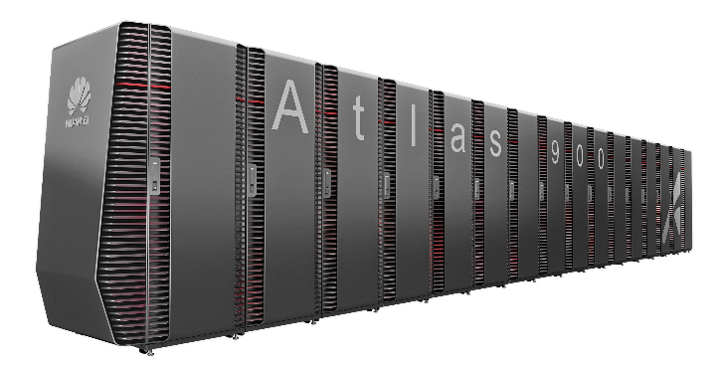
Huawei Full-Stack AI Solution
AI Applications
ModelAtrs
HiAI Service
Third Party
Application enablement
Provides end-to-end services, layered APIs, and pre-integrated solutions.
MindX
Application
MindX Edge
MindX DL
MindX SDK
ModelZoo
MindSpore
All-scenario AI computing framework that best match Ascend.
Full stack
MindSpore /TensorFlow /PyTorch /……
AI Framework
CANN
Compute Architecture for Neural Networks
CANN
Operators library and highly automated operators development tool.
Heterogeneous computing
Ascend chips
A series of AI IPs and chips based on a unified, scalable architecture.
Cloud
Chip
All scenarios

Slide 3
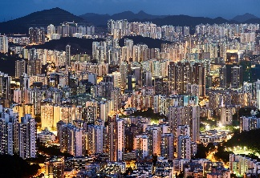





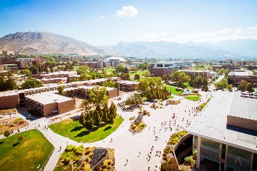

All-scenario AI computing framework
All-scenario AI applications
ModelZoo
MindSpore
Collaborative Training and inference framework
CV
NLP
Recommendation
Visuallized autotuning
MindInsight
Domain Extension Library
GNN
RL
……
All-scenario API
All-scenario applications 270+
Security and trustworthiness
MindArmour
Computation Graph compiler
Device-edge-cloud collaborative, distributed parallel architecture
城市
互联网
家庭
车联网
Chips： NPU 、GPU、CPU
物流
医疗
园区
制造

Slide 4




MindSpore: Officially open source
March 28, 2020
Official website
Code hosting platform
https://www.mindspore.cn
https://gitee.com/mindspore
Notes:
提示：
1.MindSpore采用Apache 2.0许可证，代码托管在码云Gitee，欢迎全球的合作伙伴、开发者朋友们共同参与MindSpore社区建设；
2.MindSpore于2020年3月28日正式开源，通过访问MindSpore官方网站www.mindspore.cn获取MindSpore版本和资料文档，并通过加入MindSpore微信公众号了解最新的信息；
3. 4月份会基于华为云提供MindSpore体验环境资源，详细请关注我们在官方网站和微信公众号发布的信息；

Slide 5
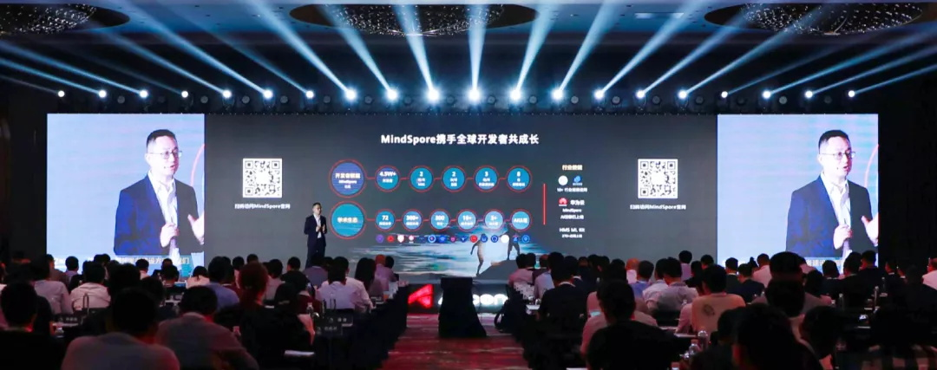
On 28th March 2020, the developer focused MindSpore was officially open sourced. From v0.2.0-alpha(40th April) to v0.7.0-beta(30th Aug), MindSpore has introduced dozens of bright new features. In September, HUAWEI CONNECT 2020 published MindSpore v1.0.0.
Notes:
提示：
1.MindSpore采用Apache 2.0许可证，代码托管在码云Gitee，欢迎全球的合作伙伴、开发者朋友们共同参与MindSpore社区建设；
2.MindSpore于2020年3月28日正式开源，通过访问MindSpore官方网站www.mindspore.cn获取MindSpore版本和资料文档，并通过加入MindSpore微信公众号了解最新的信息；
3. 4月份会基于华为云提供MindSpore体验环境资源，详细请关注我们在官方网站和微信公众号发布的信息；

Slide 6




Join us！
Website: https://www.mindspore.cn
Gitee: https://gitee.com/mindspore
GitHub: https://github.com/mindspore-ai
Mailing-list: https://mailweb.mindspore.cn/postorius/lists/
Official Website
WeChat Official Account
TikTok(China)
Official
Account
QQ Group

Slide 7
Q&A Section
Huawei HK XAI Team

Slide 8
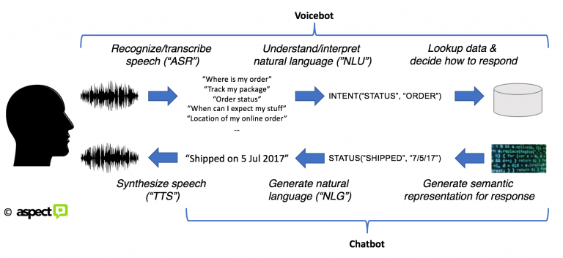
What MindSpore can do for NLP?
Image source: https://blogs.aspect.com/dont-confuse-speech-recognition-with-natural-language-understanding/
Voice Recognition
NLU
NLG
Translation
NLP Functions
BERT
Attention
Transformer
RNN
Model Architectures
Convolutions
LSTM
Embedding
Deep Learning
MindSpore Features

Slide 9

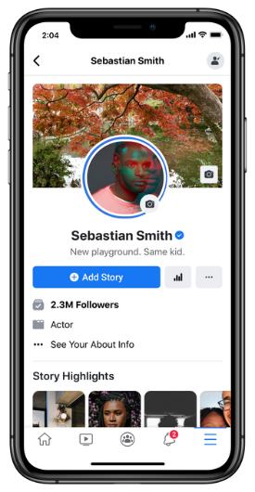
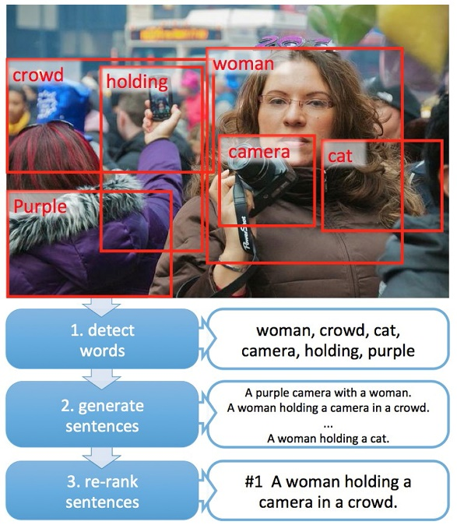
What MindSpore can do for NLP?
Customer Service Chatbot
Sentiment analysis
Social network analysis
Recommendation systems
Explainable AI
Image sources:
https://twinclescpaas.com/
https://blogs.microsoft.com/ai/picture-this-microsoft-research-project-can-interpret-caption-photos/

Slide 10
Word Embedding
Word vectors are required because text cannot be directly used by mathematical models.
One-hot vector
In the following figure, a vocabulary has 7 words, so the word vector has 7 dimensions.
Disadvantage 1: A vocabulary usually has many words, leading to numerous word vector dimensions.
Disadvantage 2: Semantic relationships are not included. The distance between word vectors cannot reflect semantic relationships.
Word2Vec, created by Google in 2013, is a group of models used to produce word vectors.
Continuous Bag of Word (CBOW) model: predicts the current word according to the contexts of one or more words.
Skip-Gram model: predicts the context according to the current word.
latitude
sweetness
USA → [1, 0, 0, 0] → [0.6, 0.02]
Japan → [0, 1, 0, 0] → [0.7, 0.05]
Orange → [0, 0, 1, 0] → [0.02, 0.6]
Apple → [0, 0, 0, 1] → [0.01, 0.5]
One-hot
Embedding

Slide 11
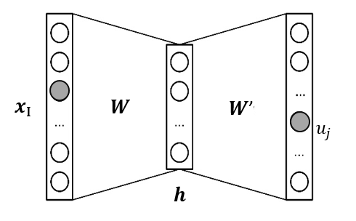
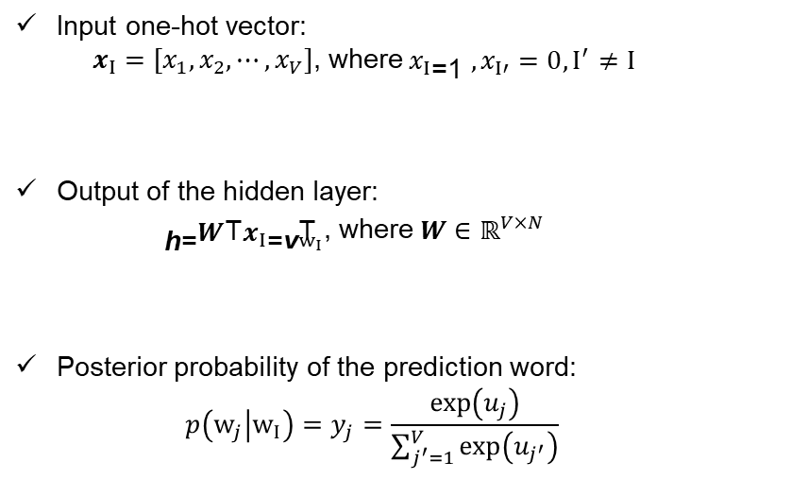
Word Embedding
Input one-hot vector:
$x_{I}=[x_{1},x_{2},⋯,x_{V}]$, where$x_{I}\text{=1}$ $,x_{I′}=0,I^{′}≠I$
Output of the hidden layer:
$\text{h}\text{=}W^{\text{T}}x_{I}\text{=}{\text{v}}_{w_{I}}^{\text{T}}$, where$W∈ℝ^{V×N}$
Posterior probability of the prediction word:
$$p\left(w_{j} | w_{I}\right)=y_{j}=\frac{\exp\left(u_{j}\right)}{\sum_{j^{′}=1}^{V}{\exp\left(u_{j^{′}}\right)}}$$
encoder
predictor
Focus word
one-hot
Context word one-hot
Embedding
Cats and dogs are popular pets
Cats and dogs are popular pets
Focus word
Context word
Cats and dogs are popular pets

Slide 12
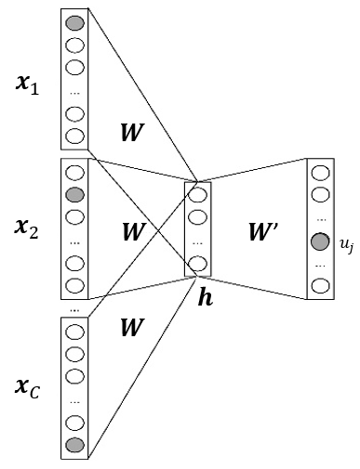
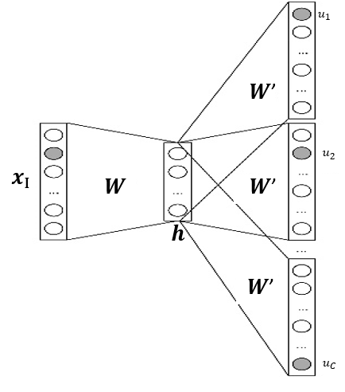
Word Embedding
Focus word
Context words
Context words
Focus word
Skip-Gram, use focus word to predicts context words
Continuous Bag of words (CBOW), use context words to predicts the focus word

Slide 13
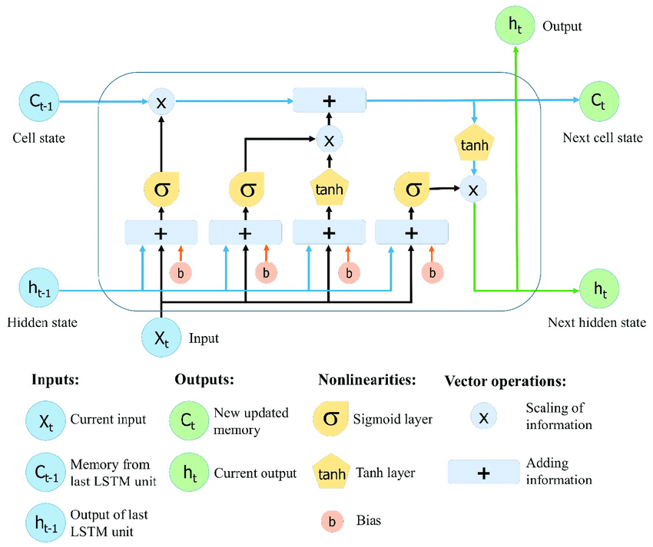
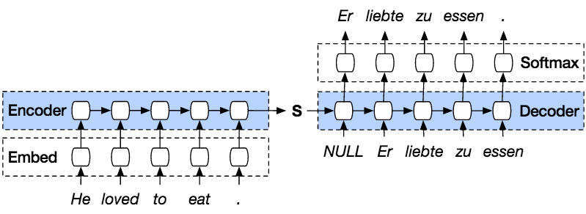
Seq2Seq
Long Short-Term Memory (LSTM)
(Indonesian)
(stop symbol)
Embed
(stop symbol)
Image source:
https://www.researchgate.net/figure/The-structure-of-the-Long-Short-Term-Memory-LSTM-neural-network-Reproduced-from-Yan_fig8_334268507
https://www.guru99.com/seq2seq-model.html
Notes:
Variable length of input
Marked with starting and ending symbol

Slide 14
What MindSpore can do for NLP?
Tutorials
Realizing Sentiment Classification With SentimentNet.
https://www.mindspore.cn/tutorial/training/en/master/advanced_use/nlp_sentimentnet.html
Chinese poem writer based on BERT network.
https://www.mindspore.cn/tutorial/training/zh-CN/master/advanced_use/nlp_bert_poetry.html
(Chinese version only, but I will explain in English)

Slide 15
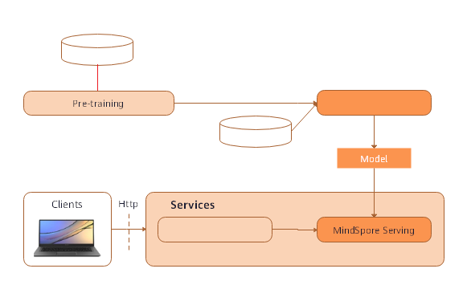
BERT Chinese Poem Writer
Text DB
Fine Tuning
Poem DB
Data Processing

Slide 16
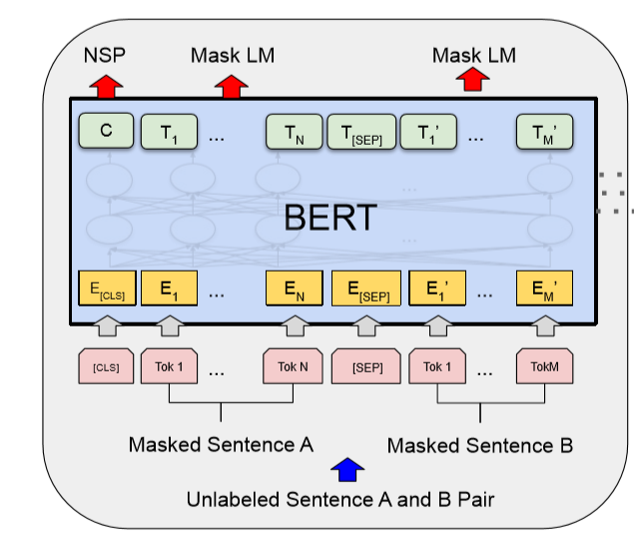
BERT Pre-training
Massive unlabeled and unstructured text DB
Join Training: Predicting masked word + judging sentence adjacency
Learn the basics of linguistic rules

Slide 17
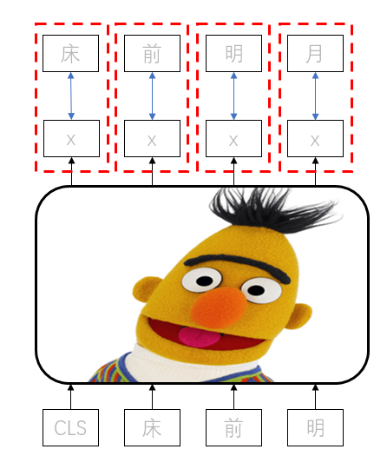
Model Fine Tuning
Poem DB with over 40000 poems
Learn poetry skills
Start symbol

Slide 18
BERT Poem Writer Testing
output = generate_random_poetry(model, s=‘’)
大堤柳暗，
春深树根。
东望一望，
断回还家。
山色渐风雨，
东风多雨禾。
无情与去，
万里所思。
(Fully automated)
Generates different content every time
Downloads:
Source Code
Poem DB
Pre-trained BERT
output = generate_random_poetry(model, s=‘天下为公’)
天下为公少，
唯君北向西。
远山无路见，
长水见人偏。
一路巴猿啸，
千峰楚客啼。
幽深有诗策，
无以话年华。
(Continuous writing)
https://www.mindspore.cn/tutorial/training/zh-CN/master/advanced_use/nlp_bert_poetry.html

Slide 19
Commercial Application of AI?
Consumer Market
Self-driving car
Recommendation System
Customer Services
Finance
Anti-laundry, anti-fraud
Loan and insurance approvals
Risk and investment analysis
Law and accounting
Entertainments
Game AIs
Image/voice processing and editing
Augmented Realities
IT & Engineering
Manufacturing robotics
Quality controls
Machine translations
Networking and system automations

Slide 20
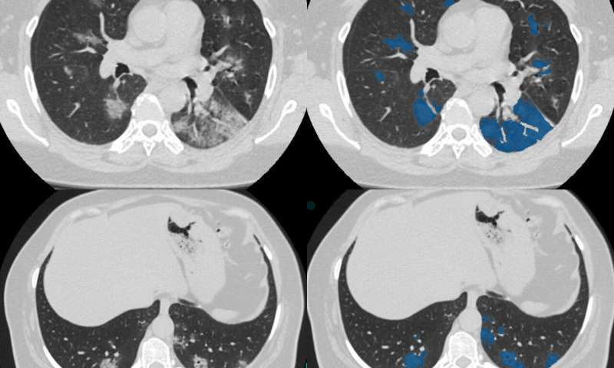
AI on medical diagnostics?
CT, PET scan diagnostics
Tissue slide cell level analysis
Integrated diagnostics
Legal & regulation restrictions
Image Sources:
https://medicalxpress.com/news/2020-05-ct-scan-database-ai-covid-.html

Slide 21
Machine Learning VS Deep Learning?
AI
Mimicking human behaviors
A* Search, Minimax, Predicate Calculus
Machine Learning
Learning from data
Linear Regressions, Decision Trees, K-Means
Learning with multi-layer neural networks
Deep Learning
VGG, ResNet, BERT

Slide 22

Perspective of AI?
Explainable AI
Win trust from humans and authorities on mission critical systems
Generative Models
StyleGNNs, creating natural pictures, paintings, faces..
Knowledge Graph/Graph Neural Networks
Massive existing graph like and highly structured databases
NLP
GPT3, GPT4… Holy grail of AI…. possible way to strong AI and Skynet
Quantum Computing
Unmatched amount of parallel computing power, GPUs on steroid
Image source:
https://www.imdb.com/title/tt0088247/

Slide 23


One button“Star+Watch”，MindSpore is waiting for you！
Thank you for paying attention to MindSpore~
Welcome to fork, watch and star MindSpore project on gitee.com, keep tracking the updates and join as a developer to build a greater MindSpore community~
Website：https://gitee.com/mindspore/mindspore
Scan the QR code with WeChat，register with one button~

Slide 24
ModelZoo crowd development is kick started!
150 option models!
https://mp.weixin.qq.com/s/RYEEq9Wt6DjSmJ2Xt-KfGQ

