Slide 1
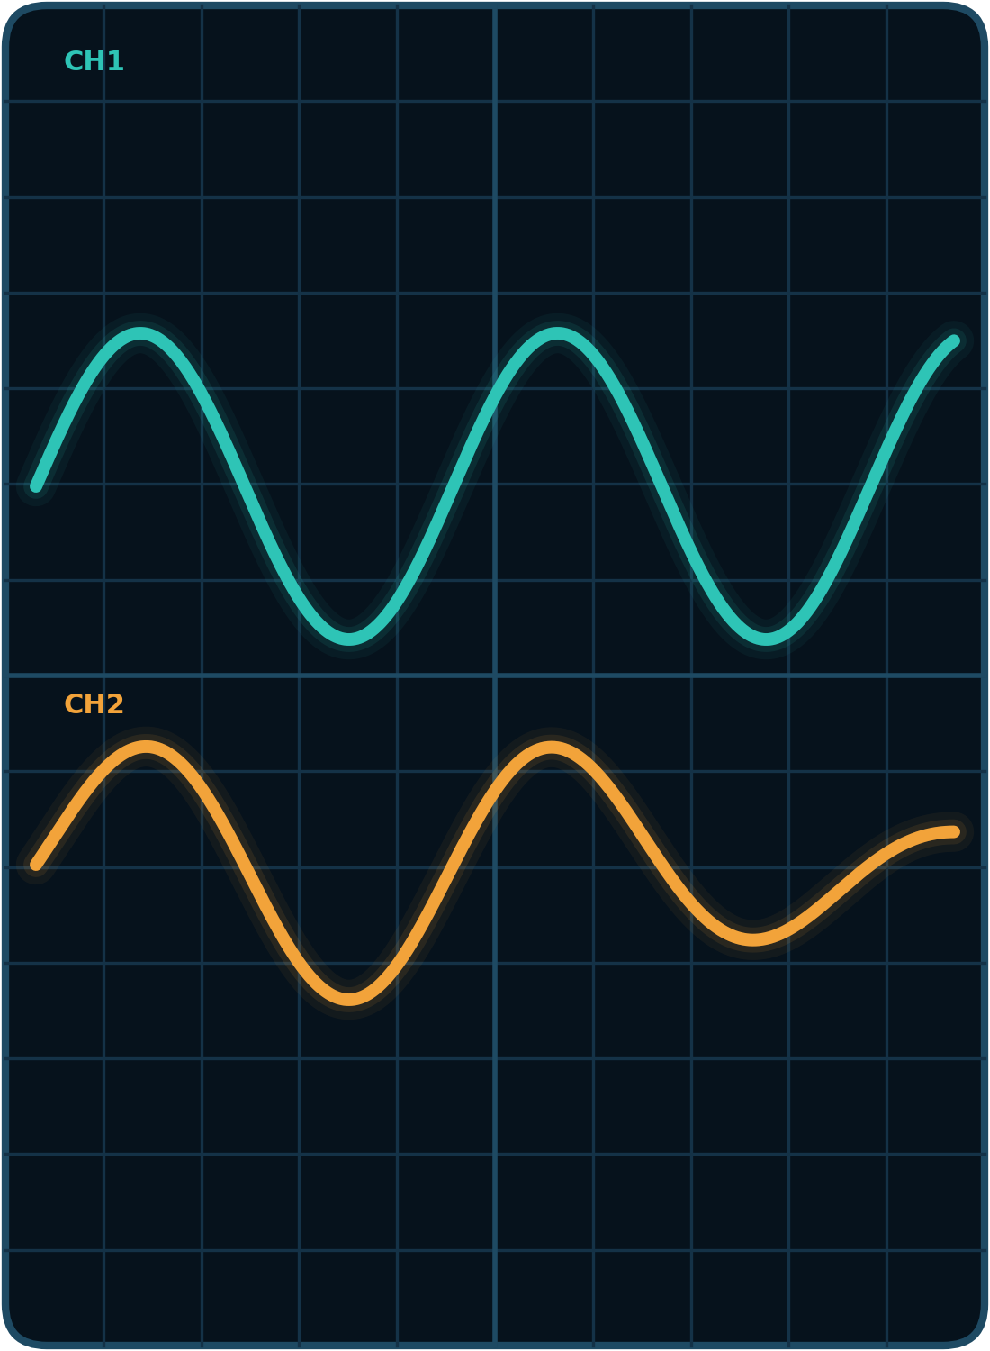
“Elektrotexnika va mexatronika” kafedrasi
O’ZBEKISTON RESPUBLIKASI OLIY TA’LIM, FAN VA INNOVATSIYALAR VAZIRLIGI
“TOSHKENT IRRIGATSIYA VA QISHLOQ XO’JALIGINI MEXANIZATSIYALASHTIRISH MUHANDISLARI INSTITUTI” MILLIY TADQIQOT UNIVERSITETI
ENERGETIKA FAKULTETI
ELEKTROTEXNIKA VA MEXATRONIKA KAFEDRASI
ELEKTR VA ELEKTRON ZANJIRLARNI MODELLASHTIRISH
MAVZU: DATCHIKLAR VA ULARNING ELEKTR VA MAGNIT ZANJIRLARINI MODELLASHTIRISH
Bajardi: Rozubaev Xushnudbek
Ilmiy rahbar: PhD, A.U.Djalilov
© Department of "Electrical Engineering and Mechatronics"
Toshkent – 2026

Slide 2
“Elektrotexnika va mexatronika” kafedrasi
MAVZU: DATCHIKLAR VA ULARNING ELEKTR VA MAGNIT ZANJIRLARINI MODELLASHTIRISH
REJA
1. Datchiklar va ularning elektr zanjirlarini modellashtirish.
2. Datchiklarning magnit zanjirlarini modellashtirish.
3. Datchiklarning struktura sxemasi va uni Simulinkda modellashtirish.
4. Xoll (Hall) datchigi va nochiziqli datchiklarning chiqish signallarini qayta ishlash hamda tahlil qilish.
© Department of "Electrical Engineering and Mechatronics"
Mustaqil ish – Rozubaev Xushnudbek | 2

Slide 3
“Elektrotexnika va mexatronika” kafedrasi
Datchiklarning elektr zanjirlarini modellashtirish
Datchiklar haqida umumiy ma’lumot
Datchik (Sensor) – nazorat qilinayotgan obyektning noelektr fizik kattaligini (harorat, bosim, siljish, kuch, tezlik, magnit maydon) o’lchash va uzatish uchun qulay bo’lgan elektr signaliga aylantiruvchi qurilma.
1. Parametrik datchiklar – tashqi fizik ta’sir natijasida o’zining elektr yoki magnit parametrini (qarshilik R, induktivlik L, sig’im C, magnit qarshilik R_{m}) o’zgartiradi.
2. Generatorli datchiklar – tashqi ta’sir natijasida o’zidan elektr yurituvchi kuch (EYuK) hosil qiladi: induksion, pyezoelektrik, termoelektr va Xoll datchiklari.
© Department of "Electrical Engineering and Mechatronics"
Mustaqil ish – Rozubaev Xushnudbek | 3

Slide 4
“Elektrotexnika va mexatronika” kafedrasi
Datchiklarning elektr zanjirlarini modellashtirish
Datchiklarni modellashtirish usullari
1. Simscape muhitida fizik modellashtirish
datchikning haqiqiy elektr va magnit sxemasi fizik elementlar (rezistor, kondensator, g’altak, magnit qarshilik) yordamida yig’iladi. Zanjir tuzilishi asl qurilmaga mos keladi.
2. Simulink muhitida struktura modellashtirish
datchikning dinamik tenglamasi va uzatish funksiyasi W(s) bloklar yordamida modellashtiriladi. Zanjir emas, matematik bog’lanish ifodalanadi.
Ikki usul bir-birini to’ldiradi: fizik model zanjirni, struktura model datchikning inersiyasi va sezgirligini aniq beradi.
© Department of "Electrical Engineering and Mechatronics"
Mustaqil ish – Rozubaev Xushnudbek | 4

Slide 5
“Elektrotexnika va mexatronika” kafedrasi
Datchiklarning elektr zanjirlarini modellashtirish
Fizik zanjirlarni hisoblash bloki (Solver Configuration)
Vazifasi – Simscape muhitida yig’ilgan elektr va magnit zanjirlarning differensial-algebraik tenglamalarini yechish parametrlarini belgilaydi. Har bir mustaqil zanjirga ulanishi shart.
Parametrlari:
1. Use local solver – mahalliy diskret hisoblagichdan foydalanish (bayroqcha o’rnatilganda).
2. Sample time – model vaqtining hisoblash qadami (s).
3. Start simulation from steady state – modellashtirishni barqarorlashgan (stasionar) rejimdan boshlash.
© Department of "Electrical Engineering and Mechatronics"
Mustaqil ish – Rozubaev Xushnudbek | 5

Slide 6
“Elektrotexnika va mexatronika” kafedrasi
Datchiklarning elektr zanjirlarini modellashtirish
Majburiy bloklar: Solver Configuration va Reference
f(x) = 0 V = 0 F_{m} = 0
Solver Configuration | Electrical Reference | Magnetic Reference
Electrical Reference va Magnetic Reference
elektr zanjirida nol potensial (V = 0) va magnit zanjirida nol magnit potensial (F_{m} = 0) tugunini belgilovchi majburiy bloklar. Ularsiz zanjir tenglamalari yechimga ega bo’lmaydi – Simscape xatolik qaytaradi.
© Department of "Electrical Engineering and Mechatronics"
Mustaqil ish – Rozubaev Xushnudbek | 6

Slide 7
“Elektrotexnika va mexatronika” kafedrasi
Datchiklarning elektr zanjirlarini modellashtirish
Fizik va Simulink signallarini o’zgartirgichlar
1. PS-Simulink Converter
Simscape datchiklari chiqishidagi fizik signalni (Physical Signal) oddiy Simulink bloklariga (Scope, Display) uzatish uchun matematik signalga aylantiradi. Parametri: Output signal unit – o’lchov birligi (V, A, Wb, Ohm yoki 1).
2. Simulink-PS Converter
Simulink manbalari (Step, Ramp, Sine Wave, Constant) signalini fizik zanjir elementiga uzatish uchun fizik signalga aylantiradi. Parametrlari: Input signal unit va Filtering and derivatives.
Simulink Signal → Simulink-PS → Fizik Datchik → PS-Simulink → Scope
© Department of "Electrical Engineering and Mechatronics"
Mustaqil ish – Rozubaev Xushnudbek | 7

Slide 8
“Elektrotexnika va mexatronika” kafedrasi
Datchiklarning elektr zanjirlarini modellashtirish
Kuchlanish datchigi (Voltage Sensor)
Vazifasi – elektr zanjirining ikki tuguni orasidagi oniy kuchlanishni (potensiallar farqini) o’lchash.
U_{out}(t) = V₍₊₎ − V₍₋₎ [Volt]
Ulanish qoidasi: PARALLEL
Ideal kuchlanish datchigining ichki qarshiligi cheksiz katta (R_{v} → ∞), shuning uchun u o’lchanayotgan elementga parallel ulanadi va zanjirdan tok olmaydi.
Portlari: (+) va (−) – elektr klemmalar; (V) – fizik signal chiqishi.
© Department of "Electrical Engineering and Mechatronics"
Mustaqil ish – Rozubaev Xushnudbek | 8

Slide 9
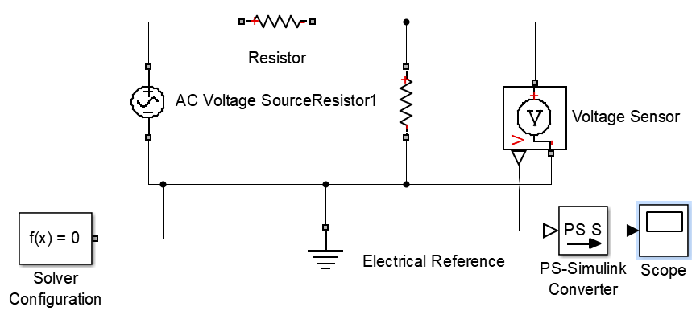
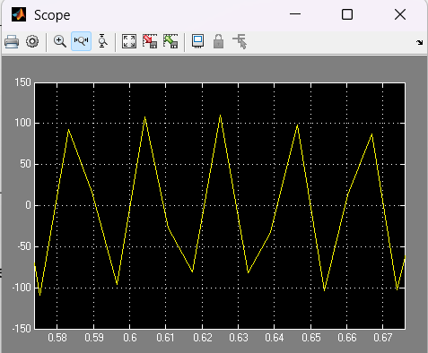
“Elektrotexnika va mexatronika” kafedrasi
Datchiklarning elektr zanjirlarini modellashtirish
Voltage Sensor blokidan foydalanish
AC Voltage Source (U_{amp} = 220 V, 50 Hz) manbasiga R₁ = R₂ = 100 Om rezistorlar ulangan. Kuchlanish bo’lgich chiqishi Voltage Sensor va Scope yordamida o’lchanadi.
1-rasm. Elektr zanjirida Voltage Sensor datchigidan foydalanish.
© Department of "Electrical Engineering and Mechatronics"
Mustaqil ish – Rozubaev Xushnudbek | 9

Slide 10
“Elektrotexnika va mexatronika” kafedrasi
Datchiklarning elektr zanjirlarini modellashtirish
Tok datchigi (Current Sensor)
Vazifasi – elektr zanjirining shoxobchasidan oqib o’tayotgan oniy tok kuchini o’lchash va fizik signalga aylantirish.
I_{out}(t) = i(t) U_{datchik} = 0 [Amper]
Ulanish qoidasi: KETMA-KET
Ideal tok datchigining ichki qarshiligi nolga teng (R_{a} = 0), shuning uchun u elektr zanjiriga ketma-ket ulanadi va kuchlanish tushuvi hosil qilmaydi.
Portlari: (+) va (−) – tok kiruvchi va chiquvchi klemmalar; (I) – fizik signal chiqishi.
© Department of "Electrical Engineering and Mechatronics"
Mustaqil ish – Rozubaev Xushnudbek | 10

Slide 11
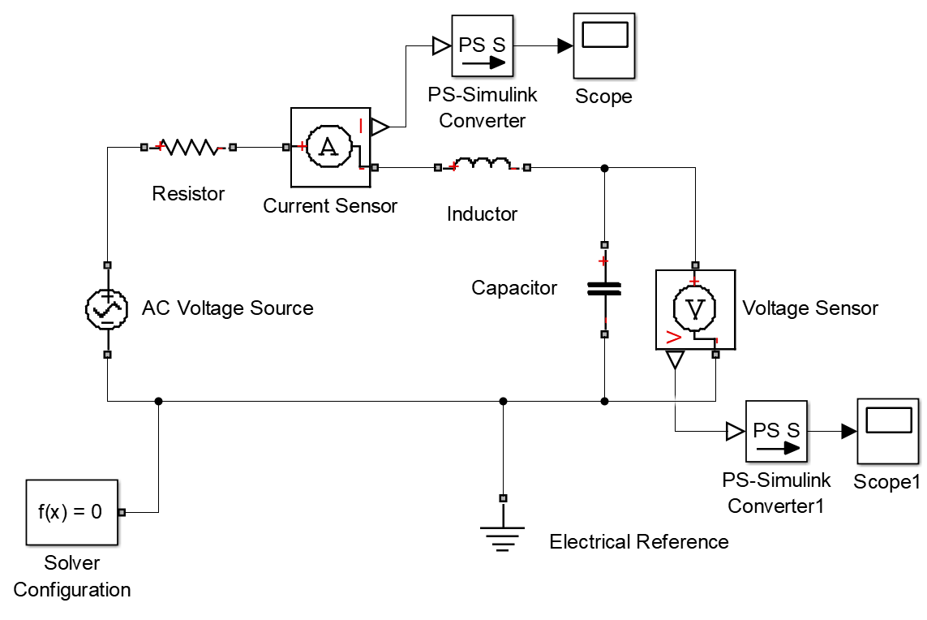
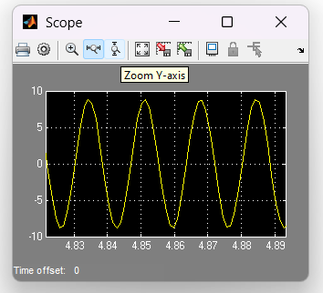
“Elektrotexnika va mexatronika” kafedrasi
Datchiklarning elektr zanjirlarini modellashtirish
Current Sensor va Voltage Sensor bloklari
Ketma-ket ulangan R, L va parallel C zanjirida tok kuchini Current Sensor, kondensator kuchlanishini Voltage Sensor yordamida o’lchash 2-rasmda keltirilgan.
2-rasm. R, L, C elektr zanjirida tok va kuchlanish datchiklari.
© Department of "Electrical Engineering and Mechatronics"
Mustaqil ish – Rozubaev Xushnudbek | 11

Slide 12
“Elektrotexnika va mexatronika” kafedrasi
Datchiklarning elektr zanjirlarini modellashtirish
Rezistiv datchiklar (Variable Resistor)
Vazifasi – tashqi fizik kattalik ta’sirida o’z qarshiligini o’zgartiruvchi rezistiv datchikni modellashtiradi.
Termorezistor – harorat | Tenzodatchik – deformatsiya | Potensiometr – siljish
Boshqaruvi va parametri
1. R porti – qarshilik qiymati fizik signal porti orqali tashqaridan beriladi (Simulink-PS Converter orqali ta’sir x(t)).
2. Minimum resistance R_{min} – datchikning minimal cheklovchi qarshiligi (Om); qarshilik nol yoki manfiy bo’lib qolishidan himoyalaydi.
© Department of "Electrical Engineering and Mechatronics"
Mustaqil ish – Rozubaev Xushnudbek | 12

Slide 13
“Elektrotexnika va mexatronika” kafedrasi
Datchiklarning elektr zanjirlarini modellashtirish
Uitston o’lchash ko’prigi (Wheatstone Bridge)
rezistiv datchikning qarshilik o’zgarishini (ΔR) chiqish kuchlanishiga (U_{out}) aylantirish uchun eng ko’p qo’llaniladigan elektr zanjir.
R(x) = R₀ + K_{R}·x(t)
U_{out} = U_{manba}·[ R(x)/(R(x) + R₁) − R₃/(R₂ + R₃) ]
Muhim: qarshilik R chiziqli o’zgarsa ham chiqish kuchlanishi U_{out} nochiziqli bo’ladi – ko’prik bo’lgichi nochiziqli.
© Department of "Electrical Engineering and Mechatronics"
Mustaqil ish – Rozubaev Xushnudbek | 13

Slide 14
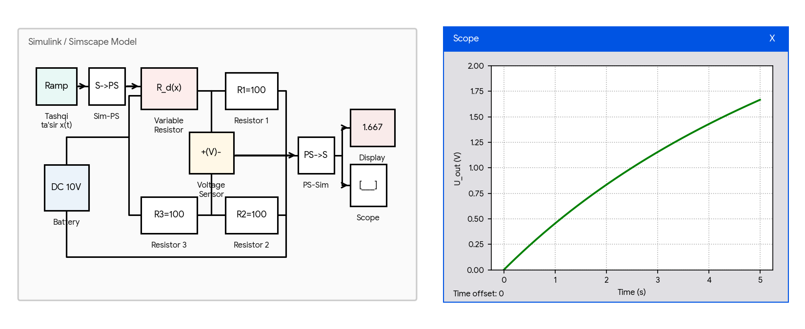
“Elektrotexnika va mexatronika” kafedrasi
Datchiklarning elektr zanjirlarini modellashtirish
Rezistiv datchikning Uitston ko’prik zanjiri
Tashqi fizik kattalik Ramp bloki orqali chiziqli o’zgarganda Variable Resistor qarshiligi 100 Om dan 200 Om gacha ortadi va ko’prik diagonalidagi Voltage Sensor chiqish kuchlanishini qayd etadi.
3-rasm. Rezistiv datchikning Uitston ko’prik elektr zanjiri.
© Department of "Electrical Engineering and Mechatronics"
Mustaqil ish – Rozubaev Xushnudbek | 14

Slide 15
“Elektrotexnika va mexatronika” kafedrasi
Datchiklarning elektr zanjirlarini modellashtirish
Sig’im datchiklari (Variable Capacitor)
Vazifasi – elektrodlar orasidagi masofa d(x), yuza S(x) yoki muhitning dielektrik singdiruvchanligi o’zgarishiga asoslangan sath, namlik, bosim va siljish datchiklarini modellashtiradi.
Boshqaruvi va parametrlari
1. C porti – sig’im qiymati fizik signal porti orqali tashqaridan beriladi.
2. Minimum capacitance C_{min} – minimal elektr sig’imi (sukunat bo’yicha 1e-12 F).
3. Series resistance – ketma-ket ulangan aktiv yo’qotish qarshiligi (Om).
4. Initial voltage – kondensatorning boshlang’ich kuchlanishi (V).
© Department of "Electrical Engineering and Mechatronics"
Mustaqil ish – Rozubaev Xushnudbek | 15

Slide 16
“Elektrotexnika va mexatronika” kafedrasi
Datchiklarning elektr zanjirlarini modellashtirish
Sig’im datchigining matematik modeli
C(x) = ε·ε₀·S / d(x)
i(t) = d( C(t)·u(t) ) / dt = C·du/dt + u·dC/dt
Ikkinchi had u·dC/dt – aynan sig’imning o’zgarishidan hosil bo’ladigan tok. Datchikning foydali signali shu hadda joylashgan.
Variable Capacitor blokidan sig’im datchigining o’zgaruvchan tok zanjirida foydalanish 4-rasmda keltirilgan.
© Department of "Electrical Engineering and Mechatronics"
Mustaqil ish – Rozubaev Xushnudbek | 16

Slide 17
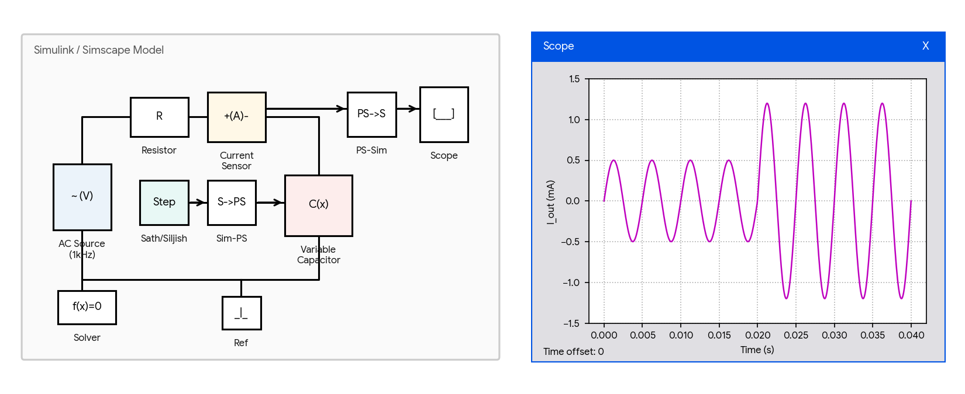
“Elektrotexnika va mexatronika” kafedrasi
Datchiklarning elektr zanjirlarini modellashtirish
Sig’im datchigining o’zgaruvchan tok zanjiri
Yuqori chastotali AC manbaga ulangan Variable Capacitor sig’imi t = 0.02 s da Step bloki ta’sirida 2.4 marta oshganda, zanjirdagi tok amplitudasi ham shuncha marta sakrab ortadi (i ≈ ωCU).
4-rasm. Sig’im datchigining elektr zanjirini modellashtirish.
© Department of "Electrical Engineering and Mechatronics"
Mustaqil ish – Rozubaev Xushnudbek | 17

Slide 18
“Elektrotexnika va mexatronika” kafedrasi
Datchiklarning elektr zanjirlarini modellashtirish
Induktiv datchiklar (Variable Inductor)
Vazifasi – magnit o’zak yoki yakor siljiganda chulg’am induktivligi L(t) o’zgarishiga asoslangan induktiv siljish, tebranish va qalinlik datchiklarini modellashtiradi.
Ψ(t) = L(t)·i(t)
u(t) = dΨ/dt = L(t)·di/dt + i(t)·dL/dt
Boshqaruvi: L porti – induktivlik fizik signal orqali beriladi.
Parametrlari: L_{min} (Gn), Series resistance (Om), Initial current (A).
© Department of "Electrical Engineering and Mechatronics"
Mustaqil ish – Rozubaev Xushnudbek | 18

Slide 19
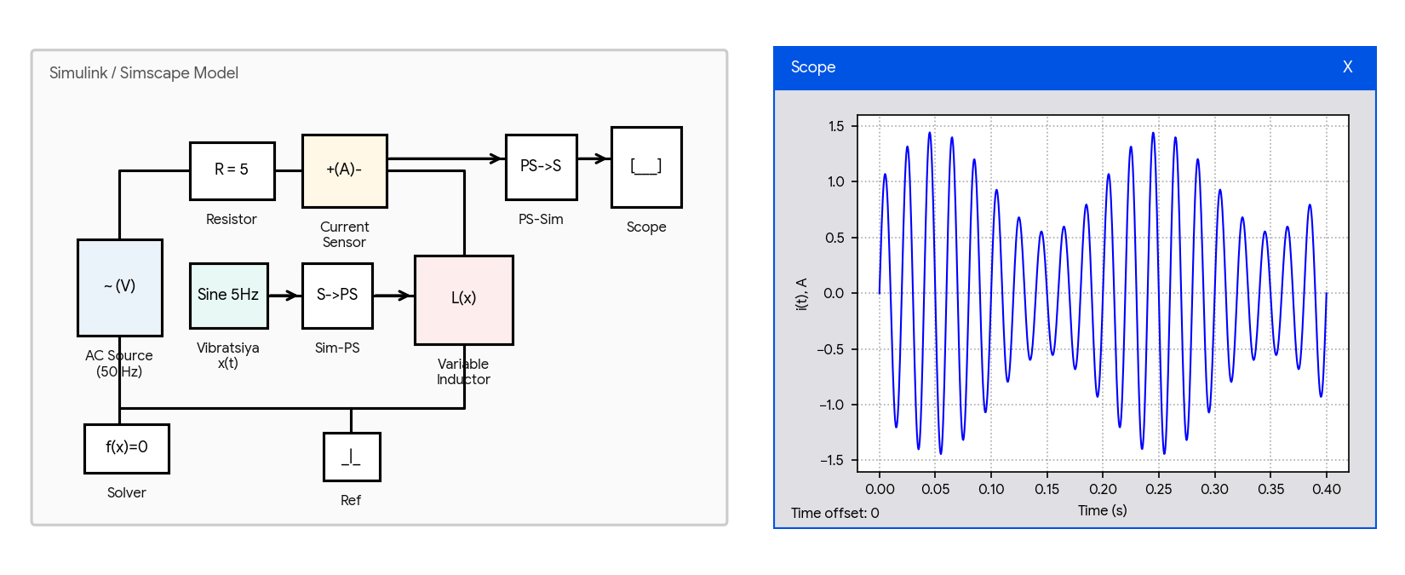
“Elektrotexnika va mexatronika” kafedrasi
Datchiklarning elektr zanjirlarini modellashtirish
Induktiv tebranish datchigi zanjiri
50 Hz elektr zanjiridagi Variable Inductor datchigiga 5 Hz mexanik tebranish (Sine Wave) ta’sir etadi. Natijada zanjir toki amplituda bo’yicha modulyatsiyalanadi.
5-rasm. Induktiv datchikning elektr zanjirini modellashtirish.
© Department of "Electrical Engineering and Mechatronics"
Mustaqil ish – Rozubaev Xushnudbek | 19

Slide 20
“Elektrotexnika va mexatronika” kafedrasi
Datchiklarning magnit zanjirlarini modellashtirish
Elektromagnit o’zgartkich (Electromagnetic Converter)
Vazifasi – induktiv, transformatorli va elektromagnit datchiklarda ELEKTR zanjirni MAGNIT zanjir bilan bog’lovchi chulg’am (g’altak) bloki.
F_{m} = N·i(t) [Amper-o’ram]
u(t) = N·dΦ/dt [Volt]
Portlari: (+), (−) – elektr klemmalar; (N), (S) – magnit zanjirning shimoliy va janubiy qutblari.
Parametri: Number of turns – chulg’am o’ramlar soni (masalan N = 500).
© Department of "Electrical Engineering and Mechatronics"
Mustaqil ish – Rozubaev Xushnudbek | 20

Slide 21
“Elektrotexnika va mexatronika” kafedrasi
Datchiklarning magnit zanjirlarini modellashtirish
Magnit qarshilik bloklari (Reluctance, Variable Reluctance)
Vazifasi – ferromagnit (po’lat) o’zakning o’zgarmas magnit qarshiligini Reluctance hamda yakor siljiganda o’zgaradigan havo tirqishi magnit qarshiligini Variable Reluctance modellashtiradi.
Omning magnit zanjirlar uchun qonuni
Φ = F_{m} / R_{m}
R_{m} = l / (μ·μ₀·S)
Magnit oqimi Φ magnit yurituvchi kuch F_{m} ga to’g’ri, to’liq magnit qarshilik R_{m} ga teskari proporsionaldir.
© Department of "Electrical Engineering and Mechatronics"
Mustaqil ish – Rozubaev Xushnudbek | 21

Slide 22
“Elektrotexnika va mexatronika” kafedrasi
Datchiklarning magnit zanjirlarini modellashtirish
Magnit qarshilik: parametrlar
1. Reluctance – po’lat o’zakning o’zgarmas magnit qarshiligi (1/H yoki A/Wb). O’zak uzunligi l, kesimi S va magnit singdiruvchanligi μ bilan aniqlanadi.
2. Minimum reluctance R_{min} – Variable Reluctance blokidagi minimal cheklovchi magnit qarshilik (1/H). Havo tirqishi nolga intilganda hisoblash uzilib qolmasligi uchun zarur.
Havo tirqishi hal qiluvchi ahamiyatga ega: havoning magnit singdiruvchanligi po’latdan minglab marta kichik, shuning uchun magnit zanjirning umumiy qarshiligini asosan tirqish belgilaydi – datchikning sezgirligi ham shundan kelib chiqadi.
© Department of "Electrical Engineering and Mechatronics"
Mustaqil ish – Rozubaev Xushnudbek | 22

Slide 23
“Elektrotexnika va mexatronika” kafedrasi
Datchiklarning magnit zanjirlarini modellashtirish
Magnit oqimi va MYuK datchiklari
1. Magnetic Flux Sensor – KETMA-KET
Magnit o’zakning ko’ndalang kesimidan o’tayotgan magnit oqimini (Φ, Wb) o’lchaydi. Ichki magnit qarshiligi nolga teng (R_{m} = 0), magnit zanjirga ketma-ket ulanadi.
2. MMF Sensor – PARALLEL
Magnit zanjirning ikki nuqtasi orasidagi magnit potensiallar farqini (U_{m} = F_{m}, A) o’lchaydi. Magnit zanjir uchastkasiga parallel ulanadi.
Ikki datchik elektr zanjirdagi Current Sensor va Voltage Sensor ning magnit zanjirdagi to’liq analogidir.
© Department of "Electrical Engineering and Mechatronics"
Mustaqil ish – Rozubaev Xushnudbek | 23

Slide 24
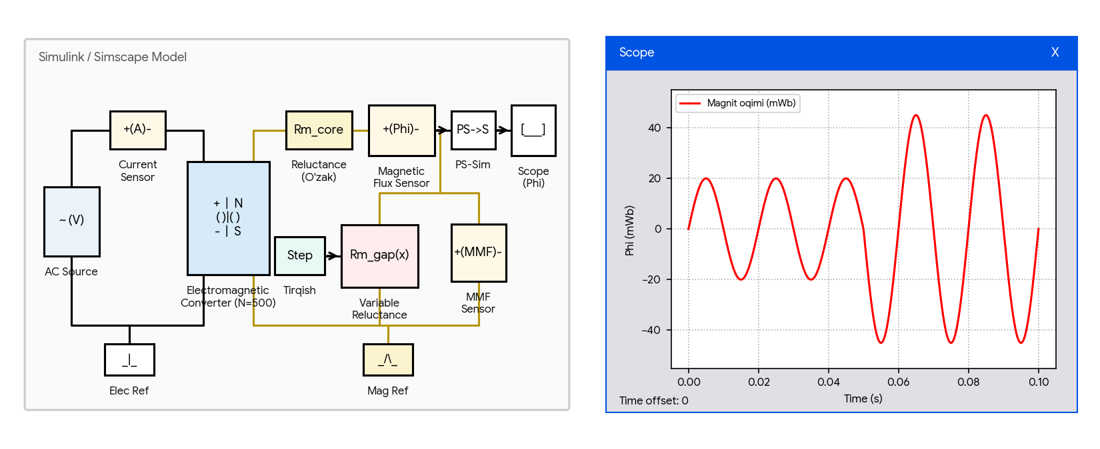
“Elektrotexnika va mexatronika” kafedrasi
Datchiklarning magnit zanjirlarini modellashtirish
Elektr va magnit zanjirlarni birgalikda modellashtirish
Induktiv datchikning chap tomonda elektr zanjiri (AC Source, Current Sensor), o’ng tomonda magnit zanjiri (Reluctance, Variable Reluctance, Magnetic Flux Sensor, MMF Sensor) modellashtirilgan.
6-rasm. Elektr va magnit zanjirlarning birgalikdagi modeli.
© Department of "Electrical Engineering and Mechatronics"
Mustaqil ish – Rozubaev Xushnudbek | 24

Slide 25
“Elektrotexnika va mexatronika” kafedrasi
Struktura sxemasi va uni Simulinkda modellashtirish
Datchiklarning umumlashgan struktura sxemasi
x(t) → Sezgir element → O’zgartirish zanjiri → Kuchaytirgich va filtr → y(t)
1. Sezgir element – fizik kattalikni mexanik siljish yoki deformatsiyaga aylantiradi (birlamchi o’zgartkich).
2. O’zgartirish zanjiri – parametr o’zgarishini elektr kuchlanish yoki tok signaliga aylantiradi (elektr va magnit zanjir).
3. Normallashtiruvchi kuchaytirgich va filtr – signalni standart sathga (0..5 V, 4..20 mA) keltiradi va shovqinlardan tozalaydi.
© Department of "Electrical Engineering and Mechatronics"
Mustaqil ish – Rozubaev Xushnudbek | 25

Slide 26
“Elektrotexnika va mexatronika” kafedrasi
Struktura sxemasi va uni Simulinkda modellashtirish
Datchiklarning matematik modeli
Dinamik jihatdan datchiklar 1-tartibli aperiodik yoki 2-tartibli tebranuvchi bo’g’in tenglamasi bilan ifodalanadi.
1-tartibli: W(s) = K / (T·s + 1)
2-tartibli: W(s) = K / (T²·s² + 2ξ·T·s + 1)
Bu yerda: K – statik sezgirlik, T – vaqt konstantasi, ξ – dempferlash koeffitsiyenti.
© Department of "Electrical Engineering and Mechatronics"
Mustaqil ish – Rozubaev Xushnudbek | 26

Slide 27
“Elektrotexnika va mexatronika” kafedrasi
Struktura sxemasi va uni Simulinkda modellashtirish
Uzatish funksiyasi bloki (Transfer Fcn)
Vazifasi – datchikning struktura sxemasidagi inersiyali bo’g’inlarni Laplas uzatish funksiyasi W(s) ko’rinishida hamda statik sezgirlik koeffitsiyentini K modellashtiradi.
Transfer Fcn bloki parametrlari
1. Numerator coefficients – uzatish funksiyasi suratining koeffitsiyentlari vektori (masalan [1]).
2. Denominator coefficients – maxrajining s darajalari kamayib borish tartibidagi koeffitsiyentlari vektori (masalan [0.5 1]).
© Department of "Electrical Engineering and Mechatronics"
Mustaqil ish – Rozubaev Xushnudbek | 27

Slide 28
“Elektrotexnika va mexatronika” kafedrasi
Struktura sxemasi va uni Simulinkda modellashtirish
Sezgirlik bloki (Gain)
Vazifasi – kirish signalini datchikning sezgirlik koeffitsiyentiga ko’paytiradi.
y(t) = K·x(t) K = Δy / Δx
Parametri: Gain – ko’paytirish koeffitsiyenti K. Datchik pasportidagi sezgirlik qiymati shu yerga kiritiladi.
1- va 2-tartibli datchiklarning struktura sxemasi va o’tish jarayoni 7-rasmda keltirilgan.
© Department of "Electrical Engineering and Mechatronics"
Mustaqil ish – Rozubaev Xushnudbek | 28

Slide 29
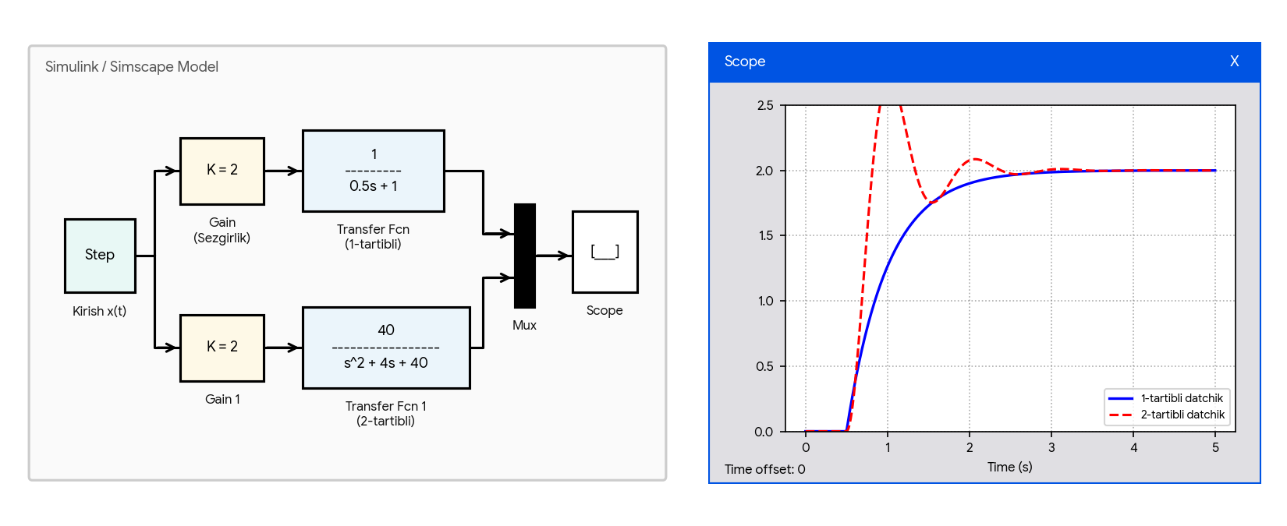
“Elektrotexnika va mexatronika” kafedrasi
Struktura sxemasi va uni Simulinkda modellashtirish
1- va 2-tartibli datchiklarning o’tish jarayoni
Kirishga t = 0.5 s da Step pog’onali signal berilganda 1-tartibli (ko’k) va 2-tartibli tebranuvchi (qizil) datchiklarning o’tish jarayoni grafiklari.
7-rasm. Birinchi va ikkinchi tartibli datchiklarning o’tish jarayoni.
© Department of "Electrical Engineering and Mechatronics"
Mustaqil ish – Rozubaev Xushnudbek | 29

Slide 30
“Elektrotexnika va mexatronika” kafedrasi
Struktura sxemasi va uni Simulinkda modellashtirish
Differensiallovchi blok (Derivative)
Vazifasi – kirish signalining vaqt bo’yicha hosilasini hisoblaydi.
y(t) = dx/dt e = −N·dΦ/dt
Induksion datchiklarda Faradey elektromagnit induksiya qonunini hamda tezlik datchiklarini modellashtirishda ishlatiladi.
Diqqat: Derivative bloki shovqinni keskin kuchaytiradi. Amalda uning oldiga past chastotali filtr yoki o’rniga Filtered Derivative bloki qo’yiladi.
© Department of "Electrical Engineering and Mechatronics"
Mustaqil ish – Rozubaev Xushnudbek | 30

Slide 31
“Elektrotexnika va mexatronika” kafedrasi
Struktura sxemasi va uni Simulinkda modellashtirish
Integrallovchi blok (Integrator)
Vazifasi – kirish signalini vaqt bo’yicha integrallaydi.
y(t) = y₀ + ∫ x(τ) dτ
Akselerometr (tezlanish datchigi) signalidan tezlik va siljishni olishda hamda induksion g’altak kuchlanishidan magnit oqimini tiklashda qo’llaniladi.
Parametrlari
1. Initial condition – integrallashning boshlang’ich qiymati y₀.
2. Limit output – chiqish signalini yuqori va quyi chegaralar (Saturation limits) bilan cheklash.
© Department of "Electrical Engineering and Mechatronics"
Mustaqil ish – Rozubaev Xushnudbek | 31

Slide 32
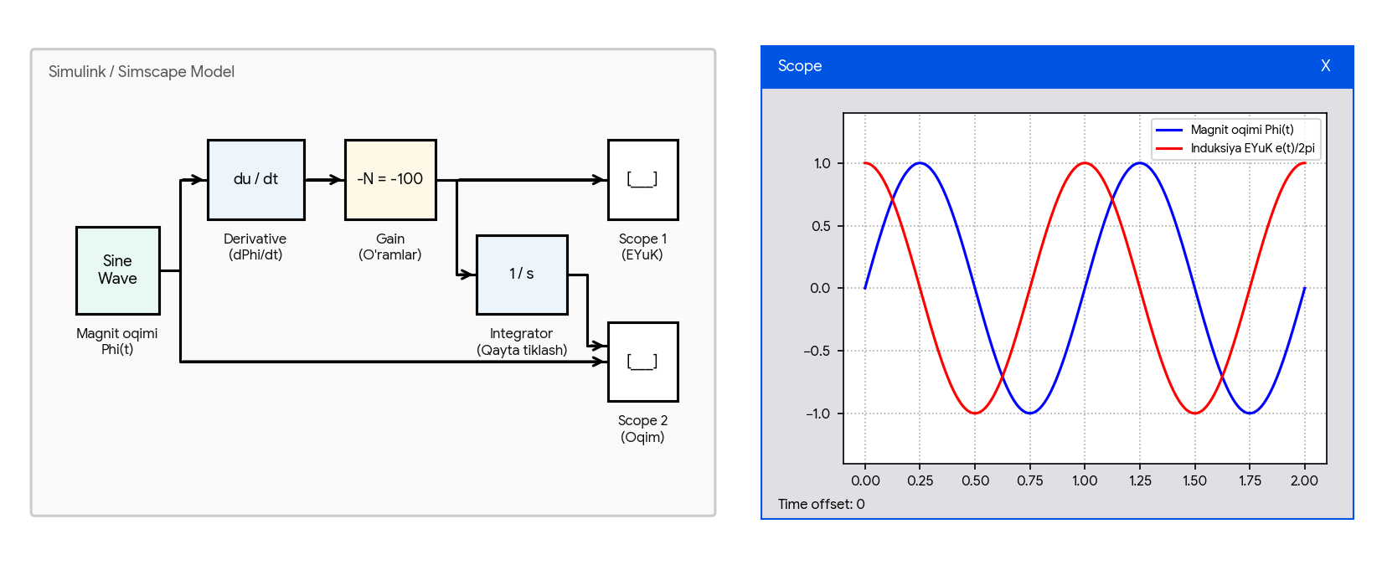
“Elektrotexnika va mexatronika” kafedrasi
Struktura sxemasi va uni Simulinkda modellashtirish
Induksion magnit datchigi
Sinusoidal magnit oqimi Φ(t) o’zgarganda Derivative va Gain bloklari yordamida induksiya EYuKni olish hamda Integrator bloki yordamida magnit oqimini qayta tiklash ko’rsatilgan.
8-rasm. Induksion datchik modeli va magnit oqimini tiklash.
© Department of "Electrical Engineering and Mechatronics"
Mustaqil ish – Rozubaev Xushnudbek | 32

Slide 33
“Elektrotexnika va mexatronika” kafedrasi
Struktura sxemasi va uni Simulinkda modellashtirish
Holatlar fazosi bloki (State-Space)
Vazifasi – murakkab elektromagnit va elektromexanik datchiklarning o’zaro bog’langan mexanik, magnit va elektr tenglamalar tizimini matritsalar ko’rinishida ifodalaydi.
dx/dt = A·x + B·u
y = C·x + D·u
Holat vektori x tashkil etuvchilari
1. x₁ – yakor siljishi;
2. x₂ – yakor tezligi;
3. x₃ – g’altakdagi tok (yoki magnit oqimi).
© Department of "Electrical Engineering and Mechatronics"
Mustaqil ish – Rozubaev Xushnudbek | 33

Slide 34
“Elektrotexnika va mexatronika” kafedrasi
Struktura sxemasi va uni Simulinkda modellashtirish
State-Space bloki parametrlari
A (n × n) – tizimning xususiy dinamika matritsasi.
B (n × m) – kirish ta’siri (boshqaruv) matritsasi.
C (p × n) – datchikning o’lchanadigan chiqish matritsasi.
D – to’g’ridan-to’g’ri uzatish matritsasi.
Initial conditions – boshlang’ich holat vektori x₀.
State-Space modelining afzalligi: bitta blok bilan bir vaqtda mexanik, magnit va elektr dinamikani birgalikda ifodalash mumkin – uzatish funksiyasi esa faqat bitta kirish-chiqish juftligini beradi.
© Department of "Electrical Engineering and Mechatronics"
Mustaqil ish – Rozubaev Xushnudbek | 34

Slide 35
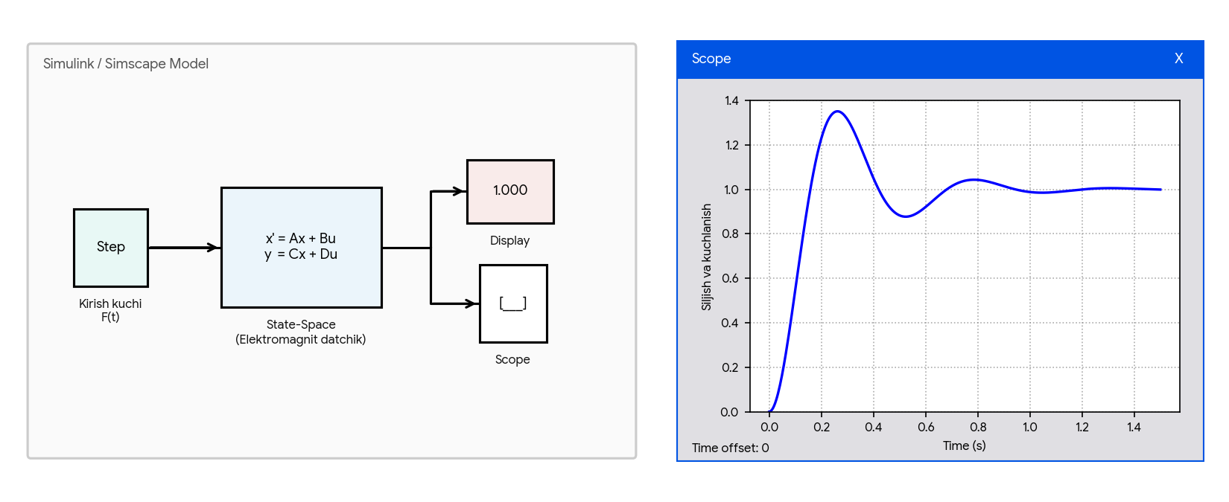
“Elektrotexnika va mexatronika” kafedrasi
Struktura sxemasi va uni Simulinkda modellashtirish
Elektromagnit kuch va siljish datchigi
Elektromagnit kuch va siljish datchigining holatlar fazosi modelini State-Space bloki yordamida tadqiq qilish va uning o’tish jarayoni tasvirlangan.
9-rasm. Elektromagnit datchikning holatlar fazosi modeli.
© Department of "Electrical Engineering and Mechatronics"
Mustaqil ish – Rozubaev Xushnudbek | 35

Slide 36
“Elektrotexnika va mexatronika” kafedrasi
Xoll datchigi va nochiziqli datchiklar signallari
Xoll (Hall) magnit datchigi
Ishlash prinsipi – tok oqib o’tayotgan yarimo’tkazgich plastinka magnit maydonga joylashtirilganda, tok I va magnit induksiya B yo’nalishiga perpendikulyar ko’ndalang Xoll EYuK hosil bo’ladi.
E_{H} = (R_{H} / d)·I·B = K_{H}·I·B
Bu yerda: R_{H} – Xoll doimiysi, d – plastinka qalinligi, K_{H} – datchik sezgirligi.
Chiqish signali tok va induksiyaning ko’paytmasi ga proporsional – shuning uchun Simulinkda Product bloki bilan modellashtiriladi.
© Department of "Electrical Engineering and Mechatronics"
Mustaqil ish – Rozubaev Xushnudbek | 36

Slide 37
“Elektrotexnika va mexatronika” kafedrasi
Xoll datchigi va nochiziqli datchiklar signallari
Xoll datchigi: Simulink bloklari
1. Constant bloki – datchikning o’zgarmas boshqaruv tokini (I = 0.2 A) shakllantiradi.
2. Sine Wave bloki – o’zgaruvchan magnit maydon induksiyasini B(t) shakllantiradi.
3. Product va Gain bloklari – tok va magnit induksiyani o’zaro ko’paytirib, Xoll sezgirlik koeffitsiyentiga K_{H} ko’paytiradi.
Xoll datchigi generatorli datchik: o’zi EYuK hosil qiladi, shuning uchun uni Uitston ko’prigi kerak emas – chiqish signali to’g’ridan-to’g’ri o’lchanadi.
© Department of "Electrical Engineering and Mechatronics"
Mustaqil ish – Rozubaev Xushnudbek | 37

Slide 38
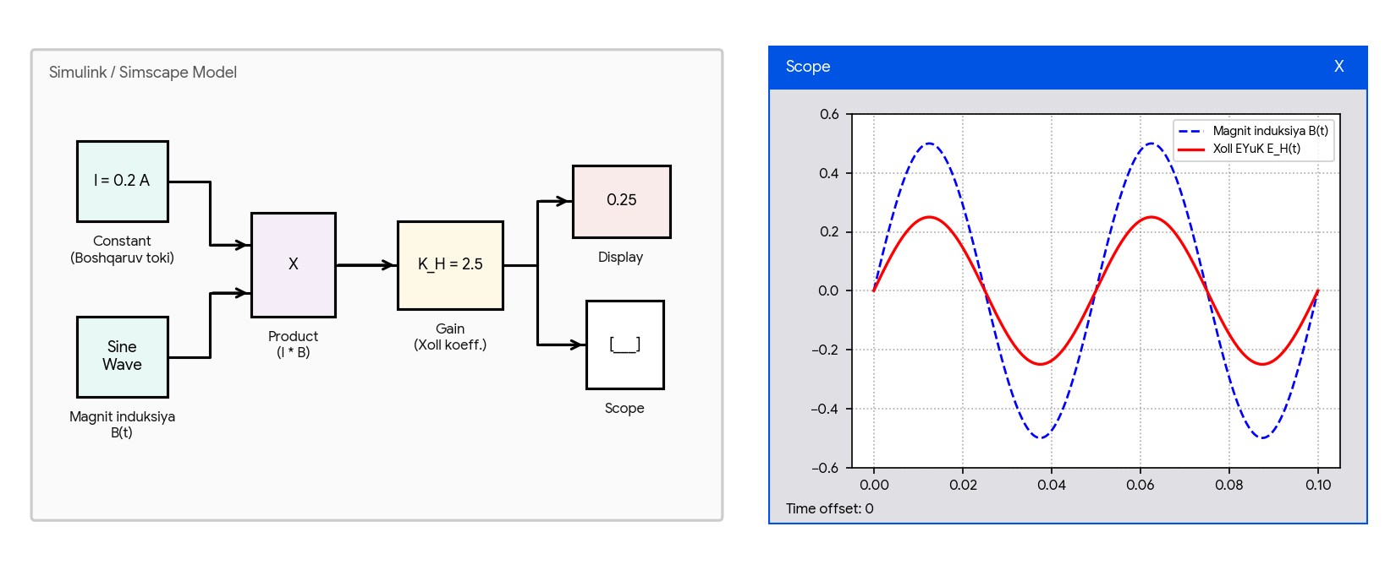
“Elektrotexnika va mexatronika” kafedrasi
Xoll datchigi va nochiziqli datchiklar signallari
Xoll datchigining Simulink modeli
Xoll effekti asosida ishlovchi magnit induksiya datchigining Constant, Sine Wave, Product va Gain bloklari yordamida yig’ilgan modeli.
10-rasm. Xoll datchigining Simulink modeli va chiqish signali.
© Department of "Electrical Engineering and Mechatronics"
Mustaqil ish – Rozubaev Xushnudbek | 38

Slide 39
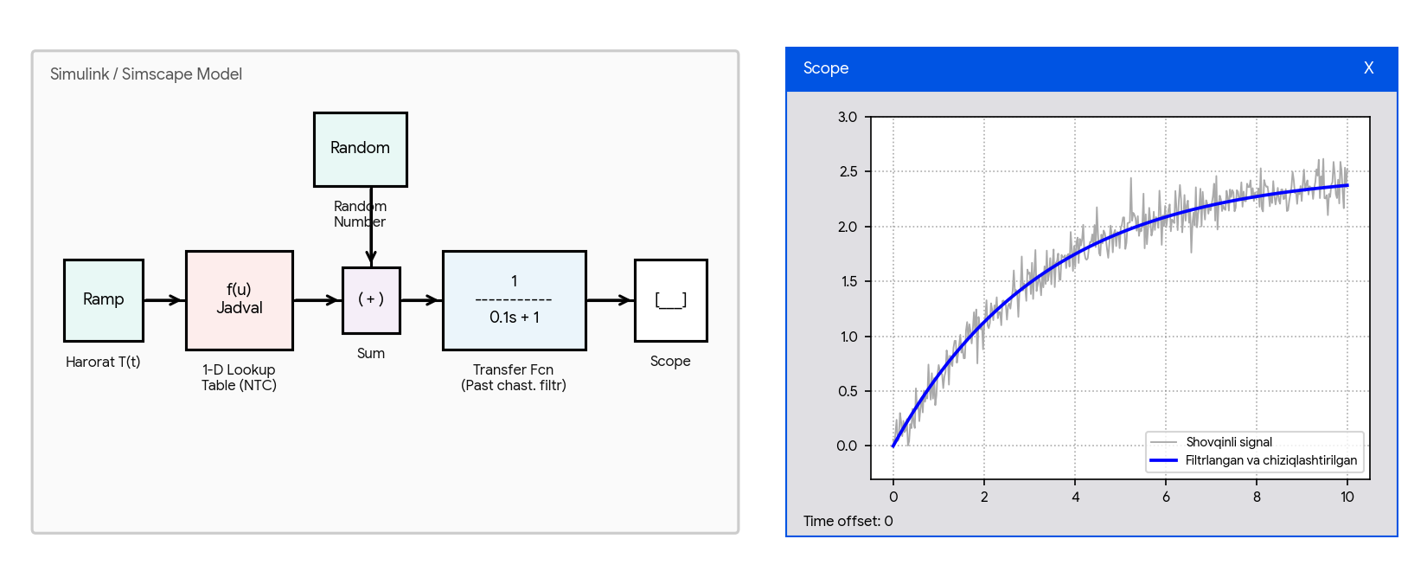
“Elektrotexnika va mexatronika” kafedrasi
Xoll datchigi va nochiziqli datchiklar signallari
Nochiziqli datchik va shovqinni filtrlash
Nochiziqli datchik xarakteristikasini 1-D Lookup Table yordamida jadval asosida berish hamda tashqi Random Number shovqinini past chastotali filtr (Transfer Fcn) bilan tozalash.
11-rasm. Nochiziqli datchik signali va filtrlash natijasi.
© Department of "Electrical Engineering and Mechatronics"
Mustaqil ish – Rozubaev Xushnudbek | 39

Slide 40
“Elektrotexnika va mexatronika” kafedrasi
XULOSA
1. Parametrik datchiklar (Variable Resistor, Variable Capacitor, Variable Inductor) Simscape’da fizik signal porti orqali boshqariladi – shu port datchikni oddiy elementdan ajratib turadi.
2. Elektr va magnit zanjirlarni Electromagnetic Converter bog’laydi; magnit zanjirda Magnetic Flux Sensor va MMF Sensor elektr zanjirdagi tok va kuchlanish datchiklarining analogi bo’lib xizmat qiladi.
3. Struktura modellashtirish (Transfer Fcn, State-Space) datchikning inersiyasi, tebranishi va sezgirligini baholashga imkon beradi.
4. Uitston ko’prigi va Xoll datchigi misolida nochiziqlik muhim ahamiyatga ega: chiqish signalini chiziqlashtirish yoki Lookup Table bilan korreksiyalash talab etiladi.
© Department of "Electrical Engineering and Mechatronics"
Mustaqil ish – Rozubaev Xushnudbek | 40

Slide 41
“Elektrotexnika va mexatronika” kafedrasi
FOYDALANILGAN ADABIYOTLAR
1. Mohammad Nuruzzaman. Modeling and Simulation in SIMULINK for Engineers and Scientists. New York, Author House, 2004. – 225 pages.
2. В.П. Дьяконов. MATLAB 6.5 SP1/7 + Simulink 5/6. Основы применения. М.: СОЛОН-Пресс, 2005. – 800 с.
3. Дьяконов В.П., Абраменкова И.В. MATLAB. Обработка сигналов и изображений. СПб.: Питер, 2002. – 602 с.
4. Герман-Галкин С.Г. Лабораторные работы на ПК. СПб.: Учитель и ученик, КОРОНА принт, 2002. – 304 с.
5. Черных И.В. Моделирование электротехнических устройств в MATLAB, SimPowerSystems и Simulink. – М.: ДМК Пресс, 2008. – 288 с.
© Department of "Electrical Engineering and Mechatronics"
Mustaqil ish – Rozubaev Xushnudbek | 41

Slide 42
“Elektrotexnika va mexatronika” kafedrasi
E’TIBORINGIZ UCHUN RAHMAT!
Datchiklar va ularning elektr va magnit zanjirlarini modellashtirish
Bajardi: Rozubaev Xushnudbek
Ilmiy rahbar: PhD, A.U.Djalilov
“Elektrotexnika va mexatronika” kafedrasi • Toshkent – 2026
© Department of "Electrical Engineering and Mechatronics"
Mustaqil ish – Rozubaev Xushnudbek | 42

