Slide 1
Machine Learning Approaches for Fraud Detection in Financial Transactions
Xurui Zhang
CISC 5800 Machine Learning
5/12/2025

Slide 2
INTRODUCTION
The goal of this project is to develop a robust machine learning model for fraud detection using a synthetic dataset of financial transactions.
The dataset contains numerical, categorical, and temporal features, enabling a binary classification task to distinguish fraudulent transactions from legitimate ones. Financial fraud poses significant risks to both institutions and consumers, and this project aims to explore how machine learning techniques can enhance fraud detection systems by improving accuracy and interpretability.
Notes:
Financial fraud is a major concern in today’s world. My goal was to build a machine learning model that can accurately detect fraudulent transactions. The task is binary classification: predict whether a transaction is fraudulent or not.

Slide 3
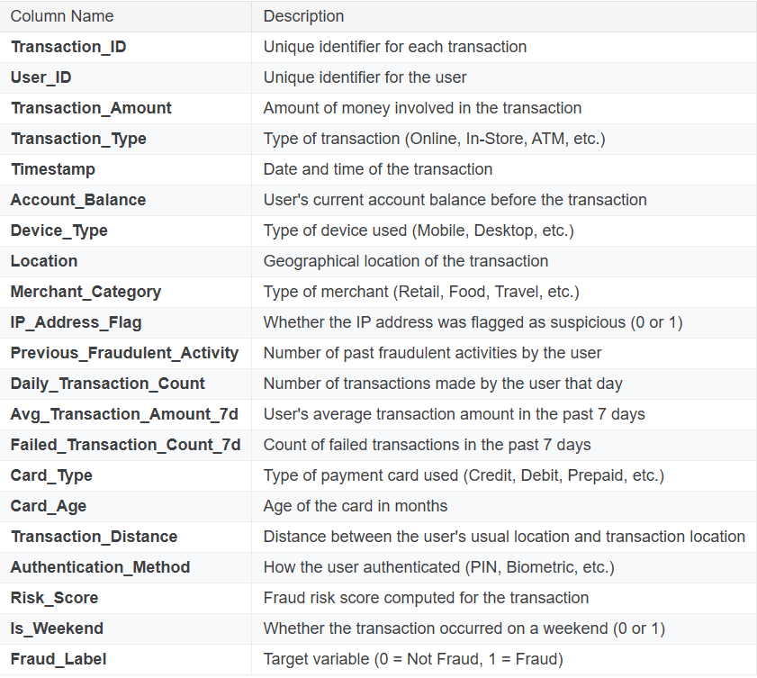
Feature Description

Slide 4
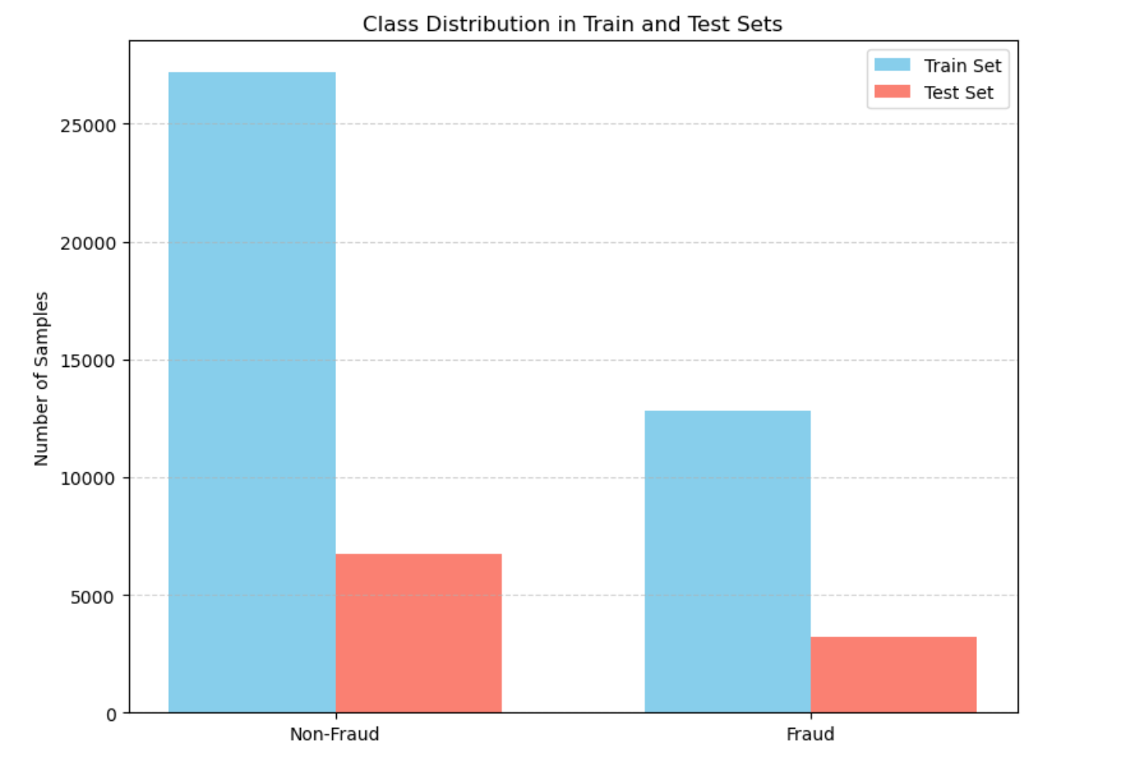
Data imbalance

Slide 5
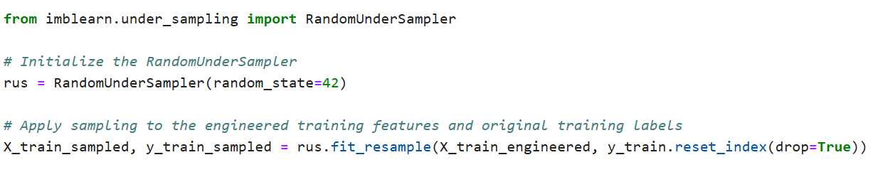
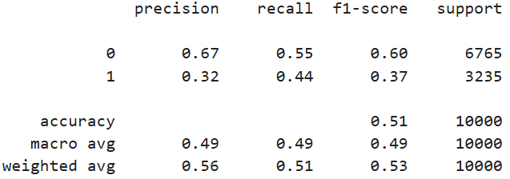
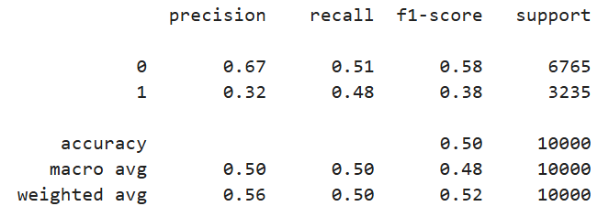
Try to use add random samples:
Random Forest model
SVM model

Slide 6
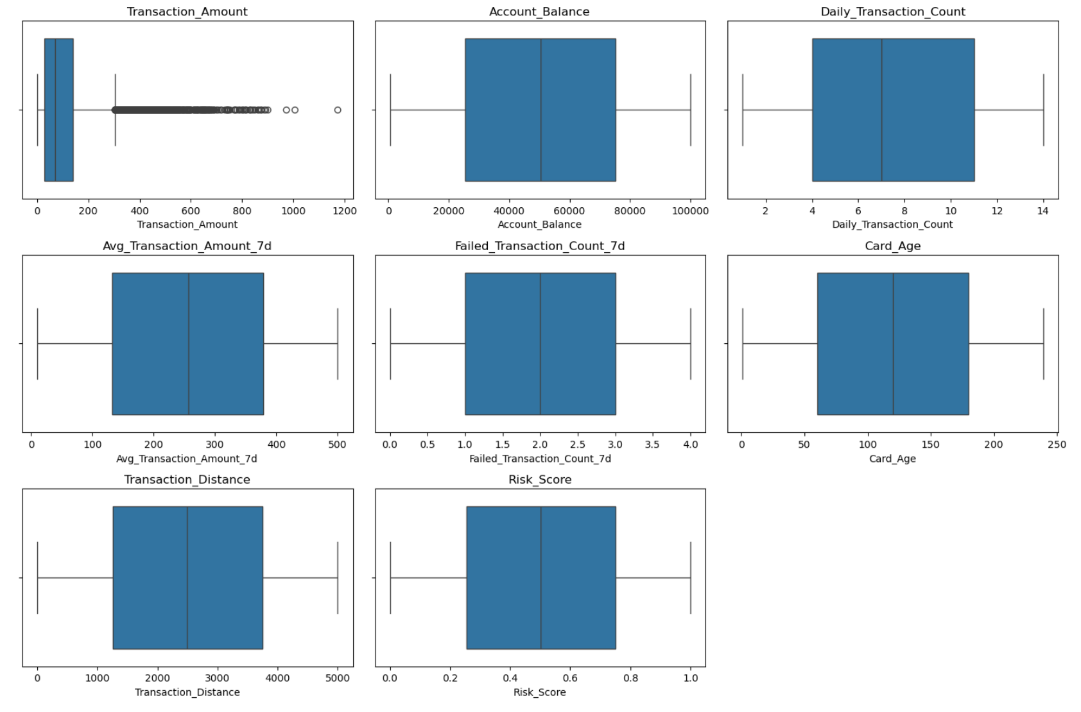
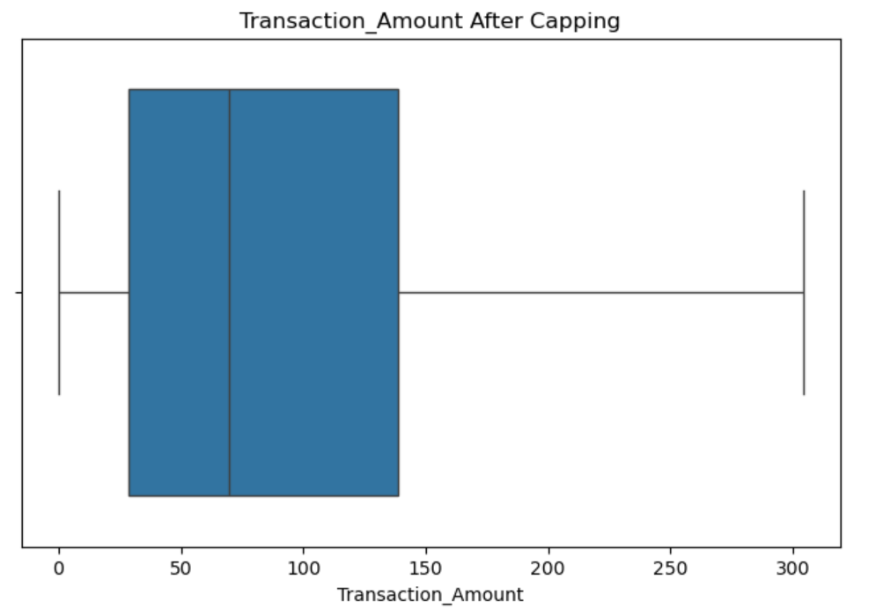
Detecting Data Availability
Check missing data
Checking data with outliers
After capping:

Slide 7
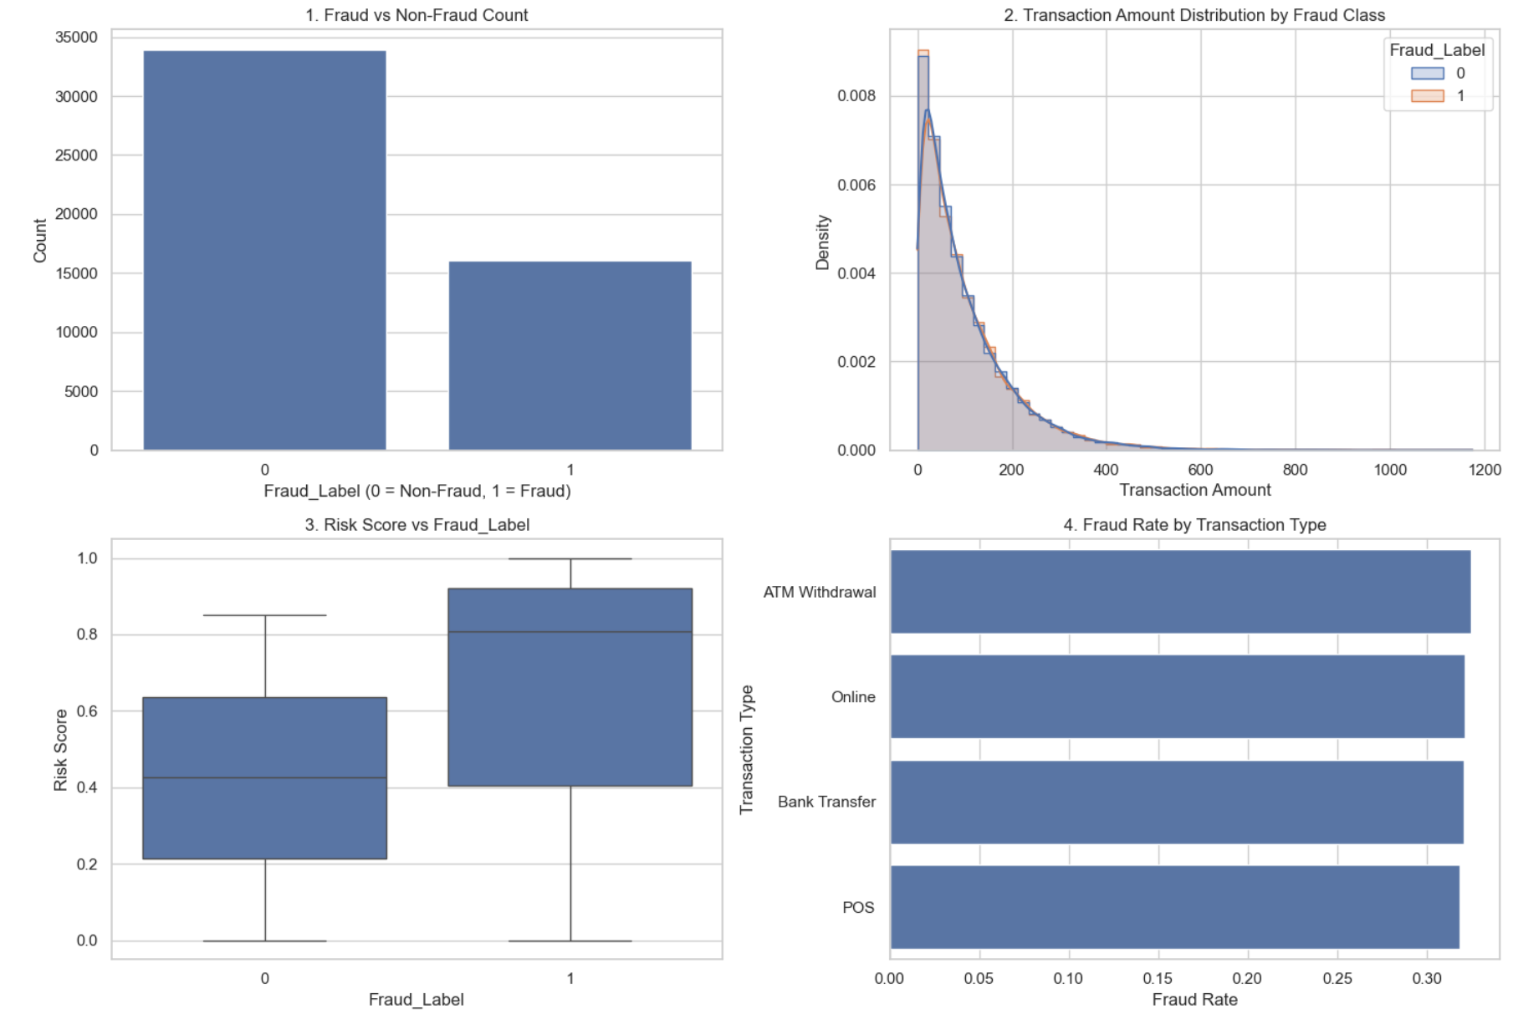
Visualization

Slide 8
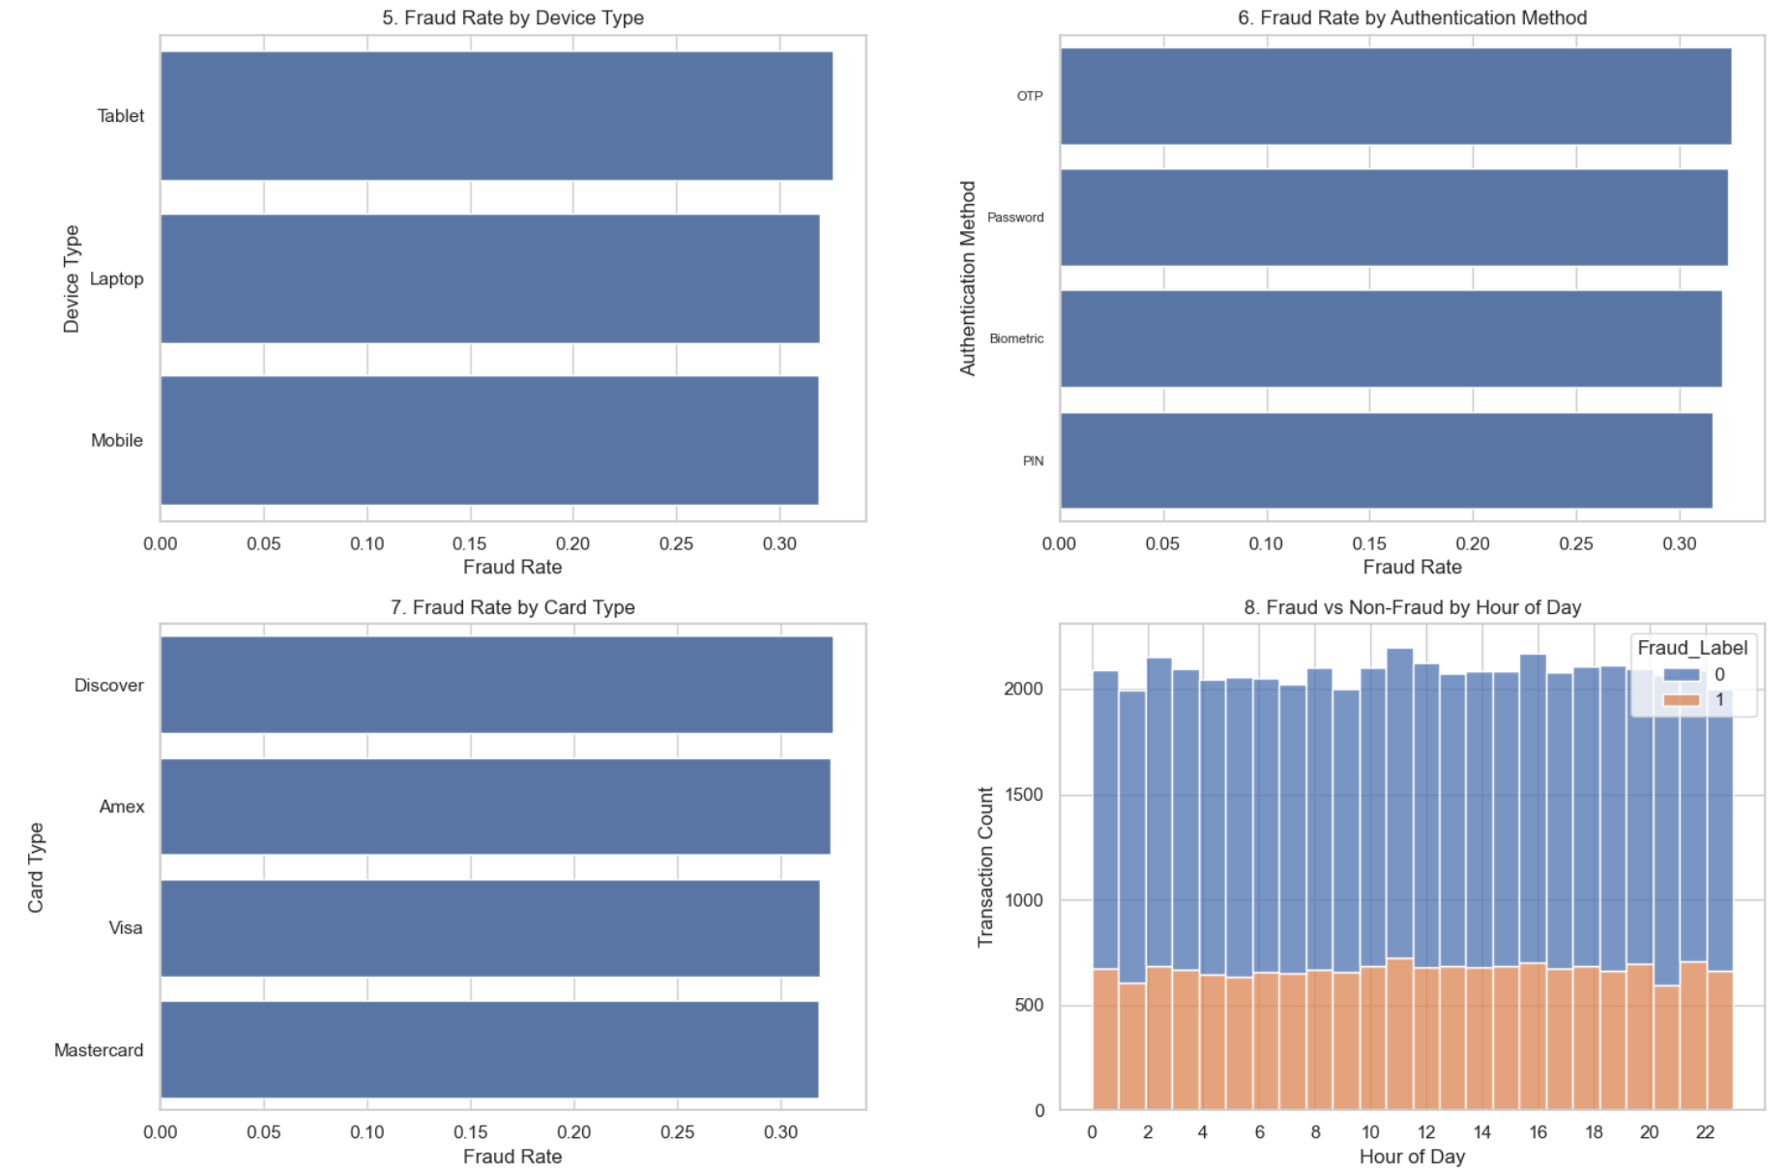
Visualization

Slide 9
Timestamp Feature Processing
Processing: converts the string to a standard datetime object (for easy extraction of information).
Extract numeric features with predictive value from the datetime:
Transaction_Hour: Captures the time of day pattern.
Transaction_DayOfWeek: captures periodic patterns within a week (e.g. weekends).
Transaction_Month and Transaction_Day: captures monthly or seasonal patterns.
Is_Weekend: Explicitly marks weekend transactions.
Delete the original Timestamp column.
Result: Time information is converted into multiple discrete or limited range numeric features
Category-based feature processing
Processing: uses One-Hot Encoding.
Convert each category type feature into multiple new binary (0/1) numeric features
(one column for each category).
One-hot encoded: ['Transaction_Type', 'Device_Type', 'Location', 'Merchant_Category’,
'Card_Type', 'Authentication_Method']

Slide 10
Addressing Class Imbalance (using SMOTE)
Problem: Real-world fraud data is typically highly imbalanced (many more non-fraud cases than fraud).
Models trained on imbalanced data can be biased towards the majority class, performing poorly on the minority class (Fraud).
Solution: Applied SMOTE (Synthetic Minority Over-sampling Technique).
What SMOTE does: Generates synthetic examples of the minority class (only in the training data).
Goal: To balance the class distribution in the training set, helping the model learn patterns of fraud more effectively.
Feature Scaling
Ensures all numerical features are on a similar scale, preventing features with larger values from dominating the learning process.
Used StandardScaler: Standardizes features by removing the mean and scaling to unit variance.
Application:
Identified specific numerical columns to scale (e.g., transaction amount, balance, counts, distances, time features).
Fitted the scaler only on the training data (the resampled set).
Applied the same fitted scaler to transform both the training and testing data. This prevents data leakage from the test set.

Slide 11
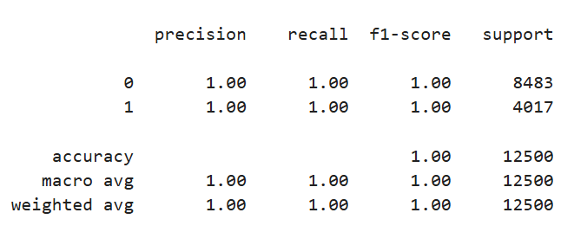
XGBoost Model: Initial Training & Evaluation Objective: Build a fraud detection model using XGBoost. Data: Trained on preprocessed and balanced training data (using SMOTE). Model: XGBoost Classifier (robust, tree-based algorithm). Initial Results (with Risk_Score feature): Remark: Unusually perfect performance observed on the test set.

Slide 12
Understanding the Impact of Risk_Score
Investigation: The exceptionally high performance raised concerns about potential data issues.
Finding: The Risk_Score feature showed an almost perfect correlation with the Fraud_Label.
In synthetic datasets, such features might be directly engineered from the target.
In real-world scenarios, this strong correlation could indicate Data Leakage, where information from the target variable is inadvertently included in the features.
Decision: To ensure a more realistic and generalizable model performance evaluation, the Risk_Score feature was removed from the dataset.

Slide 13
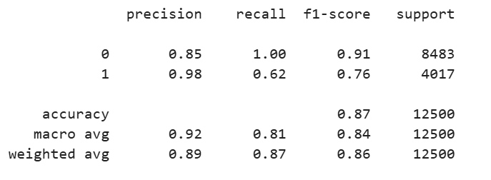
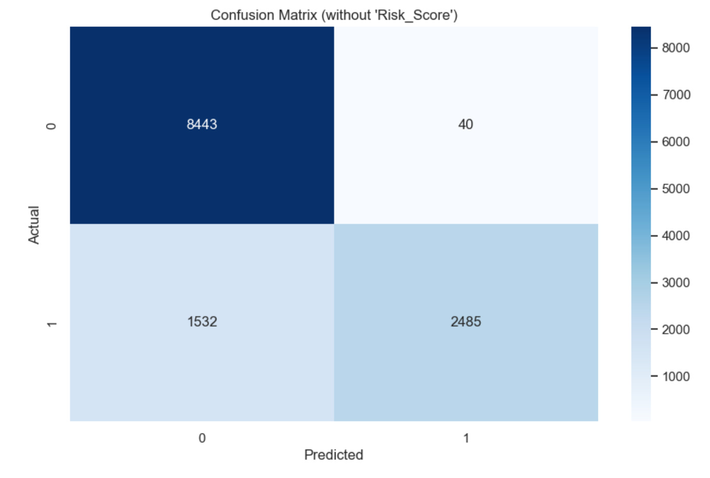
Model Re-evaluation Without Risk_Score
Retraining: The XGBoost model was retrained using the same preprocessing steps, but without the Risk_Score feature.
Key Evaluation Metrics:
Confusion Matrix:
Conclusion: The model continues to show strong performance in detecting fraud, with high precision and a good balance of recall. Importantly, without the Risk_Score feature, the results are no longer unrealistically perfect, providing a more realistic assessment of the model's capabilities for real-world application.

Slide 14
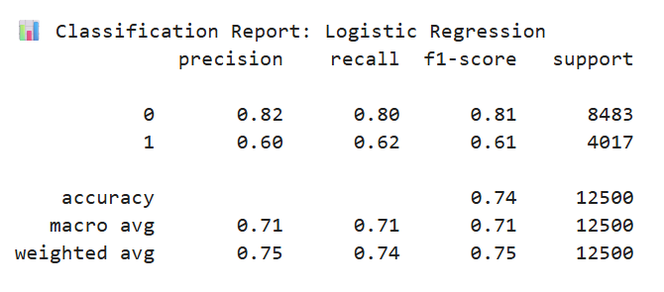
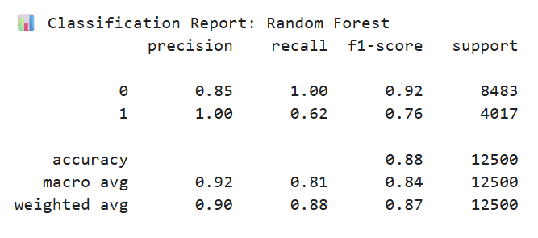
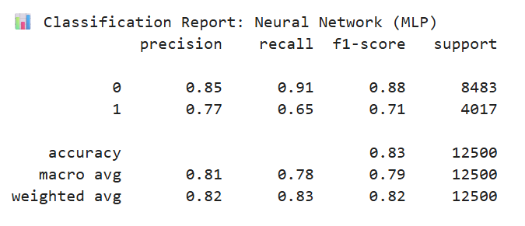
Other Models

Slide 15
Conclusion
Machine learning techniques were successfully applied to the financial fraud detection problem.
Class imbalance was addressed effectively using SMOTE to ensure balanced training.
Feature engineering, including time-based feature extraction and categorical encoding, enhanced model performance.
A data leakage issue was identified and mitigated by removing the Risk_Score feature.
The XGBoost and Random Forest models achieved strong performance, especially in terms of precision.
Although fraud recall could be further improved, overall model accuracy was high.
The project highlights the importance of careful preprocessing and critical feature evaluation.
Results demonstrate the practical value of machine learning in reducing financial fraud risks.

Slide 16
THANKS!

