Slide 1
程序的机器级表示(2)
王晶
jwang@ruc.edu.cn，信息楼124
2023年10月

Slide 2
ISA = Assembly/Machine Code View
CPU
Memory
Register file
Addresses
Data
Code
Data
Stack
PC
Condition
Codes
Instructions
Programmer-Visible State
  PC: Program counter
    Address of next instruction
  Register file
    Heavily used program data
  Condition codes
    Store status information about most recent arithmetic or logical operation
    Used for conditional branching
  Memory
    Byte addressable array
    Code and user data
    Stack to support procedures

Slide 3
复习：IA-32和8086的寄存器模型
32位 |  | 16位 | 8位
EAX |  | AH | AL | AX
EBX |  | BH | BL | BX
ECX |  | CH | CL | CX
EDX |  | DH | DL | DX
ESP |  | SP
EBP |  | BP
ESI |  | SI
EDI |  | DI
EIP |  | IP
EFLAGS |  | FLAGS
 |  | CS
 |  | DS
 |  | ES
 |  | SS
 |  | FS
 |  | GS
1.通用寄存器
2.指令指针
寄存器
说明
代表IA-32寄存器模型的新增部分 | 代表8086的寄存器模型
3.标志寄存器
4.段寄存器

Slide 4
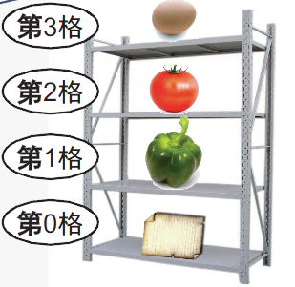
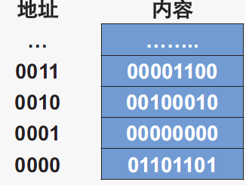
复习：主存储器的组织形式
主存储器通常按字节为单元进行划分
内容：存储单元中存放的二进制信息
地址：每个存储单元对应的序号

Slide 5
复习：存储器组织
每个存储单元以字节为基本存储单位
  即字节编址（Byte Addressable）
  一个字节（Byte）等于8个二进制位（Bit）
物理地址
  从0开始顺序编排，直到处理器支持的最大存储单元
  N位宽的地址线，寻址范围：2^{N}
逻辑地址
  编程时所使用的地址
  实模式下由“段基值”和“偏移量”构成
Notes:
32位汇编语言程序设计
第1章 汇编语言基础

Slide 6
汇编语言
一种较低级的程序设计语言
主要是机器语言的符号化描述
通常为特定计算机或计算机系列专门设计
x86汇编语言示例
ARM汇编语言示例
MOV AX, 0H
MOV BX, [20H]
ADD AX, BX
ADD BX, 1H
JMP label_next
MOV R0, #0
LDR R2, #0x10020
ADD R0, R0, R2
ADD R2, R2, #1
B label_next

Slide 7
汇编语言相比于高级语言的优缺点
优点
  可充分利用机器的硬件功能和结构特点，加快程序的执行速度，减少目标代码的存储空间
  适用于编写实时控制程序、实时通信程序，以及某些系统软件程序
缺点
  与描述计算过程的需要差距大，编程效率低
  与机器硬件的具体结构联系过于紧密，在不同体系结构之间极难移植
Notes:
Assembly is hard to learn.
Assembly is hard to read and understand.
Assembly is hard to debug.
Assembly is hard to maintain.
Assembly is hard to write.
Assembly language programming is time consuming.
Improved compiler technology has eliminated the need for assembly language.
Today, machines are so fast that we no longer need to use assembly.
If you need more speed, you should use a better algorithm rather than switch to assembly language.
Machines have so much memory today, saving space using assembly is not important.
Assembly language is not portable.

Slide 8

学习汇编语言的目的

Slide 9
学习汇编语言的目的
编译器也能生成汇编，为什么还要学习汇编
理解编译器的优化能力
  不能过于贬低：比绝大多数人工强
  也不能过于夸大：
    有些看似简单的地方，为了避免bug，不敢优化
    有些复杂问题还是很难优化（例如并行编译）
分析代码中低效的部分，以便提升程序性能
  汇编与性能直接对应

Slide 10
From writing assembly code to understand assembly code
直接写汇编程序
  熟悉汇编语言
  习惯汇编的思维方式（可以直接操控硬件）
  建立高级语言（C）和汇编之间的联系
逆向工程
  从C翻译到汇编
  理解在系统中程序到底做了什么
  帮助找出bug
  帮助找出程序的安全隐患
  帮助找出性能差的环节

Slide 11
程序的机器级表示
如何生成汇编语言程序
汇编语言程序的结构

Slide 12
Turning C into Object Code
  Code in files p1.c p2.c
  Compile with command: gcc –Og p1.c p2.c -o p
    Use basic optimizations (-Og) [New to recent versions of GCC]
    Put resulting binary in file p
text
C program (p1.c p2.c)
Compiler (gcc –Og -S) 编译器
text
Asm program (p1.s p2.s)
Assembler (gcc or as)汇编器
Static libraries (.a)
binary
Object program (p1.o p2.o)
Linker (gcc or ld) 链接器
binary
Executable program (p)

Slide 13
Compiling Into Assembly
C Code (sum.c)
Generated x86-64 Assembly
long plus(long x, long y);
void sumstore(long x, long y,
long *dest)
{
long t = plus(x, y);
*dest = t;
}
sumstore:
pushq %rbx
movq %rdx, %rbx
call plus
movq %rax, (%rbx)
popq %rbx
ret
Obtain (on shark machine) with command
  gcc –Og –S sum.c
Produces file sum.s
Warning: Will get very different results on other machines (Andrew Linux, Mac OS-X, …) due to different versions of gcc and different compiler settings.

Slide 14
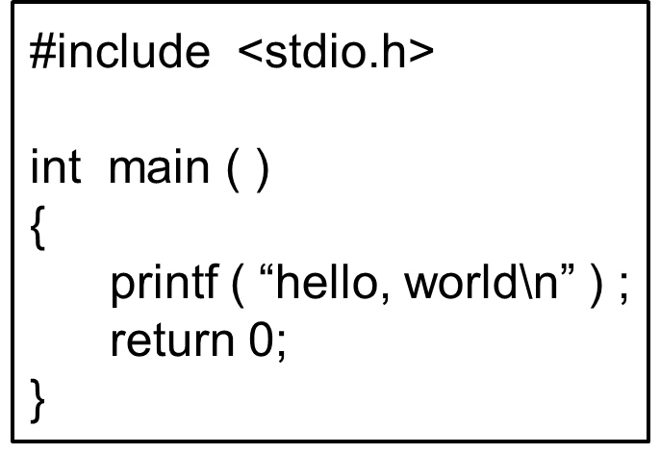
汇编和反汇编
“gcc –c test.s –o test.o”将test.s汇编为test.o
“objdump -d test.o”将test.o 反汇编为.s文件
00000000 <add>:
0: 55 push %ebp
1: 89 e5 mov %esp, %ebp
3: 83 ec 10 sub $0x10, %esp
6: 8b 45 0c mov 0xc(%ebp), %eax
9: 8b 55 08 mov 0x8(%ebp), %edx
c: 8d 04 02 lea (%edx,%eax,1), %eax
f: 89 45 fc mov %eax, -0x4(%ebp)
12: 8b 45 fc mov -0x4(%ebp), %eax
15: c9 leave
16: c3 ret
gcc -E test.c -o test.i
gcc -S test.i -o test.s
或
gcc –S test.c –o test.s
test.s
add:
pushl %ebp
movl %esp, %ebp
subl $16, %esp
movl 12(%ebp), %eax
movl 8(%ebp), %edx
leal (%edx, %eax), %eax
movl %eax, -4(%ebp)
movl -4(%ebp), %eax
leave
ret
位移量
机器指令
汇编指令
编译得到的与反汇编得到的汇编指令形式稍有差异

Slide 15
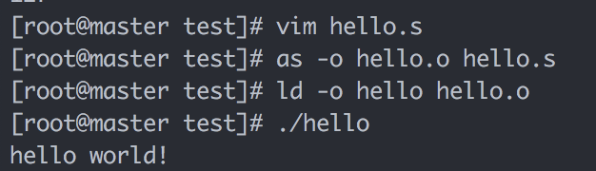
工具
汇编器
  as, gcc依赖的汇编器
链接器
  ld
调试器
  Gdb
$ as hello.s -o hello.o
$ ld hello.o -o hello
$ ./hello
$ echo $? #打印返回值
反汇编器
  objdump –d sum
  Useful tool for examining object code
  Analyzes bit pattern of series of instructions
  Produces approximate rendition of assembly code
  Can be run on either a.out (complete executable) or .o file

Slide 16
Alternate Disassembly
Object
Disassembled
0x0400595:
0x53
0x48
0x89
0xd3
0xe8
0xf2
0xff
0xff
0xff
0x48
0x89
0x03
0x5b
0xc3
Dump of assembler code for function sumstore:
0x0000000000400595 <+0>: push %rbx
0x0000000000400596 <+1>: mov %rdx,%rbx
0x0000000000400599 <+4>: callq 0x400590 <plus>
0x000000000040059e <+9>: mov %rax,(%rbx)
0x00000000004005a1 <+12>:pop %rbx
0x00000000004005a2 <+13>:retq
Within gdb Debugger
  gdb sum
  disassemble sumstore
  Disassemble procedure
  x/14xb sumstore
  Examine the 14 bytes starting at sumstore

Slide 17
What Can be Disassembled?
% objdump -d WINWORD.EXE
WINWORD.EXE: file format pei-i386
No symbols in "WINWORD.EXE".
Disassembly of section .text:
30001000 <.text>:
30001000: 55 push %ebp
30001001: 8b ec mov %esp,%ebp
30001003: 6a ff push $0xffffffff
30001005: 68 90 10 00 30 push $0x30001090
3000100a: 68 91 dc 4c 30 push $0x304cdc91
Reverse engineering forbidden by
Microsoft End User License Agreement
Anything that can be interpreted as executable code
Disassembler examines bytes and reconstructs assembly source

Slide 18
程序的机器级表示
如何生成汇编语言程序
汇编语言程序的结构

Slide 19
What it really looks like
.globl sumstore
.type sumstore, @function
sumstore:
.LFB35:
.cfi_startproc
pushq %rbx
.cfi_def_cfa_offset 16
.cfi_offset 3, -16
movq %rdx, %rbx
call plus
movq %rax, (%rbx)
popq %rbx
.cfi_def_cfa_offset 8
ret
.cfi_endproc
.LFE35:
.size sumstore, .-sumstore

Slide 20
What it really looks like
.globl sumstore
.type sumstore, @function
sumstore:
.LFB35:
.cfi_startproc
pushq %rbx
.cfi_def_cfa_offset 16
.cfi_offset 3, -16
movq %rdx, %rbx
call plus
movq %rax, (%rbx)
popq %rbx
.cfi_def_cfa_offset 8
ret
.cfi_endproc
.LFE35:
.size sumstore, .-sumstore
Things that look weird and are preceded by a ‘.’ are generally directives.
sumstore:
pushq %rbx
movq %rdx, %rbx
call plus
movq %rax, (%rbx)
popq %rbx
ret

Slide 21
“Hello World” Example
.data
msg : .string "hello world!\n"
len = . – msg
.text
.global _start
_start:
movq $len, %rdx ;第4个参数，字符串长度
movq $msg, %rcx ;第3个参数，字符串地址
movq $1, %rbx ;第2个参数，1指定标准输出（0-标准输入）
movq $4, %rax ;第1个参数，4为系统调用号：sys_write
int $0x80 ;80中断，系统调用
movl $0, %ebx ;参数1，退出代码，指定的返回值
movl $1, %eax ;1号系统调用：sys_exit
int $0x80

Slide 22
汇编语言程序的结构
.text 程序段
.data 数据段
.stack 堆栈段

Slide 23
Code Examples
instruction
//C code int accum = 0; int sum(int x, int y) { int t = x+y; accum += t; return t; } | _sum: pushl %ebp movl %esp,%ebp movl 12(%ebp),%eax addl 8(%ebp),%eax addl %eax, accum movl %ebp,%esp popl %ebp ret
Obtain with command gcc –O2 -S code.c Assembly file code.s
addl 8(%ebp),%eax

Slide 24
From C Codes to Assembly codes
Instruction
  Performs a very elementary operation only
Add two signed integers
  C code:
    int t = x+y;
  Assembly code:
    addl 8(%ebp),%eax
    Add 2 4-byte integers
    Similar to expression x +=y

Slide 25
Machine Instruction
C Code
  Store value t where designated by dest
Assembly
  Move 8-byte value to memory
    Quad words in x86-64 parlance
  Operands:
    t: Register %rax
    dest: Register %rbx
    *dest: Memory M[%rbx]
Object Code
  3-byte instruction
  Stored at address 0x40059e
*dest = t;
movq %rax, (%rbx)
0x40059e: 48 89 03

Slide 26
Operations in Assembly Instructions
Program（程序）
  is a sequence of instructions
Instruction（指令）
  Performs only a very elementary operation
Sequential execution mode（执行方式）
  Normally one by one in sequential
  Conditionally branch to a new instruction address
Typically operates data stored in registers
Transfers data between memory and a register

Slide 27
Understanding Machine Execution
指令存在哪里?
  In memory
  Code area
指令如何执行?
  %eip stores an address of memory,
  from the address, machine can read a whole instruction once
  increase %eip
    %eip is also called program counter (PC)
  then execute the instruction

Slide 28
Code Layout
0xffffffff
memory invisible to
user code
kernel virtual memory
0xc0000000
Linux/x86
process
memory
image
Read/write data
Read only data
Read only code
%eip
0x08048000
forbidden

Slide 29
Sequential execution
f()
{
int i = 3 ;
}
kernel virtual memory
08048390 <_f>:
90: 55 push %ebp
91: 89 e5 mov %esp,%ebp
93: 83 ec 14 sub $0x14,%esp
96: c7 45 fc movl $03, -0x4(%ebp)
9d: c9 03 00 00 00 leave
9e: c3 ret
Read/write data
Read only data
Read only code
%eip
0x08048000
forbidden
Notes:
LEAVE指令是将栈指针指向帧指针，然后POP备份的原帧指针到%EBP

Slide 30
Sequential execution
PC
08 04 83 9e
 | c3 | ret
 | c9 | leave
9c | 00
 | 00
 | 00
 | 03
98 | fc
 | 45
 | c7 | movl $0x3,-0x4(%ebp)
 | 14
94 | ec
 | 83 | sub $0x14,%esp
 | e5
 | 89 | mov %esp,%ebp
90 | 55 | push %ebp
00000000 <_f>:
0: 55 push %ebp
1: 89 e5 mov %esp,%ebp
3: 83 ec 14 sub $0x14,%esp
6: c7 45 fc 03 00 00 00
movl $0x3,-0x4(%ebp)
d: c9 leave
e: c3 ret
PC
08 04 83 9d
PC
08 04 83 96
PC
08 04 83 93
PC
08 04 83 91
PC
08 04 83 90

Slide 31
汇编语言程序的结构
.text 程序段
.data 数据段
  数据类型：是什么
  数据寻址：怎么找
  数据移动：怎么用
.stack 堆栈段

Slide 32
Operands（操作数）
高级语言
  常量
  变量
汇编语言
  Immediate（立即数）:
  Register（寄存器）
  Memory（存储器）
  A = A + 4
memory
variable
register
  movl 8(%ebp), %eax
  addl $4, %eax
constant
immediate

Slide 33
Assembly Characteristics: Data Types
High level
  Integer data of 1, 2, 4, or 8 bytes
  Floating point data of 4, 8, or 10 bytes
  SIMD vector data types of 8, 16, 32 or 64 bytes
ASM level
  Data values
  Addresses (untyped pointers)
  No aggregate types such as arrays or structures，No distinctions even between signed or unsigned integers
  Just contiguously allocated bytes in memory
  Code: Byte sequences encoding series of instructions

Slide 34
常量vs变量
.data
msg : .string "hello world!\n"
len = . – msg
符号常量
  Len = . – msg
  符号常量使用标识符表达一个数值
  在变为机器代码时会直接替换为对应的值
变量
  本质是(临时)拥有一段内存，变量即内存的地址
  在变为机器代码时会直接替换为对应内存段的首地址
  .ascii 字符串
  .short 短整型 16位2字节
  .int .long 长整型 32位4字节 (同一平台C语言中long 为8字节）
  .byte 1个字节
  .float 浮点单精度
  .double 浮点双精度

Slide 35

主观题
10分
8086架构，DS=2000H，要求画出内存状态图Hint: intel系列CPU采用小端方式
.data
  byte1 .byte 10110111b
  byte2 = . – byte1
  word1 .short -9
  dword1 .int 2274H
  word2 .short 2274Q
作答

Slide 36
例题
假设是8086，DS=2000H，要求画出内存状态图
  Hint: intel系列CPU采用小端方式
.data
  byte1 .byte 10110111b
  byte2 = . – byte1
  word1 .short -9
  dword1 .int 2274H
  word2 .short 2274Q
0xB7
0xF7
0xFF
0x74
0x22
0x00
0x00
0xBC
010 010 111 100
0x04
0100 1011 1100
4 B C

Slide 37
汇编语言程序的结构
.text 程序段
.data 数据段
  数据类型：是什么
  数据寻址：怎么找
  数据移动：怎么用
.stack 堆栈段

Slide 38
数据寻址方式的分类
数据在指令中
立即寻址
寄存器寻址
直接寻址
寄存器间接寻址
寄存器相对寻址
基值变址寻址
相对基址变址寻址
比例变址寻址
数据在寄存器中
数据在存储器中

Slide 39
1.立即寻址（Immediate Addressing）
操作数作为指令机器码的一部分，在取出指令的同时就取出了操作数
 | 存储器
高地址
 | ……..
 | 87H | 操作数
 | 26H
 | 10111000 | 操作码
 | ……..
低地址
汇编指令 | MOV | 8762H, | AX
机器码 | 10111000 …….....
8726H
AX
Notes:
MOV Reg,Imm -> 1011wrrr

Slide 40
2.寄存器寻址（Register Addressing）
操作数在寄存器中，指令中指明寄存器号
汇编指令 | MOV | AX, | BX
机器码 | 1000101111000011
1234H
AX
5678H
BX
1234H
AX
1234H
BX
执行前
执行后
Notes:
MOV Reg,Reg -> 1000101woorrrmmm

Slide 41
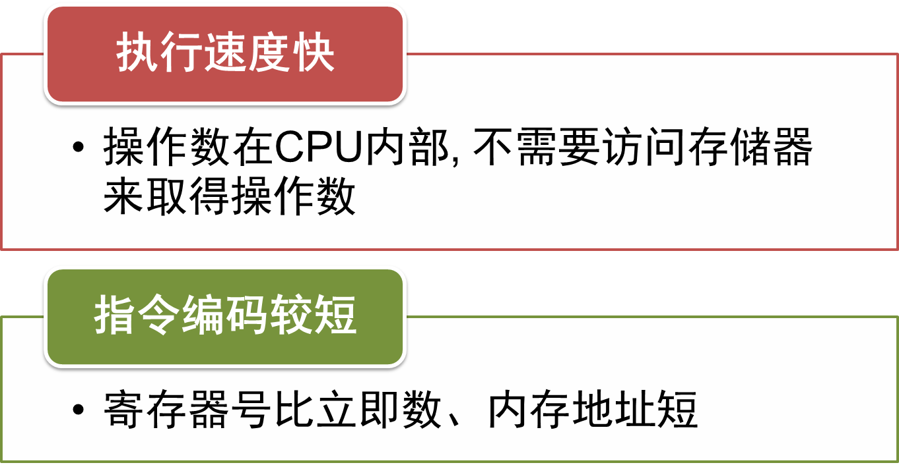
寄存器寻址的优点
*在编程中，应尽量使用这种寻址方式的指令
*常用数据大多存放在寄存器中，int/float

Slide 42
数据寻址方式的分类
立即寻址
寄存器寻址
直接寻址
寄存器间接寻址
寄存器相对寻址
基值变址寻址
相对基址变址寻址
比例变址寻址
数据在存储器中

Slide 43
3.直接寻址（Direct Addressing）
指令中直接给出操作数的有效地址，有效地址指向存放在存储器中的操作数
 | 存储器
高地址
 | ……..
23001H | 20H
23000H | 10H
 | ……..
20000H
 | ……..
 | 30H | 操作数
 | 00H
 | OP | 操作码
 | ……..
低地址
汇编指令 | MOV | %AX, | （3000H）
操作数默认存放在DS指向的数据段中，即
(3000H)=DS:(3000H)
设：DS=2000H，
则：物理地址=2000H×10H+3000H
=23000H
数据段
2010H
AX
代码段

Slide 44
要点说明
如果数据存放在数据段以外的其它段（例如附加段），则应在指令中给出“段跨越前缀”
  示例1：MOV AX , ES:[3000H]
  示例2：ES: MOV AX , [3000H]
为避免指令字过长，规定双操作数指令不能两个操作数都用直接寻址方式
  错误示例：MOV DS:[2000H] , DS:[3000H]

Slide 45
4.寄存器间接寻址（Register Indirect Addressing）
指令中给出寄存器号，指定的寄存器中存放着操作数的有效地址
 | 存储器
高地址
 | ……..
1001H | 50H
1000H | A0H
 | ……..
0000H
 | ……..
低地址
汇编指令 | MOV | %AX, | （%BX）
设： | BX=1000H
数据段
50A0H
AX

Slide 46
5.寄存器相对寻址（Register Relative Addressing）
操作数的有效地址是一个基址或变址寄存器的内容与一个位移量之和
有效地址 = | BX BP SI DI | + | 8位 16位 32位 （带符号数）
 | 基址或变址 |  | 位移量
主存以字节为可寻址单位
地址的加减是以字节为单位

Slide 47
寻址方式示例
 | 存储器
高地址
 | ……..
5001H | 12H
5000H | 34H
 | ……..
0000H
 | ……..
 | 30H | 位移量
 | 00H
 | OP | 操作码
 | OP
 | ……..
低地址
 | MOV | %AX, | (%SI+3000H)
 | MOV | %AX, | 3000H(%SI)
设： | SI=2000H
则： | 地址 =2000H+3000H =5000H
数据段
1234H
AX
代码段

Slide 48
6.比例变址寻址（Scaled Indexed Addressing）
操作数的有效地址由基址寄存器、变址寄存器、比例因子和位移量按如下公式生成
有效地址 = | EAX EBX ECX EDX ESP EBP ESI EDI | + | EAX EBX ECX EDX EBP ESI EDI | × | 1 2 4 8 | + | 8位 16位 32位 （带符号数）
 | 基址 |  | 变址 |  | 比例 因子 |  | 位移量
Notes:
考虑在此前添加一页，综合介绍“寻址方式的关键词”，便于学生记忆
立即
寄存器
直接
间接
相对
基址
变址

Slide 49
通用公式
比例变址寻址是IA-32新增的寻址方式
提供了存储器操作数寻址方式的通用公式
寄存器
间接寻址
有效地址 = | EAX EBX ECX EDX ESP EBP ESI EDI | + | 8位 16位 32位 （带符号数） | + | EAX EBX ECX EDX EBP ESI EDI | × | 1 2 4 8
 | 基址 |  | 位移量 |  | 变址 |  | 比例因子
基址变址
寻址

Slide 50
Indexed Addressing Mode
expression for memory address
Imm(E_{b}, E_{i}, s)
  Constant “displacement” Imm: 1, 2 or 4 bytes
  Base register E_{b}: Any of 8 integer registers
  Index register E_{i} : Any, except for %esp
  S: Scale: 1, 2, 4, or 8
The address represented by Imm(E_{b}, E_{i}, s)
  imm + R[E_{b}] + R[E_{i}] * s
It gives the value
  M[imm + R[E_{b}] + R[E_{i}] * s]

Slide 51
Addressing Mode（寻址方式）
Type | Form | Operand value | Name
Immediate | $Imm | Imm | Immediate
Register | E_{a} | R[E_{a}] | Register
Indexed | Imm | M[Imm] | Absolute
Indexed | (E_{a}) | M[R[E_{a}]] | Indirect
Indexed | Imm(E_{b}) | M[Imm+ R[E_{b}]] | Base+displacement
Indexed | (E_{b}, E_{i}) | M[R[E_{b}]+ R[E_{i}]] | Indexed
Indexed | Imm(E_{b}, E_{i}) | M[Imm+ R[E_{b}]+ R[E_{i}]] | Scaled indexed
Indexed | (, E_{i}, s) | M[R[E_{i}]*s] | Scaled indexed
Indexed | (E_{b}, E_{i}, s) | M[R[E_{b}]+ R[E_{i}]*s] | Scaled indexed
Indexed | Imm(E_{b}, E_{i}, s) | M[Imm+ R[E_{b}]+ R[E_{i}]*s] | Scaled indexed

Slide 52
Address | Value
0x100 | 0xFF
0x104 | 0xAB
0x108 | 0x13
0x10C | 0x11
Register | Value
%eax | 0x100
%ecx | 0x1
%edx | 0x3
Operand
Value
%eax
0x100
(%eax)
0xFF
$0x108
0x108
有$表示值，没有表示地址
0x108
0x13
260(%ecx,%edx)
(0x108)0x13
(%eax,%edx,4)
(0x10C)0x11

Slide 53
汇编语言程序的结构
.text 程序段
.data 数据段
  数据类型：是什么
  数据寻址：怎么找
  数据移动：怎么用
.stack 堆栈段

Slide 54
Moving Data
%rax
%rcx
Moving Data
  movq Source, Dest:
Operand Types
  Immediate: Constant integer data
    Example: $0x400, $-533
    Like C constant, but prefixed with ‘$’
    Encoded with 1, 2, or 4 bytes
  Register: One of 16 integer registers
    Example: %rax, %r13
    But %rsp reserved for special use
    Others have special uses for particular instructions
  Memory: 8 consecutive bytes of memory at address given by register
    Simplest example: (%rax)
    Various other “address modes”
%rdx
%rbx
%rsi
%rdi
%rsp
%rbp
%rN
Warning: Intel docs use
mov Dest, Source

Slide 55
MOV Operand Combinations
Source
Dest
Src,Dest
C Analog
Reg
movq $0x4,%rax
temp = 0x4;
Imm
Mem
movq $-147,(%rax)
*p = -147;
store
Reg
movq %rax,%rdx
temp2 = temp1;
MOV
Reg
Mem
movq %rax,(%rdx)
*p = temp;
store
Mem
Reg
movq (%rax),%rdx
temp = *p;
load
Cannot do memory-memory transfer with a single instruction

Slide 56
Data Formats
Move data instruction
  mov (general)
  movb (move byte)
  movw (move word)
  movl (move double word)
  movq (move quadruple word)

Slide 57
Data Movement
Instruction | Effect | Description
movl S, D | D ← S | Move double word
movw S, D | D ← S | Move word
movb S, D | D ← S | Move byte
movsbl S, D | D ← SignedExtend( S) | Move sign-extended byte
movzbl S, D | D ← ZeroExtend(S) | Move zero-extended byte
pushl S | R[%esp] ← R[%esp]-4 M[R[%esp]] ← S | Push
popl D | D ← M[R[%esp]] R[%esp] ← R[%esp]+4 | Pop

Slide 58
Data Movement Example
movl $0x4050, %eax immediate register
movl %ebp, %esp register register
movl (%edx, %ecx), %eax memory register
movl $-17, (%esp) immediate memory
movl %eax, -12(%ebp) register memory

Slide 59
Access Objects with Different Sizes
int main(void){
char c = 1;
short s = 2;
int i = 4;
long l = 4L;
long long ll = 8LL;
return;
}
%ebp
-8
-12
-16
8048335:c6 movb $0x1,0xffffffe5(%ebp)
8048339:66 movw $0x2,0xffffffe6(%ebp)
804833f:c7 movl $0x4,0xffffffe8(%ebp)
8048346:c7 movl $0x4,0xffffffec(%ebp)
804834d:c7 movl $0x8,0xfffffff0(%ebp)
8048354:c7 movl $0x0,0xfffffff4(%ebp)
-20
-24
-26
-27

Slide 60
Array in Assembly
Persistent usage
  Store the base address
void f(void){
int i, a[16];
for(i=0; i<16; i++)
a[i]=i;
}
movl %edx,-0x44(%ebp,%edx,4)
a: -0x44(%ebp)
i: %edx

Slide 61
Data Movement Example
Initial value %dh=8d %eax =98765432
movb %dh, %al %eax=9876548d
movsbl %dh, %eax %eax=ffffff8d
movzbl %dh, %eax %eax=0000008d
1-byte registers-8个
  %al, %ah, %cl, %ch, %dl, %dh, %bl, %bh
2-byte registers-8个
  %ax, %cx, %dx, %bx, %si, %di, %sp, %bp

Slide 62
Example of Simple Addressing Modes
void swap
(long *xp, long *yp)
{
long t0 = *xp;
long t1 = *yp;
*xp = t1;
*yp = t0;
}
swap:
movq (%rdi), %rax
movq (%rsi), %rdx
movq %rdx, (%rdi)
movq %rax, (%rsi)
ret

Slide 63
Understanding Swap()
Memory
void swap
(long *xp, long *yp)
{
long t0 = *xp;
long t1 = *yp;
*xp = t1;
*yp = t0;
}
Registers
%rdi
%rsi
%rax
%rdx
Register Value
%rdi xp
%rsi yp
%rax t0
%rdx t1
swap:
movq (%rdi), %rax # t0 = *xp
movq (%rsi), %rdx # t1 = *yp
movq %rdx, (%rdi) # *xp = t1
movq %rax, (%rsi) # *yp = t0
ret

Slide 64
Understanding Swap()
Memory
Registers
Address
123
0x120
%rdi
0x120
0x118
%rsi
0x100
0x110
%rax
0x108
%rdx
456
0x100
swap:
movq (%rdi), %rax # t0 = *xp
movq (%rsi), %rdx # t1 = *yp
movq %rdx, (%rdi) # *xp = t1
movq %rax, (%rsi) # *yp = t0
ret

Slide 65
Understanding Swap()
Memory
Registers
Address
123
0x120
%rdi
0x120
0x118
%rsi
0x100
0x110
%rax
123
0x108
%rdx
456
0x100
swap:
movq (%rdi), %rax # t0 = *xp
movq (%rsi), %rdx # t1 = *yp
movq %rdx, (%rdi) # *xp = t1
movq %rax, (%rsi) # *yp = t0
ret

Slide 66
Understanding Swap()
Memory
Registers
Address
123
0x120
%rdi
0x120
0x118
%rsi
0x100
0x110
%rax
123
0x108
%rdx
456
456
0x100
swap:
movq (%rdi), %rax # t0 = *xp
movq (%rsi), %rdx # t1 = *yp
movq %rdx, (%rdi) # *xp = t1
movq %rax, (%rsi) # *yp = t0
ret

Slide 67
Understanding Swap()
Memory
Registers
Address
456
0x120
%rdi
0x120
0x118
%rsi
0x100
0x110
%rax
123
0x108
%rdx
456
456
0x100
swap:
movq (%rdi), %rax # t0 = *xp
movq (%rsi), %rdx # t1 = *yp
movq %rdx, (%rdi) # *xp = t1
movq %rax, (%rsi) # *yp = t0
ret

Slide 68
Understanding Swap()
Memory
Registers
Address
456
0x120
%rdi
0x120
0x118
%rsi
0x100
0x110
%rax
123
0x108
%rdx
456
123
0x100
swap:
movq (%rdi), %rax # t0 = *xp
movq (%rsi), %rdx # t1 = *yp
movq %rdx, (%rdi) # *xp = t1
movq %rax, (%rsi) # *yp = t0
ret

Slide 69
MOV 指令遵循的规则
两个操作数的尺寸必须一致
两个操作数不能同时为内存操作数
目的操作数不能是CS，EIP和IP
立即数不能直接送至段寄存器
段寄存器之间不能直接传送数据
不能一次传送多个对象
标识寄存器（EFlags）和指令指针寄存器（IP）不能用MOV指令设置

Slide 70
课堂练习
下列汇编语句错在哪里？
  mov $0xF, (%bl)
  movl %ax, (%esp)
  movw (%eax), 4(%esp)
  movl %eax, %dx
  movb %si, 8(%esp)
  movb %ah, %sh
  movl %eax, 0x123

Slide 71
主观题
10分
已知原型为
Void decode1 (long *xp, long *yp, long *zp);
的函数编译成汇编，得到如下代码
# xp in %rdi, yp in %rsi, zp in %rdx
Decode1:
  Movq (%rdi), %r8
  Movq (%rsi), %rcx
  Movq (%rdx), %rax
  Movq %r8, (%rsi)
  Movq %rcx, (%rdx)
  Movq %rax, (%rdi)
请写出等效的C语言代码
作答

Slide 72
课堂练习
已知原型为
Void decode1 (long *xp, long *yp, long *zp);
的函数编译成汇编，得到如下代码
# xp in %rdi, yp in %rsi, zp in %rdx
Decode1:
  Movq (%rdi), %r8
  Movq (%rsi), %rcx
  Movq (%rdx), %rax
  Movq %r8, (%rsi)
  Movq %rcx, (%rdx)
  Movq %rax, (%rdi)
请写出等效的C语言代码
  long x = *xp;
  long y = *yp;
  long z = *zp;
  *yp = x;
  *zp = y
  *xp = z;
Notes:
long x = *xp;
Long y = *yp;
Long z = *zp;
*yp = x;
*zp = y
*xp = z;

Slide 73
汇编语言程序的结构
.text 程序段
.data 数据段
.stack 堆栈段

Slide 74
堆栈操作
Stack is a special kind of data structure
  It can store objects of the same type
The top of the stack must be explicitly specified（栈顶）
  It is denoted as top
There are two operations on the stack
  push and pop
There is a hardware stack in x86
  速度快，通过push, pop等指令操作
  从高地址向低地址，逆序生长
  栈顶由%esp指示

Slide 75
Stack Layout
0xffffffff
memory invisible to
user code
kernel virtual memory
0xc0000000
Stack
Downward growth
%esp
Read/write data
Linux/x86 process
memory image
Read only data
Read only code
%eip
0x08048000
forbidden

Slide 76
Stack Operation
Instruction | Effect
pushl S | decreases the %esp (enlarge the stack) stores the value in a register into the stack： R[%esp] ← R[%esp]-4 M[R[%esp]] ← S
popl D | stores the value in the top of the stack into a register increases the %esp (shrink the stack)： D ← M[R[%esp]] R[%esp] ← R[%esp]+4
压栈时，
先修改栈指针，
后压入数据
弹栈时，
先弹出数据，
后修改栈指针

Slide 77
Stack operations
%eax | 0x123
%edx | 0
%esp | 0x108
Increasing
address
pushl %eax ?
%esp
0x108
Stack “top”

Slide 78
Stack operations
%eax | 0x123
%edx | 0
%esp | 0x104
pushl %eax
0x108
0x104
%esp
Stack “top”

Slide 79
Stack operations
%eax | 0x123
%edx | 0
%esp | 0x104
0x123
pushl %eax
popl %edx ?
0x108
0x104
%esp
Stack “top”

Slide 80
Stack operations
%eax | 0x123
%edx | 0x123
%esp | 0x104
0x123
pushl %eax
popl %edx ?
0x108
0x104
%esp
Stack “top”

Slide 81
Stack operations
%eax | 0x123
%edx | 0x123
%esp | 0x108
0x123
popl %edx
0x108
%esp
0x104
Stack “top”

Slide 82
Example (C Code)
#include <stdio.h>
int accum = 0;
int sum(int x, int y)
{
int t = x + y;
accum += t;
return t;
}
int main()
{
int s;
s = sum(4,3);
printf(" %d %d \n", s, accum);
return 0;
}

Slide 83
Example (object Code)
08048360 <sum>:
8048360: 55 push %ebp
8048361: 89 e5 mov %esp,%ebp
8048363: 8b 45 0c mov 0xc(%ebp),%eax
8048366: 8b 55 08 mov 0x8(%ebp),%edx
8048369: 5d pop %ebp
804836a: 01 d0 add %edx,%eax
804836c: 01 05 f0 95 04 08 add %eax, 0x80495f0
8048372: c3 ret

Slide 84
Example (object Code)
08048360 <sum>:
8048360: 55 push %ebp
8048361: 89 e5 mov %esp,%ebp
8048363: 8b 45 0c mov 0xc(%ebp),%eax
8048366: 8b 55 08 mov 0x8(%ebp),%edx
8048369: 5d pop %ebp
804836a: 01 d0 add %edx,%eax
804836c: 01 05 f0 95 04 08 add %eax, 0x80495f0
8048372: c3 ret

Slide 85
Example (object Code)
08048360 <sum>:
8048360: 55 push %ebp
8048361: 89 e5 mov %esp,%ebp
8048363: 8b 45 0c mov 0xc(%ebp),%eax
8048366: 8b 55 08 mov 0x8(%ebp),%edx
8048369: 5d pop %ebp
804836a: 01 d0 add %edx,%eax
804836c: 01 05 f0 95 04 08 add %eax, 0x80495f0
8048372: c3 ret

Slide 86
Pointers vs. Addresses
Pointer in C
Data Movement Example

Slide 87
Pointers in C
In C, an object may be
  an integer
  a structure or
  some other program unit
  Declaring Pointers
  T *p;

Slide 88
Pointers in C
In C, the value of a pointer in C is
  the virtual address of the first byte of some block of storage
  Type information is used to
    identify the length of the object
    interpret the object *p
Generating Pointers
p = &obj

Slide 89
Example
int main()
{
int a = 4 ;
/* “address of” operator creates a pointer */
int b = exchange(&a, 3);
printf(“a = %d, b = %d\n”, a, b);
}

Slide 90
Example
•
•
•
Stack
%ebp
4
a
b
int main()
{
int a = 4 ;
int b = exchange(&a, 3);
printf(“a = %d, b = %d\n”, a, b);
}
Can the variable a be in a register?

Slide 91
Example
•
•
•
Stack
%ebp
4
a
b
3
&a
%esp
int main()
{
int a = 4 ;
int b = exchange(&a, 3);
printf(“a = %d, b = %d\n”, a, b);
}

Slide 92
Example
int exchange(int *xp, int y)
{
/* operator * performs deferencing */
int x = *xp ;
*xp = y ;
return x ;
}

Slide 93
Example
1 pushl %ebp
2 movl %esp, %ebp
3 movl 8(%ebp), %eax #xp
4 movl 12(%ebp), %edx #y
5 movl (%eax), %ecx # x
6 movl %edx, (%eax)
7 movl %ecx, %eax
8 movl %ebp, %esp
9 popl %ebp
int exchange(int *xp, int y)
{
int x = *xp ;
*xp = y ;
return x ;
}

Slide 94
Example
1 pushl %ebp
2 movl %esp, %ebp
3 movl 8(%ebp), %eax #xp
4 movl 12(%ebp), %edx #y
5 movl (%eax), %ecx # x
6 movl %edx, (%eax)
7 movl %ecx, %eax
8 movl %ebp, %esp
9 popl %ebp
•
•
•
Stack
%ebp
4
a
b
y
xp
3
&a
Rtn adr
%esp

Slide 95
Example
1 pushl %ebp
•
•
•
Stack
%ebp
4
a
b
y
xp
1 pushl %ebp
2 movl %esp, %ebp
3 movl 8(%ebp), %eax #xp
4 movl 12(%ebp), %edx #y
5 movl (%eax), %ecx # x
6 movl %edx, (%eax)
7 movl %ecx, %eax
8 movl %ebp, %esp
9 popl %ebp
12
3
8
&a
4
Rtn adr
0
Old %ebp
%esp

Slide 96
Example
2 movl %esp, %ebp
•
•
•
Stack
Offset
4
a
b
y
xp
1 pushl %ebp
2 movl %esp, %ebp
3 movl 8(%ebp), %eax #xp
4 movl 12(%ebp), %edx #y
5 movl (%eax), %ecx # x
6 movl %edx, (%eax)
7 movl %ecx, %eax
8 movl %ebp, %esp
9 popl %ebp
12
3
8
&a
4
Rtn adr
0
Old %ebp
%ebp
%esp

Slide 97
Example
3 movl 8(%ebp), %eax
%eax: xp
•
•
•
Stack
Offset
4
a
b
y
xp
1 pushl %ebp
2 movl %esp, %ebp
3 movl 8(%ebp), %eax #xp
4 movl 12(%ebp), %edx #y
5 movl (%eax), %ecx # x
6 movl %edx, (%eax)
7 movl %ecx, %eax
8 movl %ebp, %esp
9 popl %ebp
12
3
8
&a
4
Rtn adr
Old %ebp
%ebp
%esp
0

Slide 98
Example
3 movl 8(%ebp), %eax
4 movl 12(%ebp), %edx
%eax: xp
%edx: 3
•
•
•
Stack
Offset
4
a
b
y
xp
1 pushl %ebp
2 movl %esp, %ebp
3 movl 8(%ebp), %eax #xp
4 movl 12(%ebp), %edx #y
5 movl (%eax), %ecx # x
6 movl %edx, (%eax)
7 movl %ecx, %eax
8 movl %ebp, %esp
9 popl %ebp
12
3
8
&a
4
Rtn adr
0
Old %ebp
%ebp
%esp

Slide 99
Example
3 movl 8(%ebp), %eax
4 movl 12(%ebp), %edx
5 movl (%eax), %ecx
%eax: xp
%edx: 3
%ecx: 4
•
•
•
Stack
Offset
4
a
b
y
xp
12
3
1 pushl %ebp
2 movl %esp, %ebp
3 movl 8(%ebp), %eax #xp
4 movl 12(%ebp), %edx #y
5 movl (%eax), %ecx # x
6 movl %edx, (%eax)
7 movl %ecx, %eax
8 movl %ebp, %esp
9 popl %ebp
8
&a
4
Rtn adr
0
Old %ebp
%ebp
%esp

Slide 100
Example
3 movl 8(%ebp), %eax
4 movl 12(%ebp), %edx
5 movl (%eax), %ecx
6 movl %edx, (%eax)
%eax: xp
%edx: 3
%ecx: 4
*xp(a): 3
•
•
•
Stack
Offset
3
a
b
y
xp
12
3
8
&a
4
Rtn adr
0
Old %ebp
%ebp
%esp

Slide 101
Data Movement Example
3 movl 8(%ebp), %eax
4 movl 12(%ebp), %edx
5 movl (%eax), %ecx
6 movl %edx, (%eax)
7 movl %ecx, %eax
%eax: xp
%edx: y
%ecx: 4
*xp(a): 3
%eax: 4 (old *xp) return value
•
•
•
Stack
Offset
3
a
b
y
xp
12
3
8
&a
4
Rtn adr
0
Old %ebp
%ebp
%esp

Slide 102
Data Movement Example
8 movl %ebp, %esp (do nothing)
9 popl %ebp
•
•
•
%ebp
Stack
3
a
b
y
xp
1 pushl %ebp
2 movl %esp, %ebp
3 movl 8(%ebp), %eax #xp
4 movl 12(%ebp), %edx #y
5 movl (%eax), %ecx # x
6 movl %edx, (%eax)
7 movl %ecx, %eax
8 movl %ebp, %esp
9 popl %ebp
12
3
8
&a
4
Rtn adr
%esp
0

Slide 103
Example
•
•
•
Stack
Offset
3
b
3
&a
%esp
int main()
{
int a = 4 ;
int b = exchange(&a, 3);
printf(“a = %d, b = %d\n”, a, b);
}
%eax 4
Return value

Slide 104
Example
•
•
•
Stack
Offset
3
4
b
3
&a
%esp
int main()
{
int a = 4 ;
int b = exchange(&a, 3);
printf(“a = %d, b = %d\n”, a, b);
}

Slide 105
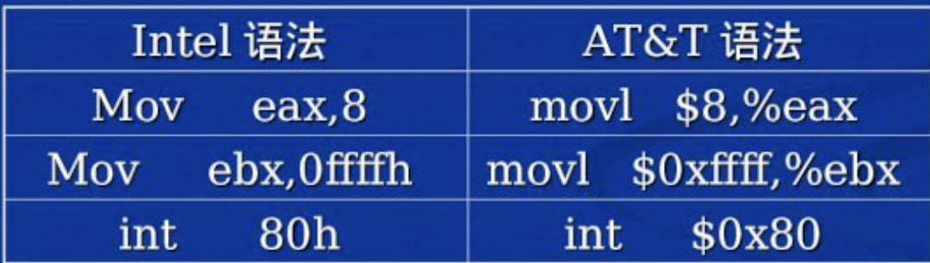
语法
Intel格式
  寄存器参数：
  dst, src (←)
  Len equ $ - msg
  Len = $ - msg
AT&T格式
  寄存器参数：
  src, dst (→)
  寄存器%
  常量、变量$
  Len = . – msg
  加长度后缀
    movb传送字节
    movw传送字
    movl传送双字
    (long word)
    movq传送四字
  gcc –O1 –S –masm=intel code.c可以生成intel风格的汇编代码

Slide 106
Example 2
查询CPU的厂商ID
.data
output: .ascii "The processor Vendor ID is 'xxxxxxxxxxxx'\n"
.text
.global _start
_start:
movl $0, %eax
cpuid
movl $output, %edi
movl %ebx, 28(%edi)
movl %edx, 32(%edi)
movl %ecx, 36(%edi)
movl $4, %eax
movl $1, %ebx
movl $output, %ecx
movl $42, %edx
int $0x80
movl $1, %eax
movl $0, %ebx
int $0x80

