Slide 1
程序的机器级表示(3)
王晶
jwang@ruc.edu.cn，信息楼124
2023年10月

Slide 2




8086指令的主要类别
运算类指令
例如：加、减、乘、除，与、或、非等
传送类指令
例如：从存储器到通用寄存器，从通用寄存器到I/O接口等
微处理器
存储器
I/O
接口
外设
系统总线
控制类指令
例如：暂停处理器、清除标志位等
转移类指令
例如：无条件转移、条件转移、过程调用等
Notes:
32位汇编语言程序设计
第3章 通用数据处理指令

Slide 3




8086指令的运行结果
改变通用寄存器的内容
*如 ADD AX, DX
改变存储器单元的内容
*如 MOV [10H], CX
其它
……
改变标志位
*如产生进位
改变指令指针
*如 JMP [BX]
改变外设端口的内容
*如访问显示端口
微处理器
存储器
I/O
接口
外设
系统总线

Slide 4
8086指令的汇编形式
目的操作数
源操作数
指令助记符
源操作数
ADD | AX, | [3000H]
MOV | AX, | 8726H
JMP | [BX]
HLT
双操作数指令
双操作数指令
源操作数
单操作数指令
目的操作数
无操作数指令
源操作数

Slide 5
学习指令的注意事项
指令的功能——该指令能够实现何种操作。通常指令助记符就是指令功能的英文单词或其缩写形式
指令支持的寻址方式——该指令中的操作数可以采用何种寻址方式
指令对标志的影响——该指令执行后是否对各个标志位有影响，以及如何影响
其他方面——该指令其他需要特别注意的地方，如指令执行时的约定设置、必须预置的参数、隐含使用的寄存器等

Slide 6
Arithmetic Operations
Data Manipulation
Instruction | Effect | Description
lea S, D | D ← &S | Load effective address
inc D | D ← D + 1 | Increment
dec D | D ← D – 1 | Decrement
neg D | D ← -D | Negate
not D | D ← ~D | Complement
add S, D | D ← D + S | Add
sub S, D | D ← D – S | Subtract
cmp S, D | D – S | Subtract
imull S, D | D ← D * S | Multiply

Slide 7
比较指令CMP
将目的操作数减去源操作数，差值不回送目的操作数，按照减法结果影响状态标志
SUB reg,imm/reg/mem ;reg－imm/reg/mem
SUB mem,imm/reg ;mem－imm/reg
根据标志状态获知两个操作数的大小关系
给条件转移等指令使用其形成的状态标志
SUB与CMP？
Notes:
32位汇编语言程序设计
第3章 通用数据处理指令

Slide 8
LEA指令说明
LEA指令（Load Effective Address）
格式：LEA SRC , REG
操作：把源操作数（SRC）的有效地址（即偏移地址）装入指定寄存器（REG）
说明：
  源操作数必须是存储器操作数
  目的操作数必须是16位通用寄存器

Slide 9
LEA指令示例
LEA (BX+DI+6H), BX
1000H
BX
0200H
DI
1206H
BX
0200H
DI
执行前
执行后
注意区别于：
MOV (BX+DI+6H), BX

Slide 10
Examples for Lea Instruction
%eax holds x, %ecx holds y
Expression
Result
leal 6(%eax), %edx
6+x
leal (%eax, %ecx), %edx
x+y
leal (%eax, %ecx, 4), %edx
x+4*y
leal 7(%eax, %eax, 8), %edx
7+9*x
leal 0xA(, %ecx, 4), %edx
10+4*y
leal 9(%eax, %ecx, 2), %edx
9+x+2*y

Slide 11
Why use LEA?
CPU designers’ intended use: calculate a pointer to an object
  An array element, perhaps
  For instance, to pass just one array element to another function
Compiler authors like to use it for ordinary arithmetic
  It can do complex calculations in one instruction
  It’s one of the only three-operand instructions the x86 has
  It doesn’t touch the condition codes (we’ll come back to this)
Assembly | C equivalent
lea (%rbx,%rdi,8), %rax | rax = &rbx[rdi]
Assembly | C equivalent
lea (%rbx,%rbx,2), %rax | rax = rbx * 3

Slide 12
Arithmetic and Logical Operations
Logical Operations
Instruction | Effect | Description
xor S, D | D ← D ^ S | Exclusive-or
or S, D | D ← D | S | Or
and S, D | D ← D & S | And
test S, D | D & S | And
sal k, D | D ← D << k | Left shift
shl k, D | D ← D << k | Left shift
sar k, D | D ← D >> k | Arithmetic right shift
shr k, D | D ← D >> k | Logical right shift

Slide 13
测试指令TEST
按位进行逻辑与运算，不返回逻辑与结果
  TEST reg,imm/reg/mem ;reg ∧ imm/reg/mem
  TEST mem,imm/reg ;mem ∧ imm/reg
TEST指令像AND指令一样来设置状态标志
TEST指令常用于检测一些条件是否满足，一般后跟条件转移指令，目的是利用测试条件转向不同的分支

Slide 14
Special Arithmetic Operations
imull S | R[%edx]:R[%eax] ←S*R[%eax] | Signed full multiply
mull S | R[%edx]:R[%eax] ←S*R[%eax] | Unsigned full multiply
Cltd | R[%edx]:R[%eax] ← SignExtend(R[%eax]) | Convert to quad word
idiv S | R[%edx] ← R[%edx]:R[%eax] mod S R[%eax] ← R[%edx]:R[%eax] ÷ S | Signed divide
divl S | R[%edx] ←R[%edx]:R[%eax] mod S R[%eax] ← R[%edx]:R[%eax] ÷ S | Unsigned divide

Slide 15
Examples
Initially x at %ebp+8, y at %ebp+12
1 movl 8(%ebp), %eax
2 imull 12(%ebp)
3 pushl %edx
4 pushl %eax
1 movl 8(%ebp), %eax
2 cltd
3 idivl 12(%ebp)
4 pushl %eax
5 pushl %edx

Slide 16
Arithmetic and Logical Operations
Address | Value
0x100 | 0xFF
0x104 | 0xAB
0x108 | 0x13
0x10C | 0x11
Register | Value
%eax | 0x100
%ecx | 0x1
%edx | 0x3
Instruction
Destination
Value
addl %ecx, (%eax)
0x100
0x100
subl %edx, 4(%eax)
0x104
0xA8
imull $16, (%eax, %edx, 4)
0x10C
0x110
incl 8(%eax)
0x108
0x14
decl %ecx
%ecx
0x0
subl %edx, %eax
%eax
0xFD

Slide 17
Sidebar: instruction suffixes
Most x86 instructions can be written with or without a suffix
  imul %rcx, %rax
  imulq %rcx, %rax
The suffix indicates the operation size
  b=byte, w=short, l=int, q=long
  If present, must match register names
Assembly output from the compiler (gcc –S)
usually has suffixes
Disassembly dumps (objdump –d, gdb ‘disas’)
usually omit suffixes
Intel’s manuals always omit the suffixes
There’s no difference!

Slide 18
Assembly Code for Arithmetic Expressions
int arith(int x, int y, int z)
{
int t1 = x+y;
int t2 = z*48;
int t3 = t1&0xFFFF;
int t4 = t2*t3;
return t4;
}
movl 12(%ebp),%eax Get y
movl 16(%ebp),%edx Get z
addl 8(%ebp),%eax Compute t1=x+y
leal (%edx,%edx,2),%edx Compute 3*z
sall $4,%edx Compute t2=48*z
andl $0xFFFF,%eax Compute t3=t1&FFFF
imull %edx,%eax Set t4 as return val

Slide 19

填空题
2分
long shift_left4_rightn(long x, long n) {
  x <<= 4;
  x >>= n;
  return x;
}
对应的汇编为：
# x in %rdi, n in %rsi
Shift_left4_rightn:
  Movq %rdi, %rax
  ______ [填空1] ________ # x <<= 4
  Movl %esi, %ecx
  _________ [填空2] _____ # x >>= n
  请参考注释，补全代码
作答

Slide 20
练习答案
long shift_left4_rightn(long x, long n) {
  x <<= 4;
  x >>= n;
  return x;
}对应的汇编为：
# x in %rdi, n in %rsi
Shift_left4_rightn:
  Movq %rdi, %rax
  __ Salq $4, %rax______ # x <<= 4
  Movl %esi, %ecx
  __ Sarq %cl, %rax_____ # x >>= n
  请参考注释，补全代码

Slide 21
填空题
4分
arith2:
  #x@%rdi, y@rsi, z@rdx
  Orq %rsi, %rdi
  Sarq $3, %rdi
  Notq %rdi
  Movq %rdx, %rax
  Subq %rdi, %rax
  Ret
Long arith2(long x, long y, long z)
{
  Long t1 = [填空1]
  Long t2 = [填空2]
  Long t3 = [填空3]
  Long t4 = [填空4]
  Return t4;
}
作答

Slide 22
课堂练习
Long arith2(long x, long y, long z) {
  Long t1 = x | y;
  Long t2 = t1 >> 3;
  Long t3 = ~t2;
  Long t4 = z-t3;
  Return t4;
}
Arith2:
  #x@%rdi, y@rsi, z@rdx
  Orq %rsi, %rdi
  Sarq $3, %rdi
  Notq %rdi
  Movq %rdx, %rax
  Subq %rdi, %rax
  Ret
填写空缺的C语言语句
Notes:
Long t1 = x | y;
Long t2 = t1 >> 3;
Long t3 = ~t2;
Long t4 = z-t3;

Slide 23
Today
Control: Condition codes
Conditional branches
Loops
Switch Statements

Slide 24
Control flow
extern void op1(void);
extern void op2(void);
void decision(int x) {
if (x) {
op1();
} else {
op2();
}
}
decision
x != 0
op2
op1
return

Slide 25
Control flow in assembly language
extern void op1(void);
extern void op2(void);
void decision(int x) {
if (x) {
op1();
} else {
op2();
}
}
decision:
subq $8, %rsp
testl %edi, %edi
je .L2
call op1
jmp .L1
.L2:
call op2
.L1:
addq $8, %rsp
ret

Slide 26
Processor State (x86-64, Partial)
Information about currently executing program
  Temporary data
  ( %rax, … )
  Location of runtime stack
  ( %rsp )
  Location of current code control point
  ( %rip, … )
  Status of recent tests
  ( CF, ZF, SF, OF )
Registers
%rax
%r8
%rbx
%r9
%rcx
%r10
%rdx
%r11
%rsi
%r12
%rdi
%r13
%rsp
%r14
%rbp
%r15
%rip
Instruction pointer
Current stack top
CF
ZF
SF
OF
Condition codes

Slide 27
状态标志
状态标志是处理器最基本的标志
一方面：作为加减运算和逻辑运算的辅助结果
另一方面：构成各种条件，实现程序分支
15 12
11
10
9
8
7
6
5
4
3
2
1
0
OF
DF
IF
TF
SF
ZF
0
AF
0
PF
1
CF
8086的标志

Slide 28
进位标志CF（Carry Flag）
当加减运算结果的最高有效位有进位（加法）或借位（减法）时，进位标志置1，即CF＝1；否则CF＝0
针对无符号整数，判断加减结果是否超出表达范围
  N个二进制位表达无符号整数的范围：
  0～2^{N}-1
  8位：0～＋255
  16位：0～＋65535
  32位：0～＋2³²－1

Slide 29
CF set when
1xxxxxxxxxxxx...
+
1xxxxxxxxxxxx...
Carry
1
xxxxxxxxxxxxx...
1
0xxxxxxxxxxxx...
-
1xxxxxxxxxxxx...
Borrow
1xxxxxxxxxxxx...
For unsigned arithmetic, this reports overflow

Slide 30
溢出标志OF（Overflow Flag）
有符号数加减结果有溢出，则OF＝1；否则OF＝0
针对有符号整数，判断加减结果是否超出表达范围
  N个二进制位（补码）表达有符号整数的范围：
  －2^{N－1}～2^{N－1}-1
  8位：－128～＋127
  16位：－32768～＋32767
  32位：－2³¹～＋2³¹－1
杯中水已满，
再加就溢出！

Slide 31
OF set when
yxxxxxxxxxxxx...
a
+
yxxxxxxxxxxxx...
b
zxxxxxxxxxxxx...
t
z = ~y
  (a>0 && b>0 && t<0) || (a<0 && b<0 && t>=0)
For signed arithmetic, this reports overflow

Slide 32
进位和溢出的区别
进位标志反映无符号整数运算结果是否超出范围
  有进位，加上进位或借位后运算结果仍然正确
溢出标志反映有符号整数运算结果是否超出范围
  有溢出，运算结果已经不正确
处理器按照无符号整数求得结果
  设置进位标志CF
  设置溢出标志OF
程序员决定
  操作数是无符号数，关心进位
  操作数是有符号数，注意溢出

Slide 33
零标志ZF（Zero Flag）
运算结果为0，则ZF＝1，否则ZF＝0
结果是0，
ZF标志不是0 ！
举例
8位二进制数相加：
00111010＋01111100＝10110110
结果不是0，ZF＝0
8位二进制数相加：
10000100＋01111100＝[1]00000000
结果是0，ZF＝1
进位
结果

Slide 34
符号标志SF（Sign Flag）
运算结果最高位为1，则SF＝1；否则SF＝0
最高位＝符号位＝SF
举例
8位二进制数相加：
00111010＋01111100＝10110110
最高位＝1：SF＝1
8位二进制数相加：
10000100＋01111100＝[1]00000000
最高位＝0：SF＝0
进位
结果

Slide 35
SF set when
yxxxxxxxxxxxx...
+
yxxxxxxxxxxxx...
1xxxxxxxxxxxx...
For signed arithmetic, this reports when result is a negative number

Slide 36
Setting Conditional Codes
Implicit Setting By Arithmetic Operations
  addl Src,Dest
  C analog: t = a+b
  CF set if carry out from most significant bit
    Used to detect unsigned overflow
  ZF set if t == 0
  SF set if t < 0
  OF set if two’s complement overflow
    (a>0 && b>0 && t<0) || (a<0 && b<0 && t>=0)

Slide 37
Setting Conditional Codes
Explicit Setting by Compare Instruction
  cmpl Src2,Src1
  cmpl b,a like computing a-b without setting destination
  CF set if carry out from most significant bit
    Used for unsigned comparisons
  ZF set if a == b
  SF set if (a-b) < 0
  OF set if two’s complement overflow
    (a>0 && b<0 && (a-b)<0) ||
    (a<0 && b>0 && (a-b)>0)

Slide 38
Setting Conditional Codes
Explicit Setting by Test instruction
  testl Src2,Src1
  Sets condition codes based on value of Src1 & Src2
    Useful to have one of the operands be a mask
  testl b,a like computing a&b without setting destination
  ZF set when a&b == 0
  SF set when a&b < 0

Slide 39
Conditional Code (特殊规则)
lea instruction (数据移动类的都不影响EFlags)
  has no effect on condition codes
Xorl instruction
  The carry and overflow flags are set to 0
Shift instruction
  Carry flag is set to the last bit shifted out
  Overflow flag is set to 0
Inc/dec instruction
  Do NOT set carry flag
Mull/imull instruction
  CF=OF=0 iff the first half of result is useless; else, CF=OF=1

Slide 40
例：加法运算
判断SF, ZF, CF, OF
movw $0075h, %ax ;ax=0075h
movw $01a2h, %cx ;cx=01a2h
addw, %cx, %ax ;ax=0217h
SF=0、ZF=0、CF=0 、 OF=0
movw $77ach, %ax, ;ax=77ach
movw $4b35h, %cx ;cx=4b35h
addw %cx, %ax ;ax=c2e1h
SF=1、ZF=0、CF=0 、 OF=1

Slide 41
例：减法运算
movl $75h, %eax ;ax=00000075h
movl $1a2h, %ecx ;cx=000001a1h
subl %ecx, %eax ;ax=fffffed3h
SF=1、ZF=0、CF=1(借位) 、 OF=0
movw $c36eh, %ax ;ax=c36eh
movw $ef00h, (%ebx) ; (%ebx)=ef00h
subw %ax, (%ebx) ; (%ebx)=2b92h
SF=0、ZF=0、CF=0 、 OF=0

Slide 42
Accessing Conditional Codes
Conditional codes不能直接读写（像其他寄存器一样用move等指令）
写入：主要是通过相关的运算来设置标识位
读取：
  通过set系列指令，根据eflags状态来设置参数的值
    Sete %al
  通过一些特定指令来读取判断（条件跳转语句，条件传送数据等）
特殊方法：pushf, popf可以用于修改eflags

Slide 43
Accessing Conditional Codes
Instruction | Synonym | Effect | Set Condition
Sete | Setz | ZF | Equal/zero
Setne | Setnz | ~ZF | Not equal/not zero
Sets |  | SF | Negative
Setns |  | ~SF | Nonnegative
Setl | Setnge | SF^OF | Less
Setle | Setng | (SF^OF)|ZF | Less or Equal
Setg | Setnle | ~(SF^OF)&~ZF | Greater
Setge | Setnl | ~(SF^OF) | Greater or Equal
Seta | Setnbe | ~CF&~ZF | Above
Setae | Setnb | ~CF | Above or equal
Setb | Setnae | CF | Below
Setbe | Setna | CF|ZF | Below or equal
有符
号数
无符
号数

Slide 44
Example: setl (Signed <)
Condition: SF^OF
SF | OF | SF ^ OF | Implication
0 | 0 | 0
1 | 0 | 1
0 | 1 | 1
1 | 1 | 0
No overflow, so SF implies not <
No overflow, so SF implies <
Overflow, so SF implies negative overflow, i.e. <
Overflow, so SF implies positive overflow, i.e. not <
negative overflow case
1xxxxxxxxxxxx...
a
-
0xxxxxxxxxxxx...
b
0xxxxxxxxxxxx...
t

Slide 45
 | 例： |  |  | flags |  |  |  | interpretation
 | operand1 | operand2 | difference | CF | OF | SF | ZF | signed | unsigned
1 | 3B | 3B | 00 | 0 | 0 | 0 | 1 | op1=op2 | op1=op2
2 | 3B | 15 | 26 | 0 | 0 | 0 | 0 | op1>op2 | op1>op2
3 | 15 | 3B | DA | 1 | 0 | 1 | 0 | op1<op2 | op1<op2
4 | F9 | F6 | 03 | 0 | 0 | 0 | 0 | op1>op2 | op1>op2
5 | F6 | F9 | FD | 1 | 0 | 1 | 0 | op1<op2 | op1<op2
6 | 15 | F6 | 1F | 1 | 0 | 0 | 0 | op1>op2 | op1<op2
7 | F6 | 15 | E1 | 0 | 0 | 1 | 0 | op1<op2 | op1>op2
8 | 68 | A5 | C3 | 1 | 1 | 1 | 0 | op1>op2 | op1<op2
9 | A5 | 68 | 3D | 0 | 1 | 0 | 0 | op1<op2 | op1>op2
of xor sf cf

Slide 46
Reading Condition Codes (Cont.)
SetX Instructions:
  Set single byte based on combination of condition codes
One of addressable byte registers
  Does not alter remaining bytes
  Typically use movzbl to finish job
    32-bit instructions also set upper 32 bits to 0
int gt (long x, long y)
{
return x > y;
}
Register | Use(s)
%rdi | Argument x
%rsi | Argument y
%rax | Return value
cmpq %rsi, %rdi # Compare x:y
  setg %al # Set when >
  movzbl %al, %eax # Zero rest of %rax
ret

Slide 47
Explicit Reading Condition Codes (Cont.)
SetX Instructions:
  Set single byte based on combination of condition codes
One of addressable byte registers
  Does not alter remaining bytes
  Typically use movzbl to finish job
    32-bit instructions also set upper 32 bits to 0
Beware weirdness movzbl (and others)
movzbl %al, %eax
0x00000000
%rax
%rax
%al
0x000000
%al
%al
0x000000
%eax
Register | Use(s)
%rdi | Argument x
%rsi | Argument y
%rax | Return value
int gt (long x, long y)
{
return x > y;
}
Zapped to all 0’s
cmpq %rsi, %rdi # Compare x:y
  setg %al # Set when >
  movzbl %al, %eax # Zero rest of %rax
ret

Slide 48
Exercise
SetX | Condition | Description
sete | ZF | Equal / Zero
setne | ~ZF | Not Equal / Not Zero
sets | SF | Negative
setns | ~SF | Nonnegative
setg | ~(SF^OF)&~ZF | Greater (signed)
setge | ~(SF^OF) | Greater or Equal (signed)
setl | SF^OF | Less (signed)
setle | (SF^OF)|ZF | Less or Equal (signed)
seta | ~CF&~ZF | Above (unsigned)
setb | CF | Below (unsigned)
cmpq b,a like computing a-b w/o setting dest
CF set if carry/borrow out from most significant
bit (used for unsigned comparisons)
ZF set if a == b
SF set if (a-b) < 0 (as signed)
OF set if two’s-complement (signed) overflow
%rax | SF | CF | OF | ZF
0x0000 0000 0000 0000 | 0 | 0 | 0 | 1
0xFFFF FFFF FFFF FFFF | 1 | 1 | 0 | 0
0xFFFF FFFF FFFF FFFF | 1 | 0 | 0 | 0
0xFFFF FFFF FFFF FF01 | 1 | 0 | 0 | 0
0x0000 0000 0000 0001 | 1 | 0 | 0 | 0
xorq %rax, %rax
subq $1, %rax
cmpq $2, %rax
setl %al
movzblq %al, %eax
Note: setl and movzblq do not modify condition codes

Slide 49
Exercise
SetX | Condition | Description
sete | ZF | Equal / Zero
setne | ~ZF | Not Equal / Not Zero
sets | SF | Negative
setns | ~SF | Nonnegative
setg | ~(SF^OF)&~ZF | Greater (signed)
setge | ~(SF^OF) | Greater or Equal (signed)
setl | SF^OF | Less (signed)
setle | (SF^OF)|ZF | Less or Equal (signed)
seta | ~CF&~ZF | Above (unsigned)
setb | CF | Below (unsigned)
cmpq b,a like computing a-b w/o setting dest
CF set if carry/borrow out from most significant
bit (used for unsigned comparisons)
ZF set if a == b
SF set if (a-b) < 0 (as signed)
OF set if two’s-complement (signed) overflow
%rax | SF | CF | OF | ZF
0x0000 0000 0000 0000 | 0 | 0 | 0 | 1
0xFFFF FFFF FFFF FFFF | 1 | 1 | 0 | 0
0xFFFF FFFF FFFF FFFF | 1 | 0 | 0 | 0
0xFFFF FFFF FFFF FF01 | 1 | 0 | 0 | 0
0x0000 0000 0000 0001 | 1 | 0 | 0 | 0
xorq %rax, %rax
subq $1, %rax
cmpq $2, %rax
setl %al
movzblq %al, %eax
Note: setl and movzblq do not modify condition codes

Slide 50
课堂练习
int comp (data_t a, data_t b) {
  return a COMP b;
}
64位机环境下，对于下面每个汇编指令序列，确定哪种数据类型data_t和比较操作COMP会导致编译器产生如下代码：
  A. cmpl %esi, %edi; setl %al
  B. cmpw %si, %di; setge %al
  C. cmpb %sil, %dil; setbe %al
  D. cmpq %rsi, %rdi; setne %al

Slide 51
练习答案
int comp (data_t a, data_t b) {
  return a COMP b;
}
64位机环境下，对于下面每个汇编指令序列，确定哪种数据类型data_t和比较操作COMP会导致编译器产生如下代码：
  A. cmpl %esi, %edi; setl %al int, <
  B. cmpw %si, %di; setge %al short, >=
  C. cmpb %sil, %dil; setbe %al unsigned char, <=
  D. cmpq %rsi, %rdi; setne %al long, unsigned long, 或指针，!=

Slide 52
Today
Control: Condition codes
Conditional branches
Loops
Switch Statements

Slide 53
Control
程序的执行
  数据流 (Accessing and operating data)
  控制流 (control the sequence of operations)
默认情况顺序执行
  指令按照其在程序中出现的顺序执行
改变控制流
  Jump 跳转指令，产生分支执行
  分支语句对性能有一定影响，分支预测失败会有较大的惩罚（根源在于内存访问速度远低于CPU运算速度）

Slide 54
Unconditional jump
Jumps unconditionally
Direct jump: jmp label
  jmp .L
Indirect jump: jmp *Operand
  jmp *%eax
  jmp *(%eax)

Slide 55
Conditional jump
或者跳转，或者继续顺序执行
  取决于一定的condition codes
  Jz(je), jnz(jne)
  Js, jns
  有符号数：jl(jnge), jg(jnle), jle(jng), jge(jnl)
  无符号数：ja(jnbe), je(jnae), jae(jnb), jbe(jna)
都是direct jump类型

Slide 56
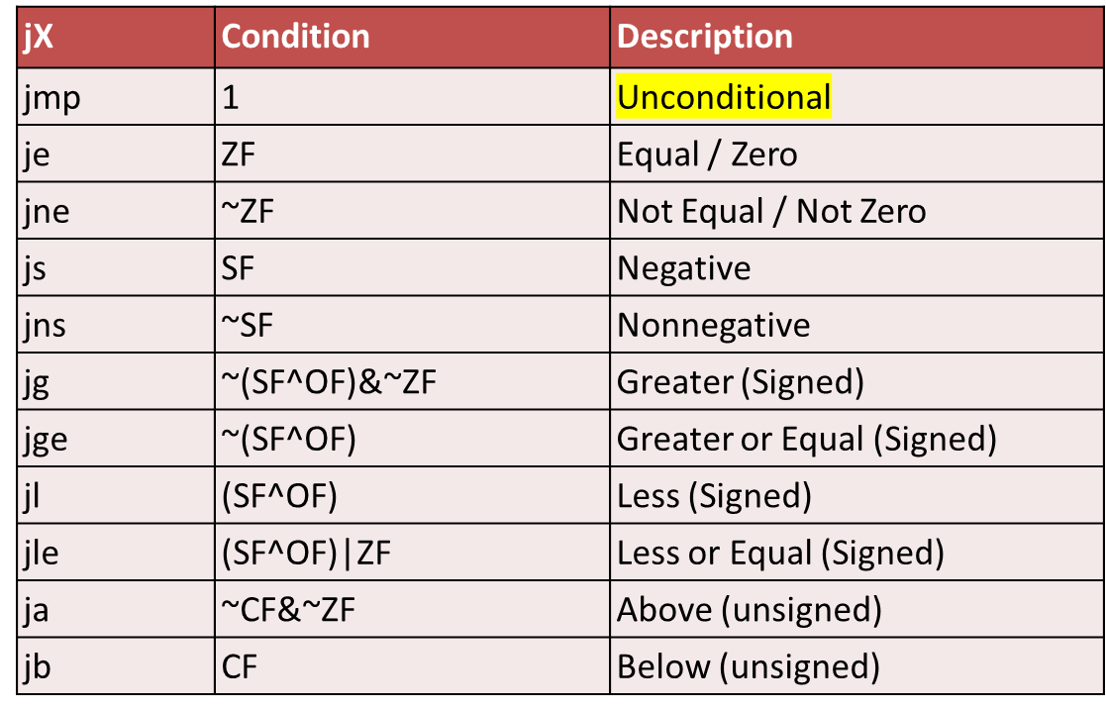
Jumping
满足条件就跳转，
否则顺序执行
jX Instructions
  Jump to different part of code depending on condition codes

Slide 57
相对寻址Relative Based Indexed Addressing
指令的地址由程序计数器PC的内容和指令地址码相加得到
主要用于转移指令，缩短指令长度。
主存空间
现行指令
JMP
+30
…
2000
JMP NEXT
2001
PC
2001
…
2031
ADD AX，BX
PC在指令中不指定，是隐含的，所以可以缩短指令长度。
…

Slide 58
相对寻址举例
LDA # 0
LDX # 0
M
ADD X, D
M+1
INX
M+2
CPX # N
M+3
JNE M
*
– 3
DIV # N
STA ANS
*
指令 BNE
– 3
操作数的有效地址为
EA = ( M+3 ) – 3 = M

Slide 59
按字节寻址的相对寻址举例
8
8
2000 H
OP
JMP * + 8
2000 H
OP
位移量
06 H
二字节指令
2008 H
2008 H
设 当前指令地址 PC = 2000H
转移后的目的地址为 2008H
因为 取出 JMP * + 8 后 PC = 2002H
转移后的目的地址为 1FFDH
第二个字节为 FBH

Slide 60
PC-relative in the Relocatable Object
8: 7e 0d jle 17<silly+0x17>
a: 89 d0 mov %edx, %eax dest1:
3 c: c1 f8 sar %eax
e: 29 c2 sub %eax, %edx
10: 8d 14 52 lea (%edx, %edx, 2), %edx
6 13: 85 d2 test %edx, %edx
15: 7f f3 jg a<silly+0x10>
17: 89 d0 movl %edx, %eax dest2:
d+a = 17
17+f3(-d) =a

Slide 61
PC-relative in the Executable Object
804839: 7e 0d jle 17<silly+0x17>
804839e: 89 d0 mov %edx, %eax dest1:
3 80483a0: c1 f8 sar %eax
80483a2: 29 c2 sub %eax, %edx
80483a4: 8d 14 52 lea (%edx, %edx, 2), %edx
6 80483a7: 85 d2 test %edx, %edx
80483a9: 7f f3 jg a<silly+0x10>
80483ab: 89 d0 movl %edx, %eax dest2:
d+804839e = 80483ab
80483ab+f3(-d) = 804839e

Slide 62
课堂练习
下列XXXX的值是什么？
  1)
    0x804828f: 74 05 je XXXX
    0x8048291: e8 1e 00 00 00 call 80482b4
  2)
    0x8048357: 72 e7 jb XXXX
    0x8048359: c6 05 10 a0 04 08 01 movb $0x1, 0x804a010
Notes:
8048296
8048340

Slide 63
练习答案
下列XXXX的值是什么？
  1)
    0x804828f: 74 05 je XXXX (0x8048296)
    0x8048291: e8 1e 00 00 00 call 80482b4
  2)
    0x8048357: 72 e7 jb XXXX (0x8048340)
    0x8048359: c6 05 10 a0 04 08 01 movb $0x1, 0x804a010

Slide 64
课堂练习
3)
  XXXX: 74 12 je 8048391
  XXXX: b8 00 00 00 00 mov $0x0, %eax
4)
  80482bf: e9 e0 ff ff ff jmp XXXX
  80482c4: 90 nop

Slide 65
练习答案
3)
  0x804837d: 74 12 je 8048391
  0x804837f: b8 00 00 00 00 mov $0x0, %eax
4)
  80482bf: e9 e0 ff ff ff jmp 0x80482a4
  80482c4: 90 nop

Slide 66
Conditional Branch Example (Old Style)
Get to this shortly
Generation
  server> gcc –Og -S –fno-if-conversion control.c
absdiff:
cmpq %rsi, %rdi # x:y
jle .L4
movq %rdi, %rax
subq %rsi, %rax
ret
.L4: # x <= y
movq %rsi, %rax
subq %rdi, %rax
ret
long absdiff
(long x, long y)
{
long result;
if (x > y)
result = x-y;
else
result = y-x;
return result;
}
Register | Use(s)
%rdi | Argument x
%rsi | Argument y
%rax | Return value

Slide 67
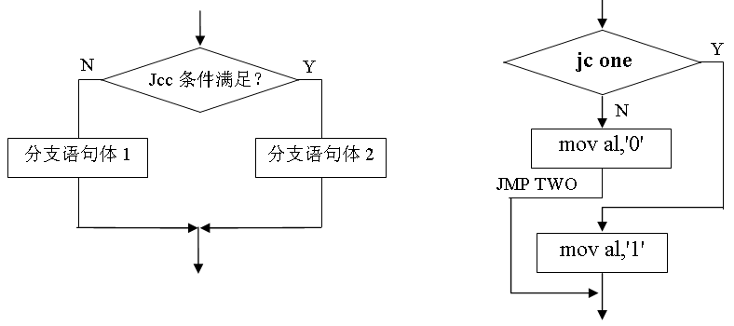
Expressing with Goto Code
C allows goto statement
Jump to position designated by label
long absdiff
(long x, long y)
{
long result;
if (x > y)
result = x-y;
else
result = y-x;
return result;
}
long absdiff_j
(long x, long y)
{
long result;
int ntest = x <= y;
if (ntest) goto Else;
result = x-y;
goto Done;
Else:
result = y-x;
Done:
return result;
}
Jcc条件满足
分支1
分支2

Slide 68
General Conditional Expression Translation (Using Branches)
C Code
val = Test ? Then_Expr : Else_Expr;
val = x>y ? x-y : y-x;
Goto Version
ntest = !Test;
if (ntest) goto Else;
val = Then_Expr;
goto Done;
Else:
val = Else_Expr;
Done:
. . .
  Create separate code regions for then & else expressions
  Execute appropriate one

Slide 69
Using Conditional Moves
Conditional Move Instructions
  Instruction supports:
    if (Test) Dest ← Src
  Supported in post-1995 x86 processors
  GCC tries to use them
    But, only when known to be safe
Why?
  Branches are very disruptive to instruction flow through pipelines
  Conditional moves do not require control transfer
C Code
val = Test
? Then_Expr
: Else_Expr;
Goto Version
result = Then_Expr;
eval = Else_Expr;
nt = !Test;
if (nt) result = eval;
return result;

Slide 70
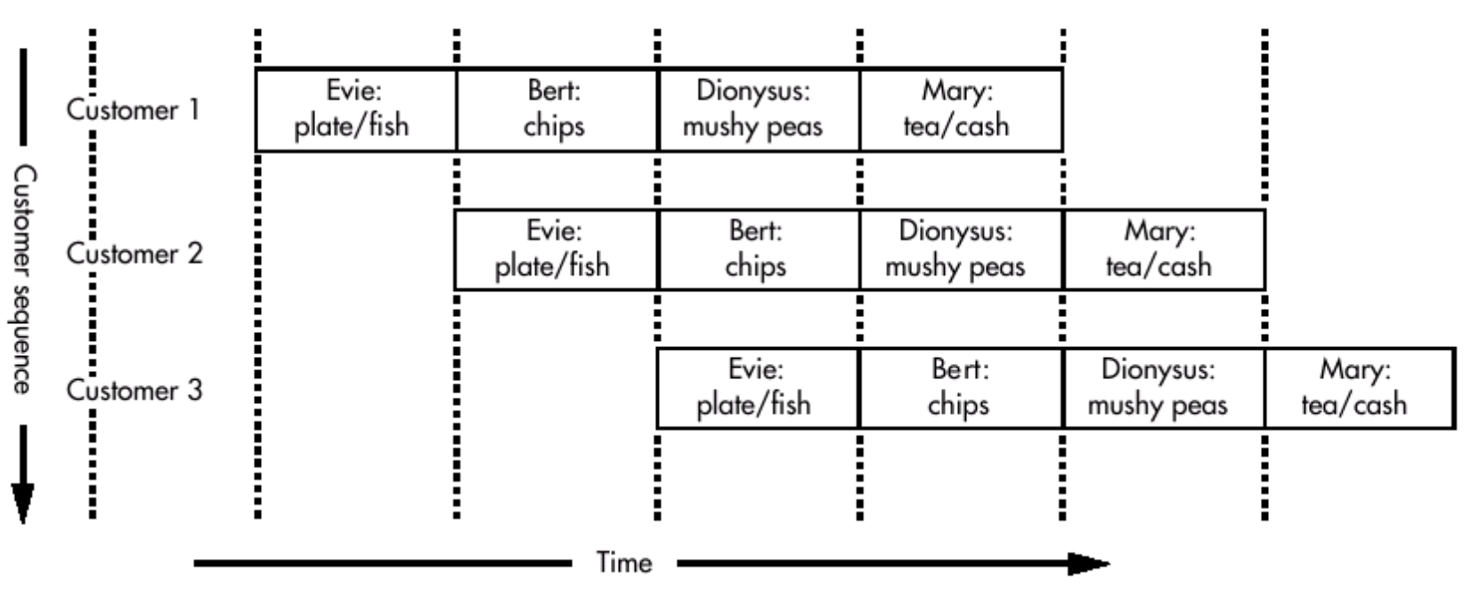
流水线（pipeline）
Evie炸鱼店
  提供：炸鳕鱼、炸薯片、豌豆粥、茶
  排队问题
  加长柜台，排队移动中依次得到各种食物

Slide 71

流水线（pipeline）
优点
  资源充分利用，减少排队时间
  每个工人的工作简单，容易培训，成本低，不容易出错
挑战：
  Daphne和Lola一起来，Daphne不买茶，则Lola不买薯片。所以Lola驻足观望Daphne是否买茶（气泡）
  对信誉不好的Cyril，要等Mary点完钱，Evie才给他盛炸鱼（Cyril要用前面三个顾客用的资源—Mary，资源冲突）

Slide 72
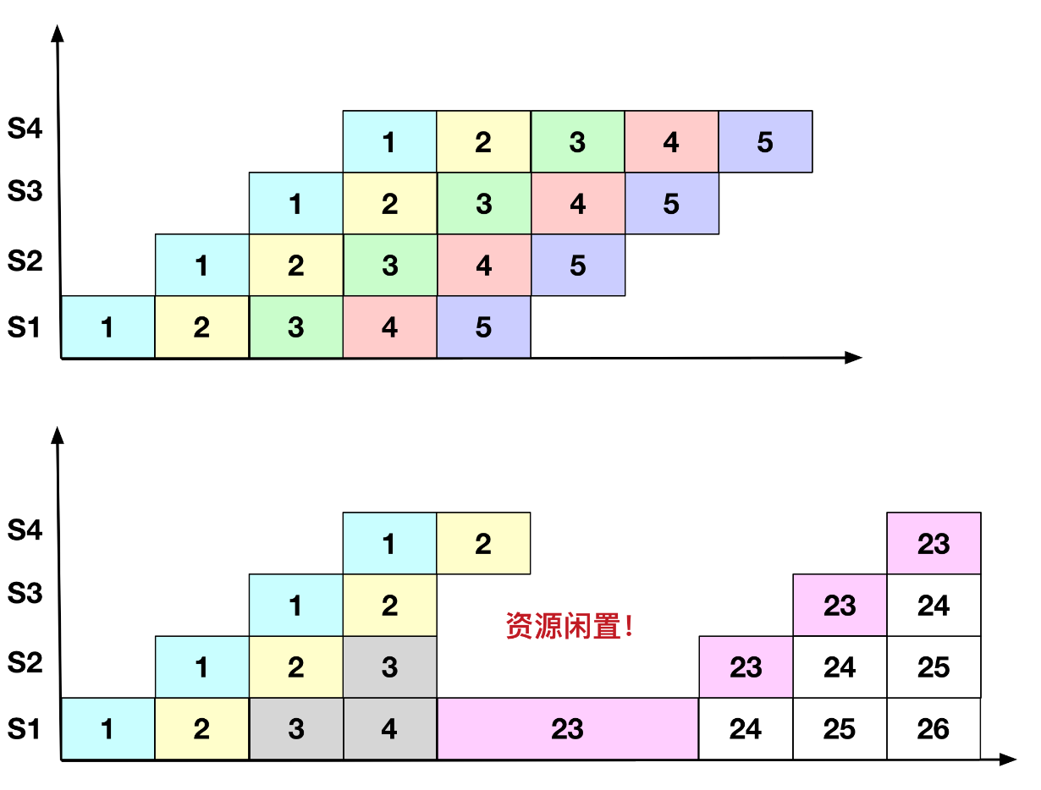
流水线（pipeline）
如果分支预测失败
  需要再去加载新的指令，很长时间内，流水线各个环节没有指令需要运行，处于空闲状态，性能下降

Slide 73
Conditional Move Example
long absdiff
(long x, long y)
{
long result;
if (x > y)
result = x-y;
else
result = y-x;
return result;
}
Register | Use(s)
%rdi | Argument x
%rsi | Argument y
%rax | Return value
absdiff:
movq %rdi, %rax # x
subq %rsi, %rax # result = x-y
movq %rsi, %rdx
subq %rdi, %rdx # eval = y-x
cmpq %rsi, %rdi # x:y
cmovle %rdx, %rax # if <=, result = eval
ret

Slide 74
Bad Cases for Conditional Move
Expensive Computations
val = Test(x) ? Hard1(x) : Hard2(x);
Bad Performance
Both values get computed
Only makes sense when computations are very simple
Risky Computations
val = p ? *p : 0;
Unsafe
Both values get computed
May have undesirable effects
Computations with side effects
val = x > 0 ? x*=7 : x+=3;
Illegal
Both values get computed
Must be side-effect free

Slide 75
Today
Control: Condition codes
Conditional branches
Loops
Switch Statements

Slide 76

“Do-While” Loop Example
C Code
Goto Version
long pcount_do
(unsigned long x) {
long result = 0;
do {
result += x & 0x1;
x >>= 1;
} while (x);
return result;
}
long pcount_goto
(unsigned long x) {
long result = 0;
loop:
result += x & 0x1;
x >>= 1;
if(x) goto loop;
return result;
}
Count number of 1’s in argument x (“popcount”)
Use conditional branch to either continue looping or to exit loop
x86 being CISC has a popcount instruction

Slide 77
General “Do-While” Translation
C Code
Goto Version
do
Body
while (Test);
loop:
Body
if (Test)
goto loop
Body:
{
Statement₁;
Statement₂;
…
Statement_{n};
}

Slide 78
“Do-While” Loop Compilation
Goto Version
long pcount_goto
(unsigned long x) {
long result = 0;
loop:
result += x & 0x1;
x >>= 1;
if(x) goto loop;
return result;
}
Register | Use(s)
%rdi | Argument x
%rax | result
movl $0, %eax # result = 0
.L2: # loop:
movq %rdi, %rdx
andl $1, %edx # t = x & 0x1
addq %rdx, %rax # result += t
shrq %rdi # x >>= 1
jne .L2 # if (x) goto loop
rep; ret
Notes:
andl $1, %edx #该32位操作对rdx高32位置零

Slide 79
General “While” Translation #1
“Jump-to-middle” translation
Used with -Og
Goto Version
goto test;
loop:
Body
test:
if (Test)
goto loop;
done:
While version
while (Test)
Body

Slide 80
While Loop Example #1
C Code
Jump to Middle Version
long pcount_while
(unsigned long x) {
long result = 0;
while (x) {
result += x & 0x1;
x >>= 1;
}
return result;
}
long pcount_goto_jtm
(unsigned long x) {
long result = 0;
goto test;
loop:
result += x & 0x1;
x >>= 1;
test:
if(x) goto loop;
return result;
}
Compare to do-while version of function
Initial goto starts loop at test

Slide 81
General “While” Translation #2
While version
“Do-while” conversion
Used with –O1
while (Test)
Body
Goto Version
Do-While Version
if (!Test)
goto done;
loop:
Body
if (Test)
goto loop;
done:
if (!Test)
goto done;
do
Body
while(Test);
done:

Slide 82
While Loop Example #2
C Code
Do-While Version
long pcount_while
(unsigned long x) {
long result = 0;
while (x) {
result += x & 0x1;
x >>= 1;
}
return result;
}
long pcount_goto_dw
(unsigned long x) {
long result = 0;
if (!x) goto done;
loop:
result += x & 0x1;
x >>= 1;
if(x) goto loop;
done:
return result;
}
Initial conditional guards entrance to loop
Compare to do-while version of function
  Removes jump to middle. When is this good or bad?
Notes:
If more often not entering loop, then skip unnecessary unconditional jump to the middle, which just evaluates to done.

Slide 83
“For” Loop Form
General Form
Init
for (Init; Test; Update )
Body
i = 0
Test
#define WSIZE 8*sizeof(int)
long pcount_for
(unsigned long x)
{
size_t i;
long result = 0;
for (i = 0; i < WSIZE; i++)
{
unsigned bit =
(x >> i) & 0x1;
result += bit;
}
return result;
}
i < WSIZE
Update
i++
Body
{
unsigned bit =
(x >> i) & 0x1;
result += bit;
}

Slide 84
“For” Loop → While Loop
For Version
for (Init; Test; Update )
Body
While Version
Init;
while (Test ) {
Body
Update;
}

Slide 85
For-While Conversion
long pcount_for_while
(unsigned long x)
{
size_t i;
long result = 0;
i = 0;
while (i < WSIZE)
{
unsigned bit =
(x >> i) & 0x1;
result += bit;
i++;
}
return result;
}
Init
i = 0
Test
i < WSIZE
Update
i++
Body
{
unsigned bit =
(x >> i) & 0x1;
result += bit;
}

Slide 86
“For” Loop Do-While Conversion
Goto Version
C Code
long pcount_for_goto_dw
(unsigned long x) {
size_t i;
long result = 0;
i = 0;
if (!(i < WSIZE))
goto done;
loop:
{
unsigned bit =
(x >> i) & 0x1;
result += bit;
}
i++;
if (i < WSIZE)
goto loop;
done:
return result;
}
long pcount_for
(unsigned long x)
{
size_t i;
long result = 0;
for (i = 0; i < WSIZE; i++)
{
unsigned bit =
(x >> i) & 0x1;
result += bit;
}
return result;
}
Init
!Test
Body
Update
Test
Initial test can be optimized away – why?
Notes:
Can optimize away when initial condition is known. Ie, compiler knows that i=0 b/c it is in the for loop, compiler knows bound if it is not variable, hence, can cut.

Slide 87
Today
Control: Condition codes
Conditional branches
Loops
Switch Statements

Slide 88
Switch Statement Example
long switch_eg
(long x, long y, long z)
{
long w = 1;
switch(x) {
case 1:
w = y*z;
break;
case 2:
w = y/z;
/* Fall Through */
case 3:
w += z;
break;
case 5:
case 6:
w -= z;
break;
default:
w = 2;
}
return w;
}
Multiple case labels
  Here: 5 & 6
Fall through cases
  Here: 2
Missing cases
  Here: 4

Slide 89
Jump Table Structure
Switch Form
Jump Table
Jump Targets
switch(x) {
case val_0:
Block 0
case val_1:
Block 1
• • •
case val_n-1:
Block n–1
}
jtab:
Targ0
Targ0:
Code Block
0
Targ1
Targ2
Targ1:
Code Block
1
•
•
•
Targ2:
Code Block
2
Targn-1
•
•
•
Translation (Extended C)
goto *JTab[x];
Targn-1:
Code Block
n–1

Slide 90
Switch Statement Example
long switch_eg(long x, long y, long z)
{
long w = 1;
switch(x) {
. . .
}
return w;
}
Setup:
Register | Use(s)
%rdi | Argument x
%rsi | Argument y
%rdx | Argument z
%rax | Return value
switch_eg:
movq %rdx, %rcx
cmpq $6, %rdi # x:6
ja .L8
jmp *.L4(,%rdi,8)
What range of values takes default?
Note that w not initialized here
Notes:
Cmpq 6 rdi → go to default if above all case values
W not initialized until it is sure to be used.

Slide 91
Switch Statement Example
long switch_eg(long x, long y, long z)
{
long w = 1;
switch(x) {
. . .
}
return w;
}
Jump table
.section .rodata
.align 8
.L4:
.quad .L8 # x = 0
.quad .L3 # x = 1
.quad .L5 # x = 2
.quad .L9 # x = 3
.quad .L8 # x = 4
.quad .L7 # x = 5
.quad .L7 # x = 6
Setup:
switch_eg:
movq %rdx, %rcx
cmpq $6, %rdi # x:6
ja .L8 # Use default
jmp *.L4(,%rdi,8) # goto *JTab[x]
Indirect
jump

Slide 92
Assembly Setup Explanation
Table Structure
  Each target requires 8 bytes
  Base address at .L4
Jumping
  Direct: jmp .L8
  Jump target is denoted by label .L8
  Indirect: jmp *.L4(,%rdi,8)
  Start of jump table: .L4
  Must scale by factor of 8 (addresses are 8 bytes)
  Fetch target from effective Address .L4 + x*8
    Only for 0 ≤ x ≤ 6
Jump table
.section .rodata
.align 8
.L4:
.quad .L8 # x = 0
.quad .L3 # x = 1
.quad .L5 # x = 2
.quad .L9 # x = 3
.quad .L8 # x = 4
.quad .L7 # x = 5
.quad .L7 # x = 6

Slide 93
Jump Table
Jump table
switch(x) {
case 1: // .L3
w = y*z;
break;
case 2: // .L5
w = y/z;
/* Fall Through */
case 3: // .L9
w += z;
break;
case 5:
case 6: // .L7
w -= z;
break;
default: // .L8
w = 2;
}
.section .rodata
.align 8
.L4:
.quad .L8 # x = 0
.quad .L3 # x = 1
.quad .L5 # x = 2
.quad .L9 # x = 3
.quad .L8 # x = 4
.quad .L7 # x = 5
.quad .L7 # x = 6

Slide 94
Code Blocks (x == 1)
switch(x) {
case 1: // .L3
w = y*z;
break;
. . .
}
.L3:
movq %rsi, %rax # y
imulq %rdx, %rax # y*z
ret
Register | Use(s)
%rdi | Argument x
%rsi | Argument y
%rdx | Argument z
%rax | Return value

Slide 95
Handling Fall-Through
long w = 1;
. . .
switch(x) {
. . .
case 2:
w = y/z;
/* Fall Through */
case 3:
w += z;
break;
. . .
}
case 2:
w = y/z;
goto merge;
case 3:
w = 1;
merge:
w += z;

Slide 96
Code Blocks (x == 2, x == 3)
.L5: # Case 2
movq %rsi, %rax
cqto
idivq %rcx # y/z
jmp .L6 # goto merge
.L9: # Case 3
movl $1, %eax # w = 1
.L6: # merge:
addq %rcx, %rax # w += z
ret
long w = 1;
. . .
switch(x) {
. . .
case 2:
w = y/z;
/* Fall Through */
case 3:
w += z;
break;
. . .
}
Register | Use(s)
%rdi | Argument x
%rsi | Argument y
%rdx | Argument z
%rax | Return value

Slide 97
Code Blocks (x == 5, x == 6, default)
switch(x) {
. . .
case 5: // .L7
case 6: // .L7
w -= z;
break;
default: // .L8
w = 2;
}
.L7: # Case 5,6
movl $1, %eax # w = 1
subq %rdx, %rax # w -= z
ret
.L8: # Default:
movl $2, %eax # 2
ret
Register | Use(s)
%rdi | Argument x
%rsi | Argument y
%rdx | Argument z
%rax | Return value

Slide 98
多判断条件的短路性
逻辑与运算
while (sum < 1000) and (count ≤ 24) loop
... { body of loop }
end while;
两个条件必须都成立<==>任一个不成立都退出
whileSum: cmpw $1000, $sum ; sum < 1000 ?
jnl endWhileSum ; exit if not
cmpw $24, %cx ; count <= 24 ?
jnle endWhileSum ; exit if not
. . . ; body of loop . .
jmp whileSum ; go check condition again
endWhileSum:

Slide 99
多判断条件的短路性
while (sum < 1000) or (flag=1) loop
... { body of loop }
end while;
逻辑或运算
whileSum: cmpw $1000, $sum ; sum < 1000 ?
jl body ; execute body if so
cmpb $1, %dh ; flag=1 ?
jne endWhileSum ; exit if not
body: . . . ; body of loop . .
….
jmp whileSum ; go check condition again
endWhileSum:

Slide 100
Loop 指令实现 for 循环
LOOP label
  利用 ECX 计数器自动减1，方便实现计数循环的程序结构。
  ECX ← ECX－1 ;dec ecx
  如果 ECX≠0，转标号 label 继续循环 ;jnz label
  否则继续执行循环指令下面的语句
  操作数 label 采用相对短转移寻址方式，及向后128个字节或向前127个字节。

Slide 101
使用“loop”的80x86汇编代码
  for count := 20 downto 1 loop
  ... { body of loop }
  end for
movl $20, %ecx ; number of iterations
forCount: . . . ; body of loop
. . .
loop forCount ; repeat body 20 times
movl $number, %ecx ; number of iterations
forIndex: . . . ; body of loop
. . .
loop forIndex ; repeat body number times

Slide 102
可靠的 for 循环
当ecx中的值为0时，循环不会执行
movl $number, %ecx ; number of iterations
cmpl $0, %ecx ; number = 0 ?
jle endFor ; skip loop if number = 0
forIndex: . . . ; body of loop
. . .
loop forIndex ; repeat body number times
endFor:
movl $number, %ecx ; number of iterations
jecxz endFor ; skip loop if number = 0
forIndex: . . . ; body of loop
. . .
loop forIndex ; repeat body number times
endFor:

Slide 103
课堂练习
# x @ %rdi, y @ %rsi
Test:
leaq 0(,%rdi,8), %rax
testq %rsi, %rsi
jle .L2
movq %rsi, %rax
subq %rdi, %rax
movq %rdi, %rdx
andq %rsi, %rdx
cmpq %rsi, %rdi
cmovge %rdx, %rax
.L2:
addq %rsi, %rdi
cmpq $-2, %rsi
cmovle %rdi, %rax
ret
填写C语言代码：
Long test (long x, long y) {
long val = ________;
if (_______) {
if (_______) {
val = ________;
else
val = ________;
} else if (_______)
val = _______;
return val;
}
8x
y>0
x<y
y-x
y&x
y<=-2
x+y

Slide 104
练习答案
# x @ %rdi, y @ %rsi
Test:
leaq 0(,%rdi,8), %rax
testq %rsi, %rsi
jle .L2
movq %rsi, %rax
subq %rdi, %rax
movq %rdi, %rdx
andq %rsi, %rdx
cmpq %rsi, %rdi
cmovge %rdx, %rax
.L2:
addq %rsi, %rdi
cmpq $-2, %rsi
cmovle %rdi, %rax
ret
Long test (long x, long y) {
long val = ____8x____;
if (___y>0____) {
if (___x<y____) {
val = ___y-x_____;
else
val = ___x&y_____;
} else if (___y<=-2____)
val = __x+y_____;
return val;
}

Slide 105
课堂练习
程序填空，变量映射关系，并解释函数功能
Int fun_a(unsigned x) {
int val = 0;
while ( x ) {
val ^= x;
x>>=1
}
return val&0x01;
}
x@$ebp+8
Movl 8(%ebp), %edx
Movl $0, %eax
Testl %edx, %edx
Je .L7
.L10:
xorl %edx, %eax
shrl %edx ;逻辑右移1位
jne .L10
.L7:
andl $1, %eax

Slide 106
课堂练习
程序填空，变量映射关系，并解释函数功能
Int fun_a(unsigned x) {
int val = 0;
while ( x ) {
val ^= x;
x>>=1
}
return val&0x01;
}
x@$ebp+8
Movl 8(%ebp), %edx
Movl $0, %eax
Testl %edx, %edx
Je .L7
.L10:
xorl %edx, %eax
shrl %edx ;逻辑右移1位
jne .L10
.L7:
andl $1, %eax

Slide 107
课堂练习
函数fun_b(unsigned long x) {
  Long val = 0;
  Long i;
  For (… ; … ; …) {
    …
  }
  Return val;
}
Gcc生成的汇编代码如右所示。
完成下面工作：
  A. 根据汇编代码，填写C代码缺失的部分；
  B. 解释循环前为什么没有初始测试，也没有初始跳转到循环内部的测试部分；
  C. 用自然语言描述这个函数的功能
# x in %rdi
1 func_b:
Movl $64, %edx
movl $0, %eax
.L10:
movq %rdi, %rcx
andl $1, %ecx
addq %rax, %rax
orq % rcx, %rax
shrq %rdi
subq $1, %rdx
jne .L10
ret

Slide 108
练习答案
fun_b(unsigned long x) {
  Long val = 0;
  Long i;
  For (i=64; i!=0 ; i--) { // 尽量忠于原意
    Val = (val << 1) | (x&1)
    X >>= 1;
  }
  Return val;
}
2）因为循环次数是常量
3）将x镜像反转

Slide 109
练习3.31
Switcher：
cmpq $7, %rdi
ja .L2
jmp *.L4(,%rdi,8)
.section .rodata
.L7: # Case 5
xorq $15, %ris
movq %rsi, %rdi
.L3: # Case 0
leaq 112(%rdx), %rdi
jmp .L6
.L5: # Case 2/7
leaq (%rdx，%rsi),%rdi
salq $2, %rdi
jmp .L6
.L2: # Case 1/6
movq %rsi, %rdi
.L6: # Case 4
movq %rsi, （%rcx）
ret
2
3
long switcher(long a, long b, long c，long *dest)
{
long val;
switch(a) {
case ____ :
  c = ____;
  /* Fall Through */
case ____ :
val = ____;
break;
case ____ :
case ____ :
val = ____;
break;
case ____ :
val = ____;
break;
default:
val = ____;
}
*dest=val
}
.L4:
.quad .L3 # x = 0
.quad .L2 # x = 1
.quad .L5 # x = 2
.quad .L2 # x = 3
.quad .L6 # x = 4
.quad .L7 # x = 5
.quad .L2 # x = 6
.quad .L5 # x = 7
1

Slide 110
Summarizing
C Control
  if-then-else
  do-while
  while, for
  switch
Assembler Control
  Conditional jump
  Conditional move
  Indirect jump (via jump tables)
  Compiler generates code sequence to implement more complex control
Standard Techniques
  Loops converted to do-while or jump-to-middle form
  Large switch statements use jump tables
  Sparse switch statements may use decision trees (if-elseif-elseif-else)

Slide 111
Summary
Today
  Control: Condition codes
  Conditional branches & conditional moves
  Loops
  Switch statements
Next Time
  Stack
  Call / return
  Procedure call discipline

Slide 112
Finding Jump Table in Binary
00000000004005e0 <switch_eg>:
4005e0: 48 89 d1 mov %rdx,%rcx
4005e3: 48 83 ff 06 cmp $0x6,%rdi
4005e7: 77 2b ja 400614 <switch_eg+0x34>
4005e9: ff 24 fd f0 07 40 00 jmpq *0x4007f0(,%rdi,8)
4005f0: 48 89 f0 mov %rsi,%rax
4005f3: 48 0f af c2 imul %rdx,%rax
4005f7: c3 retq
4005f8: 48 89 f0 mov %rsi,%rax
4005fb: 48 99 cqto
4005fd: 48 f7 f9 idiv %rcx
400600: eb 05 jmp 400607 <switch_eg+0x27>
400602: b8 01 00 00 00 mov $0x1,%eax
400607: 48 01 c8 add %rcx,%rax
40060a: c3 retq
40060b: b8 01 00 00 00 mov $0x1,%eax
400610: 48 29 d0 sub %rdx,%rax
400613: c3 retq
400614: b8 02 00 00 00 mov $0x2,%eax
400619: c3 retq

Slide 113
Finding Jump Table in Binary (cont.)
00000000004005e0 <switch_eg>:
. . .
4005e9: ff 24 fd f0 07 40 00 jmpq *0x4007f0(,%rdi,8)
. . .
% gdb switch
(gdb) x /8xg 0x4007f0
0x4007f0: 0x0000000000400614 0x00000000004005f0
0x400800: 0x00000000004005f8 0x0000000000400602
0x400810: 0x0000000000400614 0x000000000040060b
0x400820: 0x000000000040060b 0x2c646c25203d2078
(gdb)

Slide 114
Finding Jump Table in Binary (cont.)
% gdb switch
(gdb) x /8xg 0x4007f0
0x4007f0: 0x0000000000400614 0x00000000004005f0
0x400800: 0x00000000004005f8 0x0000000000400602
0x400810: 0x0000000000400614 0x000000000040060b
0x400820: 0x000000000040060b 0x2c646c25203d2078
. . .
4005f0: 48 89 f0 mov %rsi,%rax
4005f3: 48 0f af c2 imul %rdx,%rax
4005f7: c3 retq
4005f8: 48 89 f0 mov %rsi,%rax
4005fb: 48 99 cqto
4005fd: 48 f7 f9 idiv %rcx
400600: eb 05 jmp 400607 <switch_eg+0x27>
400602: b8 01 00 00 00 mov $0x1,%eax
400607: 48 01 c8 add %rcx,%rax
40060a: c3 retq
40060b: b8 01 00 00 00 mov $0x1,%eax
400610: 48 29 d0 sub %rdx,%rax
400613: c3 retq
400614: b8 02 00 00 00 mov $0x2,%eax
400619: c3 retq

