Slide 1
Android System Programming
Tips and Tricks
Tim Bird
Sony Network Entertainment, Inc.
<tim.bird (at) am.sony.com>

Slide 2
Overview
Intro to Android
Working with Source
Interacting with the Target
Debug and Trace tools
Performance tools
Random thoughts on Android
Resources

Slide 3

Intro to Android
Google runtime on top of Linux
Obligatory
Architecture
diagram:

Slide 4
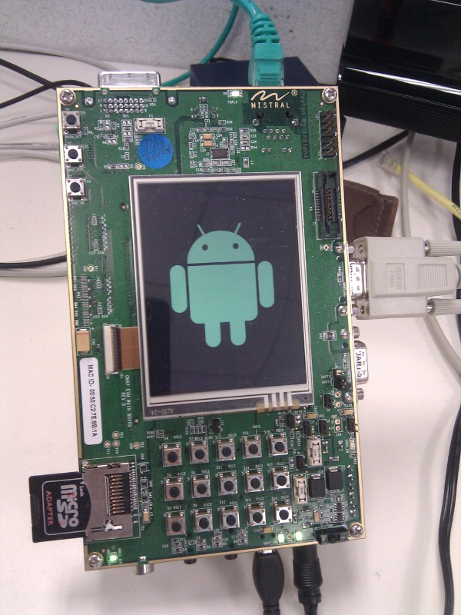






Android device proliferation

Slide 5
Working With Source

Slide 6
Working with Source
Git
Repo
Build System
  Building fast
  Adding a program to the build

Slide 7
Git
Android open source project uses 'git'
You need to learn to use git well, really
  Need to know how to do a 'git rebase' especially for kernel patches
  git rebase -i
Kernel patch rebase needed for moving kernel versions, porting work, etc.
Lots of online resources
  Recommended online book: http://progit.org/book/

Slide 8
Repo
Export REPO_TRACE=1 is handy to see what git commands are happening
Repo tricks
  Repo forall -c 'git diff <remote_branch>'
  Repo forall -c 'echo $REPO_PATH;git remote -v'
    Use to see upstream remotes from which to compare and merge with.
  Repo manifest -r -o my-tag-file.xml
    Make a repository snapshot manifest

Slide 9
Build system
Lots of interesting stuff in build/envsetup.sh
  help
  choosecombo/lunch
  jgrep/cgrep
  godir
Interesting 'make' targets:
  showcommands – psuedo-target to show build commands
  sdk – can build the SDK from scratch

Slide 10
Fast building
Parallel make threads
  'make -j6'
    Use 2 more than your number of CPUs (include hyperthreaded CPUs)
Compiled output cache
  ccache is in /prebuilt area
    'export USE_CCACHE=1'
    Great for rebuilds (21 minutes on my desktop)
Make only a specific module
  mm – build only the module(s) in the current directory (and below)
  I usually combine with a custom install script, which copies from out/target/product/<board>

Slide 11
Adding a program to the build
Make a directory under 'external'
  e.g. <android>/external/myprogram
Create your C/cpp files.
Create Android.mk as clone of external/ping/Android.mk
  Change the names ping.c and ping to match your C/cpp files and program name
Add the directory name in ANDROID/build/core/main.mk after external/zlib as external/myprogram
Make from the root of the source tree

Slide 12
Interacting with the Target

Slide 13
Interacting with the Target
Android has some very nice integration engineering
Tools discussed
  Fastboot
  ADB
Useful development configurations

Slide 14
Fastboot
“fastboot” is a both tool and a bootloader protocol
Required by Google for certified devices
Would be really nice to adopt as an industry standard
  e.g. maybe support fastboot in U-Boot
Fastboot operations
  Install kernel
  Install new flash image
  Boot directly from host
Very useful for test automation

Slide 15
ADB
Android Debug Bridge
Tool for all kinds of target interactions (install, logging, remote shell, file copy)
  shell [<command>]
  push/pull
  Logcat
  Install/uninstall
Print this and keep it under your pillow...
  http://developer.android.com/guide/developing/tools/adb.html

Slide 16
ADB (cont.)
Can work over network, instead of USB
  Useful if you run build inside virtual machine on host
    e.g. I build on Ubuntu 8.04 on Fedora 12 (64-bit) host
  It's simple:
    export ADBHOST=192.168.2.1
  For some reason, I have to kill the server after rebooting target
    adb kill-server
    Calling ‘adb’ will re-spawn the server automatically

Slide 17
Development configurations
Host
Host
Target
USB
Network
Serial
Functionality testing
Power control
Host
Network
Target
Kernel
TFTP
Root filesystem
NFS
Host
Target
Target
Integration and Performance testing
USB
kernel
root
fs
data
flash
Network

Slide 18
Trace and Debug Tools

Slide 19
Trace and Debug tools
Logging
  Kernel log (dmesg)
  Logcat
  Stdio redirection
Strace
Bootchart
Dumpsys
DDMS
gdb

Slide 20
Kernel log
It's there, use dmesg to access after boot
Turn on PRINTK_TIMES for timestamps
Increase buffer size: CONFIG_LOG_BUF_SHIFT
Can emit messages into log by writing to /dev/kmsg
  Very handy to synchronize with kernel messages

Slide 21
Logcat
Logging system in kernel
  Integrated throughout Android system (C++ and Java access)
Increase logging levels
  Flags to control logging level in code (DEBUG emits more??)
Different logs (main, event, etc.)
  Event is funky, is coded for size
  See jamboree presentation on log info http://blog.kmckk.com/archives/2936958.html (Presentation by Tetsuyuki Kobayashi)

Slide 22
Logcat
Use from host to redirect to a file
To get main log info, use:
  e.g. adb logcat –v time –d *:V >test.log
To get info from 'events' log, use -b:
  e.g. adb logcat –b events –v time –d | grep boot
Filter using <tag>:<loglevel>
  Can use ANDROID_LOG_TAGS environment variable
I wrote my own logdelta tool, to see time between events
  See http://elinux.org/Improving_Android_Boot_Time#logdelta

Slide 23
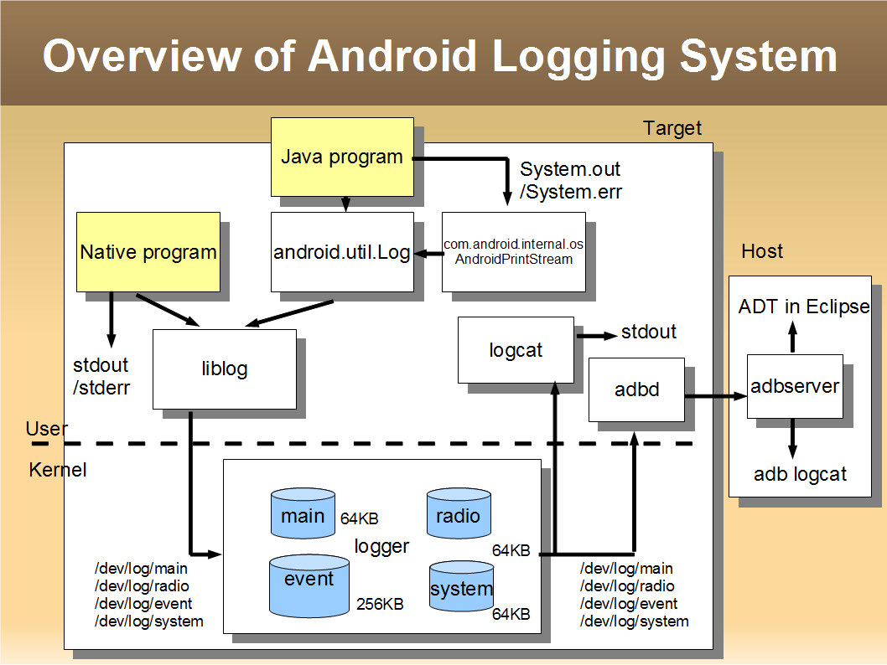
Logging system overview diagram
* Shameless ripoff of Tetsuyuki Kobayashi

Slide 24
Logcat results (events)
I/boot_progress_start( 754): 12559
I/boot_progress_preload_start( 754): 17879
I/boot_progress_preload_end( 754): 28546
I/boot_progress_system_run( 768): 29230
I/boot_progress_pms_start( 768): 29697
I/boot_progress_pms_system_scan_start( 768): 30117
I/boot_progress_pms_data_scan_start( 768): 44171
I/boot_progress_pms_scan_end( 768): 50006
I/boot_progress_pms_ready( 768): 50505
I/boot_progress_ams_ready( 768): 53166
I/boot_progress_enable_screen( 768): 56793

Slide 25
Stdio redirection
You can send stdout and stderr to the log:
  logwrapper myprogram
Redirecting Dalvik output:
Redirecting C/cpp output:
  Myprogram | xargs log
    Assumes you have busybox xargs installed
# stop
# setprop log.redirect-stdio true
# start

Slide 26
Strace
Shows system calls for a process (or set of processes)
Is part of AOSP since Eclair
Can add to init.rc to trace initialization.
  For example, to trace zygote startup, in /init.rc change:
to
service zygote /system/bin/app_process -Xzygote /system/bin --zygote --start-system-server
service zygote /system/xbin/strace -tt -o/data/boot.strace /system/bin/app_process -Xzygote
/system/bin --zygote --start-system-server

Slide 27
Bootchart
'init' gathers data on startup
  Must re-compile 'init' with support for bootchart data collection
A tool on the host produces a nice graphic
See http://elinux.org/Bootchart and http://elinux.org/Using_Bootchart_on_Android

Slide 28
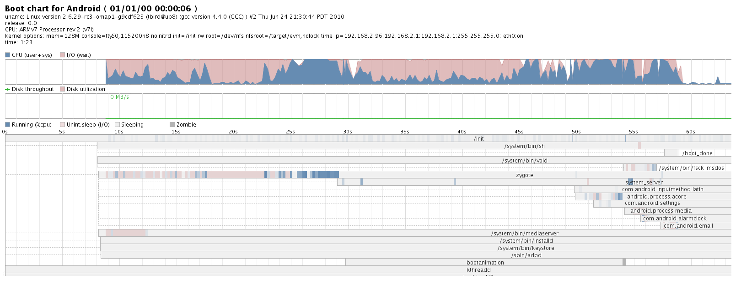
Bootchart output

Slide 29
Dumpstate/dumpsys
Dumps huge amounts of information about the system, including status, counts and statistics
Dumpstate reproduces lots of stuff from /proc
  Does a dumpsys as well
Dumpsys show status information from Android
services
  e.g. dumpsys alarm
First part of dump has list of services you can dump

Slide 30
DDMS
Dalvik Debug Monitor Service
  http://developer.android.com/guide/developing/tools/ddms.html
Lots of features, controllable via eclipse
To watch allocations in C/c++ code, try:
  Set “native=true” in ~/.android/ddms.cfg
  Use standalone ddms program
  On target do:
# setprop libc.debug.malloc 1
# stop
# start

Slide 31
GDB
How to invoke:
Note that gdbclient is a function in build/envsetup.sh
Files are stripped in output dir
  Unstripped files are at;
    ./out/target/product/generic/obj/EXECUTABLES/<name of module>_intermediates/LINKED/<name of the executable>
1. adb forward tcp:5039 tcp:5039
2. adb shell gdbserver :5039 <exename> <arguments if any>
3. In another shell, gdbclient <exename>
Or, manually: $ arm-eabi-gdb
…
# file . /out/target/product/generic/symbols/system/bin/app_process
# set solib-search-path ./out/target/product/generic/symbols/system/lib
# target remote localhost:5039

Slide 32
More debug tips
See http://omappedia.org/wiki/Android_Debugging
Tons of tips, including:
  How to debug a native program segfault
  How to use kernel profiler and oprofile
  How to use gdb and DDD
  Info is for Zoom2 board, but some things should work on your board also

Slide 33
Performance Tools

Slide 34
Performance Tools
Smem
Traceview
0xbench
Perf??

Slide 35
Smem
Tools for analyzing system-wide memory usage
  Can slice, dice, and visualize memory info snapshot
Run smemcap on target, grab data with adb, then analyze on host
See http://elinux.org/Using_smem_on_Android

Slide 36
Traceview
Shows trace of Java methods
Also shows profile information
User can start and stop tracing either using DDMS
App can start and stop tracing programmatically
Google: “android traceview”

Slide 37
0xbench
Has several built-in benchmarks, such as Linpack, Scimark2, and LibMicro
Project page at: http://code.google.com/p/0xbench
Is available in Android Market
Some tests require root privileges

Slide 38
Perf
Standard kernel tool for performance analysis
Now that Android is on more recent kernels, it should work out of the box
  Have to admit that I haven’t done it yet
  Anyone here used it?

Slide 39
Miscellaneous tools
procrank
setprop/getprop
sqlite (command line)
start/stop
  Can stop/start whole system

Slide 40
Procrank
Shows a quick summary of processes, sorted by VSS, RSS, PSS or USS
  See http://elinux.org/Android_Memory_Usage
Output:
# procrank
PID Vss Rss Pss Uss cmdline
1217 36848K 35648K 17983K 13956K system_server
1276 32200K 32200K 14048K 10116K android.process.acore
1189 26920K 26920K 9293K 5500K zygote
1321 20328K 20328K 4743K 2344K android.process.media
1356 20360K 20360K 4621K 2148K com.android.email
1303 20184K 20184K 4381K 1724K com.android.settings
1271 19888K 19888K 4297K 1764K com.android.inputmethod.latin
1332 19560K 19560K 3993K 1620K com.android.alarmclock
1187 5068K 5068K 2119K 1476K /system/bin/mediaserver
1384 436K 436K 248K 236K procrank
1 212K 212K 200K 200K /init
753 572K 572K 171K 136K /system/bin/rild
748 340K 340K 163K 152K /system/bin/sh
751 388K 388K 156K 140K /system/bin/vold
1215 148K 148K 136K 136K /sbin/adbd
757 352K 352K 117K 92K /system/bin/dbus-daemon
760 404K 404K 104K 80K /system/bin/keystore
759 312K 312K 102K 88K /system/bin/installd
749 288K 288K 96K 84K /system/bin/servicemanager
752 244K 244K 71K 60K /system/bin/debuggerd

Slide 41
setprop/getprop
Many services have debug elements controlled by properties
Many properties are set in /init.rc
You can also query and set properties on the command line
  Use 'getprop' (with no args) to see list of properties
Have to examine source for properties with special effects (or see some tip on a mailing list)
  Example: setting the DNS server address manually:
    setprop net.nds1 xx.yy.zz.aa

Slide 42
Sqlite
You can inspect and modify sqlite data directly from the command line (or over adb)
  Here's an example of setting the http_proxy for a development board
Most databases are under a directory called 'databases', and end in '.db'
# cd /data/data/com.android.providers.settings/databases
# sqlite3 settings.db
SQLite version 3.5.9
Enter ".help" for instructions
sqlite> insert into system values(99,'http_proxy','192.168.1.1:80');
sqlite>.exit
#

Slide 43
Wrapup

Slide 44
Random thoughts on Android
Throws POSIX out the window
  This is refreshing
  Has some downsides, but most things are OK
  Can finally jettison some legacy baggage
Seems destined to be a major embedded Linux platform
  Only drawback(?) is non-native apps
  But even this has pros and cons
Would like to see consolidation
  You can use an Android kernel for “regular” embedded Linux work

Slide 45
Resources
eLinux wiki Android portal:
  http://elinux.org/Android_Portal
Use android-porting, android-platform, and android-kernel mailing lists, depending on where your issue is
  See
http://elinux.org/Android_Web_Resources#Mailing_Lists
My e-mail: tim.bird (at) am.sony.com

Slide 46
Thanks for your time
Questions and Answers

