Slide 1
Data Visualisation with Python and AI Tools
Code, prompt, think throughout
Python
Builds the chart
and the coding foundation
AI
Explains, recreates,
improves and extends
Human judgement
Asks better questions
and interprets responsibly
Janna Xu Cong (jannaxu@smu.edu.sg)
Research & Data Services, SMU Libraries
Please scan the QR code to record your attendance and earn your badge.
Data Visualisation with Python and AI | 1
Notes:
Welcome, and thank you for coming. I'm Janna Xu Cong, Senior Data Curator at SMU Libraries.
Today is a Python workshop supported by AI, not an AI-only workshop. Three things work together: Python builds the chart and the coding foundation, AI explains, recreates, improves and extends, and human judgement asks the better question and interprets responsibly.
A note on how we will run today. I only have one screen, so I will talk through the slides first for each idea, and then switch over to the notebook to run the code. Everything you need to understand a chart is on the slide, so you will not lose anything when I switch across.

Slide 2
By the End of This Workshop
You should leave with a repeatable workflow, not just a list of chart commands.
Choose a suitable chart for a data question
Read and adapt Python visualisation code
Use AI to explain, recreate, improve and extend Python code
Interpret visual patterns with care
Know when a chart is impressive but not necessarily useful
Data Visualisation with Python and AI | 2
Notes:
Ok, just to set a little bit expectation. We have only 1.5 hours, so we cannot include everything here. If not, it will be a one week workshop. My goal today is to give you an introduction of the some of commonly used Python visualisations, and how we can make of AI to enhance them if needed.
After this session, you should be able to choose a suitable chart for a data question, read and adapt Python visualisation code, use AI to explain, recreate, improve and extend that code, interpret visual patterns with care, and recognise when a chart is impressive but not actually useful.
The goal is a repeatable workflow, not a list of functions you have to memorise. If you leave with the workflow, you can apply it to any dataset.

Slide 3
Why Do We Visualise Data?
Data visualisation is not decoration. It is a way of thinking.
See patterns
Find shape, trends, clusters and outliers that tables hide.
A chart should trigger curiosity, not just show numbers.
Ask better questions
A clear chart helps people understand and decide.
Communicate insight
Data Visualisation with Python and AI | 3
Notes:
Before we touch any code, let's be clear about why we visualise at all.
Data visualisation is not decoration. It is a way of thinking. Three reasons matter today. First, we see patterns that tables hide - shape, trends, clusters and outliers. Second, a good chart triggers curiosity; it makes you ask a better question rather than just showing you numbers. Third, a clear chart helps other people understand and decide.
Keep that third one in mind. Most of the charts you make will be read by someone who was not in the room when you made them.

Slide 4
Why Python for Data Visualisation?
There are quicker tools. Here is what you get in exchange.
Free, and everywhere
No licence to buy, and nothing to install for today
The same code works on your laptop, a server, or a classmate or colleague’s machine, which is why it has become the shared language of research computing.
It is also the most widely taught language in data work, so what you learn today transfers to almost any team, lab or project you join later.
Why we teach it here
Reproducible The code is the record of what you did, so any chart can be remade and checked months later.
Scales The same script handles 500 rows or 5 million. A spreadsheet gives up long before that.
One place for the whole job Cleaning, analysis and charting without switching between tools.
Best supported by AI Python is the language every AI assistant knows most deeply, so the help you get is more reliable.
Transferable The same skills carry straight into data analysis, machine learning and automation.
Honest A chart you built yourself is one you can explain when someone questions it.
What you give up
A steeper start than Excel or Tableau. You trade a few hours of learning for control, repeatability and scale.
Worth it if you will make a chart fifty times. Less so if you need one bar chart, once.
You do not need to memorise the syntax. Being able to read the code and know what to change is already enough to be useful.
Why this matters today
Every chart we build today is two or three readable lines. Once you can read them, you can change them, and you can judge whether AI's version is right.
Data Visualisation with Python and AI | 4
Notes:
Before we look at which library does what, the fair question is why Python at all. There are quicker tools for a single chart - Excel will draw you a bar chart in ten seconds.
Three reasons. It is free and everywhere: no licence, runs in the browser through Colab, and the same code works on your laptop, a server or a colleague's machine. It is reproducible: the code is the record of what you did, so any chart can be remade and checked six months later - and that matters enormously for research. And it scales: the same two lines handle five hundred rows or five million, where a spreadsheet gives up.
There is also a practical reason for today. Python is the language every AI assistant knows most deeply, so the help you get is better.
Be honest about the trade-off, though. The start is steeper than Excel or Tableau. You are trading a few hours of learning for control, repeatability and scale. Whether that is worth it depends on whether you will make this chart once or fifty times.

Slide 5
Why These Python Libraries?
Each library has a job. Knowing which is which is part of the thinking.
The data layer
pandas and numpy load the file, clean it, group it and reshape it.
matplotlib vs seaborn
matplotlib is the engine. You place every element yourself: draw the chart, then set the title, the axis labels, the ticks and the colours. Full control, more lines.
seaborn sits on top of matplot. One call reads your table, picks sensible colours, labels the axes from your column names and works out the statistics for you.
A seaborn chart is still a matplotlib chart underneath, so you can fine-tune it with matplotlib afterwards.
What each one covers
matplotlib Almost anything: line, bar, scatter, histogram, box, pie, hexbin, 3D.
seaborn The statistical set: histogram, box, violin, scatter, heatmap, regression.
plotly.express Interactive versions of most of the above, plus maps.
wordcloud Word clouds.
Why this matters
Knowing which library owns which job lets you read any AI-generated code and judge whether it reached for the right tool.
Data Visualisation with Python and AI | 5
Notes:
Before we run anything, let's talk about the toolbox, because you will see all of these in the notebook and I don't want them to be mysterious.
pandas and numpy are the data layer. They load the CSV, clean it, group it and reshape it. Every chart starts from a tidy DataFrame - the plotting is often the last and shortest step.
matplotlib is the foundation. Full control over every element, and it is what seaborn is built on top of. seaborn gives you statistical charts in roughly one line with much cleaner defaults. plotly.express gives you interactive charts you can hover, zoom and filter. And wordcloud turns free text into a frequency picture.
How to choose: a static chart for a report, reach for seaborn. Something unusual, or you need fine control, drop down to matplotlib. Exploring, or demoing live, use Plotly.
Why this matters for today - once you know which library owns which job, you can read any AI-generated code and judge whether it reached for the right tool. That is a real skill and it takes about five minutes to learn.

Slide 6
The Dataset: TMDB 5000 Movies
A quick look at the data we will use for every chart today.
The dataset
TMDB 5000 Movies — about 4,800 films from The Movie Database.
A public dataset, widely used for teaching data analysis.
What each row contains
title, release_date — the film and when it came out
genres — categories, stored as text
budget, revenue — amounts in US dollars
runtime — length in minutes
vote_average, vote_count — audience rating and how many people voted
popularity — TMDB’s own attention score
Why this one
It mixes numbers, categories, dates and free text in a single file.
That means one dataset can demonstrate every chart type in this workshop.
Size and shape
About 4,800 rows and 20 columns — small enough to load instantly, varied enough to work with all day.
Data Visualisation with Python and AI | 6
Notes:
Now the data. We are using the TMDB 5000 Movies dataset - roughly five thousand films, each with a title, genres, budget, revenue, runtime, popularity, rating and vote count.
There are four preparation steps and each one is a decision, not a formality. The genres column arrives as JSON text, so we extract the first genre into primary_genre. We pull release_year out of release_date. We replace zeros in budget and revenue with NaN, because a zero budget almost certainly means missing, not free. And we keep only films with more than fifty votes, so the averages are based on enough people.
Two ways to load it in the notebook. Option A, upload tmdb_5000_movies.csv from your computer. Option B, pull it from Kaggle with kagglehub. If Option B does not work in your environment, just use Option A - it is not worth troubleshooting.
The caution: every cleaning decision shapes the chart. Filtering by vote count removes obscure films, which is a reasonable choice - but it is one we should say out loud rather than hide.

Slide 7
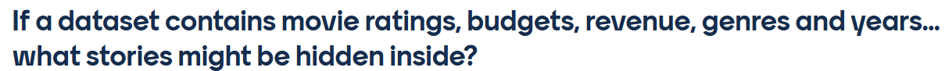
Question?
Notes:
Quick pause. Take thirty seconds and write down one question you are genuinely curious about - it can be about movies, or about your own research data.
Don't overthink it. Just one question.
Hold on to it. We will come back to these at the end of the session, and I want you to check whether you now know which chart would answer yours.

Slide 8
Part 1
Build a visualisation mindset before writing code
Data Visualisation with Python and AI | 5
Notes:
We are now in Part 1. This part is deliberately code-free.
The aim here is to build a visualisation mindset before we write anything. If the thinking is right, the code is the easy part.

Slide 9
Before We Plot: What Are We Trying to See?
Chart choice is a thinking decision, not just a technical decision.
Distribution
How is one variable spread?
Use: Histogram / box plot
Comparison & ranking
Which group is higher or lower?
Use: Bar chart / treemap
Relationship
Do variables move together?
Use: Scatter / heatmap
Time & Trend
What changes over time?
Use: Line chart
Advanced Exploration
What words recur, or what can we explore?
Use: Word cloud / Plotly / 3D scatter
Data Visualisation with Python and AI | 6
Data Visualisation with Python and AI | 9
Notes:
This is the single most useful slide in the deck. Before you plot, ask what you are trying to see.
Distribution - how is one variable spread? Histogram or box plot. Comparison and ranking - which group is higher or lower? Bar chart or treemap. Relationship - do variables move together? Scatter or heatmap. Time and trend - what changes over time? Line chart. Density - where do points concentrate? Hexbin or a 2D density plot. And for text themes or interactive detail - a word cloud, a Plotly chart, or a 3D scatter.
Chart choice is a thinking decision, not just a technical decision. If you can name the question type, the chart almost picks itself.

Slide 10
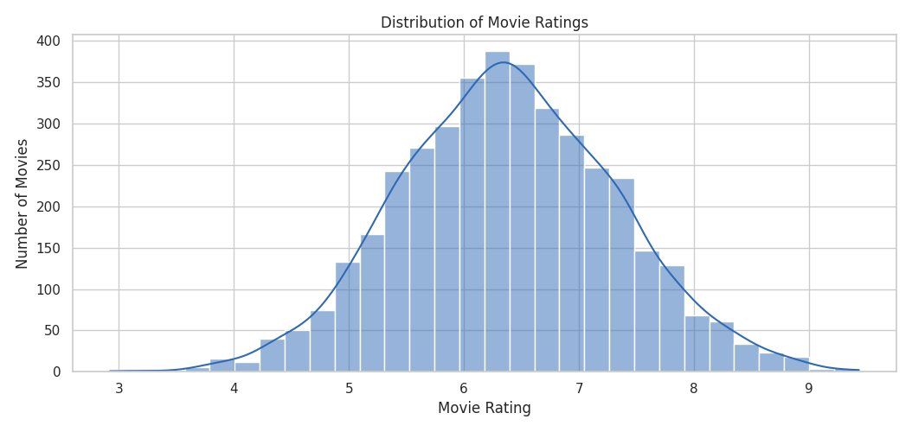
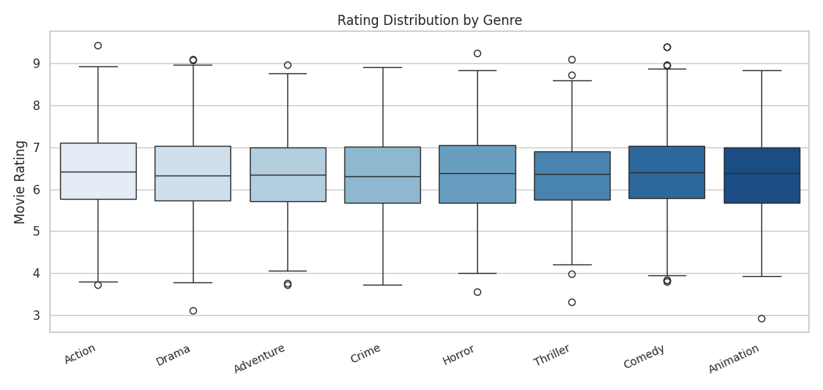
Choose Your Visualisation Carefully
Seeing the shape of one variable
Histogram
Box Plot
Best for showing how one numeric variable is spread. Y-axis must start from 0.
Best for comparing spread and outliers across groups. Shows median, quartiles and outliers.
Sample scenarios
- Distribution of movie ratings
- Spread of student exam scores
Sample scenarios
- Do ratings vary across genres
- Salary range by department
Data Visualisation with Python and AI | 10
Notes:
Before we open the notebook, I want to show you what we are actually going to build, and - more importantly - what each chart is good for. Two per slide. For each one: what it is best for, and two sample scenarios so you can map it onto your own work.
Both of these answer questions about the shape of data. The histogram takes one numeric variable and shows you how it is spread - where the centre is, how wide, whether it is skewed. Its y-axis is a count, so it must start from zero.
The box plot does the same job across groups. The box is the middle fifty per cent, the line is the median, and the dots are outliers. That is what lets you say 'these two genres have the same average but completely different spreads'.
Sample scenarios beyond movies: distribution of exam scores, or salary range by department.

Slide 11
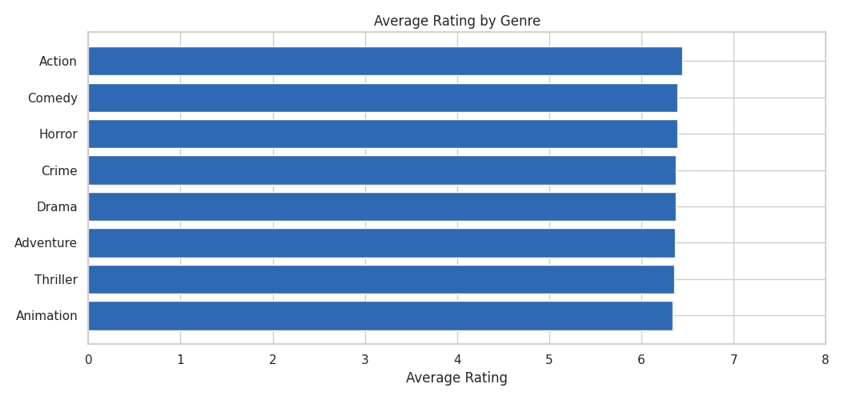
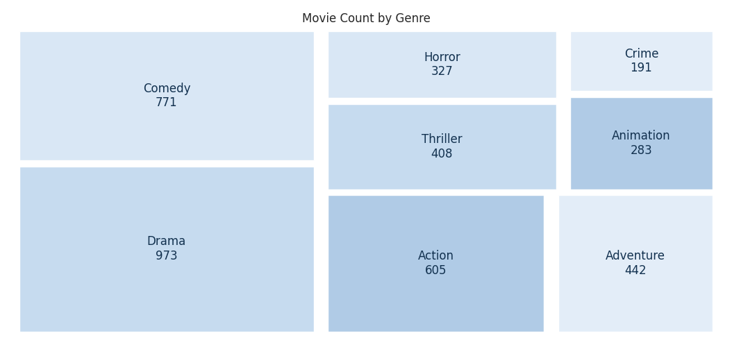
Choose Your Visualisation Carefully
Comparing groups and showing composition
Bar Chart
Treemap
Best for categorical data. The value axis must start from 0.
Best for parts of a whole when there are many categories. Area shows quantity.
Sample scenarios
- Average rating by genre
- Student enrolment by school
Sample scenarios
- Share of movies by genre
- Budget split across faculties
Data Visualisation with Python and AI | 11
Notes:
These two are about comparison and composition, and they are not interchangeable.
A bar chart ranks categories. The one rule people break constantly: the value axis must start from zero, because with a bar chart we read length as quantity. Truncate the axis and you exaggerate the difference - that is how misleading charts get made, usually by accident.
A treemap answers a different question: how does the whole divide up? Area shows quantity, so it handles many categories at once and shows you the dominant one plus the long tail in a single view.
Rule of thumb: ranking, use a bar. Share of a whole with lots of categories, use a treemap.

Slide 12
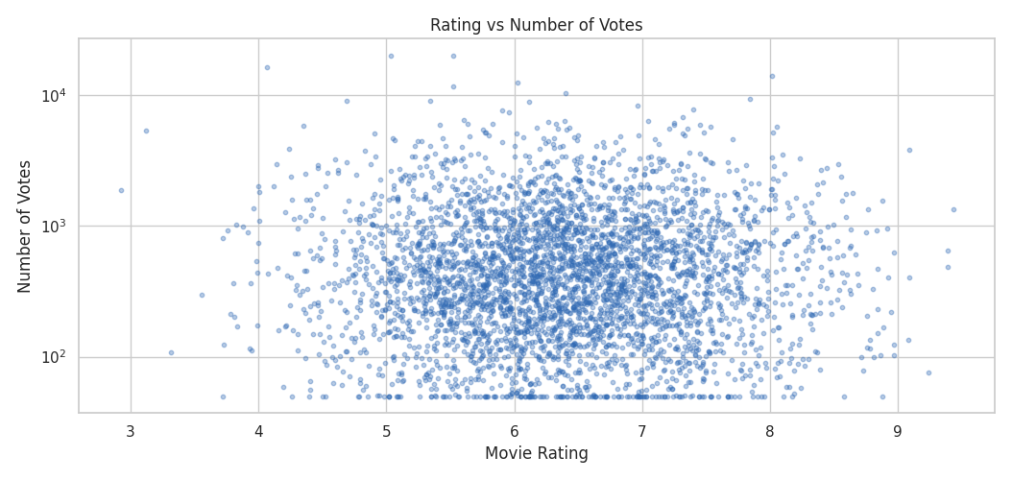
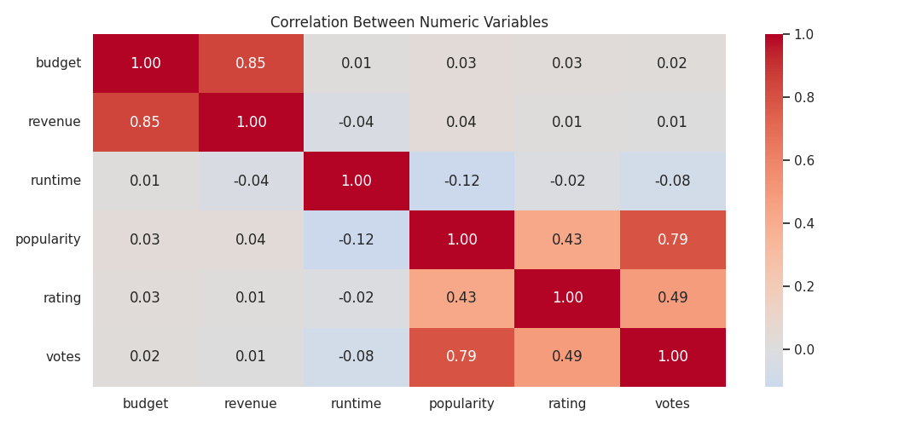
Choose Your Visualisation Carefully
Relationships between two or more variables
Scatter Plot
Heatmap
Best for two numeric variables: does one move with the other?
Best for scanning many pairwise relationships in a single view.
Sample scenarios
- Rating against number of votes
- Study hours against exam score
Sample scenarios
- Correlation between budget, revenue and rating
- Which survey items move together
Data Visualisation with Python and AI | 12
Notes:
Now relationships. Does one thing move with another?
The scatter plot is the workhorse - two numeric variables, one point per case. Rating against number of votes, or study hours against exam score.
The bubble chart pushes that to three or four variables by adding size and colour. It is genuinely more informative, and it is also where charts start to fight themselves. Four encodings is roughly the ceiling before your audience stops reading and starts squinting.
The caution for both: a pattern here suggests a relationship. It never proves cause and effect.

Slide 13
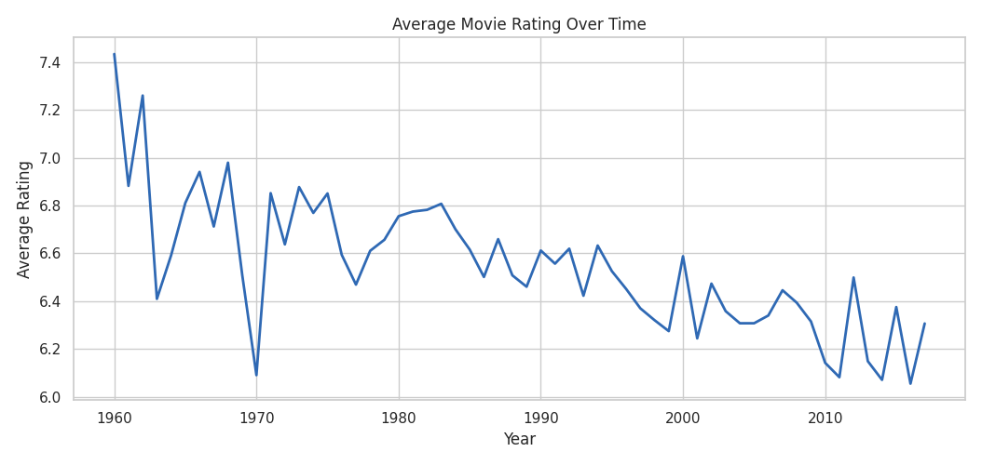
Choose Your Visualisation Carefully
Change over time, and many relationships at once
Line Chart
Best for showcasing change over time. The y-axis does not have to start from 0.
Sample scenarios
- Average rating by release year
- Monthly library visits over a decade
Data Visualisation with Python and AI | 13
Notes:
Two very different jobs on this slide.
The line chart is for change over time, and it is the one exception to the start-at-zero rule - because with a line we read the slope, not the length, so the y-axis does not have to start from zero. Average rating by release year, or monthly library visits over a decade.
The heatmap is for scanning many pairwise relationships at once. Instead of drawing fifteen scatter plots, you get one grid with the correlation values printed in. It is a screening tool - you use it to decide which pair is worth a proper look.
And the phrase from earlier applies here more than anywhere: correlation is a clue, not a conclusion.

Slide 14
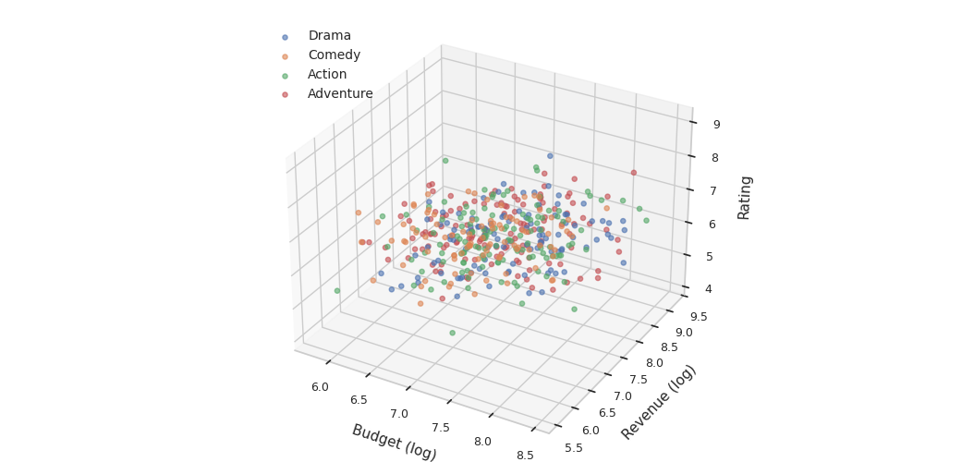
Choose Your Visualisation Carefully
Too many points, or too many dimensions
3D Scatter
Best for exploring a third numeric axis. Rarely the best choice for a report.
Sample scenarios
- Budget, revenue and rating together
- Comparing three sensor readings
Data Visualisation with Python and AI | 14
Notes:
These two are what you reach for when the standard chart stops working.
When a scatter plot has thousands of points, they pile on top of each other and you can no longer see where the mass of the data is. A hexbin bins them and colours by count, so you get concentration back. What you give up is the individual case - this chart is about the crowd, not the person.
The 3D scatter adds a third numeric axis. I have included it deliberately as the cautionary example. It is exciting to look at, it is hard to read, depth is genuinely difficult to judge, and points hide behind other points. Great for exploring on your own screen where you can rotate it. Rarely the right choice for a report.

Slide 15
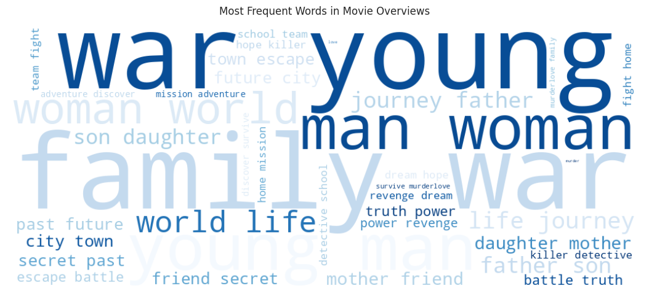
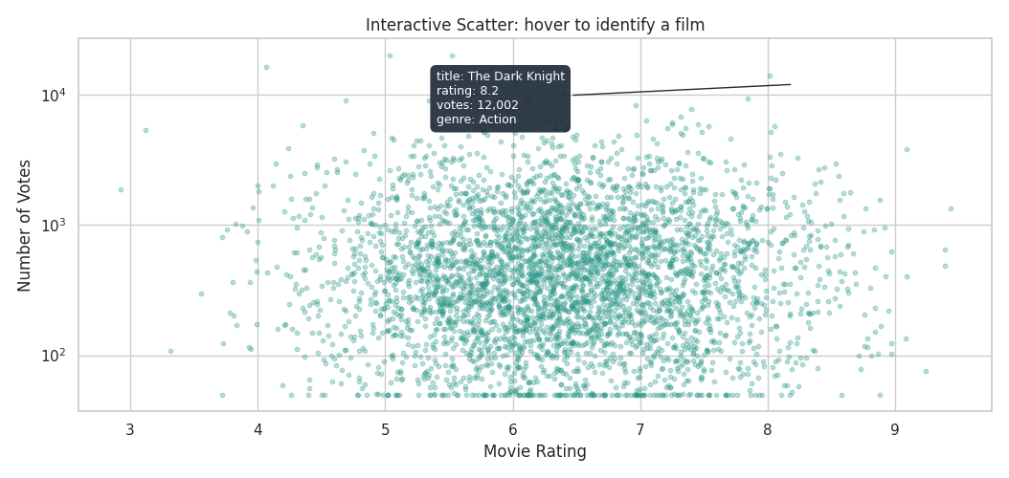
Choose Your Visualisation Carefully
Text data, and charts you can explore
Word Cloud
Interactive Plotly Chart
Best for a quick feel for which words recur in free text. Size shows frequency, not importance.
Best for exploring rather than presenting: hover, zoom and identify single cases.
Sample scenarios
- Common words in movie overviews
- Themes in open-ended survey answers
Sample scenarios
- Finding the hidden-gem films
- Letting readers explore the data themselves
Data Visualisation with Python and AI | 15
Notes:
Last pair, and both are slightly unusual.
The word cloud handles text rather than numbers - a quick feel for which words recur in free text. Common words in movie overviews, or themes in open-ended survey answers. The caution matters here: size shows frequency, not importance. Word clouds present beautifully and analyse weakly, which makes them a perfect test of the judgement question we keep returning to.
The interactive Plotly chart is for exploring rather than presenting. You hover, you zoom, you identify a single case. That is how you find the hidden-gem films. And if you share it as an HTML file, your reader can explore it themselves rather than taking your word for it.
That is the full set. Now let's go and build them.

Slide 16
Part 2
Use AI as a visualisation partner — not a replacement for learning
Data Visualisation with Python and AI | 16
Notes:
Part 2. Now we bring AI in.
The framing matters: AI is a visualisation partner, not a replacement for learning.

Slide 17
The Learning Loop We Will Use
This is a Python workshop supported by AI — not an AI-only workshop.
1
2
3
4
5
Ask
Start with a data question
Code
Study the Python script
See
Run and interpret the chart
Prompt
Use AI to explain or improve
Compare
Check Python vs AI output
Our habit today: understand first, prompt second.
Data Visualisation with Python and AI | 4
Data Visualisation with Python and AI | 17
Notes:
This is the loop we will repeat for every single visualisation today.
Ask - start with a data question. Code - study the Python script before you run it. See - run it and interpret the chart. Prompt - use AI to explain or improve it. Compare - check the Python output against what AI gives you.
The habit I want to build is: understand first, prompt second. If you prompt first, you get an answer you cannot check. If you understand first, AI becomes an accelerator instead of a substitute.

Slide 18
Part 3
Visualisation methods: Python first, AI second
Data Visualisation with Python and AI | 18
Notes:
Part 3. This is where we start switching between the slides and the notebook.
For each chart I will set it up here on the slide - the question, the code, and how the code works - and then we go across and run it. Same loop every time: Python first, AI second.

Slide 19
1. Histogram: What is normal?
Question: What is the distribution of movie ratings?
What this chart helps us see
Look for: centre, spread, skew, unusual values
sns.histplot(data=df, x='vote_average', bins=30, kde=True)
- bins=30 controls how ratings are grouped.
- kde=True adds a smooth density curve.
- Titles and axis labels are what make it readable.
AI prompt to try
Use AI to recreate it and explain each line.
Student activity
Run Python first → Try AI prompt → Compare outputs → Write one insight and one caution
Data Visualisation with Python and AI | 19
Notes:
Chart one. The question: what is the distribution of movie ratings?
One line of seaborn does it: sns.histplot with vote_average, thirty bins, and kde=True. bins=30 controls how finely the ratings are grouped - change it and the shape of the story changes, which is worth knowing. kde=True lays a smooth density curve over the bars. And the titles and axis labels are what actually make it readable to someone else.
When it comes up, look for four things: where the centre is, how wide the spread is, whether it is skewed, and whether there are unusual values at either end.
Then run the AI prompt - ask it to recreate this and explain each line - and compare. Write down one insight and one caution.

Slide 20
2. Bar Chart: Which group stands out?
Question: Which genre has the highest average rating?
What this chart helps us see
Activity: predict the top genre before running the code
genre_ratings = df.groupby('primary_genre')['vote_average'].mean()
genre_ratings.plot(kind='barh')
- groupby + .mean() gives one average per genre.
- sort_values() puts the bars in order.
- kind='barh' draws horizontal bars, easier for long labels.
AI prompt to try
Use AI to remake it in seaborn and add value labels.
Student activity
Run Python first → Try AI prompt → Compare outputs → Write one insight and one caution
Data Visualisation with Python and AI | 20
Notes:
Chart two. Which genre has the highest average rating?
Before I run it - predict. Which genre do you think comes out on top? Hold your guess.
The code groups by primary_genre, takes the mean of vote_average, sorts the values, and plots horizontal bars. groupby plus mean gives one number per genre. sort_values puts them in order, which is what makes a bar chart readable. And barh - horizontal bars - is the right choice here because genre names are long.
After it runs: was your guess right? Are the differences actually large, or are they all within half a point? And should we trust an average alone, when some genres have far fewer films than others? Hold that thought, because the box plot answers it.

Slide 21
3. Treemap: How is the whole divided?
Question: How are movies distributed across genres?
What this chart helps us see
Look for: dominant genres, and the long tail of small ones
genre_counts = df.groupby('primary_genre').size()
fig = px.treemap(genre_counts, values='movie_count')
- size() counts the movies in each genre; reset_index names the column.
- path sets the hierarchy; values sets each rectangle's area.
- Area encodes quantity — a bigger rectangle means more movies.
AI prompt to try
Ask AI to recreate it in Plotly and explain how to read a treemap.
Student activity
Run Python first → Try AI prompt → Compare outputs → Write one insight and one caution
Data Visualisation with Python and AI | 21
Notes:
Chart three, and this one is new. A treemap - how is the whole divided?
The question: how are movies distributed across genres? We count the films in each genre with groupby and size, reset_index names that count column, and px.treemap draws it.
The thing to understand about a treemap is that area encodes quantity. A bigger rectangle simply means more movies. That makes it very good at showing you a dominant category and the long tail of small ones at the same time, which a bar chart does less vividly.
Ask AI to recreate it in Plotly and explain how to read a treemap - the interpretation is the part people get wrong.

Slide 22
4. Word Cloud: What themes appear in text?
Question: Which words appear most often in movie overviews?
What this chart helps us see
Look for: recurring themes — and words that only look important
text = ' '.join(df['overview'].dropna())
wc = WordCloud(stopwords=stopwords).generate(text)
- All overviews are joined into one long string.
- Stopwords remove filler words such as 'the', 'movie' and 'story'.
- Word size shows frequency, not importance — that is the caution here.
AI prompt to try
Ask AI to rebuild it and explain what word size and colour really mean.
Student activity
Run Python first → Try AI prompt → Compare outputs → Write one insight and one caution
Data Visualisation with Python and AI | 22
Notes:
Chart four, also new, and this one is a different kind of data entirely - text.
The question: which words appear most often in movie overviews? We join every overview into one long string, then WordCloud generates the image. Stopwords are doing a lot of work here - they strip out filler like 'the', 'movie' and 'story' which would otherwise dominate.
Now the caution, and it is the most important one on this slide. Word size shows frequency, not importance. A word can be everywhere and mean nothing. Word clouds look impressive in a presentation and are genuinely weak as analysis - which makes this a perfect example of the judgement question we keep coming back to.

Slide 23
5. Box Plot: Averages can hide stories
Question: Do ratings vary widely across genres?
What this chart helps us see
Look for: variation, consistency, outliers
sns.boxplot(data=df, x='primary_genre', y='vote_average')
- The box is the middle 50%; the line inside is the median.
- Whiskers show the range, dots beyond them are outliers.
- plt.xticks(rotation=45) keeps genre labels readable.
AI prompt to try
Use AI to explain median, box, whiskers and outliers.
Student activity
Run Python first → Try AI prompt → Compare outputs → Write one insight and one caution
Data Visualisation with Python and AI | 23
Notes:
Chart five. Do ratings vary widely across genres? This is the follow-up to the bar chart.
A box plot shows what an average hides. The box is the middle fifty per cent of films, the line inside is the median, the whiskers show the range, and the dots beyond them are outliers. Rotating the x labels by forty-five degrees is what keeps the genre names readable.
Look for which genre has a wide spread, which is consistent, and where the outliers cluster.
The message to land: two genres can have the same average and completely different stories. Averages can hide stories - that is why this chart exists.

Slide 24
6. Scatter Plot: Do two things move together?
Question: Is rating related to number of votes?
What this chart helps us see
Activity: name the four quadrants
sns.scatterplot(data=df, x='vote_average', y='vote_count', alpha=0.6)
- Each point is one movie.
- alpha=0.6 makes overlapping points visible.
- Read it in quadrants: rating against number of votes.
AI prompt to try
Use AI to add colour by genre and explain what not to overclaim.
Student activity
Run Python first → Try AI prompt → Compare outputs → Write one insight and one caution
Data Visualisation with Python and AI | 24
Notes:
Chart six. Is rating related to number of votes?
Each point is one movie. alpha=0.6 makes the points semi-transparent so you can see where they pile up.
Read it in quadrants. High rating with high votes - popular and well-rated. High rating with few votes - possible hidden gems, and that is the interesting corner. Low rating with high votes - popular but not loved. Low rating with few votes - films that never found an audience.
And the caution: a scatter plot can suggest a relationship. It does not prove cause and effect. Do not let a nice-looking cloud of points talk you into a causal claim.

Slide 25
7. Heatmap: Many relationships at once
Question: Which numeric variables are related?
What this chart helps us see
Key phrase: correlation is a clue, not a conclusion
corr_matrix = df[numeric_cols].corr()
sns.heatmap(corr_matrix, annot=True, cmap='coolwarm')
- .corr() computes correlations between numeric columns.
- annot=True prints the values; fmt='.2f' rounds them.
- cmap='coolwarm' shows both direction and strength.
AI prompt to try
Use AI to explain correlation values and causation risk.
Student activity
Run Python first → Try AI prompt → Compare outputs → Write one insight and one caution
Data Visualisation with Python and AI | 25
Notes:
Chart seven. Which numeric variables are related to each other?
We select the numeric columns, call .corr() to compute correlations between them, and hand that matrix to sns.heatmap. annot=True prints the actual values, fmt='.2f' rounds them to two decimals, and cmap='coolwarm' shows both direction and strength through colour.
Look for the strongest pair, and then ask whether it actually makes sense. Budget and revenue will be strong - that is unsurprising. The interesting ones are the weak relationships you expected to be strong.
The key phrase for this slide, and please write it down: correlation is a clue, not a conclusion.

Slide 26
8. Trend Line: What changes over time?
Question: How have average ratings changed over years?
What this chart helps us see
Look for: trend, noise, sample-size issues
yearly = df.groupby('release_year')['vote_average'].mean().reset_index()
sns.lineplot(data=yearly, x='release_year', y='vote_average')
- groupby('release_year').mean() gives one value per year.
- .reset_index() turns the result back into a DataFrame.
- Early years have few films, so they swing more.
AI prompt to try
Use AI to add a rolling average and explain volatility.
Student activity
Run Python first → Try AI prompt → Compare outputs → Write one insight and one caution
Data Visualisation with Python and AI | 26
Notes:
Chart eight. How have average ratings changed over time?
We group by release_year, take the mean, reset_index to get a DataFrame back, and draw a line.
Three things to look for: is there a trend, how much is just noise, and are there sample-size problems. That third one matters here - the early years have very few films in this dataset, so those points swing wildly. That is not a change in film quality, it is a change in how much data we have.
Ask AI to add a rolling average and explain the volatility. It is a good example of AI making a chart genuinely better rather than just prettier.

Slide 27
9. Interactive Scatter: From chart to discovery
Question: Can we identify individual movies?
What this chart helps us see
Activity: find one interesting point
fig = px.scatter(df, x='vote_average', y='vote_count', hover_data=['title'])
fig.show()
- plotly.express builds interactive charts.
- hover_data controls what appears when you hover.
- labels renames the axes so they read clearly.
AI prompt to try
Use AI to add genre colour and richer hover information.
Student activity
Run Python first → Try AI prompt → Compare outputs → Write one insight and one caution
Data Visualisation with Python and AI | 27
Notes:
Chart nine. Now we go interactive. Can we identify individual movies?
plotly.express builds this. hover_data controls what appears when you hover, and labels renames the axes so they read as English rather than column names.
When I run this, hover around and find three things: one highly rated film with many votes, one highly rated film with very few votes, and one point that just looks odd.
This is the shift from overview to detail. A static chart tells you the shape. An interactive one lets you ask 'which one is that?' - and that question is usually where the real insight starts.

Slide 28
10. Bubble Chart: More than two variables
Question: How do budget, revenue, popularity and genre relate?
What this chart helps us see
Ask: richer insight or visual overload?
fig = px.scatter(df, x='budget', y='revenue', size='popularity', color='primary_genre', log_x=True, log_y=True)
- Bubble size shows popularity; colour shows genre.
- log_x and log_y handle very wide value ranges.
- Four variables at once — check it is still readable.
AI prompt to try
Use AI to critique whether the chart is too complex.
Student activity
Run Python first → Try AI prompt → Compare outputs → Write one insight and one caution
Data Visualisation with Python and AI | 28
Notes:
Chart ten. How do budget, revenue, popularity and genre relate - all at once?
Four variables on one chart. Budget on x, revenue on y, bubble size shows popularity, colour shows genre. The log scales on both axes matter, because budgets and revenues span several orders of magnitude and without them everything collapses into one corner.
Look for the low-budget high-revenue films, and the expensive flops.
Then the honest question: is this richer insight, or visual overload? Four variables is roughly where a chart starts fighting itself. Ask AI to critique whether it is too complex - it is surprisingly good at that.

Slide 29
11. Hexbin / 2D Density: When scatter is too crowded
Question: Where are movies concentrated?
What this chart helps us see
Look for: dense regions, not individual movies
plt.hexbin(df['vote_average'], df['vote_count'], gridsize=30, cmap='Blues')
- hexbin groups many points into hexagonal bins.
- gridsize controls how fine the bins are.
- Darker areas simply mean more movies.
AI prompt to try
Use AI to explain why density can be clearer than dots.
Student activity
Run Python first → Try AI prompt → Compare outputs → Write one insight and one caution
Data Visualisation with Python and AI | 29
Notes:
Chart eleven. Our scatter plot had thousands of overlapping points. What do we do when scatter gets too crowded?
hexbin groups the points into hexagonal bins and colours them by how many fall in each. gridsize controls how fine those bins are. Darker areas simply mean more movies.
What this shows that the scatter plot could not is the concentration - where the mass of the data actually sits. What you lose is the individual point.
That trade-off is the lesson: sometimes the clearer chart is the one that shows less.

Slide 30
12. 3D Scatter: Impressive, but useful?
Question: How do budget, revenue and rating relate in 3D?
What this chart helps us see
Critical question: would a 2D chart communicate better?
fig = px.scatter_3d(df, x='budget', y='revenue', z='vote_average', color='primary_genre')
- z adds a third numeric axis.
- Colour shows genre; rotation helps exploration.
- Ask whether a 2D chart would communicate better.
AI prompt to try
Use AI to identify one benefit and one limitation.
Student activity
Run Python first → Try AI prompt → Compare outputs → Write one insight and one caution
Data Visualisation with Python and AI | 30
Notes:
Chart twelve, and I have saved this one for last on purpose.
Budget, revenue and rating in three dimensions. The z-axis adds the third variable, colour shows genre, and you can rotate it.
Now be honest with yourself. Is it visually exciting? Yes. Is it easy to read? Not really - depth is hard to judge, points hide behind other points, and every reader sees it from a different angle unless they rotate it themselves.
Would you put this in a report? Would a simple 2D chart communicate better? Almost always, yes. Advanced charts are not the same thing as better charts, and knowing the difference is the whole point of this workshop.

Slide 31
The Most Important Skill: Human Judgement
A chart can be technically correct but still misleading, confusing, or unsuitable.
Ask before presenting
• What question does this answer?
• Who is the audience?
• Is the chart type suitable?
Check before trusting
• Did AI use the right column?
• Are missing values handled?
• Are labels clear?
Interpret with care
• What pattern do I see?
• What else could explain it?
• What should I not overclaim?
Good visualisation is not about showing everything. It is about showing what matters.
Data Visualisation with Python and AI | 31
Notes:
Step back from the code for a moment. This is the skill that outlasts every library on the earlier slide.
A chart can be technically correct and still misleading, confusing or simply unsuitable.
Before you present, ask: what question does this answer, who is the audience, and is the chart type suitable. Before you trust an AI-generated chart, check: did it use the right column, are missing values handled, are the labels clear. And when you interpret, ask: what pattern do I see, what else could explain it, and what should I not overclaim.
Good visualisation is not about showing everything. It is about showing what matters.

Slide 32
Student Challenge: One Chart, One Insight
Choose one question. Build one chart. Improve it with AI. Share one insight.
Step 1: Choose
Pick one question:
• Budget vs revenue?
• Ratings by genre?
• Ratings over time?
• Hidden gems?
• Outliers?
Step 2: Build + prompt
Run the Python code first.
Then ask AI to recreate, explain, improve or extend the chart.
Step 3: Share
Chart type:
Question:
Python helped me...
AI helped me...
One insight:
One caution:
Data Visualisation with Python and AI | 32
Notes:
Your turn. One chart, one insight.
Step one, choose a question - budget versus revenue, ratings by genre, ratings over time, hidden gems, or outliers. Or use the question you wrote down at the start.
Step two, run the Python code first, then ask AI to recreate, explain, improve or extend it.
Step three, be ready to share: your chart type, your question, what Python helped you with, what AI helped you with, one insight and one caution.
You have about fifteen minutes. I'll come round - flag me if the data won't load.

Slide 33
Quick Activity: Chart Match Challenge
Match the question to the most suitable visualisation.
Distribution of movie ratings
Histogram
Which genre has the most movies
Treemap / bar chart
Ratings vary across genres
Box plot
Common themes in movie overviews
Word cloud
Data Visualisation with Python and AI | 33
Notes:
Let's test that immediately. Four questions, four chart types. Think first, don't call it out yet.
Distribution of movie ratings - histogram. Which genre has the most movies - treemap or bar chart. Do ratings vary across genres - box plot. Common themes in movie overviews - a word cloud.
Now the harder question, and this is the one I really want you to sit with. If AI suggests a beautiful but unsuitable chart, would you still use it? Most people say no in a workshop and yes at 11pm before a deadline.

Slide 34
Final Reflection
What will you do differently when creating visualisations?
Start with a question, not a chart type
Learn the Python logic before relying on AI
Use AI to explain, improve and extend — not to replace thinking
Choose clarity over complexity
End with an insight and a caution
Closing message
Python builds the chart. AI supports the learning. Humans decide what is meaningful, clear, and responsible.
Data Visualisation with Python and AI | 34
Notes:
Last reflection before we close. What will you do differently?
Start with a question, not a chart type. Learn the Python logic before relying on AI. Use AI to explain, improve and extend - not to replace thinking. Choose clarity over complexity. And end with an insight and a caution, every time.
The closing message is the one from the first slide, and I hope it means more now: Python builds the chart. AI supports the learning. Humans decide what is meaningful, clear and responsible.

Slide 35
AI as a Visualisation Partner
AI is most useful when we direct it clearly.
AI can help with
• Generate code
• Explain code
• Improve labels and colours
• Suggest alternatives
• Interpret patterns
• Warn about limitations
AI should not replace
• Your question
• Your understanding
• Your judgement
• Your responsibility to verify
• Your audience awareness
Our rule today
Python first.
AI second.
Compare always.
AI responds better when our thinking is clearer.
Data Visualisation with Python and AI | 35
Notes:
Let's be specific about the division of labour.
AI is genuinely good at generating code, explaining code you did not write, improving labels and colours, suggesting alternative charts, helping interpret patterns and flagging limitations.
AI should not replace your question, your understanding, your judgement, your responsibility to verify, or your awareness of who the audience is.
Our rule today is simple: Python first, AI second, compare always. And the thing to notice as we go - AI responds better when our own thinking is clearer. A vague prompt is usually a symptom of a vague question.

Slide 36
Thank You
Questions, discussion, and sharing
Code first. Prompt second. Think throughout.
Data Visualisation with Python and AI | 38
Notes:
That's everything. Thank you for your time and your questions.
My email is on the first slide - do get in touch if you get stuck with your own data, that is exactly what the Libraries data team is here for.
Code first. Prompt second. Think throughout. Happy to take questions now.

