Slide 1
Latent Variable Perceptron Algorithm for Structured Classification
Xu Sun, Takuya Matsuzaki,
Daisuke Okanohara, Jun’ichi Tsujii
University of Tokyo

Slide 2
Outline
Motivation
Latent-dynamic conditional random fields
Latent variable perceptron algorithm
  Training
  Convergence analysis
Experiments
  Synthetic data
  Real world tasks
Conclusions

Slide 3
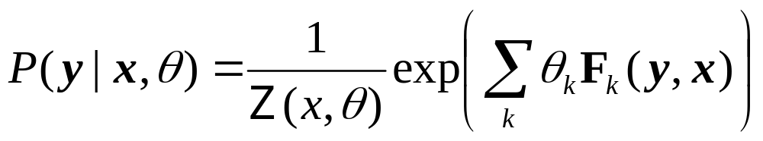
Conditional Random Field (CRF)
y₁
y₂
y₃
y₄
y_{n}
x₁
x₂
x₃
x₄
x_{n}
CRF performs well on a bunch of applications
Problem: CRF does not model internal sub-structure
Notes:
Add reference for CRF
Ad P(Y|X) equation

Slide 4
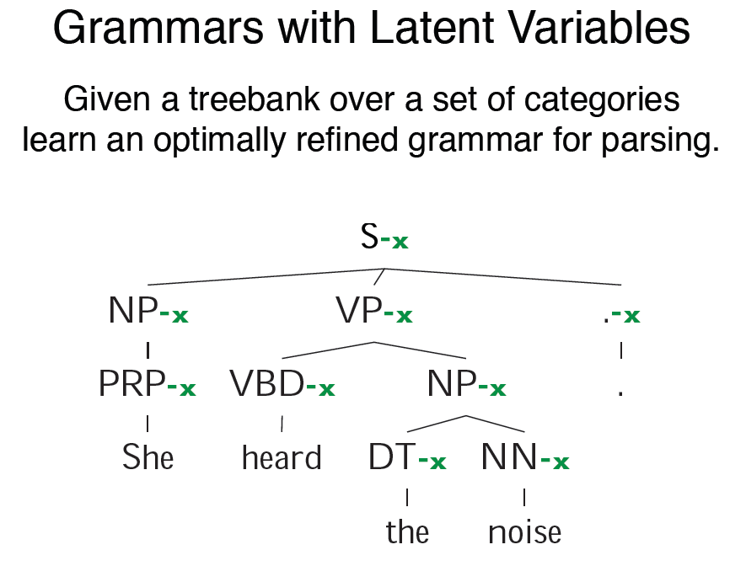
An Example (Petrov08)
Notes:
For example, in the noun phrase (NP) chunking task, suppose that there are two lexical sequences, ``He is her --" and ``He gave her --". The observed sequences, ``He is her" and ``He gave her", would both be conventionally labeled by `BOB', where B signifies the `beginning NP', and O the `outside NP'. However, this labeling may be too general to encapsulate their respective syntactic dynamics.

Slide 5
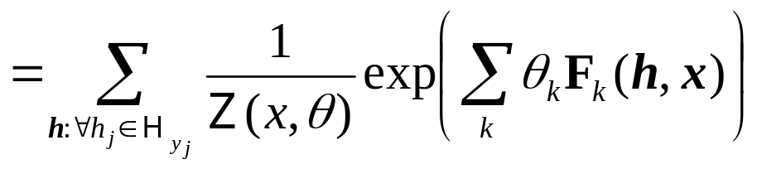
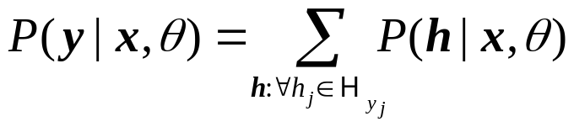
Latent-Dynamic CRF (Morency07)
y₁
y₂
y₃
y₄
y_{n}
y_{j} : label
h₁
h₂
h₃
h₄
h_{n}
h_{j} : hidden state
x_{j} : observations
x₁
x₂
x₃
x₄
x_{n}
Same as CRF
Notes:
Get to this slide faster

Slide 6
Efficiency problem on training
Training a latent dynamic CRF is slow
  The forward-backward lattice is larger than CRF
  a complexity (roughly) like a semi-Markov CRF
  Normally need days-level time to train on a normal scale NLP problem (e.g., named entity recognition task: BioNLP/NLPBA-2004)
For large scale NLP tasks, then?

Slide 7
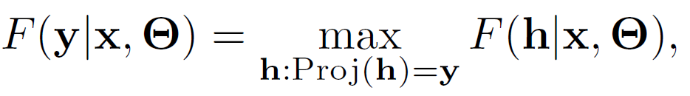
Definitions
Define the score of a label sequence F as the max-score among its latent sequence
Projection from a latent sequence to a label sequence:

Slide 8
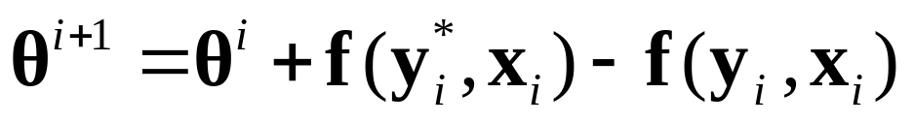
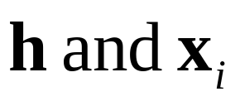
Latent variable perceptron
Perceptron additive update:
Latent variable perceptron update:
Viterbi gold latent path
Viterbi latent path
Features are purely defined on

Slide 9
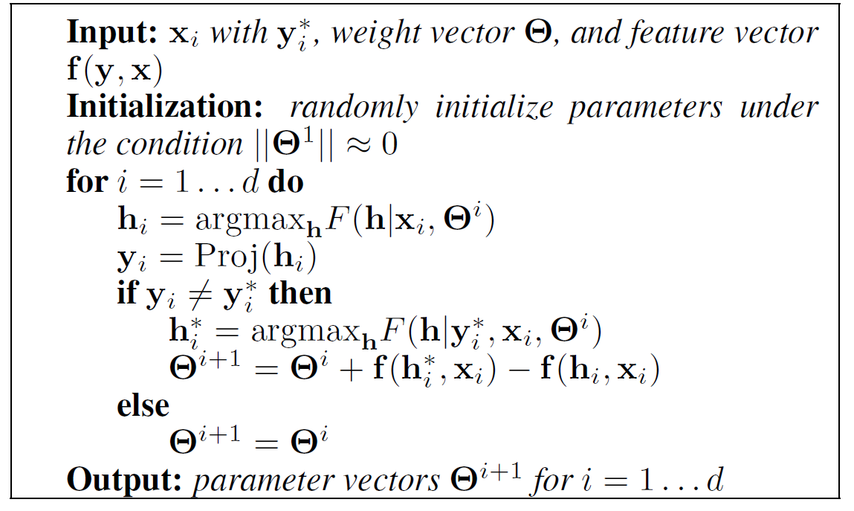
Parameter training

Slide 10
Parameter training
Why do the deterministic projection?
For efficiency.

Slide 11
Convergence analysis
We know perceptron is convergent. How about the latent perceptron?
To show: the convergence property of the latent perceptron is on a similar level of the perceptron.
Will the random initialization & Viterbi search on the latent path make the update/training endless?

Slide 12

Convergence analysis
Splitting of the global feature vector:
It is straightforward to prove that

Slide 13
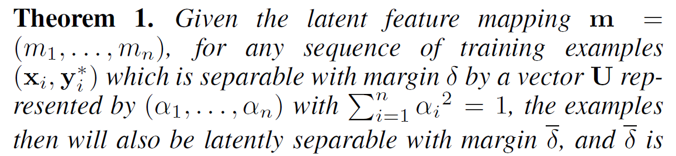
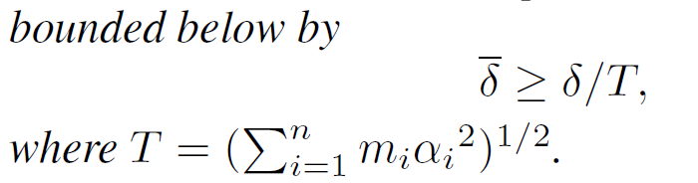
Separability
Will the feature vectors with random settings of latent variables still being separable? YES

Slide 14
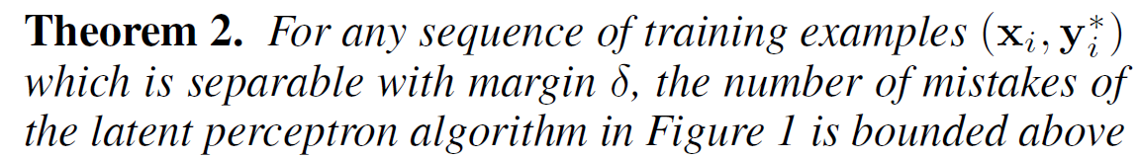
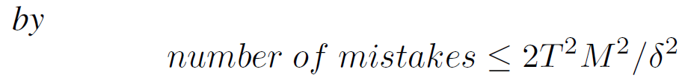

Convergence
Will latent perceptron converge? YES
Comparison to perceptron:

Slide 15
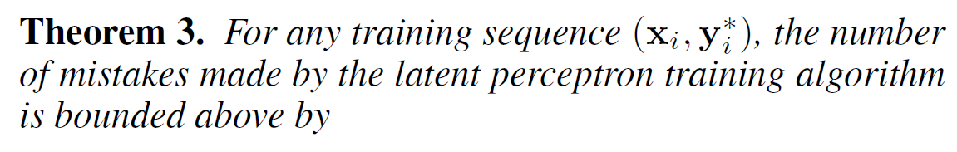
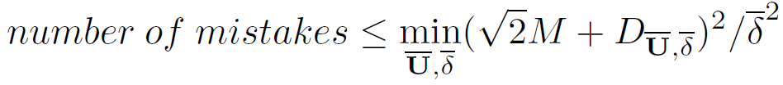
Inseparable data
For inseparable data? Updates also up-bounded

Slide 16
Convergence property
In other words, using latent perceptron is safe
  a separable data will remain separable with a bound
  after a finite number of updates, the latent perceptron is guaranteed to converge
  as for the data which is not separable, there is a bound on the number of updates

Slide 17
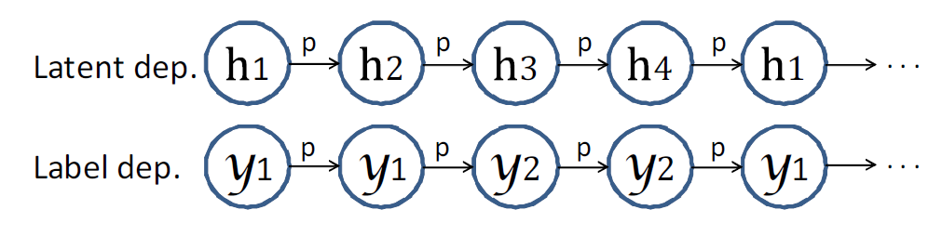
Experiments on synthetic data

Slide 18
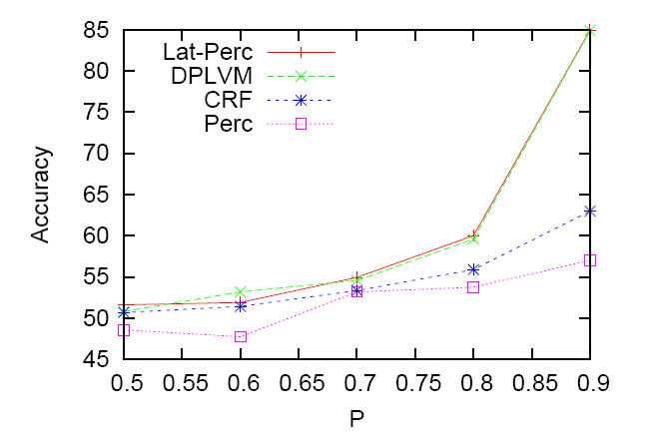
Experiments on synthetic data
Latent dynamic CRF
Averaged perceptron here
Significance of latent-dependencies

Slide 19
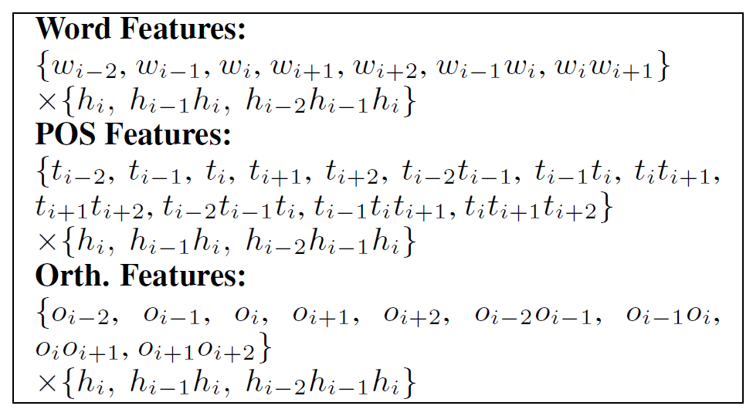
On real problem: Bio-NER

Slide 20
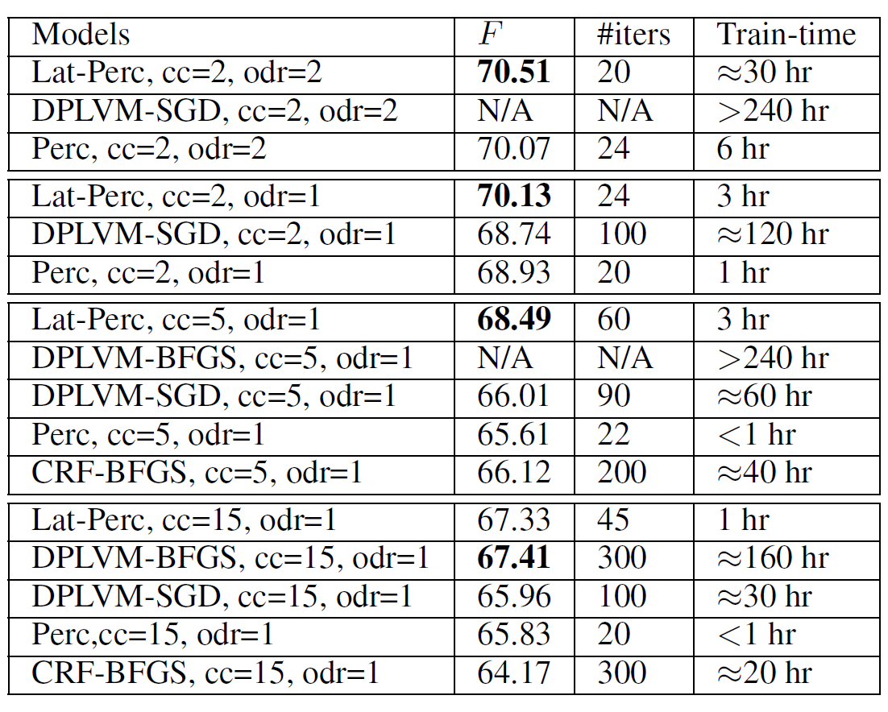
Bio-NER: scalability test
Perc means averaged perceptron

Slide 21
Conclusions
Proposed a fast latent conditional model
Made convergence analysis, and showed that latent perceptron is safe
Provided a modified parameter averaging algo.
Experiments showed:
  Encouraging performance
  Good scalability

Slide 22
Thanks!

