Slide 1
SMTP Protocol Library
Initial (Final) presentation for Internet pracatice
Task assigned by: Prof. Dr. Kranzlmüller

Slide 2
SMTP Briefly instruction
Full Name: Simple Mail Transfer Protocol
Purpose: SMTP is an Internet standard for email transmission across IP networks
Importance: It forms the foundation of email delivery, enabling the sending, receiving, and relaying of email messages.

Slide 3
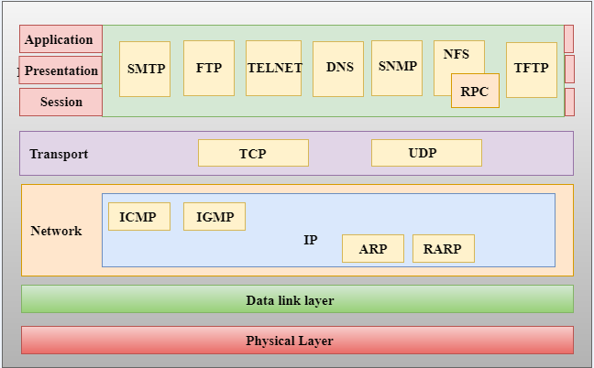
SMTP instruction

Slide 4
SMTP client side
Establishing a Connection
Sending Email
Routing and Delivery
Closing the Session

Slide 5
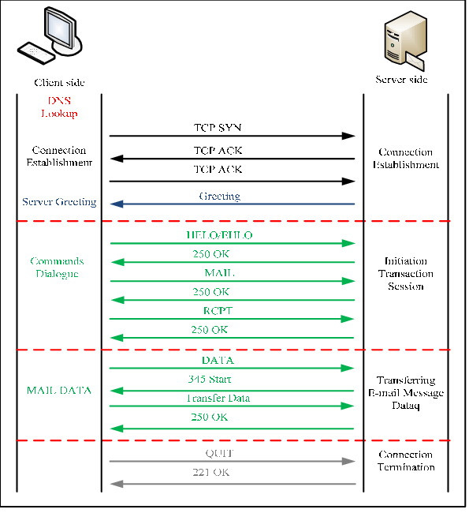
SMTP client side
Establishing a Connection
Sending Email
1 :A mail client initiates a TCP connection to the SMTP server on port 25 (standard),
2 : Helo or Ehlo : to introduce the client to the server
3: MAIL FROM : Specifies the sender's email address.
4: RCPT TO : Defines one or more recipients of the email.
5:DATA:Indicates the start of the email body, which includes headers (From, To, Subject) and the body content.
6: QUIT: break out the connection

Slide 6
SMTP server side
Correct response to commands from the client
250 Requested mail action OK, completed
354 Start mail input, end with ‘<CRLF>.<CRLF>’
421 service not available , closing transmission channel
500 Syntax error, command unrecognized
and Delivery
Routing and delivery
After the SMTP server receives an email, it first needs to determine the recipient's mail server address. This step involves a DNS lookup of the recipient's email domain (e.g., @example.com) for the corresponding MX (mail exchange) record, which indicates the address of the server that handles mail for that domain.

Slide 7
Thank you for listening.

