Slide 1
Guidance for SBEwithCI

Slide 2
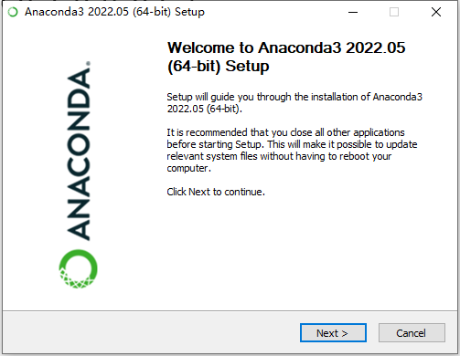
Install the Anaconda3
\Lab\Python\Anaconda3-2022.05-Windows-x86_64.exe
Just follow the default installation setting

Slide 3
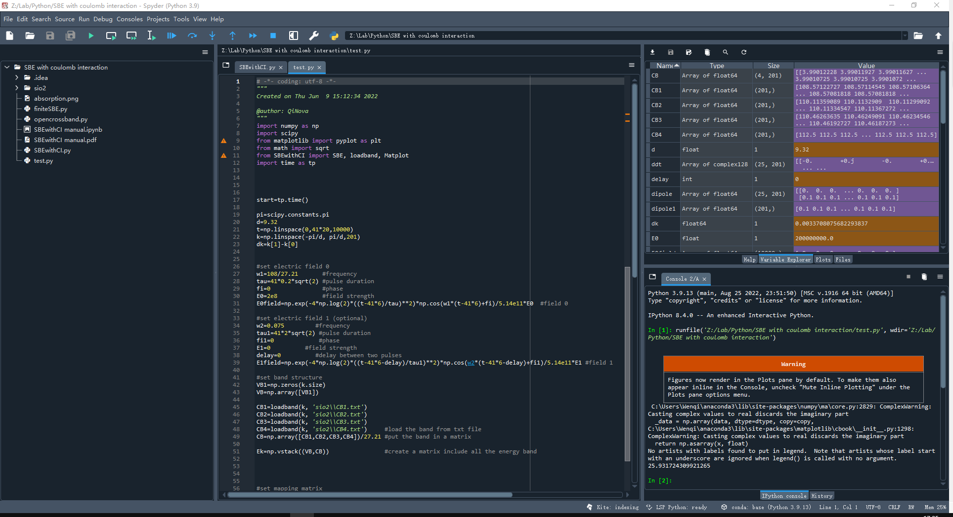
Spyder

Slide 4
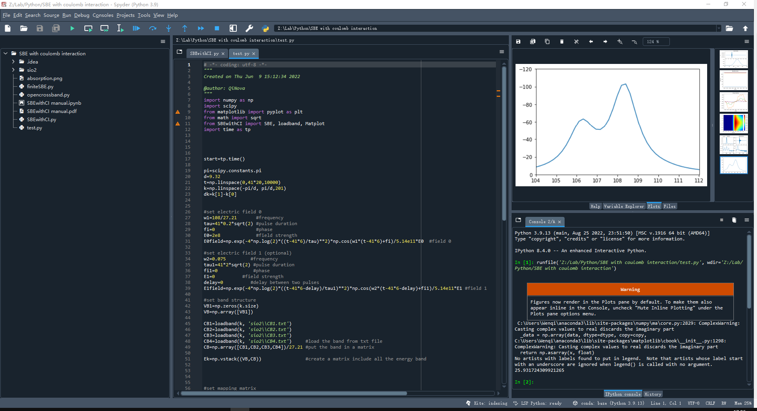
Spyder

Slide 5
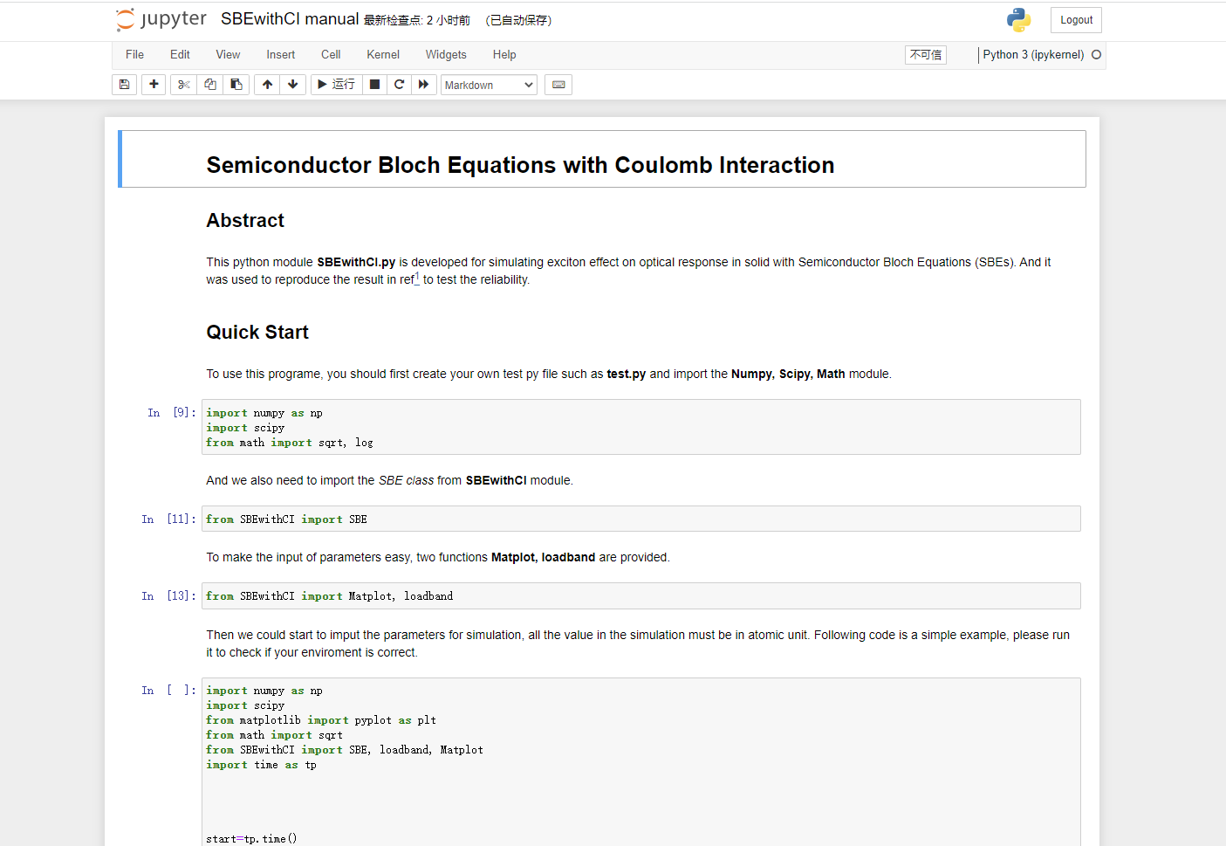
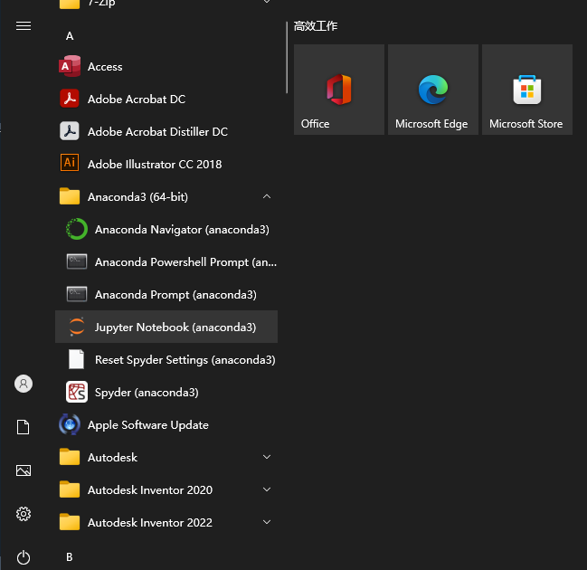
Jupyter Notebook

Slide 6
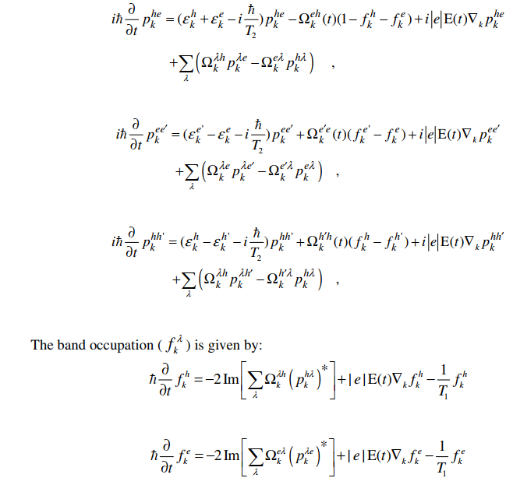

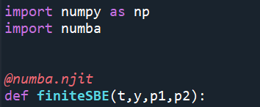
SBE with Coulomb Interaction
Derivative equation‘s function is in finiteSBE.py, and it is complied by numba.jit.
The PDE is solved by scipy’s solver---solve_ivp

Slide 7
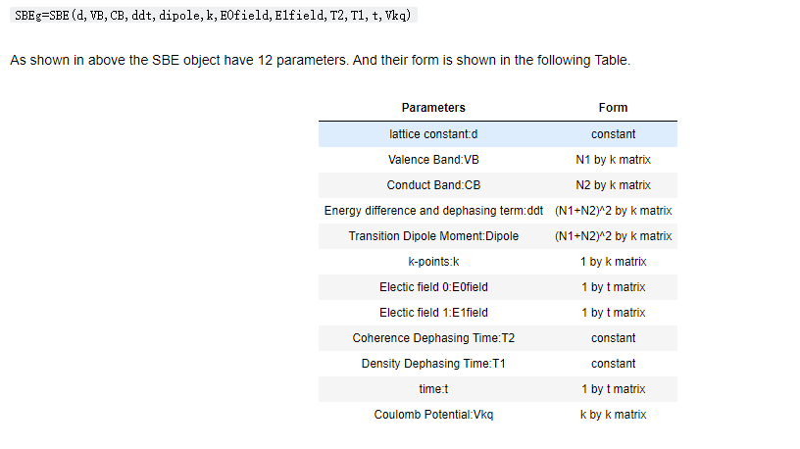
Parameter Input

Slide 8
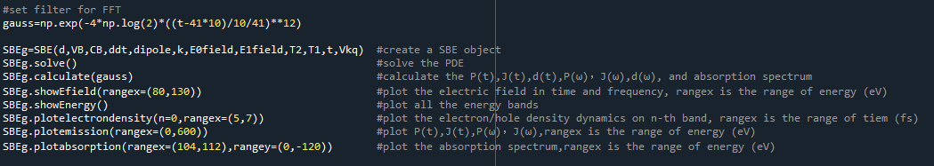
Run the simulation

Slide 9
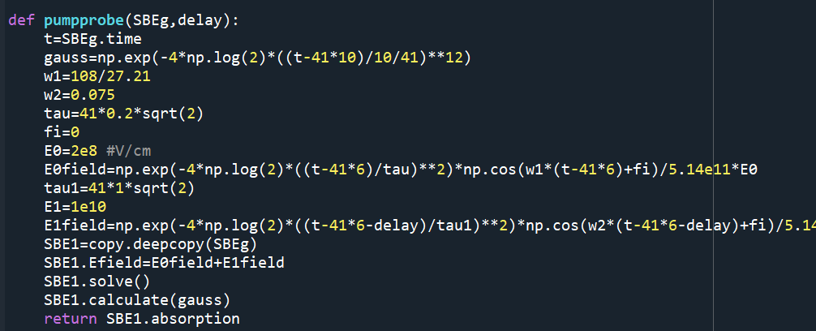
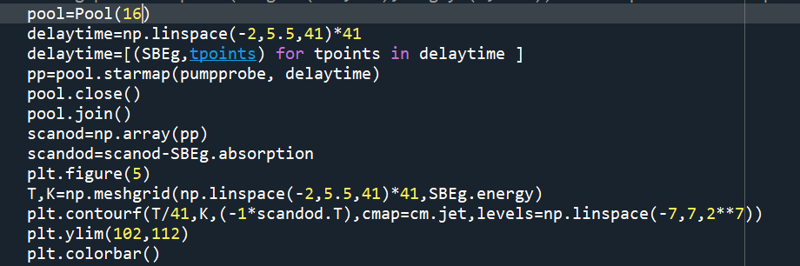
Parallel Computing
Although 16 subprocesses were used in the calculation, the improvement on my own PC was 50%. ~670 seconds for 41 delay points.
The reason is that the functions in numpy and numba are already parallel, even the single process calculation will use 70-80% CPU.

