Slide 1
Job Connect
Group Members:
Saba Riaz
Abdul Momin
Hamza Naveed
i210624
i221326
i220961

Slide 2
Functional Requirements
User Registration and Login
Job Management
Job Listings
Job Applications
Notifications
Job Test Integration
Job Filters
Admin Dashboard
User Support
System Logs

Slide 3
Non-Functional Requirements
Performance
Security
Scalability
Availability and Reliability
Usability
Compatibility
Maintainability
Backup and Recovery
Legal and Compliance
Interoperability

Slide 4
Use Cases
Register
Login
Authenticate User
Update Profile
Take Skill Assessment
Search Jobs
Apply for Job
View Job Matches
View Application Status
Provide Feedback
Post Job
Search Candidates
Schedule Interview
Manage Jobs
Generate Reports
Manage Users
Authentication Service
Authenticate User

Slide 5
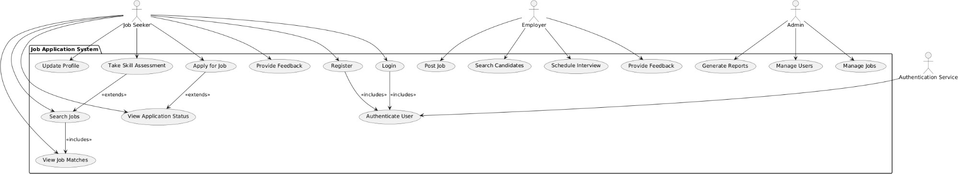
Use Case Diagram

Slide 6
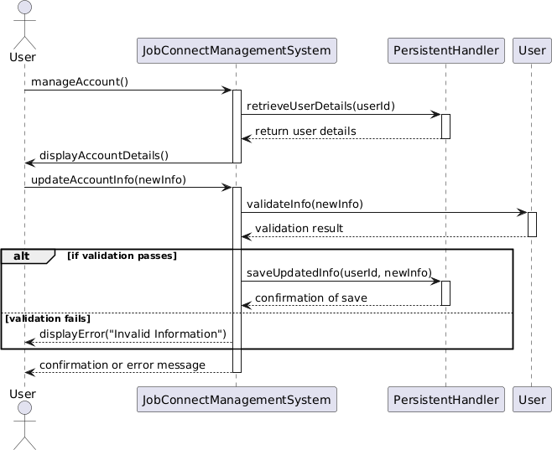
Sequence diagrams
Manage User Account:

Slide 7
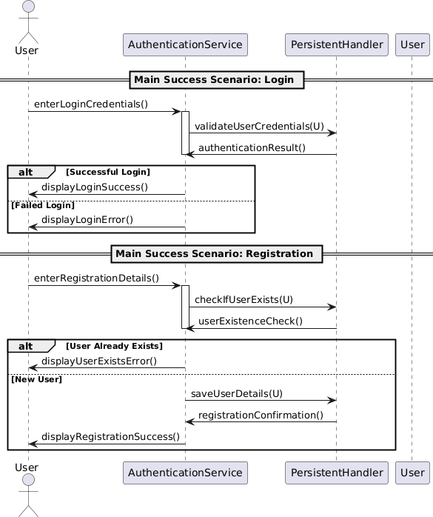
Sequence diagrams
Login:

Slide 8
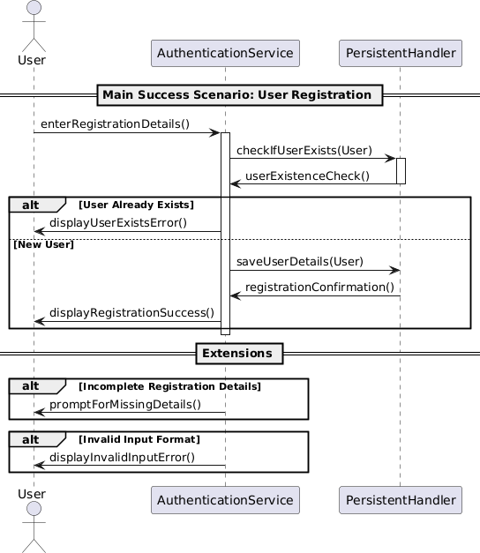
Sequence diagrams
Registration

Slide 9
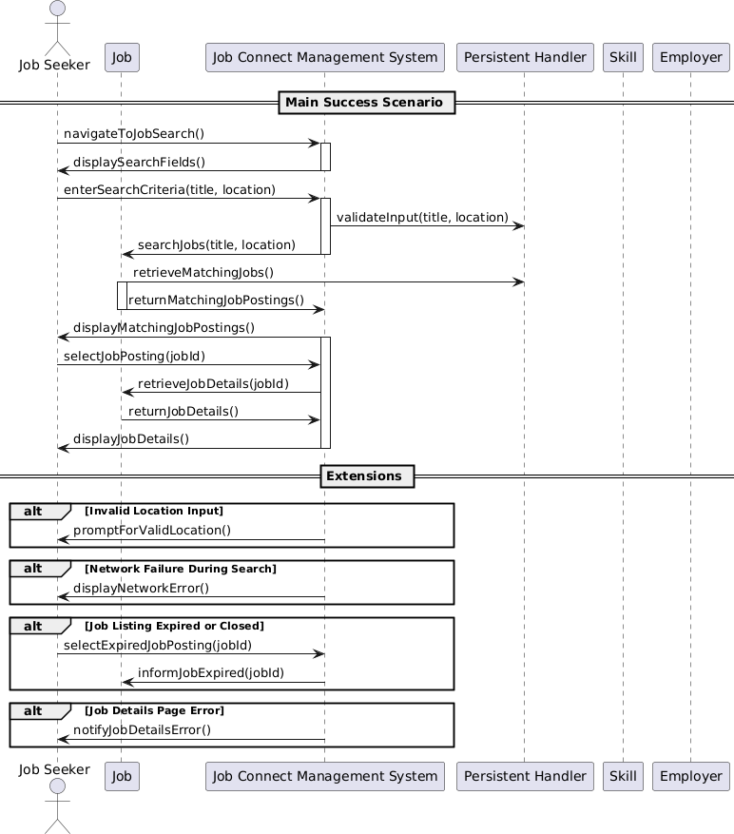
Sequence diagrams
Search for Job Opportunities:

Slide 10
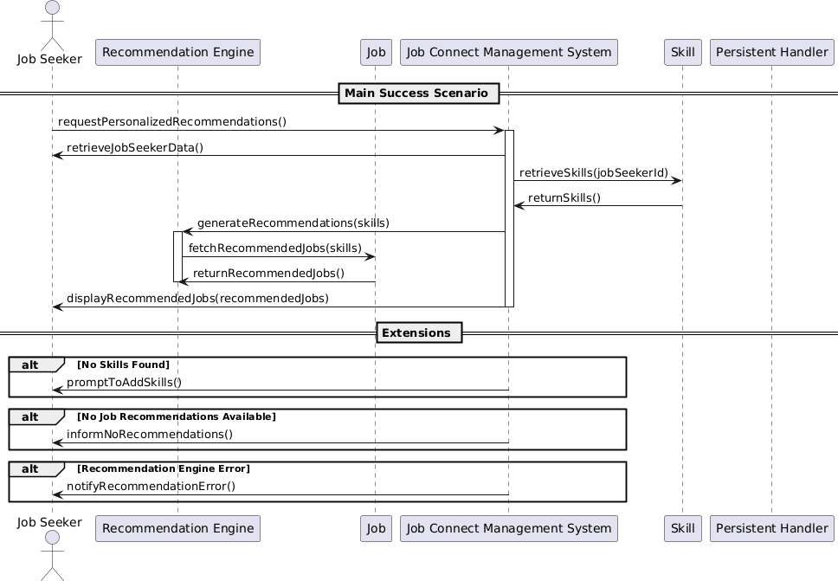
Sequence diagrams
Personalized Job Recommendations

Slide 11
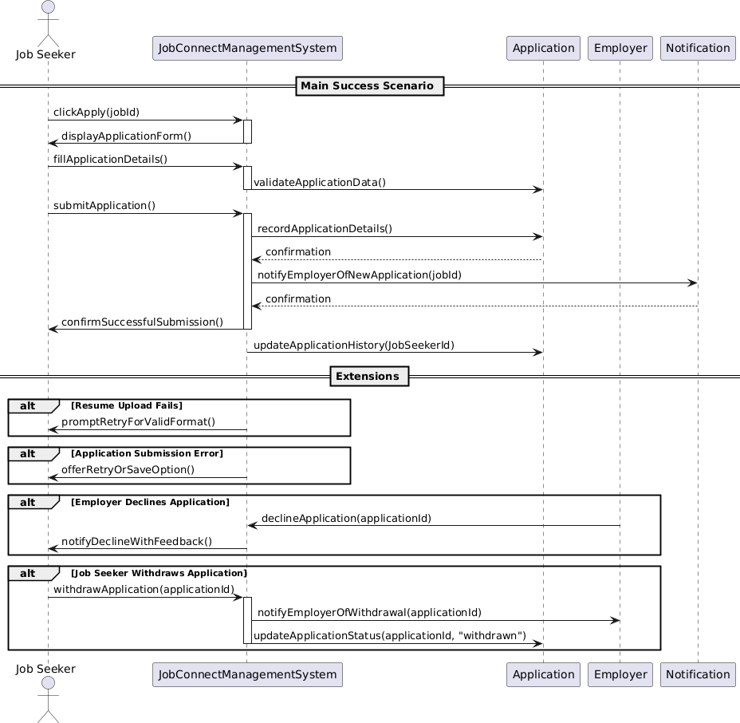
Sequence diagrams
Apply for Job:

Slide 12
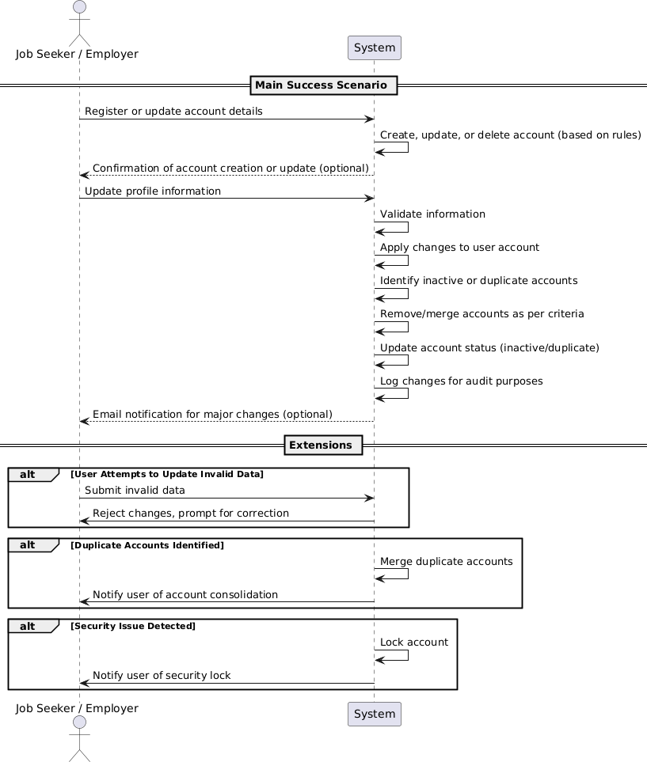
Sequence diagrams

Slide 13
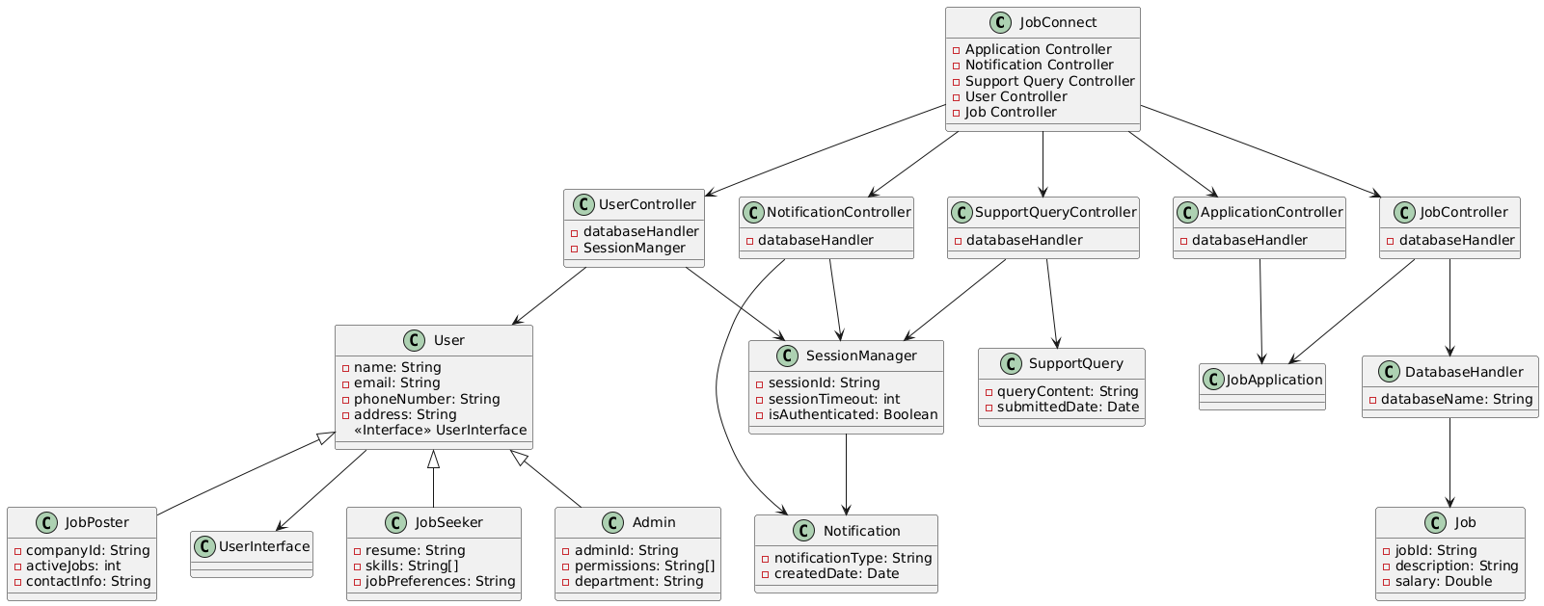
Class Diagram

Slide 14
Design Pattern
Grasp Pattern
Job Connect: Creator Class
Controller Classes : 5 controller classes
Information Expert : Job Connect Class
Low Coupling : User Interface Class
High Cohesion: Our project contain high cohesion(e.g., our user class is only responsible for maintaining user related actions)
Pure Fabrication: Database Persistent

Slide 15
Design Pattern
GOF
Facade: Database Handler because it is perfoming all the related function
Singleton: Session Manager class
Factory : User Controller, Application Controller, Job Controller, Notification Controller and Support Query Controller
Adapter: User implementing User Interface
Observer: Notification class
Strategy: Application Controller

Slide 16
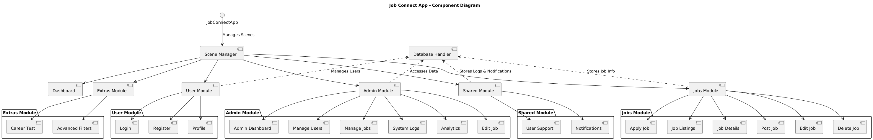
Component Diagram

Slide 17
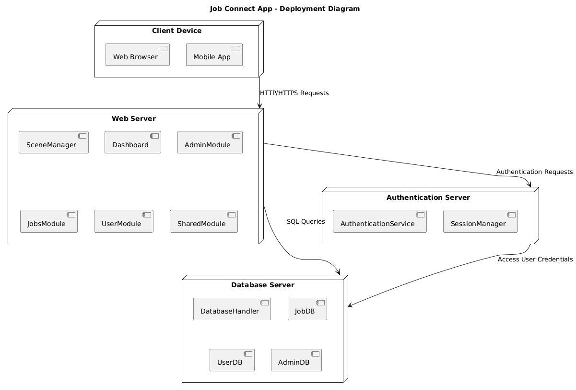
Deployment Diagram

Slide 18
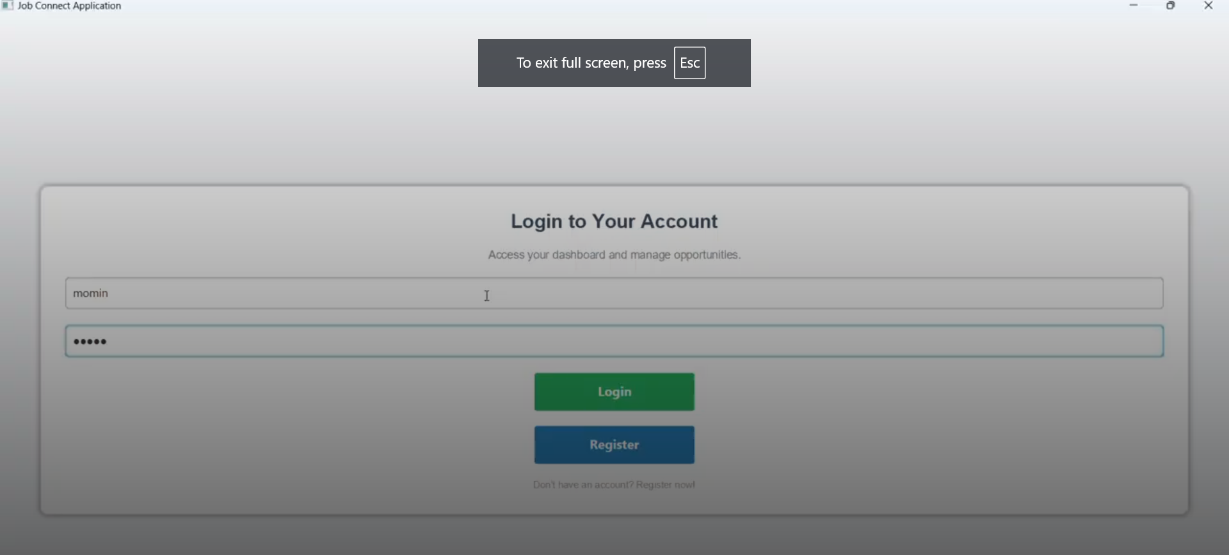
Graphical User Interface (GUI)
Login

Slide 19
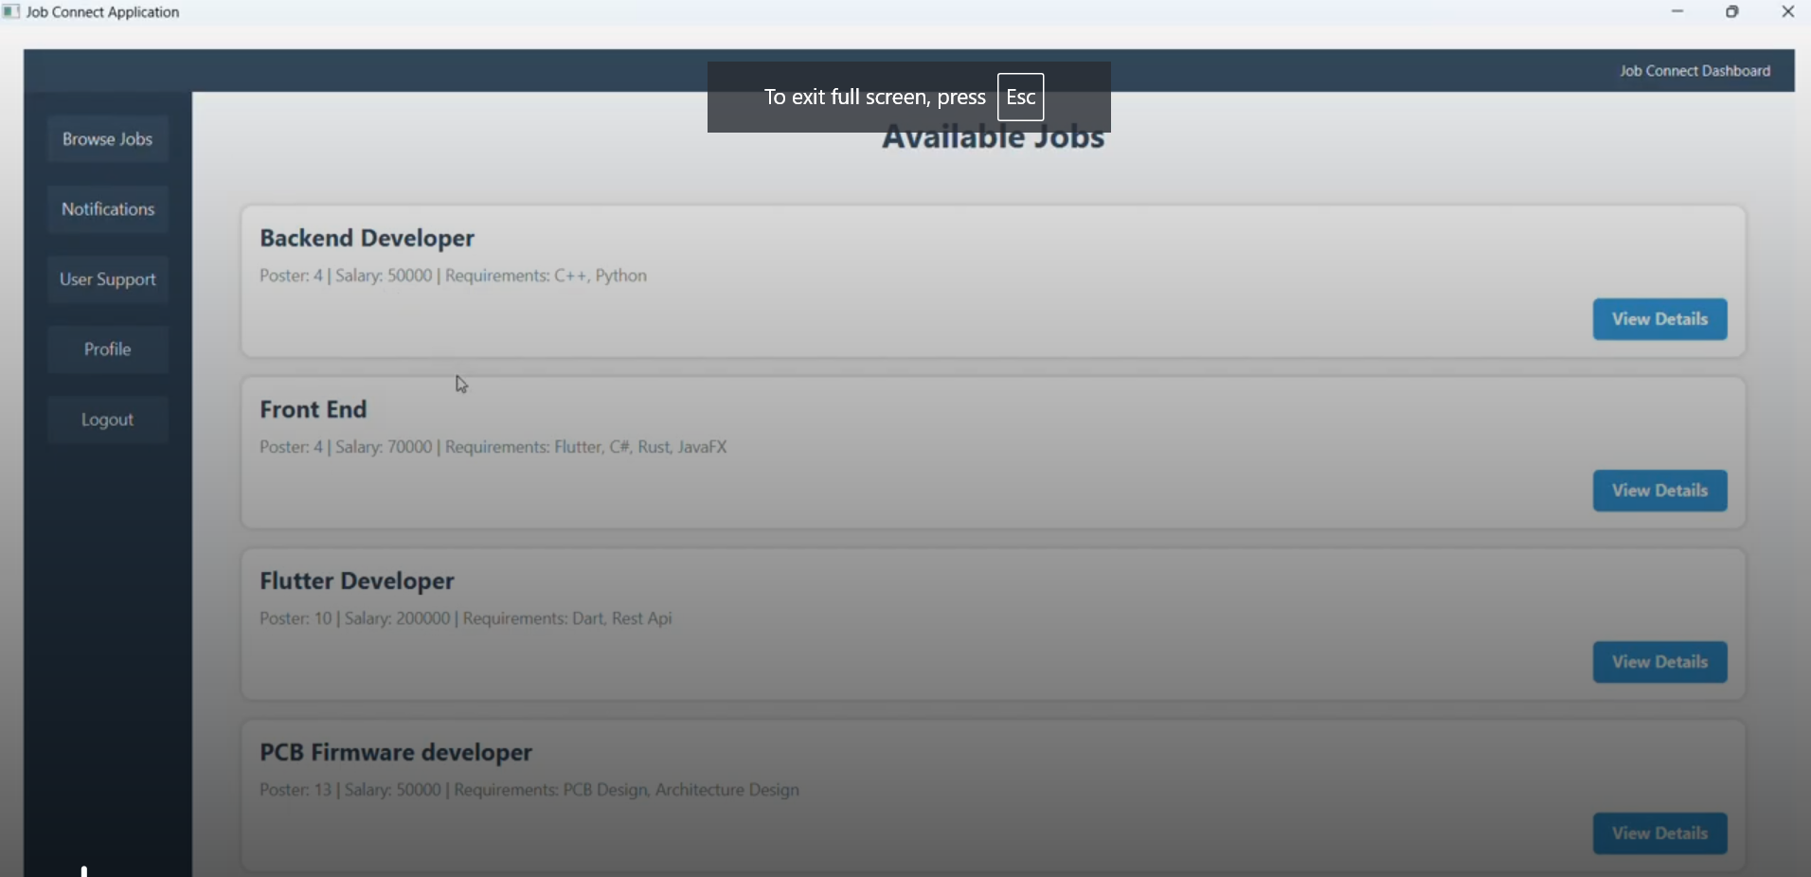
Graphical User Interface (GUI)
Available Jobs

Slide 20
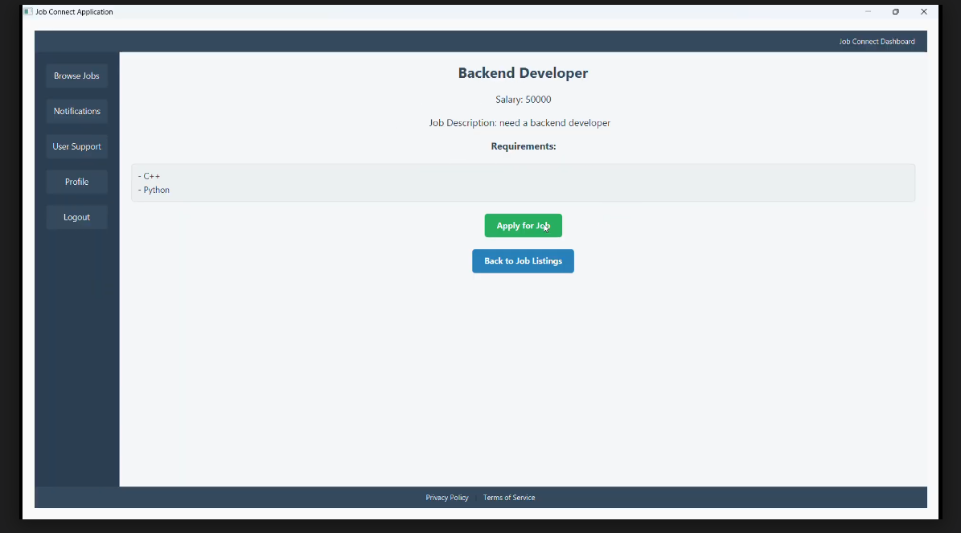
Graphical User Interface (GUI)
Apply for Job

Slide 21
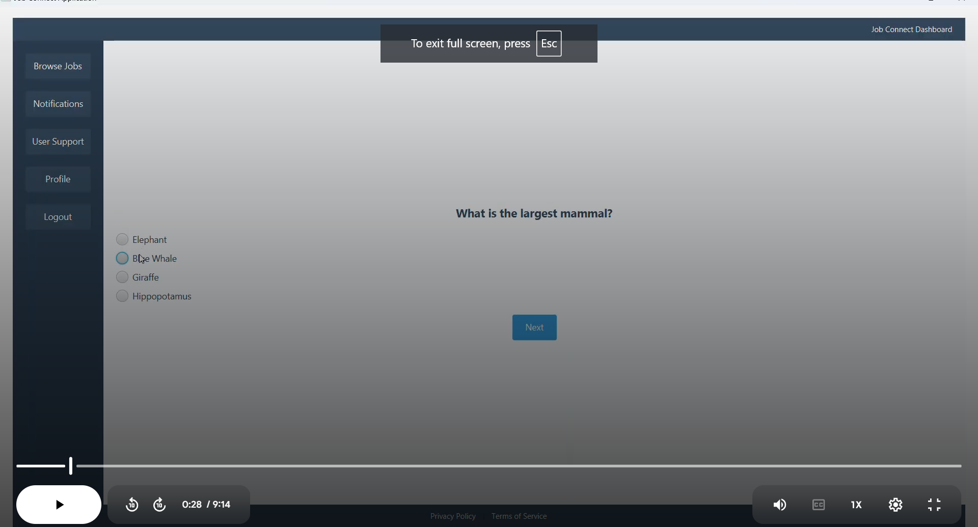
Graphical User Interface (GUI)
Job Test

Slide 22
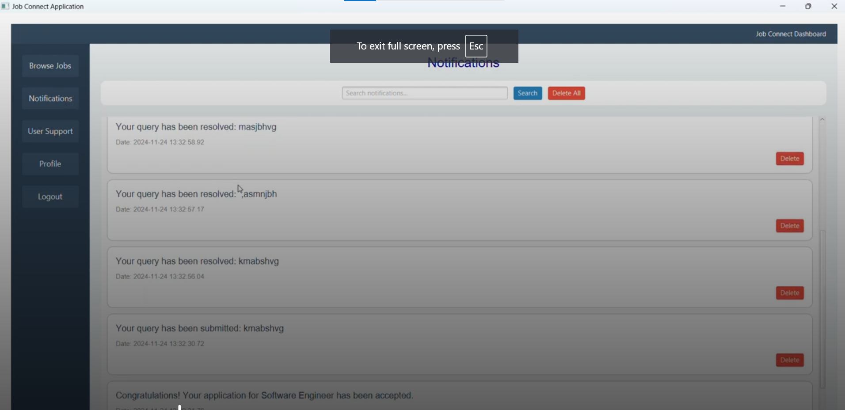
Graphical User Interface (GUI)
Notifications

Slide 23
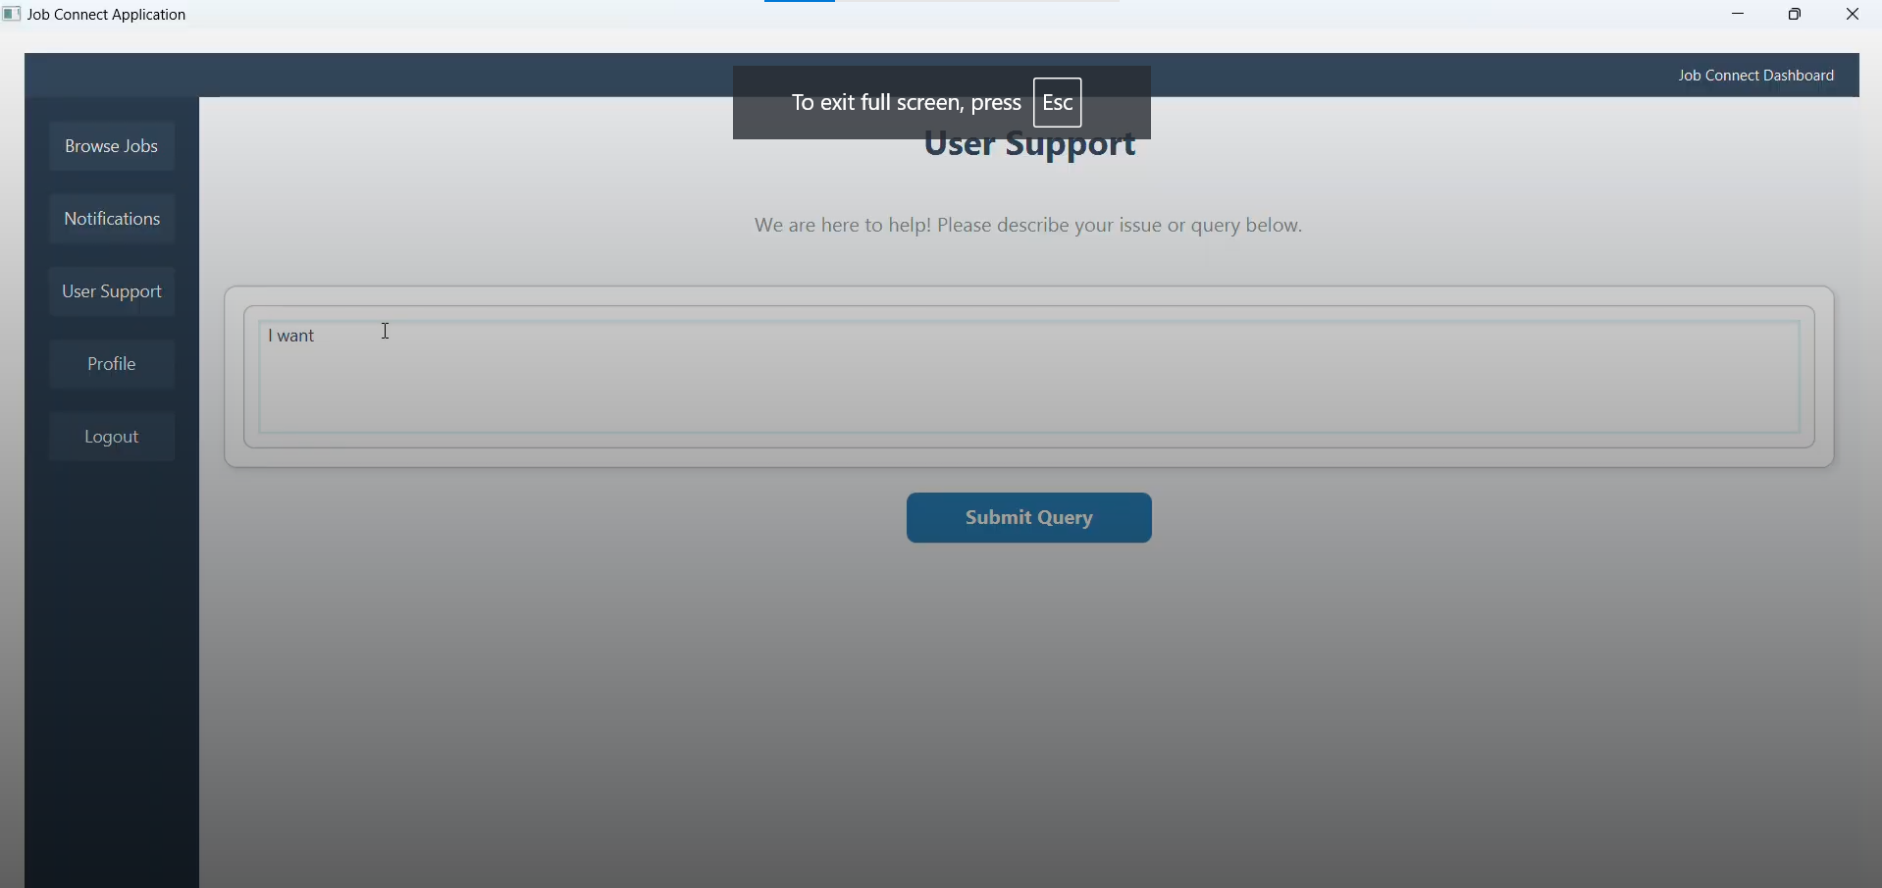
Graphical User Interface (GUI)
User Support
User support

Slide 24
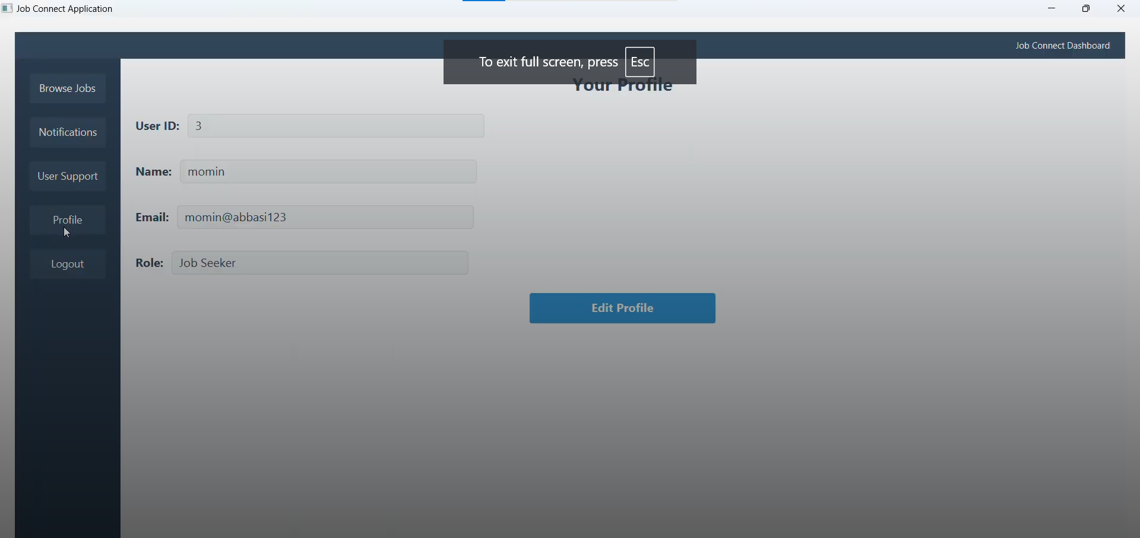
Graphical User Interface (GUI)
View user profile

Slide 25
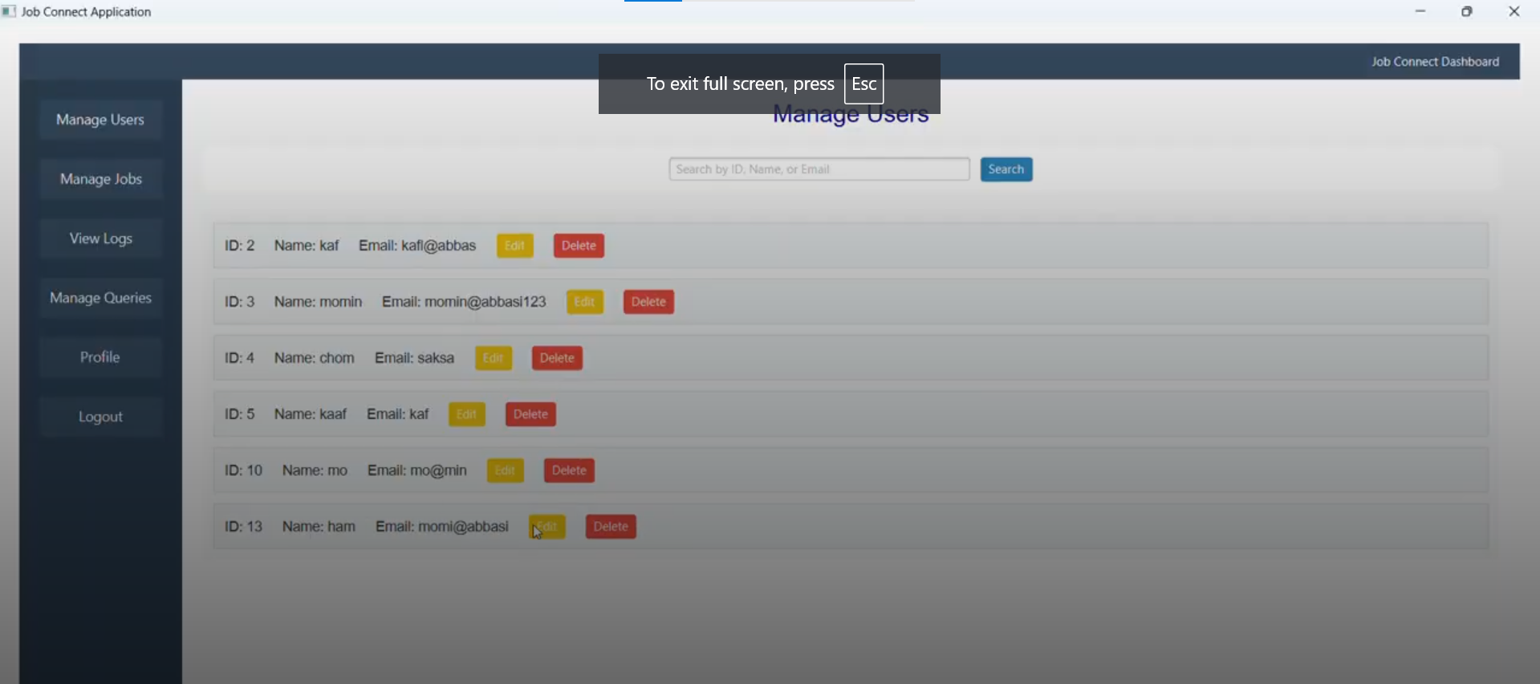
Graphical User Interface (GUI)
Manage Users

Slide 26
Graphical User Interface (GUI)
View user profile

Slide 27
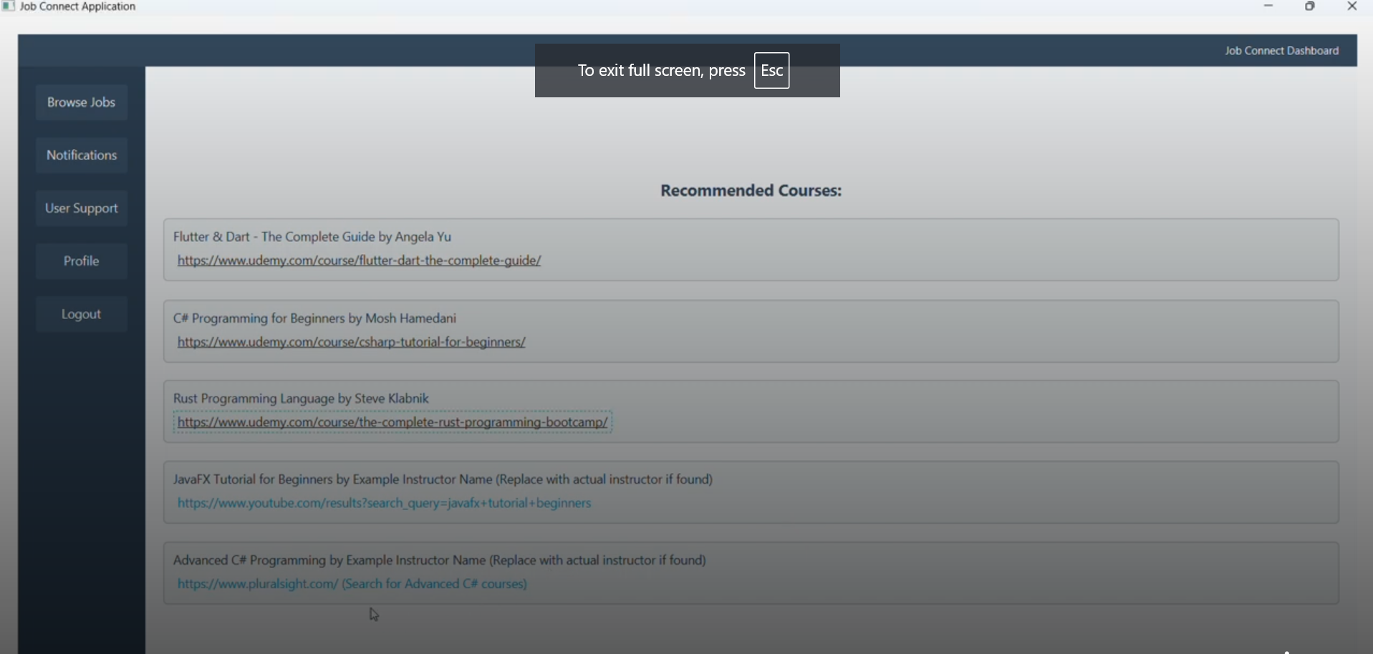
Graphical User Interface (GUI)
Courses Recommendation

Slide 28


