Slide 1
Playing Cards Recognition Using Template Matching
Ai Jiang (A20384274)
Li Xu (A20300818)
November 21, 2017

Slide 2
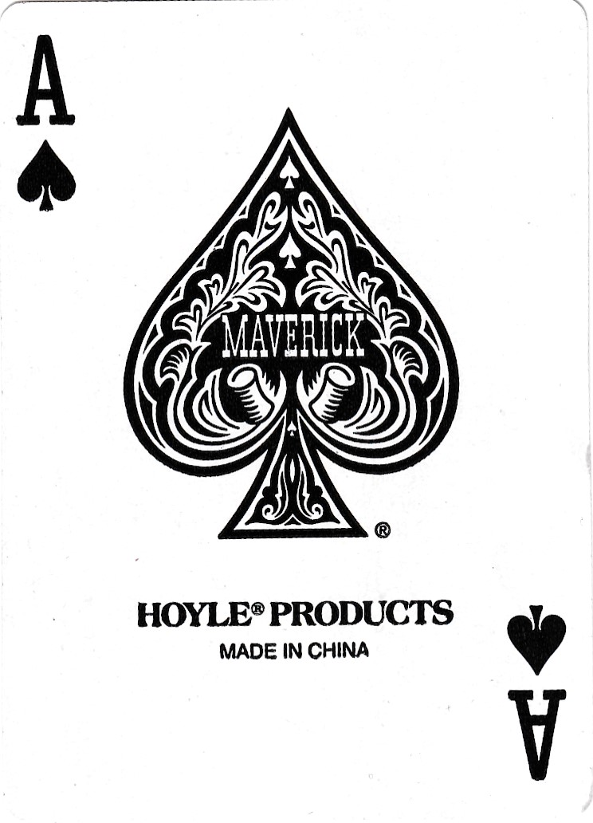
Playing Cards
52 different playing cards (we do not consider two joker cards)
Every card has a rank and a suit
Rank: A, 2, 3,...,J, Q, K
Suit: Spade, Heart, Club and Diamond

Slide 3
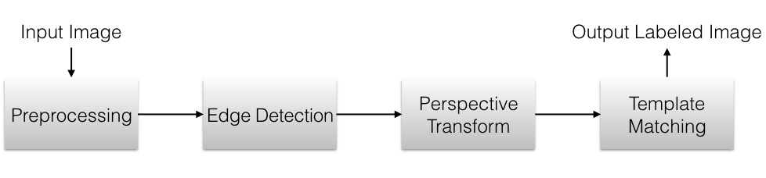
Overview

Slide 4
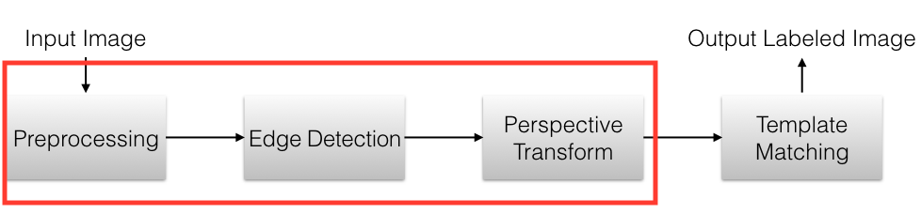
Overview

Slide 5
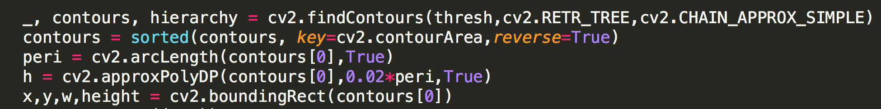
Find Card
Preprocessing: Grayscale and blur the input card image to reduce noise
Edge Detection: Find contour of the input card image
Perspective Transform: Rotate the input card image to the same orientation as templates.

Slide 6
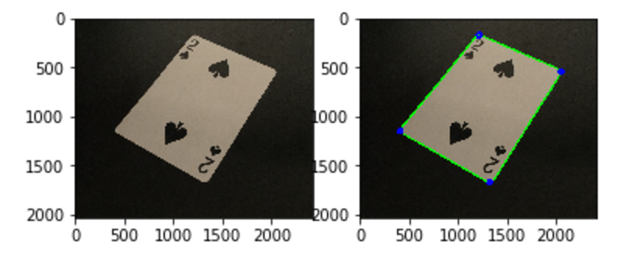
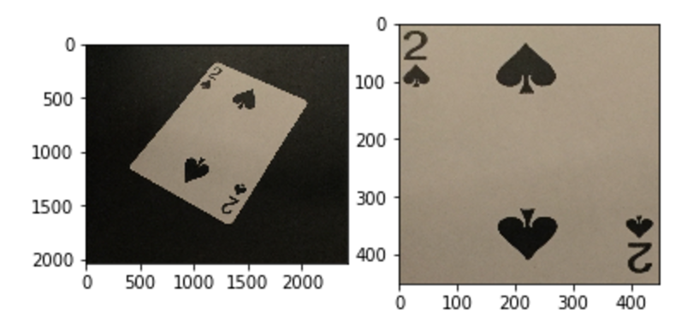
Find Card
Card Contour & Corner Points Transformed Card

Slide 7
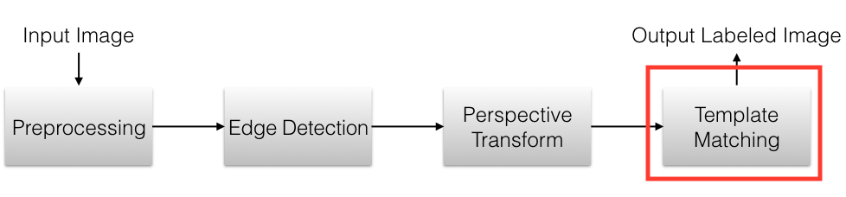
Overview

Slide 8
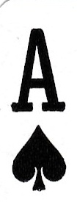
Template Matching
Use template to slide over input image
Find the location of template in input image
Template
Input Image

Slide 9
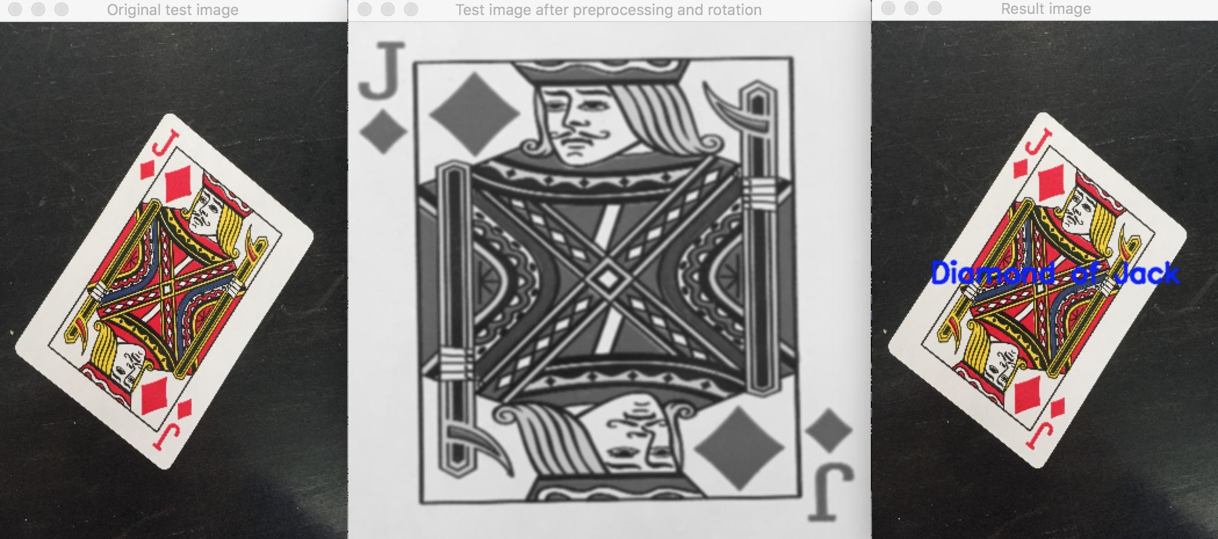
Template Matching
cv2.TM_CCOEFF means coefficient template matching
cv2.minMaxLoc finds maxVal in result image, which means how much two images match together
Iterate all templates with input image to find best match
Notes:
Cv2. matchTemplate returns a grayscale image, where each pixel represents how much does the neighbourhood of that pixel match with template.

Slide 10
Demo

Slide 11
Questions?
Thanks!

