Slide 1
Experimental Design
“Growth is simply series of experiments”
Notes:
In this era of big Data every touch point with customer is a data point. Active data driven companies are not only generate actionable insights from data. Experimental analysis helps you drive those actionable insights. I came across this beautiful quote which I thought is worth putting in “Growth is simply series of experiments”. The innovative ideas either were stopped on the whiteboard or presentation or they yielded bad results. Experiementation gave us the power of gauging the worth of idea in terms of customer satisfaction or trunaround that it would result and the expected profits or numbers that it would generate.

Slide 2
You Need to Know
Some questions have answers that require only a lookup:
What is the policy regarding the use of demographic variables in predictive models?
When did you last send a marketing email to segment 17?
Some questions do not have readily available answers:
Does it really matter whether you use first-class postage when sending direct mailings for a cruise line?
Is it better to assign consultants to projects based on geography or on line of business?

Slide 3
Statistical Models Can Answer Questions
The models that data scientists use can answer many of the questions that you have.
Do you have the data to perform an analysis and answer the question?
Did you account for the types of variables that are in your control as well as the types of variables over which you have no control?

Slide 4
Questions Often Require Comparisons
Does your question imply that a comparison is needed?
First-class versus bulk-rate postage
Geographical versus line-of-business assignments
Did you conduct an experiment?

Slide 5
What Is an Experiment?
According to Merriam-Webster:
a scientific test in which you perform a series of actions and carefully observe their effects in order to learn about something.
something that is done as a test
something that you do to see how well or how badly it works
Experiments differ from observational data in the types of conclusions you can draw from them

Slide 6
Observational versus Experimental
Observation: “As my son gets taller, the national debt increases.”
Incorrect conclusion: “Stop feeding your son!”
Correct conclusion: “A child’s height and the national debt increased over time.”
Correlation does not imply causation.

Slide 7
Observational versus Experimental
Experiment: “As I increase the dose of a drug by 5 mg, the symptoms decrease by 12%, on average, compared to a control group.”
With an experiment, you can evaluate the cause-effect relationship between the things that you change in the experiment and the variable that you are measuring.
Experiments enable you to identify causal drivers.

Slide 8
Consider This…
What is the question that you want to answer?
What is the population that you want the answer to pertain to?
What types of things do you want to compare that you can control?
How is the outcome measured (Y_{obs})?
What else impacts Y_{obs} that you cannot control?

Slide 9
Consider This…
What is the question that you want to answer?
1. Does postage make a difference in the response rate?
2. Did the recent changes to Marketing allocation increase profit on projects?

Slide 10
Consider This…
What is the question that you want to answer?
What is the population that you want the answer to pertain to?
1. The “luxury traveler” segment
2. Analytical consultants in the field

Slide 11
Consider This…
What is the question that you want to answer?
What is the population that you want the answer to pertain to?
What types of things do you want to compare that you can control?
1. The class of postage on the offer envelope
2. The specific project a consultant is assigned to work on

Slide 12
Consider This…
What is the question that you want to answer?
What is the population that you want the answer to pertain to?
What types of things do you want to compare that you can control?
How is the outcome measured (Y_{obs})?
1. The number of responses from each postage group
2. Profit as a fraction of budget for each project

Slide 13
Consider This…
What is the question that you want to answer?
What is the population that you want the answer to pertain to?
What types of things do you want to compare that you can control?
How is the outcome measured (Y_{obs})?
What else impacts Y_{obs} that you cannot control?
1. Gender, vacation already taken that year, children
2. Consultant’s past performance, budget size

Slide 14
Experiments Enable Small-Scale Deployments
Many business decisions should be fact-checked to assess whether they have the intended consequences…and no unintended ones.
Testing out many possible scenarios on a small scale enables you to compare which is the most profitable.
Small demonstrations of success make it easier to communicate value to stakeholders.
Experiments answer questions of causation.
Notes:
There are, in fact, ways to design causal models without performing an experiment, which

Slide 15
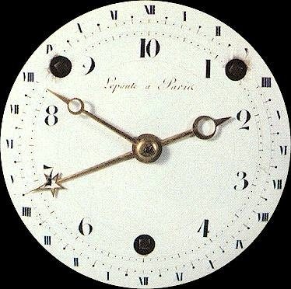
Basic Terms in Design of Experiments (DOE)
Response
Randomization
Factor
Replication
Factor Level
Orthogonality
Effect
Treatment
Power
Experimental Unit
Notes:
In an experiment, the variable that measures the outcome of interest is called the response variable. It is also known as the dependent variable.
A factor is an independent or predictor variable that is a possible source of variation in the response variable.
An effect is the relationship between a factor and a response.
A factor level is a particular value of a factor. In other words, the specific types or amounts of the factor used in the experiment.
A treatment is a combination of factor levels used in the experiment. This is sometimes also referred to as the condition.
An experimental unit is the smallest object to which a treatment is applied. It is the smallest part of the experimental material where any two experimental units can receive different treatments.
A replication occurs when you assign more than one experimental unit to a treatment.
Internal to an organization, you may have your own jargon, but these words are the ones you are likely to see in any articles you might read.
Better include “power” and “significance,” here, just as a review for this audience.
AND, particularly for this audience, bring up the fact that power and sample size are intimately connected. That means that when they get a particular sample size out of the power calculations that we’ll show, they need to keep in mind that there may be a difference between the number of names / households that they pull for a test and the number of experimental units they actually get to observe. In my experience, direct mail campaigns lose 7%-15% of their volume during merge/purge, the process by which individuals who recently signed up for Do Not Solicit registries, or whose FICO score dropped dramatically, etc., are screened out of the mail file.
Clockface picture is http://en.wikipedia.org/wiki/File:Horloge-republicaine1.jpg
File:Horloge-republicaine1.jpg
From Wikipedia, the free encyclopedia
Jump to: navigation, search
File
File history
File links
No higher resolution available. Horloge-republicaine1.jpg‎ (374 × 372 pixels, file size: 31 KB, MIME type: image/jpeg)
This is a file from the Wikimedia Commons. The description on its description page there is shown below. Commons is a freely licensed media file repository. You can help.
Description Horloge-republicaine1.jpg Clock dial of the French Revolution, Photographic reproduction of a two-dimensional work of art of the late 18th/early 19th century
Source http://www.antique-horology.org/_Editorial/RepublicanCalendar/default.htm
Date Author Unknown
Permission (Reusing this image) See below.
This is a faithful photographic reproduction of an original two-dimensional work of art. The work of art itself is in the public domain for the following reason: This image (or other media file) is in the public domain because its copyright has expired. This applies to the United States, Australia, the European Union and those countries with a copyright term of life of the author plus 70 years.
Note that a few countries have copyright terms longer than 70 years: Mexico has 100 years, Colombia has 80 years, and Guatemala and Samoa have 75 years. This image may not be in the public domain in these countries, which moreover do not implement the rule of the shorter term. Côte d'Ivoire has a general copyright term of 99 years and Honduras has 75 years, but they do implement that rule of the shorter term.
العربية | Asturianu | Български | Català | Česky | Dansk | Deutsch | English | Ελληνικά | Esperanto | Español | Euskara | فارسی | Français | Gaeilge | Galego | עברית | हिन्दी | Bahasa Indonesia | Italiano | 日本語 | 한국어 | Kurdî / كوردی | Lietuvių | Magyar | Nederlands | ‪Norsk (nynorsk)‬ | Македонски | Bahasa Melayu | Plattdüütsch | Polski | Português | Română | Русский | Slovenčina | Slovenščina | Shqip | Suomi | Svenska | Sámegiella | ไทย | Türkçe | 中文 | ‪中文(简体)‬ | ‪中文(繁體)‬ | 粵語 | +/-
The official position taken by the Wikimedia Foundation is that "faithful reproductions of two-dimensional public domain works of art are public domain, and that claims to the contrary represent an assault on the very concept of a public domain". For details, see Commons:When to use the PD-Art tag. This photographic reproduction is therefore also considered to be in the public domain.
Please be aware that depending on local laws, re-use of this content may be prohibited or restricted in your jurisdiction. See Commons:Reuse of PD-Art photographs. العربية | Česky | Deutsch | Ελληνικά | English | Español | فارسی | Suomi | Français | עברית | Bahasa Indonesia | Italiano | 日本語 | 한국어 | Magyar | Plattdüütsch | Nederlands | Polski | Português | Română | Русский | Slovenščina | Српски / Srpski | Basa Sunda | Svenska | Türkçe | Українська | 中文 | ‪中文(繁體)‬ | ‪中文(简体)‬ | +/-
File history
Click on a date/time to view the file as it appeared at that time.
(latest | earliest) View (newer 50) (older 50) (20 | 50 | 100 | 250 | 500) Date/TimeThumbnailDimensionsUserComment current14:19, 16 August 2005374×372 (31 KB)Rama 14:12, 16 August 2005150×149 (7 KB)Rama (Clock dial of the French Revolution http://www.antique-horology.org/_Editorial/RepublicanCalendar/default.htm Photographic reproduction of a two-dimensional work of art of the late 18th/early 19th century, hence Public Domain. {{PD}} [[Category:French) (latest | earliest) View (newer 50) (older 50) (20 | 50 | 100 | 250 | 500) File links
The following pages on the English Wikipedia link to this file (pages on other projects are not listed):
Arabic numerals
Clock
French Republican Calendar
Clock face
User:Halcatalyst
Decimal time
User:DavidSpencer.ca
Wikipedia:Featured topics
Wikipedia:Userboxes/Time
Wikipedia:Reference desk archive/Miscellaneous/January 2006
User:HB098
User:Doodlepoodle
User:Zeality/Sandbox2
User:Canadian
User:Andy120290
User:Chenhsi
User:Wasd
User:Typ932
User:Darrencomp
User talk:Ryan Postlethwaite/archive7
User talk:Phaedriel/Archive 32
User:Jake the Editor Man/Real Page
Wikipedia:Featured topics/Chrono titles
User:ClonedPickle
User:Spinningspark
User:UserboxMania
User:UserboxMania/DayName
User:A. Exeunt/Userboxes
User:Vian brazil
User:Cristi215
User:Ihsbislns
User:Jimmyswift
User:Leeheonjin
User:Gzyeah
User:Mastercomputerpro9999
User:Diligent Terrier/Sandbox/Old Userpage
User:Abhaac
User:Goodvac
User:LB22/Sandbox
User:Gr8opinionater
User:Tjleo209 014
User:Omfg rank ten guy
User:Frao61
User:LB22/Userboxes/UBX Others Have Made
User:LB22/Labs
User:Miagirljmw14
User:Lio.c87
User:LB22/Sidebar and Userboxes
User:LB22/Menu
User:LB22/Signatures
User:UnusualGazelle
User:LB22/Sandbox2
User:LB22/Inside
User:Pavlen666
User:Nerdygeek101
User:MTan355
User:Azmi1995
User:Pdas00
User:Paperwheel
User:Paperwheel/boxes
User:Leeheonjin/Backup
User:Xx--Jodiiee--xx
User:Lightning Storm McQueen
User:KC Panchal
User:Icykip2005
User:KC Panchal/Sandbox/User page
User:Tm93
User:BurningBeauty
User:Apollonius 1236
User:Etineskid
User talk:Ryan Postlethwaite/AH
User:Darkirre
User:Darkirre/Babil
User:Marshall Williams2
Portal:Video games/Featured topic/2
Portal:Video games/Featured topic
User:ZoRCoCuK/User
User:Wikipeeeeedia
User:CrashGordon94
User:Nurasko
User:Hacker's union
User:Cleonkho
User:Fld300b
User:Elev77
User:Navy blue84/userboxes
User:Jamiebijania/Userboxes
User:Daniel Benfield
Retrieved from "http://en.wikipedia.org/wiki/File:Horloge-republicaine1.jpg"
Views
File
Discussion
View source
Personal tools
Log in / create account
Navigation
Main page
Contents
Featured content
Current events
Random article
Search
Interaction
About Wikipedia
Community portal
Recent changes
Contact Wikipedia
Donate to Wikipedia
Help
Toolbox
What links here
Upload file
Special pages
Printable version
Privacy policy
About Wikipedia
Disclaimers

Slide 16
Basic Terms in DOE: Response
A response is the variable of interest in the analyses. It is sometimes called the target or dependent variable.
Examples:
Response rate to direct mail solicitations
Default (“bad”) rate among credit customers
Balance transfer amount
Fraud
Number of items purchased from a catalog
Spend, six months after acquisition

Slide 17
Basic Terms in DOE: Factor
A factor is an independent variable that is a potential source of variation in the response metric.
Examples:
Teaser or introductory APR
Color of envelope
Balance transfer fee
Presence or absence of a sticker on a catalog
First-class versus third-class mail
Others?

Slide 18
Basic Terms in DOE: Factor Level
A factor level is a particular value, or setting, of a factor.
Examples:
1.99% introductory APR
White envelope
2% balance transfer fee
Airline mile reward offer
Third-class mail
Others?

Slide 19
Basic Terms in DOE: Effect
An effect captures and measures the relationship between changes in factor levels and changes the response metric.

Slide 20
Examples of an Effect
An offer with a sticker on it garners $10 more, in purchases, than an offer without.

Slide 21
Examples of an Effect
An offer with a sticker on it garners $10 more, in purchases, than an offer without.
The white envelope has a 22% higher response rate than the gray envelope.

Slide 22
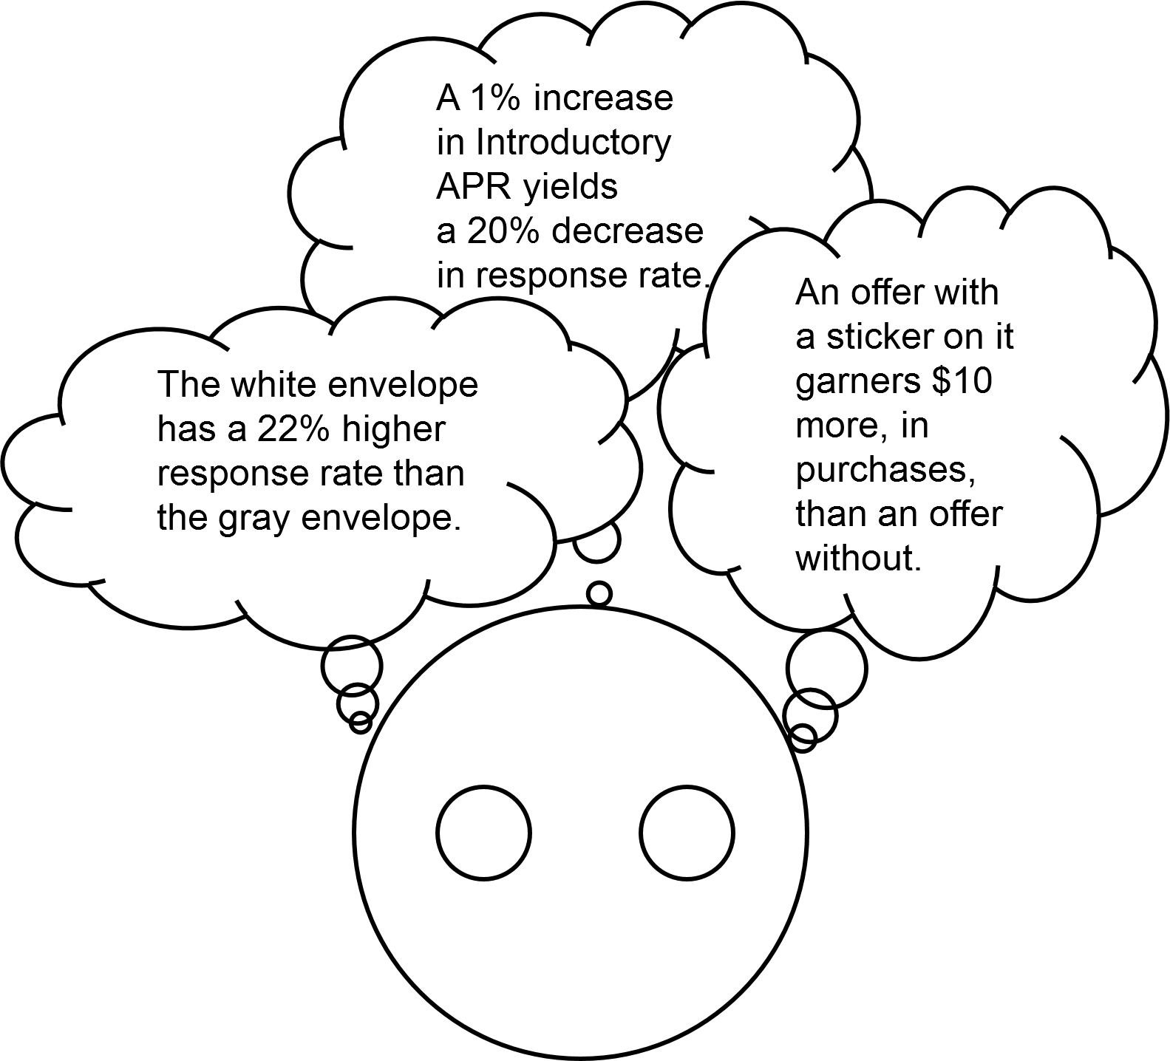

Slide 23
Basic Terms in DOE: Treatment
A treatment is a combination of all of the factors, each at one level. In a typical marketing context, a treatment constitutes a unique offer.
Examples:
2.99% Intro Rate, in a White Envelope, 4.99% Goto rate
0% Intro Rate, in a Gray Envelope, 7.99% Goto rate
2.99% Intro Rate, in a Gray Envelope, 7.99% Goto rate
0% Intro Rate, in a White Envelope, 4.99% Goto rate
you have three factors, each at two levels.

Slide 24

Basic Terms in DOE: Treatment
A treatment is a combination of all of the factors, each at one level. In a typical marketing context, a treatment constitutes a unique offer.
Examples:
1.99% Intro Rate, in a White Envelope, 4.99% Goto rate
0% Intro Rate, in a Gray Envelope, 4.99% Goto rate
1.99% Intro Rate, in a Gray Envelope, 7.99% Goto rate
0% Intro Rate, in a White Envelope, 4.99% Goto rate
...

Slide 25

Basic Terms in DOE: Treatment
A treatment is a combination of all of the factors, each at one level. In a typical marketing context, a treatment constitutes a unique offer.
Examples:
1.99% Intro Rate, in a White Envelope, 4.99% Goto rate
0% Intro Rate, in a Gray Envelope, 4.99% Goto rate
1.99% Intro Rate, in a Gray Envelope, 7.99% Goto rate
0% Intro Rate, in a White Envelope, 4.99% Goto rate
...

Slide 26
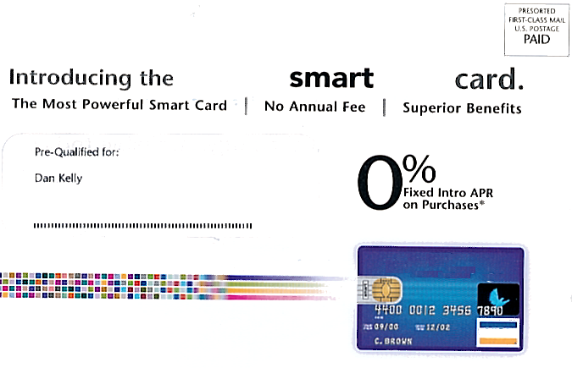
Basic Terms in DOE: Treatment
A treatment is a combination of all of the factors, each at one level. In a typical marketing context, a treatment constitutes a unique offer.
Examples:
1.99% Intro Rate, in a White Envelope, 4.99% Goto rate
0% Intro Rate, in a Gray Envelope, 4.99% Goto rate
1.99% Intro Rate, in a Gray Envelope, 7.99% Goto rate
0% Intro Rate, in a White Envelope, 4.99% Goto rate

Slide 27
Idea Exchange
Web-based experiments are popular because they are relatively inexpensive to implement and they can be modified in real time. Suppose that you are designing a web-based experiment to compare different promotional offers on a retail site.
What types of factors might influence whether a customer purchases a product and the amount a customer spends?
Think of at least two factors you
would want to design into your study.

Slide 28
Other Terms in DOE
An experimental unit is the smallest unit to which a treatment can be applied.
Replication occurs when more than one experimental unit receives the same treatment.
Power is the probability that you will detect an effect, if one exists.
Notes:
Experimental Units example: a credit card offer can be sent to an individual, i.e., many per household; a mortgage offer can only be made one per household.
Replication is often difficult in agriculture or manufacturing, because the experimental unit might be a batch of TVs, or an acre of corn. But in these examples, replication is going to be par for the course.

Slide 29
Efficiency
Experiment Designer
Can you quantify these terms?
Number of items tested
Margin of error
Financial costs
Total sample size
Others?
VP of Marketing
Either a large numerator, a small denominator, or both!
Amount of Information
Cost of Experiment
...

Slide 30
Randomization
After an experiment is defined, the next step is to randomly assign treatments to experimental units.
A typical approach to randomization of N customers to k treatments involves the following steps:
Define the population of interest.
Select a simple random sample from the population equal to the total sample size, N (for example, N=100,000).
Randomly partition the sample into k equal groups (for example, k=4 groups of 25,000 each).
Assign each group to one of the four treatments.

Slide 31
Orthogonality
Another ideal property of an experimental design is orthogonality, it guarantees that the effect of one factor or interaction can be estimated separately from the effect of any other factor or interaction in the model of this property:
Statistical interpretation – Estimates have low variance.

Slide 32
Blocking
Blocks are groups of experimental units that are homogeneous in some way. Typically, they represent nuisance variability.
Examples: region, school, company
Blocks might or might not be randomly selected.
Because units exist in blocks, rather than being assigned to them, blocks reflect a restriction on the randomization in an experiment.

Slide 33
Covariates
Covariates are characteristics of the experimental units that are measured but cannot be assigned or imposed upon them.
Examples: age, gender, income
Covariates are usually not selected, but are characteristics of the units that have been selected.

Slide 34
What Is the Difference?
Blocks and covariates are sometimes treated interchangeably, and the distinction is not always clear.
Blocks are typically categorical and can be thought of as groups of experimental units. Blocks are often used as random effects in models.
For example, a neighborhood is a group of households.
Covariates can be continuous or categorical and are characteristics of the individual experimental unit. Covariates are often used as (fixed) predictors in models.
For example, a person is male or female and is of a particular age.

Slide 35
Idea Exchange
Imagine you are designing an experiment to find the best seating arrangement for a restaurant. Your factor is seating arrangement (A, B, or C).
These are your responses:
Total food and drink sales per party
Customer satisfaction ratings
In addition to the factor in the experiment
(seating arrangement), list two or three
possible block variables and/or covariates
that might be considered in this experiment.

Slide 36


Focus on Designs: A-B Tests
CHAMPION
CHALLENGER

Slide 37
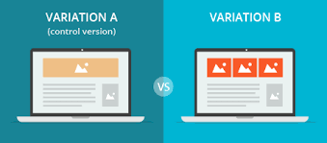
A/B testing
Randomized controlled trials
Typical use case: Comparing versions of a web page
Which variation has a higher conversion rate?

Slide 38
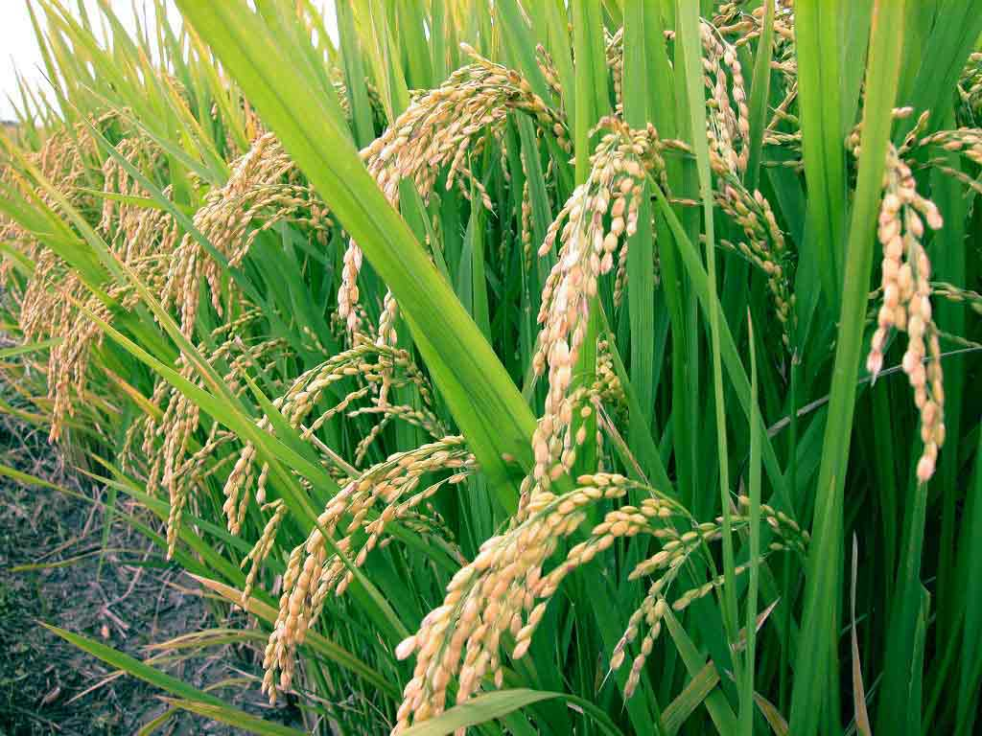
A/B testing, 100 years ago: Crop yeilds
Farmer Ron wants to test two fertilizers
Steps taken by Ron,
Chooses how many plots to use (Sample Size)
Waits for crop cycle, collects data at the end
What are the chances that I would see the same results if there was no difference?
If p-value<5%, his results are significant

Slide 39
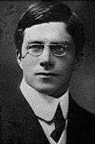
A/B testing today Vs 100 years ago
In 1916:
Data was expensive and slow
Practitioners were trained statisticians
In 2019:
Data is cheap and real-time
Everybody is practitioner
Sir Ronald Fisher

Slide 40
How different is A/B testing today ?
Time is money!
So you continuously monitor results dashboard
And you rely on the dashboard to tell you when your results are ready
This is called adaptive sample size testing:
You adjust the test length in the real time, based on data coming in.

Slide 41
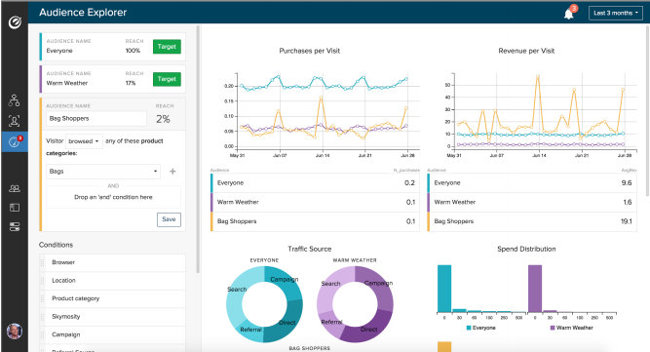
A/B testing today

