Slide 1
Data Visual

Slide 2
What is Data Visualization?
It is taking bunch of numbers and text and transforming them into something that our brains can process
“you can see a lot by looking” Yogi Berra
Visualization is important in many problems
Allow senior leaders to make decisions
Illustrate reasons for actions
Identify fundraising opportunities for NPOs
Virus breakout tracking

Slide 3
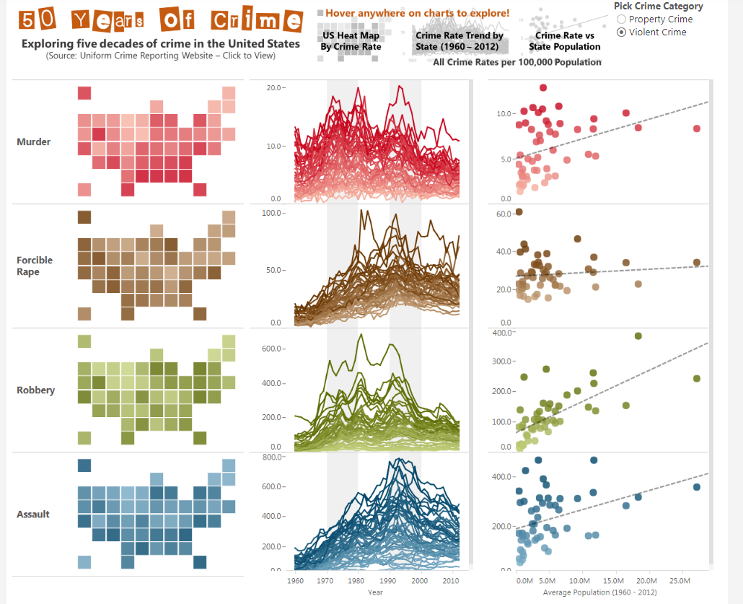
Examples of Data Visualizations
50 years of Crime in US https://public.tableau.com/en-us/s/gallery/50-years-crime-us

Slide 4
Examples (Cont.)
You can find patterns, correlations, relationships across time and geography
Power of computers:
Go through millions of rows in few seconds
Interactivity

Slide 5
Relationship between business analytics and visualization
Business analytics is about
Asking questions using statistical and quantitative tools
Produce explanatory and predictive analysis that answer questions
Data visualization is a business analytics tool
targets data-driven or fact-based decision making
through visualizations and drill down to the details that they need really quickly
But why? Same info is in the excel sheet
Nicer
Picture superiority effect

Slide 6
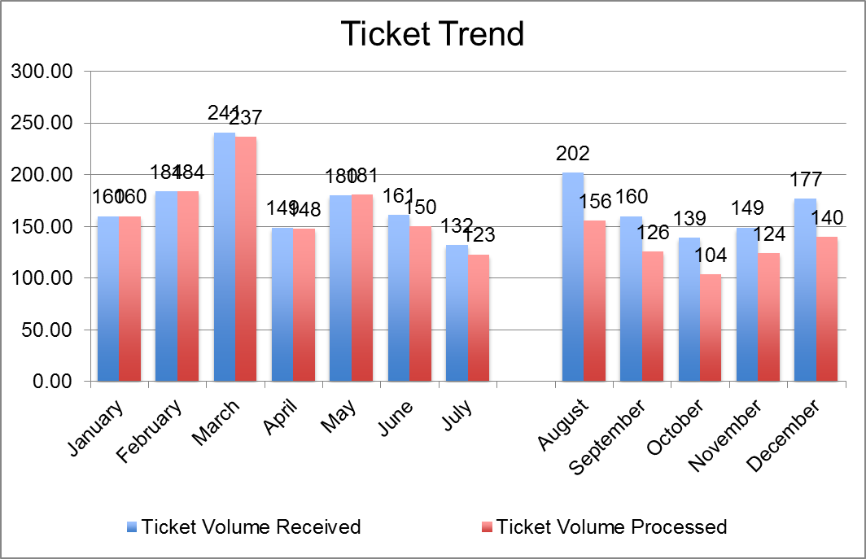
Ticket Volume Over Time | January | February | March | April | May | June | July |  | August | September | October | November | December
 | Jan | Feb | Mar | Apr | May | Jun | Jul |  | Aug | Sep | Oct | Nov | Dec
Ticket Volume Received | 160 | 184 | 241 | 149 | 180 | 161 | 132 |  | 202 | 160 | 139 | 149 | 177
Ticket Volume Processed | 160 | 184 | 237 | 148 | 181 | 150 | 123 |  | 156 | 126 | 104 | 124 | 140

Slide 7
Big Data World
Big data is not just BIG
To be called big data, data has to be
Increasing in volume
Increasing at high velocity
With lots of varieties
Then what is machine learning?
Uncovers the relationship between all these varities
Examples: credit card monitoring

Slide 8
Visualization Tools
Visualization concepts and designs are the same regardless the tools
Famous visualization tools:
Excel (PowerPivot)
Python and R
Tableau

Slide 9
Tableau’s Versions
Very powerful data connection
Interactive with quite small delay
Easy to master
Different Versions:
Tableau public
Tableau desktop
Tableau server

Slide 10



Slide 11

Not free
Secure
Can connect to many data sources and databases

Slide 12
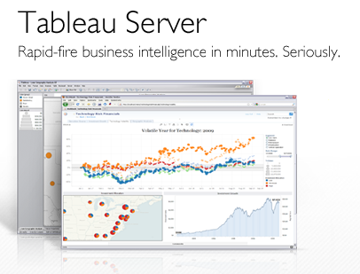
Extremely powerful
Costs lots of money
Collaboration
You can control how others see your data, even when it's embedded on a public website.
More secure access to data and prevent people from downloading those data sets.

Slide 13
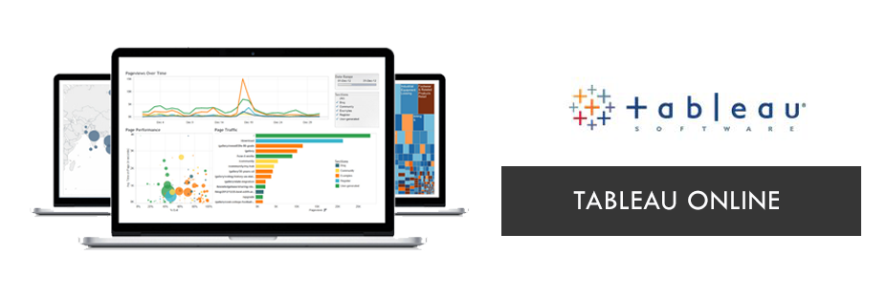
Tableau Online is intended to be a way to allow control of your data when embedding data visualizations.
No need for server
The viewer needs a Tableau Online account as well
Visualizations produced with Tableau Online cannot be shared with the public like it can with Tableau Server or Tableau Public, unless you save it as a Tableau Public file.

Slide 14
First Visualization
Our first visualization used will be based on a ready made visualization by Govind Acharya
https://public.tableau.com/profile/govind.acharya#!/vizhome/Lesson1-4firstvisualizationdata/Sheet1
Download the workbook from the above link
Let’s rock and roll

Slide 15
What do we want to learn in our first visualization
Navigate our way in Tableau
Build maps
Build interactive visualization

