Slide 1

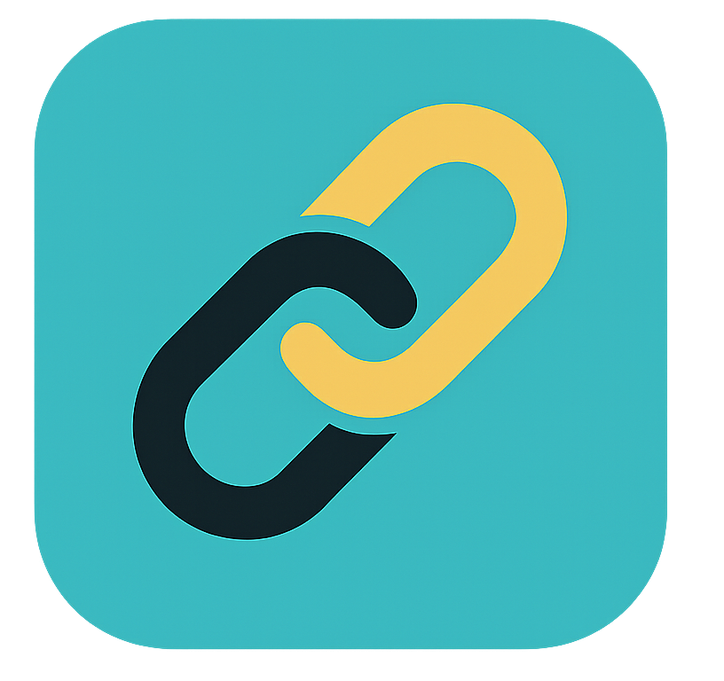
AutoLedger

Slide 2
AGENDA
Our Offer
The Problem & Solution
Key Features & How it Works
SmartContract Example
Market Strategy & Business Model
Launch Plan
Your Offers & Q&A

Slide 3
We are asking for $50,000 in exchange for 10% equity in autoledger.

Slide 4



Meet Bob.

Slide 5


Bob wants a newer used car...

Slide 6


Bob Checks Carfax...

Slide 7

But the report is incomplete!

Slide 8

Bob feels lost. Who can he trust?

Slide 9

Introducing AutoLedger!

Slide 10

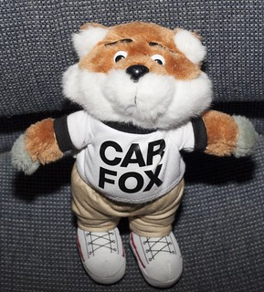
The Problem
Incomplete/Outdated Reports
Carfax and similar services often miss critical data
1 in 10 used cars have undisclosed accidents
Fragmented Databases
Service, title, and accident records spread across garages, DMVs, insurers
Fraud is Rampant
Odometer rollbacks (450,000 cars/year in the US)
Title washing across state lines to hide severe damage
Expensive, Inefficient Transactions
DMV bottlenecks, high dealership fees, and slow escrow services
Impact
Buyers pay too much
Sellers lose trust
The system favors middlemen, not customers
Notes:
Samer

Slide 11
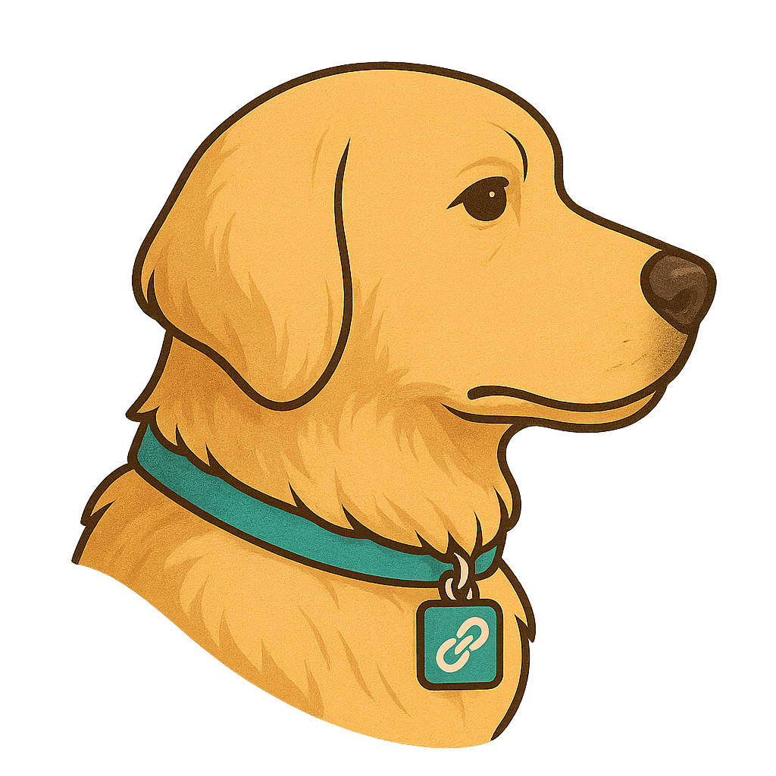
Our Solution
^{Meet Gidget!}
Gidget stands guard over your car's true story – making sure every mile, accident, and service is honestly recorded.
Notes:
Samer

Slide 12
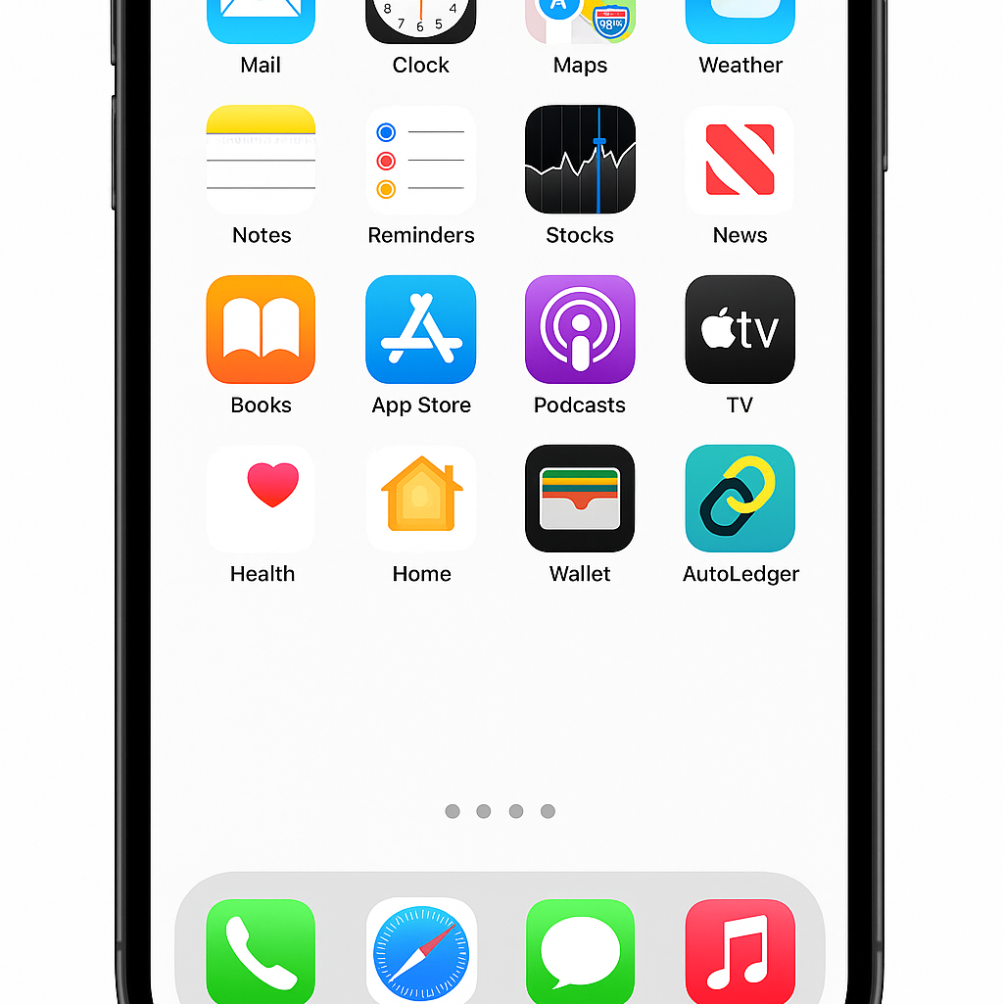
Key Features
Complete History in One Place Merges data from mechanics, DMVs, insurers, and owners into a single, tamper-proof record.
Peer-to-Peer Ownership Transfers Use smart contracts to transfer ownership or leases without brokers, escrow services, or hidden fees.
Verified Maintenance Records Only licensed and verified service providers can update the vehicle’s history.
Mobile App Integration Instantly scan a VIN to view the full verified service and ownership history.

Slide 13
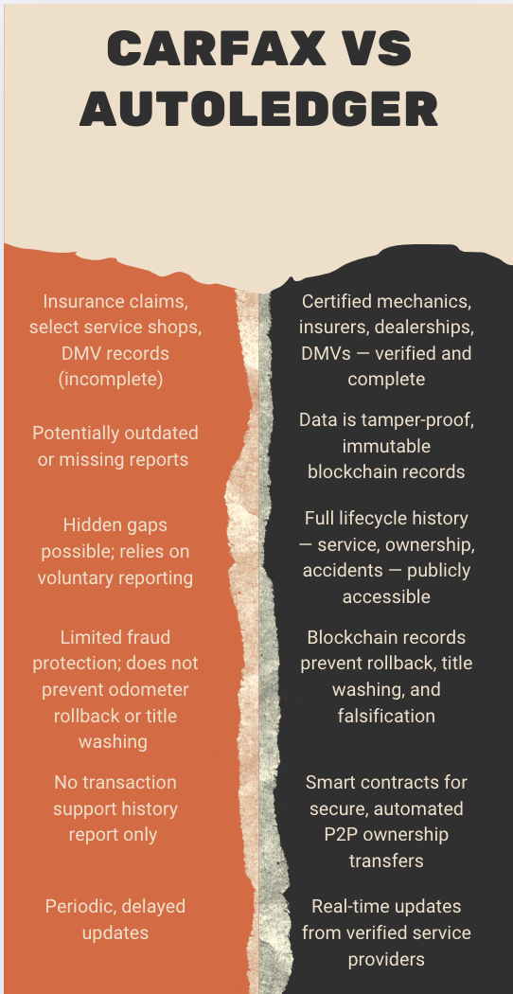

Slide 14
// SPDX-License-Identifier: MIT
pragma solidity ^0.8.0;
contract AutoLedgerEscrow {
address public buyer;
address public seller;
uint public price;
bool public inspectionPassed;
bool public paymentMade;
constructor(address _buyer, address _seller, uint _price) {
buyer = _buyer;
seller = _seller;
price = _price;
}
function passInspection() public {
require(msg.sender == buyer, "Only buyer can approve inspection.");
inspectionPassed = true;
}
function depositPayment() public payable {
require(msg.sender == buyer, "Only buyer can deposit funds.");
require(msg.value == price, "Payment must match the agreed price.");
paymentMade = true;
}
function finalizeSale() public {
require(inspectionPassed && paymentMade, "Requirements not met.");
payable(seller).transfer(price);
}
}
Property | Value
Buyer | 0x5B38Da6a701c568545dCfcB03FcB875f56beddC4
Seller | 0xAb8483F64d9C6d1EcF9b849Ae677dD3315835cb2
Price | 5 wei (for simulation purposes)
Contract Address | 0x652c9ACcC53e765e1d96e2455E618dAaB79bA595
Environment | JavaScript VM (Cancun)
Transaction Status | ✅ Success (0x1)

Slide 15
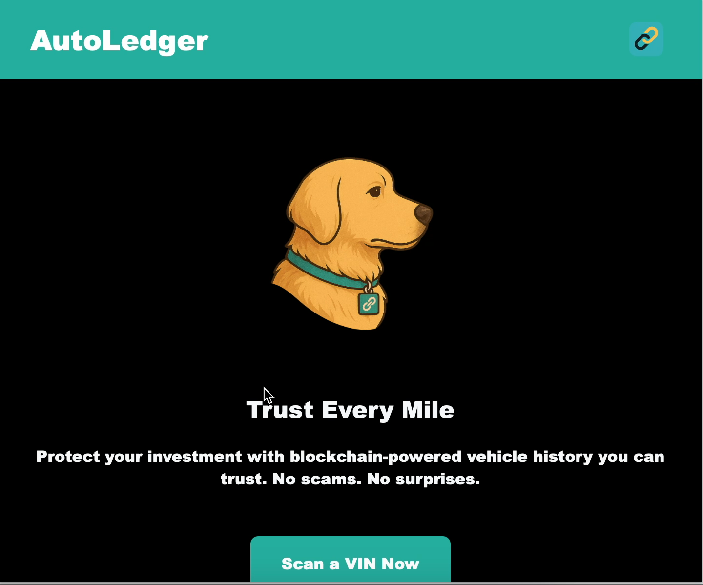
How It Works
Buyer scans the vehicle’s VIN using the AutoLedger app.
Full verified history appears instantly from the blockchain.
Smart contract automatically sets up a secure transaction.
Payment is held safely in a smart escrow system.
Upon payment release, ownership transfers digitally and permanently.
New owner and updated records are recorded immutably on-chain.

Slide 16
Potential Challenges
Adoption Resistance:
Getting businesses and consumers to trust a new system.
How we overcome it:
Start with luxury dealers and early adopters.
Legacy System Integration:
Slow adoption by DMVs and institutions.
How we overcome it:
Build simple API data feeds for DMVs, fleets.
Data Accuracy at Scale:
Verifying service records across millions of vehicles.
How we overcome it:
Vet mechanics and offer rewards for verified service logs.
Consumer Education
Teaching buyers and sellers how to use blockchain verification easily.
How we overcome it:
Focus on user-friendliness and instant VIN scan simplicity.

Slide 17
Go-to-market strategy
Partnerships with Dealerships and Repair Shops Collaborate with trusted service providers to preload vehicle histories and encourage adoption.
Incentivize Service Providers Offer token-based rewards or reputation boosts for verified and accurate service entries.
Mobile App Launch Roll out a consumer-friendly app for easy VIN scanning and record access, focusing on transparency and ease of use.
Marketing Campaign Featuring "Gidget" Mascot Build brand trust and recognition through a relatable, friendly mascot in ads, social media, and at car events.
Pilot Programs Start with dealership partnerships in select cities to prove concept and gather user feedback before broader rollout.

Slide 18
Business model
How will AutoLedger win over the market?
Partner with luxury dealerships to certify high-value vehicles.
Enable trusted mechanics to upload service records to blockchain instantly.
Incentivize insurers and lenders to offer discounts for verified histories.
Provide free VIN lookup tools for consumers to verify vehicle records.
Launch ”AutoLedger Verified” certification badges for listings and promotions.
Transaction Fees
Small fee for verified title transfers and service updates – Carfax only sells static reports.
Premium Verified Reports
Offer live, tamper-proof ownership and service histories – Carfax data can be incomplete or outdated.
Dealer & Fleet Subscriptions
Unlimited VIN access and real-time updates for a flat monthly rate – Carfax charges expensive per-report fees.
Future Data Licensing
License blockchain verification to DMVs, insurers, and fleets – Carfax cannot integrate live data into external systems.
Notes:
Partner with luxury dealerships to certify high-value vehicles
How:
Offer early-adopter partnerships where AutoLedger setup is free for the first year.
Give dealers "AutoLedger Verified" digital certificates they can attach to listings.
Help them sell cars faster by advertising “blockchain-verified history” to buyers who care about provenance.
Enable trusted mechanics to upload service records to blockchain instantly
How:
Build a simple mobile app/web portal for mechanics to upload service logs linked to VINs.
Pre-approve trusted repair shops into a Verified Provider Network (VPN).
Reward shops with free marketing badges (“Certified AutoLedger Service Provider”).
Incentivize insurers and lenders to offer discounts for verified histories
How:
Partner with select insurance companies and lenders.
Show them data that cars with full blockchain histories = lower risk (fewer accidents, fraud cases).
Offer AutoLedger Certification Discounts (lower premiums or better loan terms).
Provide free VIN lookup tools for consumers to verify vehicle records
How:
Launch a free VIN scan feature on AutoLedger app and website.
Allow buyers to check ownership + service records instantly.
Every VIN scan that finds an AutoLedger record = free marketing (“proof it works”).
Launch "AutoLedger Verified" certification badges for listings and promotions
How:
Create a recognizable AutoLedger Verified badge.
Give it FREE to dealerships, mechanics, and sellers with verified cars.
Promote cars with badges on listings (websites, apps, auctions).

Slide 19
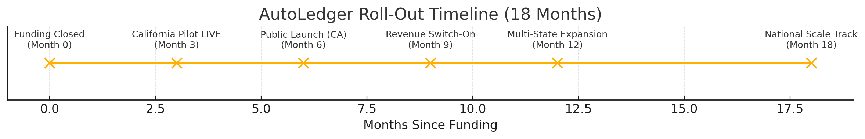
Next Steps

Slide 20
AutoLedger Funding Journey
Pre-Seed $50K Private Investors
Seed Round $500K–$750K Angels + Early VCs
Series A $5M–$8M Tech & Blockchain VCs
Series B $20M–$30M Large VCs + Corporate Partners

Slide 21

Thanks to AutoLedger, Bob is riding in style with a car report he can trust.

Slide 22


Slide 23
Thank You! ☺ Any Questions?

