Slide 1

FanPass Protocol
The Future of Fan Loyalty
Jeffrey Wells, Zach Frederick, Jack Peel, and AJ Gottschalk
Notes:
Welcome, everyone. Today, I’m excited to introduce you to FanPass Protocol, a blockchain-based fan loyalty system that transforms how fans are recognized and rewarded. Whether you’re cheering courtside or from the nosebleeds, your support will finally be verified, recorded, and rewarded. Over the next 20 minutes, we’ll walk through the current problems in fan loyalty, how FanPass solves them, and the future it creates for fans, teams, and sponsors.

Slide 2

Introducing: FanPass Protocol
Decentralized Blockchain
Tracks and rewards authentic fan engagement
Fan Identity is portable and verifiable
Uses Proof-Of-Attendance NFTs, geolocation, and engagement tokens
Notes:
FanPass solves these problems using blockchain. With decentralized technology, we can reward real fan actions—being there, chanting, showing up. Your identity as a fan becomes something you truly own and can carry from sport to sport, team to team. We’ll use geolocation, NFTs, and a token system to capture and validate every cheer, chant, and trip you make for your team.

Slide 3
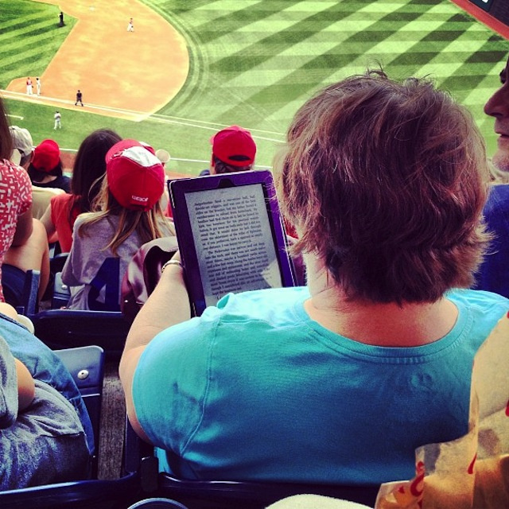
The Problem
Centralized programs
Rewards limited
Lack of recognition
No cross sport
Transparency and ownership missing
Notes:
Most current loyalty programs only reward spending—like buying tickets or merchandise. They ignore real passion, like traveling to away games or supporting your team loudly and consistently. Plus, these systems are fragmented. Your loyalty to one team or league doesn’t carry over to others. And fans don’t actually own their loyalty records—it’s all centralized and opaque.

Slide 4

Use Cases for FanPass Protocol
FanPass protocol is going to be able to be used by every team in each of the US’ top five sports leagues.
People will be able to collect NFTs at games that they go to and prove that they are participating in the game and using FanPass.
These can be sold for $FAN coins and exchanged for rewards. Creating value system for $FAN and rewarding fans for participating in the game and rooting on their team.
This can reward fans for going to all teams sporting events and maximize fan participation and not only fan spending.

Slide 5
Who’s Our Target Market?
The first target market is the five big leagues in the US, the MLB, MLS, NBA, NFL, and NHL. These leagues currently have independent rewards system and sometimes with them each team has an individual rewards system. By using FanPass Protocol these leagues can combine their rewards systems into one place and grow support for their teams.

Slide 6
Who’s Our Target Market?
The second target market for us is the sports fan. Sports fans today are passionate about their teams and the entertainment fact of sporting events. However, they’re not rewarded in a meaningful way for their participation, especially those who participate in a sporting event that doesn’t include their favorite team. However, FanPass Protocol will allow them to be rewarded for their participation, fandom, and love of sports.

Slide 7




Current Competitive Landscape
The current competitive landscape is filled with the likes of current sporting teams platforms & the leagues platforms. The primary purpose of these apps are for purchasing of team gear, tickets, and for following team news.

Slide 8
What makes us different?
Fan Pass allows you to gain rewards through all of your favorite teams and doesn’t require that you have multiple accounts for multiple teams.
Every game you go to will allow you to use the Fan Pass Protocol.
In addition to this unlike typical reward programs which will only allow you to use rewards at their shop, this allows you to diversify rewards.
Examples
Earning rewards at a Blue’s game could help you save up $FAN tokens for a Cardinals Jersey reward.
If a Blue’s Jersey is a reward option for 20 $FAN tokens for example and that jersey is normally $100 then its about $5 per $FAN token, people can transact their $FAN tokens for other cryptocurrencies allowing you to be paid essentially for your participation.

Slide 9
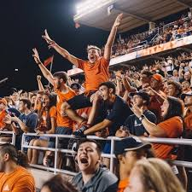
Key Components
Proof of Attendance NFTS
Geotagged
collectible and rare moments
FanEngage Tokens ($FAN)
Earned through activities
Redeemable for perks
Fan Identity Passport
Tracks miles, rivalries, streaks, etc.
Team and League DAOs:
Community led decisions

Slide 10
What are next steps for FanPass?
The first step for FanPass is to start acquiring customers - through the help of current owners, widespread fan knowledge and venture backing we will need to gain the business of the big leagues.
Whilst gaining our customers we will also need to focus heavily on our protocol and our coding as it is essential that are $FAN coin be able to hold value for fans to truly be rewarded.
Last step of our initial three step plan is to work on creating geotagged NFTs and premade templates. This will make it easier for teams to implement and create a strong marketing pitch.

Slide 11
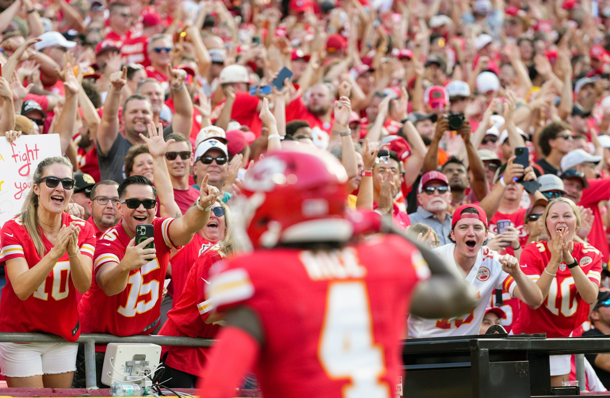
Revenue Build and Long-Term Sustainability
The main way that Fan Pass will bring in revenue is through league partnerships.
Each NFL team brings in around ~$581M and this is primarily because of fan spending. If we can provide a system that engages even more fans it should be extremely attractive to them.
These will be obtained in step one of our process by pitching our idea to companies that have helped similar ideas starting out. Primarily VCs that have helped with rewards type apps or protocols previously.
By obtaining league partnerships for a fee we can earn premiums to keep Fan Pass running. They will gain fan engagement and it will help us in running our protocol.

Slide 12

Revenue Build and Long-Term Sustainability
In addition to this by holding our own $FAN tokens we can monetize the value that we see in our platform.
Our tokens will become more valuable as they continue to be bought by leagues and fans in order to redeem rewards. While the token will be tethered we will still be able to earn interest on assets held as most stablecoins do.
Stabilization is necessary for proper pricing of rewards, and leagues will have to pay fee for the number of tokens they would like.

Slide 13
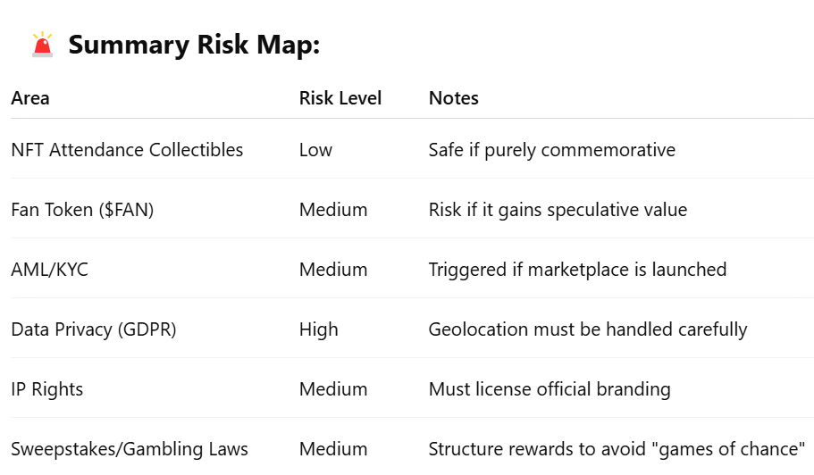
Regulations & Risks

Slide 14
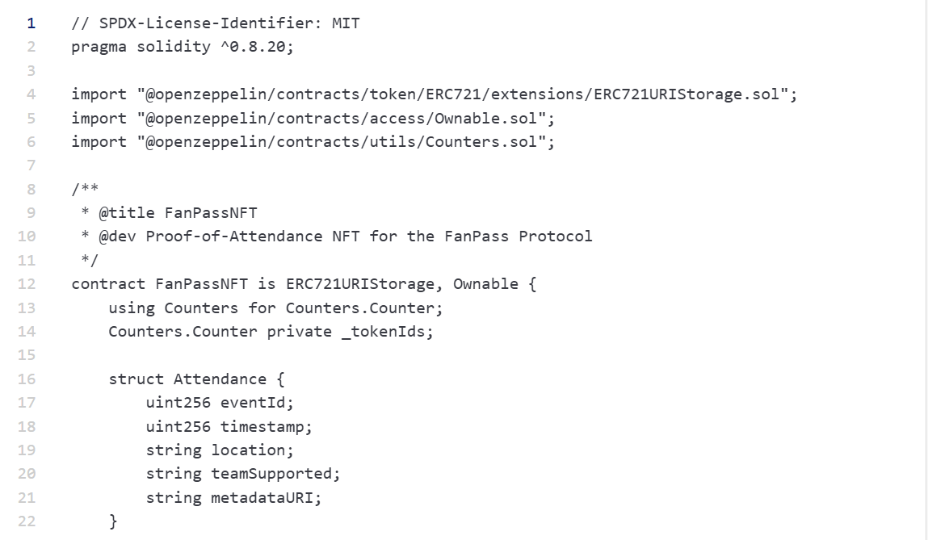
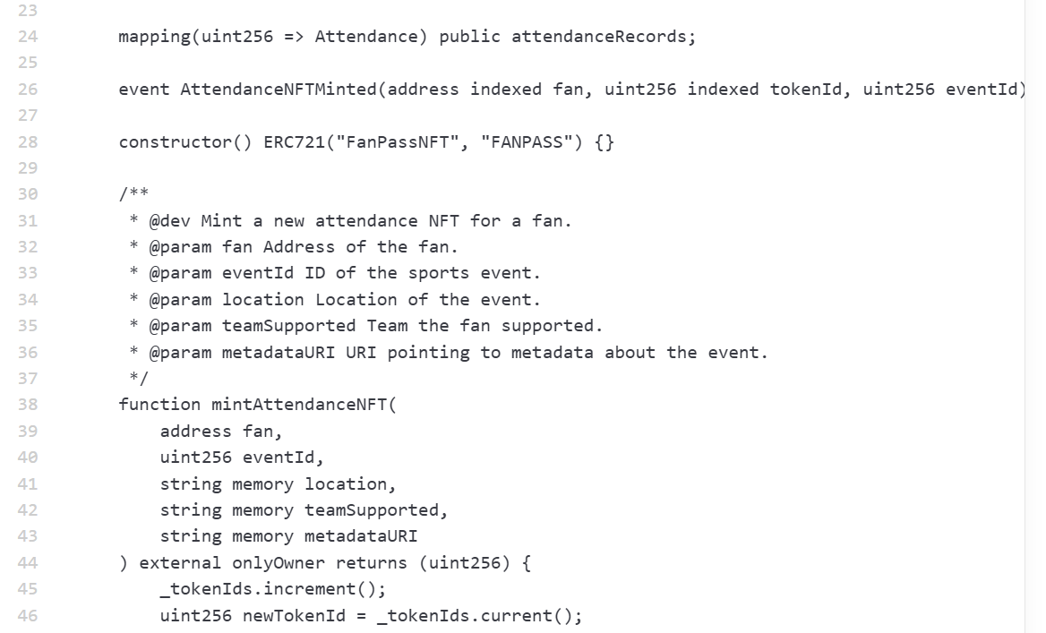
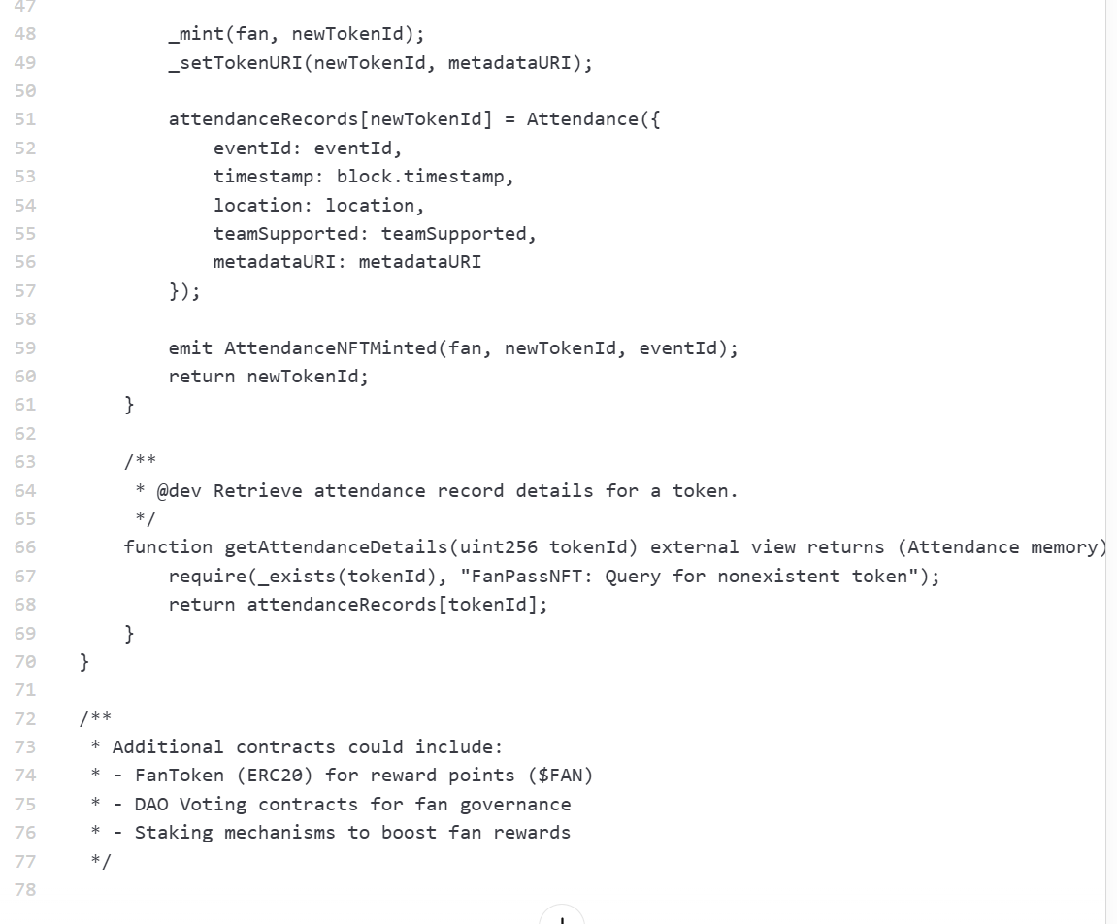
Coding
FanPassNFT Contract
Minting Attednance NFT’s
Attendance Record
Security
Extendability
Notes:
This smart contract, FanPassNFT powers the proof of attendance system for the fanpass protocol. It allows teams and event organizers to mint NFT’s for fans who attend live sports events.

Slide 15
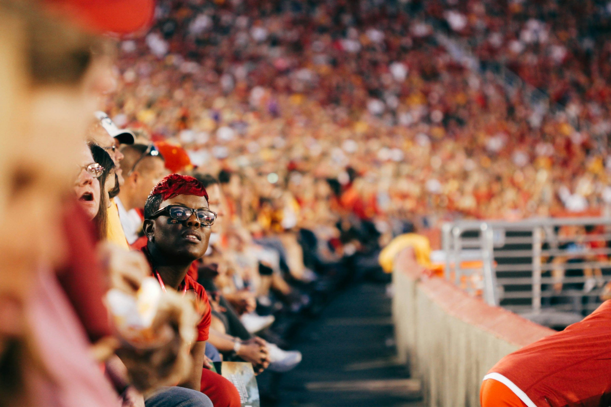
Key Resources
&
Partners
Resources
Code
Partners
Sport Fans
Sport Organizations
Venues and Ticketing Platforms

Slide 16
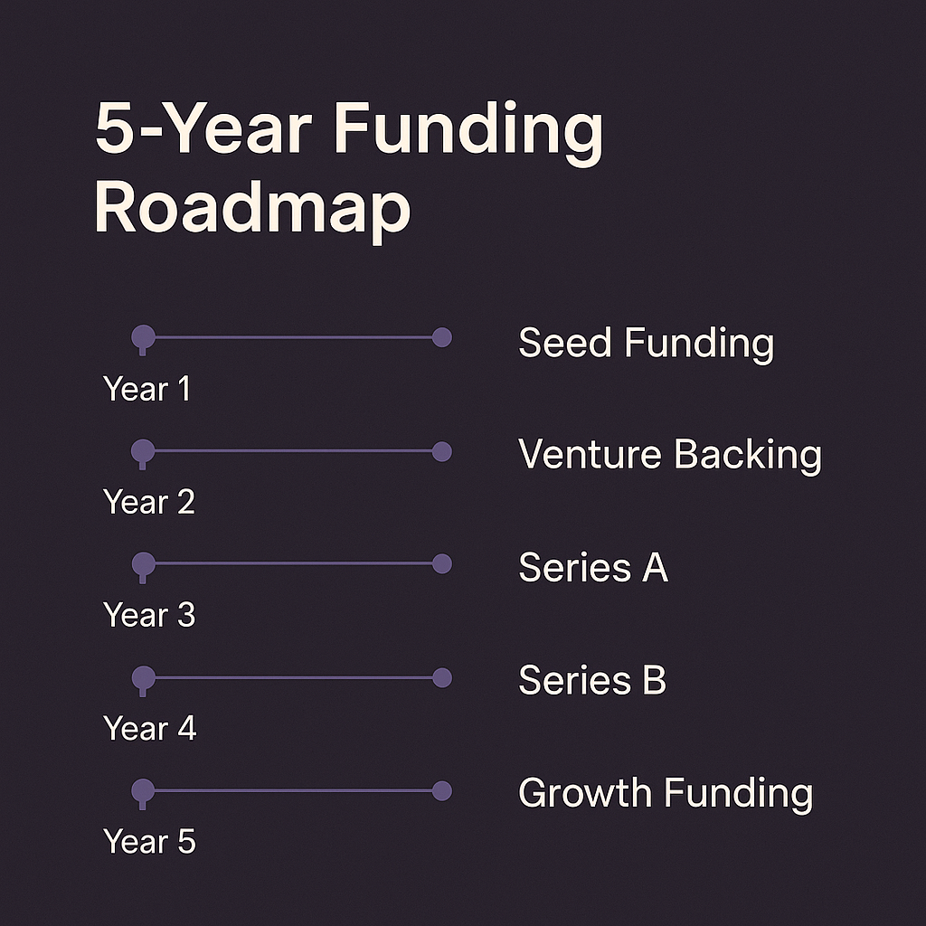
Funding Roadmap
Notes:
Year 1: we focus on building and launching small pilot programs, funded by angel investors and strategic grants.
Year 2: we pursue our first venture backing. This funding will allow us to expand into more stadiums, teams, and launch the $FAN token ecosystem
Year 3: Year 3 is about scaling. With Series A funding, we'll partner with major leagues, roll out fan DAOs, and introduce AR experiences to boost engagement
Year 4: In Year 4, Series B funding supports our international expansion and the launch of a fan-to-fan marketplace for NFTs and merchandise.
we'll be aiming for either a major growth round, acquisition, or IPO — positioning FanPass as the global leader in fan engagement tech.

Slide 17
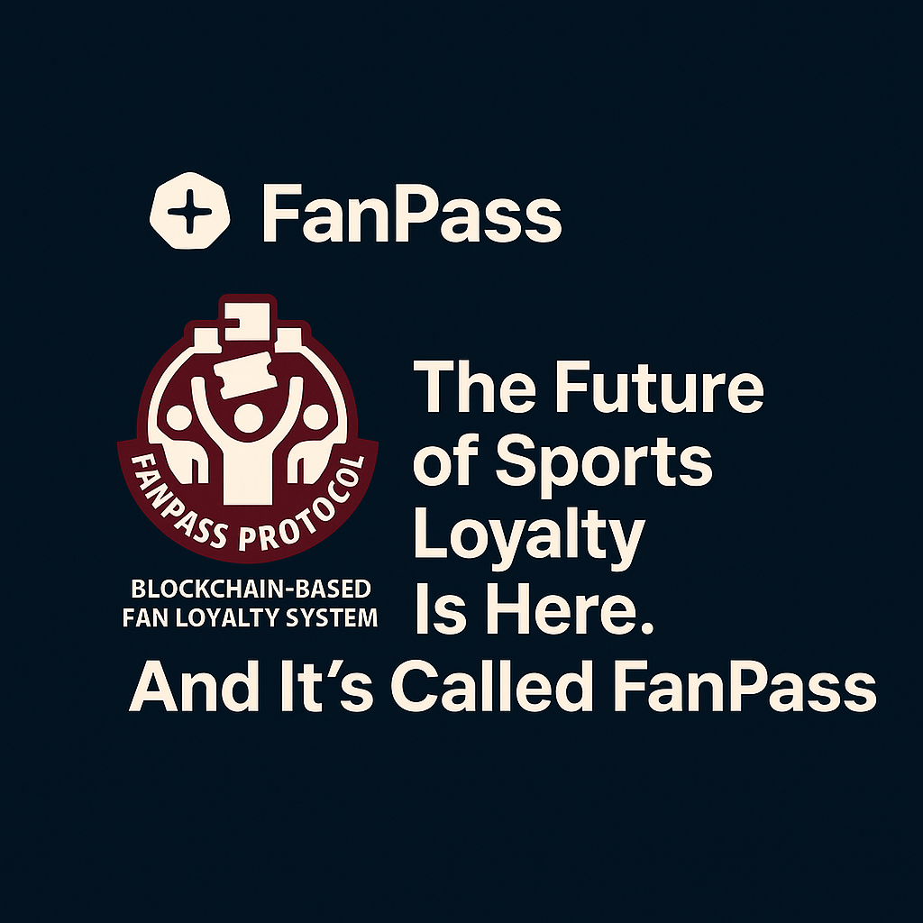
Notes:
At FanPass, we’re not just building another rewards app — we're revolutionizing what it means to be a fan.
We're turning every chant, every mile traveled, and every ticket scanned into real, verifiable loyalty — owned by the fan, powered by blockchain, and portable across teams and sports worldwide.
We invite you to join us in redefining fandom — to create a world where passion is not just felt, but rewarded.

Slide 18
