Slide 1

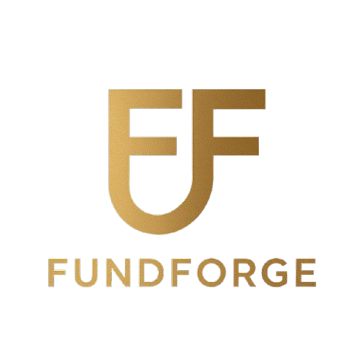
FundForge
"Blockchain-Powered Marketplace for Custom Index Funds"​
Graham Bishop, Mikey Callahan, Mark Kosir, Sansh Kumar, Andy Nguyen

Slide 2
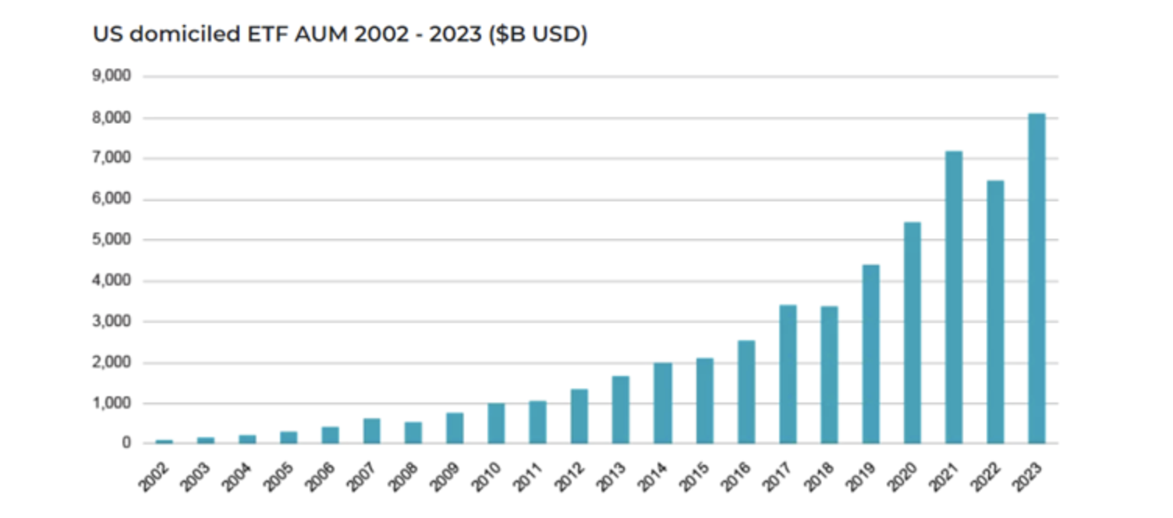
U.S. Index Fund Market
More than 12% of U.S. households, or over 15 million people held index funds in 2023.
The U.S. index fund market has seen an average annual inflow of around $585 billion for the past four years.
The total AUM of U.S. domiciled index funds exceeded $8 trillion in 2023 and is expected to exceed $10 trillion by 2027.
Index funds are created exclusively by banks and asset management companies like JP Morgan, BlackRock, or S&P 500.

Slide 3

Today, everyday investors have ideas - but no tools to turn them into investable products. FundForge changes that.
"What if ANYONE
— not just Wall Street —
could build and sell their own index funds?"
With more than 40,000 tradable securities worldwide, the possibilities for creating index funds are virtually endless — offering limitless room for creativity and a personal touch.

Slide 4
Problem:
"There’s no way for individuals to easily create, share, and profit from personalized investment strategies without costly and complex fund structures."
🧾 High Fees
0.5% - 1% expense ratio
$5 - $10 per trade for commission
⚖️ Regulatory Hurdles
Lengthy initiation processes
Annual costs associated with regulatory compliance
🛠️ No Customization Tools
Limited customization
Lack of personalization and flexibility

Slide 5
Solution:
FundForge
Tokenized indexes allow easy sharing, investing, and tracking on-chain.
Automatic smart contract rebalancing removes the need for fund managers and middlemen
Built-in royalty system lets strategy creators earn when others invest in their indexes.
No regulatory fund setup needed — users create, launch, and monetize strategies directly on the blockchain.

Slide 6
Market
TAM
$12.5T+

Slide 7
Market
TAM
$2.5T+
SAM
SAM
(Serviceable Addressable Market)
20%
Crypto-Comfortable Investors
SOM
$1.25B+
SOM
(Serviceable Obtainable Market)
0.05%
Early Adoption (2 Years)

Slide 8


Competitors & Edge
M1 Finance
Enzyme Finance
FundForge
Custom Index Creation
Monetization for Creators
True Strategy Ownership
Blockchain-Based Trust
Asset Class Focus
User accessibility

Slide 9
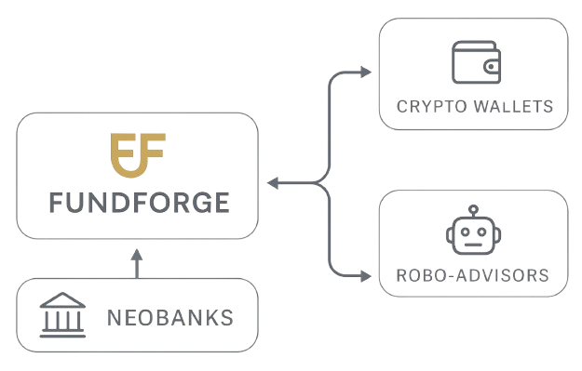
Business Model
B2B (Business to Business)
Revenue Source
Creation Fee | Flat fee to create a new index
Minting/Redemption Fees | % cut on buying/selling shares
Optional Premium Services | Advanced analytics, featured indexes
API (Application Programming Interface)
User Incentive
Earn fees as an index creator | Build an audience and get passive income
Customizable portfolios | Invest in what matters to you
Lower costs | Save compared to traditional funds

Slide 10
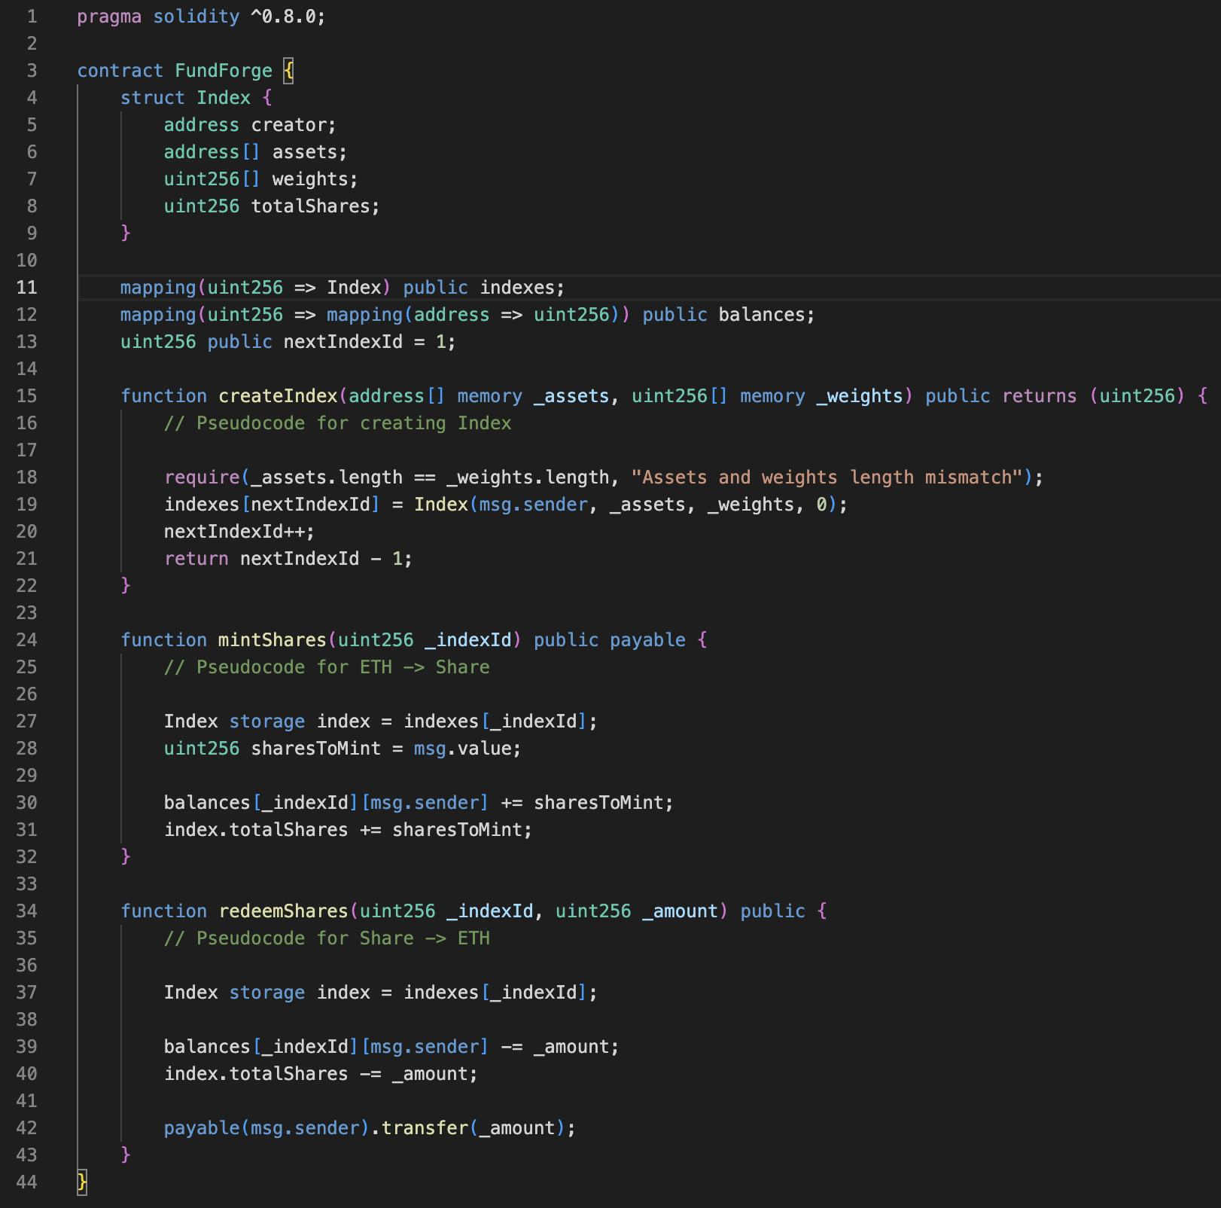
Index data structure
Function to create
custom index
Function to convert
index shares to ETH
Function to convert
ETH to index shares
Notes:
Bullet points: - digital badging system co-developed with Barry-Wehmiller
- leaderboard for engagement and metrics
- modern UI/UX design
- gamified leadership development

Slide 11

Risk, Solution, and Viability Matrix
External
Risk: Adoption Risk
Mitigation: UI/UX + Simulation Mode(Risk-Free)
Risk: Credibility Risk
Mitigation: Performance Metrics, Staked Collateral, Smart Contracts
High Risk
Low Risk
Risk: Regulatory Risk
Mitigation: Platform-Only Model, Legal Counsel, SEC Compliance
Internal

Slide 12

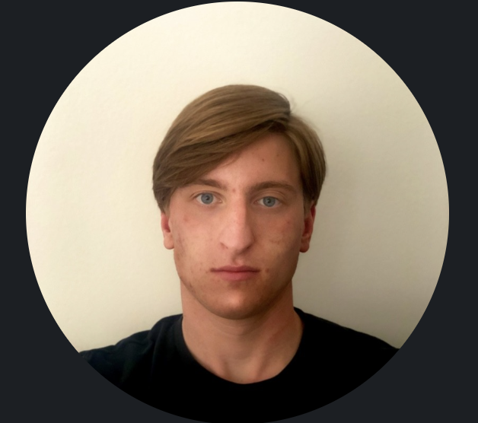





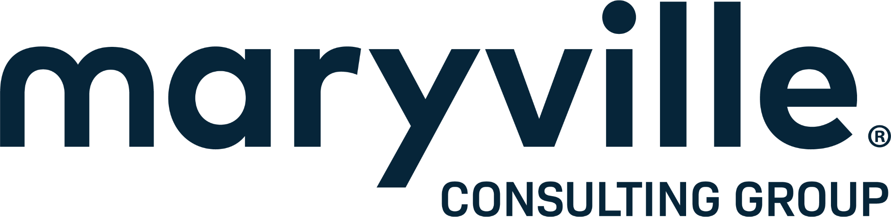
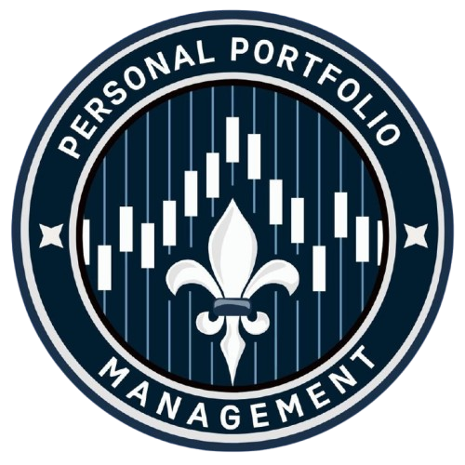
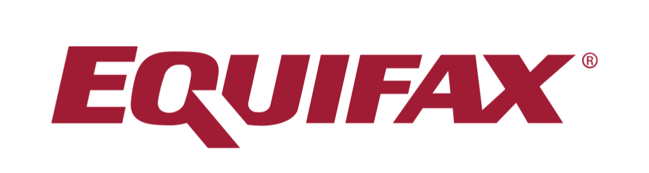

Team at FundForge
A team that is hungry to make an impact
CFO
Mikey Callahan
Equifax FP&A
CTO
Graham Bishop
Blockchain Developer
Sansh Kumar
Andy Nguyen
Mark Kosir

Slide 13
Timeline
May – July 2025
Initial Planning & Team Formation
Aug – Sep 2025
Market Research
Initial Prototype Website
Oct 2025
Investor Outreach
Seed Round Preparation
Oct – Dec 2025
Seed Funding
MVP Development
Jan – Feb 2026
Beta Testing & Refining Product
Public Launch Preparation & Marketing Push
Feb – May 2026
Public Launch & Scaling
Fall 2026
Ongoing Growth & Expansion
Notes:
May – July: Conceptualize idea for Blockchain Powered Marketplace Custom Index Fund and assemble core personnel like founders, blockchain developers, financial experts, and legal advisors
August – September: Conduct competitive analysis into the market and explore potential partnerships with fintech/banks. Also develop our protoype focusing on core feaures of: fund creation, smart contracts, and marketplace interface.
October: Finalize pitch, business plan, and financial projections while networking at start-up events alongside fintech conferences. We will also fine-tune the prototype based on feedback.
Oct – Dec: Finalize minimum viable product with essential features, hire additional developers and staff, bring in investors, and continue to refine product based on feedback.
Jan – Feb: Launch a private better to test platform functionality. Collect user experience and check accuracy of index funds. Procure marketing materials for a public launch
Feb – May: Launch platform to the public with user acquisition strategies like referrals and targeted ads. We will also start scaling company's operations of customer service, marketing, and legal support.
Fall 2026: Continue to expand product by adding more customization options while focusing on customer retention strategies and improve UI. Expand the team with more staff while actively monitoring for new potential regulatory practices.
Final Remarks: This timeline provides a structured approach for our plan to launch fundforge while considering key elements like: product development, investor engagement, and market entry.

Slide 14
Revenue Model (2025-2026)
Core Development: $120,000
Smart Contract Development: $30,000
UI/UX Designer: $15,000
Legal Compliance Setup: $25,000
Cloud Infrastructure: $10,000
Total: $200,000
Recurring Revenue From Investors
2025
Oct - Dec
Jan - Feb
Feb - May
May - Oct
2026
$200,000
MVP Development
$35,000
Beta Testing
$100,000
Public Launch
$330,000
Refinement / Maintenance
Marketing and Outreach
Notes:
This is our revenue model based off of events from our timeline. You can see we'll start with developing our MVP which will cost $200,000 due to stuff like... (on slide). We will then move forward toward a beta test and a public launch. Eventually, we will end with our refinement and maintenance of FundForge

Slide 15
We are on the verge of revolutionizing how people invest, enabling anyone to create and trade customized index funds securely, transparently, and efficiently through blockchain technology.
We're looking for visionary investors and partners to help us succeed in this ambitious project.
Together, we can redefine the financial landscape and empower millions of investors worldwide.
The Future of Investment is Here
Notes:
The future of investment is here!
We've built a platform poised to transform how people invest index funds while protected by blockchain technology and being transparent.
This is not just a product, this is a way to revolutionize a whole industry.
So the time to act is now, join us at fundforge to build the future of investment together.
Thank you. Question, Comments, Concerns?

