Slide 1

IdeaFirst
Elizabeth Wangley, Jasmine Sun, Fanglei Ruan, Dong Ding
Notes:
The idea is interesting! Below are some comments and suggestions for the project:
Please explain more clearly how the patent or design pattern is usually filed, especially in terms of submitting proof or supporting evidence. Are these steps the most time-consuming in the current process? Clarifying this can help the audience better understand the problem you’re addressing.
Using blockchain here is promising, but consider the issue of evidence validation. Is there any verification step before something gets posted? For instance, anyone could upload a file and claim they designed a fashion pattern—how do you prevent idea theft before the pattern is officially filed?
If timestamping is the main feature, please explain why blockchain is superior to other trusted timeproof methods like notary services. You could emphasize blockchain’s advantages such as 24/7 availability, low cost, and tamper-proof immutability—features that are hard to replicate with traditional methods.
Please clarify your business model. How will the project make money? Is it through transaction fees for each record? Or do you issue a token and rely on token demand/value growth in the long term?
Consider whether you envision a public or private blockchain. Some users may want confidentiality during the filing process. How will you ensure that submissions are valid and verifiable while still protecting the privacy of the filer and their intellectual property?

Slide 2
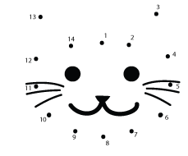
Interactive Activity - Connect the Dots
Notes:
Elizabeth
Have 2 people do connect the dots.
Whoever finishes first, is an individual
Whoever is 2nd, is a corporation, get a team of 4 in total
Round 2: Filing and paying for Patent
Both individuals and corporations get 4 drawings to complete
Corporate should win and get the IP, but we know in reality the individual is who actually came up with the idea
https://www.bigactivities.com/ctd/dinosaurs/brachiosaurus/brachiosaurus.php
https://www.bigactivities.com/ctd/dinosaurs/stegosaurus/stegosaurus.php
https://www.bigactivities.com/ctd/dinosaurs/triceratops/triceratops.php
https://www.bigactivities.com/ctd/dinosaurs/tyrannosaurus_rex/t_rex.php
https://www.bigactivities.com/ctd/dinosaurs/pterodactyl/pterodactyl.php

Slide 3
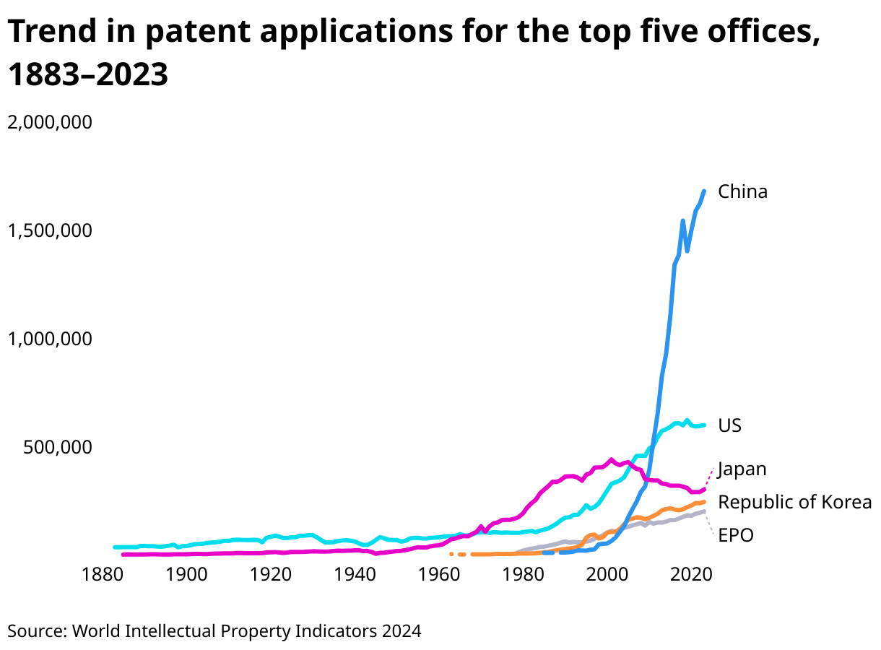
Current Patent Application Process
Current Steps:
Preparation
Application
Examination
Authorization and Issuance
Notes:
https://ipwatchdog.com/2015/04/04/the-cost-of-obtaining-a-patent-in-the-us/id=56485/
https://www.wipo.int/web-publications/world-intellectual-property-indicators-2024-highlights/en/patents-highlights.html
Dong

Slide 4
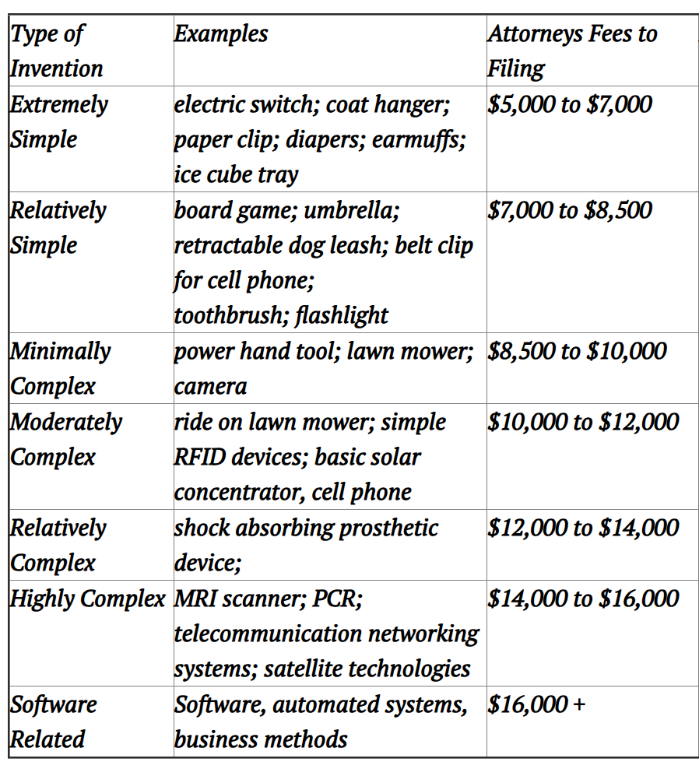
Current Patent Application Process
Application Requirements and Challenges:
Clear description of invention
Drawings and Diagrams
List of Features or Claims
Prior Art Search by Attorney
Complex legal language
Cost
Notes:
Dong

Slide 5
IdeaFirst (Core Operations)
Clients will be able to upload their IP materials
Backend hashes the material in forms of SHA-256, then recording it to the public blockchain, and offering more privacy protections for client
Record steps
IP Hash
Owner Wallet Address
Timestamp
Optional metadata
Notes:
Elizabeth

Slide 6
Why Blockchain?
Tamper-proof and immutable records
24/7 global accessibility
Lower costs and faster registration
Decentralized and verifiable trust
Privacy protection through hashing
Notes:
Once a record is entered onto the blockchain, it can’t be altered or deleted without leaving a trace, this can guarantee the integrity of the proof of creation in a way that centralized services can’t always ensure
Unlike the legal filing systems or offices that operate during limited hours and can vary by country, the blockchain networks are online 24/7 and can be accessed globally
Traditional intellectual property protection involves legal fees, notarizations and other filings which can be time consuming and expensive, blockchain is able to dramatically reduce both the cost and time to generate a verifiable record
One of blockchain’s biggest strengths is that it decentralizes trust. Instead of depending on a notary or patent office to verify ownership, the network itself acts as the authority. Anyone can independently check the timestamp and data without needing to file a request or rely on an institution, which is especially useful in dispute or licensing negotiations
By using technology like hashing, the platform can store a proof of the idea without publicly revealing the idea itself. This protects confidentiality while still timestamping the creation event.
Jasmine

Slide 7
Tools/Services
Layer | Tools/Services
Blockchain | Ethereum, polygon, Arbitrum
Smart contracts | Solidityu, chainlink functions, API3
API Gateway | Flask/FastAPI backend, AWS API gateway
Oracle | Chainlink/API3 Node setup
Frontend | React, Next.js, Web3.js or ethers.js
Security | Penetration Testing, Smart contract audit
Notes:
Elizabeth
API to connect frontend and backend
Oracle to access real-world data(API)

Slide 8
Why API
Client uploads IP documents, system hashes and sends to Dapp
Smart contract calls oracle to check for IP conflicts
API returns result
No conflict IP is time stamped on blockchain
Conflict sent for manual review
Violation contract is automatically rejected
All actions are logged immutably for transparency
Notes:
Fanglei
Smart contract can’t directly call external API, due to blockchain’s isolated for security
Unable to directly fetch live data like USPTO rules or IP duplicate checks inside the smart contract
External API provider Oracle could resolve the problem and fetch external API data and feed it into the smart contract

Slide 9
API Type | Example source | Purpose
USPTO Patent Database API | USPTO Open Data Portal | Check if similar patents exist
Copyright Office API | US Copyright office public records | Verify Copyright filings
Trademark office APIs | USPTO trademark API | Check live trademark status
WIPO patentScope API | WIPO Patentscope | International Patent search
IP law update feeds | Third Party providers(Bloomberg law, lexisnexis) | Compliance rules update checker
Notes:
Fanglei

Slide 10
Dapp and Token Mechanism
Dashboard
Manage IP rights, submit new ip, view ownership certificates
Portfolio manager
Shows IP as tokenized assets
Exchange/Marketplace
Clients will be able to list their IP tokens for licensing, sale, or collateralized loans
Payment system
Clients pay service fee on our platform’s native token (IF token)
Pegged to USDT to maintain price stability
Clients has the ability to swap IF token with USDT anytime
Notes:
Fanglei

Slide 11
Coding
Contract IdeaFirst {
Struct IdeaProof {
Address creator;
uint 256 timestamp;
string description;
}
mapping(address => IdeaProof[]) public IdeaProofs;
function submitIdea(string memory _description) public {
Ideaproofs[msg.sender].push(IdeaProof(msg.sender, block.timestamp, _description));
}
function getIdeas() public view returns (string[] memory descriptions, uint256[] memory timestamps)
uint256 numIdeas = IdeaProofs[msg.sender].length;
descriptions = new string[](numIdeas);
timestamps = new uint256[](numIdeas);
for (uint i = 0; i < length; i++) {
descriptions[i] = IdeaProofs[msg.sender][i].description;
timestamps[i] = IdeaProofs[msg.sender][i].timestamp;
}}}
Notes:
Elizabeth
Decentralized storage system Interplanatery File system stores off the chain and then a hash reference can be stored on the blockchain
Example of how a description of the idea could be uploaded

Slide 12
Target Market
Individuals: Artists, writers, designers, and inventors needing fast proof of original work without paying for full IP legal protection upfront.
Startup Founders and Engineers: Early-stage entrepreneurs securing proof of concept (PoC) and prototype ideas before pitching to investors or filing patents.
Fashion, Media, and Tech Industries: Companies and freelancers protecting designs, content, branding ideas, software concepts, or creative works from being copied.
Notes:
Jasmine

Slide 13
Legal Regulatory Compliance
Deeply aligning platform regulation with USPTO, WIPO and Local IP laws for clients
Disclaimers
Registering hash with us does not equal official patent or copyright registration but it serves as evidence to protect our client’s interest
Optional USPTO integration
Looking into getting direct relation or partnership with USPTO, WIPO as license service provider (paying USPTO, WIPO portion of the fees we collect if partnership goes through)
Terms of service
Users must agree that they retain all liability for legal compliance regarding their ip content
KYC/AML compliance
Smart contract audits
Externally audited to avoid theft
Notes:
Dong
Risk - data is protected and private

Slide 14
Revenue Model
Service | Pricing model
IP hash registration | Flat fee per IP (IF token)
Smart contract deployment | Setup fee + maintenance
Tokenization service | Fee per tokenized asset
Premium Model | Subscription(details on next slide)
Licensing and royalty enforcement | Taking small cut from royalty payments
Ads for Legal/Patent services | Referral commissions from legal partners
Notes:
Jasmine
IP hash - $10
Setup maintenance subscription - $3/month
Funding will be discussed in the paper report

Slide 15
Premium Subscription
Filing a provisional patent application
Filing a copyright registration
Reminders for renewal based on expiration dates (trademark renewal and others)
Requiring integration of e signature APIs like docusign, Adobe sign
Notes:
Jasmine

Slide 16

Who is ready to invest?!

