Slide 1
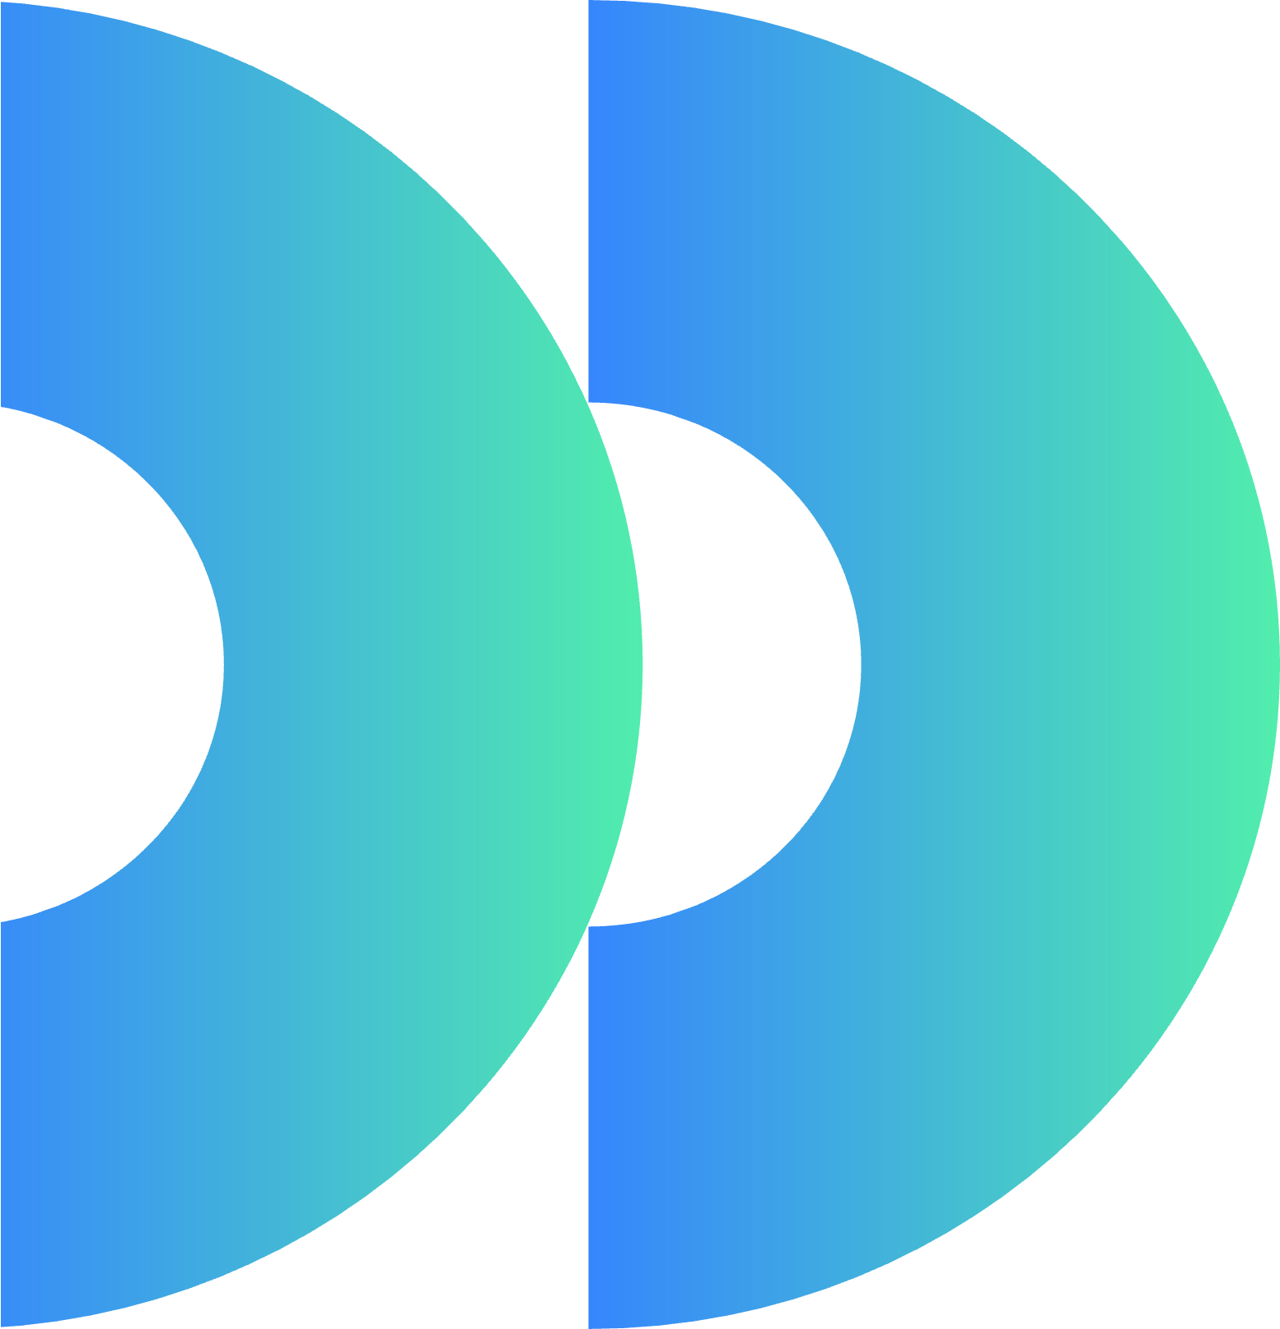
AuthentiChain
Blockchain as Disruptor in Intellectual Property
Ella Stover, Krishna Uppugunduri,Danni Ding, Sun Choi, Tyrin Boyd, Johnny Yeung

Slide 2


The Problem
no affordable or accessible way to protect IP
Intermediaries
no tamper-proof ownership record
costly and complex legal protection
No direct marketplace
Creators lose control once work is public
Protecting intellectual property is not accessible for small creators.
Notes:
ella

Slide 3

Why Is This Relevant?
More people are becoming creators
Legal IP protection affordability
Designs are easily copied and stolen online
Brands are looking for new and original designs
No simple system connects creators and buyers directly
Notes:
ella

Slide 4
AuthetiChain as a Solution
01.
02.
03.
04.
Distributed Ledger Technology
Smart Contracts
Tokenization
Tamper-Proof Records
Notes:
ella
Distributed Ledger Technology (DLT): Stores immutable records of ownership and timestamps
Smart Contracts: Automatically execute payments, royalties, and ownership transfers
Tokenization: Converts creative work into digital assets that can be bought, sold, or partially owned
Tamper-Proof Records: Ensures proof of ownership cannot be altered or disputed

Slide 5
Key Steps
01.
02.
03.
04.
05.
“Timestamping" engine:
-Artists upload work, generate a unique SHA-256 hash, and anchor it to the blockchain to prove origin.
Automate sales using Smart Licenses that instantly transfer rights and royalties when a brand buys a design.
Integrate AI Oracles that scan retail sites (Amazon/Shein). If a match is found without a corresponding hash, the system flags the theft.
Onboard major brands and expand to other IP types (music, code, manuscripts), making blockchain the new global "Patent Office" for the little guy.
Partner with "Web3-friendly" law firms to ensure blockchain certificates are court-ready. Launch the community-backed Litigation Fund
Notes:
Sun

Slide 6
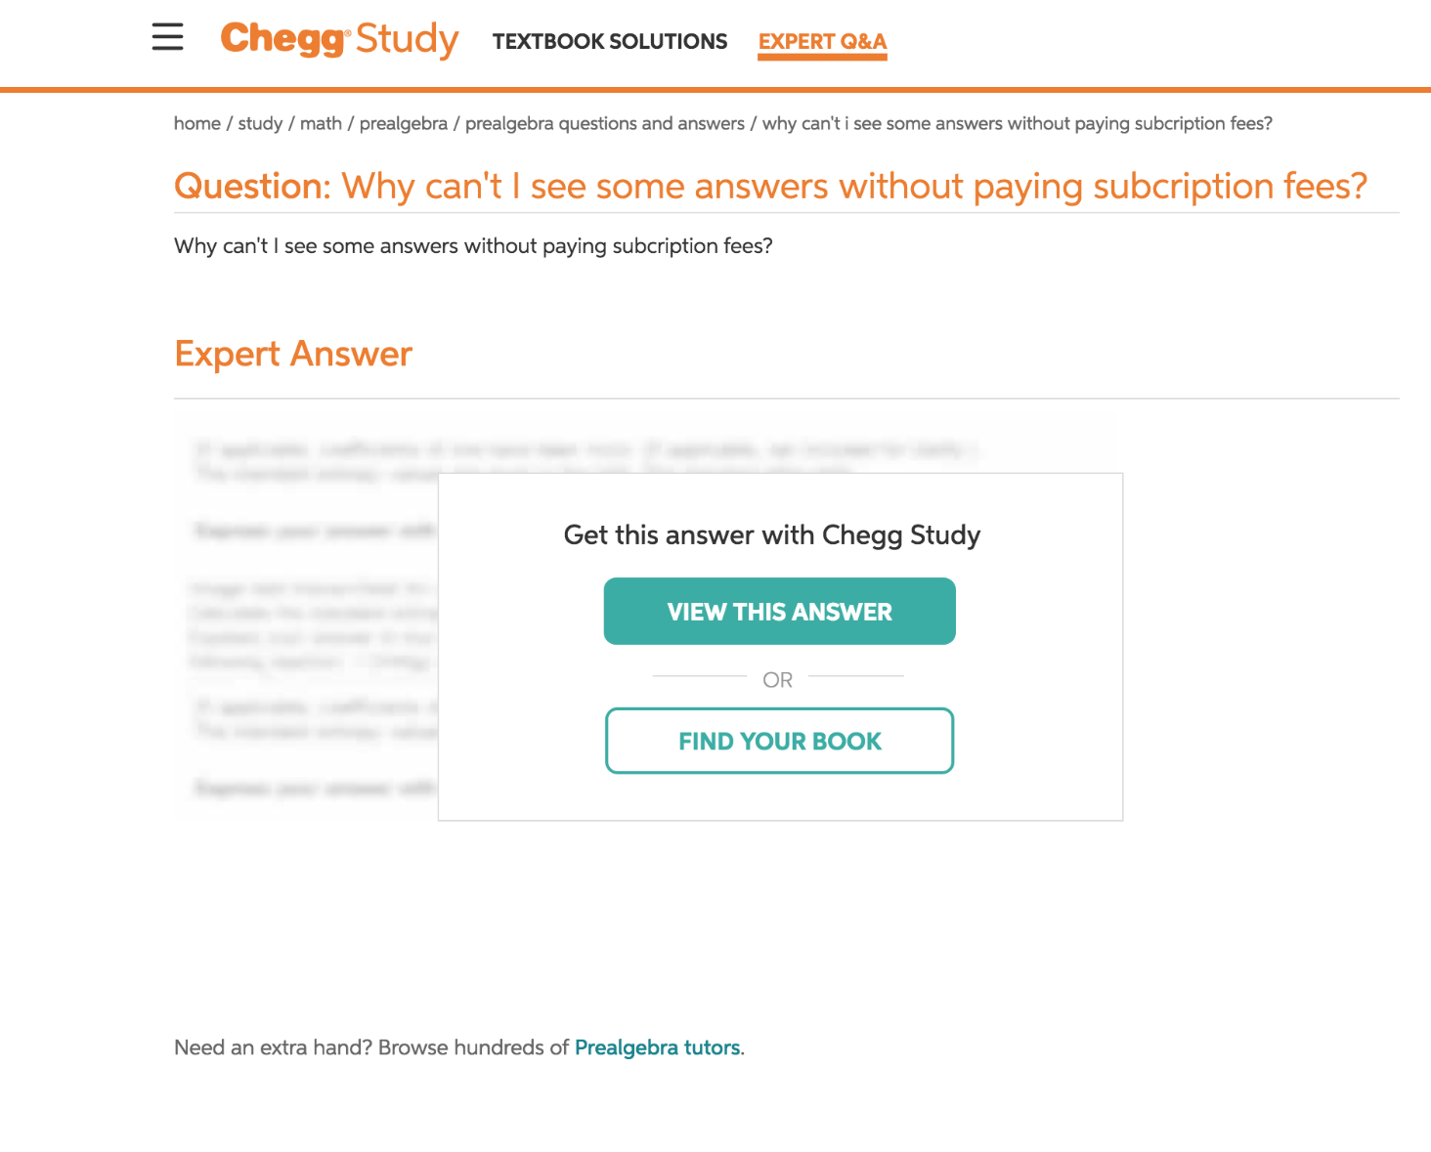
How users Interact
creators upload work
all views are traced and logged
work is partially shown like WSJ or chegg
interested client can pay to access and view the work fully
Notes:
Sun

Slide 7
Revenue Model
Storage fees (for hosting designs)
Percentage of each sale
Transaction fees for transfers
Subscription tiers (premium features, lower commissions)
Protection/legal service fees
Notes:
johnny

Slide 8

Features and Subscription
Base Features
Premium Subscription
Claim (fee percentage of value)
Protection fee
Lawsuit percentage
Recommend 2 clients a week
Buy prioritized transaction
regular transaction free
Tamper proof, sell 24/7
Lower commission fees
Connect to unlimited clients
Prioritized transactions fees lower
Enhanced Algoritm
Legal consultation access
Discounted legal services
Help with filing claims
https://www.perplexity.ai/apps/70cf57a2-2e76-4ec7-a61d-ccdee8a2658e
Notes:
Tyrin Offer coverage like:
“We cover X% of legal costs if your work is infringed”
Funded through:
Premium subscriptions
Protection fees

Slide 9

Competitors
Fiverr
US Patenet and Trademark Office
Upwork
Adobe
Notes:
User adoption and trust in blockchain- Many creators are unfamiliar with blockchain or may associate it with complexity or risk
Verifying true ownership at upload- Blockchain records are permanent, but they only verify what is entered. If someone uploads stolen work and claims ownership first, the system could validate incorrect information. This means additional verification layers (like identity checks or dispute processes) are necessary.
Legal enforcement still required off-chain- disputes still need to be resolved in courts or legal systems. The platform can provide strong evidence, but it cannot replace legal enforcement entirely. We are Not a law firm — platform provides tools, not direct legal representation, Offer optional legal support partnerships, Provide evidence (blockchain records) to strengthen cases
High competition from existing platforms
Educating users on blockchain and IP protection- Many creators don’t fully understand intellectual property rights, let alone blockchain. The platform must simplify both concepts and clearly communicate why this solution is better than existing options.
Fiverr – connects creators with clients but no IP protection
United States Patent and Trademark Office – official IP protection but costly and slow
Upwork – similar to Fiverr, focuses on jobs not ownership
Adobe – tools for creation, not ownership tracking
“Our advantage is combining protection, monetization, and direct access into one platform—something none of these competitors currently offer.”

Slide 10
Challenges
User adoption and trust in blockchain
Verifying true ownership at upload
Legal enforcement still required off-chain
High competition from existing platforms
Educating users on blockchain and IP protection
Costly
Notes:
User adoption and trust in blockchain- Many creators are unfamiliar with blockchain or may associate it with complexity or risk
Verifying true ownership at upload- Blockchain records are permanent, but they only verify what is entered. If someone uploads stolen work and claims ownership first, the system could validate incorrect information. This means additional verification layers (like identity checks or dispute processes) are necessary.
Legal enforcement still required off-chain- disputes still need to be resolved in courts or legal systems. The platform can provide strong evidence, but it cannot replace legal enforcement entirely. We are Not a law firm — platform provides tools, not direct legal representation, Offer optional legal support partnerships, Provide evidence (blockchain records) to strengthen cases
High competition from existing platforms
Educating users on blockchain and IP protection- Many creators don’t fully understand intellectual property rights, let alone blockchain. The platform must simplify both concepts and clearly communicate why this solution is better than existing options.
Fiverr – connects creators with clients but no IP protection
United States Patent and Trademark Office – official IP protection but costly and slow
Upwork – similar to Fiverr, focuses on jobs not ownership
Adobe – tools for creation, not ownership tracking
“Our advantage is combining protection, monetization, and direct access into one platform—something none of these competitors currently offer.”

Slide 11
Questions

