Slide 1

CrediChain
Blockchain for Hiring Documents
Kathleen Connolly, Luca Lo Nardo, Sebastian Munoz, Declan Townsend

Slide 2

Existing Problems
The current hiring process is slow, fragmented, and expensive.
Transcripts are retrieved from a third party, not directly from universities.
Courts maintain criminal records in different databases.
Recommendation letters can be forged and resumes can contain lies.
Candidates repeatedly submit the same sensitive documents to multiple employers.
Notes:
Personal experience/testimony here

Slide 3
Our Solution
Strategic Shift: A blockchain platform that stores verified credentials using smart contracts.
What does this involve?
Eliminating many verification steps
User-friendly interface where individuals can store their credentials
Employer access where documents can be requested
Upload ability for institutions (universities, courts, recommenders, etc.)
Notes:
Eliminating many verification steps
use example explanation

Slide 4








Without Blockchain
Applicant submits resume and documents
Employer collects documents
Employer contacts institutions/employers for verification
Manual Process, slow response
Risk of fraud, errors, delays
With Blockchain
Applicant shares verification link
Employer access blockchain
Smart contract verifies credential
Verified & trusted in seconds
Better decisions, faster hiring

Slide 5


Why Blockchain?
Blockchain transforms verification from a manual trust process into an automated trust system.
Traditional Database
Centralized control (single authority)
Data can be altered or manipulated
Requires trust in one organization
Manual, slow verification processes
CrediChain
Decentralized (no single owner)
Immutable, tamper-proof records
Shared trust across institutions
Instant, automated verification

Slide 6
Competitors
Competitive Advantage: The competition specializes in providing one specific element, ours is a one-stop shop that holds all types of relevant records.
Appii
Career History
Niche
Workwolf
Digital Passports

Slide 7
Our Vision

Slide 8






Integrate with HR/ATS systems
Expand institutional partnerships
Drive network effects across users
Secure digital credential system
User identity + document storage
Smart contract-based access control
Launch
Partner with universities and certification bodies
Onboard early employers and users
Define verification standards
Build
Scale

Slide 9
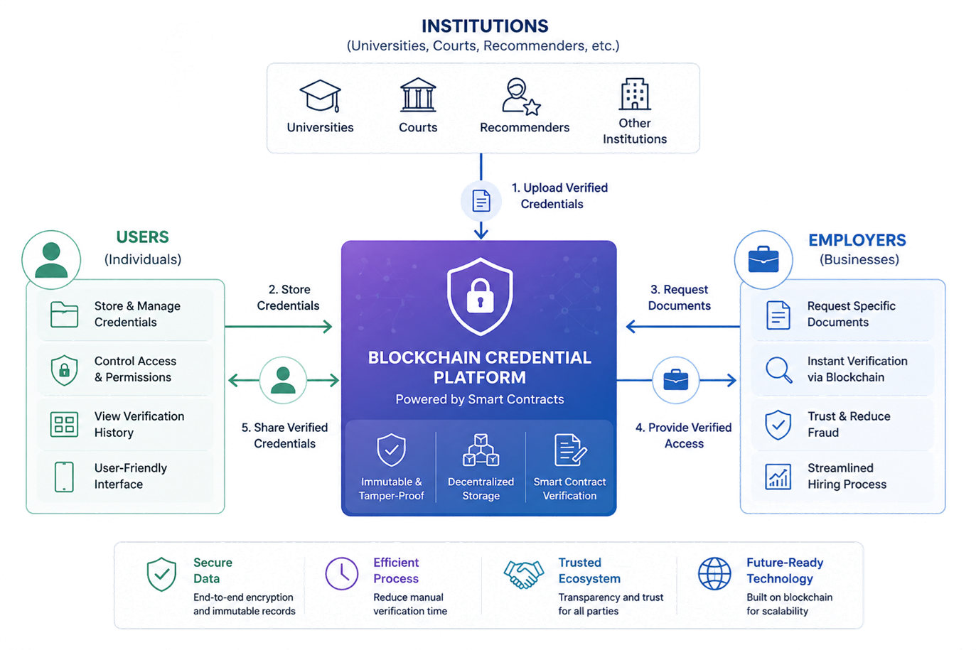
Notes:
Subscription and Transaction-Based Model
Employers: pay an annual fee for access to candidate credentials on the platform
Individuals: small transaction fee for storing, managing, and verified records
Institutions: subscription or per credential fee to issue the documentations

Slide 10

Economics
Revenue Assumptions (Pilot Year)
Employer subscription: $3000/year per firm
Verification fee: $5 per credential check
University credential issuance fee: $0.50 per record
Pilot Scenario:
25 employers x $3,000 = $75,000
10,000 verifications x $5 = $50,000
50,000 credentials x $0.50 = $25,000
Projected Revenue: $150,000
Cost Assumptions:
Platform development: $40,000
Compliance/security: $15,000
Cloud/Storage: $6,000 annually
University integration pilots: $10,000
Estimated Operating Costs: $71,000

Slide 11
Risk Assessment & Mitigation
Risk Category | What Could Go Wrong | Mitigation Strategy | Estimated Cost
Security Risk | Smart contract vulnerabilities or exploits | Third-party audits + formal code testing | $10-15k a year
Regulatory Risk | Data privacy issues, unclear credential ownership | Permissioned blockchain + legal compliance review | $10-15k a year
Adoption Risk | Universities/employers slow to adopt | Pilot program with universities first | $3-5k per institution
Network Effects Risk | Platform fails to reach critical mass | Anchor partnerships + phased rollout strategy | $5-10k (onboarding/marketing)

Slide 12
Implementation
Solidity Building Blocks
authorizeEmployer(candidate, employer)
issueCredential(candidate, credentialHash, credentialType)
verifyCredential(candidate, credentialHash)
revokeCredential(credentialx)
recordAccess(candidate, employer)
-> institution writes a verified credential to chain
-> candidate grants employer viewing permission
-> employer confirms authenticity
-> issuer invalidates outdated credentials
-> logs every time a document is viewed
Notes:
Blockchain is not storing every hiring document — it is storing proof that the document is authentic.

Slide 13
Questions

