Slide 1

Notes:
Speaker 1: Today we are going to explain a simple idea behind faster AI answers: speculative decoding. When we use a chatbot, the answer can be smart, but sometimes it still feels slow. Our goal is to explain why that happens, and how speculative decoding can make the response feel faster without changing the main quality controller.
We will keep the explanation simple. The key sentence to remember is: a small model drafts, and a large model checks.

Slide 2
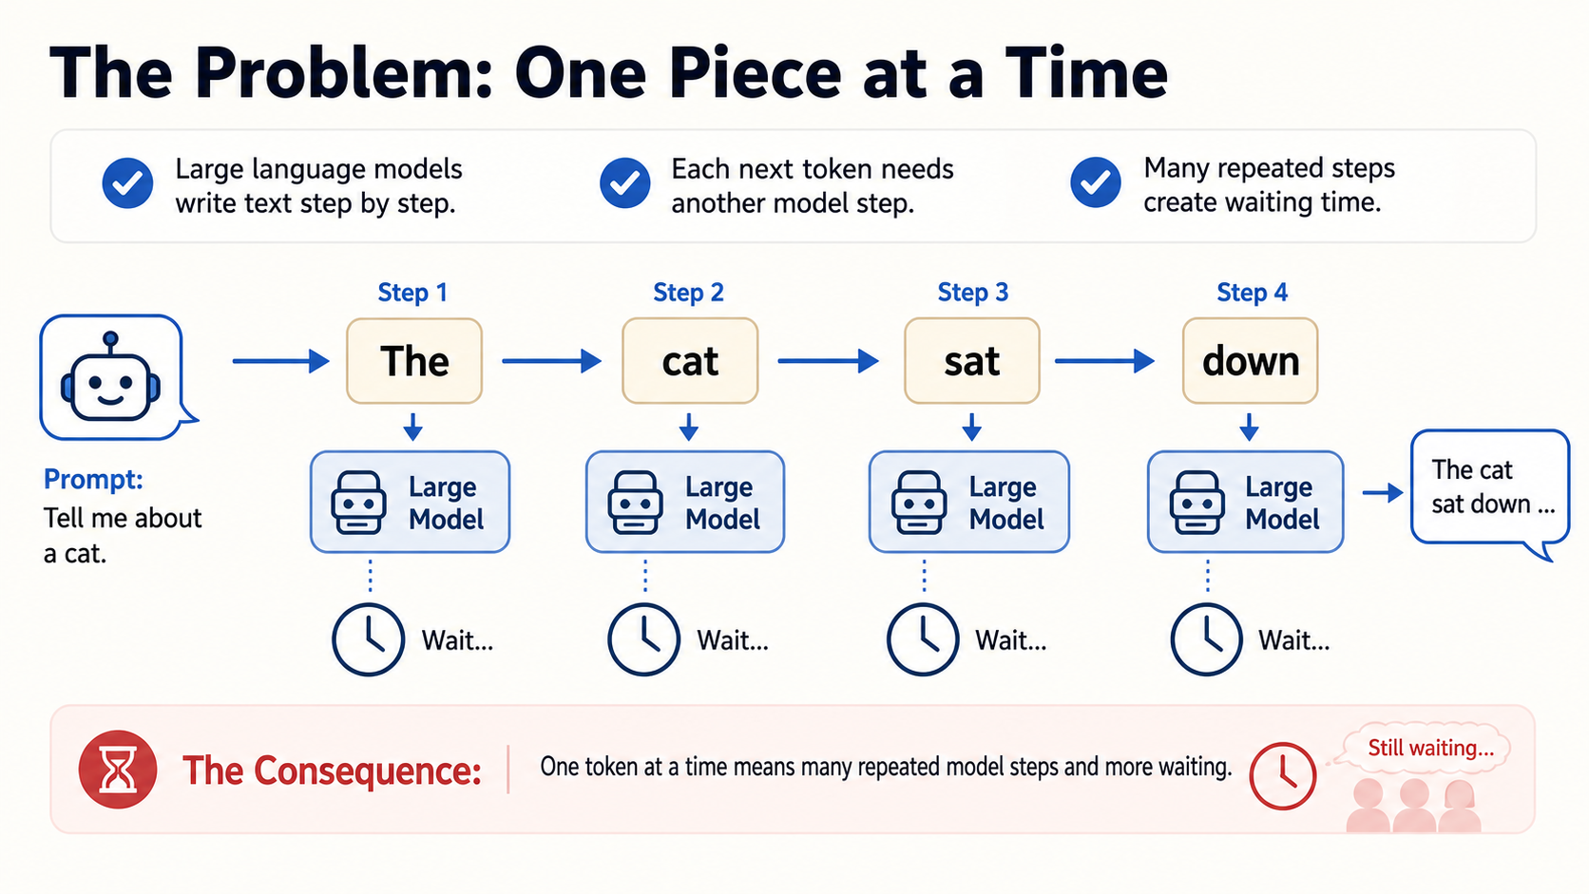
Notes:
Speaker 1: To understand the speed problem, we need one word: token. A token is a small piece of text, often a word or part of a word. A large language model usually writes by predicting one next token, then another next token, and then another.
On this slide, the sentence is built step by step: "The", "cat", "sat", "down". Each step needs the large model to run again. One step is fine, but a long answer may need many steps, so the waiting time adds up.

Slide 3
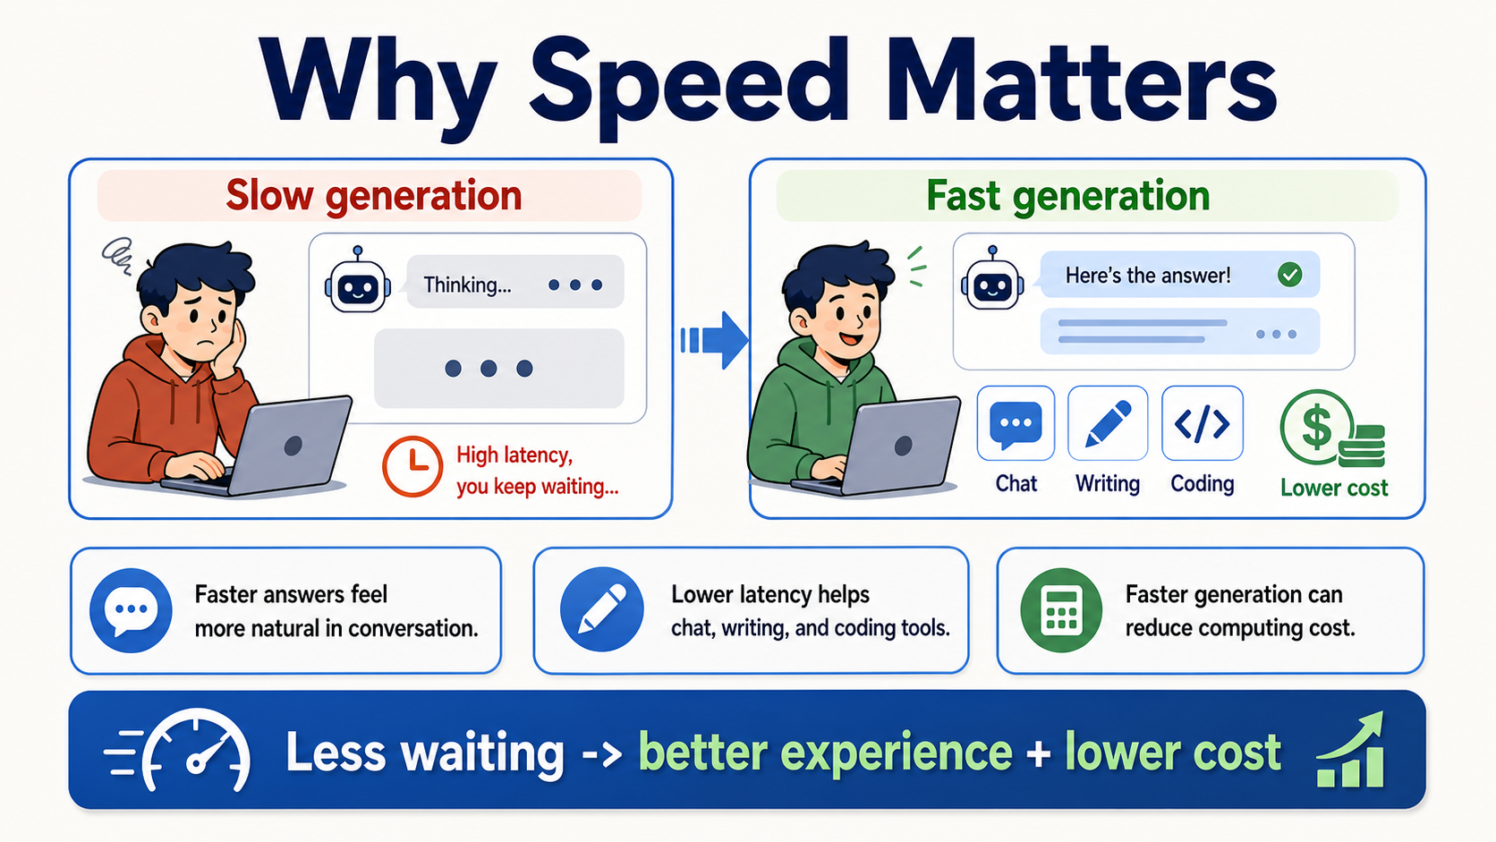
Notes:
Speaker 1: Speed matters because AI tools are interactive. In a conversation, even a short delay can make the interaction feel less natural. Faster answers make chatbots, writing tools, and coding assistants feel smoother.
There is also a practical side. If a system can produce the same quality answer with less waiting, it may also use computing resources more efficiently. So the next question is not just "Can AI be smarter?" It is also "Can the same AI answer with less delay?"

Slide 4
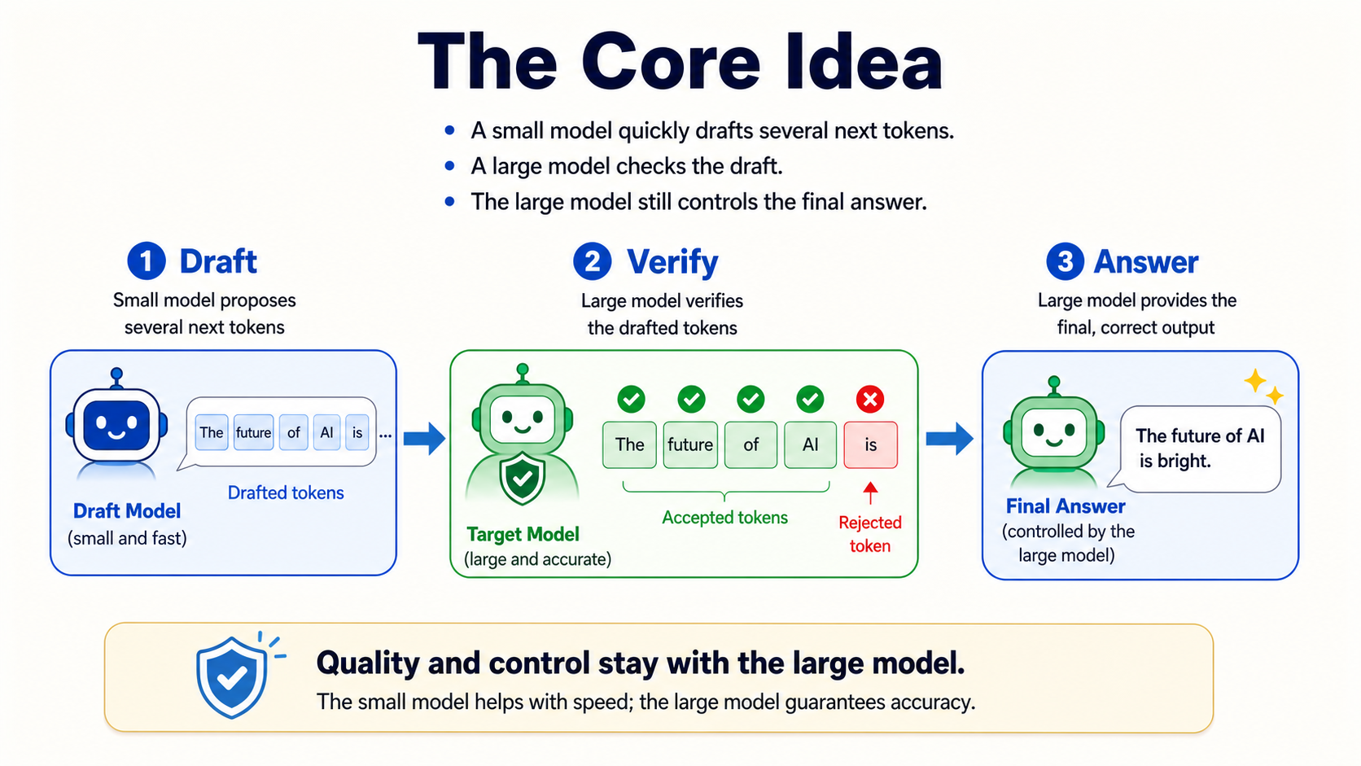
Notes:
Speaker 2: Before we go technical, let us use a simple intuition. Imagine you are writing an answer, and someone gives you a short draft first. Even if the draft is not perfect, it can still save time because you do not start from a blank page.
Speculative decoding uses the same kind of idea. A fast helper prepares a draft, and a more careful checker decides what can stay. For now, the important story is not the algorithm. It is the teamwork: draft first, check second, answer last.

Slide 5
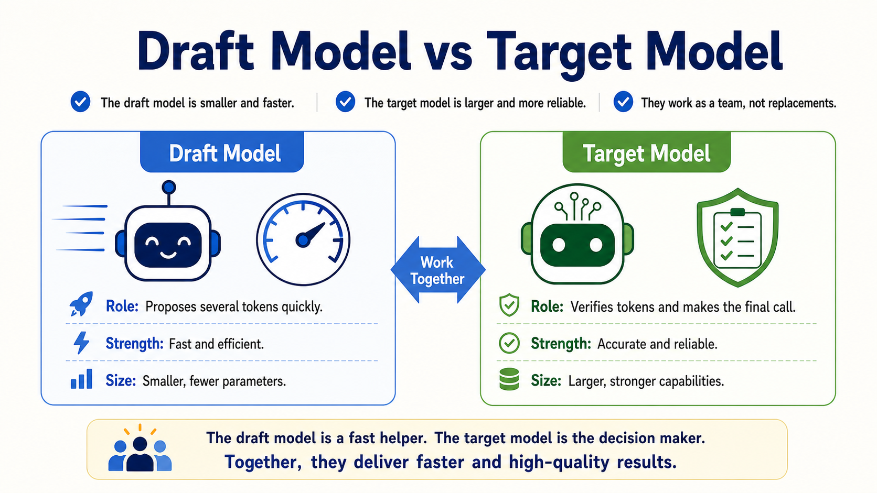
Notes:
Speaker 2: In this teamwork, the two models have different personalities. The draft model is like a fast assistant. Its strength is speed: it can prepare something quickly so the main model does not begin from zero.
The target model is like the final reviewer. It is larger, slower, and more reliable. So the small model is not replacing the large model. It is only making the large model's job easier, the same way a rough outline can make writing faster.

Slide 6
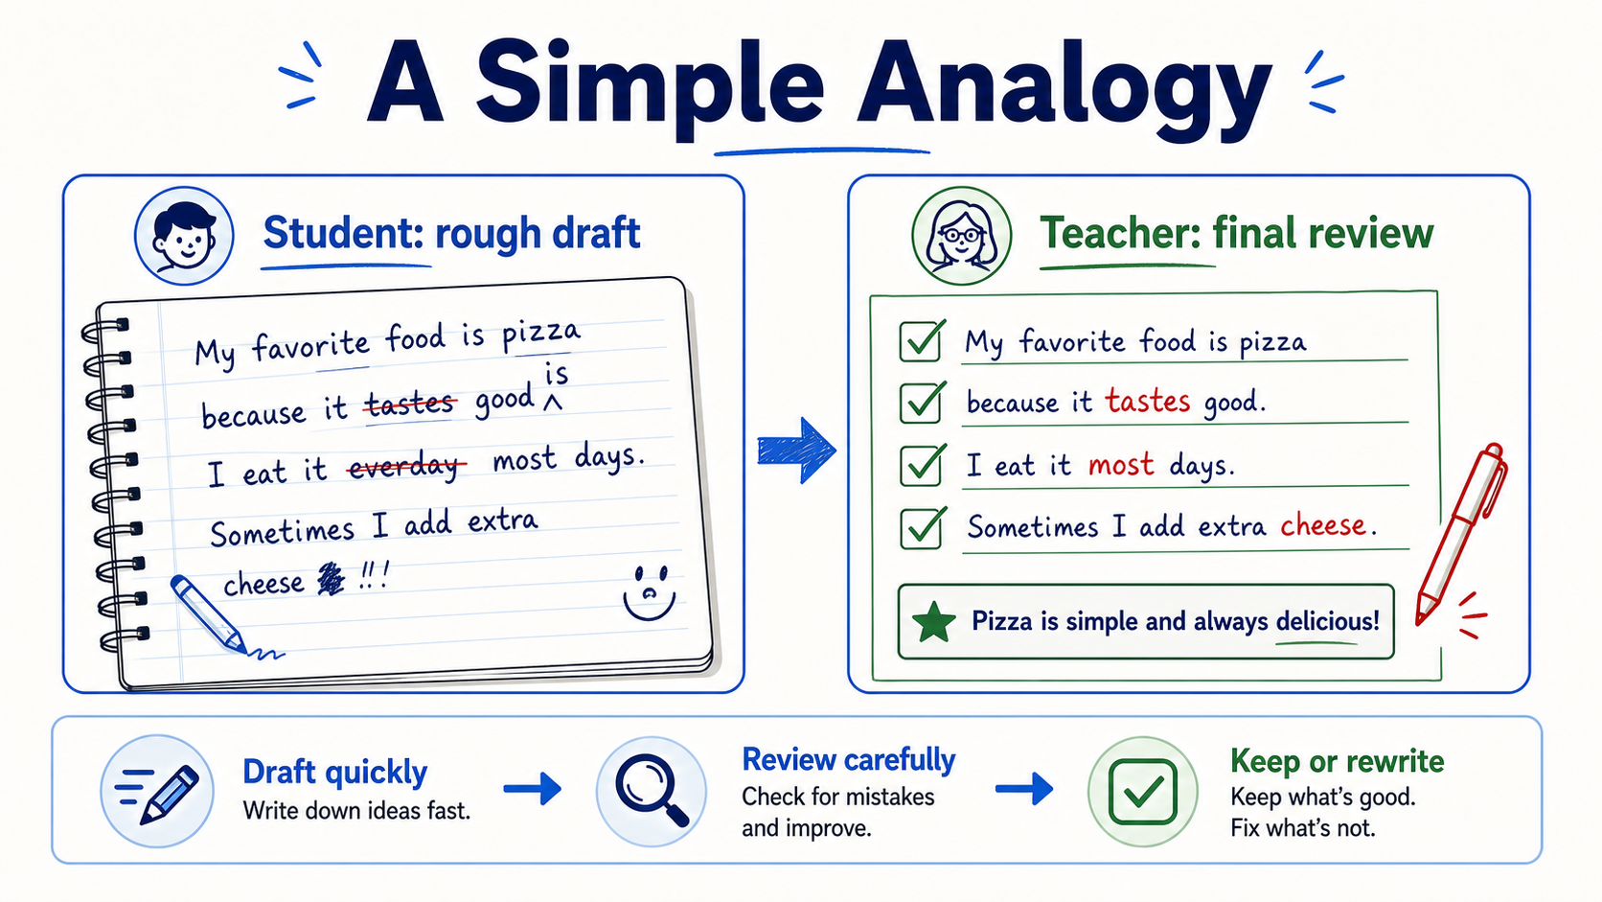
Notes:
Speaker 2: The student-and-teacher analogy makes this easy to remember. The student writes quickly, so the teacher has something to read instead of starting from an empty page.
But the teacher is still responsible for the final version. The teacher may keep useful parts, change weak parts, or rewrite a sentence. With this analogy in mind, Speaker 3 can now explain what this looks like inside text generation.

Slide 7
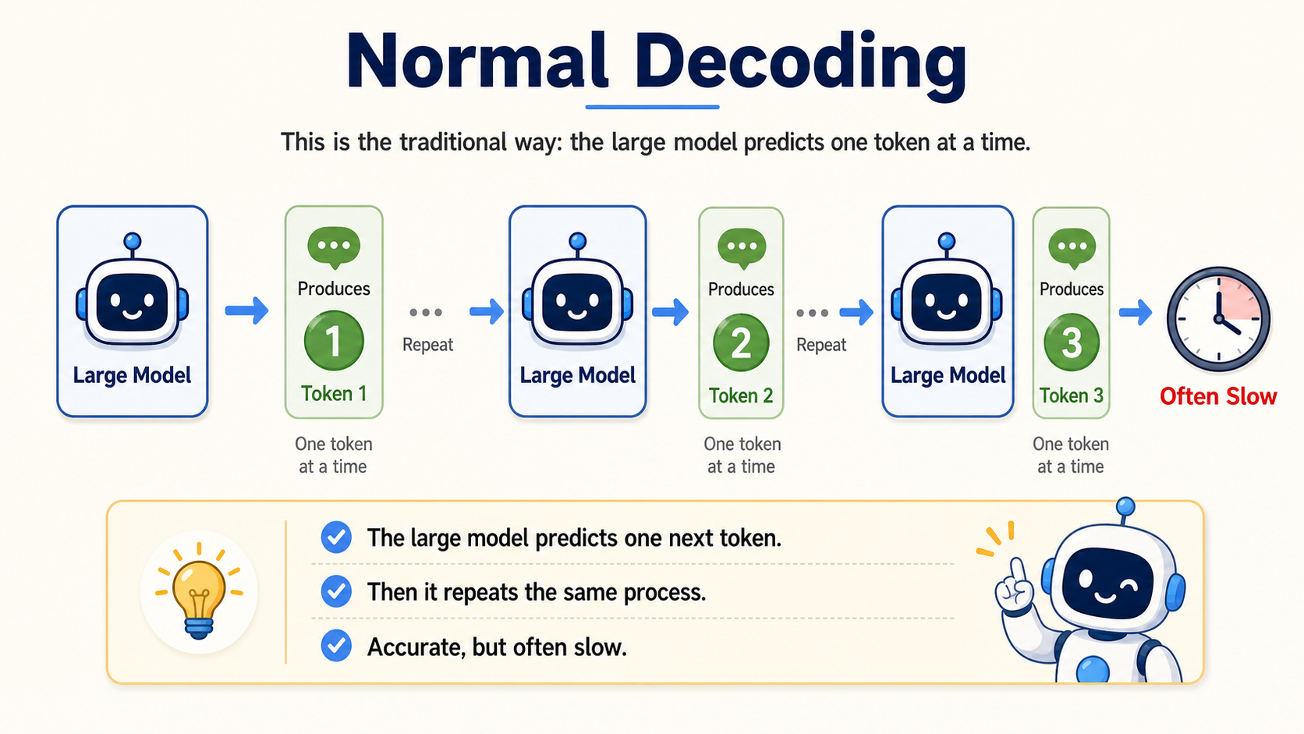
Notes:
Speaker 3: Now we can make the explanation a little more technical. A language model does not write a whole sentence at once. At each step, it computes probabilities for possible next tokens, chooses one token, and runs again.
This is called autoregressive generation. It is accurate because the target model controls every step, but it is sequential: token 2 depends on token 1, token 3 depends on token 2, and so on. That dependency chain creates latency.

Slide 8
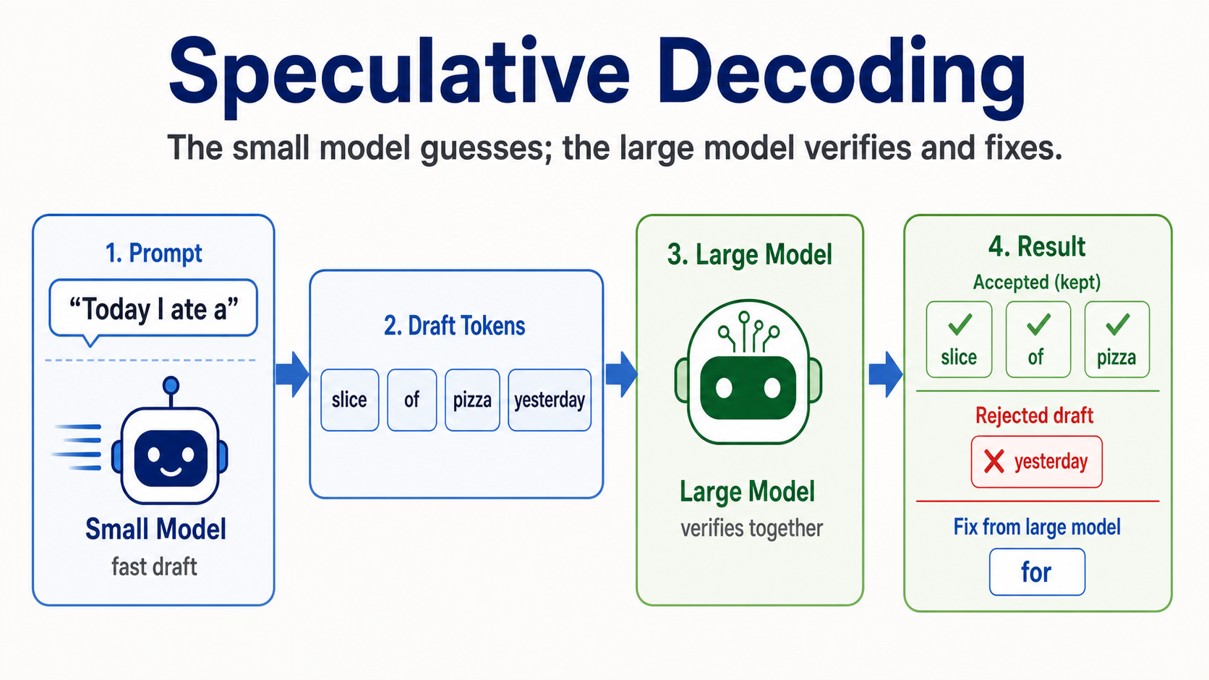
Notes:
Speaker 3: Speculative decoding reduces that sequential waiting. The draft model predicts several candidate tokens ahead of time: here, "slice", "of", "pizza", and "yesterday".
Then the target model verifies these candidates in one larger step. It accepts the longest correct prefix: "slice", "of", and "pizza". At the first wrong token, "yesterday", it rejects the draft and uses the target model's own next token, shown as "for". The speedup comes from accepting multiple draft tokens at once.

Slide 9
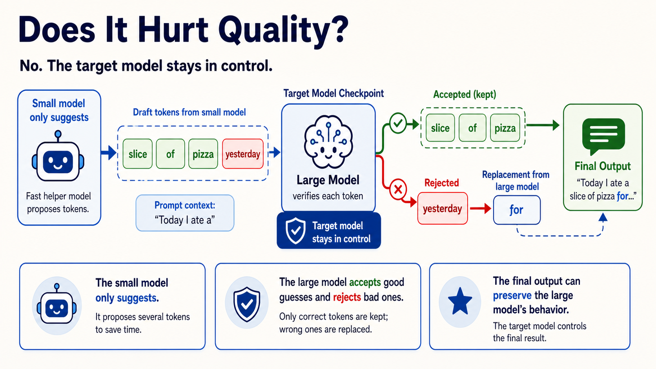
Notes:
Speaker 3: The technical concern is whether this changes output quality. In standard speculative decoding, the draft model is only a proposal model. The target model still checks the probabilities and controls which tokens are accepted.
If the draft model guesses well, we save time by accepting several tokens. If it guesses badly, the target model rejects the bad part and continues normally. That is why the method can preserve the target model's behavior while improving latency: the small model helps with speed, but it does not own the final distribution.

Slide 10
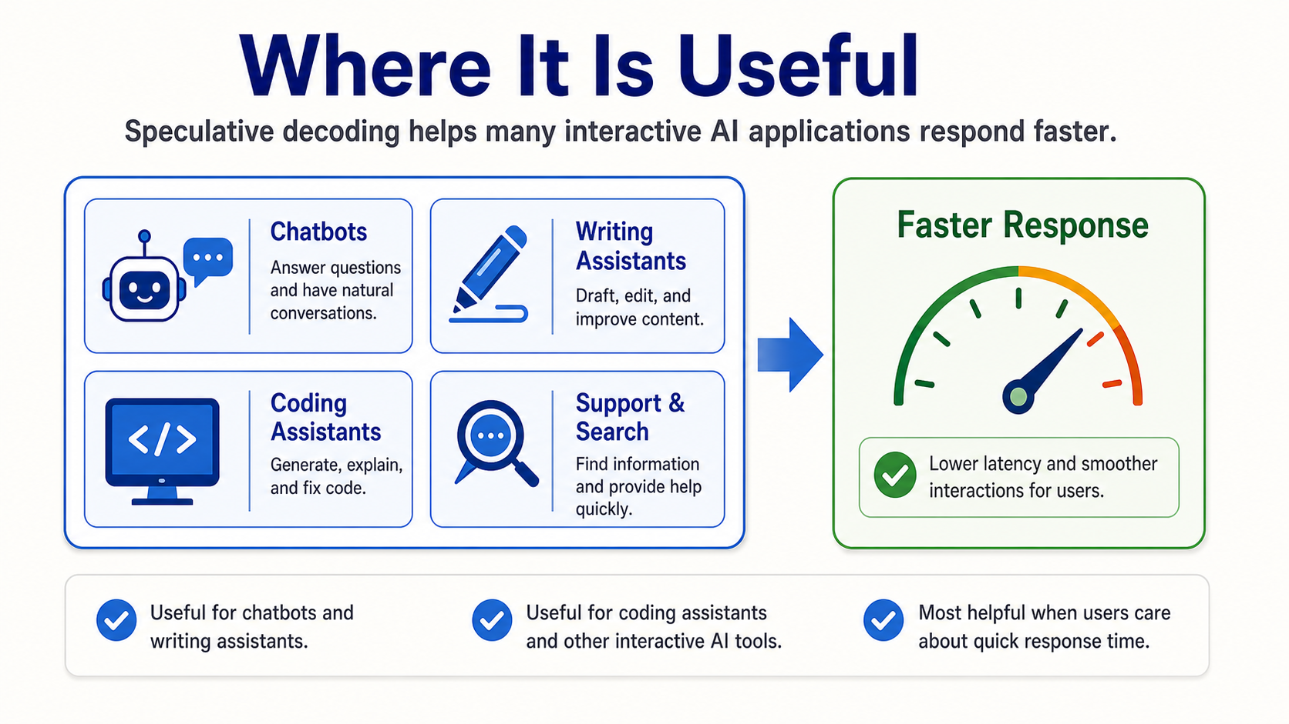
Notes:
Speaker 4: Speculative decoding is especially useful for interactive AI applications. Chatbots, writing assistants, coding assistants, and search or support tools all benefit from lower latency.
The reason is simple: users are waiting while the model generates. If the answer appears faster, the tool feels more natural and useful. This is why the idea matters outside research papers; it can improve real user-facing systems.

Slide 11
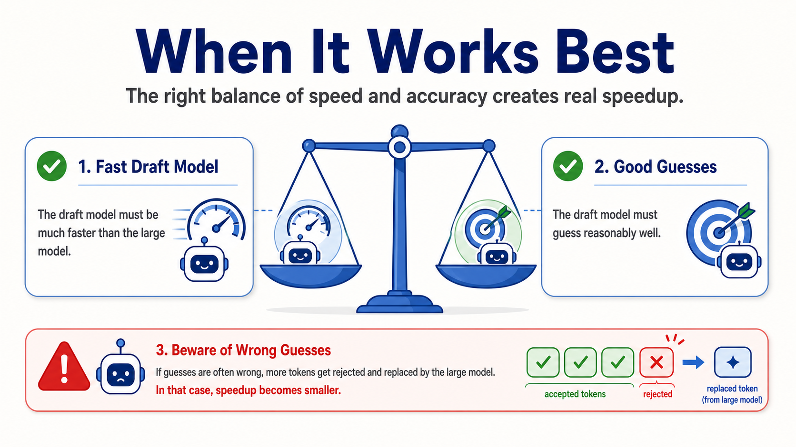
Notes:
Speaker 4: Speculative decoding is helpful, but it is not magic. It works best when two conditions are true. First, the draft model must be much faster than the large model. Second, it must guess reasonably well.
If the small model often guesses wrong, many tokens will be rejected and replaced. Then the speedup becomes smaller. So the best case is a fast helper model that is also good enough to make many useful guesses.

Slide 12
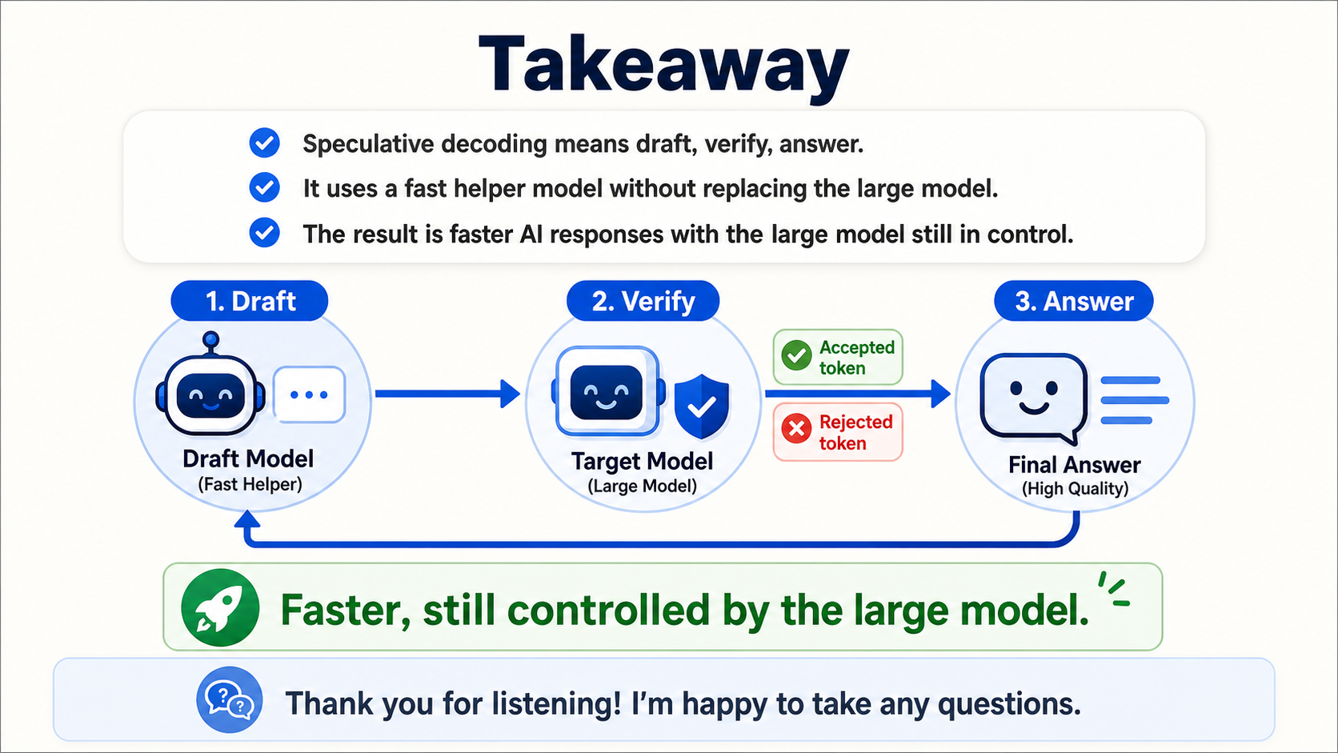
Notes:
Speaker 4: To conclude, speculative decoding can be summarized in three words: draft, verify, answer. A fast helper model drafts several tokens, and the large target model verifies them.
The small model helps with speed, but the large model stays in control. That is the main reason speculative decoding is useful: it can make AI responses faster while preserving the quality of the model we actually want to use. Thank you for listening. We are happy to take any questions.

