Slide 1
NoSQL and Big Data Processing Hbase, Hive and Pig, etc.
Adopted from slides by By Perry Hoekstra, Jiaheng Lu, Avinash Lakshman, Prashant Malik, and Jimmy Lin

Slide 2
History of the World, Part 1
Relational Databases – mainstay of business
Web-based applications caused spikes
Especially true for public-facing e-Commerce sites
Developers begin to front RDBMS with memcache or integrate other caching mechanisms within the application (ie. Ehcache)
Notes:
-> For the longest time (and still true today), the big relational database vendors such as Oracle, IBM, Sybase, and a lesser extent Microsoft were the mainstay of how data was stored.
-> During the Internet boom, startups looking for low-cost RDBMS alternatives turned to MySQL and PostgreSQL.
-> The ‘Slashdot Effect’ occurs when a popular website links to a smaller site, causing a massive increase in traffic.
-> Hooking your RDBMS to a web-based application was a recipe for headaches, they are OLTP in nature. Could have hundreds of thousands of visitors in a short-time span.
-> To mitigate, began to front the RDBMS with a read-only cache such as memcache to offload a considerable amount of the read traffic.
-> As datasets grew, the simple memcache/MySQL model (for lower-cost startups) started to become problematic.

Slide 3
Scaling Up
Issues with scaling up when the dataset is just too big
RDBMS were not designed to be distributed
Began to look at multi-node database solutions
Known as ‘scaling out’ or ‘horizontal scaling’
Different approaches include:
Master-slave
Sharding
Notes:
-> Best way to provide ACID and a rich query model is to have the dataset on a single machine.
-> However, there are limits to scaling up (Vertical Scaling).
-> Past a certain point, an organization will find it is cheaper and more feasible to scale out (horizontal scaling) by adding smaller, more inexpensive (relatively) servers rather than investing in a single larger server.
-> A number of different approaches to scaling out (Horizontal Scaling).
-> DBAs began to look at master-slave and sharding as a strategy to overcome some of these issues.

Slide 4
Scaling RDBMS – Master/Slave
Master-Slave
All writes are written to the master. All reads performed against the replicated slave databases
Critical reads may be incorrect as writes may not have been propagated down
Large data sets can pose problems as master needs to duplicate data to slaves

Slide 5
Scaling RDBMS - Sharding
Partition or sharding
Scales well for both reads and writes
Not transparent, application needs to be partition-aware
Can no longer have relationships/joins across partitions
Loss of referential integrity across shards
Notes:
-> Different sharding approaches:
-> Vertical Partitioning: Have tables related to a specific feature sit on their own server. May have to rebalance or reshard if tables outgrow server.
-> Range-Based Partitioning: When single table cannot sit on a server, split table onto multiple servers. Split table based on some critical value range.
-> Key or Hash-Based partitioning: Use a key value in a hash and use the resulting value as entry into multiple servers.
-> Directory-Based Partitioning: Have a lookup service that has knowledge of the partitioning scheme . This allows for the adding of servers or
changing the partition scheme without changing the application.
-> http://adam.heroku.com/past/2009/7/6/sql_databases_dont_scale

Slide 6
Other ways to scale RDBMS
Multi-Master replication
INSERT only, not UPDATES/DELETES
No JOINs, thereby reducing query time
This involves de-normalizing data
In-memory databases
Notes:
-> The multi-master replication system is responsible for propagating data modifications made by each member to the rest of the group, and resolving any conflicts that might arise between concurrent changes made by different members.
-> For INSERT-only, data is versioned upon update.
-> Data is never DELETED, only inactivated.
-> JOINs are expensive with large volumes and don’t work across partitions.
-> Denormalization leads to even larger databases, reduces query time.
-> Consistency is the responsibility of the application.
-> In-memory databases have not caught on mainstream and regular RDBMS are more disk-intensive that memory-intensive. Vendors looking to fix this.

Slide 7
What is NoSQL?
Stands for Not Only SQL
Class of non-relational data storage systems
Usually do not require a fixed table schema nor do they use the concept of joins
All NoSQL offerings relax one or more of the ACID properties (will talk about the CAP theorem)
Notes:
-> NoSQL was a term coined by Eric Evans. He states that ‘… but the whole point of seeking alternatives is that you need to solve a problem that relational databases are a bad fit for. …
-> This is why people are continually interpreting nosql to be anti-RDBMS, it's the only rational conclusion when the only thing some of these projects share in common is that they are not relational databases.’
-> Emil Elfrem stated it is not a ‘NO’ SQL but more of a ‘Not Only” SQL.

Slide 8
Why NoSQL?
For data storage, an RDBMS cannot be the be-all/end-all
Just as there are different programming languages, need to have other data storage tools in the toolbox
A NoSQL solution is more acceptable to a client now than even a year ago
Think about proposing a Ruby/Rails or Groovy/Grails solution now versus a couple of years ago
Notes:
-> Too often as consultants, when we talk about data storage, we immediately reach for a relational database.
-> Relational databases offer a very good general purpose solution to many different data storage needs.
-> In other words, it is the safe choice and will work in many situations.
-> Need to have some knowledge of alternatives, if nothing else to know when a NoSQL solution needs further investigation.

Slide 9
How did we get here?
Explosion of social media sites (Facebook, Twitter) with large data needs
Rise of cloud-based solutions such as Amazon S3 (simple storage solution)
Just as moving to dynamically-typed languages (Ruby/Groovy), a shift to dynamically-typed data with frequent schema changes
Open-source community
Notes:
-> However, the people with the largest datasets (terrabyte/petabyte) began to realize that sharding was putting a bandage on their issues. The more aggressive thought leaders (Google, Facebook, Twitter) began to explore alternative ways to store data. This became especially true in 2008/2009.
-> These datasets have high read/write rates.
-> With the advent of Amazon S3, a large respected vendor made the statement that maybe is was okay to look at alternative storage solutions other that relational.
-> All of the NoSQL options with the exception of Amazon S3 (Amazon Dynamo) are open-source solutions. This provides a low-cost entry point to ‘kick the tires’.

Slide 10
Dynamo and BigTable
Three major papers were the seeds of the NoSQL movement
BigTable (Google)
Dynamo (Amazon)
Gossip protocol (discovery and error detection)
Distributed key-value data store
Eventual consistency
CAP Theorem (discuss in a sec ..)
Notes:
-> BigTable: http://labs.google.com/papers/bigtable.html
-> Dynamo: http://www.allthingsdistributed.com/2007/10/amazons_dynamo.html and http://www.allthingsdistributed.com/files/amazon-dynamo-sosp2007.pdf
-> Amazon and consistency
* http://www.allthingsdistributed.com/2010/02
* http://www.allthingsdistributed.com/2008/12

Slide 11
The Perfect Storm
Large datasets, acceptance of alternatives, and dynamically-typed data has come together in a perfect storm
Not a backlash/rebellion against RDBMS
SQL is a rich query language that cannot be rivaled by the current list of NoSQL offerings
Notes:
-> So you have reached a point where a read-only cache and write-based RDBMS isn’t delivering the throughput necessary to support a particular application.
-> You need to examine alternatives and what alternatives are out there.
-> The NoSQL databases are a pragmatic response to growing scale of databases and the falling prices of commodity hardware.
-> Most likely, 10 years from now, the majority of data is still stored in RDBMS.

Slide 12
CAP Theorem
Three properties of a system: consistency, availability and partitions
You can have at most two of these three properties for any shared-data system
To scale out, you have to partition. That leaves either consistency or availability to choose from
In almost all cases, you would choose availability over consistency
Notes:
-> Proposed by Eric Brewer (talk on Principles of Distributed Computing July 2000).
-> Partitionability: divide nodes into small groups that can see other groups, but they can't see everyone. -> Consistency: write a value and then you read the value you get the same value back. In a partitioned system there are windows where that's not true. -> Availability: may not always be able to write or read. The system will say you can't write because it wants to keep the system consistent. -> To scale you have to partition, so you are left with choosing either high consistency or high availability for a particular system. You must find the right
overlap of availability and consistency.
-> Choose a specific approach based on the needs of the service. -> For the checkout process you always want to honor requests to add items to a shopping cart because it's revenue producing.
In this case you choose high availability. Errors are hidden from the customer and sorted out later. -> When a customer submits an order you favor consistency because several services--credit card processing, shipping and handling, reporting—
are simultaneously accessing the data.

Slide 13
The CAP Theorem
Availability
Consistency
Partition tolerance
Notes:
13
PODC:ACM Symposium on Principles of Distributed Computing(PODC)International Conference

Slide 14
The CAP Theorem
Once a writer has written, all readers will see that write
Availability
Consistency
Partition tolerance

Slide 15
Consistency
Two kinds of consistency:
strong consistency – ACID(Atomicity Consistency Isolation Durability)
weak consistency – BASE(Basically Available Soft-state Eventual consistency )
Notes:
Cluster里面至少有一个replica是最新的，其他的replica最终会达到一致

Slide 16
ACID Transactions
A DBMS is expected to support “ACID transactions,” processes that are:
Atomic : Either the whole process is done or none is.
Consistent : Database constraints are preserved.
Isolated : It appears to the user as if only one process executes at a time.
Durable : Effects of a process do not get lost if the system crashes.

Slide 17
Atomicity
A real-world event either happens or does not happen
Student either registers or does not register
Similarly, the system must ensure that either the corresponding transaction runs to completion or, if not, it has no effect at all
Not true of ordinary programs. A crash could leave files partially updated on recovery

Slide 18
Commit and Abort
If the transaction successfully completes it is said to commit
The system is responsible for ensuring that all changes to the database have been saved
If the transaction does not successfully complete, it is said to abort
The system is responsible for undoing, or rolling back, all changes the transaction has made

Slide 19
Database Consistency
Enterprise (Business) Rules limit the occurrence of certain real-world events
Student cannot register for a course if the current number of registrants equals the maximum allowed
Correspondingly, allowable database states are restricted
cur_reg <= max_reg
These limitations are called (static) integrity constraints: assertions that must be satisfied by all database states (state invariants).

Slide 20
Database Consistency (state invariants)
Other static consistency requirements are related to the fact that the database might store the same information in different ways
cur_reg = |list_of_registered_students|
Such limitations are also expressed as integrity constraints
Database is consistent if all static integrity constraints are satisfied

Slide 21
Transaction Consistency
A consistent database state does not necessarily model the actual state of the enterprise
A deposit transaction that increments the balance by the wrong amount maintains the integrity constraint balance ≥ 0, but does not maintain the relation between the enterprise and database states
A consistent transaction maintains database consistency and the correspondence between the database state and the enterprise state (implements its specification)
Specification of deposit transaction includes balance′ = balance + amt_deposit , (balance′ is the next value of balance)

Slide 22
Dynamic Integrity Constraints (transition invariants)
Some constraints restrict allowable state transitions
A transaction might transform the database from one consistent state to another, but the transition might not be permissible
Example: A letter grade in a course (A, B, C, D, F) cannot be changed to an incomplete (I)
Dynamic constraints cannot be checked by examining the database state

Slide 23
Transaction Consistency
Consistent transaction: if DB is in consistent state initially, when the transaction completes:
All static integrity constraints are satisfied (but constraints might be violated in intermediate states)
Can be checked by examining snapshot of database
New state satisfies specifications of transaction
Cannot be checked from database snapshot
No dynamic constraints have been violated
Cannot be checked from database snapshot

Slide 24
Isolation
Serial Execution: transactions execute in sequence
Each one starts after the previous one completes.
Execution of one transaction is not affected by the operations of another since they do not overlap in time
The execution of each transaction is isolated from all others.
If the initial database state and all transactions are consistent, then the final database state will be consistent and will accurately reflect the real-world state, but
Serial execution is inadequate from a performance perspective

Slide 25
Isolation
Concurrent execution offers performance benefits:
A computer system has multiple resources capable of executing independently (e.g., cpu’s, I/O devices), but
A transaction typically uses only one resource at a time
Hence, only concurrently executing transactions can make effective use of the system
Concurrently executing transactions yield interleaved schedules

Slide 26
Concurrent Execution
begin trans
..
op_{1,1}
..
op_{1,2}
..
commit
sequence of db
operations output by T₁
T₁
op_{1,1} op_{1.2}
local computation
DBMS
op_{1,1} op_{2,1} op_{2.2} op_{1.2}
T₂
op_{2,1} op_{2.2}
interleaved sequence of db
operations input to DBMS
local variables

Slide 27
Durability
The system must ensure that once a transaction commits, its effect on the database state is not lost in spite of subsequent failures
Not true of ordinary programs. A media failure after a program successfully terminates could cause the file system to be restored to a state that preceded the program’s execution

Slide 28
Implementing Durability
Database stored redundantly on mass storage devices to protect against media failure
Architecture of mass storage devices affects type of media failures that can be tolerated
Related to Availability: extent to which a (possibly distributed) system can provide service despite failure
Non-stop DBMS (mirrored disks)
Recovery based DBMS (log)

Slide 29
Consistency Model
A consistency model determines rules for visibility and apparent order of updates.
For example:
Row X is replicated on nodes M and N
Client A writes row X to node N
Some period of time t elapses.
Client B reads row X from node M
Does client B see the write from client A?
Consistency is a continuum with tradeoffs
For NoSQL, the answer would be: maybe
CAP Theorem states: Strict Consistency can't be achieved at the same time as availability and partition-tolerance.
Notes:
-> http://cloudera-todd.s3.amazonaws.com/nosql.pdf

Slide 30
Eventual Consistency
When no updates occur for a long period of time, eventually all updates will propagate through the system and all the nodes will be consistent
For a given accepted update and a given node, eventually either the update reaches the node or the node is removed from service
Known as BASE (Basically Available, Soft state, Eventual consistency), as opposed to ACID
Notes:
-> http://en.wikipedia.org/wiki/Eventual_consistency
-> http://www.allthingsdistributed.com/2008/12/eventually_consistent.html
The types of large systems based on CAP aren't ACID they are BASE (http://queue.acm.org/detail.cfm?id=1394128): * Basically Available - system seems to work all the time * Soft State - it doesn't have to be consistent all the time * Eventually Consistent - becomes consistent at some later time
Everyone who builds big applications builds them on CAP and BASE: Google, Yahoo, Facebook, Amazon, eBay, etc

Slide 31
The CAP Theorem
System is available during software and hardware upgrades and node failures.
Availability
Consistency
Partition tolerance

Slide 32
Availability
Traditionally, thought of as the server/process available five 9’s (99.999 %).
However, for large node system, at almost any point in time there’s a good chance that a node is either down or there is a network disruption among the nodes.
Want a system that is resilient in the face of network disruption

Slide 33
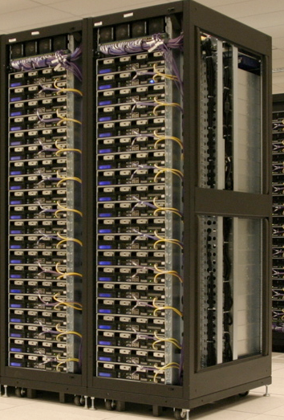
The CAP Theorem
A system can continue to operate in the presence of a network partitions.
Availability
Consistency
Partition tolerance

Slide 34
The CAP Theorem
Theorem: You can have at most two of these properties for any shared-data system
Availability
Consistency
Partition tolerance

Slide 35
What kinds of NoSQL
NoSQL solutions fall into two major areas:
Key/Value or ‘the big hash table’.
Amazon S3 (Dynamo)
Voldemort
Scalaris
Memcached (in-memory key/value store)
Redis
Schema-less which comes in multiple flavors, column-based, document-based or graph-based.
Cassandra (column-based)
CouchDB (document-based)
MongoDB(document-based)
Neo4J (graph-based)
HBase (column-based)
Notes:
-> Not an exhaustive list, just some of the more well-known.
-> HBase is the data storage solution for Hadoop.
-> Graph: is a network database that uses edges and nodes to represent and store data.
-> Document: views are stored as rows which are kept sorted by key. Can adapt to variations in document structure.

Slide 36
Key/Value
Pros:
very fast
very scalable
simple model
able to distribute horizontally
Cons:
- many data structures (objects) can't be easily modeled as key value pairs
Notes:
-> http://chariotsolutions.blogspot.com/2010/01/why-you-need-nosql-in-your-toolbox.html

Slide 37
Schema-Less
Pros:
- Schema-less data model is richer than key/value pairs
eventual consistency
many are distributed
still provide excellent performance and scalability
Cons:
- typically no ACID transactions or joins

Slide 38
Common Advantages
Cheap, easy to implement (open source)
Data are replicated to multiple nodes (therefore identical and fault-tolerant) and can be partitioned
Down nodes easily replaced
No single point of failure
Easy to distribute
Don't require a schema
Can scale up and down
Relax the data consistency requirement (CAP)
Notes:
-> As the data is written, the latest version is on at least one node. The data is then versioned/replicated to other nodes within the system.
-> Eventually, the same version is on all nodes.

Slide 39
What am I giving up?
joins
group by
order by
ACID transactions
SQL as a sometimes frustrating but still powerful query language
easy integration with other applications that support SQL
Notes:
-> No JDBC
-> Data integrity at the application layer

Slide 40
Big Table and Hbase (C+P)
Notes:
HBase is strongly consistent. Each row is hosted by a single region server at a time, and a combination of row locks and multiversion concurrency control is used to provide consistency within a row. During failover, we take care to not allow writes from a new regionserver until the previous one has been blocked out. There are currently a couple of rare bugs where this doesn't work quite right (see HBASE-2231 for example) but they are all blockers for the next release. Replication is taken care of at the HDFS layer. In the next release of HBase it will also be completely durable - no edit will be acked to the client until it has been flushed to three HDFS replicas.

Slide 41
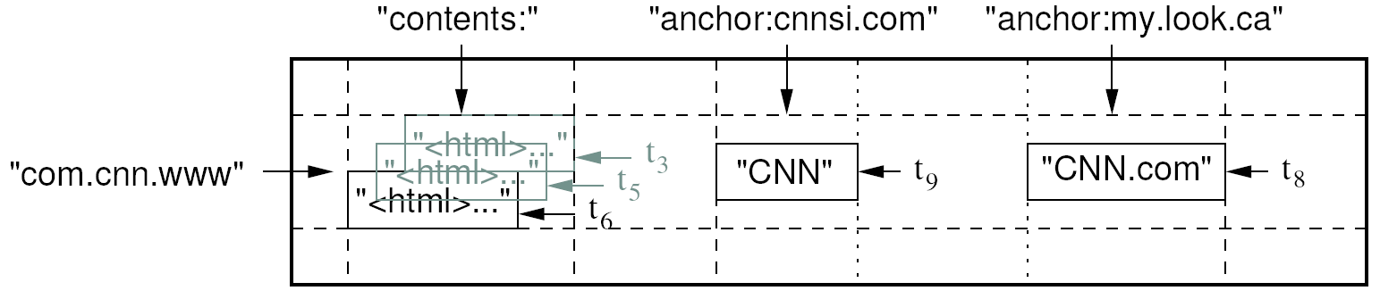
Data Model
A table in Bigtable is a sparse, distributed, persistent multidimensional sorted map
Map indexed by a row key, column key, and a timestamp
(row:string, column:string, time:int64) → uninterpreted byte array
Supports lookups, inserts, deletes
Single row transactions only
Image Source: Chang et al., OSDI 2006

Slide 42
Rows and Columns
Rows maintained in sorted lexicographic order
Applications can exploit this property for efficient row scans
Row ranges dynamically partitioned into tablets
Columns grouped into column families
Column key = family:qualifier
Column families provide locality hints
Unbounded number of columns

Slide 43
Bigtable Building Blocks
GFS
Chubby
SSTable

Slide 44
SSTable
Basic building block of Bigtable
Persistent, ordered immutable map from keys to values
Stored in GFS
Sequence of blocks on disk plus an index for block lookup
Can be completely mapped into memory
Supported operations:
Look up value associated with key
Iterate key/value pairs within a key range
64K block
64K block
64K block
SSTable
Index
Source: Graphic from slides by Erik Paulson

Slide 45
Tablet
Dynamically partitioned range of rows
Built from multiple SSTables
Tablet
Start:aardvark
End:apple
64K block
64K block
64K block
SSTable
64K block
64K block
64K block
SSTable
Index
Index
Source: Graphic from slides by Erik Paulson

Slide 46
Table
Multiple tablets make up the table
SSTables can be shared
Tablet
Tablet
aardvark
apple
apple_two_E
boat
SSTable
SSTable
SSTable
SSTable
Source: Graphic from slides by Erik Paulson

Slide 47
Architecture
Client library
Single master server
Tablet servers

Slide 48
Bigtable Master
Assigns tablets to tablet servers
Detects addition and expiration of tablet servers
Balances tablet server load
Handles garbage collection
Handles schema changes

Slide 49
Bigtable Tablet Servers
Each tablet server manages a set of tablets
Typically between ten to a thousand tablets
Each 100-200 MB by default
Handles read and write requests to the tablets
Splits tablets that have grown too large

Slide 50
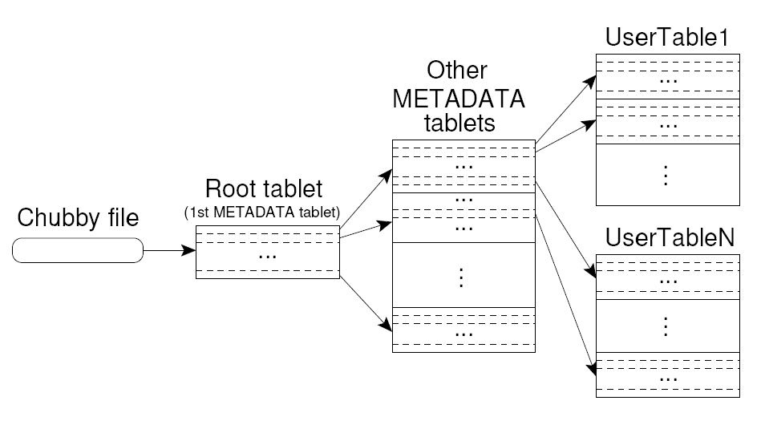
Tablet Location
Upon discovery, clients cache tablet locations
Image Source: Chang et al., OSDI 2006

Slide 51
Tablet Assignment
Master keeps track of:
Set of live tablet servers
Assignment of tablets to tablet servers
Unassigned tablets
Each tablet is assigned to one tablet server at a time
Tablet server maintains an exclusive lock on a file in Chubby
Master monitors tablet servers and handles assignment
Changes to tablet structure
Table creation/deletion (master initiated)
Tablet merging (master initiated)
Tablet splitting (tablet server initiated)

Slide 52
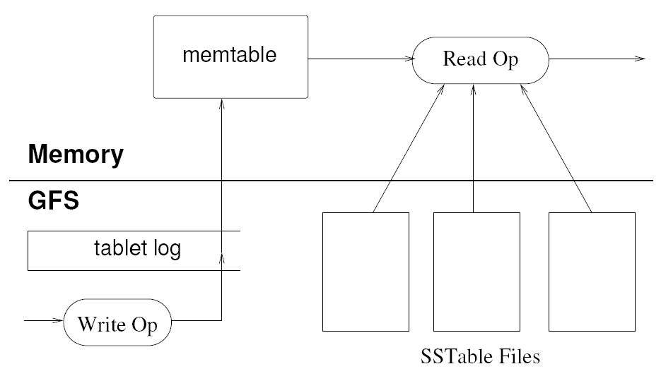
Tablet Serving
“Log Structured Merge Trees”
Image Source: Chang et al., OSDI 2006

Slide 53
Compactions
Minor compaction
Converts the memtable into an SSTable
Reduces memory usage and log traffic on restart
Merging compaction
Reads the contents of a few SSTables and the memtable, and writes out a new SSTable
Reduces number of SSTables
Major compaction
Merging compaction that results in only one SSTable
No deletion records, only live data

Slide 54
Bigtable Applications
Data source and data sink for MapReduce
Google’s web crawl
Google Earth
Google Analytics

Slide 55
Lessons Learned
Fault tolerance is hard
Don’t add functionality before understanding its use
Single-row transactions appear to be sufficient
Keep it simple!

Slide 56
HBase is an open-source, distributed, column-oriented database built on top of HDFS based on BigTable!

Slide 57
HBase is ..
A distributed data store that can scale horizontally to 1,000s of commodity servers and petabytes of indexed storage.
Designed to operate on top of the Hadoop distributed file system (HDFS) or Kosmos File System (KFS, aka Cloudstore) for scalability, fault tolerance, and high availability.

Slide 58
Benefits
Distributed storage
Table-like in data structure
multi-dimensional map
High scalability
High availability
High performance

Slide 59
Backdrop
Started toward by Chad Walters and Jim
2006.11
Google releases paper on BigTable
2007.2
Initial HBase prototype created as Hadoop contrib.
2007.10
First useable HBase
2008.1
Hadoop become Apache top-level project and HBase becomes subproject
2008.10~
HBase 0.18, 0.19 released

Slide 60
HBase Is Not …
Tables have one primary index, the row key.
No join operators.
Scans and queries can select a subset of available columns, perhaps by using a wildcard.
There are three types of lookups:
Fast lookup using row key and optional timestamp.
Full table scan
Range scan from region start to end.

Slide 61
HBase Is Not …(2)
Limited atomicity and transaction support.
HBase supports multiple batched mutations of single rows only.
Data is unstructured and untyped.
No accessed or manipulated via SQL.
Programmatic access via Java, REST, or Thrift APIs.
Scripting via JRuby.

Slide 62
Why Bigtable?
Performance of RDBMS system is good for transaction processing but for very large scale analytic processing, the solutions are commercial, expensive, and specialized.
Very large scale analytic processing
Big queries – typically range or table scans.
Big databases (100s of TB)

Slide 63
Why Bigtable? (2)
Map reduce on Bigtable with optionally Cascading on top to support some relational algebras may be a cost effective solution.
Sharding is not a solution to scale open source RDBMS platforms
Application specific
Labor intensive (re)partitionaing

Slide 64
Why HBase ?
HBase is a Bigtable clone.
It is open source
It has a good community and promise for the future
It is developed on top of and has good integration for the Hadoop platform, if you are using Hadoop already.
It has a Cascading connector.

Slide 65
HBase benefits than RDBMS
No real indexes
Automatic partitioning
Scale linearly and automatically with new nodes
Commodity hardware
Fault tolerance
Batch processing

Slide 66
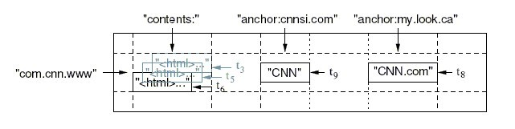
Data Model
Tables are sorted by Row
Table schema only define it’s column families .
Each family consists of any number of columns
Each column consists of any number of versions
Columns only exist when inserted, NULLs are free.
Columns within a family are sorted and stored together
Everything except table names are byte[]
(Row, Family: Column, Timestamp) → Value
Column Family
Row key
TimeStamp
value

Slide 67
Members
Master
Responsible for monitoring region servers
Load balancing for regions
Redirect client to correct region servers
The current SPOF
regionserver slaves
Serving requests(Write/Read/Scan) of Client
Send HeartBeat to Master
Throughput and Region numbers are scalable by region servers

Slide 68
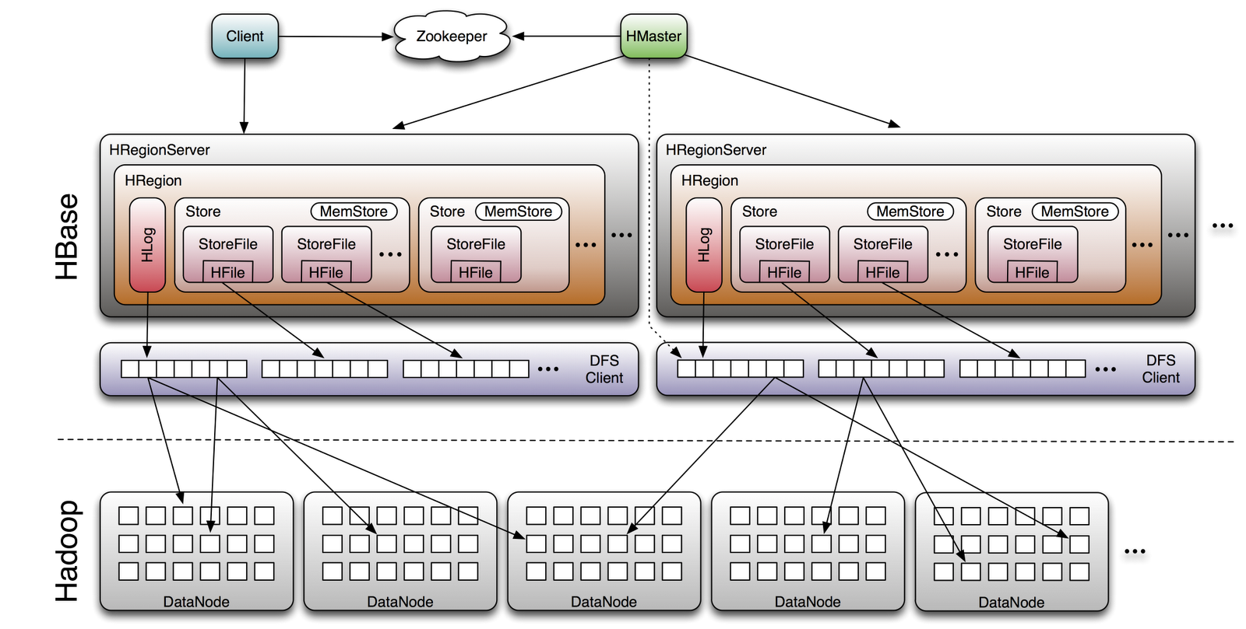
Architecture

Slide 69
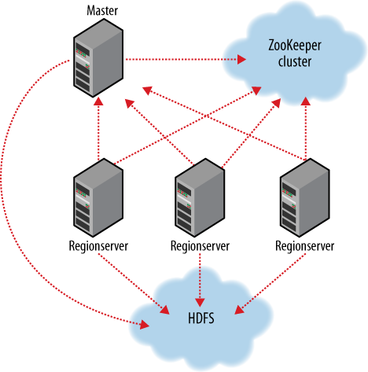
ZooKeeper
HBase depends on ZooKeeper and by default it manages a ZooKeeper instance as the authority on cluster state

Slide 70
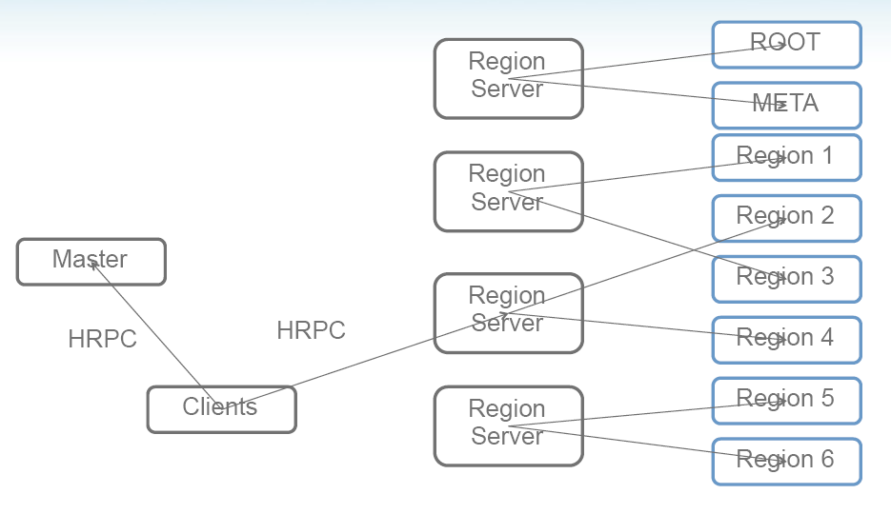
Operation
The -ROOT- table holds the list of .META. table regions
The .META. table holds the list of all user-space regions.

Slide 71
Installation (1)
START Hadoop…
$ wget http://ftp.twaren.net/Unix/Web/apache/hadoop/hbase/hbase-0.20.2/hbase-0.20.2.tar.gz $ sudo tar -zxvf hbase-*.tar.gz -C /opt/ $ sudo ln -sf /opt/hbase-0.20.2 /opt/hbase $ sudo chown -R $USER:$USER /opt/hbase
$ sudo mkdir /var/hadoop/
$ sudo chmod 777 /var/hadoop

Slide 72
Setup (1)
$ vim /opt/hbase/conf/hbase-env.sh
export JAVA_HOME=/usr/lib/jvm/java-6-sun export HADOOP_CONF_DIR=/opt/hadoop/conf export HBASE_HOME=/opt/hbase export HBASE_LOG_DIR=/var/hadoop/hbase-logs export HBASE_PID_DIR=/var/hadoop/hbase-pids export HBASE_MANAGES_ZK=true export HBASE_CLASSPATH=$HBASE_CLASSPATH:/opt/hadoop/conf
$ cd /opt/hbase/conf $ cp /opt/hadoop/conf/core-site.xml ./ $ cp /opt/hadoop/conf/hdfs-site.xml ./ $ cp /opt/hadoop/conf/mapred-site.xml ./

Slide 73
Setup (2)
<configuration> <property> <name> name </name> <value> value </value> </property>
</configuration>
Name | value
hbase.rootdir | hdfs://secuse.nchc.org.tw:9000/hbase
hbase.tmp.dir | /var/hadoop/hbase-${user.name}
hbase.cluster.distributed | true
hbase.zookeeper.property.clientPort | 2222
hbase.zookeeper.quorum | Host1, Host2
hbase.zookeeper.property.dataDir | /var/hadoop/hbase-data

Slide 74
Startup & Stop
$ start-hbase.sh
$ stop-hbase.sh

Slide 75
Testing (4)
$ hbase shell
> create 'test', 'data'
0 row(s) in 4.3066 seconds
> list
test
1 row(s) in 0.1485 seconds
> put 'test', 'row1', 'data:1', 'value1'
0 row(s) in 0.0454 seconds
> put 'test', 'row2', 'data:2', 'value2'
0 row(s) in 0.0035 seconds
> put 'test', 'row3', 'data:3', 'value3'
0 row(s) in 0.0090 seconds
> scan 'test'
ROW COLUMN+CELL
row1 column=data:1, timestamp=1240148026198, value=value1
row2 column=data:2, timestamp=1240148040035, value=value2
row3 column=data:3, timestamp=1240148047497, value=value3
3 row(s) in 0.0825 seconds
> disable 'test'
09/04/19 06:40:13 INFO client.HBaseAdmin: Disabled test
0 row(s) in 6.0426 seconds
> drop 'test'
09/04/19 06:40:17 INFO client.HBaseAdmin: Deleted test
0 row(s) in 0.0210 seconds
> list
0 row(s) in 2.0645 seconds

Slide 76
Connecting to HBase
Java client
get(byte [] row, byte [] column, long timestamp, int versions);
Non-Java clients
Thrift server hosting HBase client instance
Sample ruby, c++, & java (via thrift) clients
REST server hosts HBase client
TableInput/OutputFormat for MapReduce
HBase as MR source or sink
HBase Shell
JRuby IRB with “DSL” to add get, scan, and admin
./bin/hbase shell YOUR_SCRIPT

Slide 77
Thrift
$ hbase-daemon.sh start thrift
$ hbase-daemon.sh stop thrift
a software framework for scalable cross-language services development.
By facebook
seamlessly between C++, Java, Python, PHP, and Ruby.
This will start the server instance, by default on port 9090
The other similar project “rest”

Slide 78
References
Introduction to Hbase
trac.nchc.org.tw/cloud/raw-attachment/wiki/.../hbase_intro.ppt

Slide 79
ACID
Atomic: Either the whole process of a transaction is done or none is.
Consistency: Database constraints (application-specific) are preserved.
Isolation: It appears to the user as if only one process executes at a time. (Two concurrent transactions will not see on another’s transaction while “in flight”.)
Durability: The updates made to the database in a committed transaction will be visible to future transactions. (Effects of a process do not get lost if the system crashes.)

Slide 80
CAP Theorem
Consistency: Every node in the system contains the same data (e.g. replicas are never out of data)
Availability: Every request to a non-failing node in the system returns a response
Partition Tolerance: System properties (consistency and/or availability) hold even when the system is partitioned (communicate lost) and data is lost (node lost)

Slide 81
Cassandra Structured Storage System over a P2P Network

Slide 82
Why Cassandra?
Lots of data
Copies of messages, reverse indices of messages, per user data.
Many incoming requests resulting in a lot of random reads and random writes.
No existing production ready solutions in the market meet these requirements.

Slide 83
Design Goals
High availability
Eventual consistency
trade-off strong consistency in favor of high availability
Incremental scalability
Optimistic Replication
“Knobs” to tune tradeoffs between consistency, durability and latency
Low total cost of ownership
Minimal administration

Slide 84
innovation at scale
google bigtable (2006)
consistency model: strong
data model: sparse map
clones: hbase, hypertable
amazon dynamo (2007)
O(1) dht
consistency model: client tune-able
clones: riak, voldemort
cassandra ~= bigtable + dynamo

Slide 85
proven
The Facebook stores 150TB of data on 150 nodes
web 2.0
used at Twitter, Rackspace, Mahalo, Reddit, Cloudkick, Cisco, Digg, SimpleGeo, Ooyala, OpenX, others

Slide 86
Data Model
Columns are added and modified dynamically
KEY
ColumnFamily1 Name : MailList Type : Simple Sort : Name
Name : tid1
Value : <Binary>
TimeStamp : t1
Name : tid2
Value : <Binary>
TimeStamp : t2
Name : tid3
Value : <Binary>
TimeStamp : t3
Name : tid4
Value : <Binary>
TimeStamp : t4
Column Families are declared upfront
ColumnFamily2 Name : WordList Type : Super Sort : Time
Name : aloha
Name : dude
SuperColumns are added and modified dynamically
C1
V1
T1
C2
V2
T2
C3
V3
T3
C4
V4
T4
C2
V2
T2
C6
V6
T6
Columns are added and modified dynamically
ColumnFamily3 Name : System Type : Super Sort : Name
Name : hint1
<Column List>
Name : hint2
<Column List>
Name : hint3
<Column List>
Name : hint4
<Column List>

Slide 87
Write Operations
A client issues a write request to a random node in the Cassandra cluster.
The “Partitioner” determines the nodes responsible for the data.
Locally, write operations are logged and then applied to an in-memory version.
Commit log is stored on a dedicated disk local to the machine.

Slide 88
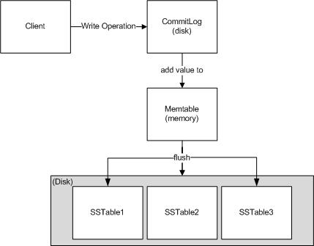
write op

Slide 89
Write cont’d
Key (CF1 , CF2 , CF3)
Data size
Number of Objects
Lifetime
Memtable ( CF1)
Commit Log
Binary serialized
Key ( CF1 , CF2 , CF3 )
Memtable ( CF2)
FLUSH
Memtable ( CF2)
Data file on disk
Dedicated Disk
<Key name><Size of key Data><Index of columns/supercolumns>< Serialized column family>
---
---
---
---
<Key name><Size of key Data><Index of columns/supercolumns>< Serialized column family>
K₁₂₈ Offset
K₂₅₆ Offset
K₃₈₄ Offset
Bloom Filter
BLOCK Index <Key Name> Offset, <Key Name> Offset
(Index in memory)

Slide 90
Compactions
D E L E T E D
K1 < Serialized data >
K2 < Serialized data >
K3 < Serialized data >
--
--
--
K2 < Serialized data >
K10 < Serialized data >
K30 < Serialized data >
--
--
--
K4 < Serialized data >
K5 < Serialized data >
K10 < Serialized data >
--
--
--
Sorted
Sorted
Sorted
MERGE SORT
Index File
K1 < Serialized data >
K2 < Serialized data >
K3 < Serialized data >
K4 < Serialized data >
K5 < Serialized data >
K10 < Serialized data >
K30 < Serialized data >
Loaded in memory
K1 Offset
K5 Offset
K30 Offset
Bloom Filter
Sorted
Data File

Slide 91
Write Properties
No locks in the critical path
Sequential disk access
Behaves like a write back Cache
Append support without read ahead
Atomicity guarantee for a key
“Always Writable”
accept writes during failure scenarios

Slide 92
Read
Client
Query
Result
Cassandra Cluster
Read repair if digests differ
Closest replica
Result
Replica A
Digest Query
Digest Response
Digest Response
Replica B
Replica C

Slide 93
Partitioning
And Replication
h(key1)
1
0
E
A
N=3
C
h(key2)
F
B
D
1/2
93
Notes:
93

Slide 94
Cluster Membership and Failure Detection
Gossip protocol is used for cluster membership.
Super lightweight with mathematically provable properties.
State disseminated in O(logN) rounds where N is the number of nodes in the cluster.
Every T seconds each member increments its heartbeat counter and selects one other member to send its list to.
A member merges the list with its own list .

Slide 95
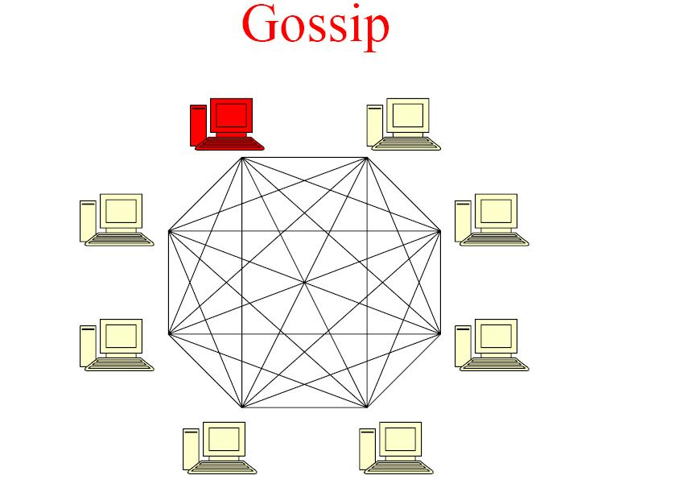

Slide 96
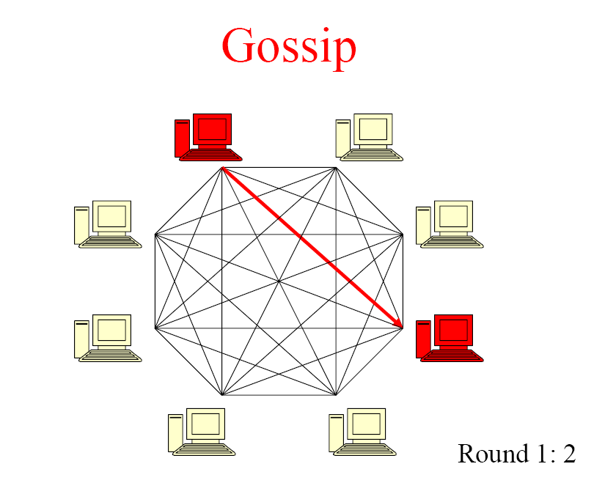

Slide 97
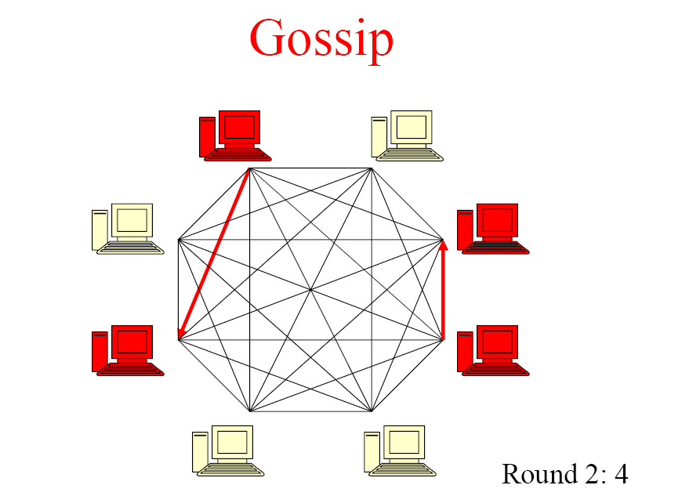

Slide 98
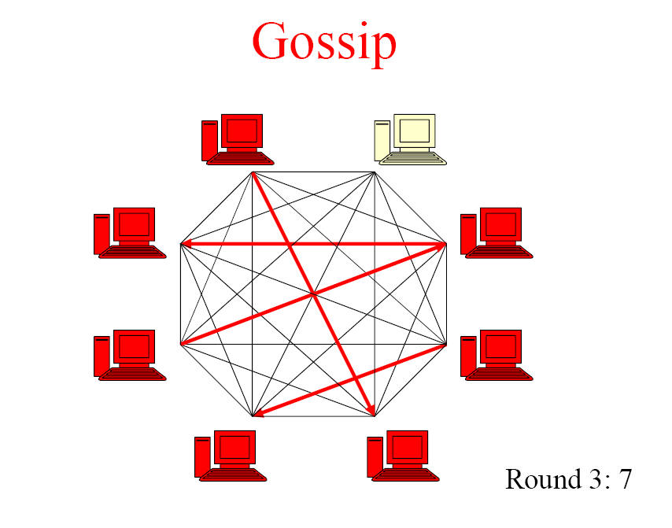

Slide 99
Accrual Failure Detector
Valuable for system management, replication, load balancing etc.
Defined as a failure detector that outputs a value, PHI, associated with each process.
Also known as Adaptive Failure detectors - designed to adapt to changing network conditions.
The value output, PHI, represents a suspicion level.
Applications set an appropriate threshold, trigger suspicions and perform appropriate actions.
In Cassandra the average time taken to detect a failure is 10-15 seconds with the PHI threshold set at 5.

Slide 100
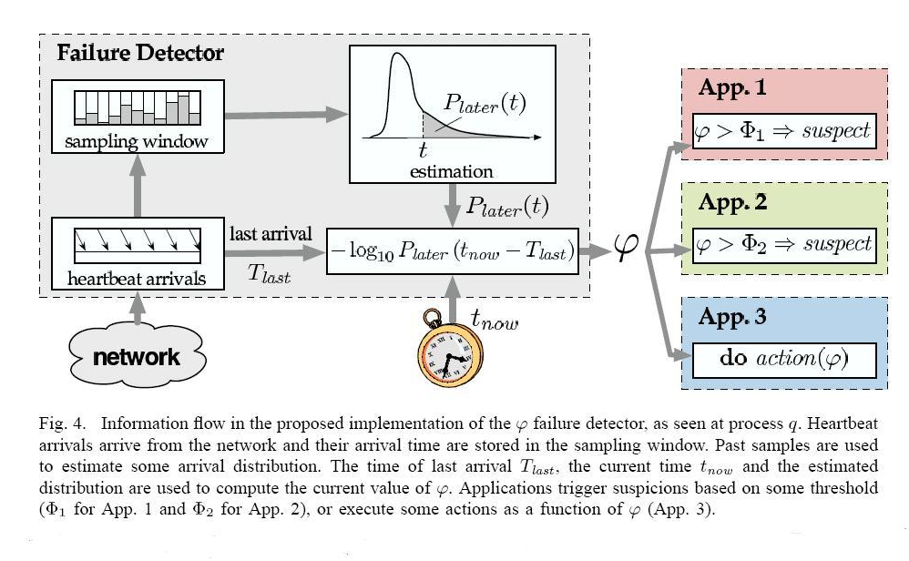
Information Flow in the Implementation

Slide 101
Performance Benchmark
Loading of data - limited by network bandwidth.
Read performance for Inbox Search in production:
 | Search Interactions | Term Search
Min | 7.69 ms | 7.78 ms
Median | 15.69 ms | 18.27 ms
Average | 26.13 ms | 44.41 ms

Slide 102
MySQL Comparison
MySQL > 50 GB Data Writes Average : ~300 ms Reads Average : ~350 ms
Cassandra > 50 GB Data Writes Average : 0.12 ms Reads Average : 15 ms

Slide 103
Lessons Learnt
Add fancy features only when absolutely required.
Many types of failures are possible.
Big systems need proper systems-level monitoring.
Value simple designs

Slide 104
Future work
Atomicity guarantees across multiple keys
Analysis support via Map/Reduce
Distributed transactions
Compression support
Granular security via ACL’s

Slide 105
Hive and Pig

Slide 106
Need for High-Level Languages
Hadoop is great for large-data processing!
But writing Java programs for everything is verbose and slow
Not everyone wants to (or can) write Java code
Solution: develop higher-level data processing languages
Hive: HQL is like SQL
Pig: Pig Latin is a bit like Perl

Slide 107


Hive and Pig
Hive: data warehousing application in Hadoop
Query language is HQL, variant of SQL
Tables stored on HDFS as flat files
Developed by Facebook, now open source
Pig: large-scale data processing system
Scripts are written in Pig Latin, a dataflow language
Developed by Yahoo!, now open source
Roughly 1/3 of all Yahoo! internal jobs
Common idea:
Provide higher-level language to facilitate large-data processing
Higher-level language “compiles down” to Hadoop jobs

Slide 108
Hive: Background
Started at Facebook
Data was collected by nightly cron jobs into Oracle DB
“ETL” via hand-coded python
Grew from 10s of GBs (2006) to 1 TB/day new data (2007), now 10x that
Source: cc-licensed slide by Cloudera

Slide 109
Hive Components
Shell: allows interactive queries
Driver: session handles, fetch, execute
Compiler: parse, plan, optimize
Execution engine: DAG of stages (MR, HDFS, metadata)
Metastore: schema, location in HDFS, SerDe
Source: cc-licensed slide by Cloudera

Slide 110
Data Model
Tables
Typed columns (int, float, string, boolean)
Also, list: map (for JSON-like data)
Partitions
For example, range-partition tables by date
Buckets
Hash partitions within ranges (useful for sampling, join optimization)
Source: cc-licensed slide by Cloudera

Slide 111
Metastore
Database: namespace containing a set of tables
Holds table definitions (column types, physical layout)
Holds partitioning information
Can be stored in Derby, MySQL, and many other relational databases
Source: cc-licensed slide by Cloudera

Slide 112
Physical Layout
Warehouse directory in HDFS
E.g., /user/hive/warehouse
Tables stored in subdirectories of warehouse
Partitions form subdirectories of tables
Actual data stored in flat files
Control char-delimited text, or SequenceFiles
With custom SerDe, can use arbitrary format
Source: cc-licensed slide by Cloudera

Slide 113
Hive: Example
Hive looks similar to an SQL database
Relational join on two tables:
Table of word counts from Shakespeare collection
Table of word counts from the bible
SELECT s.word, s.freq, k.freq FROM shakespeare s
JOIN bible k ON (s.word = k.word) WHERE s.freq >= 1 AND k.freq >= 1 ORDER BY s.freq DESC LIMIT 10;
the 25848 62394
I 23031 8854
and 19671 38985
to 18038 13526
of 16700 34654
a 14170 8057
you 12702 2720
my 11297 4135
in 10797 12445
is 8882 6884
Source: Material drawn from Cloudera training VM

Slide 114
Hive: Behind the Scenes
SELECT s.word, s.freq, k.freq FROM shakespeare s
JOIN bible k ON (s.word = k.word) WHERE s.freq >= 1 AND k.freq >= 1 ORDER BY s.freq DESC LIMIT 10;
(Abstract Syntax Tree)
(TOK_QUERY (TOK_FROM (TOK_JOIN (TOK_TABREF shakespeare s) (TOK_TABREF bible k) (= (. (TOK_TABLE_OR_COL s) word) (. (TOK_TABLE_OR_COL k) word)))) (TOK_INSERT (TOK_DESTINATION (TOK_DIR TOK_TMP_FILE)) (TOK_SELECT (TOK_SELEXPR (. (TOK_TABLE_OR_COL s) word)) (TOK_SELEXPR (. (TOK_TABLE_OR_COL s) freq)) (TOK_SELEXPR (. (TOK_TABLE_OR_COL k) freq))) (TOK_WHERE (AND (>= (. (TOK_TABLE_OR_COL s) freq) 1) (>= (. (TOK_TABLE_OR_COL k) freq) 1))) (TOK_ORDERBY (TOK_TABSORTCOLNAMEDESC (. (TOK_TABLE_OR_COL s) freq))) (TOK_LIMIT 10)))
(one or more of MapReduce jobs)

Slide 115
Hive: Behind the Scenes
STAGE DEPENDENCIES:
Stage-1 is a root stage
Stage-2 depends on stages: Stage-1
Stage-0 is a root stage
STAGE PLANS:
Stage: Stage-1
Map Reduce
Alias -> Map Operator Tree:
s
TableScan
alias: s
Filter Operator
predicate:
expr: (freq >= 1)
type: boolean
Reduce Output Operator
key expressions:
expr: word
type: string
sort order: +
Map-reduce partition columns:
expr: word
type: string
tag: 0
value expressions:
expr: freq
type: int
expr: word
type: string
k
TableScan
alias: k
Filter Operator
predicate:
expr: (freq >= 1)
type: boolean
Reduce Output Operator
key expressions:
expr: word
type: string
sort order: +
Map-reduce partition columns:
expr: word
type: string
tag: 1
value expressions:
expr: freq
type: int
Stage: Stage-2
Map Reduce
Alias -> Map Operator Tree:
hdfs://localhost:8022/tmp/hive-training/364214370/10002
Reduce Output Operator
key expressions:
expr: _col1
type: int
sort order: -
tag: -1
value expressions:
expr: _col0
type: string
expr: _col1
type: int
expr: _col2
type: int
Reduce Operator Tree:
Extract
Limit
File Output Operator
compressed: false
GlobalTableId: 0
table:
input format: org.apache.hadoop.mapred.TextInputFormat
output format: org.apache.hadoop.hive.ql.io.HiveIgnoreKeyTextOutputFormat
Stage: Stage-0
Fetch Operator
limit: 10
Reduce Operator Tree:
Join Operator
condition map:
Inner Join 0 to 1
condition expressions:
0 {VALUE._col0} {VALUE._col1}
1 {VALUE._col0}
outputColumnNames: _col0, _col1, _col2
Filter Operator
predicate:
expr: ((_col0 >= 1) and (_col2 >= 1))
type: boolean
Select Operator
expressions:
expr: _col1
type: string
expr: _col0
type: int
expr: _col2
type: int
outputColumnNames: _col0, _col1, _col2
File Output Operator
compressed: false
GlobalTableId: 0
table:
input format: org.apache.hadoop.mapred.SequenceFileInputFormat
output format: org.apache.hadoop.hive.ql.io.HiveSequenceFileOutputFormat

Slide 116
Example Data Analysis Task
Find users who tend to visit “good” pages.
Visits
Pages
user | url | time
Amy | www.cnn.com | 8:00
Amy | www.crap.com | 8:05
Amy | www.myblog.com | 10:00
Amy | www.flickr.com | 10:05
Fred | cnn.com/index.htm | 12:00
url | pagerank
www.cnn.com | 0.9
www.flickr.com | 0.9
www.myblog.com | 0.7
www.crap.com | 0.2
. . .
. . .
Pig Slides adapted from Olston et al.

Slide 117
Conceptual Dataflow
Load
Visits(user, url, time)
Load
Pages(url, pagerank)
Canonicalize URLs
Join
url = url
Group by user
Compute Average Pagerank
Filter
avgPR > 0.5
Pig Slides adapted from Olston et al.

Slide 118
System-Level Dataflow
Visits
Pages
. . .
. . .
load
load
canonicalize
join by url
. . .
group by user
. . .
compute average pagerank
filter
the answer
Pig Slides adapted from Olston et al.

Slide 119
MapReduce Code
Pig Slides adapted from Olston et al.

Slide 120
Pig Latin Script
Visits = load ‘/data/visits’ as (user, url, time);
Visits = foreach Visits generate user, Canonicalize(url), time;
Pages = load ‘/data/pages’ as (url, pagerank);
VP = join Visits by url, Pages by url;
UserVisits = group VP by user;
UserPageranks = foreach UserVisits generate user, AVG(VP.pagerank) as avgpr;
GoodUsers = filter UserPageranks by avgpr > ‘0.5’;
store GoodUsers into '/data/good_users';
Pig Slides adapted from Olston et al.

Slide 121
Java vs. Pig Latin
1/20 the lines of code
1/16 the development time
Performance on par with raw Hadoop!
Pig Slides adapted from Olston et al.

Slide 122
Pig takes care of…
Schema and type checking
Translating into efficient physical dataflow
(i.e., sequence of one or more MapReduce jobs)
Exploiting data reduction opportunities
(e.g., early partial aggregation via a combiner)
Executing the system-level dataflow
(i.e., running the MapReduce jobs)
Tracking progress, errors, etc.

Slide 123
Hive + HBase?

Slide 124
Integration
Reasons to use Hive on HBase:
A lot of data sitting in HBase due to its usage in a real-time environment, but never used for analysis
Give access to data in HBase usually only queried through MapReduce to people that don’t code (business analysts)
When needing a more flexible storage solution, so that rows can be updated live by either a Hive job or an application and can be seen immediately to the other
Reasons not to do it:
Run SQL queries on HBase to answer live user requests (it’s still a MR job)
Hoping to see interoperability with other SQL analytics systems

Slide 125

Integration
How it works:
Hive can use tables that already exist in HBase or manage its own ones, but they still all reside in the same HBase instance
Hive table definitions
HBase
Points to an existing table
Manages this table from Hive

Slide 126
Integration
How it works:
When using an already existing table, defined as EXTERNAL, you can create multiple Hive tables that point to it
Hive table definitions
HBase
Points to some column
Points to other columns, different names

Slide 127
Integration
How it works:
Columns are mapped however you want, changing names and giving types
Hive table definition
HBase table
persons
people
name STRING
d:fullname
age INT
d:age
siblings MAP<string, string>
d:address
f:
Notes:
a column name was changed, one isn’t used, and a map points to a family

Slide 128
Integration
Drawbacks (that can be fixed with brain juice):
Binary keys and values (like integers represented on 4 bytes) aren’t supported since Hive prefers string representations, HIVE-1634
Compound row keys aren’t supported, there’s no way of using multiple parts of a key as different “fields”
This means that concatenated binary row keys are completely unusable, which is what people often use for HBase
Filters are done at Hive level instead of being pushed to the region servers
Partitions aren’t supported

Slide 129
Data Flows
Data is being generated all over the place:
Apache logs
Application logs
MySQL clusters
HBase clusters

Slide 130
Data Flows
Moving application log files
Transforms format
HDFS
Dumped into
Read nightly
Wild log file
Tail’ed continuously
Parses into HBase format
Inserted into
HBase

Slide 131
Data Flows
Moving MySQL data
Dumped nightly with CSV import
HDFS
MySQL
Tungsten replicator
Inserted into
Parses into HBase format
HBase

Slide 132
Data Flows
Moving HBase data
CopyTable MR job
HBase MR
HBase Prod
Read in parallel
Imported in parallel into
* HBase replication currently only works for a single slave cluster, in our case HBase replicates to a backup cluster.

Slide 133
Use Cases
Front-end engineers
They need some statistics regarding their latest product
Research engineers
Ad-hoc queries on user data to validate some assumptions
Generating statistics about recommendation quality
Business analysts
Statistics on growth and activity
Effectiveness of advertiser campaigns
Users’ behavior VS past activities to determine, for example, why certain groups react better to email communications
Ad-hoc queries on stumbling behaviors of slices of the user base

Slide 134
Use Cases
Using a simple table in HBase:
CREATE EXTERNAL TABLE blocked_users(
userid INT,
blockee INT,
blocker INT,
created BIGINT)
STORED BY 'org.apache.hadoop.hive.hbase.HBaseStorageHandler’
WITH SERDEPROPERTIES ("hbase.columns.mapping" =
":key,f:blockee,f:blocker,f:created")
TBLPROPERTIES("hbase.table.name" = "m2h_repl-userdb.stumble.blocked_users");
HBase is a special case here, it has a unique row key map with :key
Not all the columns in the table need to be mapped

Slide 135
Use Cases
Using a complicated table in HBase:
CREATE EXTERNAL TABLE ratings_hbase(
userid INT,
created BIGINT,
urlid INT,
rating INT,
topic INT,
modified BIGINT)
STORED BY 'org.apache.hadoop.hive.hbase.HBaseStorageHandler’
WITH SERDEPROPERTIES ("hbase.columns.mapping" =
":key#b@0,:key#b@1,:key#b@2,default:rating#b,default:topic#b,default:modified#b")
TBLPROPERTIES("hbase.table.name" = "ratings_by_userid");
#b means binary, @ means position in composite key (SU-specific hack)

Slide 136
Graph Databases

Slide 137
NEO4J (Graphbase)
A graph is a collection nodes (things) and edges (relationships) that connect
pairs of nodes.
Attach properties (key-value pairs) on nodes and relationships
Relationships connect two nodes and both nodes and relationships can hold an
arbitrary amount of key-value pairs.
A graph database can be thought of as a key-value store, with full support for
relationships.
http://neo4j.org/

Slide 138
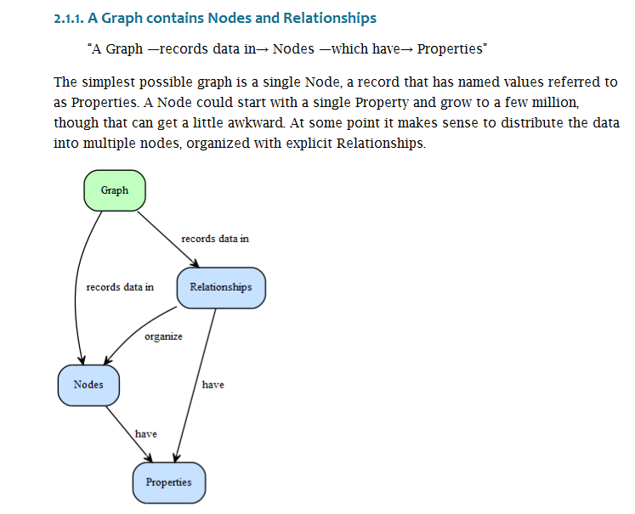
NEO4J

Slide 139
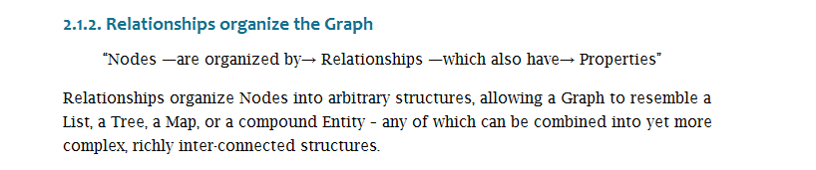
NEO4J

Slide 140
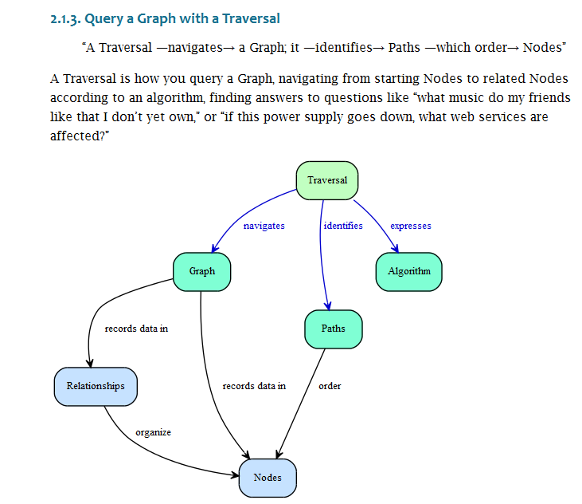
NEO4J

Slide 141
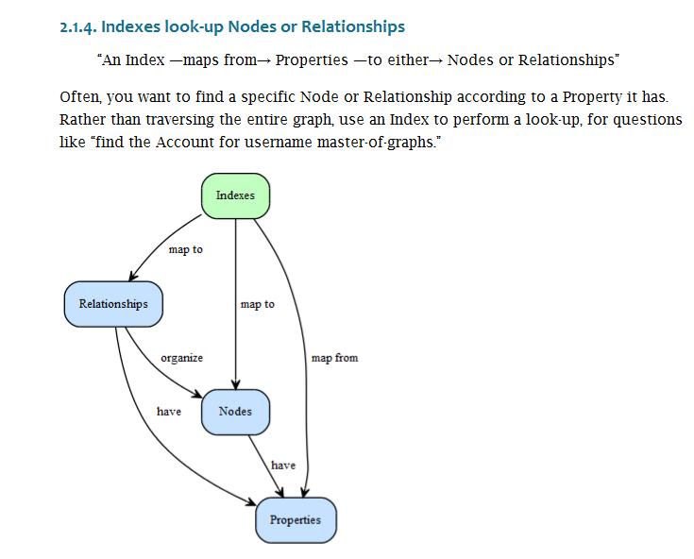
NEO4J

Slide 142
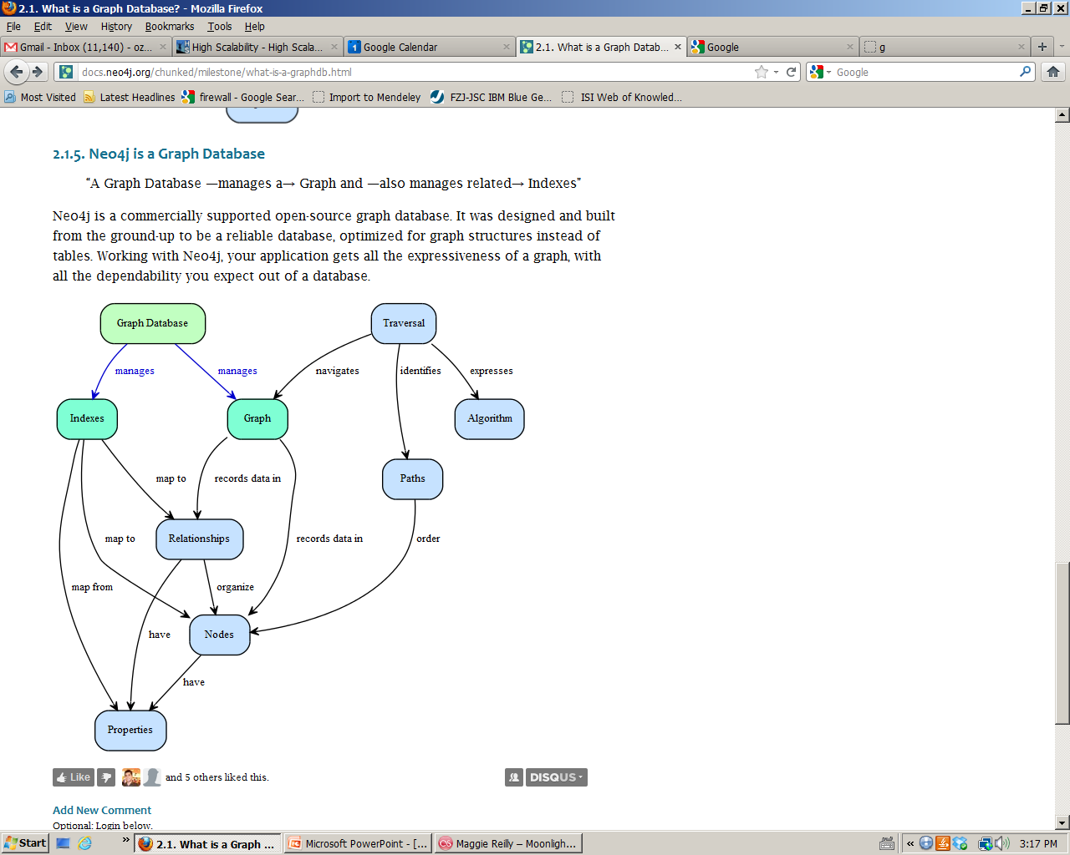
NEO4J

Slide 143
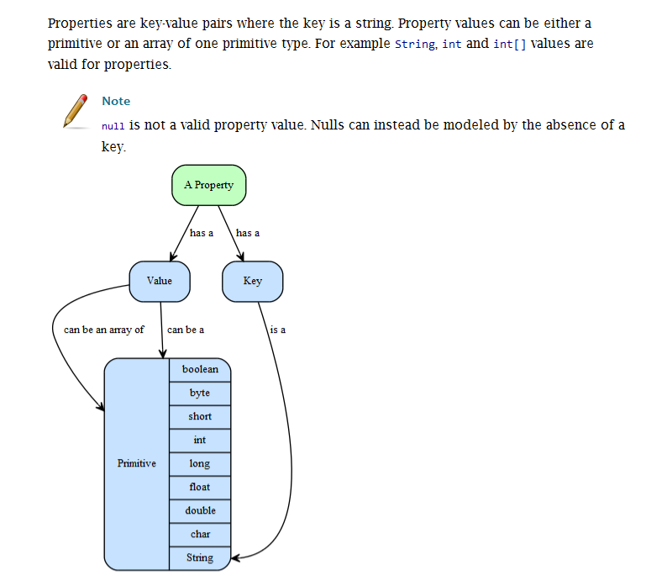
NEO4J
Properties

Slide 144
NEO4J Features
Dual license: open source and commercial
Well suited for many web use cases such as tagging, metadata annotations,
social networks, wikis and other network-shaped or hierarchical data sets
Intuitive graph-oriented model for data representation. Instead of static and
rigid tables, rows and columns, you work with a flexible graph network
consisting of nodes, relationships and properties.
Neo4j offers performance improvements on the order of 1000x
or more compared to relational DBs.
A disk-based, native storage manager completely optimized for storing
graph structures for maximum performance and scalability
Massive scalability. Neo4j can handle graphs of several billion
nodes/relationships/properties on a single machine and can be sharded to
scale out across multiple machines
Fully transactional like a real database
Neo4j traverses depths of 1000 levels and beyond at millisecond speed.
(many orders of magnitude faster than relational systems)

