Slide 1
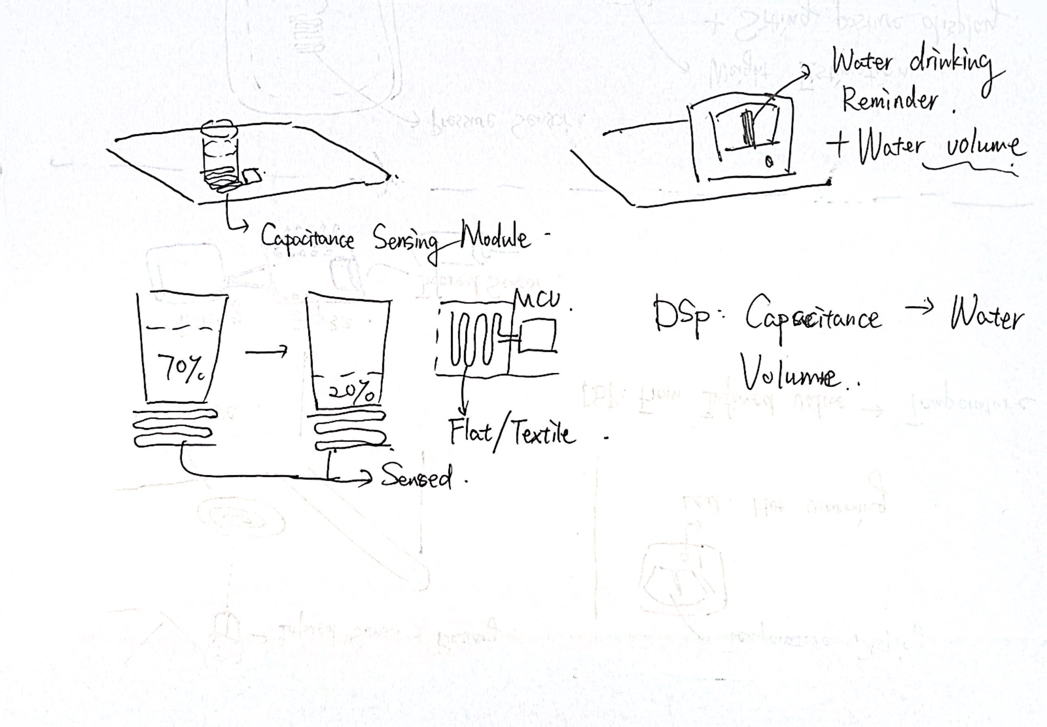
On-table drinking reminder
Idea: Wirelessly monitor the water volume on table and remind users on drinking water
Sketch
Wireless: WIFI
Power: battery/charged
Processing: implement the decoding algorithm to interpret water volume from capacitive sensor and develop a recommendation algorithm

Slide 2
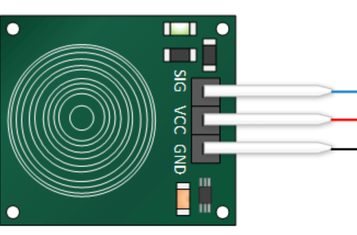
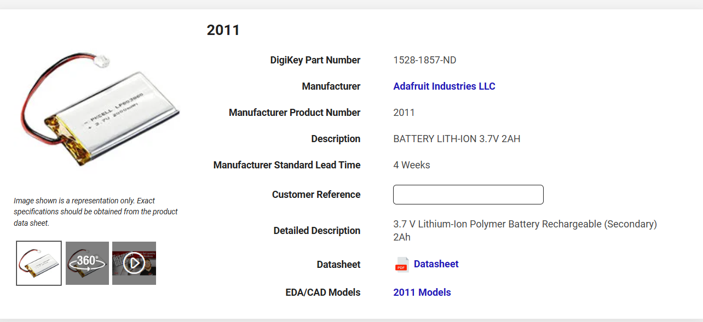
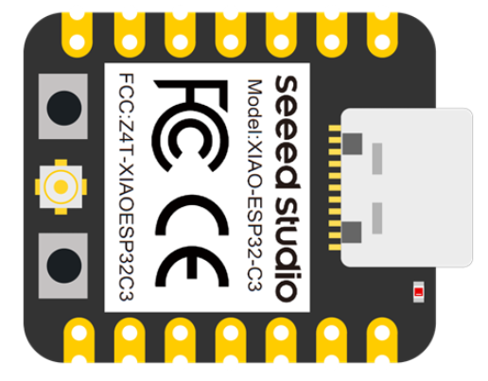
Sensor
Capacitive sensor sense the capacitance
Water has capacitance, different volume of water resulted in different capacitance, then the volume of the water can be detected by decoding the sensed capacitance by the sensor
This module support decoding the capacitance via the transformed voltage, which can be sensed using Analog reading through MCU
Capacitive Sensor: TTP223
MCU: Xiao ESP32C3

Slide 3
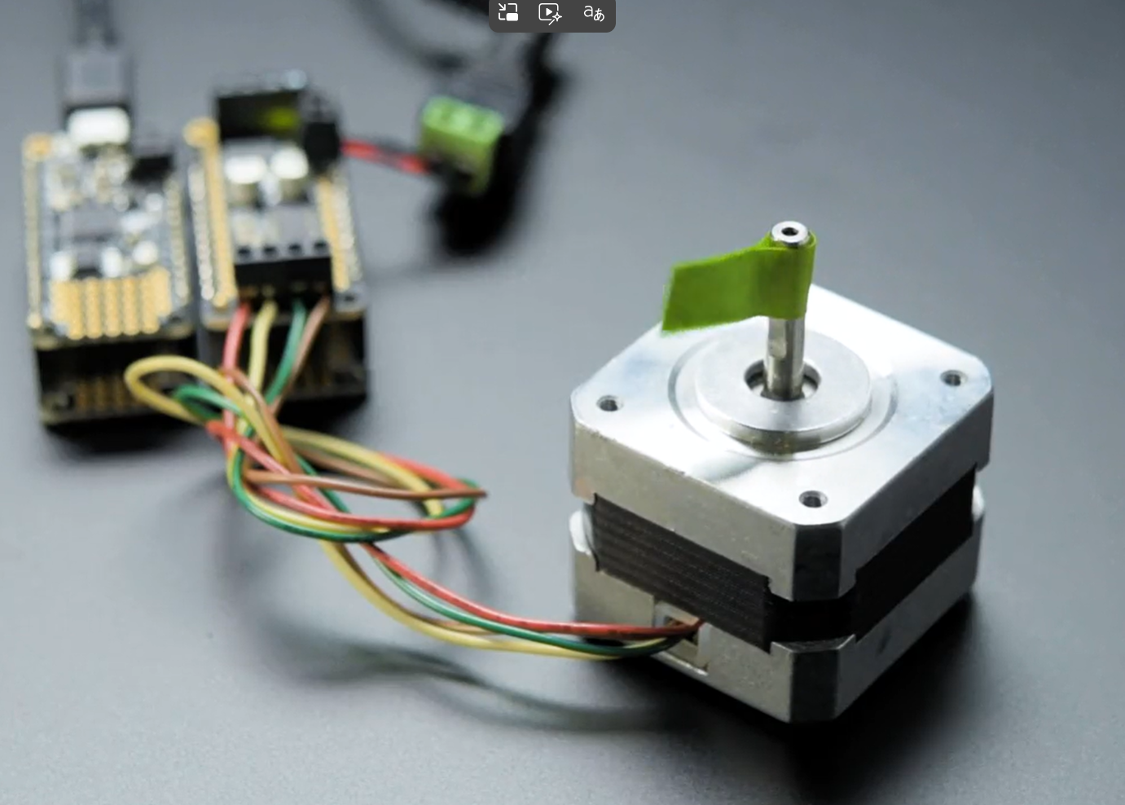
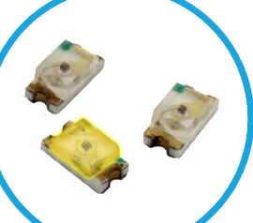
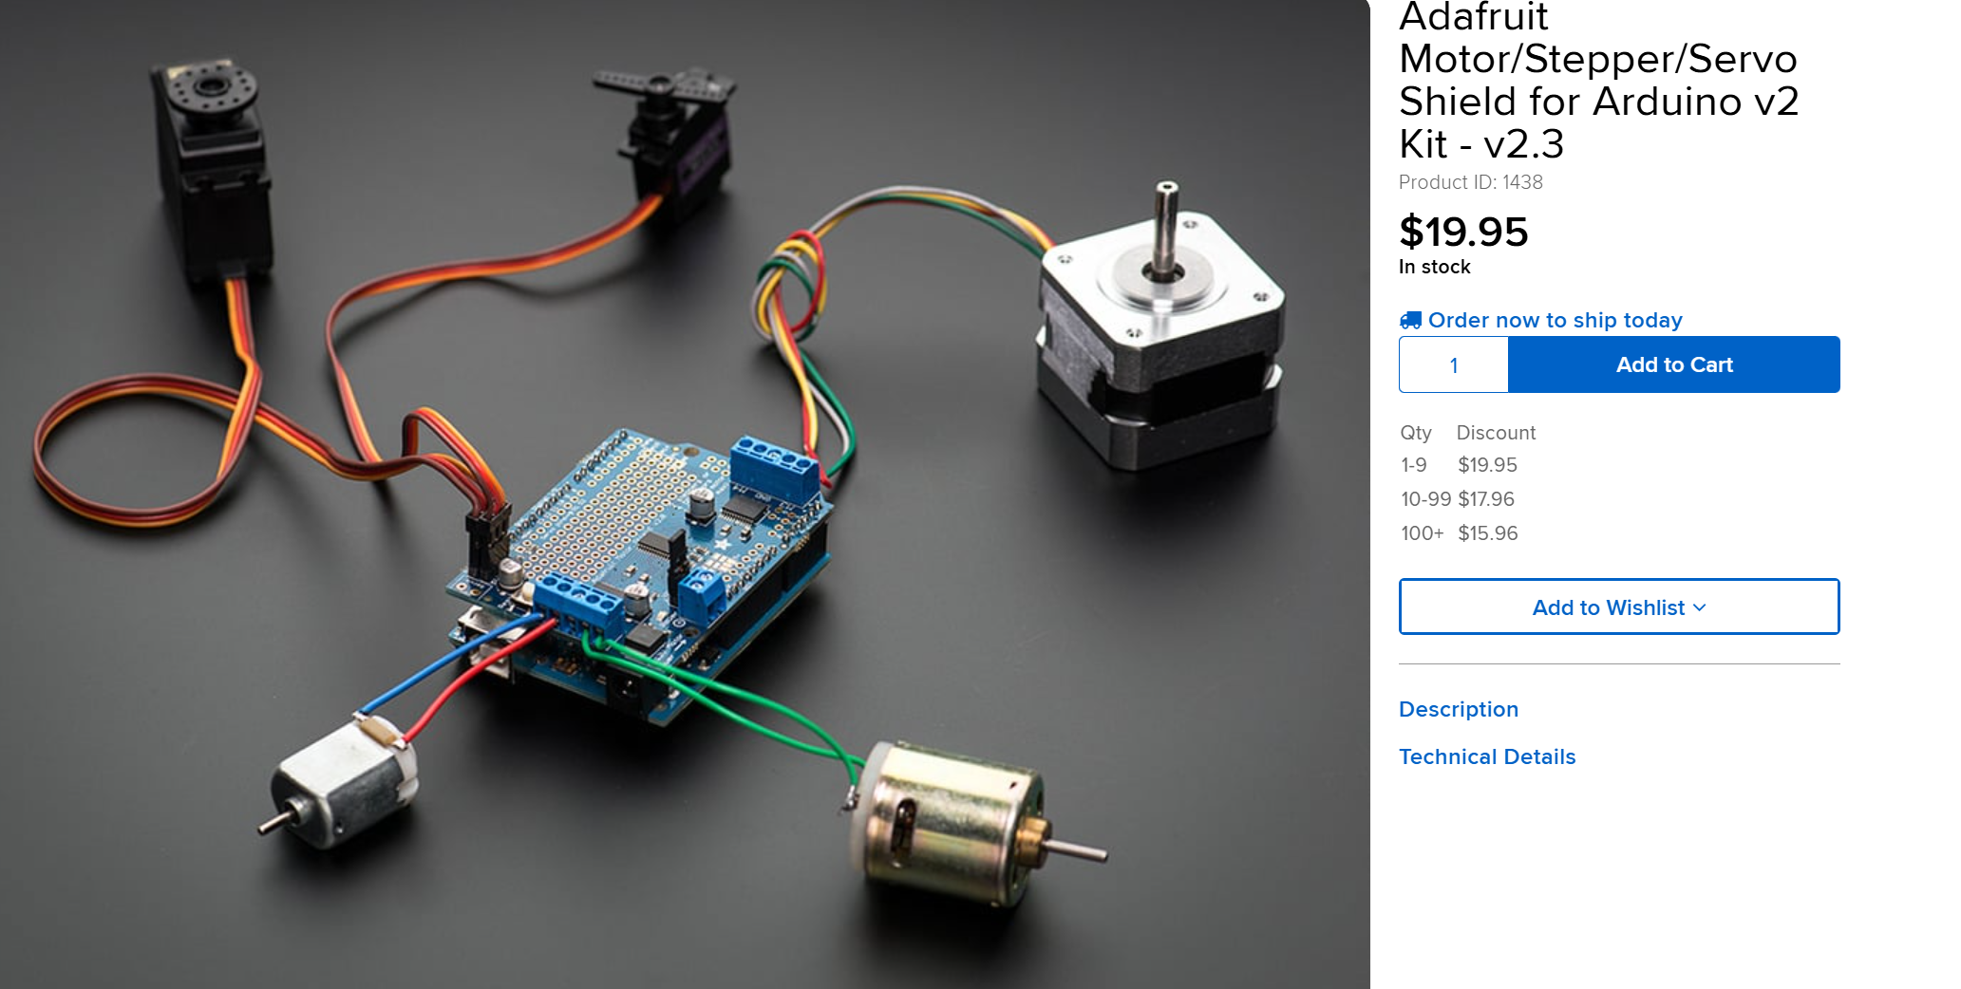
Display
Stepper-driven motor + Adafruit motor shield + LED + MCU
The inner counter of MCU record the time between two times of drinking water and let the LED glow once the time interval is bigger than a threshold.
The motor with gauge needle will rotate according to the water volume when water is stably placed on the capacitive sensor.
Motor: C140 motor
LED: LSM0603 Series 0603 SMD LED
Motor shield chip: TB6612FNG
MCU: Xiao ESP32C3

Slide 4
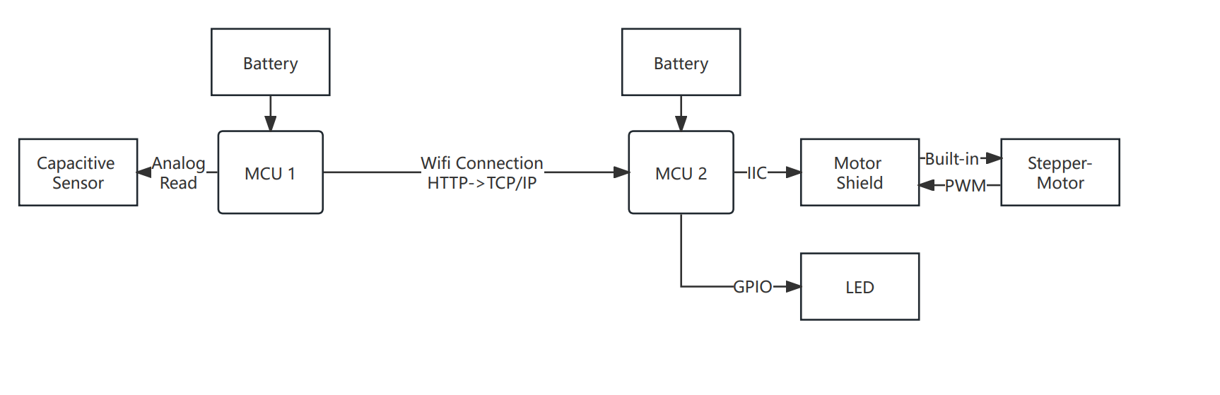
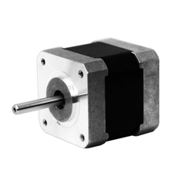
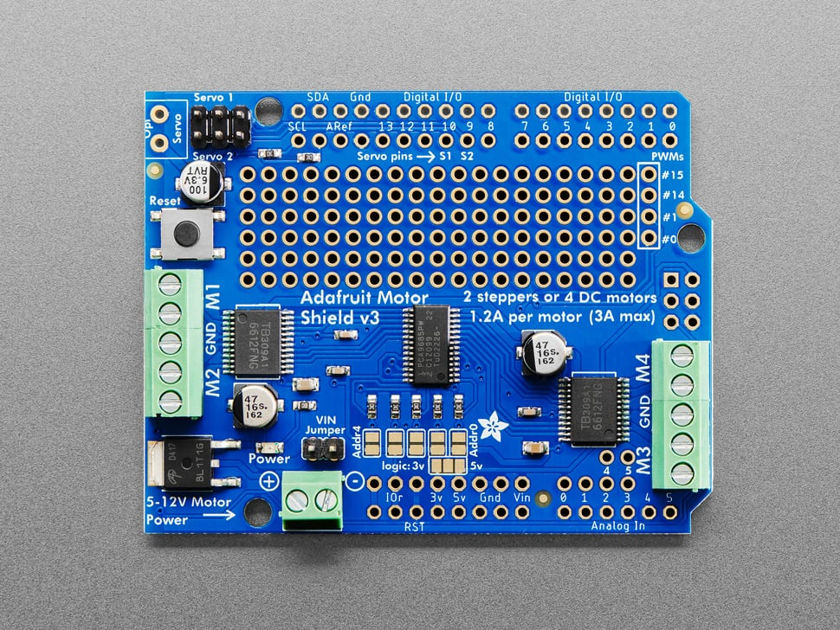
Figure & Diagram
Output, GND
VCC/GND/SIG
WIFI antenna
VCC/GND/SCL/SDA
Built-in PWM control

Slide 5
