Slide 1
Exceptional Control Flow II
(Process Operations)

Slide 2
Outline
Process id
Exiting Processes
Creating Processes
Reaping Child Processes
Putting Processes to Sleep
Loading and Running Programs

Slide 3
Obtaining Process ID’s
Process ID
  PID
  Each process has a unique positive PID
Getpid()
  Returns the PID of the calling process
Getppid()
  Returns the PID of its parent
    The process that created the calling process

Slide 4
Obtaining Process ID’s
#include <unistd.h> #include <sys/types.h> pid_t getpid(void); pid_t getppid(void); returns: PID of either the caller or the parent
The getpid and getppid routines return an integer value of type pid_t
pid_t
  Defined in types.h as an int on Linux systems

Slide 5
Exit Function
#include <stdlib.h> void exit(int status); this function does not return
The exit function terminates the process with an exit status of status.

Slide 6
如何创建和初始化进程？
建一个空的数据结构，再填充每个域
复制（内核init进程是所有进程的祖先，pid=1）
  fork()
    创建新进程（子进程），由父进程复制而来
    两个进程都从fork返回
      父进程返回创建的子进程PID
      子进程返回0
  exec(…)
    参数传进来一个program，更换当前进程的code和data，执行传进来的program指令

Slide 7
Fork Function
A parent process
  creates a new running child process
  by calling the fork function
#include <unistd.h> #include <sys/types.h> pid_t fork(void); Returns: 0 to child, PID of child to parent, -1 on error

Slide 8
Fork Function
新创建的子进程
  几乎，但不是完全地，与父进程相同
父进程和新创建的子进程有不同的PID

Slide 9
Fork Function
子进程
  得到一份父进程用户层虚拟机地址空间的完全拷贝
    including the text, data, and bss segments, heap, and user stack.
  同时也得到父进程已打开的文件描述符（ file descriptors ）的完全拷贝
    意味着子进程可以直接读，写父进程中已经打开的任何文件

Slide 10
Fork Function
Called once
  In the parent process
Returns twice:
  In the parent process
    Return the PID of the child
  In the newly created child process.
    Return 0
The return value provides an unambiguous way
  whether the program is executing in the parent or the child.

Slide 11
Fork Function
1 #include "csapp.h"
2
3 int main()
4 {
5 pid_t pid;
6 int x = 1;
7
8 pid = Fork();
9 if (pid == 0) { /* child */
10 printf("child : x=%d\n", ++x);
11 exit(0);
12 }
13
14 /* parent */
15 printf("parent: x=%d\n", --x);
16 exit(0);
17 }

Slide 12
Fork Function
Call once, return twice.
  As mentioned before
  This is fairly straightforward for programs that create a single child.
  Programs with multiple instances of fork
    can be confusing
    need to be reasoned about carefully

Slide 13
Fork Function
Concurrent execution
  The parent and the child are separate processes that run concurrently.
  The instructions in their logical control flows can be interleaved by the kernel in an arbitrary way.
  We can never make assumptions about the interleaving of the instructions in different processes.

Slide 14
Fork Function
Duplicate but separate address spaces
  Immediately after the fork function returned in each process, the address space of each process is identical.
    Local variable x has a value of 1 in both the parent and the child when the fork function returns in line 8.

Slide 15
Fork Function
Duplicate but separate address spaces.
  The parent and the child are separate processes
    they each have their own private address spaces.
    Any subsequent changes that a parent or child makes to x
      private
      not reflected in the memory of the other process.

Slide 16
Fork Function
Duplicate but separate address spaces
  The variable x has different values in the parent and child when they call their respective printf statements. (++x/--x)
Shared files
  Like stdout
  Communication between child and parent

Slide 17
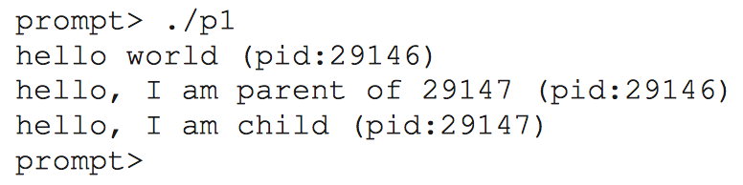
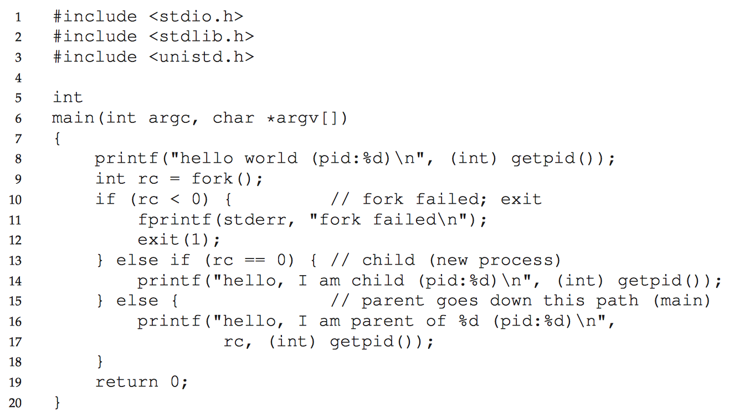
Fork Function

Slide 18
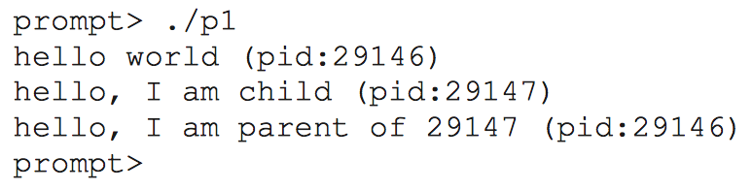
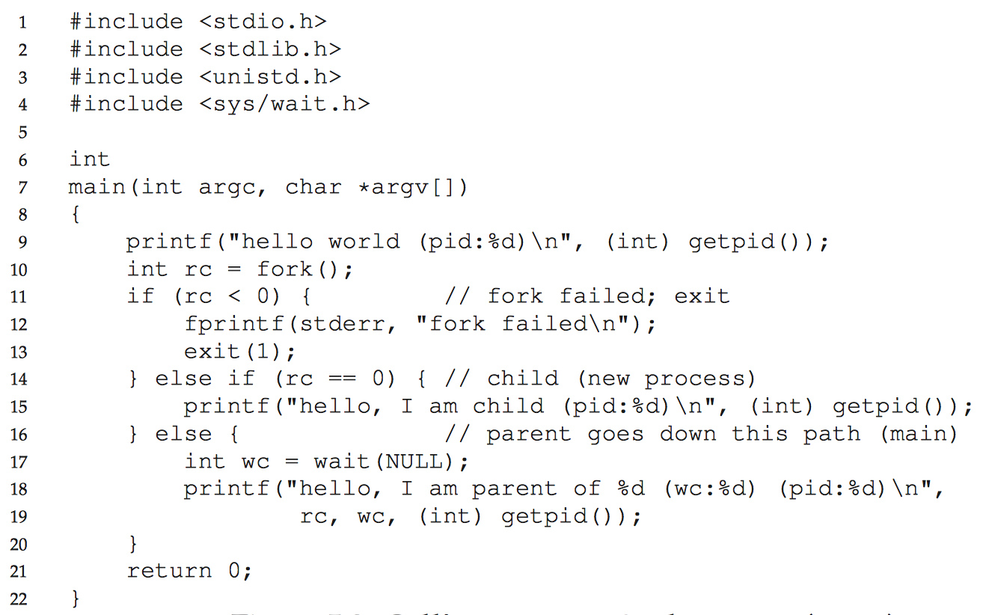
Fork Function

Slide 19
Fork Function
1 #include "csapp.h"
2
3 int main()
4 {
5 Fork();
6 printf("hello!\n");
7 exit(0);
8 }
(a) Calls fork once. (b) Prints two output lines.
hello
hello
fork

Slide 20
Fork Function
1 #include "csapp.h"
2
3 int main()
4 {
5 Fork();
6 Fork();
7 printf("hello!\n");
8 exit(0);
9 }
(c) Calls fork twice. (d) Prints four output lines.
hello
hello
fork
hello
hello
fork
fork

Slide 21
Fork Function
1 #include "csapp.h"
2
3 int main()
4 {
5 Fork();
6 Fork();
7 Fork();
8 printf("hello!\n");
9 exit(0);
10 }
(e) Calls fork three times. (f) Prints eight output lines.
hello
hello
fork
hello
hello
fork
fork
hello
hello
fork
hello
hello
fork
fork
fork

Slide 22
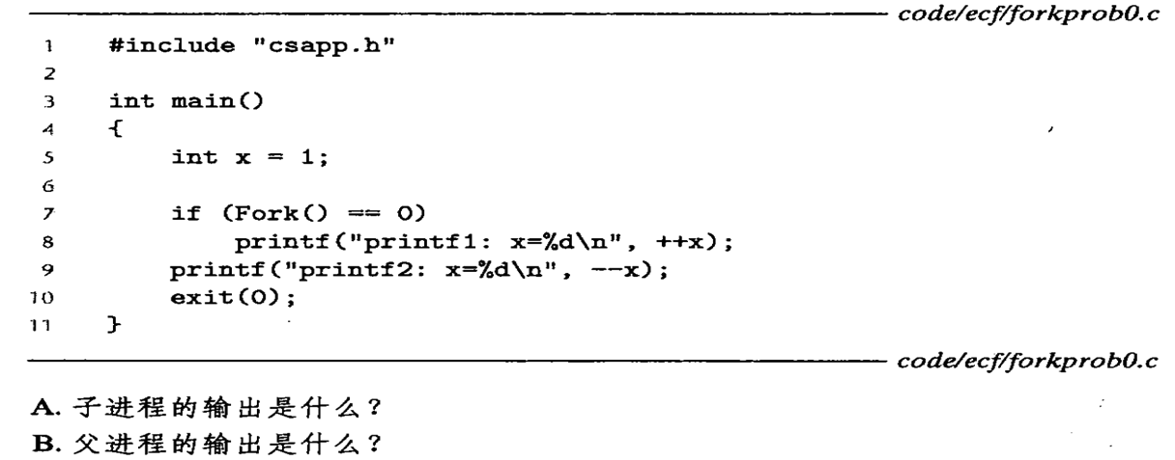
课堂练习
C.共多少种输出可能?（假设每行一定完整输出）
Notes:
(a++和++a的区别，前者本身的值是a，而后者的值是a+1)
子进程：x=2, x=1
父进程：x=0
3种

Slide 23
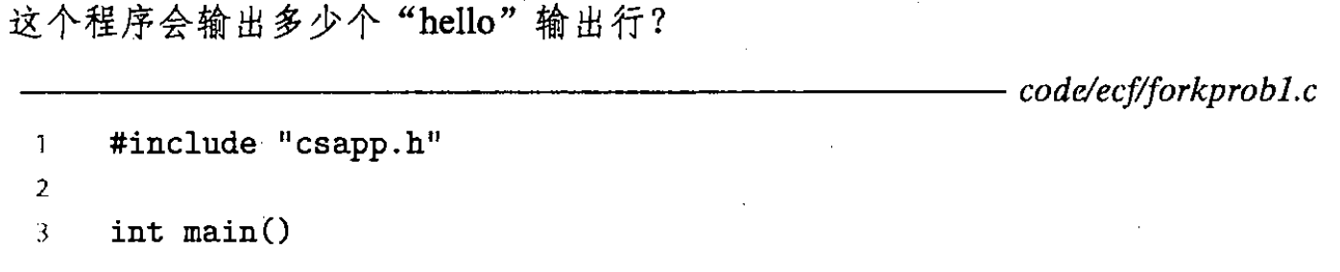
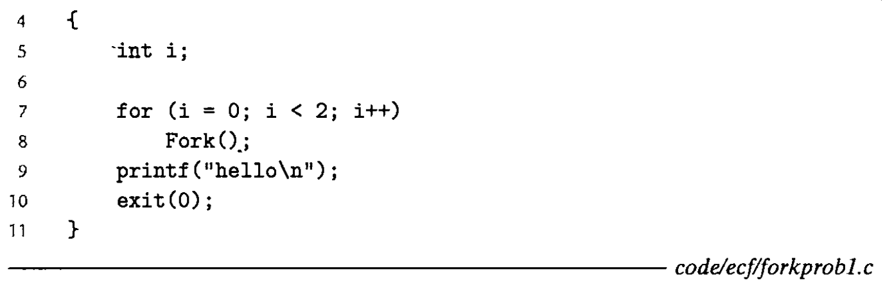
课堂练习
Notes:
4个

Slide 24
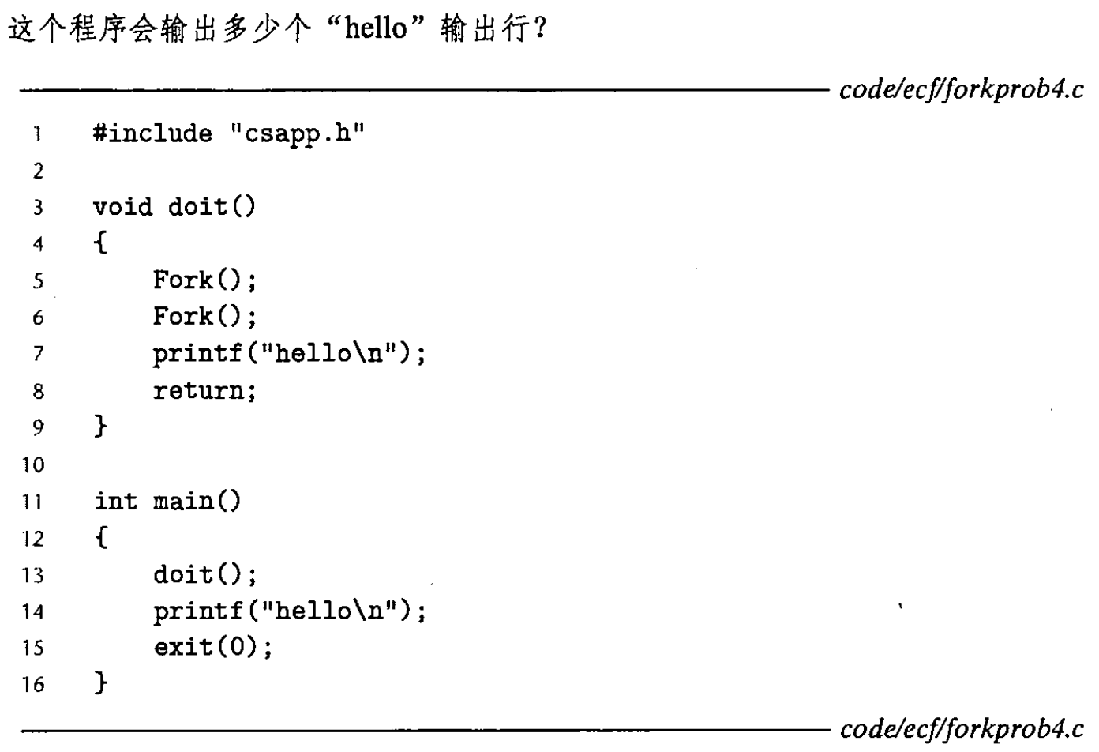
课堂练习
Notes:
8个
共4个进程，每个进程在doit()和main()中各输出一个hello

Slide 25
Zombie
Kernel并不会在进程终止后立刻将其清理掉
已终止的进程一般会保持在terminated状态，直到被其parent收割（reaped）

Slide 26
Zombie
When the parent reaps the terminated child
  内核首先把child的exit status发送给parent
  然后抛弃已经终止的进程
A terminated process that has not yet been reaped is called a zombie.

Slide 27
Zombie
If the parent process
  terminates without reaping its zombie children,
  the kernel arranges for the init process to reap them.
The init process
  has a PID of 1
  and is created by the kernel during system initialization.

Slide 28
Zombie
长期运行的程序（例如shells或servers），应该总是收割他们的zombie children
即使zombie不在运行，没有消耗CPU资源，他们也消耗了系统的内存资源

Slide 29
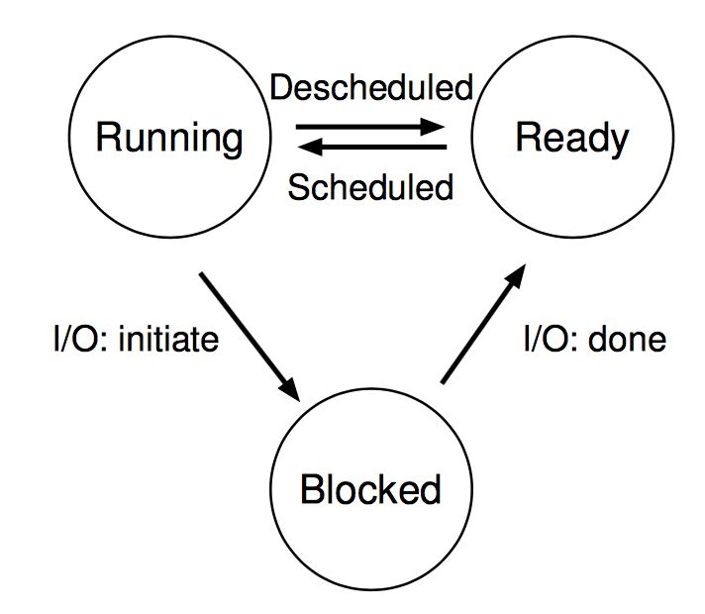
Review of Process Status
Running
Ready（就绪）
Blocked/Stopped（停止/挂起/阻塞：不会被调度）
  进行I/O访问、调用sleep、访问锁等，可能进入阻塞状态
  收到SIGSTOP、SIGTSTP、SIGTTIN或SIGTTOU信号时，进程被停止
  收到SIGCONT，进入运行状态
Terminated（终止）
Notes:
http://docs.linuxtone.org/ebooks/C&CPP/c/ch33s03.html

Slide 30
Review of Process Status
Running
Ready（就绪）
Blocked/Stopped（停止/挂起/阻塞：不会被调度）
Terminated（终止）三个原因：
  收到一个信号，该信号的默认行为时终止进程；
  从主程序返回（从main函数返回一个整型）；
  调用exit函数（记录status）

Slide 31
课堂练习
进程阻塞的原因不包括________。
  A. 时间片切换
  B. 等待I/O
  C. 进程sleep
  D. 等待解锁
Notes:
A

Slide 32
Wait_pid Function
#include <sys/types.h> #include <sys/wait.h> pid_t waitpid(pid_t pid, int *status, int options); pid_t wait(int *status); Returns: PID of child if OK, 0 (if WNOHANG) or -1 on error

Slide 33
Wait_pid Function
pid_t waitpid(pid_t pid, int *status, int options);
pid > 0
  The wait set is the singleton child process
    whose process ID is equal to pid
pid = -1
  The wait set consists of all of the parent’s child processes

Slide 34
Wait_pid Function
The waitpid function
  If the calling process has no children
    returns –1
    sets errno to ECHILD
  If interrupted by a signal
    returns –1
    sets errno to EINTR
>>

Slide 35
Wait_pid Function
pid_t waitpid(pid_t pid, int *status, int options);
options = 0
  waitpid函数的调用进程进入挂起状态，直到它的wait-set中的一个child process终止了；
  如果wait-set中的一个进程在进行waitpid调用的时候已经终止了，那么waitpid立刻返回；
  Waitpid返回导致waitpid函数返回的、已经终止的child process的PID
  已中止的child process被从系统中删除，释放其资源

Slide 36
Wait_pid Function
pid_t waitpid(pid_t pid, int *status, int options);
options
  WNOHAN: 如果wait-set中的任何子进程都还没有终止，那么立即返回，返回值为0
  如果在等待子进程终止的过程的同时，还希望做些有用的工作，这个选项会有用。

Slide 37
Wait_pid Function
pid_t waitpid(pid_t pid, int *status, int options);
options
  WUNTRACED: 将调用waitpid的进程挂起，直到wait-set中的一个子进程已经变成已终止或者被停止。返回已终止或已停止的子进程PID。

Slide 38
Wait_pid Function
pid_t waitpid(pid_t pid, int *status, int options);
options
  WCONTINUED: 将调用waitpid的进程挂起，直到wait-set中的一个正在运行的子进程终止，或者等待集合中一个被停止的进程收到SIGCONT信号重新开始。

Slide 39
Wait_pid Function
pid_t waitpid(pid_t pid, int *status, int options);
options
  WUNTRACED | WNOHANG : 立刻返回。如果等待集合中的进程都没有被停职或终止，则返回0；如果有一个停止或终止，则返回该进程的PID。

Slide 40
Wait_pid Function
pid_t waitpid(pid_t pid, int *status, int options);
Checking the exit status of a reaped child
  The status argument is non-NULL
  waitpid encodes status information about the child
    that caused the return in the status argument.
  The wait.h include file defines several macros
    for interpreting the status argument

Slide 41
Wait_pid Function
pid_t waitpid(pid_t pid, int *status, int options);
WIFEXITED(status)
  Returns true if the child terminated normally
    via a call to exit or a return.
WEXITSTATUS(status)
  Returns the exit status of a normally terminated child.
  This status is only defined if WIFEXITED returned true.

Slide 42
Wait_pid Function
pid_t waitpid(pid_t pid, int *status, int options);
WIFSIGNALED(status)
  Returns true if the child process terminated because of a signal that was not caught
WTERMSIG(status)
  Returns the number of the signal that caused the child process to terminate.
  This status is only defined if WIFSIGNALED returned true.

Slide 43
Wait_pid Function
pid_t waitpid(pid_t pid, int *status, int options);
WIFSTOPPED(status)
  Returns true if the child that caused the return is currently stopped.
WSTOPSIG(status)
  Returns the number of the signal that caused the child to stop.
  This status is only defined if WIFSTOPPED returned true.

Slide 44
Wait_pid Function (Nondeterministic)
1 #include "csapp.h"
2 #define N 2
3
4 int main()
5 {
6 int status, i;
7 pid_t pid;
8
9 /* Parent creates N children */
10 for (i = 0; i < N; i++)
11 if ((pid = Fork()) == 0) /* child */
12 exit(100+i);
13

Slide 45
Wait_pid Function (Nondeterministic)
14 /* Parent reaps N chds. in no particular order */
15 while ((pid = waitpid(-1, &status, 0)) > 0) {
16 if (WIFEXITED(status))
17 printf("child %d terminated normally with exit
18 status=%d\n", pid, WEXITSTATUS(status));
19 else
20 printf("child %d terminated abnormally\n", pid);
21 }
22
23 /* The only normal term. is if there no more chds. */
24 if (errno != ECHILD)
25 unix_error("waitpid error");
26
27 exit(0);
28}
Recall P33

Slide 46
Wait_pid Function (Nondeterministic)
unix>./waitpid1
child 22966 terminated normally with exit status=100
child 22967 terminated normally with exit status=101
There is no reaping order, every one is equally correct
  Nondeterministic behavior for currency

Slide 47
Wait_pid Function (Deterministic)
1 #include "csapp.h"
2 #define N 2
3
4 int main()
5 {
6 int status, i;
7 pid_t pid[N+1], retpid;
8
9 /* Parent creates N children */
10 for (i = 0; i < N; i++)
11 if ((pid[i] = Fork()) == 0) /* Child */
12 exit(100+i);
13
14 /* Parent reaps N children in order */
15 i = 0;

Slide 48
Wait_pid Function (Deterministic)
15 while ((retpid = waitpid(pid[i++], &status, 0)) > 0) {
16 if (WIFEXITED(status))
18 printf("child %d terminated normally with exit
19 status=%d\n", retpid, WEXITSTATUS(status));
20 else
21 printf("child %d terminated abnormally\n", retpid);
22 }
23
24 /* The only normal term. is if there are no more chds. */
25 if (errno != ECHILD)
26 unix_error("waitpid error");
27
28 exit(0);
29}

Slide 49
wait
#include <sys/types.h> #include <sys/wait.h> pid_t waitpid(pid_t pid, int *status, int options); pid_t wait(int *status); Returns: PID of child if OK, 0 (if WNOHANG) or -1 on error
wait(&status)是waitpid的简化版，相当于
  waitpid(-1, &status, 0);

Slide 50
课堂练习
Consider the following program:
int main() {
int status;
pid_t pid;
printf("Hello\n");
pid = Fork();
printf("%d\n", !pid);
if(pid!=0){
if (waitpid(-1, &status, 0) > 0) {
if (WIFEXITED(status) != 0)
printf("%d\n", WEXITSTATUS(status)); } }
printf("Bye\n");
exit(2);
}
A. How many output lines does this program generate?
B. What is one possible ordering of these output lines?
C. Give all the possible outputs

Slide 51
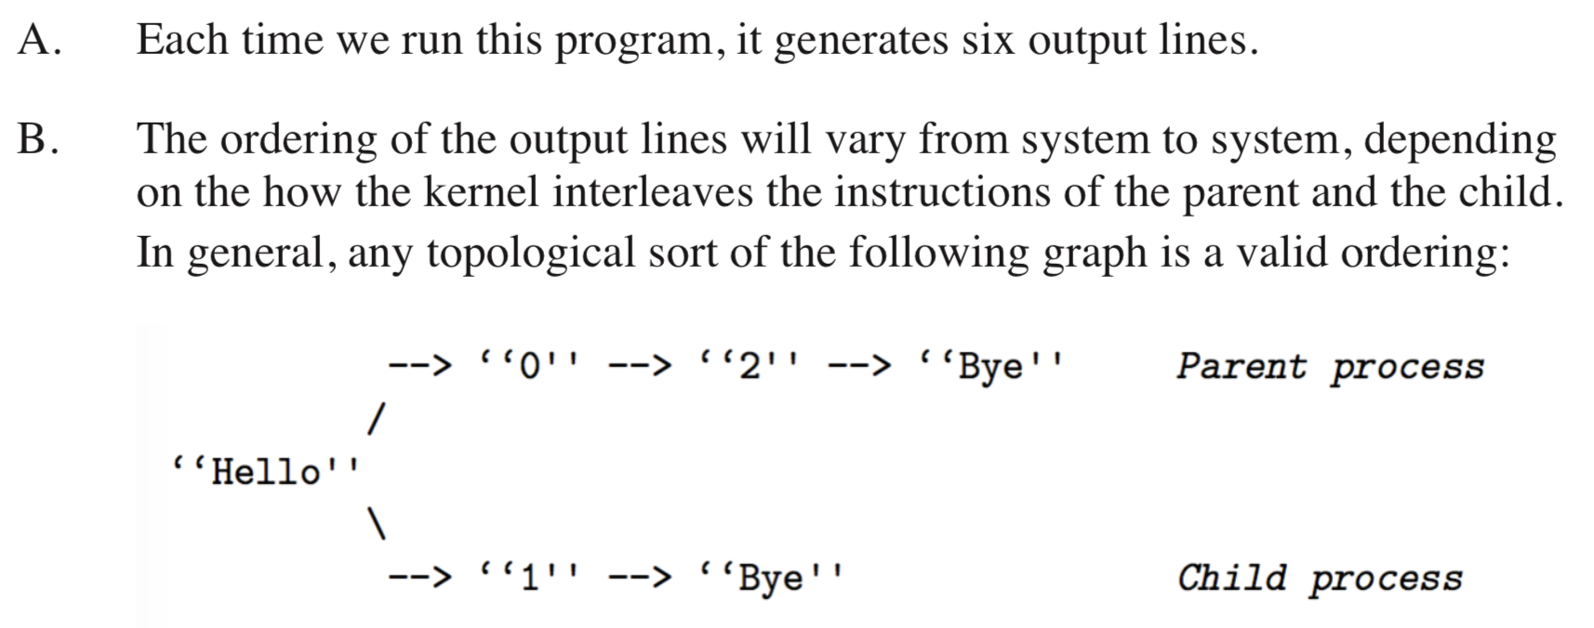
练习答案

Slide 52
Putting Process to Sleep
#include <unistd.h> unsigned int sleep(unsigned int secs); Returns: seconds left to sleep int pause(void); Always returns -1
sleep
  挂起一个进程一段时间；
  如果请求的时间量已经到了，则返回0；
  否则返回剩下还要休眠的秒数
    如果sleep函数被一个信号中断而过早返回时，会没有休眠足够的描述而提前返回。

Slide 53
Putting Process to Sleep
#include <unistd.h> unsigned int sleep(unsigned int secs); Returns: seconds left to sleep int pause(void); Always returns -1
pause
  让调用函数休眠，直到该进程收到一个信号

Slide 54
课堂练习
Write a wrapper function for sleep, called snooze, with the following interface:
unsigned int snooze(unsigned int secs);
The snooze function behaves exactly as the sleep function, except that it prints a message describing how long the process actually slept:
Slept for 4 of 5 secs.
（考虑到sleep可能收到信号提前返回）

Slide 55
练习答案
unsigned int snooze(unsigned int secs) {
unsigned int rc = sleep(secs);
printf("Slept for %u of %u secs.\n", secs - rc, secs);
return rc;
}

Slide 56
课堂练习
一个进程初始化一个长度为n的整形数组arr，然后创建一个子进程，父进程和子进程再各自创建一个进程（共4个进程），每个进程打印这个整形数组的1/4（不重复，且将整个数组打印完成，不需要考虑打印熟悉；假设n能够被4整除）。
请写出代码/伪代码。
Notes:
初始化数组后，start = 0, len = n
子进程分支中，start += len/2, len = len/2

Slide 57
课堂练习
一个进程初始化一个长度为n的整形数组arr，然后创建一个子进程，父进程和子进程再各自创建一个进程，以此类推（共2^{m}个进程），每个进程打印这个整形数组的1/2^{m}（不重复，且将整个数组打印完成，假设n能够被2^{m}整除）。
请写出代码。

Slide 58
父进程与子进程
父进程等待子进程结束
  Waitpid()
子进程等待父进程结束
  轮询（polling）
    While (getppid() != 1)
      sleep(1);
    getppid()返回父进程PID，永远成功返回
      PID=1: ？
  或者采用效率更高的信号机制

Slide 59
竞争条件
子进程和父进程各输出一个字符串
static void charatatime(char *);
int main(void) {
  pid_t pid;
  if((pid=fork()) < 0) {
    err_sys(“fork error”);
  }else if (pid == 0) {
    charatatime(“output form child\n”);
  }else {
    charatatime(“output form parant\n”);
  }
  exit(0);
}
// char at a time
Static void charatatime(char *str) {
  Char *ptr;
  Int c;
  Setbuf(stdout, NULL);
  For(ptr=str; (c=*ptr++)!=0;)
    Putc(c, stdout);
}
Setbuf(): 三种buffer方式：unbuffered, block buffered, and line buffered
http://man7.org/linux/man-pages/man3/setbuf.3.html

Slide 60
竞争条件
输出结果：
  #./a.out
  ooutput from child
  utput from parent
  #./a.out
  output from child
  output from parent
为什么？
怎么改进程序？子->父；父->子
假设有以下宏
TELL_PARENT(pid_t)
WAIT_PARENT()：阻塞
TELL_CHILD(pid_t)
WAIT_CHILD()：阻塞
来互相通信

Slide 61
竞争条件
先子后父
int main(void) {
  pid_t pid;
  if((pid=fork()) < 0) {
    err_sys(“fork error”);
  }else if (pid == 0) {
    charatatime(“output form child\n”);
    TELL_PARANT(getppid());
  }else {
    WAIT_CHILD();
    charatatime(“output form parant\n”);
  }
  exit(0);
}

Slide 62
竞争条件
先父后子
int main(void) {
  pid_t pid;
  if((pid=fork()) < 0) {
    err_sys(“fork error”);
  }else if (pid == 0) {
    WAIT_PARENT();
    charatatime(“output form child\n”);
  }else {
    charatatime(“output form parant\n”);
    TELL_CHILD(pid);
  }
  exit(0);
}

Slide 63
竞争条件
对于前面先父后子的程序，用$./a.out输出一次是正确的。但是用下列方式执行多次，输出就不正确了。
$./a.out;./a.out;./a.out
output from parent
ooutput from parent
ouotput from child
put from parent
output from child
utput from child
原因是什么？怎么样才能改正错误？如果先子后父，会不会有上述问题？

Slide 64
竞争条件
原因：
  Shell一行执行多个命令，当父进程结束，就开始执行下一个命令，不管子进程是否执行完。
  因此child的数据会与parent的随机交叉
  先子后父，不会交叉

Slide 65
竞争条件
int main(void) {
  pid_t pid;
  if((pid=fork()) < 0) {
    err_sys(“fork error”);
  }else if (pid == 0) {
    WAIT_PARENT();
    charatatime(“output form child\n”);
    TELL_PARENT(getppid());
  }else {
    charatatime(“output form parant\n”);
    TELL_CHILD(pid);
    WAIT_CHILD();
  }
  exit(0);
}

Slide 66
Loading and Running
#include <unistd.h> int execve(const char *filename, const char *argv[], const char *envp[]); does not return if OK, returns -1 on error
Loads and runs
  the executable object file filename
  with the argument list argv
  the environment variable list envp.
  returns to the calling program only if there is an error
    such as not being able to find filename.
The Execve is called once and never returns

Slide 67
Loading and Running
int execve(const char *filename, const char *argv[],
const char *envp[]);
argv[]
argv
argv[0]
"ls"
argv[1]
"-lt"
...
argv[argc-1]
NULL
"/usr/include"
envp[]
envp
envp[0]
"PWD=/usr/droh"
envp[1]
"PRINTER=iron"
...
envp[n-1]
NULL
"USER=droh"

Slide 68
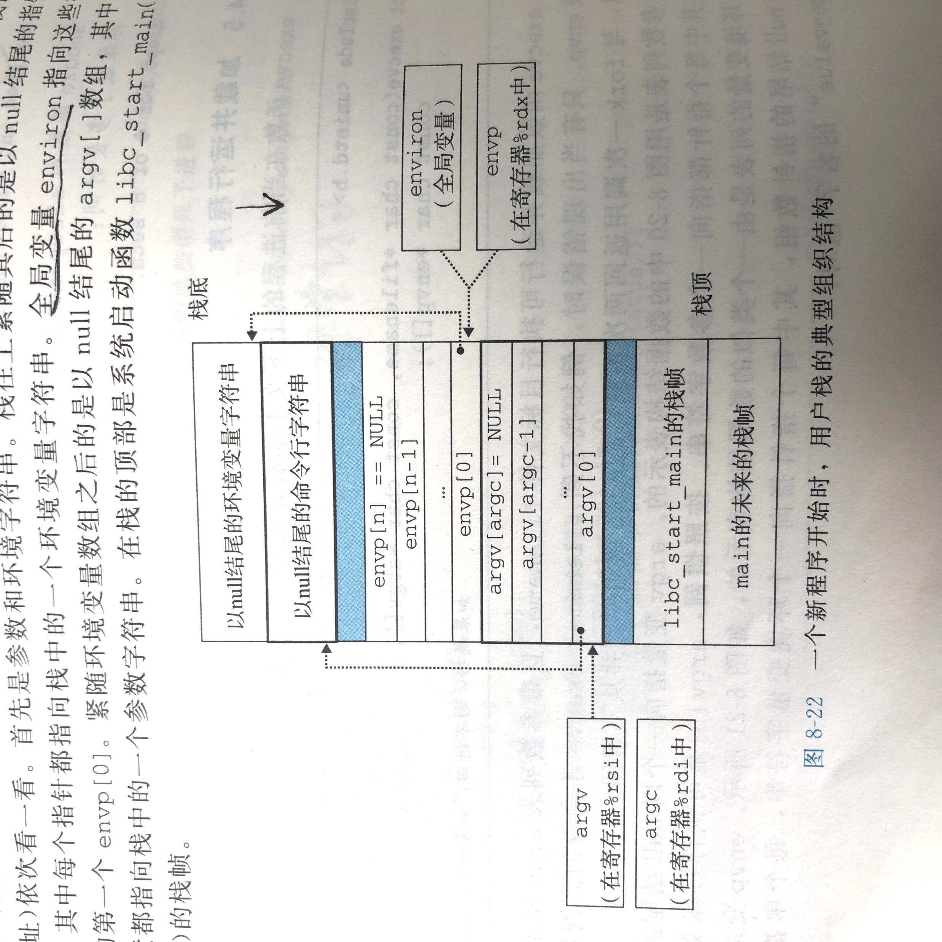
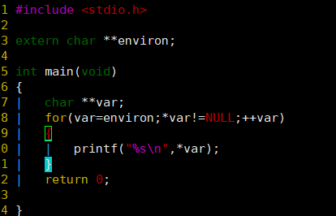
The user stack when a new program starts

Slide 69
Loading and Running
#include <unistd.h> char *getenv(const char *name); Returns: ptr to name if exists, NULL if no match. int setenv(const char *name, const char *newvalue, int overwrite); Returns: 0 on success, -1 on error. void unsetenv(const char *name); Returns: nothing.

Slide 70
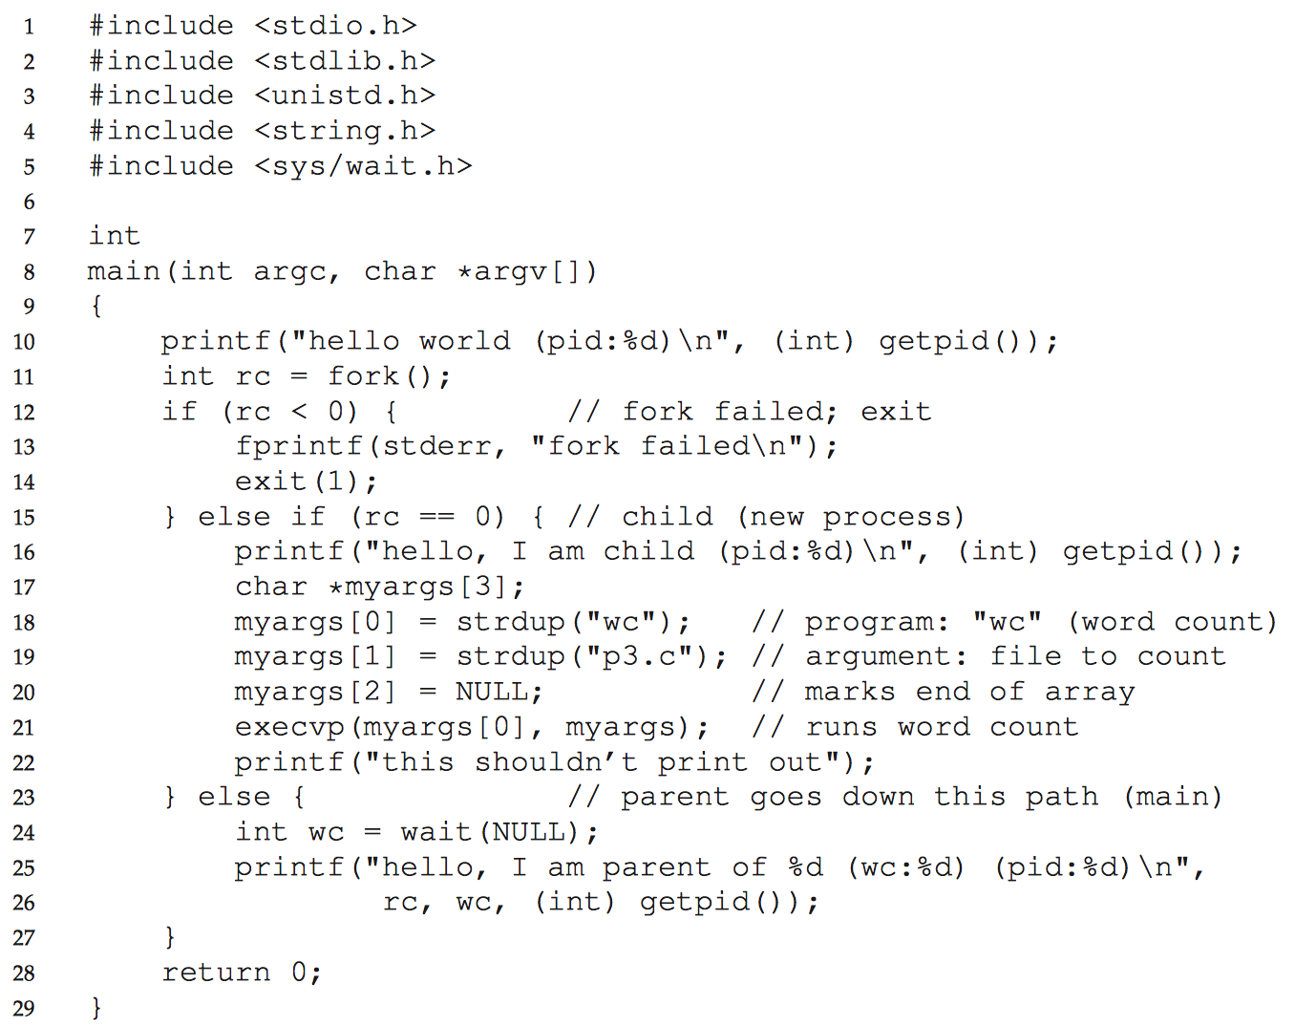
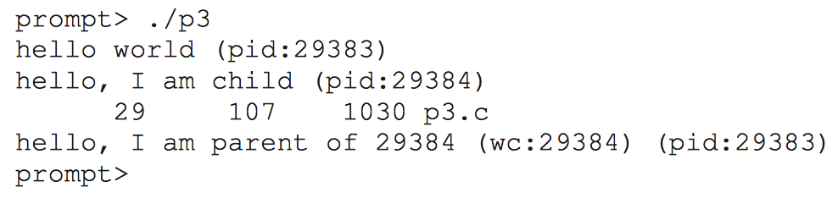
Exec
wc统计文件的行数、字数、字节数
一个字被定义为由空白、跳格或换行字符分隔的字符串

Slide 71
Why? Motivating the API
为什么采用fork和exec的组合来创建进程？
  因为用来写Unix Shell
    Shell进程（父进程）先fork出一个子进程
    然后子进程exec执行用户输入的命令/程序
    父进程wait，直到子进程结束（前端模式）
    父进程不wait，可以继续输入其他命令（后端模式&）
  而且能够解决问题
Lab1: 写一个自己的Shell程序，核心就是fork和exec

Slide 72
Unix Shell
An interactive application-level program that
  runs other program on behalf of the user
Variants: sh, csh, tcsh, ksh, bash
Performs a sequence of read/evaluate steps and terminate
  Read: reads a command line from the user
  Evaluate: parses the command line and runs programs on behalf of the user

Slide 73
/* The main routine for a simple shell program */
1 #include "csapp.h"
2 #define MAXARGS 128
3
4 /* function prototypes */
5 void eval(char*cmdline);
6 int parseline(const char *cmdline, char **argv);
7 int builtin_command(char **argv);
8

Slide 74
9 int main()
10 {
11 char cmdline[MAXLINE]; /* command line */
12
13 while (1) {
14 /* read */
15 printf("> ");
16 Fgets(cmdline, MAXLINE, stdin);
17 if (feof(stdin))
18 exit(0);
19
20 /* evaluate */
21 eval(cmdline);
22 }
23 }

Slide 75
1 /* eval - evaluate a command line */
2 void eval(char *cmdline)
3 {
4 char *argv[MAXARGS]; /* argv for execve() */
5 char buf[MAXLINE]; /* holds modified cmd line */
6 int bg; /* should the job run in bg or fg? */
7 pid_t pid; /* process id */
8
9 strcpy(buf, cmdline);
10 bg = parseline(buf, argv);
11 if (argv[0] == NULL)
12 return; /* ignore empty lines */
13

Slide 76
Parsing command line
Parse the space separated command-line arguments
Builds the argv vector
  which will eventually be passed to execve

Slide 77
1 /* parse the cmd line and build the argv array */
2 int parseline(const char *cmdline, char **argv)
3 {
4 char *delim; /* first space delimiter */
5 int argc; /* number of args */
6 int bg; /* background job? */
7
8 buf[strlen(buf)-1] = ’ ’;
/* replace trailing ’\n’ with space */
12 while (*buf && (*buf == ’ ’)) /* ignore spaces */
13 buf++;
14

Slide 78
12 /* build the argv list */
13 argc = 0;
14 while ((delim = strchr(buf, ’ ’))) {
15 argv[argc++] = buf;
16 *delim = ’\0’; /* replace space with ’\0’*/
17 buf = delim + 1;
18 while (*buf && (*buf == ’ ’)) /* ignore spaces */
19 buf++;
20 }
21 argv[argc] = NULL; /* set the end of argv list */
22
23 if (argc == 0) /* ignore blank line */
24 return 1;
25
26 /* should the job run in the background? */
27 if ((bg = (*argv[argc-1] == ’&’)) != 0)
28 argv[--argc] = NULL;
29 return bg;
30 }

Slide 79
Parsing command line
The first argument is assumed to be
  either the name of a built-in shell command
    that is interpreted immediately
  or an executable object file
    that will be loaded and run in the context of
    a new child process

Slide 80
14 if (!builtin_command(argv)) {
15 if ((pid = Fork()) == 0) { /* execute in child */
16 if (execve(argv[0], argv, environ) < 0) {
17 printf("%s: Command not found.\n", argv[0]);
18 exit(0);
19 }
20 }
21

Slide 81
14 if (!builtin_command(argv)) {
15 if ((pid = Fork()) == 0) { /* execute in child */
16 if (execve(argv[0], argv, environ) < 0) {
17 printf("%s: Command not found.\n", argv[0]);
18 exit(0);
19 }
20 }
21
34 /* if 1st arg is a builtin command,
run it and return true */
35 int builtin_command(char **argv)
36 {
37 if (!strcmp(argv[0], "quit")) /* quit command */
38 exit(0);
39 if (!strcmp(argv[0], "&")) /* ignore singleton & */
40 return 1;
41 return 0; /* not a builtin command */
42 }

Slide 82
Foreground and Background
If the last argument is a “&” character
  parseline returns 1
  indicating the program should be executed in the background
  (the shell returns to the top of the loop and waits for the next command)
Otherwise
  parseline returns 0
  indicating the program should be run in the foreground
  (the shell waits for it to complete)

Slide 83
14 if (!builtin_command(argv)) {
15 if ((pid = Fork()) == 0) { /* execute in child */
16 if (execve(argv[0], argv, environ) < 0) {
17 printf("%s: Command not found.\n", argv[0]);
18 exit(0);
19 }
20 }
21
22 /* parent waits for foreground job to terminate */
23 if (!bg) { /* foreground */
24 int status;
25 if (waitpid(pid, &status, 0) < 0)
26 unix_error("waitfg: waitpid error");
27 }
28 else
29 printf("%d %s", pid, cmdline);
30 }
31 return;
32 }

Slide 84
homework2
提交时间：3月10日
obe.ruc.edu.cn上传电子版

