Slide 1
Virtual Memory (I)
Introduction
*
Notes:
*

Slide 2
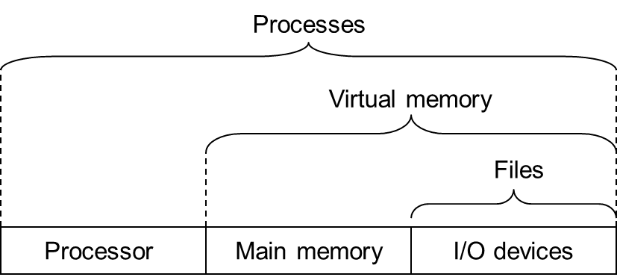
OS: Three Easy Pieces
虚拟化
持久化
并发
*

Slide 3
Virtualization
计算机主要硬件
  CPU（运算器/控制器）
    进程
  内存（存储器）
    虚拟内存
  外存（输入输出）
    文件系统
*

Slide 4
Outline
VM History
VM Overview
Memory API
VM Discussions
*

Slide 5
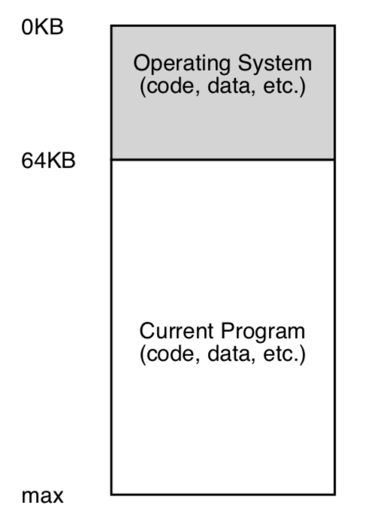
Early Systems
直接使用物理地址，没有抽象
OS还只是一些库，放在内存地址0开始的一段地址空间
用户程序从某个地址开始（如64K），使用剩余的全部内存
用户程序都要自己搞定，对OS没有多少期待
*

Slide 6
Multiprogramming and Time Sharing
Multiprogramming
  多个程序并发（不并行），当有程序在进行Io操作时，其他进程可以利用CPU，提高CPU利用率
Time Sharing
  Batch processing的反应太慢，用户感受不好
    例如debug过程反馈时间很长
  让用户感觉自己独享整个计算机
    用户的interactivity开始重要
*

Slide 7
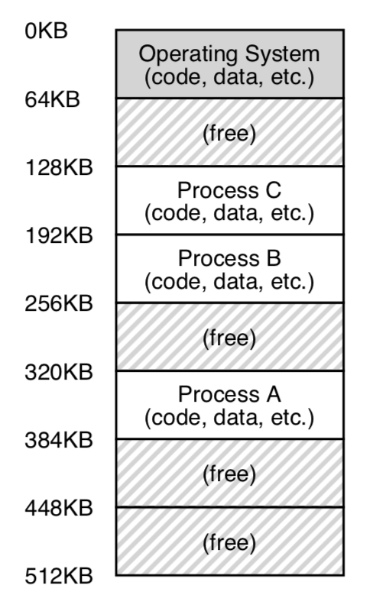
Time Sharing Implementation
Method 1. 每次一个程序独占全部内存
  好处：内存更大，程序执行更快
  缺点：切换任务时，需要有大量的I/O，因此性能很差
Method 2. 每个程序都留在内存中
  各占用一部分内存
三个进程共享内存
*

Slide 8
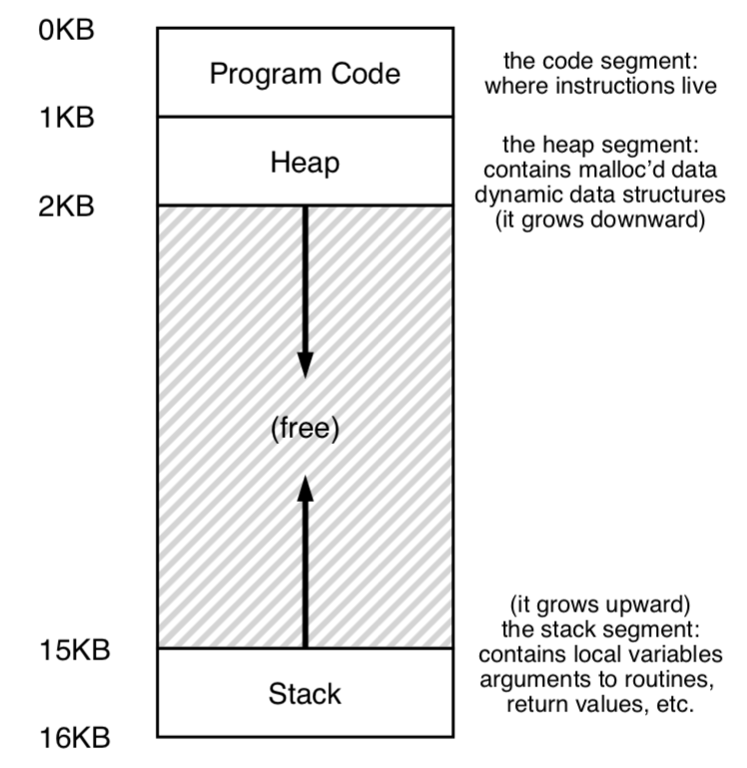
Multi-program -> Protection
为了不让进程之间互相访(po)问(huai)对方的内存
  Abstraction: address space
    每个进程应该只能看到属于自己的内存空间
    那么就不能把物理地址直接给用户
    建立虚拟地址空间，以及虚拟地址和物理地址间的映射
*

Slide 9
Multi-program -> Protection
Address space
  Code区域
  Stack区域
  Heap区域
  看不到其他进程的内存空间
  也看不到内核程序的内存空间
*

Slide 10
VM Overview
*

Slide 11
Virtual Memory
Abstraction
  假的，但是方便使用
Transparent
  用户程序感知不到，以为是真的
  在物理地址和虚拟地址上都能跑
Efficient
  否则用户不太能接受VM机制（性能是前提
Protection / Isolation
  进程无法访问其他进程、内核的地址空间
  任意一条指令执行时，不能访问到自己空间以外的地方
*

Slide 12
Virtual Memory
Addresses
  Virtual address
  Logical address
  Physical address
*

Slide 13
Physical Addressing
Attributes of the main memory
  Organized as an array of M contiguous byte-sized cells
  Each byte has a unique physical address (PA) started from 0
physical addressing
  A CPU use physical addresses to access memory
Examples
  Early PCs, DSP, embedded microcontrollers, and Cray supercomputers
*
Notes:
*

Slide 14
A System Using Physical Addressing
Main memory
0:
1:
Physical address
(PA)
2:
CPU
3:
4:
4
5:
6:
7:
8:
...
M-1:
Data word
Used in “simple” systems like embedded microcontrollers in devices like cars, elevators, and digital picture frames
*
Notes:
*

Slide 15
Virtual Addressing
Virtual addressing
  the Program accesses main memory by a virtual address (VA)
    The virtual address is converted to the appropriate physical address by hardware
*
Notes:
*

Slide 16
Virtual Addressing
Address translation
  Converting a virtual address to a physical address
  Requires close cooperation between the CPU hardware and the operating system
    HW: the memory management unit (MMU)
      Dedicated hardware on the CPU chip to translate virtual addresses on the fly
    SW: A look-up table (MMU可以访问)
      Stored in main memory
      Contents are managed by the operating system
*
Notes:
*

Slide 17
A System Using Virtual Addressing
Main memory
0:
CPU Chip
1:
Virtual address
(VA)
Physical address
(PA)
2:
CPU
MMU
3:
4:
4100
4
5:
6:
7:
8:
...
M-1:
Data word
Used in all modern servers, desktops, and laptops
One of the great ideas in computer science
*
Notes:
*

Slide 18
Address Space
N-bit Address Space
  Virtual address space:
    Set of N = 2^{n} virtual addresses {0, 1, 2, 3, …, N-1}
  Physical address space:
    Set of M = 2^{m} physical addresses {0, 1, 2, 3, …, M-1}
Each object can now have multiple addresses
  one physical address, one (or more) virtual addresses
*
Notes:
*

Slide 19
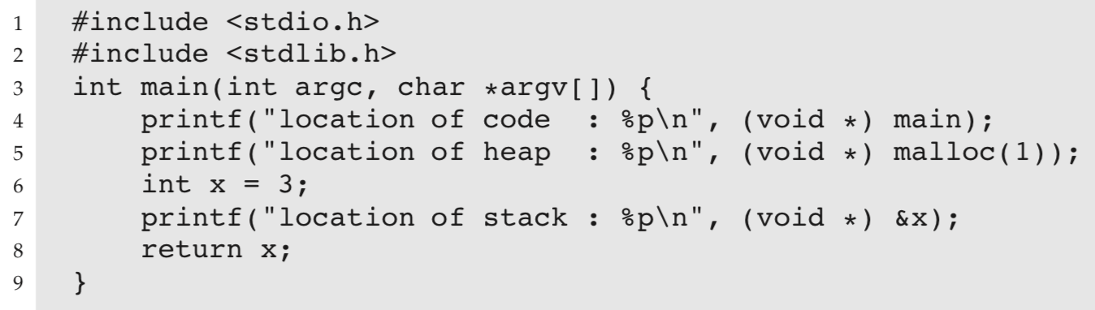
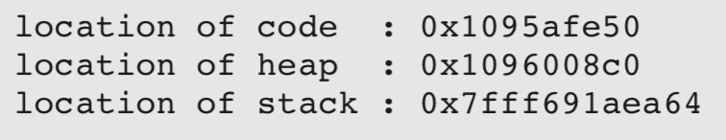
Virtual Memory
打印程序中各部分地址
  打印出来的都是virtual address
64-bit Mac OS：
  先是code，然后是heap，再是stack
*

Slide 20
练习4-1
填写下表中的空格和?
K=2¹⁰(Kilo), M=2²⁰(Mega), G=2³⁰(Giga), T=2⁴⁰(Tera), P=2⁵⁰(Peta), E=2⁶⁰(Exa)
#virtual address bits (n) | #virtual address (N) | Largest possible virtual address
8
 | 64K
 | 2?=256T
64
2³²-1=?G-1
*
Notes:
*

Slide 21
练习4-1答案
K=2¹⁰(Kilo), M=2²⁰(Mega), G=2³⁰(Giga), T=2⁴⁰(Tera), P=2⁵⁰(Peta), E=2⁶⁰(Exa)
#virtual address bits (n) | #virtual address (N) | Largest possible virtual address
8
 | 64K
32
 | 256T
64
256
255
16
64K-1
4G
4G-1
48
256T-1
16E
16E-1
*
Notes:
*

Slide 22
Memory API
*

Slide 23
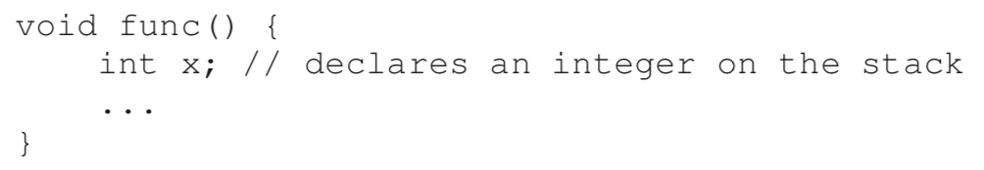
Memory API
Stack:
  申请局部变量
全局变量区
  全局变量，静态变量
*

Slide 24
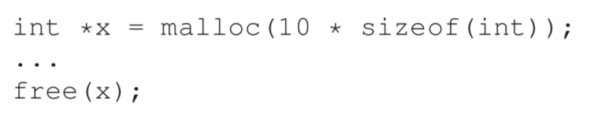
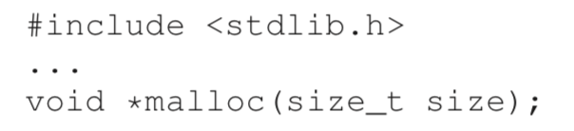
Memory API
Heap：
  Malloc(), free()
*

Slide 25
Memory API
Malloc(), free()不是system call
  只是library call，C函数库内部通过一定的结构来保存当前有多少可用内存
  如果程序 malloc的大小超出了库里所留存的空间，那么将首先调用brk系统调用来增加可用空间，然后再分配空间
    调用其他system call：brk, mmap
  free时,释放的内存并不立即返回给os, 而是保留在内部结构中
系统调用通常提供一种最小功能，而库函数通常提供比较复杂的功能。
*

Slide 26
Memory API
brk
  改变heap区大小的system call，修改heap end指针
  不要直接调用，一般都是内存分配的库函数调用
此外还用到了mmap系统调用
  后面详细介绍
*

Slide 27
Memory API
Calloc()
  Malloc() + 初始化为0
Realloc()
  重新分配空间，扩充分配空间
  具体操作是找到一个更大的空间，然后把旧的数据复制过去，返回新空间的指针
*

Slide 28
VM Discussions
*

Slide 29
Why Virtual Memory (VM)?
Uses main memory efficiently
  Use DRAM as a cache for the parts of a virtual address space
Simplifies memory management
  Each process gets the same uniform linear address space
Isolates address spaces
  One process can’t interfere with another’s memory
  User program cannot access privileged kernel information

Slide 30
Using Main Memory as a Cache
SRAM
DRAM
Disk
*
Notes:
*

Slide 31
Using Main Memory as a Cache
DRAM vs. disk is more extreme than SRAM vs. DRAM
  Access latencies:
    DRAM ~10X slower than SRAM
    Disk ~100,000X slower than DRAM
  Bottom line:
    Design decisions made for DRAM caches driven by enormous cost of misses
*
Notes:
*

Slide 32
Design Considerations
Line size? (Large vs. Small)
  Large, since disk better at transferring large blocks
Associativity? (Full vs. Direct)
  Full, to minimize miss rate（全相连/组相连/直接映射）
Write through or write back? (WB vs. WT)
  Write back, since can’t afford to perform small writes to disk
*
Notes:
*

Slide 33
Page
Virtual memory
  Organized as an array of contiguous byte-sized cells stored on disk conceptually
  Each byte has a unique virtual address that serves as an index into the array
  The contents of the array on disk are cached in main memory
*
Notes:
*

Slide 34
Page
The data on disk is partitioned into blocks
  Serve as the transfer units between the disk and the main memory
  virtual pages (VPs)
  physical pages (PPs)
    or page frames
Virtual memory
Physical memory
VP 0
Unallocated
0
VP 1
Cached
0
Empty
PP 0
Uncached
PP 1
Unallocated
Empty
Cached
Uncached
Empty
Cached
M-1
PP 2^{m-p}-1
VP 2^{n-p}-1
Uncached
N-1
Virtual pages (VPs)
stored on disk
Physical pages (PPs)
cached in DRAM
*
Notes:
*

Slide 35
Page Attributes
Unallocated:
  Pages that have not yet been allocated (or created) by the VM system
  Do not have any data associated with them
  Do not occupy any space on disk.
*
Notes:
*

Slide 36
Page Attributes
Cached:
  Allocated pages that are currently cached in physical memory.
Uncached:
  Allocated pages that are not cached in physical memory.
*
Notes:
*

Slide 37
Enabling Data Structure: Page Table
A page table is an array of page table entries (PTEs) that maps virtual pages to physical pages.
  Per-process kernel data structure in DRAM
Physical memory
(DRAM)
Physical page
number or
disk address
Valid
VP 1
PP 0
PTE 0
0
null
VP 2
1
VP 7
VP 4
PP 3
1
0
1
0
null
Virtual memory
(disk)
0
PTE 7
1
VP 1
Memory resident
page table
(DRAM)
VP 2
VP 3
VP 4
VP 6
VP 7

Slide 38
(补充)系统中常用的数据结构
数组、链表、队列、栈（多队列、环）
二叉树、平衡二叉树、红黑树
B树、B+树
LSM-Tree（多层有序）
前缀树（Trie树）、Radix Tree
Skiplist
Hash table
(Hash is sort)
Bitmap(位图), Bloom filter
*

Slide 39
Page Hit
Page hit: reference to VM word that is in physical memory (DRAM cache hit)
Physical memory
(DRAM)
Physical page
number or
disk address
Virtual address
Valid
VP 1
PP 0
PTE 0
0
null
VP 2
1
VP 7
VP 4
PP 3
1
0
1
0
null
Virtual memory
(disk)
0
PTE 7
1
VP 1
Memory resident
page table
(DRAM)
VP 2
VP 3
VP 4
VP 6
VP 7

Slide 40
Page Fault
Page fault: reference to VM word that is not in physical memory (DRAM cache miss)
Physical memory
(DRAM)
Physical page
number or
disk address
Virtual address
Valid
VP 1
PP 0
PTE 0
0
null
VP 2
1
VP 7
VP 4
PP 3
1
0
1
0
null
Virtual memory
(disk)
0
PTE 7
1
VP 1
Memory resident
page table
(DRAM)
VP 2
VP 3
VP 4
VP 6
VP 7

Slide 41
Handling Page Fault
Page miss causes page fault (an exception)
Physical memory
(DRAM)
Physical page
number or
disk address
Virtual address
Valid
VP 1
PP 0
PTE 0
0
null
VP 2
1
VP 7
VP 4
PP 3
1
0
1
0
null
Virtual memory
(disk)
0
PTE 7
1
VP 1
Memory resident
page table
(DRAM)
VP 2
VP 3
VP 4
VP 6
VP 7

Slide 42
Handling Page Fault
Page miss causes page fault (an exception)
Page fault handler selects a victim to be evicted (here VP 4)
Physical memory
(DRAM)
Physical page
number or
disk address
Virtual address
Valid
VP 1
PP 0
PTE 0
0
null
VP 2
1
VP 7
VP 4
PP 3
1
0
1
0
null
Virtual memory
(disk)
0
PTE 7
1
VP 1
Memory resident
page table
(DRAM)
VP 2
VP 3
VP 4
VP 6
VP 7

Slide 43
Handling Page Fault
Page miss causes page fault (an exception)
Page fault handler selects a victim to be evicted (here VP 4)
Physical memory
(DRAM)
Physical page
number or
disk address
Virtual address
Valid
VP 1
PP 0
PTE 0
0
null
VP 2
1
VP 7
VP 3
PP 3
1
1
0
0
null
Virtual memory
(disk)
0
PTE 7
1
VP 1
Memory resident
page table
(DRAM)
VP 2
VP 3
VP 4
VP 6
VP 7

Slide 44
Handling Page Fault
Page miss causes page fault (an exception)
Page fault handler selects a victim to be evicted (here VP 4)
Offending instruction is restarted: page hit!
Physical memory
(DRAM)
Physical page
number or
disk address
Virtual address
PP 0
Valid
VP 1
PTE 0
0
null
VP 2
VP 7
PP 3
1
VP 3
1
1
0
0
null
Virtual memory
(disk)
0
PTE 7
1
VP 1
Memory resident
page table
(DRAM)
VP 2
VP 3
VP 4
VP 6
VP 7

Slide 45
Allocating Pages
Allocating a new page (VP 5) of virtual memory.
Physical memory
(DRAM)
Physical page
number or
disk address
Valid
VP 1
PP 0
PTE 0
0
null
VP 2
1
VP 7
VP 3
PP 3
1
1
0
0
Virtual memory
(disk)
0
PTE 7
1
VP 1
Memory resident
page table
(DRAM)
VP 2
VP 3
VP 4
VP 5
VP 6
VP 7

Slide 46
Page Faults
Swapping or paging
Swapped out or paged out
Demand paging(按需页面调度--lazy)
Before fault
After fault
Memory
Memory
Page Table
Virtual
Addresses
Physical
Addresses
Page Table
Virtual
Addresses
Physical
Addresses
CPU
CPU
Disk
Disk
*
Notes:
*

Slide 47
Servicing a Page Fault
(1) Initiate Block Read
Processor Signals Controller
  Read block of length P starting at disk address X and store starting at memory address Y
Processor
Reg
Cache
bio
Memory-I/O bus
I/O
controller
Memory
Disk
Disk
*
Notes:
*

Slide 48
Servicing a Page Fault
Read Occurs
  Direct Memory Access (DMA)
  Under control of I/O controller
Processor
Reg
Cache
Memory-I/O bus
(2) DMA Transfer
I/O
controller
Memory
disk
disk
Disk
Disk
*
Notes:
*

Slide 49
Servicing a Page Fault
I / O Controller Signals Completion
  Interrupt processor
  OS resumes suspended process
Processor
Reg
(3) Read Done
Cache
Memory-I/O bus
I/O
controller
Memory
disk
disk
Disk
Disk
*
Notes:
*

Slide 50
Locality to the Rescue Again!
Virtual memory works because of locality
At any point in time, programs tend to access a set of active virtual pages called the working set
  Programs with better temporal locality will have smaller working sets

Slide 51
Locality to the Rescue Again!
If (working set size < main memory size)
  Good performance for one process after compulsory misses
If ( SUM(working set sizes) > main memory size )
  Thrashing(颠簸): Performance meltdown where pages are swapped (copied) in and out continuously

Slide 52
Why Virtual Memory (VM)?
Uses main memory efficiently
  Use DRAM as a cache for the parts of a virtual address space
Simplifies memory management
  Each process gets the same uniform linear address space
Isolates address spaces
  One process can’t interfere with another’s memory
  User program cannot access privileged kernel information

Slide 53
VM as a Tool for Memory Management
Key idea: each process has its own virtual address space
  分层思想：链接、加载、共享、内存分配等很多操作和进程空间相关，于是每个进程的内存空间一样；逻辑页->物理页单独管理，与以上这些操作无关
  否则：用户进程在做内存访问时，都需要考虑是否在内存中
Virtual Address Space for Process 1:
0
0
Physical
Address
Space (DRAM)
VP 1
VP 2
PP 2
...
N-1
Address
translation
(e.g., read-only
library code)
PP 6
Virtual Address Space for Process 2:
0
PP 8
VP 1
VP 2
...
...
N-1
M-1

Slide 54
VM as a Tool for Memory Management
Memory allocation
  Each virtual page can be mapped to any physical page
  A virtual page can be stored in different physical pages at different times
  由于有页表，分配时看起来连续的内存，物理内存页未必连续
0
0
Physical
Address
Space (DRAM)
Virtual Address Space for Process 1:
VP 1
VP 2
PP 2
...
N-1
Address
translation
(e.g., read-only
library code)
PP 6
Virtual Address Space for Process 2:
0
PP 8
VP 1
VP 2
...
...
N-1
M-1

Slide 55
VM as a Tool for Memory Management
Sharing code and data among processes
  Map virtual pages to the same physical page
Virtual Address Space for Process 1:
0
0
Physical
Address
Space (DRAM)
VP 1
VP 2
PP 2
...
N-1
Address
translation
(e.g., read-only
library code)
PP 6
Virtual Address Space for Process 2:
0
PP 8
VP 1
VP 2
...
...
N-1
M-1

Slide 56
Simplifying Linking and Loading
Memory
invisible to
user code
Kernel virtual memory
Linking
  Each program has similar virtual address space
  Code, stack, and shared libraries always start at the same address
0xc0000000
User stack
(created at runtime)
%esp
(stack
pointer)
Memory-mapped region for
shared libraries
0x40000000
brk
Run-time heap
(created by malloc)
Read/write segment
(.data, .bss)
Loaded
from
the
executable
file
Read-only segment
(.init, .text, .rodata)
否则用户程序还要关心
自己程序所在的物理地址
0x08048000
Unused
0

Slide 57
Simplifying Linking and Loading
Memory
invisible to
user code
Kernel virtual memory
Loading
  execve() allocates virtual pages for .text and .data sections
  = creates PTEs marked as invalid
  The .text and .data sections are copied, page by page, on demand by the virtual memory system
0xc0000000
User stack
(created at runtime)
%esp
(stack
pointer)
Memory-mapped region for
shared libraries
0x40000000
brk
Run-time heap
(created by malloc)
Read/write segment
(.data, .bss)
Loaded
from
the
executable
file
Read-only segment
(.init, .text, .rodata)
0x08048000
Unused
0

Slide 58
Why Virtual Memory (VM)?
Uses main memory efficiently
  Use DRAM as a cache for the parts of a virtual address space
Simplifies memory management
  Each process gets the same uniform linear address space
Isolates address spaces
  One process can’t interfere with another’s memory
  User program cannot access privileged kernel information

Slide 59
VM as a Tool for Memory Protection
Extend PTEs with permission bits
  The same physical page has different permission for different process
Physical
Address Space
Process i:
SUP
READ
WRITE
Address
VP 0:
No
Yes
No
PP 6
VP 1:
No
Yes
Yes
PP 4
VP 2:
Yes
Yes
Yes
PP 2
PP 2
•
•
•
PP 4
PP 6
Process j:
SUP
READ
WRITE
Address
PP 8
VP 0:
No
Yes
No
PP 9
PP 9
VP 1:
Yes
Yes
Yes
PP 6
VP 2:
No
Yes
Yes
PP 11
PP 11

Slide 60
VM as a Tool for Memory Protection
Page fault handler checks these before remapping
  If violated, send process SIGSEGV (segmentation fault)
Physical
Address Space
Process i:
SUP
READ
WRITE
Address
VP 0:
No
Yes
No
PP 6
VP 1:
No
Yes
Yes
PP 4
VP 2:
Yes
Yes
Yes
PP 2
PP 2
•
•
•
PP 4
(SUP=Yes: Kernel才可访问)
PP 6
Process j:
SUP
READ
WRITE
Address
PP 8
VP 0:
No
Yes
No
PP 9
PP 9
VP 1:
Yes
Yes
Yes
PP 6
VP 2:
No
Yes
Yes
PP 11
PP 11

Slide 61
Homework4 (code)
In this homework, you will gain some familiarity with memory allocation.
  First, you’ll write some buggy programs (fun!).
  Then, you’ll use some tools to help you find the bugs you inserted.
  Then, you will realize how awesome these tools are and use them in the future, thus making yourself more happy and productive.
  The tools are the debugger (e.g., gdb), and a memory-bug detector called valgrind.
*

Slide 62
Questions
1. First, write a simple program called null.c that creates a pointer to an integer, sets it to NULL, and then tries to dereference it. Compile this into an executable called null. What happens when you run this program?
2. Next, compile this program with symbol information included (with the-g flag). Doing so let’s put more information into the executable, enabling the debugger to access more useful information about variable names and the like. Run the program under the debugger by typing gdb null and then, once gdb is running, typing run. What does gdb show you?
*

Slide 63
Questions
3. Finally, use the valgrind tool on this program. We’ll use the memcheck tool that is a part of valgrind to analyze what happens. Run this by typing in the following: valgrind --leak-check=yes null. What happens when you run this? Can you interpret the output from the tool?
4. Write a simple program that allocates memory using malloc() but forgets to free it before exiting. What happens when this program runs? Can you use gdb to find any problems with it? How about valgrind (again with the --leak-check=yes flag)?
*

Slide 64
Questions
5. Write a program that creates an array of integers called data of size 100 using malloc; then, set data[100] to zero. What happens when you run this program? What happens when you run this program using valgrind? Is the program correct?
6. Create a program that allocates an array of integers (as above), frees them, and then tries to print the value of one of the elements of the array. Does the program run? What happens when you use valgrind on it?
*

Slide 65
Questions
7. Now pass a funny value to free (e.g., a pointer in the middle of the array you allocated above). What happens? Do you need tools to find this type of problem?
8. Try out some of the other interfaces to memory allocation. For example, create a simple vector-like data structure and related routines that use realloc() to manage the vector. Use an array to store the vectors elements; when a user adds an entry to the vector, use realloc() to allocate more space for it. How well does such a vector perform? How does it compare to a linked list? Use valgrind to help you find bugs.
*

