Slide 1
Virtual Memory (III) swap, system, mmap

Slide 2
Outline
Swap
Practical System Examples
Memory Mapping

Slide 3
Swap
为了支持更多的并发执行进程，所有进程的虚存空间总和可能远大于物理内存
  进程Vm空间大的好处：
    Data structure不用考虑memory空间的限制
    不过实际上完全不考虑也是不负责任的，例如外排算法（当数据量非常大时）
  不能保证每个VPN都对应一个PPN
  资源不够时，只能将部分内存中的内容交换到磁盘上

Slide 4
Swap
Swap space
  磁盘上需要保留一定空间，专门用来存放交换出来的内存中的内容
  Swap space大小直接决定Vm空间的大小
  一般假设swap空间足够

Slide 5
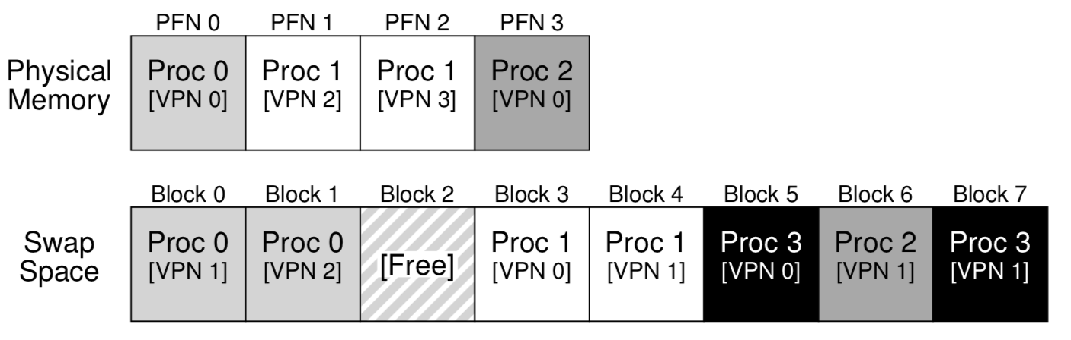
Swap
Swap space example
  4-page physical memory
  8-page swap space

Slide 6
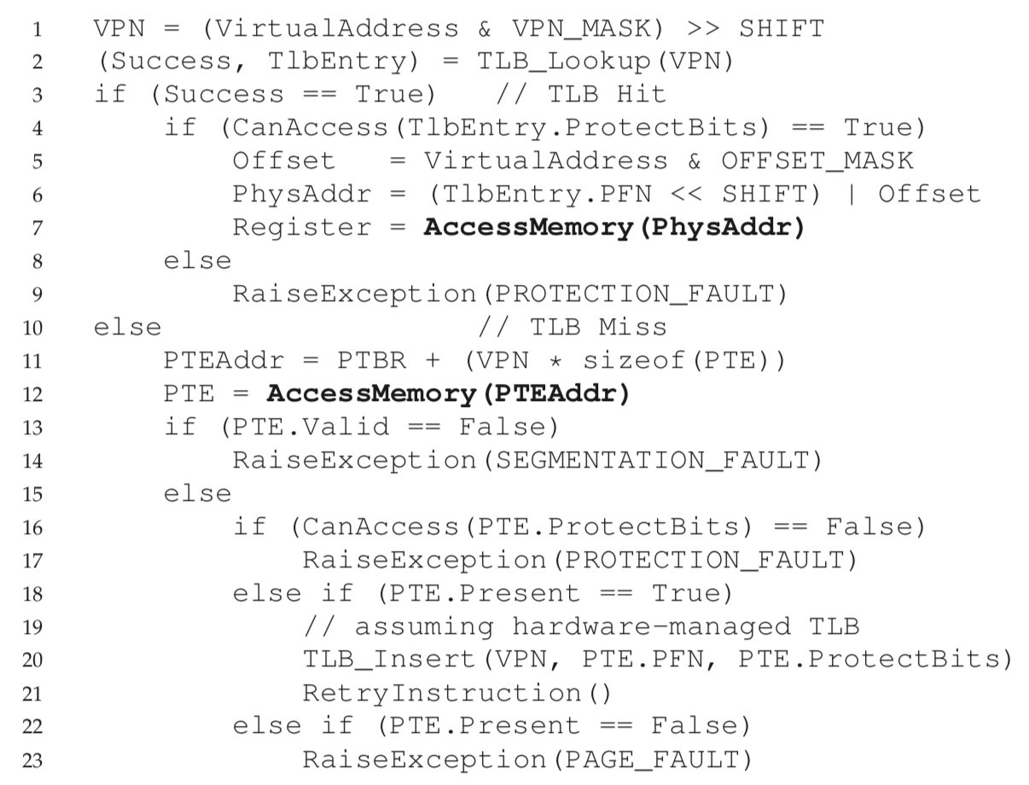
Page-Fault Control Flow Algorithm (Hardware)
内存访问流程
  Present:
  表示页面是否在RAM中
  不在RAM中则触发Page Fault Exception
这组伪代码中，
Valid=false指虚存
有效空间之外；
Present=false指
在有效空间内，但
暂时不在物理内存中
(上一章伪代码暂时没考虑page fault)

Slide 7
Page-Fault Control Flow Algorithm (Software)
对Page-Fault的处理由软件完成
  因为需要进行disk-io，比较慢，没有必要用快速硬件
  要进行page-fault处理，需要了解swap space, 与disk打交道处理I/O请求，还有很多细节
  这些对于hardware来说过于复杂

Slide 8
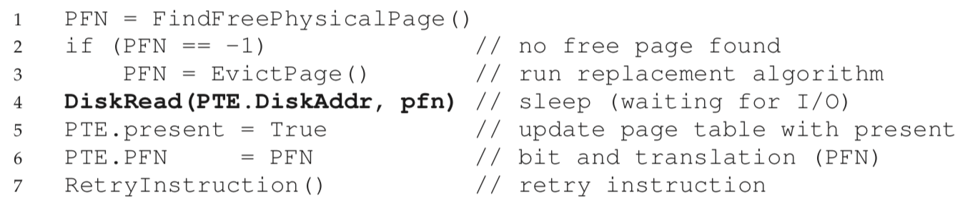
Page-Fault Control Flow Algorithm (Software)
如果物理内存满了，需要将一个page交换到swap space
EvictPage()执行该操作，其中包含磁盘写操作

Slide 9
When Replacements Really Occur
high watermark (HW )
low watermark (LW )
  当free page数量少于LW时，一个后台线程负责淘汰page，直到free page数量达到HW (swap daemon/page daemon)
后台操作的好处：
  to increase efficiency
  to allow for grouping of operations
    磁盘I/O粒度更大，性能更好

Slide 10
替换策略
OPT
FIFO
Random
LRU

Slide 11
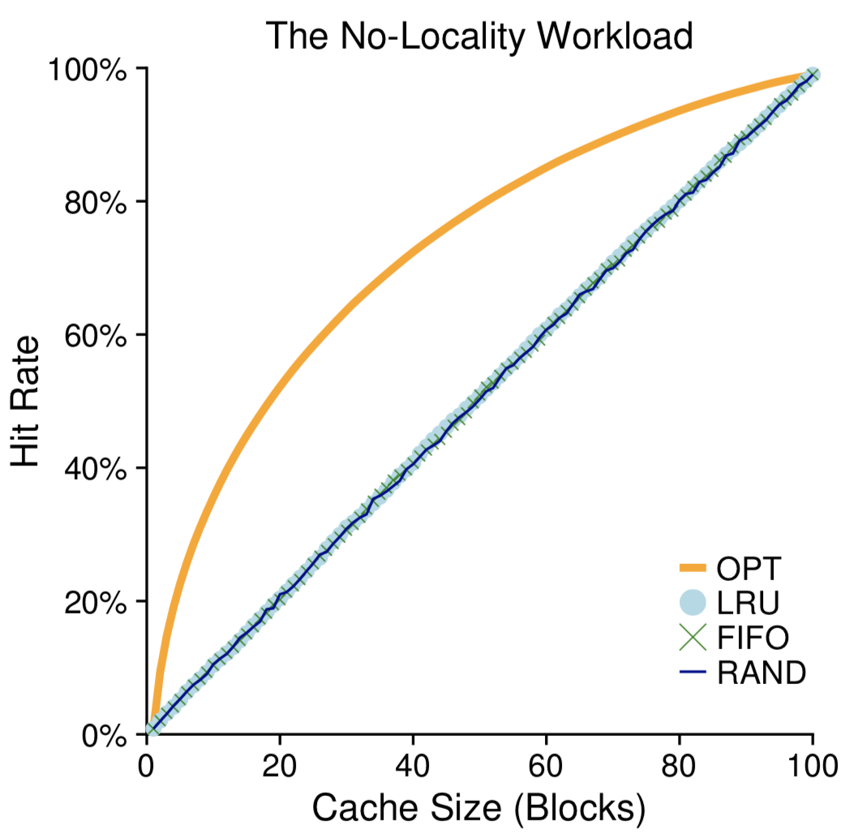
替换策略
The No-Locality Workload
  the hit rate exactly determined by the size of the cache.
  optimal performs noticeably better than the realistic policies (知道未来访问信息)

Slide 12
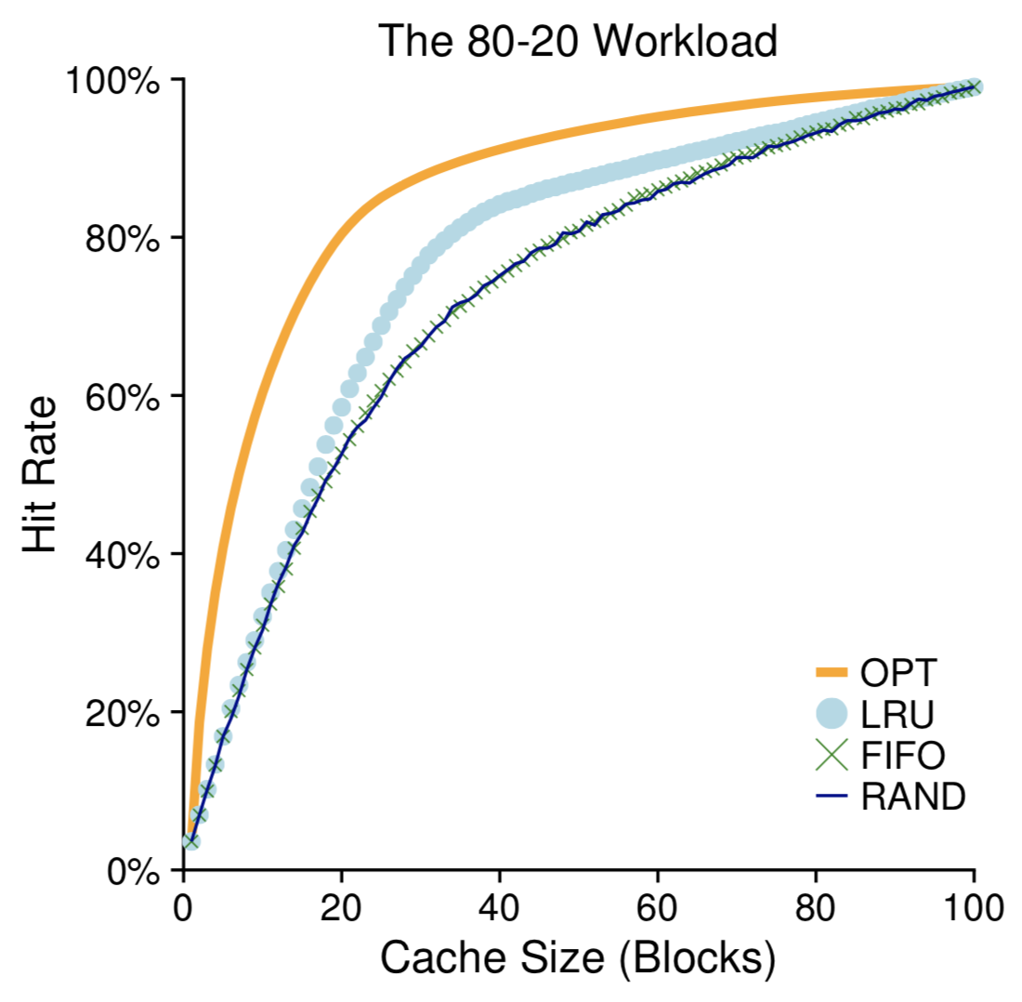
替换策略
The 80-20 Workload
  80% of the references are made to 20% of the pages
  LRU does better (利用历史信息找到hot pages)
  OPT最好，说明LRU的历史信息不是完美的

Slide 13
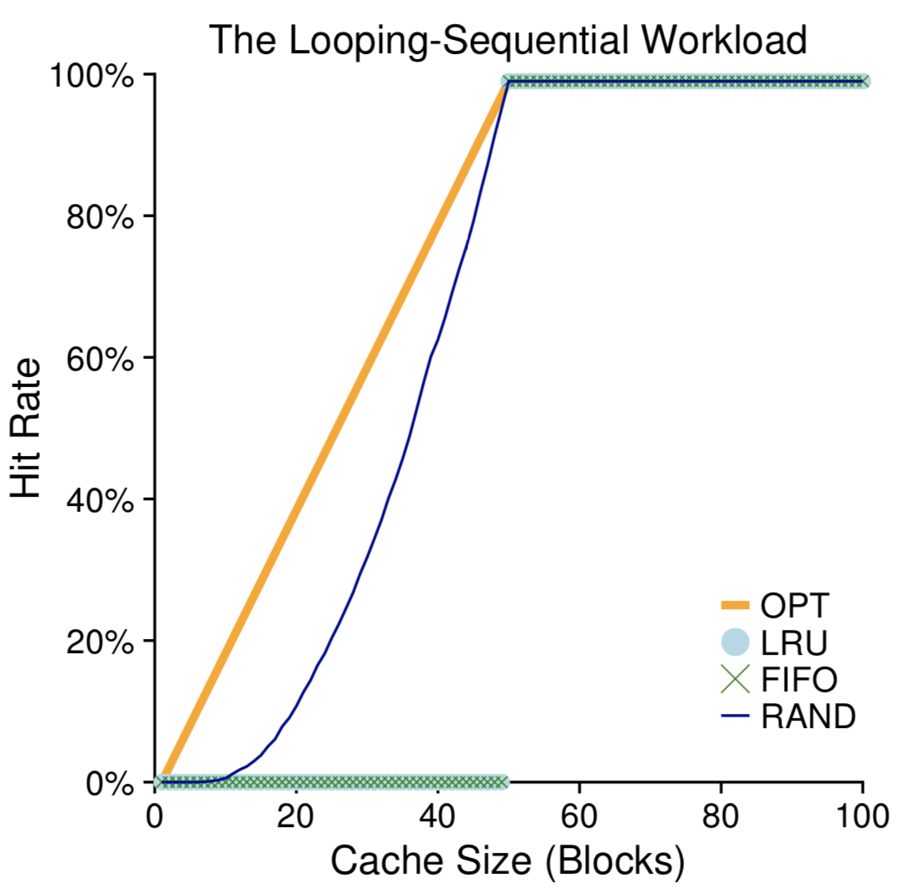
替换策略
The Looping-Sequential Workload
  循环遍历一个子集，例如page 1->50 (一共100 pages)
  Cache size大于50时，大家命中率都是100%
  Cache size小于50时，FIFO和LRU很差，因为留下最近刚访问的数据在这里时最差的策略（越老的数据越可能被访问）
  Random反而会比较好

Slide 14
Implementing Historical Algorithms
实现LRU需要很多工作：
  每次page access，需要更新一个数据结构（链表/队列等），将访问的页移动到最前面
  而FIFO，则不需要每次访问都更新数据结构；只是在replacement时修改即可（replacement数量比page access要少很多）
  Ps. LFU需要记录访问次数，这个开销更大，一般系统中都不会使用LFU这种复杂度的方法
  应用层软件系统中使用LRU或同等复杂度的多，底层系统（操作系统、数据库）可能还嫌LRU复杂度高

Slide 15
Approximating LRU
Clock算法
  为了降低LRU的开销，用一个use bit/reference bit来近似LRU（简单、可以用hardware来做）
  被访问的page, use bit设为1；
  替换时，clock hand指向的Page P如果use bit=0，则替换；否则将P的use bit设为0，继续找P+1
  ==> 如果一个page很久没访问，那么use bit=0；如果一个page频繁被访问，use bit=1（类似LRU中放到队首的行为）
  不用执行LRU的链表/队列操作

Slide 16
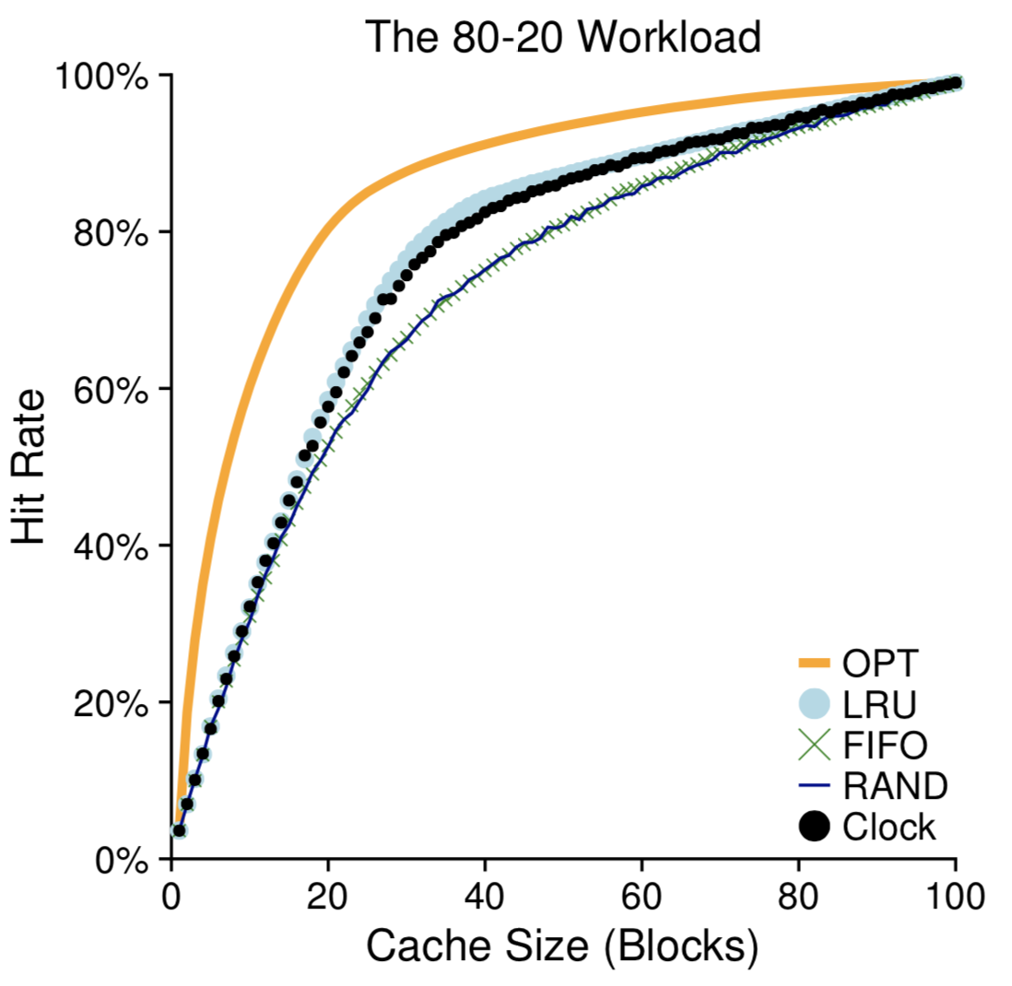
Approximating LRU
Clock算法效果
  接近于LRU，复杂度更低

Slide 17
Approximating LRU
Clock算法变种
  增加一个dirty bit，区分是clean page还是dirty page
  多个clock hands
  1 use bit -> multiple use bits
    每次--，直到0才替换
    相当于分级别，记录一定访问次数信息，区分不同数据的hotness程度

Slide 18
prefetching
OS管理物理内存资源不仅仅是通过replacement
还包括prefetching
  开销比较大
  需要比较确定（例如顺序访问）
  有很好的加速效果

Slide 19
Practical System Examples
VAX/VMS, Intel i7, Linux

Slide 20
The VAX/VMS Virtual Memory System
VAX-11
  1970’s, Digital Equipment Corporation (DEC)
    DEC由于一系列决策失误，以及PC的兴起而失败
  OS叫做VAX/VMS
    Dave Culter是主要作者之一，后来领导MS的Windows NT项目
    运行在一系列不同档次（差异极大）的计算机上
    How to avoid “the curse of generality”?

Slide 21
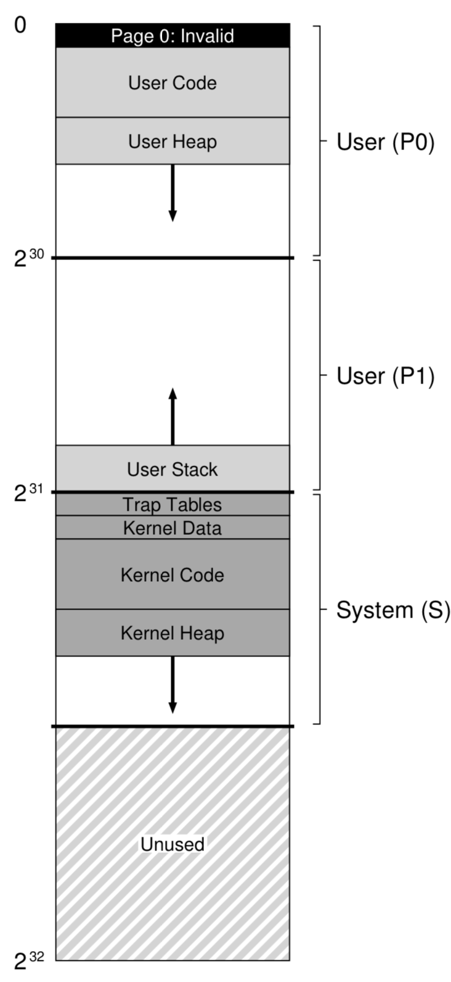
The VAX/VMS Virtual Memory System
VMS Virtual Address Space
  32-bit VA space per process
  512-byte page
  VPN: 23-bit, offset: 9-bit
  VPN的开头两位标记segment
  低位的一半地址空间为用户态程序使用
    P0: 包含code, heap
    P1: 包含stack
  高位的一半为kernel (system)使用

Slide 22
The VAX/VMS Virtual Memory System
Page较小，如何减小page table空间？
  #1. P0和P1各有一个page table，采用前面的hybrid（段页式）方案，heap下面、stack上面未使用不用记入page table
  #2. 把P0和P1的page table放到kernel的内存段
    挤占kernel内存资源
    如果物理内存满了，kernel会把自己的一部分数据交换到swap sapce

Slide 23
The VAX/VMS Virtual Memory System
The page table entry (PTE) in VAX contains the following bits:
  a valid bit
  a protection field (4 bits)
  a modify (or dirty) bit
  a field reserved for OS use (5 bits)
  and finally a physical frame number (PFN) to store the location of the page in physical memory
  no reference bit！不能用硬件来辅助replacement

Slide 24
The VAX/VMS Virtual Memory System
Replacement scheme
  Segmented FIFO
    每个进程占有物理内存页面存在上限：resident set size (RSS)
    每个进程内部按照FIFO规则替换
  second-chance lists
    为了提升FIFO的命中率
    从FIFO中淘汰的数据放入a global clean-page free list 或dirty-page list
    如果另一个进程Q要申请page，先从clean list中获取
    如果原来的进程P再次访问其中page，则回到FIFO，避免disk io
    Second-chance list越大，效果越接近LRU

Slide 25
Intel Core i7 Memory System
Processor package
Core x4
Registers
Instruction
fetch
MMU
(addr translation)
并发度为8
64/8=16 sets
L1 d-cache
32 KB, 8-way
L1 i-cache
32 KB, 8-way
L1 d-TLB
64 entries, 4-way
L1 i-TLB
128 entries, 4-way
L2 unified cache
256 KB, 8-way
L2 unified TLB
512 entries, 4-way
32KB/64B=512 cachelines
512/8=64 sets
To other
cores
QuickPath interconnect
4 links @ 25.6 GB/s each
To I/O
bridge
L3 unified cache
8 MB, 16-way
(shared by all cores)
DDR3 Memory controller
3 x 64 bit @ 10.66 GB/s
32 GB/s total (shared by all cores)
Main memory

Slide 26
Review of Symbols
Basic Parameters
  N = 2^{n} : Number of addresses in virtual address space
  M = 2^{m} : Number of addresses in physical address space
  P = 2^{p} : Page size (bytes)
Components of the virtual address (VA)
  TLBI: TLB index
  TLBT: TLB tag
  VPO: Virtual page offset
  VPN: Virtual page number
Components of the physical address (PA)
  PPO: Physical page offset (same as VPO)
  PPN: Physical page number
  CO: Byte offset within cache line
  CI: Cache index
  CT: Cache tag

Slide 27
End-to-end Core i7 Address Translation
CPU
32/64
L2, L3, and
main memory
Result
Virtual address (VA)
36
12
VPN
VPO
L1
hit
L1
miss
32
4
TLBT
TLBI
L1 d-cache
(64 sets, 8 lines/set)
TLB
hit
TLB
miss
...
...
L1 TLB (16 sets, 4 entries/set)
9
9
9
9
40
12
40
6
6
VPN1
VPN2
VPN3
VPN4
PPN
PPO
CT
CI
CO
Physical
address
(PA)
CR3
PTE
PTE
PTE
PTE
Page tables

Slide 28
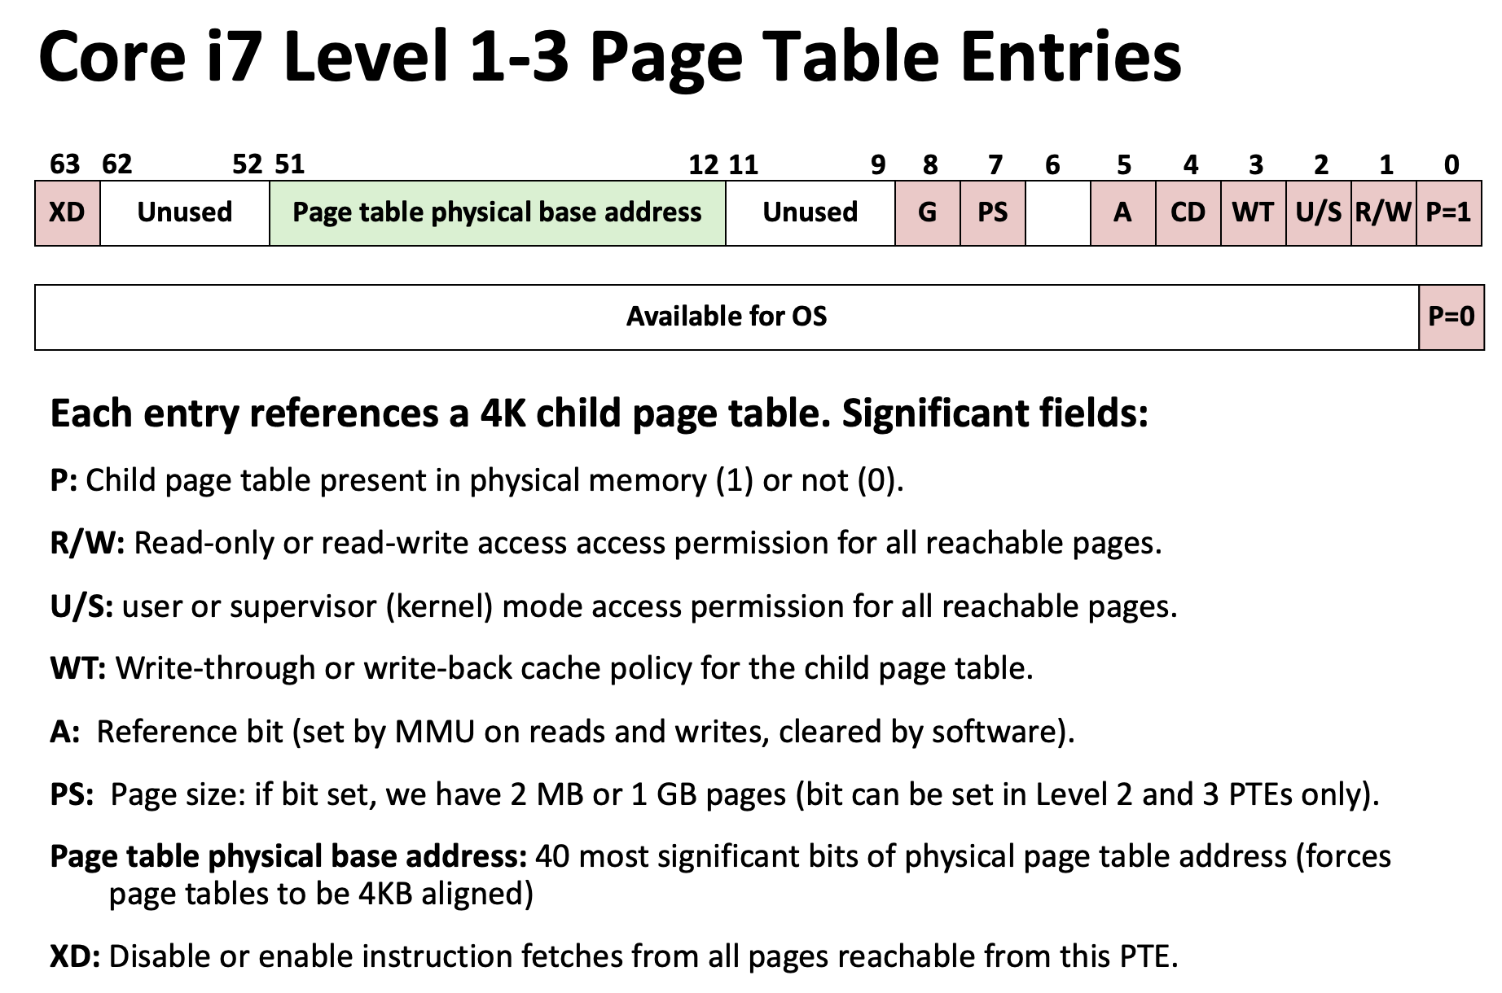


Slide 29
Core i7 Level 4 Page Table Entries
63
62
52
51
12
11
9
8
7
6
5
4
3
2
1
0
XD
Unused
Page physical base address
Unused
G
D
A
CD
WT
U/S
R/W
P=1
Available for OS (page location on disk)
P=0
Each entry references a 4K child page. Significant fields:
P: Child page is present in memory (1) or not (0)
R/W: Read-only or read-write access permission for child page
U/S: User or supervisor mode access
WT: Write-through or write-back cache policy for this page
A: Reference bit (set by MMU on reads and writes, cleared by software)
D: Dirty bit (set by MMU on writes, cleared by software)
Page physical base address: 40 most significant bits of physical page address (forces pages to be 4KB aligned)
XD: Disable or enable instruction fetches from this page.

Slide 30
Core i7 Page Table Translation
9
9
9
9
12
Virtual
address
VPN 1
VPN 2
VPN 3
VPN 4
VPO
L1 PT
Page global
directory
L2 PT
Page upper
directory
L3 PT
Page middle
directory
L4 PT
Page
table
40
40
40
40
CR3
/
/
/
/
Physical
address
of L1 PT
Offset into
physical and
virtual page
/
12
L1 PTE
L2 PTE
L3 PTE
L4 PTE
Physical
address
of page
512 GB
region
per entry
1 GB
region
per entry
2 MB
region
per entry
4 KB
region
per entry
40
/
40
12
Physical
address
PPN
PPO

Slide 31
Cute Trick for Speeding Up L1 Access
Tag Check
CT
40
6
6
Physical
address
(PA)
CT
CI
CO
PPN
PPO
Address
Translation
No
Change
Virtual
address
(VA)
CI
VPN
VPO
L1 Cache
36
12
Observation
  Bits that determine CI identical in virtual and physical address
  Can index into cache while address translation taking place
  Generally we hit in TLB, so PPN bits (CT bits) available next
  “Virtually indexed, physically tagged”
  Cache carefully sized to make this possible

Slide 32
Linux Virtual Memory System
Process-specific data structures
(e.g. task and mm structs,
page tables, kernel stack)
Different for
each process
Kernel
virtual
memory
Physical memory
Identical for
each process
Kernel code and data
User stack
%esp
Memory mapped region
for shared libraries
Process
virtual
memory
brk
Run-time heap (via malloc)
Uninitialized data (.bss)
Initialized data (.data)
Program text (.text)
x08048000 (32)
x40000000 (64)

Slide 33
Linux organizes VM as a collection of “areas”
vm_area_struct
process virtual memory
task_struct
mm_struct
vm_end
mm
pgd
vm_start
vm_prot
mmap
vm_flags
shared libraries
vm_next
0x40000000
pgd:
  page directory address (will be loaded to CR3)
vm_prot:
  read/write permissions for this area
vm_end
vm_start
data
vm_prot
vm_flags
0x0804a020
vm_next
text
vm_end
vm_start
0x08048000
vm_prot
vm_flags
vm_next
0

Slide 34
Linux organizes VM as a collection of “areas”
vm_area_struct
process virtual memory
task_struct
mm_struct
vm_end
mm
pgd
vm_start
vm_prot
mmap
vm_flags
shared libraries
vm_next
0x40000000
vm_flags
  shared with other processes or private to this process
vm_end
vm_start
data
vm_prot
vm_flags
0x0804a020
vm_next
text
vm_end
vm_start
0x08048000
vm_prot
vm_flags
vm_next
0

Slide 35
Linux page fault handling
process virtual memory
Is the VA legal?
  i.e. is it in an area defined by a vm_area_struct?
  if not then signal segmentation violation (e.g. (1))
vm_area_struct
vm_end
vm_start
r/o
shared libraries
vm_next
1
read
vm_end
vm_start
data
3
r/w
read
vm_next
2
text
write
vm_end
vm_start
r/o
vm_next
0

Slide 36
Linux page fault handling
process virtual memory
Is the operation legal?
  i.e., can the process read/write this area?
  if not then signal protection violation (e.g., (2))
If OK, handle fault
  e.g., (3)
vm_area_struct
vm_end
vm_start
r/o
shared libraries
vm_next
1
read
vm_end
vm_start
data
3
r/w
read
vm_next
2
text
write
vm_end
vm_start
r/o
vm_next
0

Slide 37
判定内存访问是否越界的方法（intel）
页表中的valid相当于present，指是否已经加载到物理内存中，不用于判定越界
判定方法：在P=0触发page-fault的处理中，
  根据访问的是哪个段，找到对应的段描述符（专用寄存器），其中包括该段的长度信息，可以判定该次访问是否越界
63
62
52
51
12
11
9
8
7
6
5
4
3
2
1
0
XD
Unused
Page physical base address
Unused
G
D
A
CD
WT
U/S
R/W
P=1
Available for OS (page location on disk)
P=0

Slide 38
Memory Mapping (mmap)

Slide 39
Memory mapping
Memory mapping（宏观效果）
  将一个文件、设备或者其它对象映射进内存
    Linux initializes the contents of a VM area by associating it with an object on disk
    A VM area can get its initial values from the object

Slide 40
Memory mapping
Memory mapping（具体行为）
  给当前进程创建一个VM的新映射，其中内容来自指定的对象（例如文件）
  但是并不是在创建映射时就加载内容，而是现用现加载（为了性能）

Slide 41
Memory mapping
Area can be backed by
  regular file on disk (e.g., an executable object file)
    initial page bytes come from a section of a file
  anonymous file (e.g. nothing)
    First fault will allocate a physical page full of 0’s (demand-zero page)
    Once the page is written to (dirtied), it is like any other page

Slide 42
Memory mapping
Dirty pages are copied back and forth between memory and a swap file.
Swap file
  Maintained by the kernel
  Also known as swap space or the swap area
  Bounds the total amount of virtual pages that can be allocated by the currently running processes

Slide 43
Demand Paging
Key point: no virtual pages are copied into physical memory until they are referenced!
  known as “demand paging”
  crucial for time and space efficiency

Slide 44
Exec() revisited
process-specific data
structures
(page tables,
task and mm structs
Kernal stack)
To run a new program p in the current process using exec():
  Free all vm_area_structs and page tables for old areas.
physical memory
same for each process
kernel code/data
kernel
VM
0xc0000000
demand-zero
%esp
stack
process
VM
Memory mapped region
for shared libraries
.data
.text
libc.so
brk
runtime heap (via malloc)
uninitialized data (.bss)
demand-zero
initialized data (.data)
.data
program text (.text)
.text
forbidden
p
0

Slide 45
Exec() revisited
process-specific data
structures
(page tables,
task and mm structs
Kernal stack)
To run a new program p in the current process using exec():
  create new vm_area_structs and page tables for new areas.
    stack, bss, data, text, shared libs.
physical memory
same for each process
kernel code/data
kernel
VM
0xc0000000
demand-zero
%esp
stack
process
VM
Memory mapped region
for shared libraries
.data
.text
libc.so
brk
runtime heap (via malloc)
uninitialized data (.bss)
demand-zero
initialized data (.data)
.data
program text (.text)
.text
forbidden
p
0

Slide 46
Exec() revisited
process-specific data
structures
(page tables,
task and mm structs
Kernal stack)
To run a new program p
in the current process using exec():
  create new vm_area_structs
  and page tables for
  new areas.
    text and data backed by ELF executable object file.
    bss and stack initialized to zero.
physical memory
same for each process
kernel code/data
kernel
VM
0xc0000000
demand-zero
%esp
stack
process
VM
Memory mapped region
for shared libraries
.data
.text
libc.so
brk
runtime heap (via malloc)
uninitialized data (.bss)
demand-zero
initialized data (.data)
.data
program text (.text)
.text
forbidden
p
0

Slide 47
Exec() revisited
process-specific data
structures
(page tables,
task and mm structs
Kernal stack)
To run a new program p
in the current process using exec():
  create new vm_area_structs
  and page tables for
  new areas.
    text, data, bss and stack area are private areas
    Shard libs are shared areas.
physical memory
same for each process
kernel code/data
kernel
VM
0xc0000000
demand-zero
%esp
stack
process
VM
Memory mapped region
for shared libraries
.data
.text
libc.so
brk
runtime heap (via malloc)
uninitialized data (.bss)
demand-zero
initialized data (.data)
.data
program text (.text)
.text
forbidden
p
0

Slide 48
Exec() revisited
process-specific data
structures
(page tables,
task and mm structs
Kernal stack)
To run a new program p in the current process using exec():
  set PC to entry point in .text
    Linux will do paging for code and data pages as needed.
physical memory
same for each process
kernel code/data
kernel
VM
0xc0000000
demand-zero
%esp
stack
process
VM
Memory mapped region
for shared libraries
.data
.text
libc.so
brk
runtime heap (via malloc)
uninitialized data (.bss)
demand-zero
initialized data (.data)
.data
program text (.text)
.text
forbidden
p
0

Slide 49
User-level memory mapping
void *mmap(void *start, int len, int prot,
int flags, int fd, int offset)
Map len bytes starting at offset offset of the
file specified by file description fd, preferably at address start (usually 0 for don’t care).
  prot: PROT_READ, PROT_WRITE
  flags: MAP_PRIVATE, MAP_SHARED
Return a pointer to the mapped area

Slide 50
User-level memory mapping
MAP_SHARED
  对应射区域的写入数据会复制回文件内，而且允许其他映射该文件的进程共享。
  但不保证立即写回文件，有一定延迟
  显式调用msync()/munmap()可以强制刷回文件
MAP_PRIVATE
  Create a private copy-on-write mapping，写入内容不反映到磁盘
  对应射区域的写入操作会产生一个映射文件的复制，即私人的"写入时复制" (copy on write)对此区域作的任何修改都不会写回原来的文件内容。
(vs. swap file?)

Slide 51
User-level memory mapping
MAP_PRIVATE
  Create a private copy-on-write mapping.
  Updates to the mapping are not visible to other processes mapping the same file, and are not carried through to the underlying file.
    一个file，有的进程作为private映射，有的进程作为shared映射，会如何？
    会分配不同的物理内存页，因为映射的类型不同（对同一个文件的多次private mmap，在修改前会对应一个物理页）
  一般用于共享库的加载（不允许修改）
  其他情况可以修改，但会写入时会产生copy-on-write，再分配新的物理内存页写入
  Page与file的关系：只在加载时相关，后面完全无关

Slide 52
User-level memory mapping
使用mmap需要注意的关键点：
  mmap映射区域大小必须是物理页大小(page_size)的整倍数（32位系统中通常是4k字节）；
  对于较大的文件，mmap需要较大的一块连续虚存空间（对应需要访问的文件大小）；而正常read/write不需要一次申请这么大的内存buffer；
  如果文件的大小一直在扩张，只要在映射区域范围内的数据，进程都可以合法得到，这和映射建立时文件的大小无关；
  映射建立之后，即使文件关闭，映射依然存在。因为映射的是磁盘的地址，不是文件本身，和文件描述符无关

Slide 53
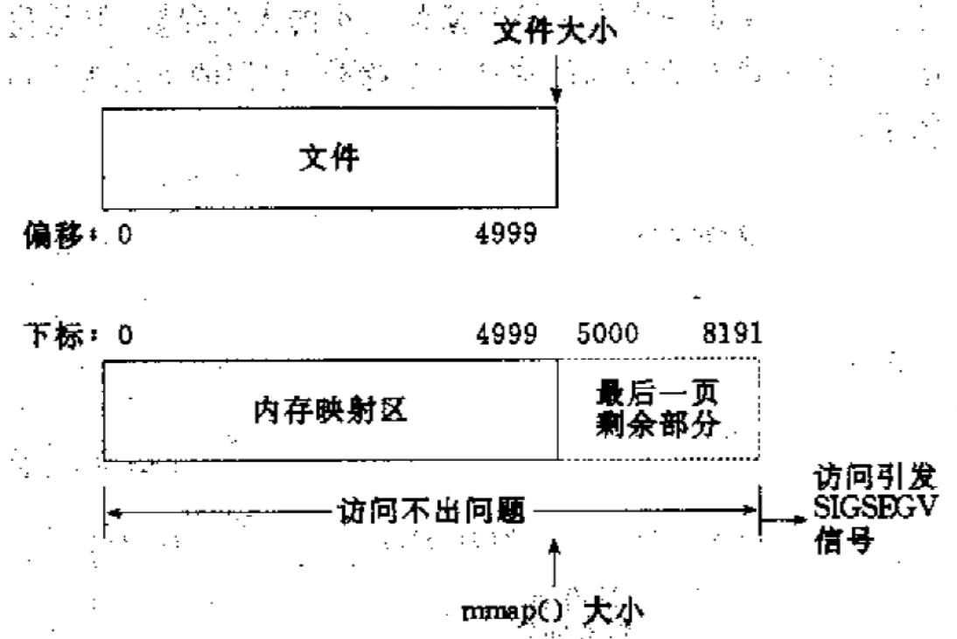
User-level memory mapping
例1. 一个文件的大小是5000字节，mmap函数从一个文件的起始位置开始，映射5000字节到虚拟内存中
  被映射的文件只有5000字节；
  5000~8191的字节部分用零填充

Slide 54
User-level memory mapping
（1）读/写前5000个字节（0~4999），会返回操作文件内容。
（2）读字节5000~8191时，结果全为0。写5000~8191时，进程不会报错，但是所写的内容不会写入原文件中 。
（3）读/写8192以外的磁盘部分，会返回一个SIGSECV错误。

Slide 55
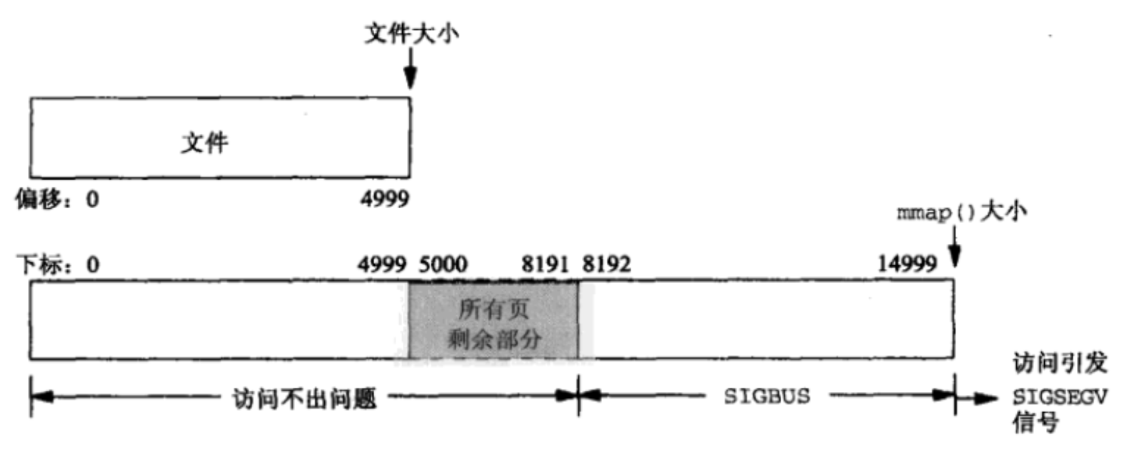
User-level memory mapping
例2. 一个文件的大小是5000字节，mmap函数从一个文件的起始位置开始，映射15000字节到虚拟内存中，即映射大小超过了原始文件的大小

Slide 56
User-level memory mapping
（1）进程可以正常读/写被映射的前5000字节(0~4999)，写操作的改动会在一定时间后反映在原文件中。
（2）对于5000~8191字节，进程可以进行读写过程，不会报错。但是内容在写入前均为0，另外，写入后不会反映在文件中。
（3）对于8192~14999字节，进程不能对其进行读写，会报SIGBUS错误。
（4）对于15000以外的字节，进程不能对其读写，会引发SIGSEGV错误。

Slide 57
SIGBUS信号
产生原因：
  地址为未对齐，地址有效，但总线不能正常使用；
  访问mmap region，超过了文件大小（上述情况）
默认行为：
  Core dump
一般比较少见，多数还是SIGSEGV

Slide 58
User-level memory mapping
void *mmap(void *start, int len,
int prot, int flags, int fd, int offset)
len bytes
start
len bytes
(or address
chosen by kernel)
offset
(bytes)
0
0
Process virtual memory
Disk file specified by
file descriptor fd

Slide 59
User-level memory mapping
Example: fast file copy
  Useful for applications like Web servers that need to quickly copy files.
  mmap allows file transfers without copying into kernel space.
    VM->PM->file, page_fault_handler
  Vs. Read/write系统调用：
    Page cache (in memory)对上屏蔽了disk，用于加快磁盘访问，kernel管理
    所以，read/write访问文件数据，一定要经过page cache
    Disk -> page cache (kernel) -> user buffer (user)

Slide 60
mmap() example: fast file copy
/*
* mmapcopy - uses mmap to copy file fd to stdout
*/
void mmapcopy(int fd, int size)
{
char *bufp;
/* map the file to a new VM area */
bufp = mmap(0, size, PROT_READ,
MAP_PRIVATE, fd, 0);
/* write the VM area to stdout */
write(1, bufp, size);
return ;
}

Slide 61
mmap() example: fast file copy
int main(int argc, char **argv)
{
struct stat stat;
/* check for required command line argument */
if ( argc != 2 ) {
printf(“usage: %s <filename>\n”, argv[0]);
exit(0) ;
}
/* open the file and get its size*/
fd = open(argv[1], O_RDONLY, 0);
fstat(fd, &stat);
mmapcopy(fd, stat.st_size);
}

Slide 62
对mmap()的理解
Mmap()的主要性能优势来自于减少copies
  vfs的read/write系统调用中，文件内容的拷贝要多经历内核缓冲区这个阶段，所以比mmap多了一次内存拷贝
  mmap只有用户空间的内存拷贝(这个阶段read/write也有)
  mmap也被称为zero-copy技术。

Slide 63
Fork() revisted
To create a new process using fork:
  make copies of the old process’s mm_struct, vm_area_struct, and page tables
    Two processes are sharing all of their physical pages (At this point)
    How to get separate spaces without copying all the virtual pages from one space to another?
      “Copy On Write” (COW) technique.

Slide 64
Shared Object
Shared Object
  映射到一个进程的Vm空间某区域的一个对象
  这个进程对这个区域的任何写入，其他也将这个对象映射到Vm空间的进程都能看到
  修改的内容也会反应到磁盘上的原始对象上（文件）
Shared Area
  Shared object映射到的Vm空间区域

Slide 65
Private object
Private Object
  与shared object相反
  对一个private object所在空间的修改，其他任何进程都看不到
  对这个区域的修改，也不会反映道磁盘中的原始对象上
Private Area
  Similar to shared area

Slide 66
Sharing Revisited: Shared Objects
Process 1
virtual memory
Physical
memory
Process 2
virtual memory
Process 1 maps the shared object
Shared
object

Slide 67
Sharing Revisited: Shared Objects
Process 1
virtual memory
Physical
memory
Process 2
virtual memory
Process 2 maps the shared object
Notice how the virtual addresses can be different
Shared
object

Slide 68
Copy-on-Write
A private object begins life in exactly the same way as a shared object, with only one copy of the private object stored in physical memory.

Slide 69
Fork() revisted
To create a new process using fork
  Copy-On-Write
    flag vm_area_struct for these areas as private “copy-on-write”.
    make pages of writeable areas read-only
    writes by either process to these pages will cause page faults
      fault handler recognizes copy-on-write, makes a copy of the page, and restores write permissions.

Slide 70
Sharing Revisited: Private COW Objects
Process 1
virtual memory
Physical
memory
Process 2
virtual memory
Private
copy-on-write
area
Private
copy-on-write object

Slide 71
Copy-on-Write
For each process that maps the private object
  The area struct is flagged as private copy-on-write
  这个区域相应的页表项被标记为read-only
  只要没有进程对这个private area进行写入，多个进程就会共享同一份物理内存

Slide 72
Copy-on-Write
For each process that maps the private object
  只要有一个进程试图对private area的一些页进行写入操作，写入操作就会触发protection fault
  Fault handler会发现这个区域比较特殊，是private copy-on-write area，不会报错，而会做一些特殊处理
    Creates a new copy of the page in physical memory
    Updates the page table entry to point to the new copy
    Restores write permissions to the page

Slide 73
Sharing Revisited: Private COW Objects
Process 1
virtual memory
Physical
memory
Process 2
virtual memory
Copy-on-write
Write to private
copy-on-write
page
Private
copy-on-write object

Slide 74
Fork() revisted
To create a new process using fork:
  Net result:
    copies are deferred until absolutely necessary
    (i.e., when one of the processes tries to modify a shared page).

Slide 75
课堂练习
假设有一个输入文件hello.txt，由字符串”Hello, world!\n”组成，编写一个C程序，使用mmap将hello.txt的内容改为”Jello, world!\n”。

Slide 76
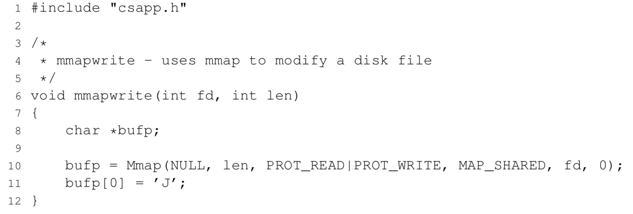
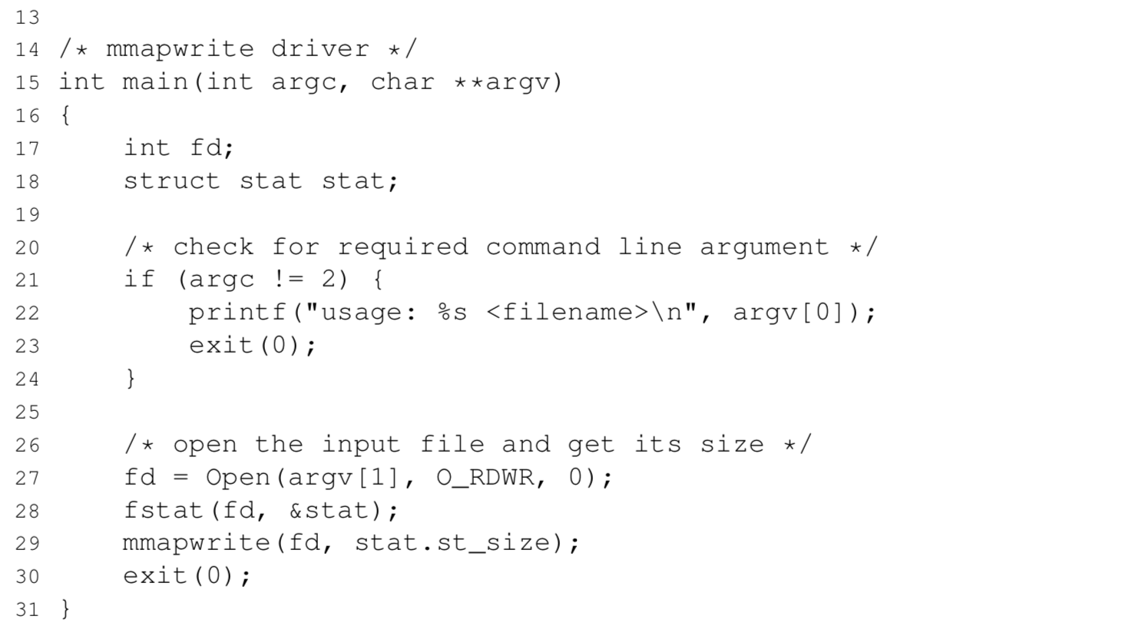
练习答案

