Slide 1
基于多线程的并发编程
线程是什么？
有什么优点？

Slide 2
Linux Virtual Memory System
Process-specific data structures (e.g. task and mm structs,
page tables, kernel stack)
Different for each process
Kernel virtual memory
Physical memory
Identical for each process
Kernel code and data
User stack
%esp
Memory mapped region for shared libraries
Process virtual memory
brk
Run-time heap (via malloc)
Uninitialized data (.bss)
Initialized data (.data)
Program text (.text)
x08048000 (32) x40000000 (64)

Slide 3
Traditional view of a process
Process = process context + code, data, heap and stack
Process context
Code, data, and stack
Program context:
Data registers
Condition codes
Stack pointer (SP)
Program counter (PC)
Kernel context:
VM structures
Descriptor table
brk pointer
stack
SP
shared libraries
brk
run-time heap
read/write data
PC
read-only code/data
0

Slide 4
Alternate view of a process
Process = thread + code, data, heap, and kernel context
Thread (main thread)
Code and Data
shared libraries
SP
stack
brk
run-time heap
Thread context:
Data registers
Condition codes
Stack pointer (SP)
Program counter (PC)
read/write data
PC
read-only code/data
0
Kernel context:
VM structures
Descriptor table
brk pointer

Slide 5
A process with multiple threads
多个线程可以共享同一个进程中的部分资源
每个线程有自己的流程控制（PC的值，寄存器的值，栈）
每个线程共享相同的code, data, heap和kernel context
每个线程共享页表
每个进程有自己的thread id (TID)

Slide 6
A process with multiple threads
Shared code and data
Thread 1 (main thread)
Thread 2 (peer thread)
shared libraries
stack 1
stack 2
run-time heap
Thread 1 context:
Data registers
Condition codes
SP1
PC1
read/write data
Thread 2 context:
Data registers
Condition codes
SP2
PC2
read-only code/data
0
Kernel context:
VM structures
Descriptor table
brk pointer

Slide 7
线程vs.进程 (1)
进程之间可以并发、共享
E.g., PostgreSQL: 多进程
MySQL: 多线程
但是开销会比较大
每个进程有自己独立的虚拟内存空间，无法按照虚拟地址共享内存；需要用IPC（进程间通信）机制，但开销更高
而在一个进程空间的多线程，天然数据共享
Data, heap, stack

Slide 8
线程vs.进程 (2)
线程切换和进程切换开销比较
Context switch需要保存的内容差别？
需要保存内容差别不大
但进程切换，访问新的kernel context, process memory，可能cache命中率较低
线程切换：不需要切换地址空间
进程切换：切换地址空间
更换页表（辅助寄存器：例如页表首地址）
TLB命中率下降
Link

Slide 9
End-to-end Core i7 Address Translation
CPU
32/64
L2, L3, and
main memory
Result
Virtual address (VA)
36
12
VPN
VPO
L1
hit
L1
miss
32
4
TLBT
TLBI
L1 d-cache
(64 sets, 8 lines/set)
TLB
hit
TLB
miss
...
...
L1 TLB (16 sets, 4 entries/set)
9
9
9
9
40
12
40
6
6
VPN1
VPN2
VPN3
VPN4
PPN
PPO
CT
CI
CO
Physical
address
(PA)
CR3
PTE
PTE
PTE
PTE
Page tables

Slide 10
Posix threads (Pthreads) interface
Pthreads: Standard interface for ~60 functions
Manipulate threads from C programs
Creating and reaping threads
pthread_create
pthread_join
Determining your thread ID
pthread_self
Terminating threads
pthread_cancel 发送中止请求给某线程
pthread_exit 线程主动退出
exit [terminates all threads]
return [terminates current thread]

Slide 11
The Pthreads "hello, world" Program
/* hello.c - Pthreads "hello, world" program */
#include "csapp.h"
/* thread routine */
void *thread(void *vargp) {
printf("Hello, world!\n");
return NULL;
}
int main() {
pthread_t tid;
Pthread_create(&tid, NULL, thread, NULL);
Pthread_join(tid, NULL);
exit(0);
}
Thread attributes
(usually NULL)
return value
(void **p)
Thread arguments
(void *p)

Slide 12
Execution of Threaded“hello, world”
main thread
call Pthread_create()
Pthread_create() returns
peer thread
call Pthread_join()
printf()
main thread waits for
peer thread to terminate
return NULL;
(peer thread
terminates)
Pthread_join() returns
exit()
terminates
main thread and
any peer threads

Slide 13
Issues with thread-based servers
线程分为joinable和detached两种模式
joinable thread可以reap，也可以被其他线程kill
must be reaped (with pthread_join) to free memory resources.
处于detached模式的thread，执行结束后自动回收资源（不会内存泄漏）

Slide 14
Issues with thread-based servers
注意避免内存泄露，不join则必须用线程的“detached”模式
Detached thread cannot be reaped or killed by other threads.
resources are automatically reaped on termination.
Default state is joinable.
use pthread_detach(pthread_self()) to make detached.

Slide 15
多线程的共享变量

Slide 16
Shared variable analysis
7 int main()
8 {
9 int i;
10 pthread_t tid;
11 char *msgs[N] = {
12 "Hello from foo",
13 "Hello from bar"
14 };
15
16 ptr = msgs;
17 for (i = 0; i < N; i++)
18 Pthread_create(&tid, NULL, thread, (void *)i);
19 Pthread_exit(NULL);
20 }
21
22 void *thread(void *vargp)
23 {
24 int myid = (int)vargp;
25 static int cnt = 0;
26
27 printf("[%d]:%s(cnt=%d)\n", myid, ptr[myid], ++cnt);
28 }
1 #include "csapp.h"
2 #define N 2
3 void *thread(void *vargp);
4
5 char **ptr;
6 /* global variable */

Slide 17
Shared variable analysis
Which variables are shared?
Variable Referenced by Referenced by Referenced by
instance main thread? peer thread-0? peer thread-1?
ptr yes yes yes
cnt no yes yes
i.m yes no no
msgs.m yes yes yes
myid.p0 no yes no
myid.p1 no no yes

Slide 18
Shared variable analysis
Answer: A variable x is shared if multiple threads reference at least one instance of x
Thus:
ptr, cnt, and msgs are shared.
i and myid are NOT shared.

Slide 19
Shared variable analysis
1 #include "csapp.h"
2
3 #define NITERS 100000000
4 void *count(void *arg);
5
6 /* shared variable */
7 unsigned int cnt = 0;
8
9 int main()
10 {
11 pthread_t tid1, tid2;
12
13 Pthread_create(&tid1, NULL, count, NULL);
14 Pthread_create(&tid2, NULL, count, NULL);
15 Pthread_join(tid1, NULL);
16 Pthread_join(tid2, NULL);
17
18 if (cnt != (unsigned)NITERS*2)
19 printf("BOOM! cnt=%d\n", cnt);
20 else
21 printf("OK cnt=%d\n", cnt);
22 exit(0);
23 }

Slide 20
Shared variable analysis
24
25 /* thread routine */
26 void *count(void *arg)
27 {
28 int i;
29 for (i=0; i<NITERS; i++)
30 cnt++;
31 return NULL;
32 }

Slide 21
Shared variable analysis
linux> badcnt
BOOM! cnt=198841183
linux> badcnt
BOOM! cnt=198261801
linux> badcnt
BOOM! cnt=198269672
cnt should be equal to 200,000,000.
What went wrong?!

Slide 22
Assembly code for counter loop
C code for thread i
for (i=0; i<NITERS; i++)
cnt++;

Slide 23
Assembly code for counter loop
Asm code for thread i
.L9:
movl -4(%ebp),%eax #i:-4(%ebp)
cmpl $99999999,%eax
jle .L12
jmp .L10
.L12:
movl cnt,%eax # Load
leal 1(%eax),%edx # Update
movl %edx,cnt # Store
.L11:
movl -4(%ebp),%eax
leal 1(%eax),%edx
movl %edx,-4(%ebp)
jmp .L9
.L10:
Head (H_{i})
Load cnt (L_{i})
Update cnt (U_{i})
Store cnt (S_{i})
Tail (T_{i})
Discussion:
cnt可以编译优化用寄存器来存吗？

Slide 24
Concurrent execution
i(thread)
instr_{i}
%eax₁
%eax₂
cnt
1
H₁
-
-
0
1
L₁
0
-
0
1
U₁
1
-
0
1
S₁
1
-
1
2
H₂
-
-
1
2
L₂
-
1
1
2
U₂
-
2
1
2
S₂
-
2
2
2
T₂
-
2
2
1
T₁
1
-
2
OK

Slide 25
Concurrent execution (cont)
Incorrect ordering: two threads increment the counter, but the result is 1 instead of 2.
i(thread)
instr_{i}
%eax₁
%eax₂
cnt
1
H₁
-
-
0
1
L₁
0
-
0
1
U₁
1
-
0
2
H₂
-
-
0
2
L₂
-
0
0
1
S₁
1
-
1
1
T₁
1
-
1
2
U₂
-
1
1
2
S₂
-
1
1
2
T₂
-
1
1

Slide 26
课堂练习
填写下表
Step | Thread | Instr | %eax1 | %eax2 | cnt
1 | 1 | H1 | - | - | 0
2 | 1 | L1
3 | 2 | H2
4 | 2 | L2
5 | 2 | U2
6 | 2 | S2
7 | 1 | U1
8 | 1 | S1
9 | 1 | T1
10 | 2 | T2

Slide 27
Progress graphs
A progress graph depicts
the discrete execution
state space of concurrent
threads.
Each axis corresponds to
the sequential order of
instructions in a thread.
Each point corresponds to
a possible execution state
(Inst₁, Inst₂).
E.g., (L₁, S₂) denotes state
where thread 1 has
completed L₁ and thread
2 has completed S₂.
Thread 2
T₂
(L₁, S₂)
S₂
U₂
L₂
H₂
Thread 1
H₁
L₁
U₁
S₁
T₁

Slide 28
Trajectories in progress graphs
Thread 2
A trajectory is a sequence
of legal state transitions
that describes one possible
concurrent execution of
the threads.
Example:
H1, L1, U1, H2, L2, S1, T1, U2, S2, T2
T₂
S₂
U₂
L₂
H₂
Thread 1
H₁
L₁
U₁
S₁
T₁

Slide 29
Critical sections and unsafe regions
Thread 2
L, U, 和S 针对共享变量cnt
形成了一个critical section
Critical section中的指令
（写相同的共享变量）
不能交错执行(interleave)
两个critical section形成的
区域叫做 unsafe regions
T₂
S₂
critical section wrt cnt
U₂
Unsafe region
L₂
H₂
Thread 1
H₁
L₁
U₁
S₁
T₁
critical section wrt cnt

Slide 30
Safe and unsafe trajectories
Thread 2
T₂
Safe trajectory
Def: A trajectory is safe
iff it doesn’t touch any
part of an unsafe region.
Claim: A trajectory is
correct (write cnt) iff
it is safe.
S₂
Unsafe region
Unsafe
trajectory
critical section wrt cnt
U₂
L₂
H₂
Thread 1
H₁
L₁
U₁
S₁
T₁
critical section wrt cnt

Slide 31
Synchronizing with semaphores
Dijkstra's P and V operations on semaphores
semaphore: non-negative integer synchronization variable.
atomic operation []
P(s): [ while (s == 0) wait(); s--; ]
Dutch for "Proberen" (test)
V(s): [ s++; ]
Dutch for "Verhogen" (increment)
Notes:
迪杰斯特拉，荷兰

Slide 32
POSIX semaphores
#include <semaphore.h>
int sem_init(sem_t *sem, 0, unsigned int value);
int sem_wait(sem_t *s); /* P(s) */
int sem_post(sem_t *s); /* V(s) */
#include “csapp.h”
void P(sem_t *s); /* Wrapper function for sem_wait */
void V(sem_t *s); /* Wrapper function for sem_wait */

Slide 33
Sharing with POSIX semaphores
#include "csapp.h"
#define NITERS 10000000
unsigned int cnt; /* counter */
sem_t sem; /* semaphore */
int main() {
pthread_t tid1, tid2;
Sem_init(&sem, 0, 1);
/* create 2 threads and wait */
...
if (cnt != (unsigned)NITERS*2)
printf("BOOM! cnt=%d\n", cnt);
else
printf("OK cnt=%d\n", cnt);
exit(0);
}

Slide 34
Sharing with POSIX semaphores
/* thread routine */
void *count(void *arg)
{
int i;
for (i=0; i<NITERS; i++) {
P(&sem);
cnt++;
V(&sem);
}
return NULL;
}

Slide 35
Safe sharing with semaphores
Thread 2
1
1
0
0
0
0
1
1
利用对信号量s（初始值为1）的P、V操作可以保卫critical section，这样提供对共享变量的互斥访问
信号量创造了一个禁止区域（s<0），这个禁止区保护了不安全区域，从而让任何路径都不能进入这个区域
T₂
1
1
0
0
0
0
1
1
V(s)
Forbidden region
0
0
0
0
S₂
-1
-1
-1
-1
0
0
-1
-1
-1
-1
0
0
U₂
Unsafe region
0
0
-1
-1
-1
-1
0
0
L₂
0
0
-1
-1
-1
-1
0
0
P(s)
1
1
0
0
0
0
1
1
H₂
1
1
0
0
0
0
1
1
H₁
P(s)
L₁
U₁
S₁
V(s)
T₁
Thread 1
Initially
s = 1

Slide 36
Issues: Deadlock
int main()
{
pthread_t tid[2];
Sem_init(&mutex[0], 0, 1); /* mutex[0] = 1 */
Sem_init(&mutex[1], 0, 1); /* mutex[1] = 1 */
Pthread_create(&tid[0], NULL, count, (void*)0);
Pthread_create(&tid[1], NULL, count, (void*)1);
Pthread_join(tid[0], NULL);
Pthread_join(tid[1], NULL);
printf("cnt=%d\n", cnt);
exit(0);
}

Slide 37
Issues: Deadlock
Thread0
Thread1
Tid[0]:
P(s₀);
P(s₁);
cnt++;
V(s₀);
V(s₁);
Tid[1]:
P(s₁);
P(s₀);
cnt++;
V(s₁);
V(s₀);
void *count(void *vargp)
{
int i;
int id = (int) vargp;
for (i = 0; i < NITERS; i++) {
P(&mutex[id]); P(&mutex[1-id]);
cnt++;
V(&mutex[id]); V(&mutex[1-id]);
}
return NULL;
}

Slide 38
Issues: Deadlock
Thread 2
deadlock
state
所操作导致潜在的死锁：等待一个永远不会为真的条件
任何进入死锁区域的路径一定会达到死锁状态
其他路径可能侥幸绕过死锁区域
V(s0)
forbidden
region for s0
V(s1)
deadlock
region
P(s0)
forbidden
region for s1
P(s1)
P(s0)
P(s1)
V(s0)
V(s1)
Thread 1
Initially, s=t=1

Slide 39
课堂练习
信号量s和t，初始状态s=1, t=0
有两个线程，工作流程都是：
P(s)，w1()，V(s)，P(t)，w2()，V(t)
A. 画出这个程序的进程图（标记禁止区）
B. 它会死锁吗？
C. 如果是，那么对初始信号量的值做哪些改变就能消除潜在的死锁呢？
D. 画出无死锁程序的进程图

Slide 40
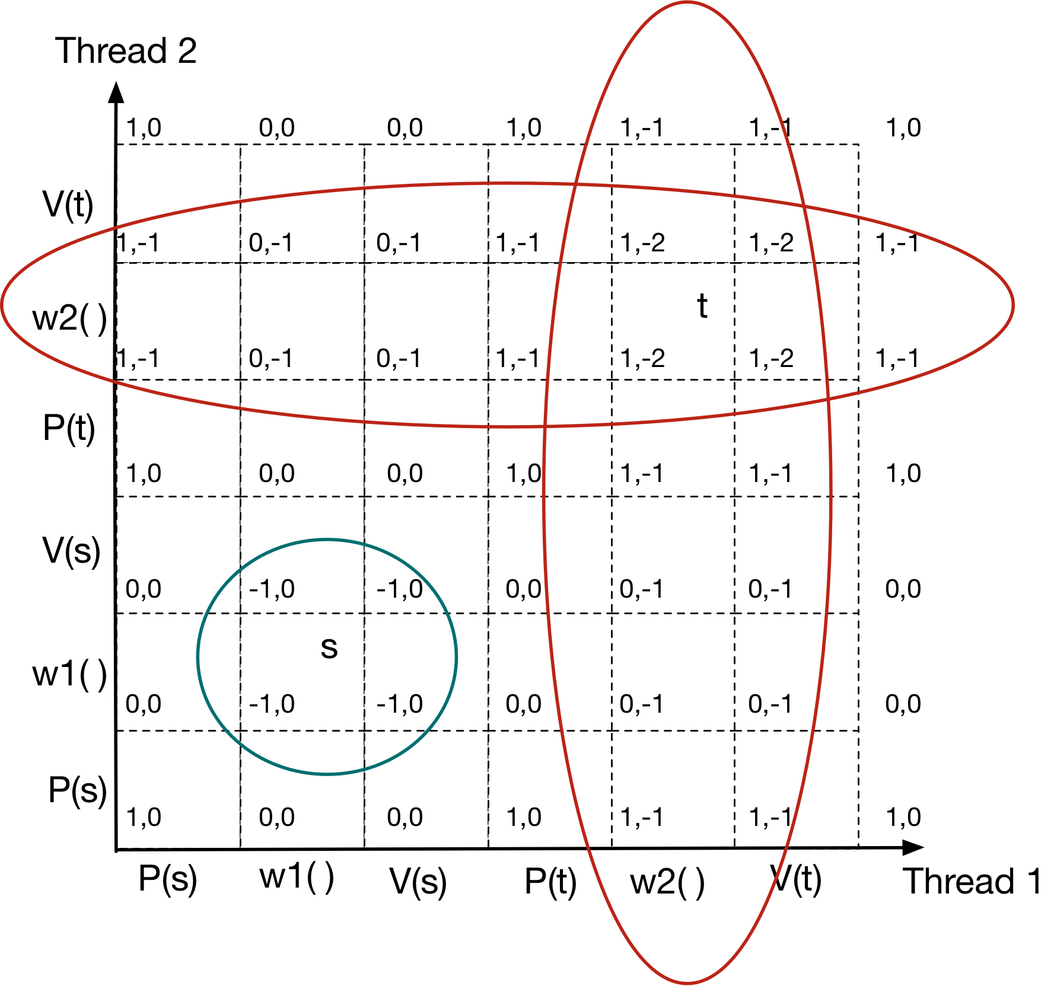
练习答案

Slide 41
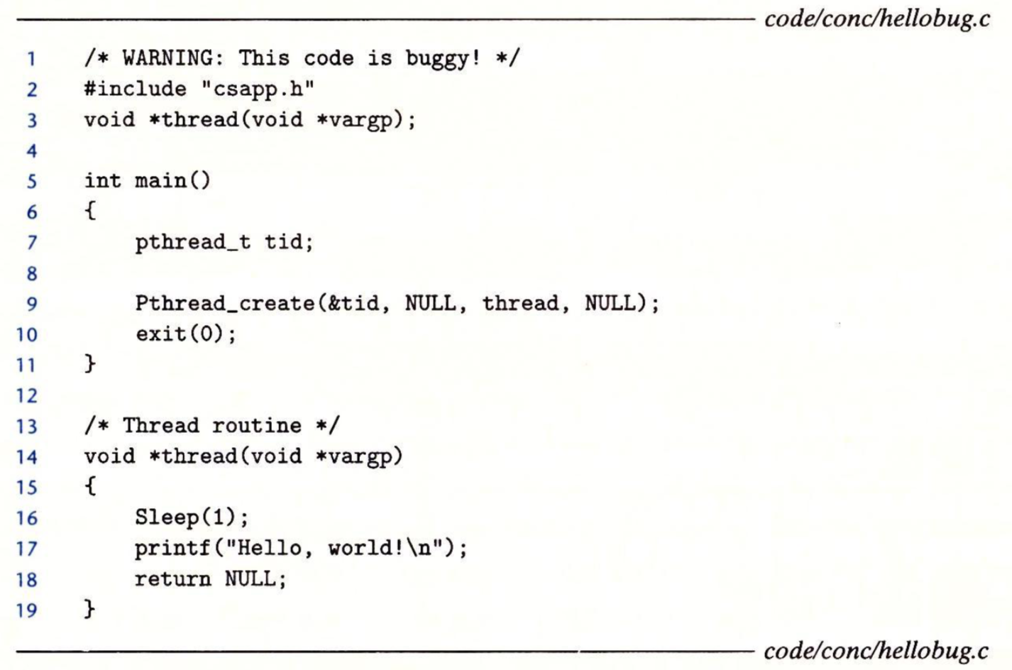
课堂练习
为什么没有输出？

Slide 42
并发：多线程并发程序实例

Slide 43
Signaling with semaphores
producer
thread
consumer
thread
shared
buffer
“生产者-消费者”同步模式：
生产者等待空的slot，插入shared buffer，并通知消费者
消费者等待shared buffer中的item，从buffer中删除，并通知生产者

Slide 44
Case Study: Prethreaded Concurrent Server
预线程化
线程池，线程数上限
生产者：master thread
消费者：worker threads（多个消费者）
Pool of
worker
threads
Service client
Client
Worker
thread
Insert
descriptors
Accept
connections
Master
thread
Remove
descriptors
...
Buffer
...
Client
Worker
thread
Service client

Slide 45
sbuf Package - Declarations
struct {
int *buf; /* Buffer array */
int n; /* Maximum number of slots */
int front; /* buf[(front+1)%n] is first item */
int rear; /* buf[rear%n] is last item */
sem_t mutex; /* protects accesses to buf */
sem_t slots; /* Counts available slots */
sem_t items; /* Counts available items */
} sbuf_;

Slide 46
sbuf Package - Implementation
void sbuf_init(sbuf_t *sp, int n)
{
sp->buf = Calloc(n, sizeof(int));
/* Buffer holds max of n items */
sp->n = n;
/* Empty buffer iff front == rear */
sp->front = sp->rear = 0;
/* Binary semaphore for locking */
Sem_init(&sp->mutex, 0, 1);
/* Initially, buf has n empty slots */
Sem_init(&sp->slots, 0, n);
/* Initially, buf has zero data items */
Sem_init(&sp->items, 0, 0);
}

Slide 47
sbuf Package - Implementation
void sbuf_insert(sbuf_t *sp, int item)
{
/* Wait for available slot */
P(&sp->slots);
/*Lock the buffer */
P(&sp->mutex);
/*Insert the item */
sp->buf[(++sp->rear)%(sp->n)] = item;
/* Unlock the buffer */
V(&sp->mutex);
/* Announce available items*/
V(&sp->items);
}

Slide 48
sbuf Package - Implementation
void sbuf_remove(sbuf_t *sp)
{
int item;
/* Wait for available item */
P(&sp->items);
/*Lock the buffer */
P(&sp->mutex);
/*Remove the item */
item = sp->buf[(++sp->front)%(sp->n)];
/* Unlock the buffer */
V(&sp->mutex);
/* Announce available slot*/
V(&sp->slots);
return item;
}

Slide 49
Case Study: Prethreaded Concurrent Server
预线程化
线程池，线程数上限
生产者：master thread
消费者：worker threads（多个消费者）
Pool of
worker
threads
Service client
Client
Worker
thread
Insert
descriptors
Accept
connections
Master
thread
Remove
descriptors
...
Buffer
...
Client
Worker
thread
Service client

Slide 50
Prethreading
#define NTHREADS 4
#define SBUFSIZE 16
/* shared buffer of connected descriptors */
sbuf_t sbuf ;
int main(int argc, char **argv)
{
int i, listenfd, connfd, port;
int clientlen = sizeof(struct sockaddr_in);
struct sockaddr_in clientaddr;
pthread_t tid;

Slide 51
Prethreading
port = atoi(argv[0]);
sbuf_init(&sbuf, SBUFSIZE);
listenfd = open_listenfd(port);
/* Create worker threads */
for (i = 0; i < NTHREADS; i++)
Pthread_create(&tid, NULL, thread, NULL);
while (1) {
connfd = Accept (listenfd,
(SA *)&clientaddr, &clientlen);
/* Insert connfd in buffer */
sbuf_insert(&sbuf, connfd);
}
}

Slide 52
Prethreading
void *thread(void *vargp)
{
Pthread_detach(pthread_self());
while (1) {
int connfd = sbuf_remove(&sbuf); /* Remove connfd from buffer */
echo_cnt(connfd); /* Service client */
Close(connfd);
}
}

Slide 53
课堂练习
假设p表示生产者数量，c表示消费者数量，n表示缓冲区大小。对于下面的每个场景，指出sbuf_insert和sbuf_remove中的互斥锁信号mutex是否为必需的。
p=1, c=1, n>1
p=1, c=1, n=1
p>1, c>1, n=1
Notes:
p=1, c=1, n>1：必要，生产者/消费者会并行访问（但p和c访问数据的不同单元，感觉应该不会冲突）
p=1, c=1, n=1：不必要，只有一个位置，slot/item会充当锁mutex的作用，只有一个人生产，之后才有一个人消费，完全串行
p>1, c>1, n=1：不必要，同上

Slide 54
Readers-Writers Problem
问题描述:
Reader threads只是读
Writer threads只是写
写操作是排他的（包括读、写）
读操作之间可以并行，而且没有数量限制
在实际系统经常发生，例如
航空在线预订系统
多线程缓存的web代理

Slide 55
Variants of Readers-Writers
First readers-writers problem (favors readers)
除非已经有一个write正在写，否则读操作都会被允许进入
新来的reader的优先级比正在等待的writer还要高
Second readers-writers problem (favors writers)
与上述读优先完全相反
以上都有可能产生Starvation (where a thread waits indefinitely)

Slide 56
Solution to First Readers-Writers Problem
int readcnt; /* Initially 0 */
sem_t mutex, w; /* Both initially 1 */
void reader(void)
{
while (1) {
P(&mutex);
readcnt++;
if (readcnt == 1) /* First in */
P(&w);
V(&mutex);
/* Reading happens here */
P(&mutex);
readcnt--;
if (readcnt == 0) /* Last out */
V(&w);
V(&mutex);
}
}
void writer(void)
{
while (1) {
P(&w);
/* Writing here */
V(&w);
}
}
Writers
Readers
rw1.c

Slide 57
课堂练习
对于读写者问题，ppt中给出的是读优先，例如
请求序列：R1, W1, R2, R3, W2
如果R2在R1结束前到达，执行顺序是R1,R2,R3,W1,W2，即后来的R会先于W执行
A. 如果最多只有N个读者，能否修改程序让读写者尽可能公平？(正在W，到来的R,W竞争；正在R，到来的R,W竞争)
B. 如何实现一个写者优先级高于读者的程序？（正在W，到来的W优先；正在R，新来的按顺序调度）

Slide 58
读写平衡的读写者问题（最多同时N个读者）
Readers
Writers
void writer(void)
{
while (1) {
int i;
P(&w);
for (i=0;i<N;i++)
P(&common_sem);
V(&w);
/* Writing happens here */
for (i=0;i<N;i++)
V(&common_sem);
}
}
sem_t w; /* Initially 1 */
sem_t common_sem; /* Initially N */
void reader(void)
{
while (1) {
P(&common_sem);
/* Reading happens here */
V(&common_sem);
}
}

Slide 59
写优先的读写者问题
int readcnt, writecnt; /* Initially 0 */
sem_t r, w, rcnt, wcnt; /* All initially 1 */
void reader(void)
{
while (1) {
P(&r);
P(&rcnt);
readcnt++;
if (readcnt == 1) /* First in */
P(&w);
V(&rcnt);
V(&r);
/* Reading happens here */
P(&rcnt);
readcnt--;
if (readcnt == 0) /* Last out */
V(&w);
V(&rcnt);
}
}
void writer(void)
{
while (1) {
P(&wcnt);
writecnt++;
if (writecnt == 1)
P(&r);
V(&wcnt);
P(&w);
/* Writing happens here */
V(&w);
P(&wcnt);
writecnt--;
if (writecnt == 0) /* Last out */
V(&r);
V(&wcnt);
}
}
Writers
Readers

Slide 60
Starvation
In the first example, readers block one writer
Writer might not get the resource
Writer is being starved of resource
Make sure that readers don’t hold resource for long

Slide 61
Thread-safe functions
Functions called from a thread must be thread-safe
Definition: A function is thread-safe iff it will always produce correct results when called repeatedly from multiple concurrent threads.

Slide 62
Thread-safe functions
线程不安全的函数分为四个类型：
类型1：不能保护共享变量
类型2：多次函数调用之间依赖同样的持久状态
类型3：返回一个指向静态变量的指针
类型4：调用其他线程不安全的函数

Slide 63
Thread-unsafe functions
类型1：不能保护共享变量
解决方法：使用Pthreads P/V操作
不需要修改调用代码（只需要改函数内部代码）
问题：同步操作会使运行变慢

Slide 64
Thread-unsafe functions (case 2)
类型2：多次函数调用之间依赖同样的持久状态
例如rand函数（本质是还是修改共享变量；不同点是实际多线程之间本来不需要交互）
unsigned int next = 1;
/* rand – return pseudo-random int on 0..32767 */
int rand(void)
{
next = next * 110351524 + 12345 ;
return (unsigned int)((next/65536) % 32768);
}
/* srand – set seed for rand() */
void srand(unsigned int seed)
{
next = seed;
}

Slide 65
Thread-unsafe functions (case 2)
把以来的全局/静态变量变为参数不断传递来记录状态
消除了全局/静态变量
很类似函数式编程的思路（Erlang等）
/* rand_r – return pseudo-random int on 0..32767 */
int rand_r(int *nextp)
{
*nextp = *nextp * 110351524 + 12345 ;
return (unsigned int)((*nextp/65536) % 32768);
}

Slide 66
Thread-safe functions
类型3：返回一个指向静态变量的指针
struct hostent *gethostbyname(char name)
{
static struct hostent host;
<contact DNS and fill in host>
return &host;
}

Slide 67
Thread-safe functions
hostp = Malloc(...));
gethostbyname_r(name, hostp);
类型3解决方法
方法1：重写函数，调用者传递存放结果的地址
问题: caller和callee的代码都需要修改
方法2：“Lock-and-copy”
问题: caller必须记得释放内存（容易忘）
struct hostent *gethostbyname_ts(char *name)
{
struct hostent *p,*q = Malloc(...);
P(&mutex);
p = gethostbyname(name);
*q = *p;
V(&mutex);
return q;
}

Slide 68
Thread-safe functions
类型4：调用其他线程不安全的函数
解决方法：只调用线程安全函数☺

Slide 69
Reentrant functions
A function is reentrant iff it accesses NO shared variables when called from multiple threads.
Reentrant functions是线程安全函数的一个重要子集
不需要同步操作

Slide 70
Reentrant functions
All functions
Thread-safe
functions
Reentrant
functions
Thread-unsafe
functions
NOTE: The fixes to Class 2 thread-unsafe
functions require modifying the function to
make it reentrant

Slide 71
Thread-safe library functions
All functions in the Standard C Library (at the back of your K&R text) are thread-safe.
Most Unix system calls are thread-safe, with a few exceptions:
Thread-unsafe function Class Reentrant version
rand 2 rand_r
Strtok 2 strtok_r
asctime 3 asctime_r
ctime 3 ctime_r
gethostbyaddr 3 gethostbyaddr_r
gethostbyname 3 gethostbyname_r
inet_ntoa 3 (none)
localtime 3 localtime_r

Slide 72
课堂练习
Try to explain following functions if they are reentrant or thread-safe.
int t;
void swap1(int *x, int *y) {
t = *x; *x = *y; *y = t; }
void swap2(int *x, int *y) {
P(&mutex); t = *x; *x = *y; *y = t; V(&mutex); }
void swap3(int *x, int *y) {
int t; t = *x; *x = *y; *y = t; }
Notes:
Swap1: 不安全；
Swap2: 线程安全
Swap3: reentrant

Slide 73
Issues: Races
A race occurs when correctness of the program depends on one thread reaching point x before another thread reaches point y
/*thread routine */
void *thread(void *vargp)
{
int myid = *((int *)vargp) ;
printf(“Hello from th. %d\n”, myid);
return NULL ;
}
#define N 4
int main()
{
pthread_t tid[N];
int i ;
for ( i=0 ; i<N ; i++ )
pthread_create(&tid[i], NULL, thread, &i);
for ( i=0 ; i<N ; i++ )
pthread_join(tid[i], NULL) ;
exit(0) ;
}
N threads are sharing i

Slide 74
Race Illustration
for (i = 0; i < N; i++)
Pthread_create(&tid[i], NULL, thread, &i);
Main thread
i = 0
Peer thread 0
i = 1
myid = *((int *)vargp)
Race!
Race between increment of i in main thread and deref of vargp in peer thread:
If deref happens while i = 0, then OK
Otherwise, peer thread gets wrong id value

Slide 75
Could this race really occur?
Main thread
Peer thread
int i;
for (i = 0; i < 100; i++) {
Pthread_create(&tid, NULL,
thread,&i);
}
void *thread(void *vargp) {
Pthread_detach(pthread_self());
int i = *((int *)vargp);
save_value(i);
return NULL;
}
race.c
Race Test
If no race, then each thread would get different value of i
Set of saved values would consist of one copy each of 0 through 99

Slide 76
Experimental Results
No Race
Single core laptop
Multicore server
The race can really happen!

Slide 77
Race Elimination
int main()
{
pthread_t tid[N];
int i, *ptr ;
for ( i=0 ; i<N ; i++ ) {
ptr = malloc((sizeof)int);
*ptr = i ;
pthread_create(&tid[i], NULL, thread, ptr);
}
for ( i=0 ; i<N ; i++ )
pthread_join(tid[i], NULL) ;
exit(0) ;
}
Avoid unintended sharing of state

Slide 78
活锁（Live Lock）
类似于死锁问题，两个thread各自持有对方想要的锁
当一个thread意识到它不能获得下一个需要获得的锁时，它会释放已获得的锁，并等待1ms再尝试一次
但是，如果两个thread都这样做，还是无法解决问题
类似于一条路上相遇的两个人都在让路
例子
Fork创建进程，但系统进程数量有上限; fork失败会等待一段时间再重试
假设系统最多100个进程，10个进程，每个要创建12个进程
每个进程创建到9个后失败，都放弃前面创建的进程，等待重试
分布式系统选举leader
都申请当leader，无法获得半数以上选票

Slide 79
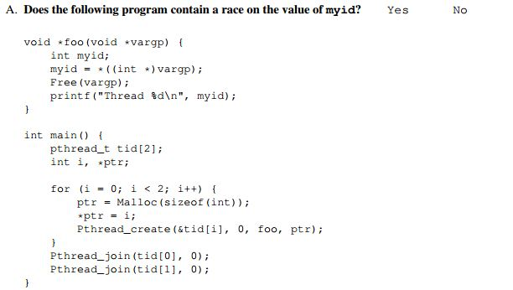
课堂练习
Notes:
A. No

Slide 80
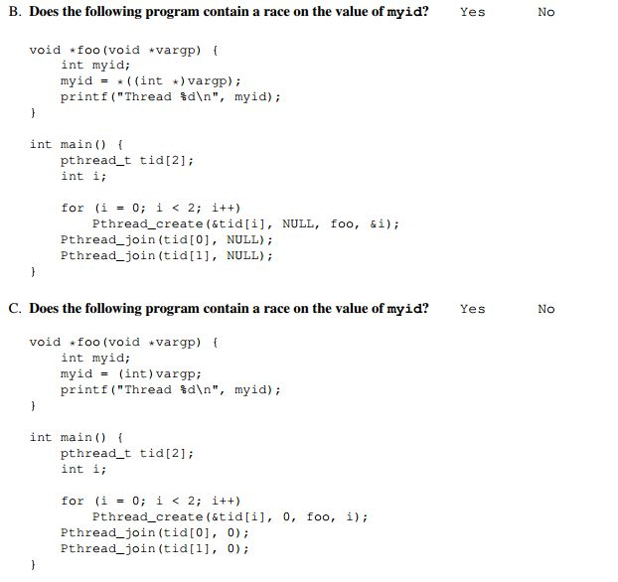
课堂练习
Notes:
B. Yes
C. No

Slide 81
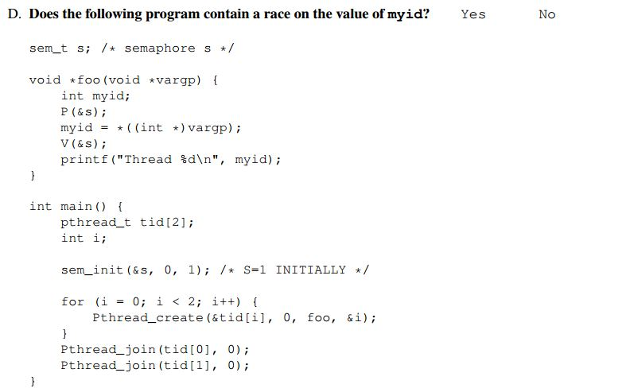
课堂练习
Notes:
D. Yes

Slide 82
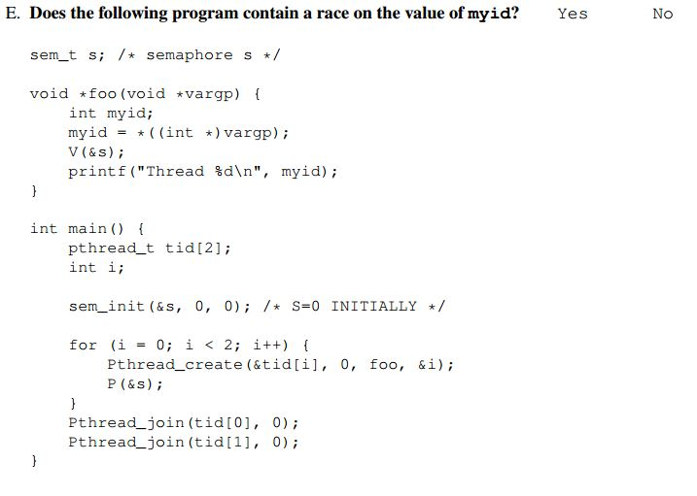
课堂练习
Notes:
E. No

Slide 83
Thread-Level Parallelism

Slide 84
Outline
Parallel Computing Hardware
Multicore
Multiple separate processors on single chip
Hyperthreading
Efficient execution of multiple threads on single core
Thread-Level Parallelism
Splitting program into independent tasks
Example 1: Parallel summation
Divide-and-conquer parallelism
Example 2: Parallel quicksort
Consistency Models
What happens when multiple threads are reading & writing shared state

Slide 85
Exploiting parallel execution
So far, we’ve used threads to deal with I/O delays
e.g., one thread per client to prevent one from delaying another
Multi-core/Hyperthreaded CPUs offer another opportunity
Spread work over threads executing in parallel
Happens automatically, if many independent tasks
e.g., running many applications or serving many clients
Can also write code to make one big task go faster
by organizing it as multiple parallel sub-tasks
并发（Concurrency）vs. 并行（parallel）

Slide 86
Typical Multicore Processor
Core 0
Core n-1
Regs
Regs
L1
d-cache
L1
i-cache
…
L1
d-cache
L1
i-cache
L2 unified cache
L2 unified cache
L3 unified cache
(shared by all cores)
Main memory
Multiple processors operating with coherent view of memory

Slide 87
Out-of-Order Processor Structure
Instruction Control
Instruction
Cache
Instruction Decoder
Registers
Op. Queue
PC
Functional Units
Data Cache
Int
Arith
Int
Arith
FP
Arith
Load /
Store
Instruction control dynamically converts program into stream of operations
Operations mapped onto functional units to execute in parallel

Slide 88
Hyperthreading Implementation
Instruction Control
Instruction
Cache
Instruction Decoder
Reg A
Op. Queue A
Reg B
Op. Queue B
PC A
PC B
Functional Units
Data Cache
Int
Arith
Int
Arith
FP
Arith
Load /
Store
Replicate enough instruction control to process K instruction streams
K copies of all registers
Share functional units

Slide 89
Benchmark Machine
Get data about machine from /proc/cpuinfo
Shark Machines
Intel Xeon E5520 @ 2.27 GHz
Nehalem, ca. 2010
8 Cores
Each can do 2x hyperthreading

Slide 90
Example 1: Parallel Summation
Sum numbers 0, …, n-1
Should add up to ((n-1)*n)/2
Partition values 1, …, n-1 into t ranges
⎣n/t⎦ values in each range
Each of t threads processes 1 range
For simplicity, assume n is a multiple of t
Let’s consider different ways that multiple threads might work on their assigned ranges in parallel

Slide 91
First attempt: psum-mutex
Simplest approach: Threads sum into a global variable protected by a semaphore mutex.
void *sum_mutex(void *vargp); /* Thread routine */
/* Global shared variables */
long gsum = 0; /* Global sum */
long nelems_per_thread; /* Number of elements to sum */
sem_t mutex; /* Mutex to protect global sum */
int main(int argc, char **argv)
{
long i, nelems, log_nelems, nthreads, myid[MAXTHREADS];
pthread_t tid[MAXTHREADS];
/* Get input arguments */
nthreads = atoi(argv[1]);
log_nelems = atoi(argv[2]);
nelems = (1L << log_nelems);
nelems_per_thread = nelems / nthreads;
sem_init(&mutex, 0, 1);
psum-mutex.c

Slide 92
psum-mutex (cont)
Simplest approach: Threads sum into a global variable protected by a semaphore mutex.
/* Create peer threads and wait for them to finish */
for (i = 0; i < nthreads; i++) {
myid[i] = i;
Pthread_create(&tid[i], NULL, sum_mutex, &myid[i]);
}
for (i = 0; i < nthreads; i++)
Pthread_join(tid[i], NULL);
/* Check final answer */
if (gsum != (nelems * (nelems-1))/2)
printf("Error: result=%ld\n", gsum);
exit(0);
}
psum-mutex.c

Slide 93
psum-mutex Thread Routine
Simplest approach: Threads sum into a global variable protected by a semaphore mutex.
/* Thread routine for psum-mutex.c */
void *sum_mutex(void *vargp)
{
long myid = *((long *)vargp); /* Extract thread ID */
long start = myid * nelems_per_thread; /* Start element index */
long end = start + nelems_per_thread; /* End element index */
long i;
for (i = start; i < end; i++) {
P(&mutex);
gsum += i;
V(&mutex);
}
return NULL;
}
psum-mutex.c

Slide 94
psum-mutex Performance
Shark machine with 8 cores, n=2³¹
Threads (Cores) | 1 (1) | 2 (2) | 4 (4) | 8 (8) | 16 (8)
psum-mutex (secs) | 51 | 456 | 790 | 536 | 681
Nasty surprise:
Single thread is very slow
Gets slower as we use more cores

Slide 95
Next Attempt: psum-array
Peer thread i sums into global array element psum[i]
Main waits for threads to finish, then sums elements of psum
Eliminates need for mutex synchronization
/* Thread routine for psum-array.c */
void *sum_array(void *vargp)
{
long myid = *((long *)vargp); /* Extract thread ID */
long start = myid * nelems_per_thread; /* Start element index */
long end = start + nelems_per_thread; /* End element index */
long i;
for (i = start; i < end; i++) {
psum[myid] += i;
}
return NULL;
}
psum-array.c

Slide 96
psum-array Performance
Orders of magnitude faster than psum-mutex

Slide 97
Next Attempt: psum-local
Reduce memory references by having peer thread i sum into a local variable (register)
/* Thread routine for psum-local.c */
void *sum_local(void *vargp)
{
long myid = *((long *)vargp); /* Extract thread ID */
long start = myid * nelems_per_thread; /* Start element index */
long end = start + nelems_per_thread; /* End element index */
long i, sum = 0;
for (i = start; i < end; i++) {
sum += i;
}
psum[myid] = sum;
return NULL;
}
psum-local.c

Slide 98
psum-local Performance
Significantly faster than psum-array

Slide 99
Characterizing Parallel Program Performance
p processor cores, T_{k} is the running time using k cores
Def. Speedup: S_{p} = T₁ / T_{p}
S_{p} is relative speedup if T₁ is running time of parallel version of the code running on 1 core.
S_{p} is absolute speedup if T₁ is running time of sequential version of code running on 1 core.
Absolute speedup is a much truer measure of the benefits of parallelism.
Def. Efficiency: E_{p} = S_{p} /p = T₁ /(pT_{p})
Reported as a percentage in the range (0, 100].
Measures the overhead due to parallelization

Slide 100
Performance of psum-local
Threads (t) | 1 | 2 | 4 | 8 | 16
Cores (p) | 1 | 2 | 4 | 8 | 8
Running time (T_{p}) | 1.98 | 1.14 | 0.60 | 0.32 | 0.33
Speedup (S_{p}) | 1 | 1.74 | 3.30 | 6.19 | 6.00
Efficiency (E_{p}) | 100% | 87% | 82% | 77% | 75%
Efficiencies OK, not great
Our example is easily parallelizable
Real codes are often much harder to parallelize
e.g., parallel quicksort later in this lecture

Slide 101
Amdahl’s Law
Gene Amdahl (Nov. 16, 1922 – Nov. 10, 2015)
Captures the difficulty of using parallelism to speed things up.
Overall problem
T Total sequential time required
p Fraction of total that can be sped up (0 ≤ p ≤ 1)
k Speedup factor
Resulting Performance
T_{k} = pT/k + (1-p)T
Portion which can be sped up runs k times faster
Portion which cannot be sped up stays the same
Least possible running time:
k = ∞
T∞ = (1-p)T

Slide 102
Amdahl’s Law Example
Overall problem
T = 10 Total time required
p = 0.9 Fraction of total which can be sped up
k = 9 Speedup factor
Resulting Performance
T₉ = 0.9 * 10/9 + 0.1 * 10 = 1.0 + 1.0 = 2.0
Least possible running time:
T∞ = 0.1 * 10.0 = 1.0

Slide 103
A More Substantial Example: Sort
Sort set of N random numbers
Multiple possible algorithms
Use parallel version of quicksort
Sequential quicksort of set of values X
Choose “pivot” p from X
Rearrange X into
L: Values ≤ p
R: Values ≥ p
Recursively sort L to get L′
Recursively sort R to get R′
Return L′ : p : R′

Slide 104
Sequential Quicksort Visualized
X
p
L
p
R
p2
L2
p2
R2
•
•
•
L′

Slide 105
Sequential Quicksort Visualized
X
L′
p
R
p3
L3
p3
R3
•
•
•
R′
L′
p
R′

Slide 106
Sequential Quicksort Code
void qsort_serial(data_t *base, size_t nele) {
if (nele <= 1)
return;
if (nele == 2) {
if (base[0] > base[1])
swap(base, base+1);
return;
}
/* Partition returns index of pivot */
size_t m = partition(base, nele);
if (m > 1)
qsort_serial(base, m);
if (nele-1 > m+1)
qsort_serial(base+m+1, nele-m-1);
}
Sort nele elements starting at base
Recursively sort L or R if has more than one element

Slide 107
Parallel Quicksort
Parallel quicksort of set of values X
If N ≤ Nthresh, do sequential quicksort
Else
Choose “pivot” p from X
Rearrange X into
L: Values ≤ p
R: Values ≥ p
Recursively spawn separate threads
Sort L to get L′
Sort R to get R′
Return L′ : p : R′

Slide 108
Parallel Quicksort Visualized
X
p
L
p
R
p2
p3
L2
p2
R2
p
L3
p3
R3
•
•
•
•
•
•
L′
p
R′

Slide 109
Thread Structure: Sorting Tasks
X
• • •
Task Threads
Task: Sort subrange of data
Specify as:
base: Starting address
nele: Number of elements in subrange
Run as separate thread

Slide 110
Small Sort Task Operation
X
• • •
Task Threads
Sort subrange using serial quicksort

Slide 111
Large Sort Task Operation
X
L
p
R
Partition Subrange
• • •
X
L
p
R
Spawn 2 tasks
• • •

Slide 112
Top-Level Function (Simplified)
void tqsort(data_t *base, size_t nele) {
init_task(nele);
global_base = base;
global_end = global_base + nele - 1;
task_queue_ptr tq = new_task_queue();
tqsort_helper(base, nele, tq);
join_tasks(tq);
free_task_queue(tq);
}
Sets up data structures
Calls recursive sort routine
Keeps joining threads until none left
Frees data structures

Slide 113
Recursive sort routine (Simplified)
/* Multi-threaded quicksort */
static void tqsort_helper(data_t *base, size_t nele,
task_queue_ptr tq) {
if (nele <= nele_max_sort_serial) {
/* Use sequential sort */
qsort_serial(base, nele);
return;
}
sort_task_t *t = new_task(base, nele, tq);
spawn_task(tq, sort_thread, (void *) t);
}
Small partition: Sort serially
Large partition: Spawn new sort task

Slide 114
Sort task thread (Simplified)
/* Thread routine for many-threaded quicksort */
static void *sort_thread(void *vargp) {
sort_task_t *t = (sort_task_t *) vargp;
data_t *base = t->base;
size_t nele = t->nele;
task_queue_ptr tq = t->tq;
free(vargp);
size_t m = partition(base, nele);
if (m > 1)
tqsort_helper(base, m, tq);
if (nele-1 > m+1)
tqsort_helper(base+m+1, nele-m-1, tq);
return NULL;
}
Get task parameters
Perform partitioning step
Call recursive sort routine on each partition

Slide 115
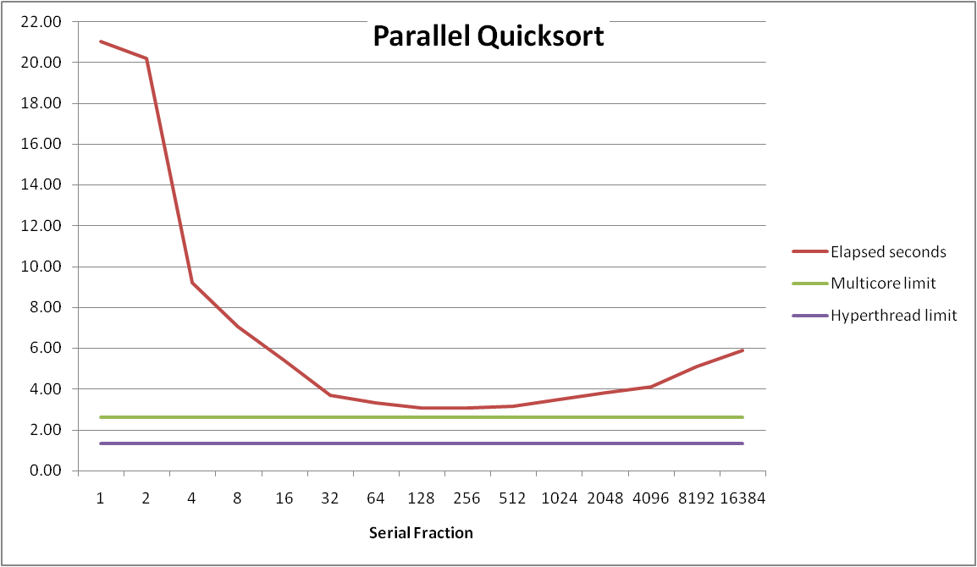
Parallel Quicksort Performance
Serial fraction: Fraction of input at which do serial sort
Sort 2²⁷ (134,217,728) random values
Best speedup = 6.84X

Slide 116
Parallel Quicksort Performance
Good performance over wide range of fraction values
F too small: Not enough parallelism
F too large: Thread overhead + run out of thread memory

Slide 117
Amdahl’s Law & Parallel Quicksort
Sequential bottleneck
Top-level partition: No speedup
Second level: ≤ 2X speedup
k^{th} level: ≤ 2^{k-1}X speedup
Implications
Good performance for small-scale parallelism
Would need to parallelize partitioning step to get large-scale parallelism
Parallel Sorting by Regular Sampling (PSRS)
H. Shi & J. Schaeffer, J. Parallel & Distributed Computing, 1992

Slide 118
PSRS排序过程(N=27，p=3)

Slide 119
Lessons Learned
Must have parallelization strategy
Partition into K independent parts
Divide-and-conquer
Inner loops must be synchronization free (e.g., local sum)
Synchronization operations very expensive
Beware of Amdahl’s Law
Serial code can become bottleneck
You can do it!
Achieving modest levels of parallelism is not difficult
Set up experimental framework and test multiple strategies

Slide 120
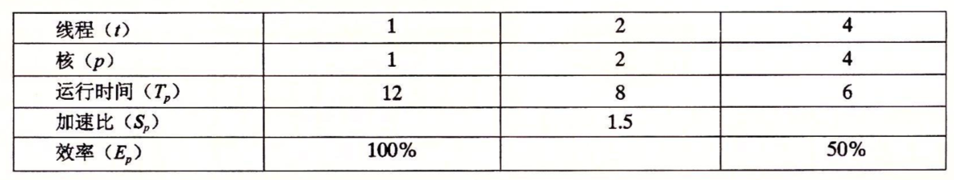
课堂练习

Slide 121
Memory Consistency
int a = 1;
int b = 100;
Thread consistency
constraints
Wa
Rb
Thread1:
Wa: a = 2;
Rb: print(b);
Thread2:
Wb: b = 200;
Ra: print(a);
Wb
Ra
What are the possible values printed?
Depends on memory consistency model
Abstract model of how hardware handles concurrent accesses
Sequential consistency
Overall effect consistent with each individual thread
Otherwise, arbitrary interleaving

Slide 122
Sequential Consistency Example
Thread consistency
constraints
int a = 1;
int b = 100;
Wa
Rb
Thread1:
Wa: a = 2;
Rb: print(b);
Thread2:
Wb: b = 200;
Ra: print(a);
Wb
Ra
Rb
Wb
Ra
100, 2
Wa
Rb
Ra
200, 2
Wb
Ra
Rb
2, 200
Ra
Wa
Rb
1, 200
Wb
Ra
Rb
2, 200
Wa
Rb
Ra
200, 2
Impossible outputs
100, 1 1, 100 200, 1
Would require reaching both Ra and Rb before Wa and Wb

Slide 123
Non-Coherent Cache Scenario
int a = 1;
int b = 100;
Write-back caches, without coordination between them
Thread1:
Wa: a = 2;
Rb: print(b);
Thread2:
Wb: b = 200;
Ra: print(a);
Thread1 Cache
Thread2 Cache
a: 2
b:100
a:1
b:200
print 1
print 100
Main Memory
a:1
b:100

Slide 124
Snoopy Caches
int a = 1;
int b = 100;
Tag each cache block with state
Invalid Cannot use value
Shared Readable copy
Exclusive Writeable copy
Thread1:
Wa: a = 2;
Rb: print(b);
Thread2:
Wb: b = 200;
Ra: print(a);
Thread1 Cache
Thread2 Cache
E
a: 2
E
b:200
Main Memory
a:1
b:100

Slide 125
Snoopy Caches
int a = 1;
int b = 100;
Tag each cache block with state
Invalid Cannot use value
Shared Readable copy
Exclusive Writeable copy
Thread1:
Wa: a = 2;
Rb: print(b);
Thread2:
Wb: b = 200;
Ra: print(a);
Thread1 Cache
Thread2 Cache
E
S
a: 2
a: 2
S
a:2
print 2
S
b:200
E
S
b:200
b:200
print 200
Main Memory
When cache sees request for one of its E-tagged blocks
Supply value from cache
Set tag to S
a:1
b:100

