Slide 1
并发-2

Slide 2
Lock-based Concurrent Data Structures

Slide 3
Basic Idea & Posix Library
Lock (variable)
Two states: available (unlocked) or acquired (locked)
Unlocked: no thread holds the lock
Locked: exactly one thread holds the lock
The POSIX library provides mutual exclusion between threads
Also known as mutex
pthread_mutex_t lock = PTHREAD_MUTEX_INITIALIZER;
pthread_mutex_lock(&lock);
balance = balance + 1;
pthread_mutex_unlock(&lock);

Slide 4
Lock-based Concurrent Data Structure
Concurrent Data Structure
Enabling many threads to access the structure
Thread safe
High performance
How to add locks to data structures?
Counter
Linked List
Queue
Hash Table

Slide 5
A Simple Counter
typedef struct __conter_t {
int value;
} counter_t
void init(counter *c) { c->value=0; }
void increment(counter_t *c) { c->value++; }
void decrement(counter_t *c) { c->value--; }
int get(counter_t *c) { return c->value; }

Slide 6
Lock-based Approach
Locks support a concurrent programming style based on mutual exclusion
Only one thread at a time executes the critical section
Acquire lock
. . . // Critical sections
Release lock

Slide 7
A Lock-based Counter
typedef struct __conter_t {
int value;
pthread_mutex_t lock;
} counter_t
void init(counter *c) {
c->value=0;
pthread_mutex_init(&c->lock, NULL);
}
void increment(counter_t *c) {
Pthread_mutex_lock(&c->lock);
c->value++;
Pthread_mutex_unlock(&c->lock);
}

Slide 8
A Lock-based Counter
void decrement(counter_t *c) {
Pthread_mutex_lock(&c->lock);
c->value--;
Pthread_mutex_unlock(&c->lock);
}
int get(counter_t *c) {
Pthread_mutex_lock(&c->lock);
rc = c->value;
Pthread_mutex_unlock(&c->lock);
return rc
}

Slide 9
一写多读是否需要加锁？
要加锁
为了维护逻辑的正确性
W1, R1: R1应该能读到W1的结果，否则逻辑不正确
CPU多核，W1和R1分在不同核上
没有锁的话，R1可能只是看到旧的cache，W1不一定触发其他核上的cache更新

Slide 10
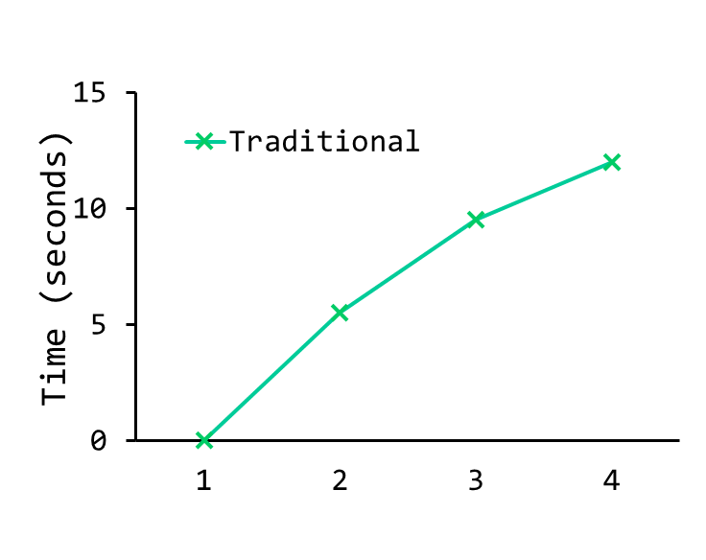
Performance
Traditional Lock-based Counter
Simple
Works correctly
Poor performance
Note that if the data structure is not too slow, you are done!
No need to do something fancy if something simple will work.
Perfect Scaling

Slide 11
Scalable Counting
Sloppy Counter
一个a single global counter，多个local physical counters (one per CPU core)
整体表现为一个counter
Example:
A machine with 4 CPUs
- 4 local counter (L1-L4)
- 1 global counter (G)
Time | L1 | L2 | L3 | L4 | G

Slide 12
Sloppy Counter
Scalable Write (increment/decrement)
Local counter由对应的local lock来控制同步
每个线程总是在同一个CPU核上增加local counter（线程绑定到CPU核）
Scalable Read (get)
Local counter的值周期性地加到global counter上（同时local counter清零）
Global counter由global lock来控制同步

Slide 13
Sloppy Counter
Sloppiness (S)
The frequency of local-to-global transfer
Smaller S: more precise and more non-scalable
Bigger S: more imprecise and more scalable
Exact (non-scalable) Read
Acquire all the local locks and the global lock

Slide 14
Example
A machine with 4 CPUs
S = 5
Time | L1 | L2 | L3 | L4 | G
0 | 0 | 0 | 0 | 0 | 0
1 | 0 | 0 | 1 | 1 | 0
2 | 1 | 0 | 2 | 1 | 0
3 | 2 | 0 | 3 | 1 | 0
4 | 3 | 0 | 3 | 2 | 0
5 | 4 | 1 | 3 | 3 | 0
6 | 5->0 | 1 | 3 | 4 | 5 (from L1)
7 | 0 | 2 | 4 | 5->0 | 10 (from L4)

Slide 15
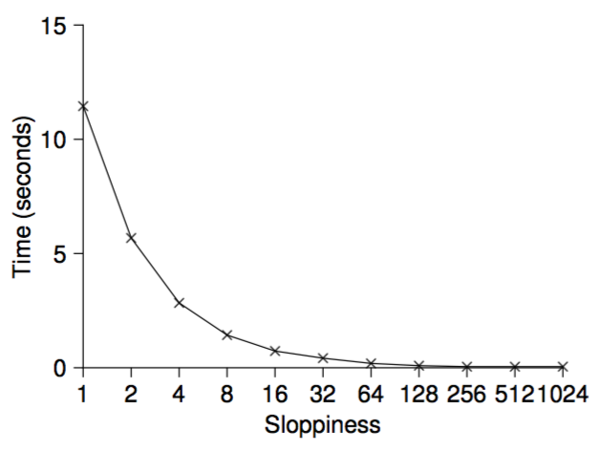
Example
A machine with 4 CPUs
Each thread adds the counter 1 million times

Slide 16
Sloppy Counter
typedef struct __counter_t {
int global // global count
pthread_mutex_t glock; // global lock
int local[NCPUS]; // local counter (per cpu)
pthread_mutex_t llock[NCPUS]; // ... and locks
int threshold; // update frequency
} counter_t;

Slide 17
Sloppy Counter
// init: record threshold, init locks, init values
// if all local counts and global count
void init (counter_t *c, int threshold) {
c->threshold = threshold;
c->global = 0;
pthread_mutex_init(&c->glock, NULL);
int i;
for (i = 0; I < NCPUS; i++) {
c->local[i] = 0;
pthread_mutex_init(c->llock[i], NULL);
}
}

Slide 18
Sloppy Counter
// update: usually, just grab local lock and update local
// amount once local count has risen by ‘threshold’,
// grab global lock and transfer local values to it
void update (counter_t *c, int threadID, int amt) {
int cpu = threadID % NCPUS;
pthread_mutex_lock(&c->llock[cpu]);
c->local[cpu] += amt; // assumes amt > 0
if (c->local[cpu] >= c->threshold) { // transfer
pthread_mutex_lock(&c->glock);
c->global += c->local[cpu];
pthread_mutex_unlock(&c->glock);
c->local[cpu] = 0;
}
pthread_mutex_unlock(&c->llock[cpu]);
}

Slide 19
Sloppy Counter
// get: just return global amount (which may not be perfect)
int get (counter_t *c) {
pthread_mutex_lock(&c->glock);
int val = c->global;
pthread_mutex_unlock(&c->glock);
return val; // only approximate!
}

Slide 20
Concurrent Linked Lists
Simple Concurrent Linked List
利用锁来同步整个insert和lookup函数
不要忘记在异常控制流上释放锁（容易出bug）
A recent study of Linux kernel patches found that a huge fraction of bugs (nearly 40%) are found on such rarely-taken code paths

Slide 21
Simple Linked List
typedef struct __node_t { // basic node structure
int key;
struct __node_t *next;
} node_t;
typedef struct __list_t { // basic list structure
node_t *head;
pthread_mutex_t lock;
} list_t
void List_Init(list_t *L) {
L->head = NULL;
pthread_mutex_init(&L->lock, NULL);
}

Slide 22
Simple Linked List
int List_Insert(list *L, int key) {
pthread_mutex_lock(&L->lock);
node_t *new = malloc(sizeof(node_t));
if (new == NULL) {
perror(“malloc”);
pthread_mutex_unlock(&L->lock);
return -1; // fail
}
new->key = key;
new->next = L->head;
L->head = new;
pthread_mutex_unlock(&L->lock);
return 0; // success
}
exceptional control flow

Slide 23
Simple Linked List
int List_Lookup(list *L, int key) {
pthread_mutex_lock(&L->lock);
node_t *curr = L->head;
while (curr) {
if (curr->key == key) {
pthread_mutex_unlock(&L->lock);
return 0; // success
}
curr = curr->next;
}
pthread_mutex_unlock(&L->lock);
return -1; // failure
}
exceptional control flow

Slide 24
Concurrent Linked Lists
Can we avoid calling unlock in the failure path?
List_Insert(): malloc() itself is thread-safe
List_Lookup(): a common exit path

Slide 25
Simple Linked List
void List_Insert(list *L, int key) {
// synchronization not needed
node_t *new = malloc(sizeof(node_t));
if (new == NULL) {
perror(“malloc”);
return;
}
new->key = key;
// just lock critical section
pthread_mutex_lock(&L->lock);
new->next = L->head;
L->head = new;
pthread_mutex_unlock(&L->lock);
}

Slide 26
Simple Linked List
int List_Lookup(list *L, int key) {
int rv = -1;
pthread_mutex_lock(&L->lock);
node_t *curr = L->head;
while (curr) {
if (curr->key == key) {
rv = 0;
break;
}
curr = curr->next;
}
pthread_mutex_unlock(&L->lock);
return rv;
}

Slide 27
Scaling Linked Lists
Hand-over-hand locking (a.k.a. lock coupling)
使用a lock per node，而不是整个list级别的锁
在释放当前结点锁之前，先抢占下一个结点的锁
但是，频繁的获得/释放锁，代价很大，所以这种方案impractical
MORE CONCURRENCY ISN’T NECESSARILY FASTER

Slide 28
Concurrent Queues
Simple (always work) Solution
Add a big lock
Michael and Scott Concurrent Queues
Add two locks, one for head, and one for tail
Queue_Enqueue always uses tail lock
Queue_Dequeue always uses head lock
A dummy node enables the separation of head and tail operations

Slide 29
Michael and Scott Concurrent Queue
typedef struct __node_t {
int key;
struct __node_t *next;
} node_t;
typedef struct __queue_t {
node_t *head;
node_t *tail;
pthread_mutex_t head_lock;
pthread_mutex_t tail_lock;
} queue_t

Slide 30
Michael and Scott Concurrent Queue
void Queue_Init(queue_t *q) {
node_t *tmp = malloc(sizeof(node_t));
tmp->next = NULL;
q->head = q->tail = temp;
pthread_mutex_init(&q->head_lock, NULL);
pthread_mutex_init(&q->tail_lock, NULL);
}

Slide 31
Michael and Scott Concurrent Queue
void Queue_Enqueu(queue_t *q, int value) {
node_t *tmp = malloc(sizeof(node_t));
assert(tmp != NULL);
tmp->value = value;
tmp->next = NULL;
pthread_mutex_lock(&q->tail_lock);
q->tail->next = tmp;
q->tail = tmp;
pthread_mutex_unlock(&->tail_lock);
}

Slide 32
Michael and Scott Concurrent Queue
void Queue_Dequeu(queue_t *q, int *value) {
pthread_mutex_lock(&q->head_lock);
node_t *tmp = q->head;
node_t *new_head = tmp->next;
if (new_head == NULL) {
phtread_mutex_unlock(&q->head_lock);
return -1; // queue was empty
}
*value = new_head->value;
q->head = new_head;
pthread_mutex_unlock(&->head_lock);
free(tmp);
return 0;
}

Slide 33
Michael and Scott Concurrent Queue
head
dummy
head
dummy
tail
head
dummy
tail
先dequeu，再enqueu，ok
tail
key
先dequeu，中间被插入enqueu操作：
node_t *tmp = q->head;后enqueu:
可以dequeu新插入数据
node_t *new_head = tmp->next;后enqueu:
dequeu return -1
ok

Slide 34
Michael and Scott Concurrent Queue
head
dummy
tail
先enqueu，中间夹杂dequeu，ok
key
head
dummy
head
tail
tail
dummy
dummy

Slide 35
Concurrent Hash Table
#define BUCKETS (101)
typedef struct __hash_t {
list_t lists[BUCKETS];
} hash_t
void Hash_Init(hash_t *H) {
int I;
for (I = 0; I < BUCKETS; i++) {
List_Init(&H->lists[i]);
}
}

Slide 36
Concurrent Hash Table
void Hash_Insert(hash_t *H, int key) {
int bucket = key % BUCKETS;
return List_Insert(&H->lists[bucket], key);
}
void Hash_Lookup(hash_t *H, int key) {
int bucket = key % BUCKETS;
return List_Lookup(&H->lists[bucket], key);
}

Slide 37
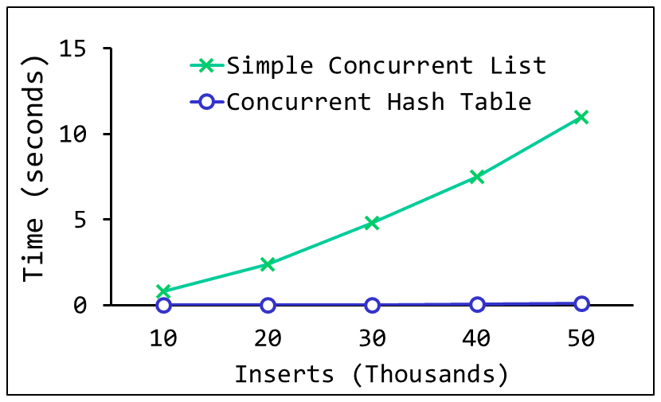
Concurrent Hash Tables
Scaling Concurrent Hash Tables
Based on concurrent lists
Each bucket is represented by a list
A lock per hash bucket

