Slide 1
Exceptional Control Flow III (Signal)

Slide 2
Outline
Signal Terminology
Sending Signals
Receiving Signals
Signal Handling Issues
Portable Signal Handling
Explicitly Blocking Signals
Synchronizing Flows to Avoid Nasty Concurrency Bugs

Slide 3
Signals
Unix signal
用于进程之间的通信
A higher-level software form of exception
That allows processes and the kernel to interrupt other processes

Slide 4
The kill Program
Kill program
is located in directory /bin/
sends an arbitrary signal to another process (不一定是杀死进程，可以是其他类型的信号)
e.g. unix> kill -9 15213
sends signal 9 (SIGKILL) to process 15213.

Slide 5
Signals Type
Signal是通知一个进程的一个消息：
系统中发生了某个类型的事件
每种signal type对应系统事件的某个类型
低层次的硬件异常
一般是由kernel的exception handler处理，正常用户进程看不到
Signal提供了一种机制，把这种exception的发生告知用户进程
高层次的软件事件
来自kernel
或来自其他用户进程

Slide 6
Hardware Events
SIGFPE signal (number 8)
If a process attempts to divide by zero, then the kernel sends it a SIGFPE signal
SIGILL signal (number 4)
If a process executes an illegal instruction, the kernel sends it a SIGILL signal.
SIGSEGV signal (number 11)
If a process makes an illegal memory reference, the kernel sends it a SIGSEGV signal.

Slide 7
Software Events
SIGINT signal (number 2)
While a process is running in the foreground
if you type a ctrl-c
then the kernel sends a SIGINT signal to the process
SIGKILL signal (number 9)
A process can forcibly terminate another process
by sending it a SIGKILL signal
SIGCHLD signal (number 17)
When a child process terminates or stops,
the kernel sends a SIGCHLD signal to the parent.

Slide 8
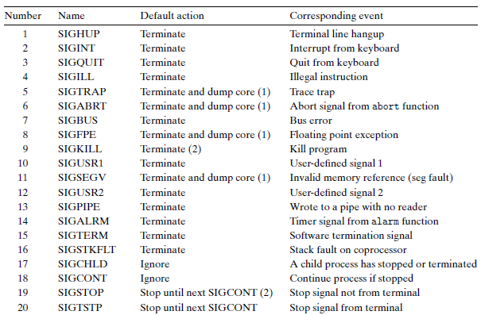
Linux Signals
> man signal

Slide 9
Linux Signals
Linux系统共定义了64种信号
不可靠信号： 也称为非实时信号，standard signal
不支持排队，信号可能会丢失, 比如发送多次相同的信号, 进程只能收到一次
信号值取值区间为1~31
可靠信号： 也称为实时信号，real-time signal
支持排队, 信号不会丢失, 发多少次, 就可以收到多少次
信号值取值区间为32~64

Slide 10
Linux Signals
kill –l可以查看所有信号
取值 | 名称 | 解释 | 默认动作
1 | SIGHUP | 挂起
2 | SIGINT | 中断
3 | SIGQUIT | 退出
4 | SIGILL | 非法指令
5 | SIGTRAP | 断点或陷阱指令
6 | SIGABRT | abort发出的信号
7 | SIGBUS | 非法内存访问
8 | SIGFPE | 浮点异常
9 | SIGKILL | kill信号 | 不能被忽略、处理和阻塞
10 | SIGUSR1 | 用户信号1
11 | SIGSEGV | 无效内存访问
12 | SIGUSR2 | 用户信号2
13 | SIGPIPE | 管道破损，没有读端的管道写数据
14 | SIGALRM | alarm发出的信号
15 | SIGTERM | 终止信号
16 | SIGSTKFLT | 栈溢出

Slide 11
Linux Signals
取值 | 名称 | 解释 | 默认动作
17 | SIGCHLD | 子进程退出 | 默认忽略
18 | SIGCONT | 进程继续
19 | SIGSTOP | 进程停止 | 不能被忽略、处理和阻塞
20 | SIGTSTP | 进程停止
21 | SIGTTIN | 进程停止，后台进程从终端读数据时
22 | SIGTTOU | 进程停止，后台进程想终端写数据时
23 | SIGURG | I/O有紧急数据到达当前进程 | 默认忽略
24 | SIGXCPU | 进程的CPU时间片到期
25 | SIGXFSZ | 文件大小的超出上限
26 | SIGVTALRM | 虚拟时钟超时
27 | SIGPROF | profile时钟超时
28 | SIGWINCH | 窗口大小改变 | 默认忽略
29 | SIGIO | I/O相关
30 | SIGPWR | 关机 | 默认忽略
31 | SIGSYS | 系统调用异常

Slide 12
Signal Terminology
Two steps to transfer a signal to a destination process
Sending a signal
Receiving a signal

Slide 13
Sending a signal
The kernel
发送（传送）信号到目标进程
在目标进程的上下文中的某些状态进行设置
信号产生的原因：
硬件原因
如敲键盘（Ctrl+C）
内核检测到某个系统事件
例如除以0，子进程终止等
进程调用了某些系统调用（如kill）
kill()，raise()，sigqueue()，alarm()，setitimer()，abort()
让内核给目标进程发信号
进程可以发送信号给自己

Slide 14
Sending a signal
kill()：用于向进程或进程组发送信号；
sigqueue()：只能向一个进程发送信号，不能向进程组发送信号；主要针对实时信号提出，与sigaction()组合使用，当然也支持非实时信号的发送；
alarm()：用于调用进程指定时间后发出SIGALARM信号；
setitimer()：设置定时器，计时达到后给进程发送SIGALRM信号，功能比alarm更强大；
abort()：向进程发送SIGABORT信号，默认进程会异常退出。
raise()：用于向进程自身发送信号；

Slide 15
Receiving a signal
目标进程接收信号
时机：当进程从内核态刚切换到用户态时；
因为信号都是内核发送的，所以这时可以处理之前发送给该进程的所有信号（从小到大处理）；
该进程工作在用户态期间，不会产生新的信号（因为要先进入内核态，才能产生信号；kill是系统调用）
在内核态，signal信号不起作用；
在用户态，signal所有未被屏蔽的信号都处理完毕；

Slide 16
Receiving a signal
对于收到的信号，进程可以有3种处理方式：
Ignore the signal
Terminate
Catch the signal
by executing a user-level function called a signal handler

Slide 17
Pending Signal
Pending signal
已经发送，但还没有接受的信号，叫做pending signal
Only one
At any point in time,
there can be at most one pending signal of a particular type
Not queued
If a process has a pending signal of type k
then any subsequent signals of type k sent to that process are not queued
they are simply discarded.
A pending signal is received at most once.

Slide 18
Blocking a Signal
进程可以选择性block特定信号的接收
当一个信号被block时
可以发送
但是pending signal不会被接受
直到该进程unblock这种signal

Slide 19
Internal Data Structures
For each process, the kernel maintains
the set of pending signals in the pending bit vector
the set of blocked signals in the blocked bit vector
The kernel sets bit k in pending
whenever a signal of type k is delivered
The kernel clears bit k in pending
whenever a signal of type k is received.

Slide 20
Process Groups
可以发送信号给一些进程
Unix系统提供一些发送信号给多个进程的机制
这些机制都依赖于进程组（process group，pg）
每个进程仅属于一个进程组
进程组由一个非负数标记（进程组ID，pgid）
默认情况下，自己和自己的父进程属于同一个进程组

Slide 21
Process Groups
#include <unistd.h>
pid_t getpgrp(void);
returns: process group ID of calling process
#include <unistd.h>
pid_t setpgid(pid_t pid, pid_t pgid);
returns: 0 on success, -1 on error
setpgid
把进程pid的进程组设置为pgid
如果pid=0, 那就是指当前进程
如果pgid=0，那就是用pid作为进程组ID
“自立门户”

Slide 22
setgpid Function
e.g. setpgid(0, 0);
Suppose process 15213 is the calling process,
then this function call
creates a new process group whose process group ID is 15213
adds process 15213 to this new group.

Slide 23
The kill Program
Kill program
is located in directory /bin/
sends an arbitrary signal to another process
e.g. unix> kill -9 15213
sends signal 9 (SIGKILL) to process 15213.

Slide 24
The kill Program
Sending signals to process group by kill
Using a negative PID
Which causes the signal to be sent to every process in process group PID
e.g. unix> kill -9 -15213
sends a SIGKILL signal to every process in process group 15213.
linux> ./forks 16
Child1: pid=24818 pgrp=24817
Child2: pid=24819 pgrp=24817
linux> ps
PID TTY TIME CMD
24788 pts/2 00:00:00 tcsh
24818 pts/2 00:00:02 forks
24819 pts/2 00:00:02 forks
24820 pts/2 00:00:00 ps
linux> /bin/kill -9 -24817
linux> ps
PID TTY TIME CMD
24788 pts/2 00:00:00 tcsh
24823 pts/2 00:00:00 ps
linux>

Slide 25
Sending Signals from the Keyboard
Job
An abstraction used by Unix shells
To represent the processes
that are created as a result of evaluating a single cmdline
At any point, there is at most one foreground job and zero or more background jobs
e.g. unix> ls | sort
a foreground job consisting of two processes connected by a pipe

Slide 26
Sending Signals from the Keyboard
The shell creates a separate process group for each job
Typically, the process group ID is taken from one of the parent processes in the job

Slide 27
Sending Signals from the Keyboard
Shell
pid=10
pgid=10
pid=20
pgid=20
Fore-
ground
job
Back-
ground
job #1
Back-
ground
job #2
pid=32
pgid=32
pid=40
pgid=40
Background
process group 32
Background
process group 40
Child
Child
pid=21
pgid=20
pid=22
pgid=20
Foreground
process group 20

Slide 28
Sending Signals from the Keyboard
Typing ctrl-c at the keyboard
causes a SIGINT signal to be sent to the shell
The shell catches the signal
Then sends a SIGINT to every process in the foreground process group
The result is to terminate the foreground job (default)

Slide 29
Sending Signals from the Keyboard
Typing crtl-z
sends a SIGTSTP signal to the shell
The shell catches the signal
Sends a SIGTSTP signal to every process in the foreground process group
The result is to stop (suspend) the foreground job (default)

Slide 30
Example of ctrl-c and ctrl-z
bluefish> ./forks 17
Child: pid=28108 pgrp=28107
Parent: pid=28107 pgrp=28107
<types ctrl-z>
Suspended
bluefish> ps w
PID TTY STAT TIME COMMAND
27699 pts/8 Ss 0:00 -tcsh
28107 pts/8 T 0:01 ./forks 17
28108 pts/8 T 0:01 ./forks 17
28109 pts/8 R+ 0:00 ps w
bluefish> fg
./forks 17
<types ctrl-c>
bluefish> ps w
PID TTY STAT TIME COMMAND
27699 pts/8 Ss 0:00 -tcsh
28110 pts/8 R+ 0:00 ps w
STAT (process state) Legend:
First letter:
S: sleeping
T: stopped
R: running
Second letter:
s: session leader
+: foreground proc group
See “man ps” for more
details
Fg: resume the most recently suspended or backgrounded job

Slide 31
Sending Signals with kill Function
#include <sys/types.h> #include <signal.h> int kill(pid_t pid, int sig); returns: 0 if OK, -1 on error
If pid is greater than zero,
then the kill function sends signal number sig to process pid
If pid is less than zero
then kill sends signal sig to every process in process group abs(pid)

Slide 32
1 #include "csapp.h"
2
3 int main()
4 {
5 pid_t pid;
6
7 /* child sleeps until SIGKILL signal received */
8 if ((pid = Fork()) == 0) {
9 Pause(); /* wait for a signal to arrive */
10 printf("control should never reach here!\n");
11 exit(0);
12 }
13
14 /* parent sends a SIGKILL signal to a child */
15 Kill(pid, SIGKILL);
16 exit(0);
17 }

Slide 33
Receiving a Signal
先决条件：
当内核从一个exception handler中返回，
而且正准备将控制权传给进程p时
Process A
Process B
user code
kernel code
context switch
Time
user code
kernel code
context switch
user code

Slide 34
Receiving a Signal
Actions
kernel checks the set of unblocked pending signals (pending & ˜blocked)
If this set is empty (the usual case)
then the kernel passes control to the next instruction (I_{next})in the logical control flow of p.
However, if the set is nonempty
then the kernel chooses some signal k in the set (typically the smallest k)
and forces p to receive signal k.
注意：发信号一定是在内核态，发完信号从内核态转为用户态时，就触发上述检测和信号处理行为

Slide 35
Receiving a Signal
The receipt of the signal triggers some action by the process.
Once the process completes the action, then control passes back to the next instruction (I_{next}) in the logical control flow of p.
(1) Signal received by process
(2) Control passes
to signal handler
I_{curr}
I_{next}
(3) Signal handler runs
(4) Signal handler
returns to
next instruction

Slide 36
Nested Signal Handlers
Handlers can be interrupted by other handlers
（宏观；微观上一定是从kernel->usr space时进入信号处理程序）
Main program
Handler S
Handler T
(2) Control passes to handler S
(1) Program catches signal s
I_{curr}
(4) Control passes to handler T
(3) Program catches signal t
(7) Main program resumes
I_{next}
(6) Handler S
returns to main program
(5) Handler T
returns to handler S

Slide 37
Receiving a Signal
Each signal type has a predefined default action, which is one of the following:
The process terminates.
The process terminates and dumps core.
The process stops until restarted by a SIGCONT signal.
The process ignores the signal.

Slide 38
Receiving a Signal
SIGKILL
The default action is to terminate the receiving process
SIGCHLD
The default action is to ignore the signal.
如果父进程调用wait()，则会监听和处理这个信号

Slide 39
Receiving a Signal
A process can modify the default action associated with a signal
by using the signal function
The only exceptions are SIGSTOP and SIGKILL, whose default actions cannot be changed.

Slide 40
Signal Function
#include <signal.h> typedef void (*signalhandler_t)(int); signalhandler_t signal(int signum, signalhandler_t *handler) returns: ptr to previous handler if OK, SIG_ERR on error (does not set errno)
此处typedef作用是定义一种函数指针类型signalhandler_t
Three ways to change default actions:
If handler is SIG_IGN, then signals of type signum are ignored.
If handler is SIG_DFL, then the action for signals of type signum reverts to the default action.
Otherwise, change action to handler (called signal handler)

Slide 41
Signal Function
Installing the handler
Changing the default action by passing the address of a handler to the signal function
Catching the signal
The invocation of the handler
Handling the signal
The execution of the handler

Slide 42
1 #include "csapp.h"
2
3 void handler(int sig) /* SIGINT handler */
4 {
5 printf("Caught SIGINT\n");
6 exit(1);
7 }
8
9 int main()
10 {
11 /* Install the SIGINT handler */
12 if (signal(SIGINT, handler) == SIG_ERR)
13 unix_error("signal error");
14
15 pause(); /* wait for the receipt of a signal */
16
17 exit(0);
18 }
思考题：这个程序退出时的status是多少？

Slide 43
Signal Function
Handling the signal
当进程捕获了一个类型为k的信号
K对应的handler函数被激活
K作为handler的参数传进去
当handler执行到它的return语句时
控制权传递回正常的程序控制流
通常会返回被signal接收中断的位置

Slide 44
Signal Function
同一个handler函数可以用于捕获不同类型的信号
所以才需要signal类型作为参数传进去

Slide 45
Sending Signals With the alarm Function
#include <unistd.h> unsigned int alarm(unsigned int secs); returns: remaining secs of previous alarm, or 0 if no previous alarm
Arranges for the kernel to send a SIGALRM signal to the calling process in secs seconds.
If secs is zero
then no new alarm is scheduled.
The call to alarm
取消掉任何待处理的（pending）闹钟
返回之前pending alarm还剩余的秒数
如果没有pending alarm，返回0

Slide 46
1 #include "csapp.h"
2 void handler(int sig)
3 {
4 static int beeps = 0;
5 printf("BEEP\n");
6 if (++beeps < 5)
7 Alarm(1); /* next SIGALRM will be delivered in 1s */
8 else {
9 printf("BOOM!\n");
10 exit(0);
11 }
12 }
13 int main()
14 {
15 Signal(SIGALRM, handler); /* install SIGALRM handler */
16 Alarm(1); /* next SIGALRM will be delivered in 1s */
17
18 /* signal handler returns control here each time */
19 while (1);
20 exit(0);
21 }

Slide 47
linux> ./alarm
BEEP
BEEP
BEEP
BEEP
BEEP
BOOM!

Slide 48
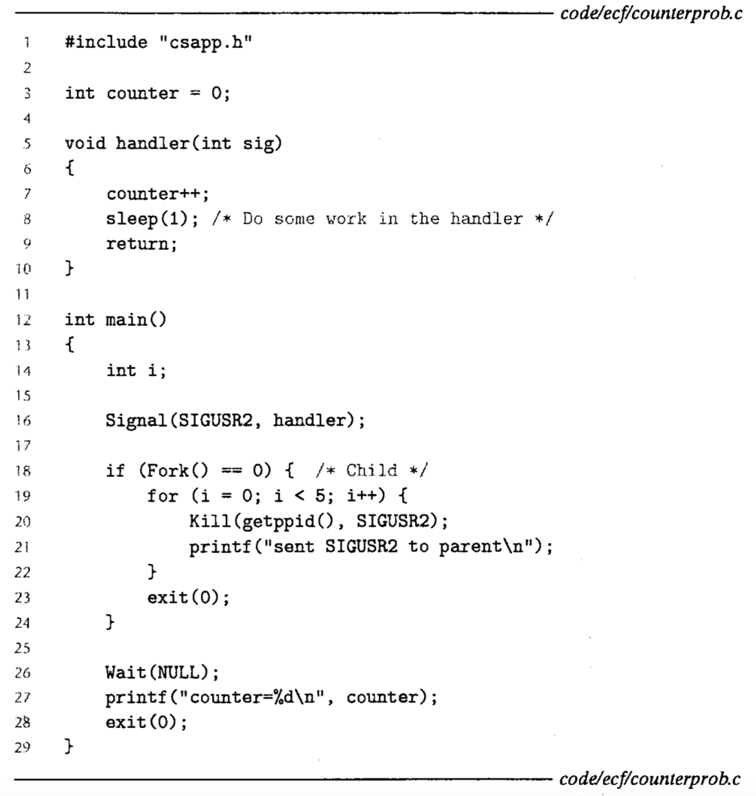
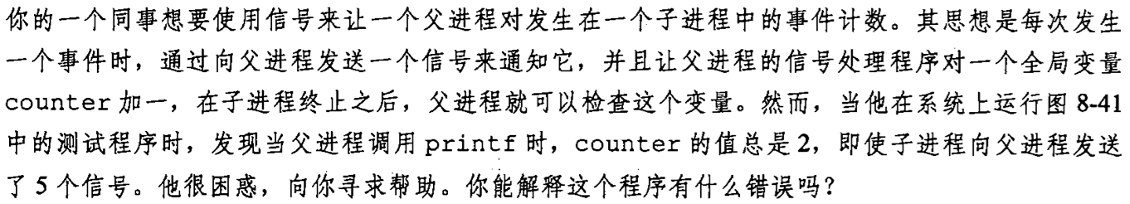
练习
Notes:
要点1：进程进入阻塞（blocked）状态，还是可能会被信号唤醒，切换到handler处理信号的。
要点2：同一个信号的handler再返回前不可再次调用，也就是进入信号处理handler的条件是之前同类信息信号的handler必须返回，才能再次进入handler。比如SIGUSR1的handler调用SIGUSR2的handler，在后者处理过程中再来SIGUSR1,是不能进入的，只是记录下来信号到达。必须等第一个SIGUSR1彻底返回，才会再次进入SIGUSR1的handler。
流程：不论先调度父进程，还是先调度子进程，第一个SIGUSR2信号很快会发出，handler处理，count++，然后进入sleep(1)。
然后再收到第二个SIGUSR2信号时，由于对第一个SIGUSR2信号的handler还没有返回，所以不能重入，信号记录，但是不会处理。
然后在sleep的1秒之内，后续的4个信号都会发出，但会叠加在一起，等从sleep(1)中返回后，处理时被当作一个信号了。

Slide 49
课堂练习
写一个耗时的不断寻找素数的程序，给信号SIGINT一个处理函数----报告当前找到的最大的素数
程序运行时，kill -2 pid，程序就会打印出来目前已找到的最大的素数
寻找素数用暴力尝试的方式即可。程序只需要完成功能，不考虑效率

Slide 50
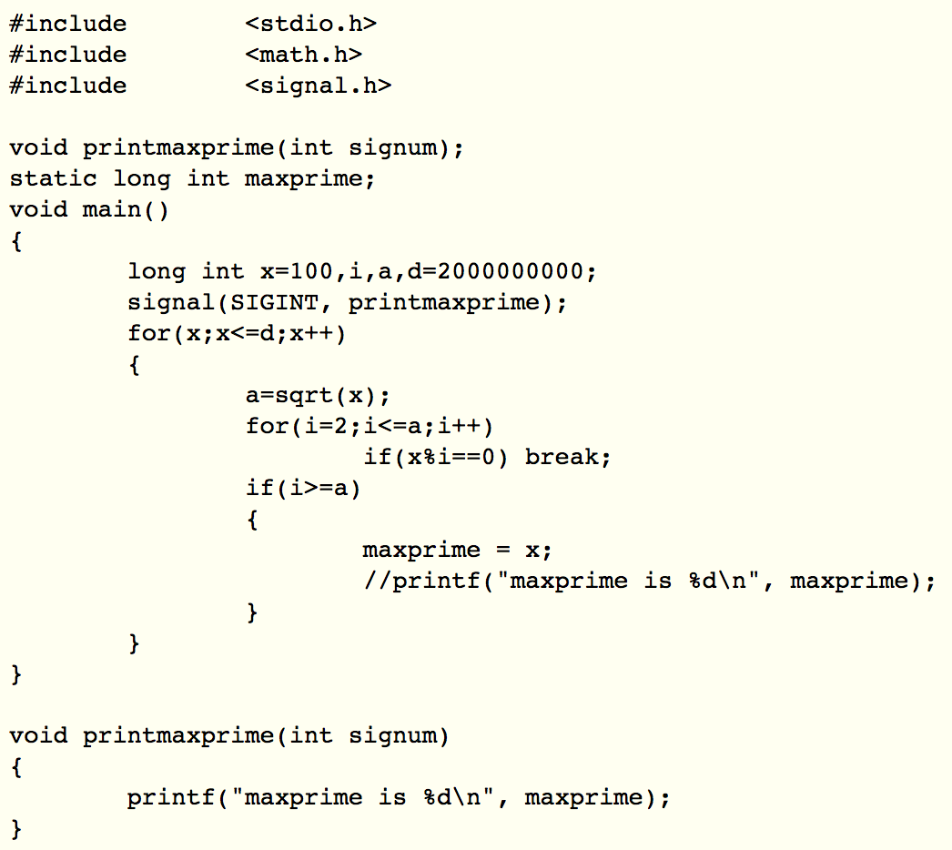
练习答案

Slide 51
Signal Handling Issues
Pending signals can be blocked
Unix signal handler一般会屏蔽当前正在处理信号同一类型的pending signals
Pending signals are not queued
在数据结构上，每一种信号类型之对应一个bit，所以只能记录有/无信号，无法记录来了几个信号
第二个及以后到达的pending signal只是被简单地丢弃了

Slide 52
Signal Handling Issues
System calls can be interrupted
Slow system calls
read, wait, and accept
On some systems
当一些slow system call被信号中断后，signal handler捕获了一个信号并进行处理和返回后，system call就不继续执行了
而是立刻返回用户程序，并设置全局变量errno来报错
例如前面提到的sleep，可能提前返回

Slide 53
14 int main()
15 {
16 int i, n; char buf[MAXBUF];
17 if (signal(SIGCHLD, handler1) == SIG_ERR)
18 unix_error("signal error");
19
20 /* parent creates children */
21 for (i = 0; i < 3; i++) {
22 if (Fork() == 0) {
23 printf("Hello from child %d\n", (int)getpid());
24 Sleep(1);
25 exit(0);
26 }
27 }
28 /* parent waits for term. input and then processes it */
29 if ((n = read(STDIN_FILENO, buf, sizeof(buf))) < 0)
30 unix_error("read");
31
32 printf("Parent processing input\n");
33 while (1) ;
34
35 exit(0);
36 }

Slide 54
1 #include "csapp.h"
2
3 void handler1(int sig)
4 {
5 pid_t pid;
6
7 if ((pid = waitpid(-1, NULL, 0)) < 0)
8 unix_error("waitpid error");
9 printf("Handler reaped child %d\n", (int)pid);
10 Sleep(2);
11 return;
12 }
13

Slide 55
linux> ./signal1
Hello from child 10320
Hello from child 10321
Hello from child 10322
Handler reaped child 10320
Handler reaped child 10322
<cr>
Parent processing input
<ctrl-z>
Suspended
linux> ps
PID TTY STAT TIME COMMAND
...
10319 p5 T 0:03 signal1
10321 p5 Z 0:00 signal1 <zombie>
10323 p5 R 0:00 ps

Slide 56
1 #include "csapp.h"
2
3 void handler2(int sig)
4 {
5 pid_t pid;
6
7 while ((pid = waitpid(-1, NULL, 0)) > 0)
8 printf("Handler reaped child %d\n", (int)pid);
9 if (errno != ECHILD)
10 unix_error("waitpid error");
11 Sleep(2);
12 return;
13 }
Option设置为WHOHAN更好，
否则第一个子进程结束，父进程
就一直阻塞在wait，直到所有
子进程结束。

Slide 57
linux> ./signal2
Hello from child 10378
Hello from child 10379
Hello from child 10380
Handler reaped child 10379
Handler reaped child 10378
Handler reaped child 10380
<cr>
Parent processing input
Notes:
Reap 18906后sleep(2);
然后再次调用handler时应该while循环回收18908和18907。

Slide 58
sigaction Function
#include <signal.h> int sigaction(int signum, struct sigaction *act, struct sigaction *oldact); returns: 0 if OK, -1 on error struct sigaction { void (*sa_handler)(); /* addr of signal handler, or SIG_IGN, or SIG_DFL */ sigset_t sa_mask; /* additional signals to block */ int sa_flags; /* signal options */ } ;

Slide 59
sigaction Function
int sigaction(int signum, const struct sigaction *act, struct sigaction *oldact);
signum：要操作的signal信号。
act：设置对signal信号的新处理方式。
oldact：原来对信号的处理方式。
返回值：0 表示成功，-1 表示有错误发生。

Slide 60
1 handler_t *Signal(int signum, handler_t *handler)
2 {
3 struct sigaction action, old_action;
4
5 action.sa_handler = handler;
/* block sigs of type being handled */
6 sigemptyset(&action.sa_mask);
/* restart syscalls if possible */
7 action.sa_flags = SA_RESTART;
8
9 if (sigaction(signum, &action, &old_action) < 0)
10 unix_error("Signal error");
11 return (old_action.sa_handler);
12 }

Slide 61
signal() vs. sigaction()
signal()：不支持信号传递信息，主要用于非实时信号安装；
sigaction():支持信号传递信息，可用于所有信号安装；

Slide 62
Signal Function
只有正在被处理的信号类型被屏蔽
同类型信号无法嵌套
在所有版本的signal实现中，信号都不支持排队
被中断的系统调用，会在可以的时候自动重新执行

Slide 63
Signal Function
一旦通过signal函数注册信号对应的处理函数，只有当再次调用signal函数，并将handler指定为SIG_IGN或SIG_DFL才能取消
SIG_IGN：忽略信号
SIG_DFL：恢复默认处理方式

Slide 64
Explicitly Blocking Signals
#include <signal.h> int sigprocmask(int how, const sigset_t *set, sigset_t *oldset) int sigemptyset(sigset_t *set) ; int sigfillset(sigset_t *set); int sigaddset(sigset_t *set, int signum); int sigdelset(sigset_t *set, int signum); Return: 0 if OK, -1 on error Int sigismember(const sigset_t *set, int signum); Returns: 1 if member, 0 if not, -1 on error

Slide 65
Explicitly Blocking Signals
sigprocmask
改变当前屏蔽信号集合（blocked signal set）的状态
SIG_BLOCK: add the signals in set to blocked (blocked = blocked | set )
SIG_UNBLOCK: Remove the signals in set from blocked (blocked = blocked & ~set)
SIG_SETMASK: blocked = set
If oldset is non-NULL, the previous value of the blocked bit vector is stored in oldset

Slide 66
Explicitly Blocking Signals
Signal set
Set manipulations are provided by the rest of the functions
Sigemptyset：将set每一个bit设置为0
Sigfillset ：将set每一个bit设置为1
Sigaddset ：在set中增加一个屏蔽信号
Sigdelset：在set中增加删除一个屏蔽信号

Slide 67
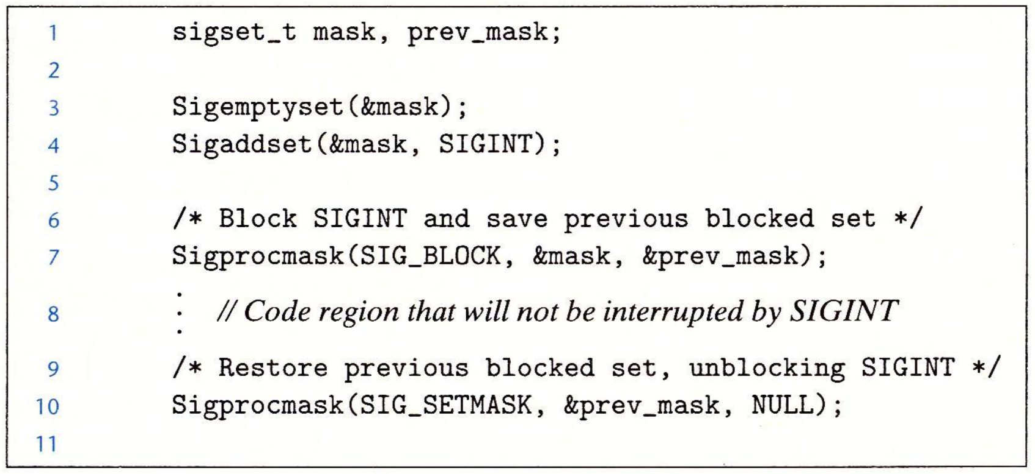
Explicitly Blocking Signals

Slide 68
Linux信号处理程序的难点
处理程序与主程序并发，共享同样的全局变量，因此可能互相干扰；
如何以及何时接收信号的规则常常有违人的直觉；
不同的系统有不同的信号处理语义

Slide 69
Guidelines for Writing Safe Handlers
G0: Keep your handlers as simple as possible
e.g., Set a global flag and return
G1: Call only async-signal-safe functions in your handlers
要么是可重入的（例如只访问局部变量），要么不能被信号处理程序中断
printf, sprintf, malloc, and exit are not safe!
G2: Save and restore errno on entry and exit
So that other handlers don’t overwrite your value of errno

Slide 70
Guidelines for Writing Safe Handlers
G3: Protect accesses to shared data structures by temporarily blocking all signals.
To prevent possible corruption
G4: Declare global variables as volatile
To prevent compiler from storing them in a register
Cannot get the updated value
G5: Declare global flags as volatile sig_atomic_t
flag: variable that is only read or written (e.g. flag = 1, not flag++)
Flag declared this way does not need to be protected like other globals

Slide 71
Safely Generating Formatted Output
Use the reentrant SIO (Safe I/O library) from csapp.c in your handlers.
ssize_t sio_puts(char s[]) /* Put string */
ssize_t sio_putl(long v) /* Put long */
void sio_error(char s[]) /* Put msg & exit */
void sigint_handler(int sig) /* Safe SIGINT handler */
{
Sio_puts("So you think you can stop the bomb with ctrl-c, do you?\n");
sleep(2);
Sio_puts("Well...");
sleep(1);
Sio_puts("OK. :-)\n");
_exit(0);
}

Slide 72
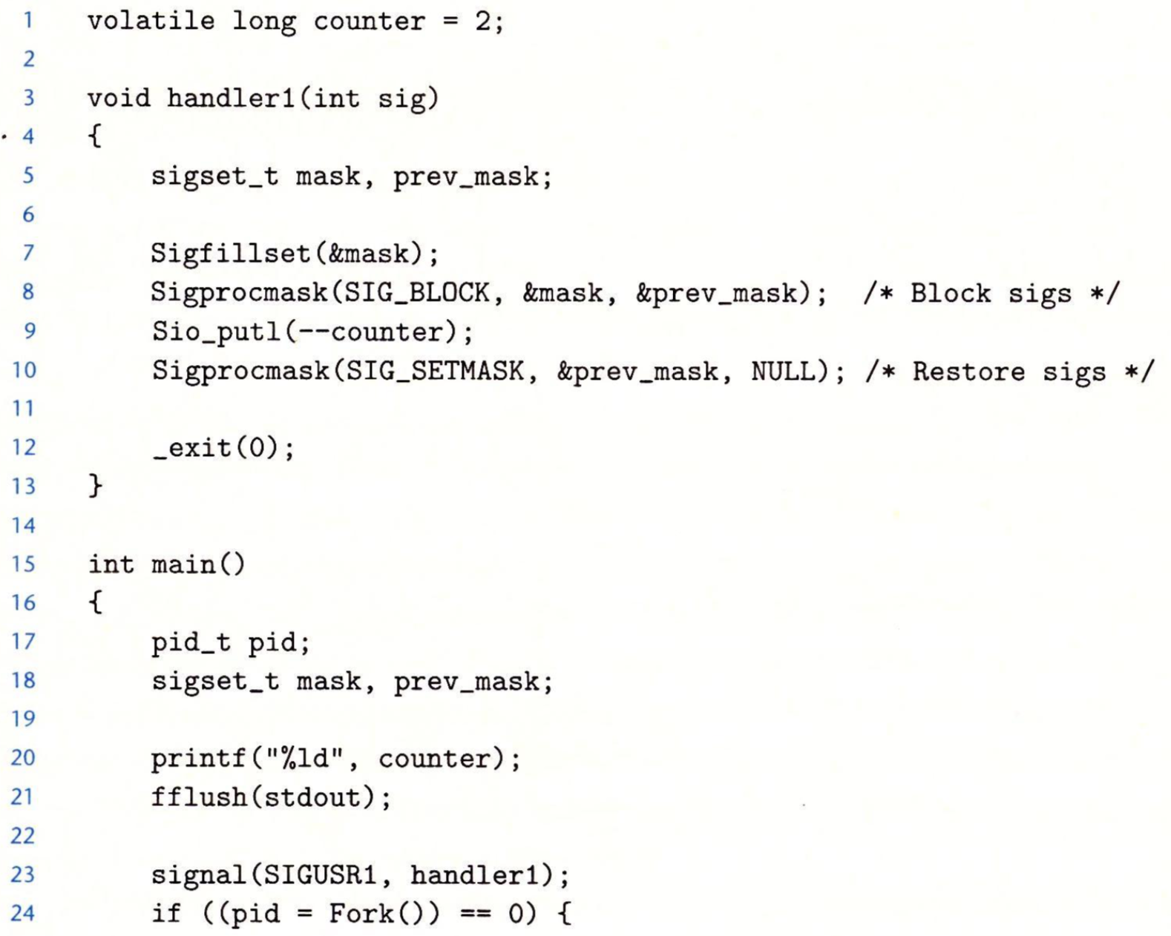
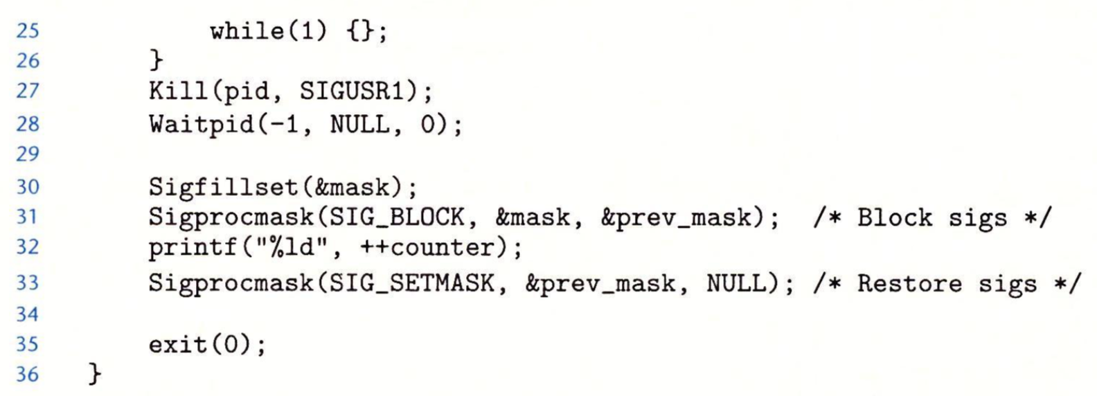
课堂练习
下列程序的输出是什么？

Slide 73
Nasty Concurrency Bugs
10 int main(int argc, char **argv)
11 {
12 int pid;
14 Signal(SIGCHLD, handler);
15 initjobs(); /* initialize the job list */
16
17 while(1) {
18 /*child process */
19 if ((pid = Fork()) == 0)
20 Execve(“/bin/ls”, argv, NULL);
21
22 /* parent process */
23 addjob(pid) ; /* Add the child to the job list */
24 }
25 exit(0)
26 }

Slide 74
Nasty Concurrency Bugs
1 void handler(int sig)
2 {
3 pid_t pid ;
/*reap a zombie child */
4 while (pid = waitpid(-1, NULL, WNOHAN) > 0)
/* delete the child from the job list */
5 deletejob(pid);
6
7 if (errno != ECHILD)
8 unix_error(“waitpid error”) ;
9 }
该程序有什么bug？

Slide 75
Nasty Concurrency Bugs
Incorrectly sequence of events
Parent executes fork and kernel schedules the newly created child
Child terminates and kernel delivers a SIGCHLD signal to parent
Parent receives the SIGCHLD signal and runs the signal handler
Signal handler calls deletejob
Parent return from fork and calls addjob
对还有没有添加的job进行删除！

Slide 76
1 void handler(int sig)
2 {
3 pid_t pid ;
/*reap a zombie child */
4 while (pid = waitpid(-1, NULL, WNOHAN) > 0)
5 deletejob(pid); /* delete the child from the job list */
6 if (errno != ECHILD)
7 unix_error(“waitpid error”) ;
8 }
9
10 int main(int argc, char **argv)
11 {
12 int pid;
13 sigset_t mask;
14
15 Signal(SIGCHLD, handler);
16 initjobs(); /* initialize the job list */
17

Slide 77
18 while(1) {
19 Sigemptyset(&mask);
20 Sigaddset(&mask, SIGCHLD);
21 Sigprocmask(SIG_BLOCK, &mask, NULL); 22
23 /*child process */
24 if ((pid = Fork()) == 0) {
25 Sigprocmask(SIG_UNBLOCK, &mask, NULL);
26 Execve(“/bin/ls”, argv, NULL);
27 }
28
29 /* parent process */
30 addjob(pid) ; /* Add the child to the job list */
31 Sigprocmask(SIG_UNBLOCK,&mask, NULL); 32 }
33 exit(0)
34 }
Block SIGCHLD
Unblock SIGCHLD

Slide 78
Explicitly Waiting for Signals
Handlers for program explicitly waiting for SIGCHLD to arrive.
volatile sig_atomic_t pid;
void sigchld_handler(int s)
{
int olderrno = errno;
pid = Waitpid(-1, NULL, 0); /* Main is waiting for nonzero pid */
errno = olderrno;
}
void sigint_handler(int s)
{
}

Slide 79
Explicitly Waiting for Signals
int main(int argc, char **argv) {
sigset_t mask, prev;
Signal(SIGCHLD, sigchld_handler);
Signal(SIGINT, sigint_handler);
Sigemptyset(&mask);
Sigaddset(&mask, SIGCHLD);
while (1) {
Sigprocmask(SIG_BLOCK, &mask, &prev); /* Block SIGCHLD */
if (Fork() == 0) /* Child */
exit(0);
/* Parent */
pid = 0;
Sigprocmask(SIG_SETMASK, &prev, NULL); /* Unblock SIGCHLD */
/* Wait for SIGCHLD to be received (wasteful!) */
while (!pid)
;
/* Do some work after receiving SIGCHLD */
printf(".");
}
exit(0);
}

Slide 80
Explicitly Waiting for Signals
Program is correct, but very wasteful
Other options:
Solution: sigsuspend
while (!pid) /* Race! */
pause();
while (!pid) /* Too slow! */
sleep(1);
Pause/sleep可能被其他信号中断，所以需要一个循环
Race: 在while条件达成后、pause开始前收到SIGCHLD信号，则pause可能会永远睡眠（没有原子性保障）

Slide 81
Waiting for Signals with sigsuspend
int sigsuspend(const sigset_t *mask)
Equivalent to atomic (uninterruptable) version of:
sigprocmask(SIG_SETMASK, &mask, &prev);
pause();
sigprocmask(SIG_SETMASK, &prev, NULL);

Slide 82
Waiting for Signals with sigsuspend
int main(int argc, char **argv) {
sigset_t mask, prev;
Signal(SIGCHLD, sigchld_handler);
Signal(SIGINT, sigint_handler);
Sigemptyset(&mask);
Sigaddset(&mask, SIGCHLD);
while (1) {
Sigprocmask(SIG_BLOCK, &mask, &prev); /* Block SIGCHLD */
if (Fork() == 0) /* Child */
exit(0);
/* Wait for SIGCHLD to be received */
pid = 0;
while (!pid)
Sigsuspend(&prev);
/* Optionally unblock SIGCHLD */
Sigprocmask(SIG_SETMASK, &prev, NULL);
/* Do some work after receiving SIGCHLD */
printf(".");
}
exit(0);
}

