Slide 1
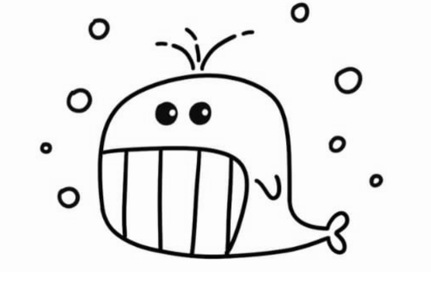
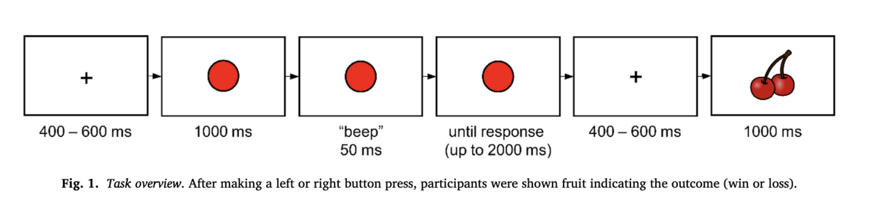
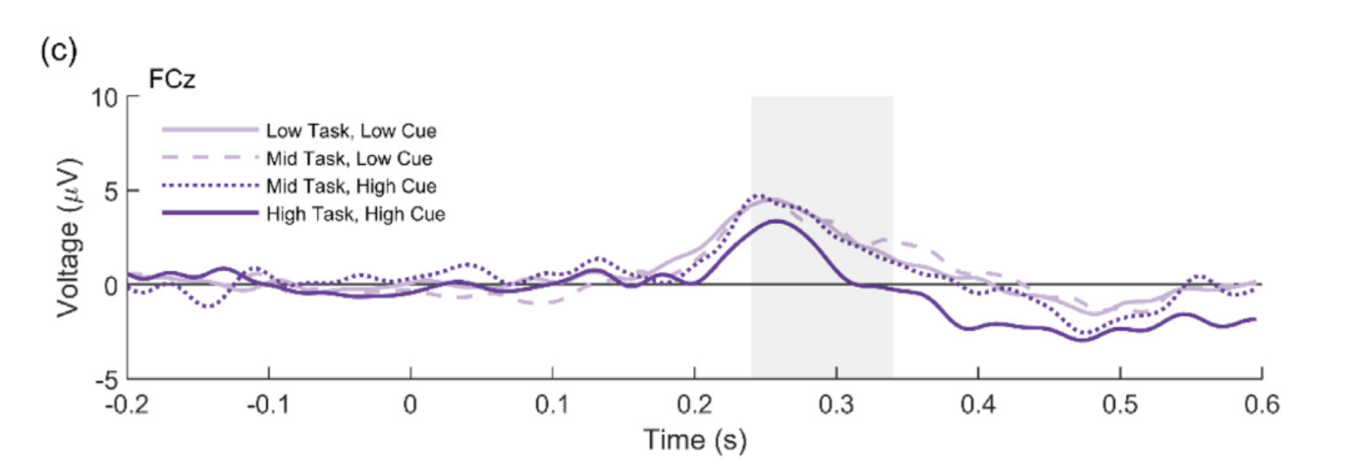
Milestone 1: Team „Whale“
Members: Zheng Lin, Qianyue Li, Yanhong Xu
Dataset: Cameron D et al. 2022, “Task-level value affects trial-level reward processing“
-doi https://doi.org/10.1016/j.neuroimage.2022.119456.
1. Experimental procedure / Main idea
2. The main research question
Whether and how reward-related anterior cingulate cortex (ACC) activity, as indexed by reward positive (RewP) varies with task value.
2 cues: high-value, low-value
3 tasks: high-value (100% high-value cue), mid-value (50% high value cue), low-value (0% high value cue)
Low-task, low-cue vs mid-task, low-cue
Mid-task, high-cue vs high-task, high-cue
3. Main finding to be replicated
4. Main type of analysis to be run
Compare the difference in magnitude of RewP for each task and cue.
Find out if RewP was reduced when average task value was high.

