Slide 1
Machine learning with Energy datasets Exploratory Data Analysis INFO 7390
Professor: Srikanth Krishnamurthy
Students: Team 2
Chenlian Xu
Qianli Ma

Slide 2
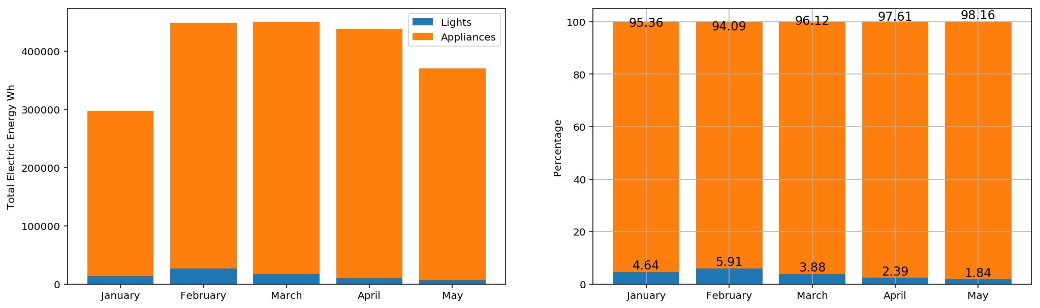
Aggregated energy consumption
Lights << Appliance
Decreases from Feb to May
Appliance level energy consumption data is needed

Slide 3
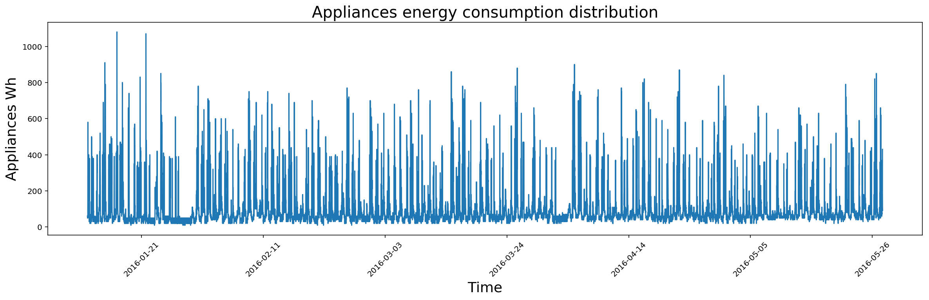
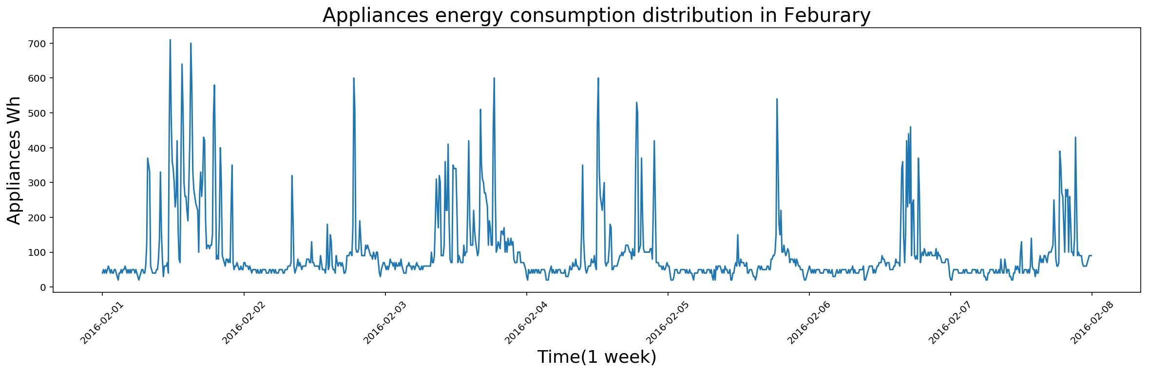
Appliances energy consumption measurement
The whole period
high variability
a specific week
two peaks

Slide 4
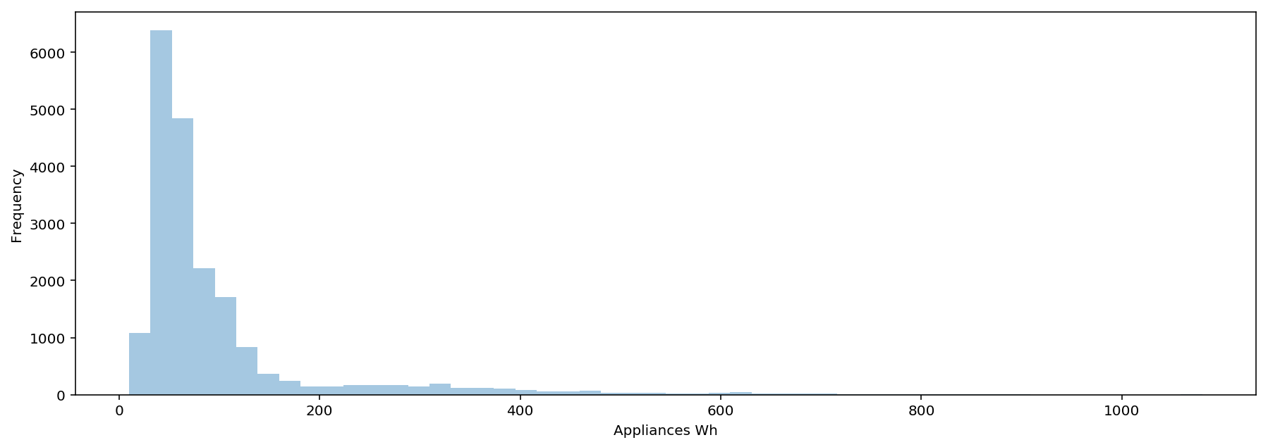
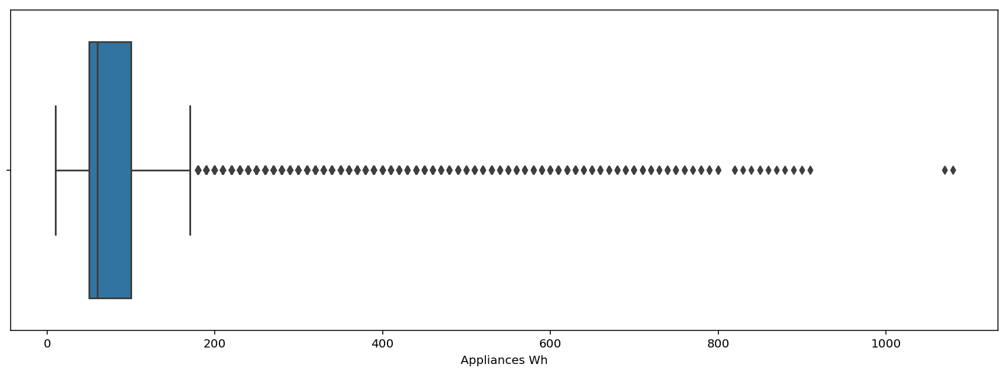
Appliances energy consumption distribution
histogram
20< most of the data < 100
long tail
boxplot
Meddle: 60Wh Lower: 10Wh Upper: 170Wh

Slide 5
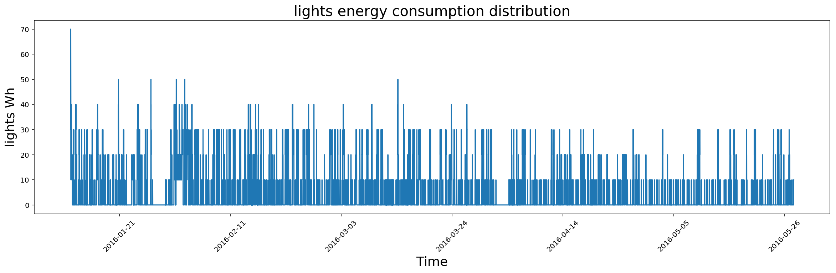
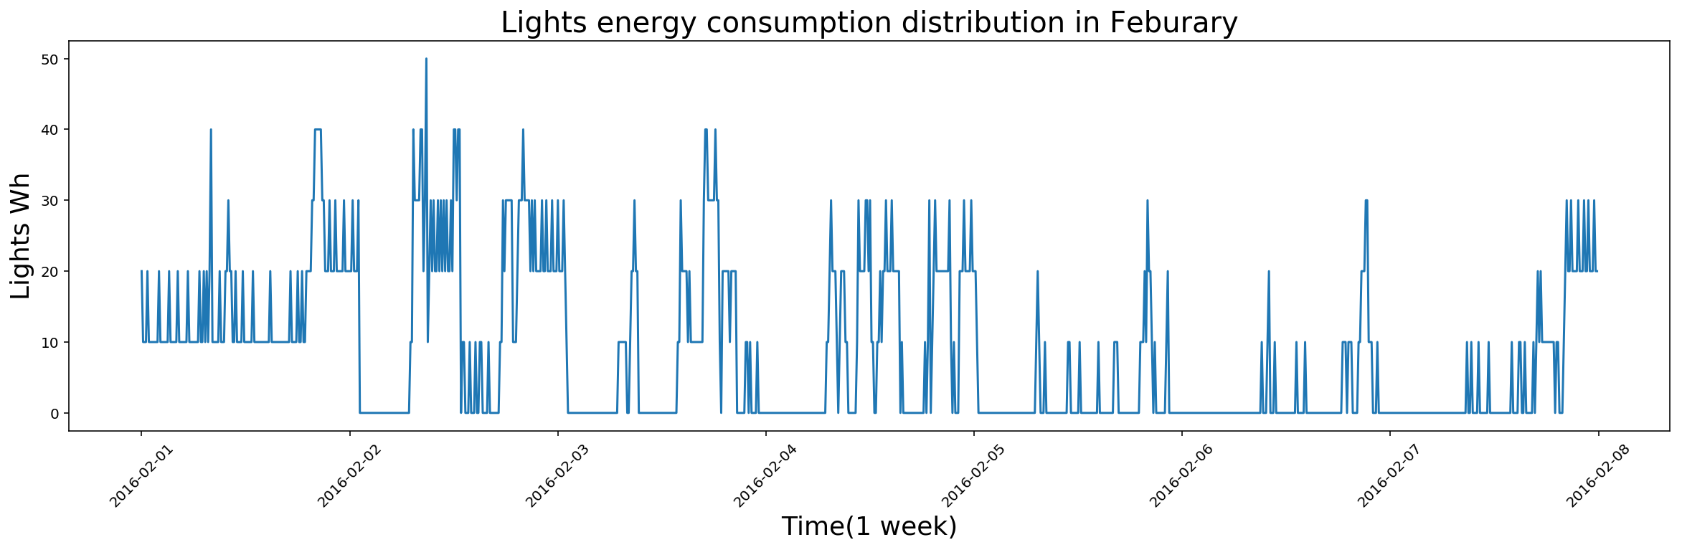
Lights energy consumption measurement
The whole period
more stable
a specific week
two peaks; a lot of straight lines in the bottom

Slide 6
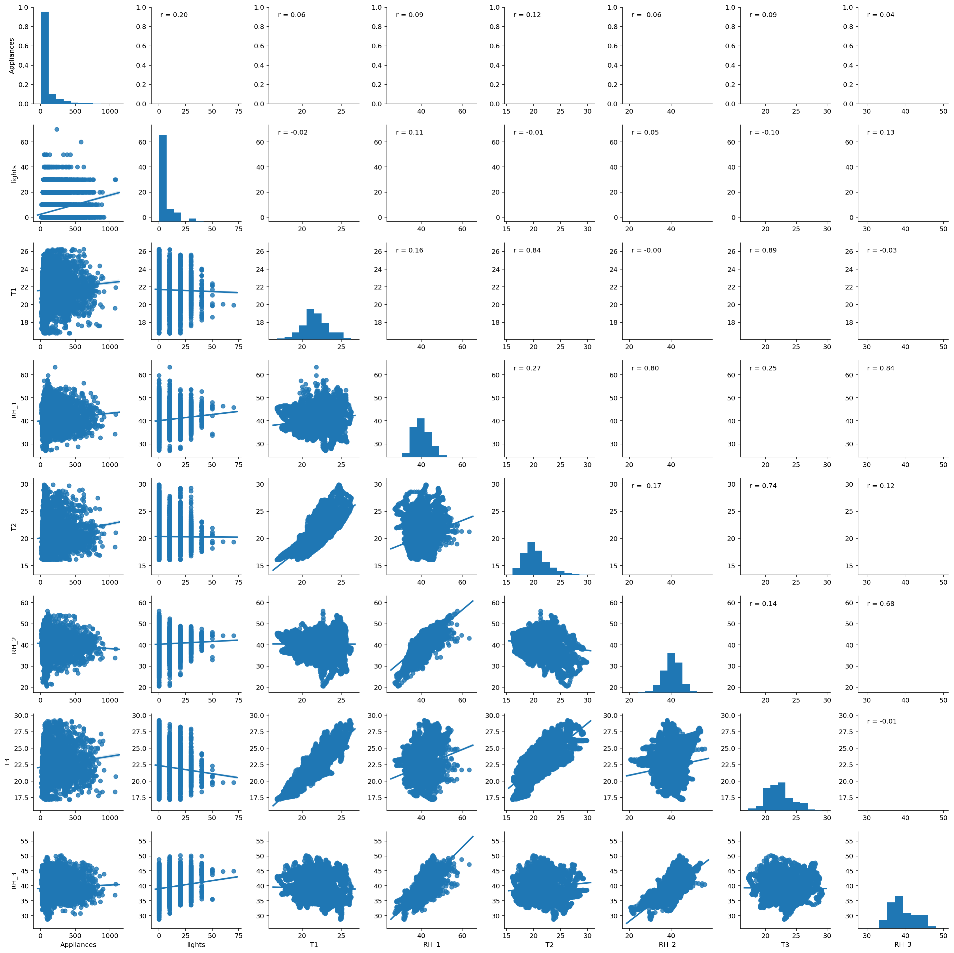
Pair plots
appliances with: lights, T1, RH1, T2, RH2, T3, RH3

Slide 7
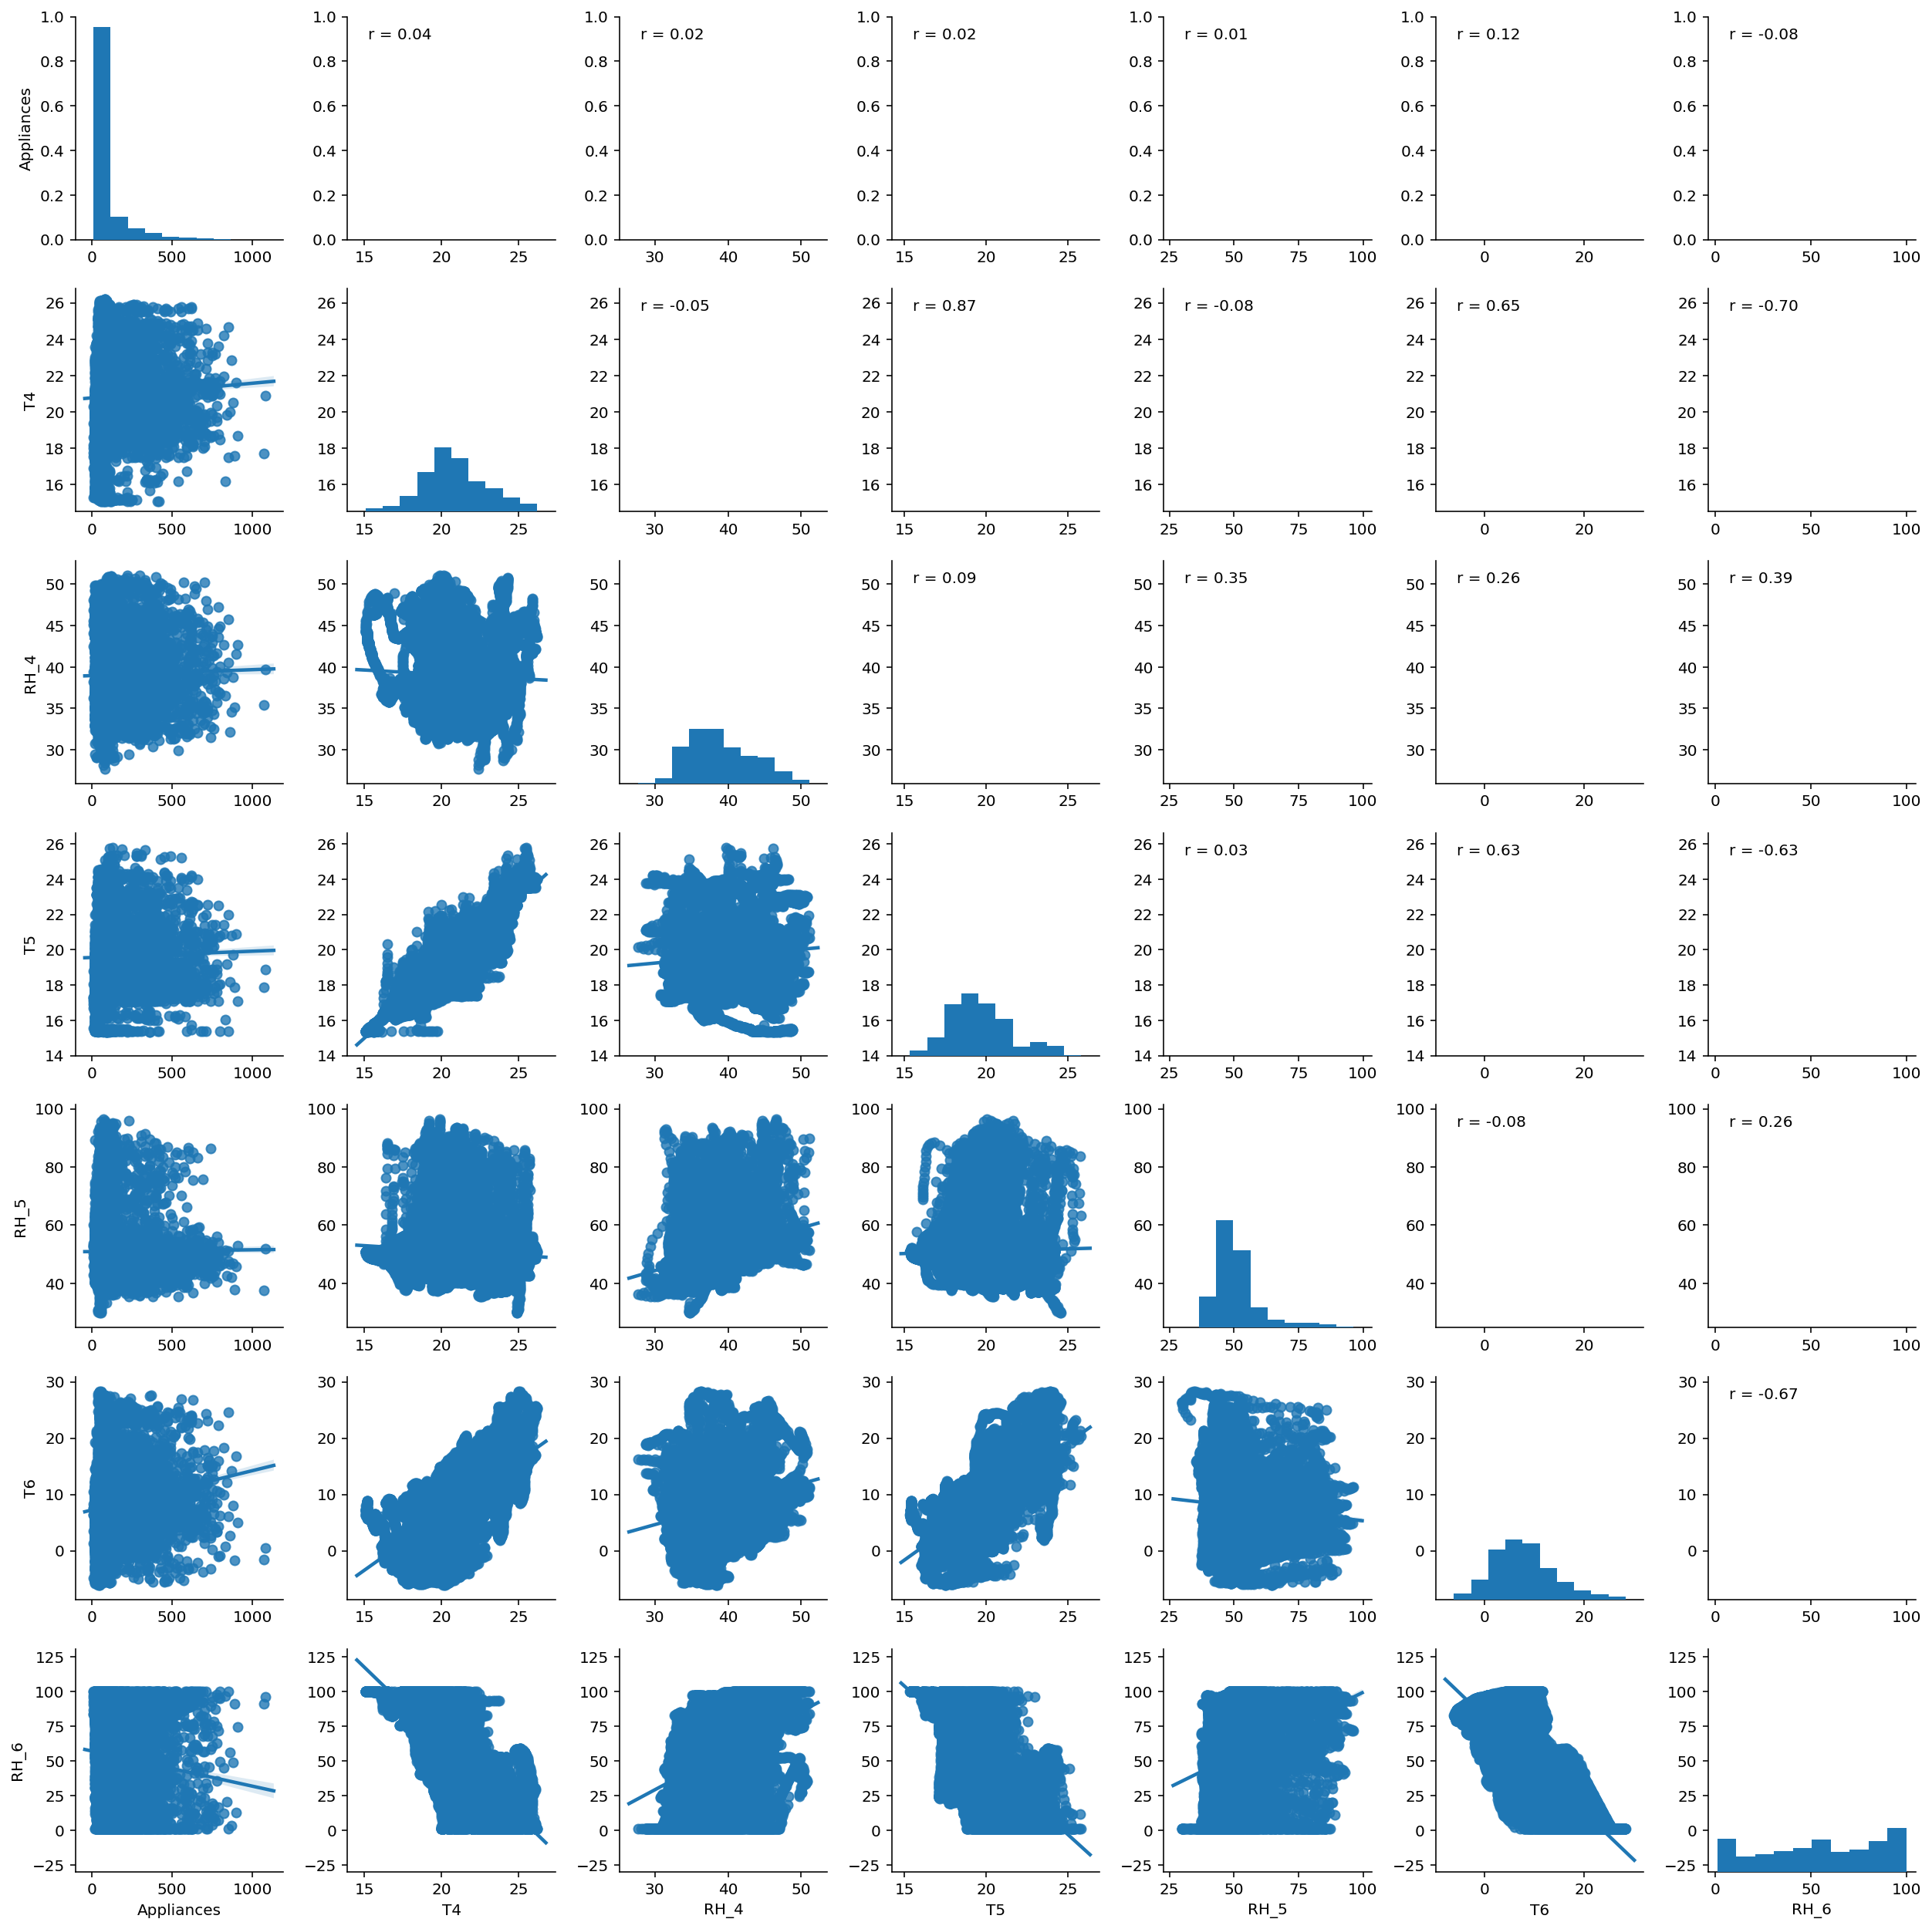
Pair plots
appliances with: T4, RH4, T5, RH5, T6, RH6

Slide 8
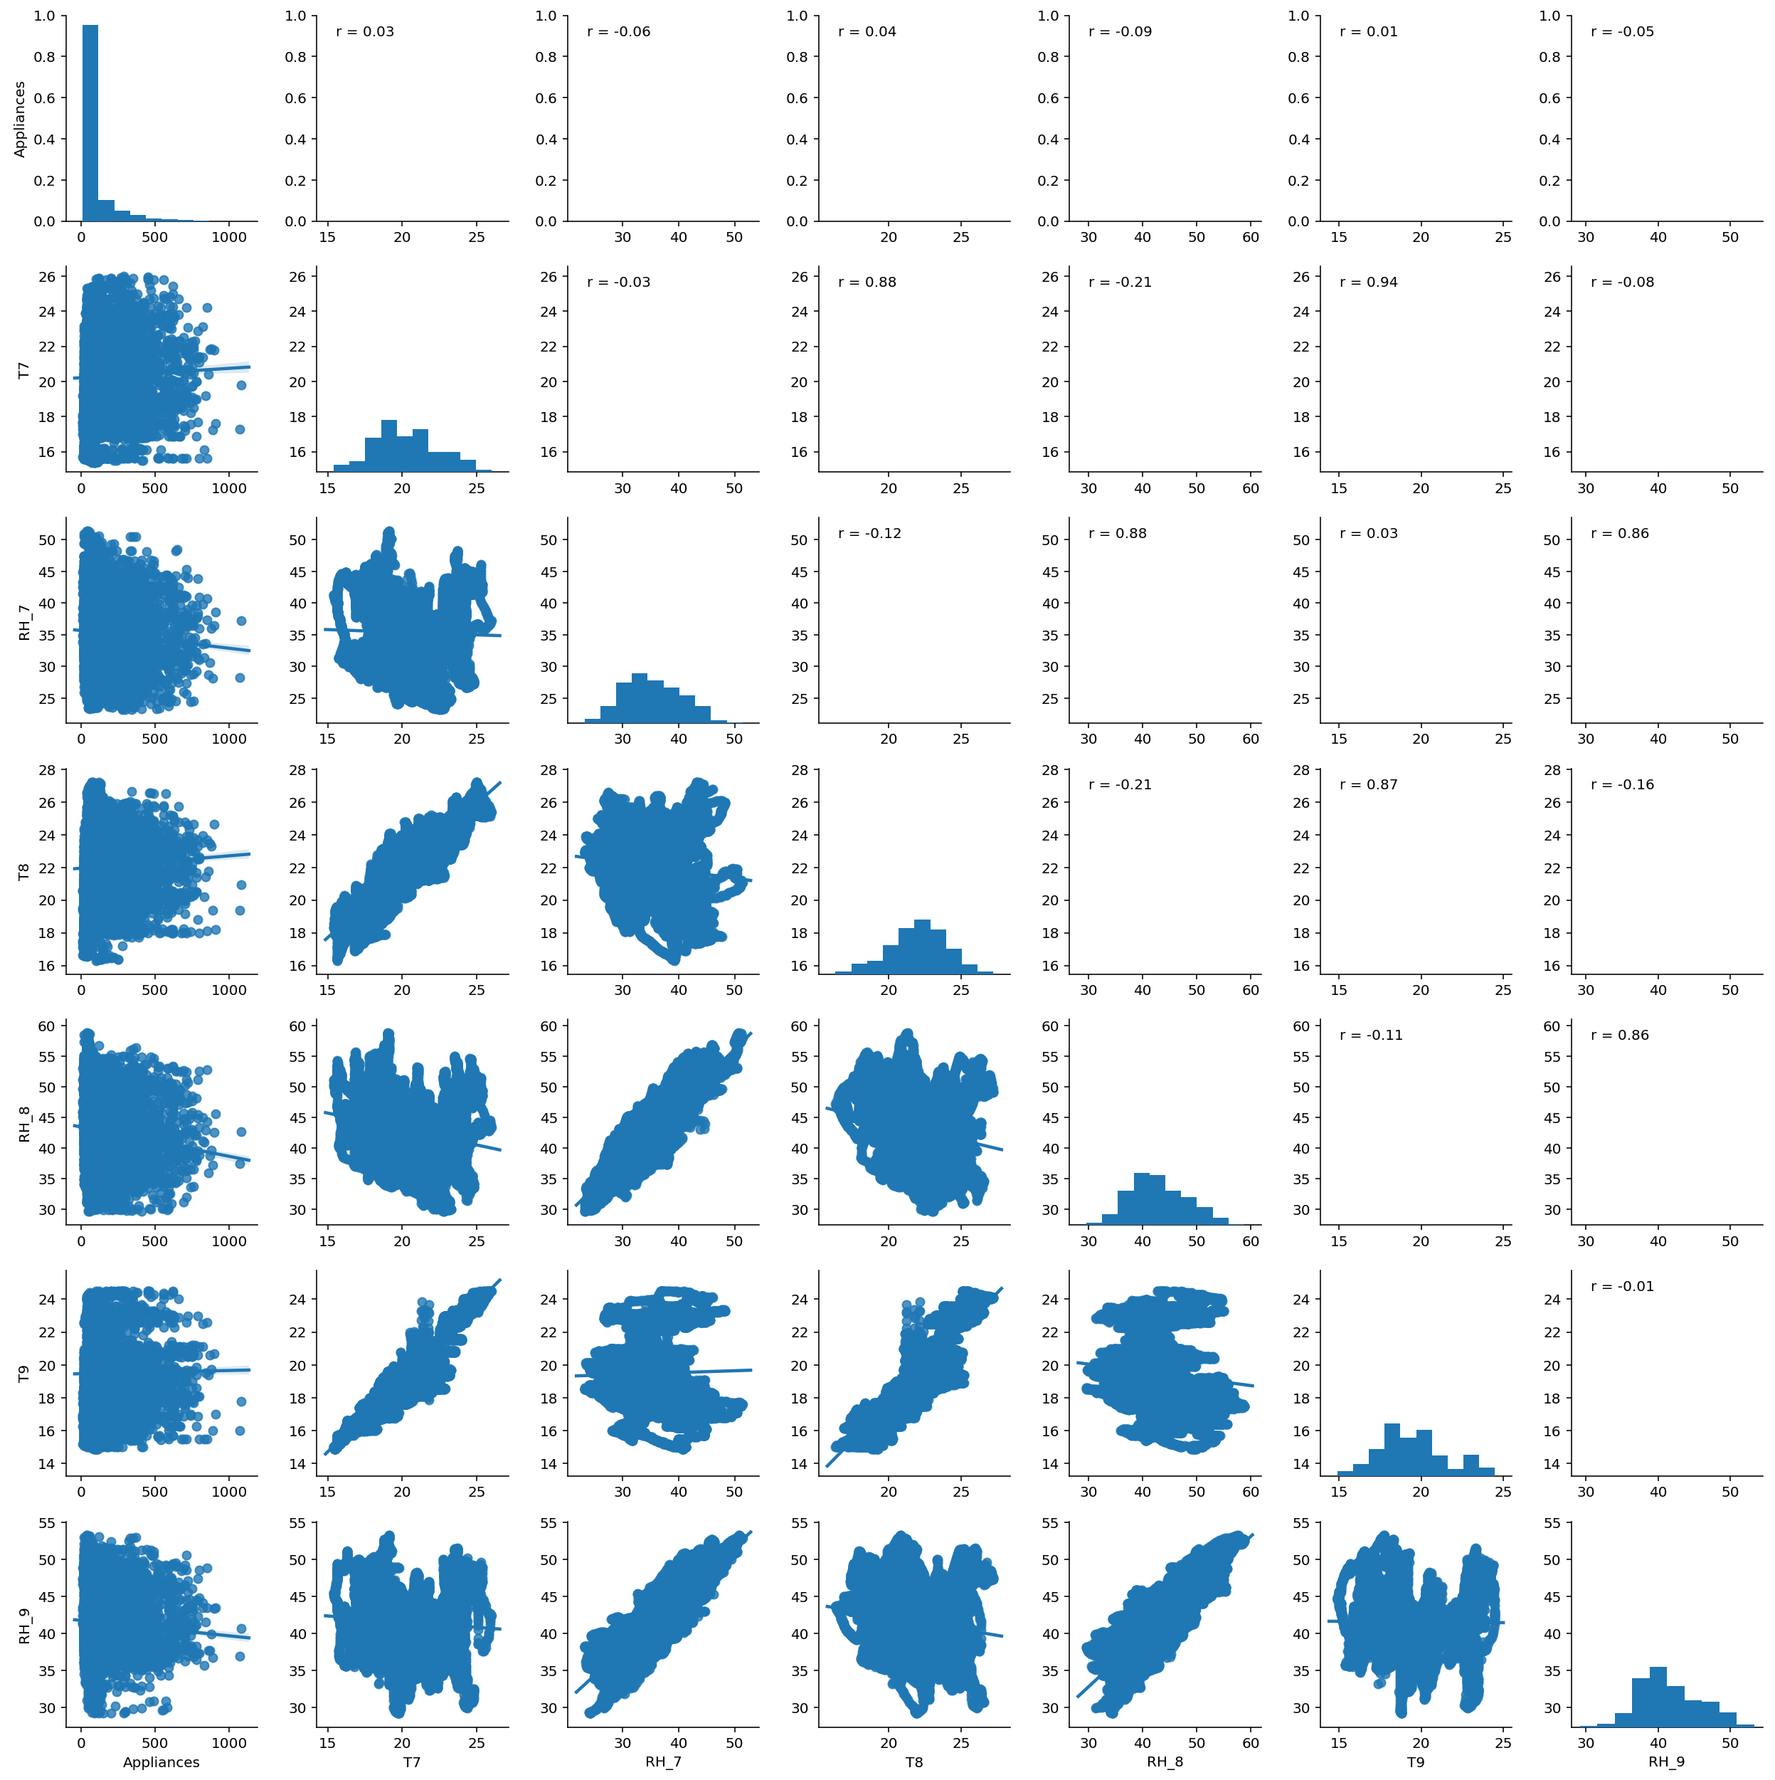
Pair plots
appliances with: T7, RH7, T8, RH8, T9, RH9

Slide 9
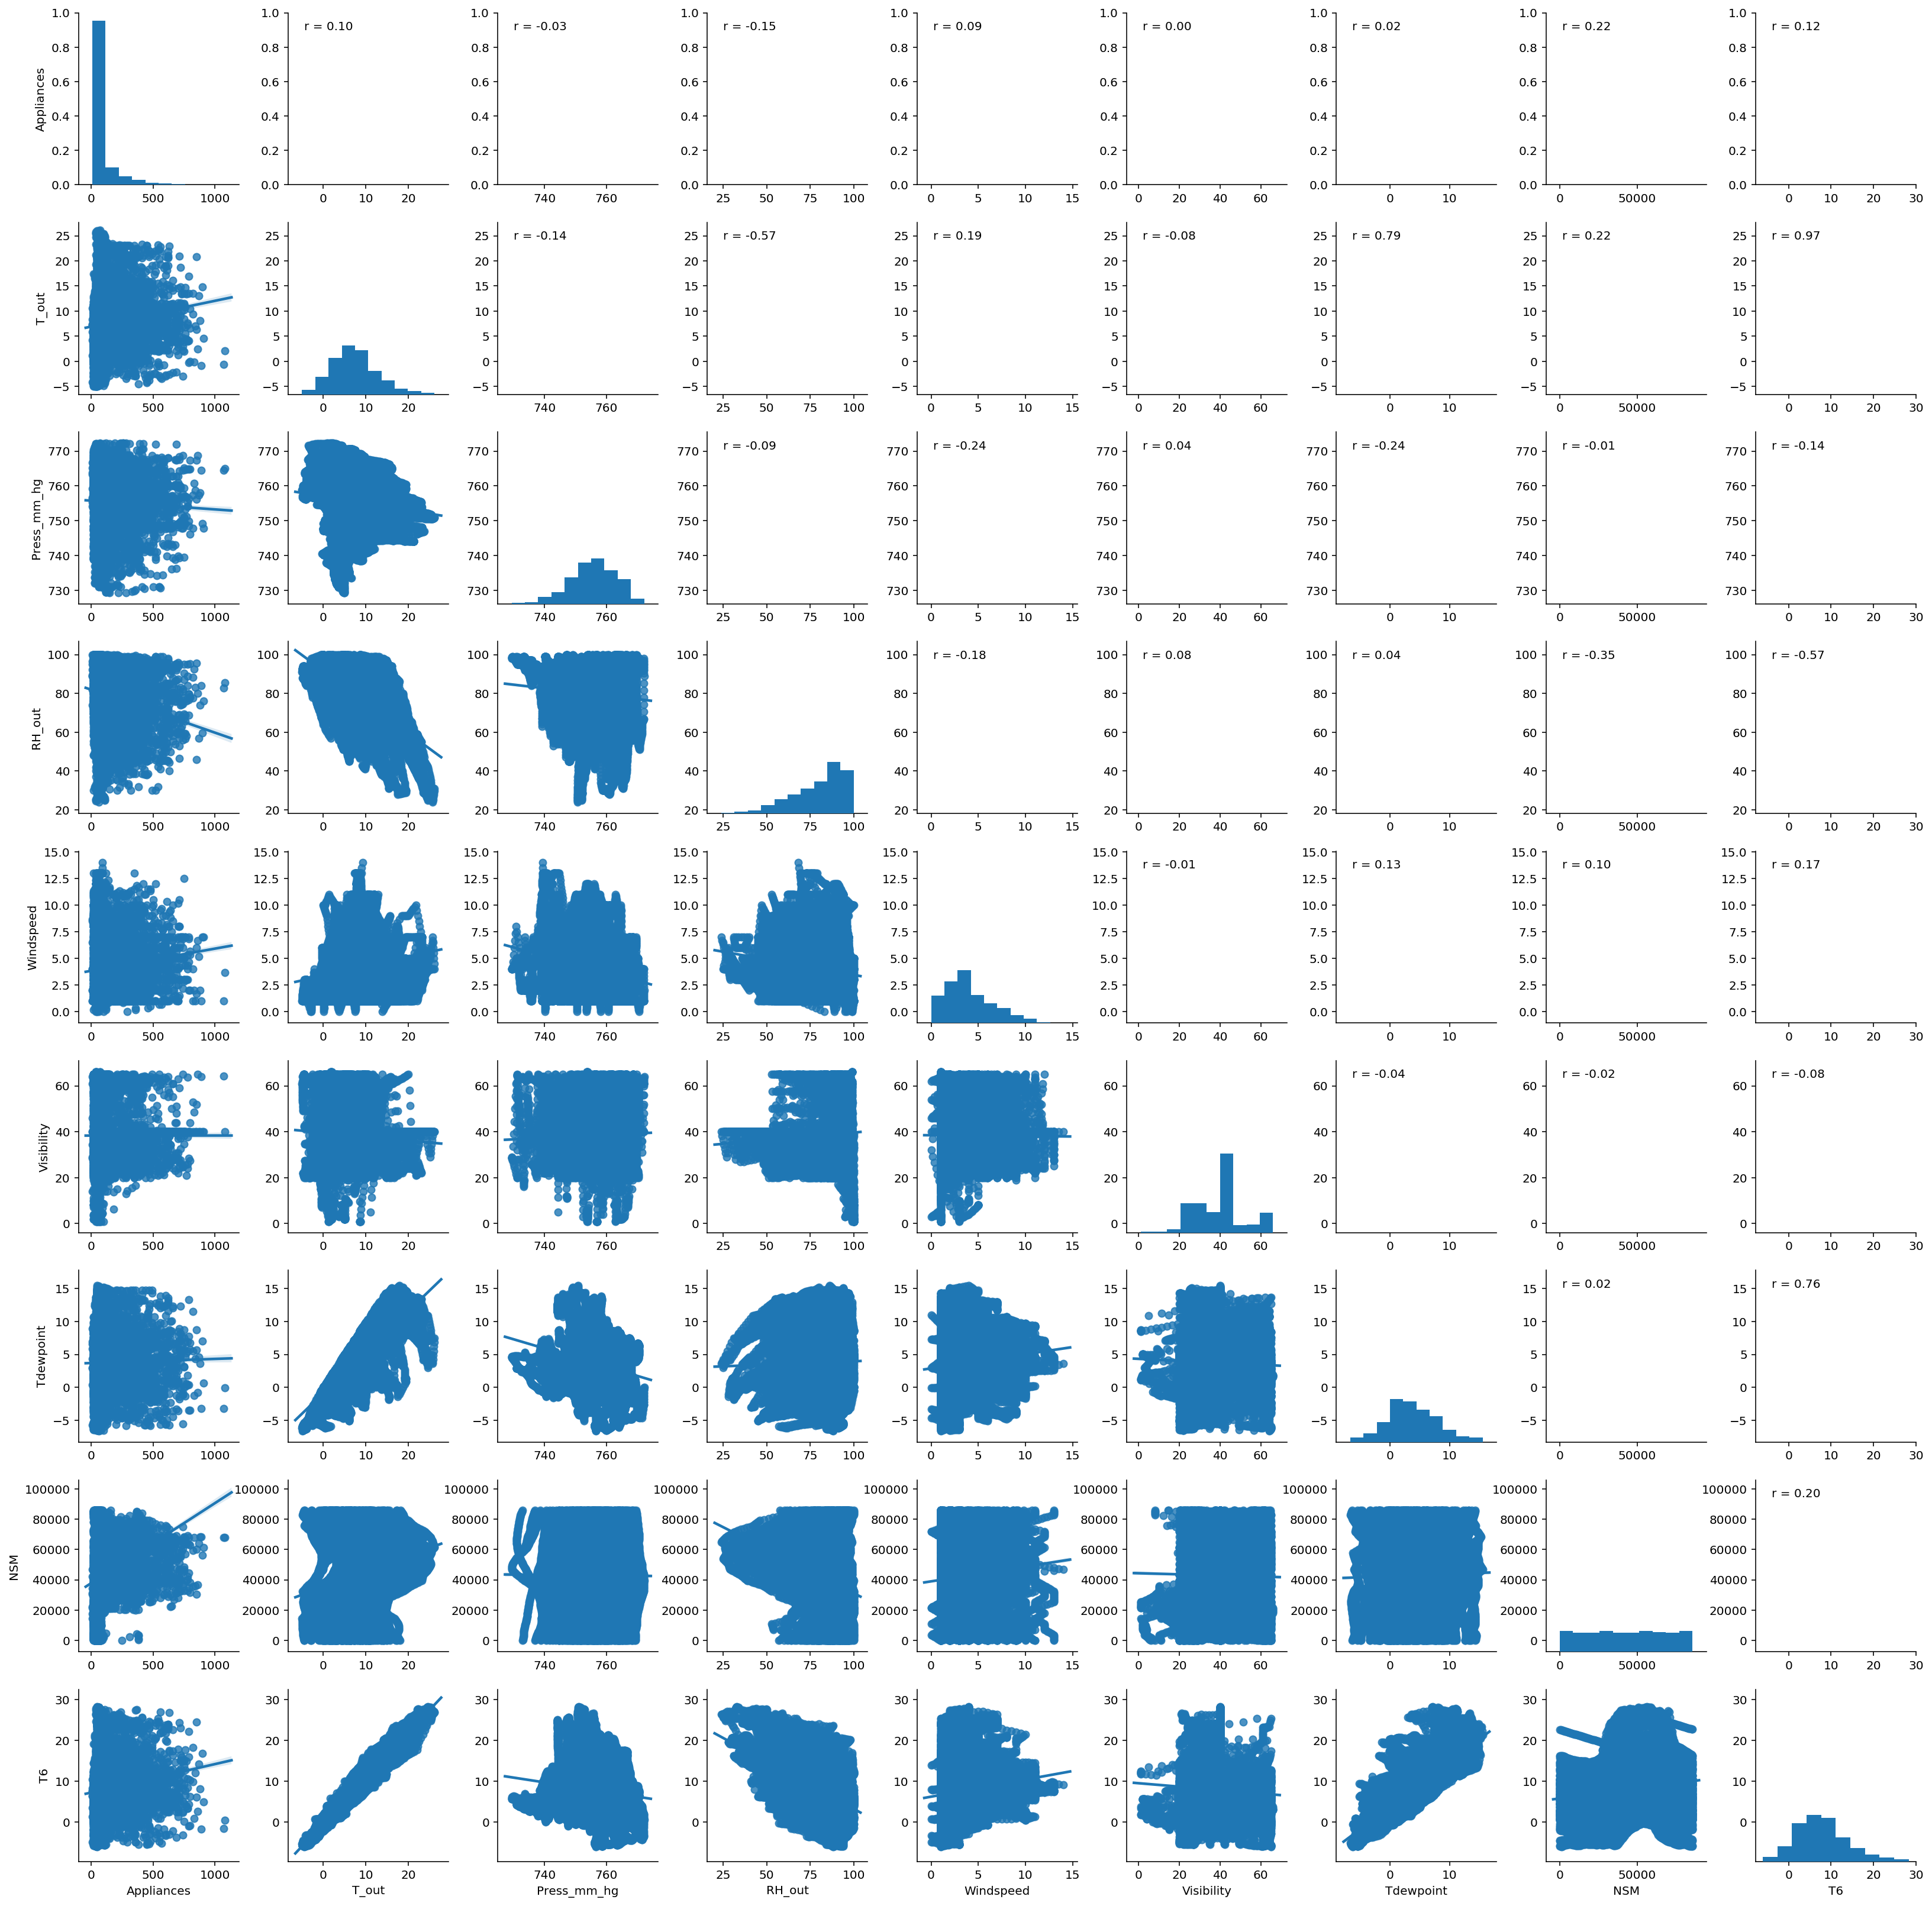
Pair plots
appliances with: T out, Pressure, RH out, Windspeed, Visibility, TDewpoint, NSM and T6

Slide 10
Rank of Pearson Correlation
Variables | Pearson Correlation
NSM | 0.22
lights | 0.20
T2 | 0.12
T6 | 0.12
T out | 0.10
RH1 | 0.09
T3 | 0.09
Windspeed | 0.09
T1 | 0.06
TH3 | 0.04
T4 | 0.04
T8 | 0.04
T7 | 0.03
RH4 | 0.02
T5 | 0.02
Tdewpoint | 0.02
RH5 | 0.01
T9 | 0.01
Visibility | 0.00
Pressure | -0.03
RH9 | -0.05
TH2 | -0.06
RH7 | -0.06
RH6 | -0.08
RH8 | -0.09
RH out | -0.15

Slide 11
Correlation with appliances energy consumption
Positive:
Number of seconds from midnight (NSM) (0.22)
light energy consumption (0.20)
Temperature outside the building (0.12)
Temperature outside the weather station (0.12)
Negative:
Humidity outside the weather station (-0.15)
Humidity in teenager room2 (-0.09)
humidity outside the building (-0.08)

Slide 12
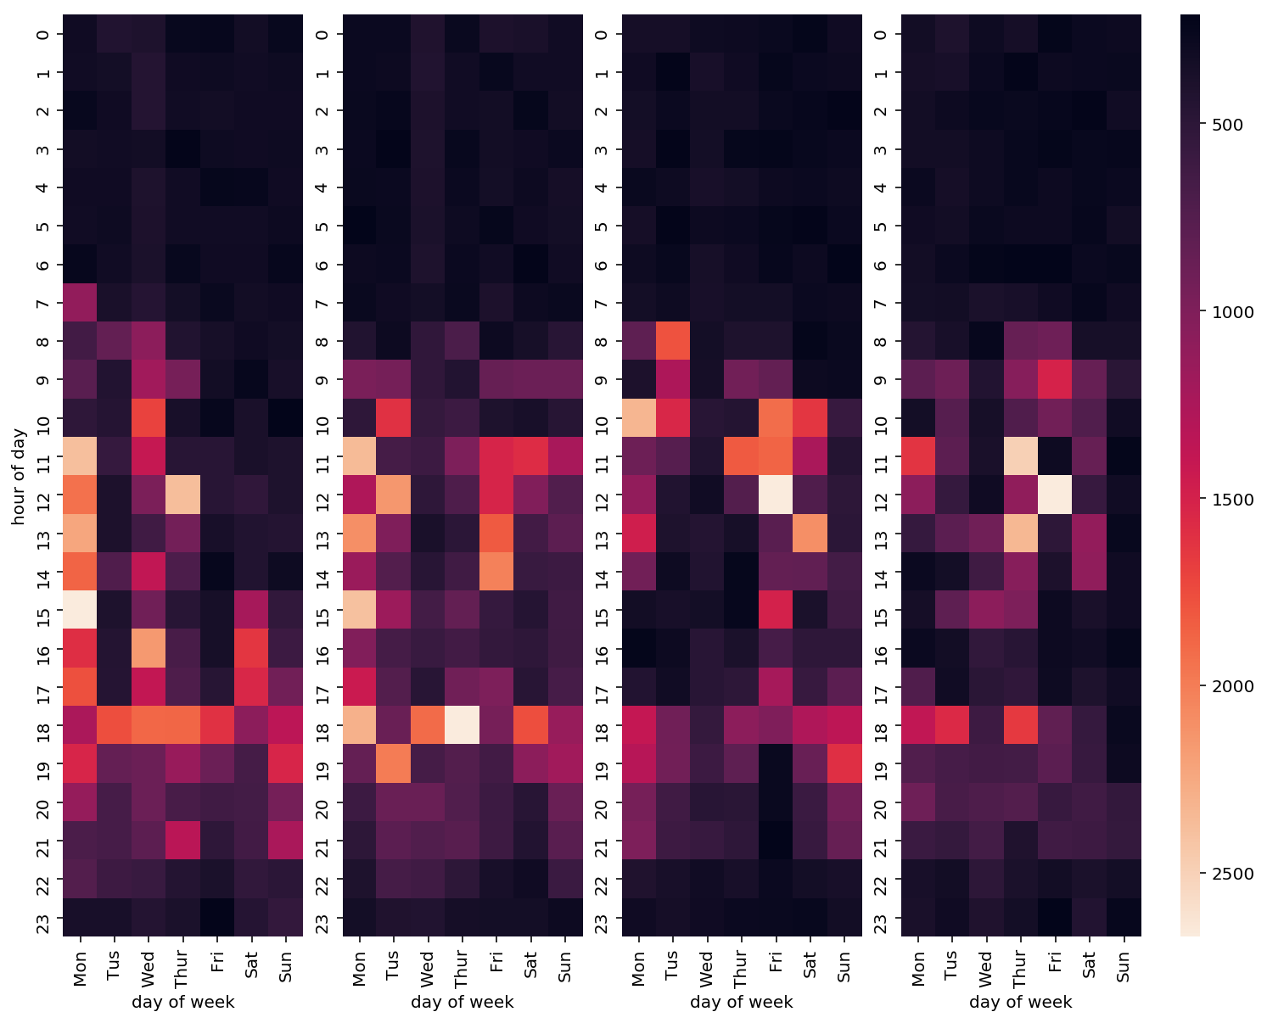
heat map for four consecutive weeks
warm up
hot spot
cool down

